Slide 1
Ectoderm and Mesoderm differentiation
scRNA-seq analysis

Slide 2
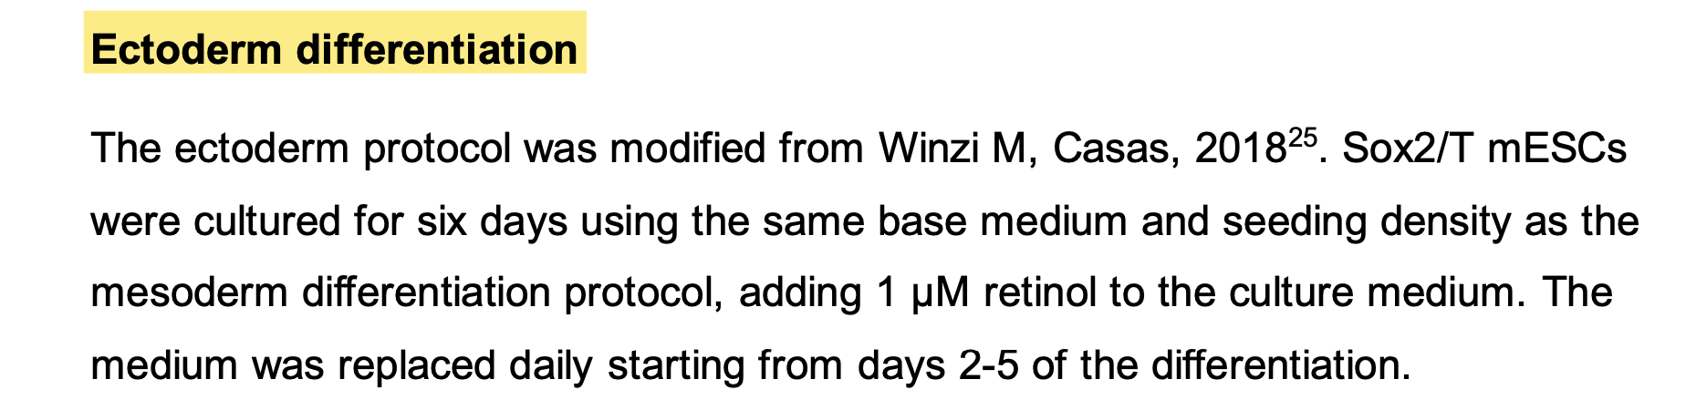
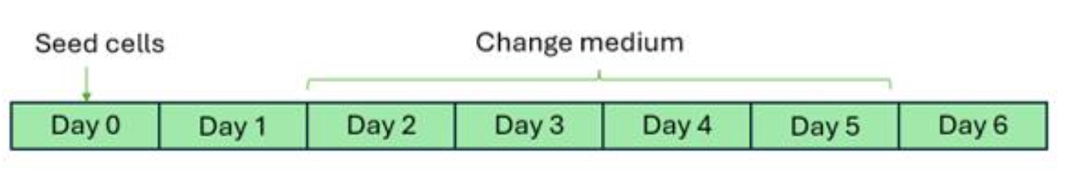

Slide 3
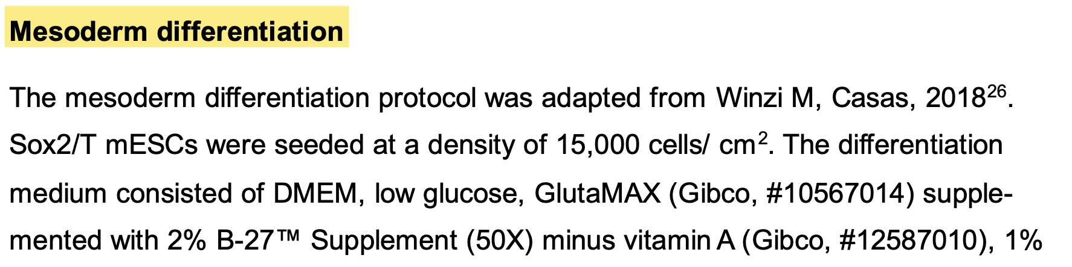
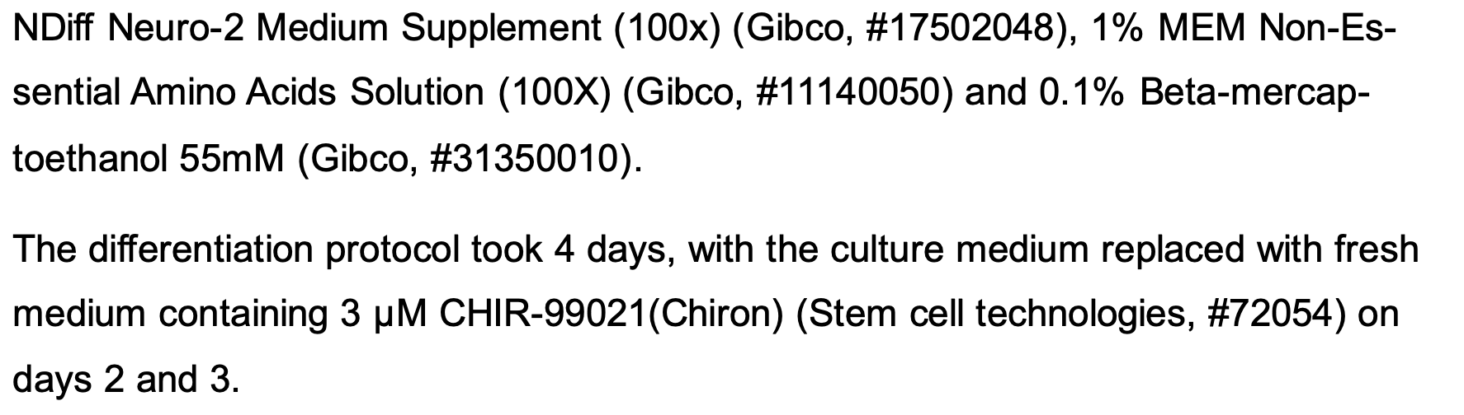
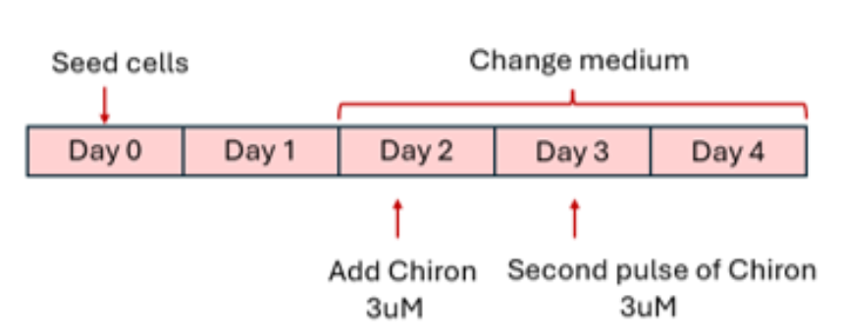

Slide 4
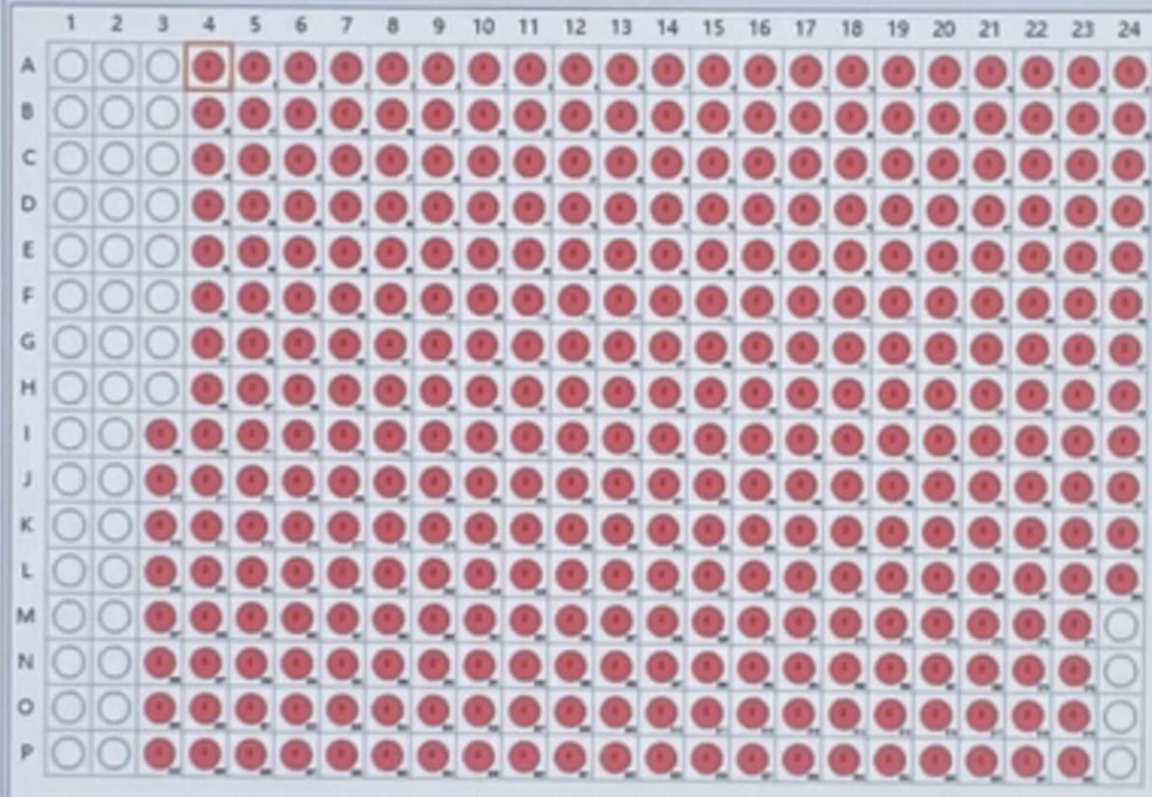

Plate sorting strategy for scVASAseq with SCD
Undifferentiated
cells
Differentiated
cells
Empty wells
(control)

