Slide 1

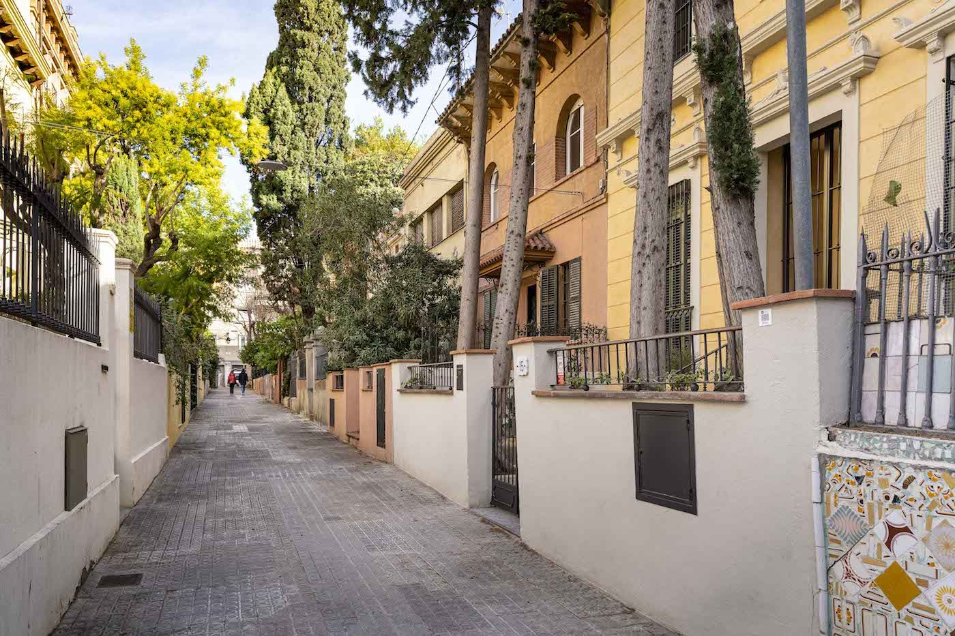
Perspectives on Urban Walking: Exploring Perceived and Objective Accessibility in Mode Selection
Jaime Orrego Oñate
Postdoctoral researcher - GEMOTT

Slide 2

Motivation
Planning applications often use objective measures of accessibility to associate policies with specific outcomes.
However, objective accessibility may be inconsistent with perceived accessibility.
As a result, outcomes may differ from expectations; destinations might be accessible for active travel, but people may not choose those modes.

Slide 3
Within mid size Spanish urban areas:
How does proximity perception and objective accessibility are related to each other?
What is the role of proximity perception in mode choice?

Slide 4
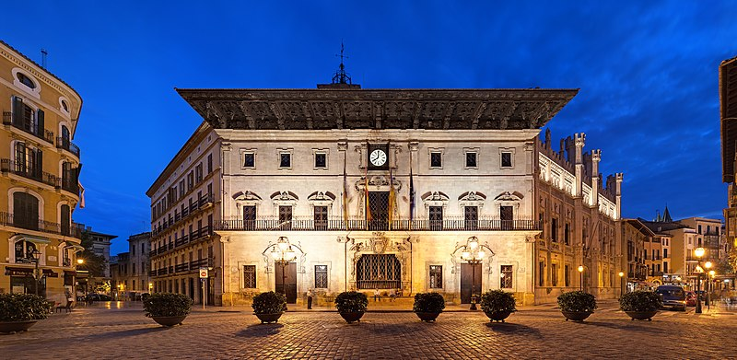
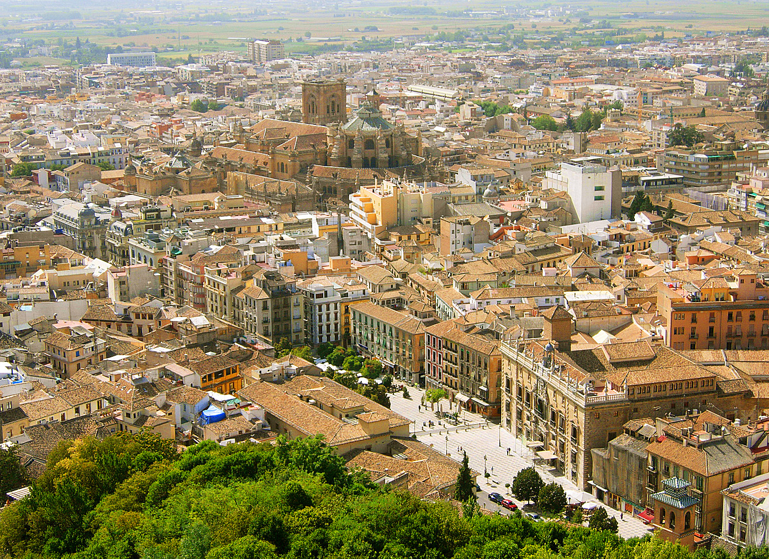
Case studies:
Mid size Spanish Cities
Granada
Palma
Valencia

Slide 5
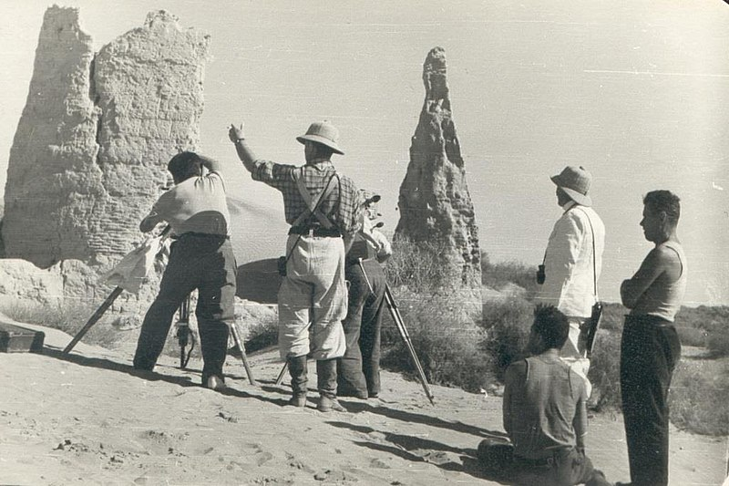
Data
1 .
_{2.}
_{3.}
Telephone survey
~1200 people (400 in each city)
200 in areas of lower accessibility and 200 in areas of higher accessibility
Variables
Socioeconomics: Education, age, gender
Proximity perception to different destinations (Shopping, Food, Entertainment)
Primary travel mode for different destinations
Residence location
High resolution accessibility data
Based on residence location
Number of shopping, entertainment and food destination within 15 minutes walk

Slide 6
Survey data
Objective Accessibility | Daily shopping | Non-daily shopping | Restaurants | Entertainment
Max | 1316 | 1316 | 650 | 226
Min | 1 | 1 | 0 | 4
Median | 277 | 279 | 140 | 87
Mean | 370 | 370 | 180 | 91
Perceived proximity
Close | 94% | 78% | 85% | 71%
Neither Close nor Far | 3% | 11% | 7% | 18%
Far | 3% | 11% | 8% | 11%

Slide 7
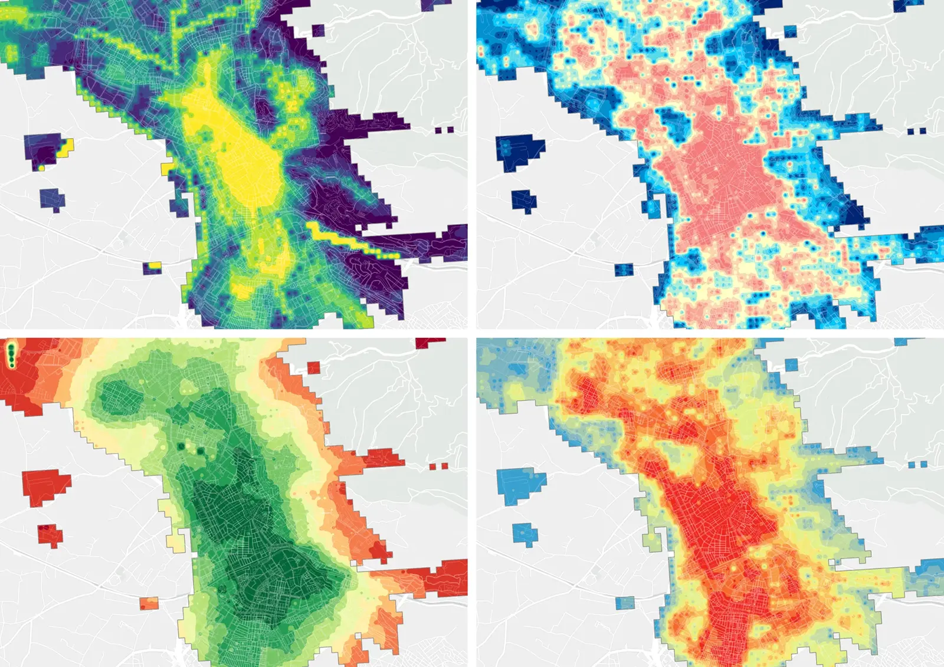
High spatial resolution environmental data Movactiva data
Grid of 100mx100m
15-min isochrones
Data from tax records
Movactiva.es

Slide 8
First Analysis
Ordered logit for Perceived Proximity
3-Levels: Close - neither Close nor Far - Far
As function of Objective Accessibility
Ordered logit: disaggregate choice model that determine the probability of an individual having a certain perception (when they are ordered)
Probability of perceived proximity of certain destinations. Based on the quantity of destinations within 15-min walk.
Four types of destination for all cities
Analysis consists in seeing the probabilities versus objective accessibility
For daily shopping: Shopping destination within 15 minutes
For non-daily shopping: Shopping destinations within 15 minutes
For restaurants: Restaurants within 15 minutes
For entertainment: Entertainment destinations such as theaters or libraries within 15 minutes

Slide 9
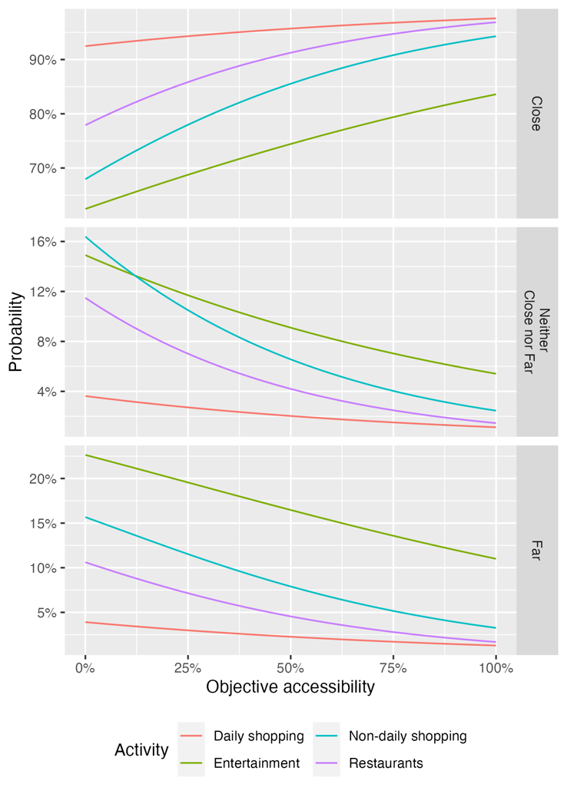
Proximity perception probability
The perception level is more sensitive to restaurants and non-daily shopping are more sensitive to accessibility in lower levels.
These two appear to be more nonlinear than daily shopping and entertainment.
In general, in this context, the majority of travelers feel like destinations are close

Slide 10
Proximity perception probability
The perception level is more sensitive to restaurants and non-daily shopping are more sensitive to accessibility in lower levels.
These two appear to be more nonlinear than daily shopping and entertainment.
In general, in this context, the majority of travelers feel like destinations are close

Slide 11
Proximity perception probability
The perception level is more sensitive to restaurants and non-daily shopping are more sensitive to accessibility in lower levels.
These two appear to be more nonlinear than daily shopping and entertainment.
In general, in this context, the majority of travelers feel like destinations are close

Slide 12
Second Analysis
Binary logit for Mode choice
2-Levels: Walking or not
As function of Objective Accessibility, Perceived Accessibility and Socioeconomic
Binary choice model between Walking and other mode
Three specification
Four types of destination in all three cities
Test goodness of fitness across models types within each group of destinations
Test marginal effects of perceived and objective accessibility across model types
Three model specifications
Objective accessibility + Sociodemographics
Perceived accessibility + Sociodemographics
Objective accessibility + Perceived Accesibility + Sociodemographics
For daily shopping: Shopping destination within 15 minutes
For non-daily shopping: Shopping destinations within 15 minutes
For restaurants: Restaurants within 15 minutes
For entertainment: Entertainment destinations such as theaters or libraries within 15 minutes

Slide 13
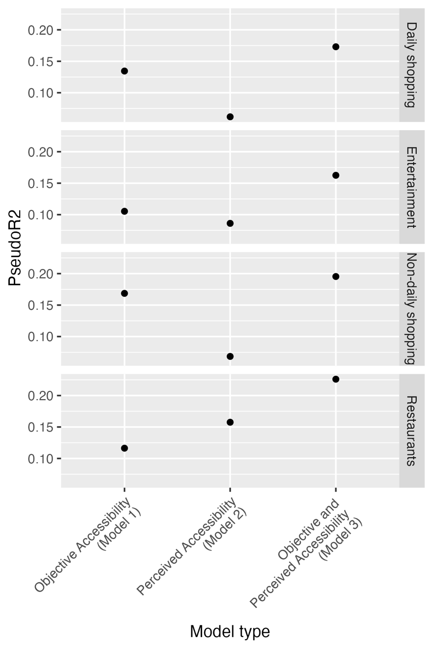
Mode choice Dependent in perceived and objective accessibility
Model 3 with both objective and perceived accessibility yield better fit
Objective accessibility is more explanatory in shopping trips (either non-daily and daily) and to a lesser degree for entertainment
Perceived accessibility appears to b more relevant than Objective accessibility for the case of cars.

Slide 14
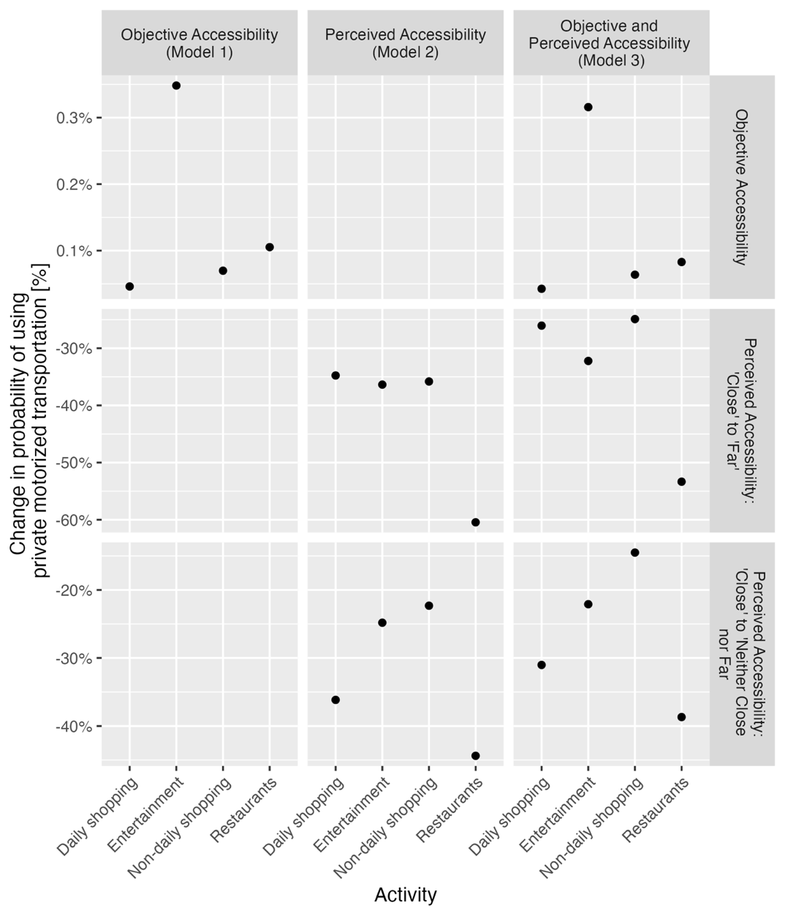
Average Marginal Effects Change in walking probability due to changes in one unit of the independent attribute
For example, a change in 1 shopping destination is associated wit an increase of 0.05% increase in walking probability.
When objective accessibility is not included in the model, perceived accessibility becomes more relevant.
This effect is not as clear when objective accessibility is included but not perceived accessibility.

Slide 15
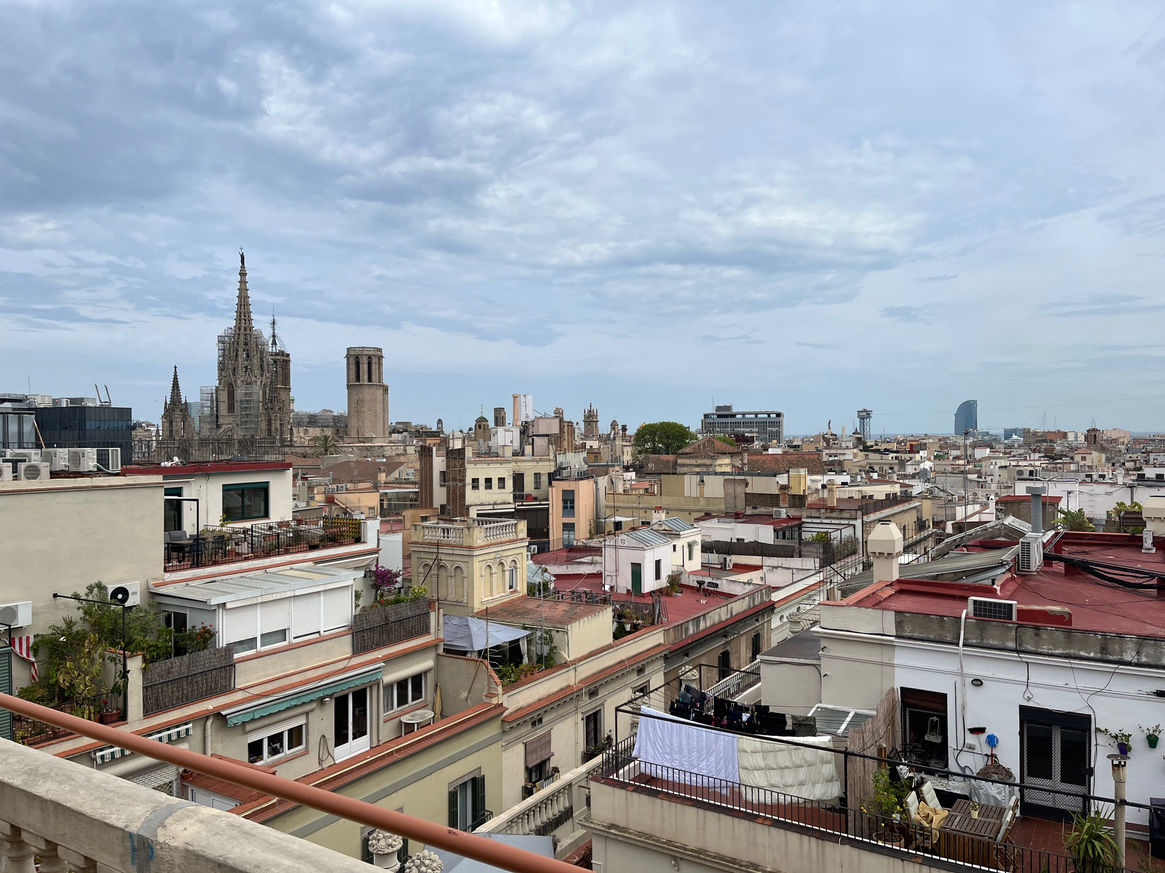
Discussion
High objective local accessibility tends to align well with high proximity perception.
This finding suggests the existence of a certain threshold in objective accessibility where it aligns with high proximity perception.
Additionally, perception plays an important role in modal choice.
However, objective accessibility tends to have a relatively consistent effect whether perceived proximity is considered or not in the behavioral model.
Finally, the relative importance of perceived proximity will depend on the type of activity, as its relevance can change between activity types.

Slide 16
Thank you! jaime.orrego@uab.cat https://gemott-uab.cat/

