Slide 1
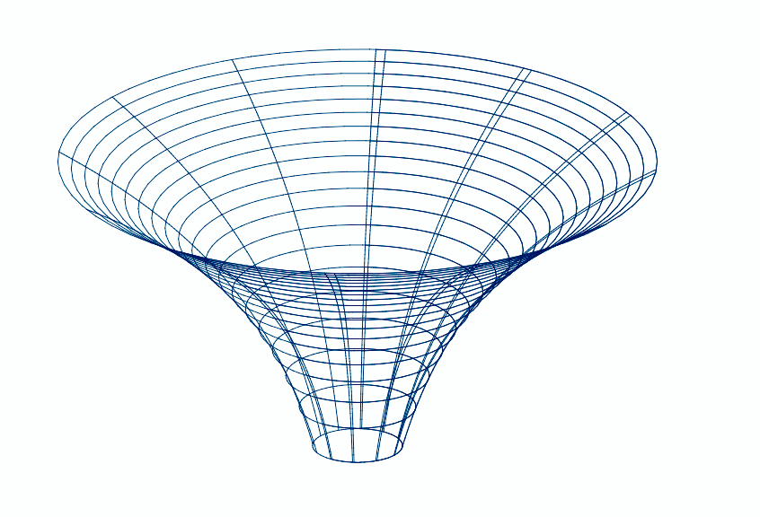

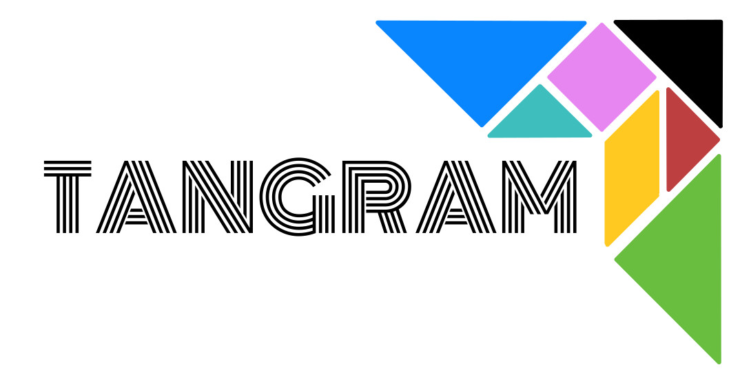
Questions, hypotheses, requests
AUDIMM
less accurate
docking
MD
QM/MM
more accurate
QM
Answers
Notes:
While GaudiMM provides starting points of a multiscale protocol, Tangram connects further stages down the funnel.

