Slide 1

2025 Q4 Net check UK
NSA CDR analysis Belfast, Bristol, Cardiff, Edinburgh, London, Leeds and Sheffield
Notes:
Angelo

Slide 2
Executive Summary
Operator | Main Finding | Recommendation | Potential Scoring Impact
VFE | Higher data failure ratio in all data test, but specially in FDFS DL&UL in Q4 compared to Q3. | E2E analysis | Data services Success Ratio ('Most reliable’) (FDFS DL&UL, Browsing and Video)
 | Improvement in CST in Q4 compared to Q3 and Q2 |  | CALL SETUP TIME (‘Best Network’)
 | Improvement in FDTT DL throughput performance in Q4 vs Q3 (* due to change in the CORE), matching similar trends as in Q2 |  | FDTT DL Throughput
 | Degradation in FDFS DL throughput performance in Q4 vs Q3 (* due to change in the CORE), matching similar trends as in Q2 |  | FDFS DL Transfer Time
 | Higher Interactivity RTT in Q4 compared to Q3, similar figures as in Q2 (*). London showing poorer performance in Q4 compared to Q2. | E2E analysis | Interactivity RTT (‘Best Network’)
 | Throughput performance when connecting to 3UK MOCN nodes mimics the 3UK performance |  | FDTT and FDFS DL&UL Throughput
 | Better Throughput performance when connecting to VFUK MOCN nodes. This relates with the higher NR TDD utilization |  | FDTT and FDFS DL&UL Throughput
Three | High unqualified data sessions in FDFS DL HTTPS test (not RF related) still present in Q4 in NSA CDR. In SA CDR this problem is not present. | E2E analysis. E2E core tracing needed | FDFS DL Success Ratio ('Most reliable')
 | Lower Call Success ratio in Q4 in London compared to Q3 (higher number of VoLTE failures) | Detail Log analysis of failures cases | Call Success Ratio ('Most reliable')
 | Degradation observed in POLQA AVG MOS in Q4 compared to Q3 mainly in Belfast and Sheffield |  | POLQA Avg MOS
 | Throughput performance when connecting to VFUK MOCN nodes mimics the VFUK performance |  | FDTT and FDFS DL&UL Throughput
 | Better Throughput performance when connecting to 3UK MOCN nodes. This relates with the higher NR TDD utilization |  | FDTT and FDFS DL&UL Throughput
(*) In 2025 Q4 Vodafone core is CISCO CORE (as in 2025 Q2) and in 2025 Q3 it was COSMOS ERICSSON

Slide 3
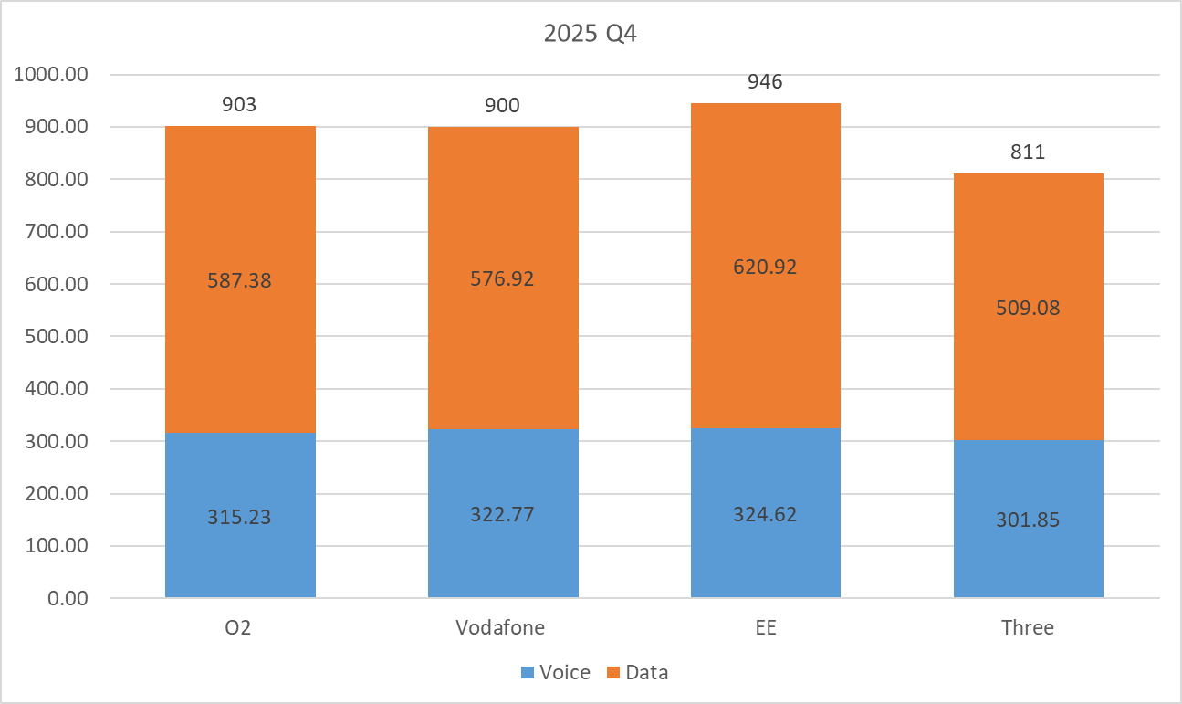
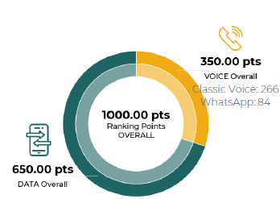
Netcheck Q4 scoring “Best network”. Drive city
Cities considered: Belfast, Bristol, Cardiff, Edinburgh, London, Leeds and Sheffield.
The ranking points are scaled to a maximum of 1.000 points, providing comparability with the overall Ranking

Slide 4
Score breakdown
NETCHECK KPIS |  | Score weight (%) | Max score over 1000 | Vodafone | O2 | Three | EE | GAP Vodafone vs EE | GAP Three vs EE
CLASSIC CALLS | CALL SUCCESS RATIO [%] | 14.28% | 142.80 | 137.41 | 133.33 | 124.56 | 132.00 | -5.41 | 7.44
 | CALL SETUP TIME [s] | 1.68% | 16.80 | 15.68 | 16.80 | 16.32 | 16.73 | 1.04 | 0.40
 | CALL SETUP TIME > 15 s [%] | 0.84% | 8.40 | 7.87 | 8.40 | 8.00 | 8.40 | 0.53 | 0.40
 | POLQA < 1.6 [%] | 4.20% | 42.00 | 33.13 | 32.31 | 32.05 | 34.17 | 1.04 | 2.12
 | POLQA [MOS | 1.40% | 14.00 | 13.81 | 13.80 | 13.71 | 13.95 | 0.14 | 0.24
 | DISTURBED & IMPAIRED CALL [%] | 2.80% | 28.00 | 25.89 | 22.02 | 21.91 | 25.88 | 0.00 | 3.98
WHATSAPP CALLS | CALL SUCCESS RATIO [%] | 5.60% | 56.00 | 53.08 | 53.05 | 50.13 | 56.00 | 2.92 | 5.87
 | POLQA < 1.6 [%] | 1.40% | 14.00 | 11.06 | 10.61 | 10.45 | 12.13 | 1.06 | 1.67
 | POLQA [MOS] | 0.47% | 4.70 | 4.11 | 4.10 | 4.10 | 4.15 | 0.04 | 0.04
 | DISTURBED & IMPAIRED CALL [%] | 0.93% | 9.30 | 7.42 | 6.87 | 7.01 | 7.42 | 0.00 | 0.41
Multi RAB | MULTI RAB DATA TRANSFER SUCCESS RATIO [%] | 1.40% | 14.00 | 13.27 | 14.00 | 13.63 | 13.82 | 0.55 | 0.19
TRANSFER | FDFS DL SUCCESS RATIO [%] | 4.68% | 46.80 | 36.37 | 43.65 | 0.00 | 45.16 | 8.79 | 45.16
 | FDFS DL TRANSFER TIME [s] | 3.12% | 31.20 | 28.77 | 29.19 | 27.70 | 31.20 | 2.43 | 3.50
 | FDFS UL SUCCESS RATIO [%] | 2.34% | 23.40 | 15.42 | 18.43 | 19.23 | 19.89 | 4.47 | 0.66
 | FDFS UL TRANSFER TIME [s] | 1.56% | 15.60 | 13.30 | 9.96 | 13.15 | 14.36 | 1.06 | 1.21
 | FDTT DL THROUGHPUT > 2Mbit/s [%] | 3.12% | 31.20 | 28.17 | 29.45 | 16.64 | 29.21 | 1.04 | 12.57
 | FDTT DL THROUGHPUT > 5Mbit/s [%] | 3.90% | 39.00 | 36.35 | 36.37 | 24.77 | 37.16 | 0.82 | 12.39
 | FDTT DL THROUGHPUT > 20Mbit/s [%] | 3.90% | 39.00 | 31.52 | 32.22 | 28.54 | 35.38 | 3.87 | 6.84
 | FDTT DL THROUGHPUT > 100Mbit/s [%] | 2.34% | 23.40 | 20.32 | 19.50 | 19.21 | 21.40 | 1.08 | 2.19
 | FDTT DL THROUGHPUT P90 [Mbit/s] | 2.34% | 23.40 | 21.33 | 18.05 | 23.40 | 23.18 | 1.86 | -0.22
 | FDTT UL THROUGHPUT > 1Mbit/s [%] | 1.56% | 15.60 | 14.94 | 12.89 | 13.44 | 15.36 | 0.42 | 1.93
 | FDTT UL THROUGHPUT > 3Mbit/s [%] | 1.95% | 19.50 | 17.62 | 16.00 | 16.57 | 18.64 | 1.03 | 2.08
 | FDTT UL THROUGHPUT > 10Mbit/s [%] | 1.95% | 19.50 | 15.13 | 13.96 | 14.21 | 16.78 | 1.65 | 2.57
 | FDTT UL THROUGHPUT > 20Mbit/s [%] | 1.17% | 11.70 | 10.29 | 9.73 | 10.12 | 10.73 | 0.44 | 0.61
 | FDTT UL THROUGHPUT P90 [Mbit/s] | 1.17% | 11.70 | 10.30 | 9.83 | 11.70 | 10.22 | -0.09 | -1.48
HTTP/HTTPs BROWSING | BROWSING TIME TO 1MB [ms] | 5.20% | 52.00 | 52.00 | 52.00 | 52.00 | 52.00 | 0.00 | 0.00
 | BROWSING SUCCESS RATIO [%] | 7.80% | 78.00 | 68.55 | 75.12 | 68.87 | 75.53 | 6.98 | 6.66
VIDEO STREAM | VIDEO STREAMING SUCCESS RATIO [%] | 8.32% | 83.20 | 77.20 | 81.92 | 76.73 | 81.14 | 3.94 | 4.41
 | VIDEO STREAMING TTFP >= 10 s [%] | 0.52% | 5.20 | 4.96 | 4.48 | 3.79 | 5.12 | 0.16 | 1.33
 | VIDEO STREAMING IRRITATING EXPERIENCE [%] | 4.16% | 41.60 | 41.34 | 40.96 | 40.30 | 41.48 | 0.13 | 1.18
INTERACTIVITY | INTERACTIVITY PACKET ERROR RATIO [%] | 0.78% | 7.80 | 6.70 | 6.59 | 0.00 | 7.43 | 0.73 | 7.43
 | INTERACTIVITY MEDIAN RTT [MS] | 3.12% | 31.20 | 26.92 | 27.64 | 29.42 | 29.56 | 2.64 | 0.13

Slide 5
KPIs prioritization: gap Vodafone vs EE
Priority
 | Netcheck KPIs | GAP Vodafone vs EE | Type of KPI
TRANSFER | FDFS DL SUCCESS RATIO [%] | 8.79 | Reliable
HTTP/HTTPs BROWSING | BROWSING SUCCESS RATIO [%] | 6.98 | Reliable
TRANSFER | FDFS UL SUCCESS RATIO [%] | 4.47 | Reliable
VIDEO STREAM | VIDEO STREAMING SUCCESS RATIO [%] | 3.94 | Reliable
TRANSFER | FDTT DL THROUGHPUT > 20Mbit/s [%] | 3.87 | Diff
WHATSAPP CALLS | CALL SUCCESS RATIO [%] | 2.92 | Reliable
INTERACTIVITY | INTERACTIVITY MEDIAN RTT [MS] | 2.64 | Diff
TRANSFER | FDFS DL TRANSFER TIME [s] | 2.43 | Diff
TRANSFER | FDTT DL THROUGHPUT P90 [Mbit/s] | 1.86 | Diff
TRANSFER | FDTT UL THROUGHPUT > 10Mbit/s [%] | 1.65 | Diff
TRANSFER | FDTT DL THROUGHPUT > 100Mbit/s [%] | 1.08 | Diff
WHATSAPP CALLS | POLQA < 1.6 [%] | 1.06 | Reliable
TRANSFER | FDFS UL TRANSFER TIME [s] | 1.06 | Diff
CLASSIC CALLS | CALL SETUP TIME [s] | 1.04 | Diff
TRANSFER | FDTT DL THROUGHPUT > 2Mbit/s [%] | 1.04 | Reliable
CLASSIC CALLS | POLQA < 1.6 [%] | 1.04 | Reliable
TRANSFER | FDTT UL THROUGHPUT > 3Mbit/s [%] | 1.03 | Diff
TRANSFER | FDTT DL THROUGHPUT > 5Mbit/s [%] | 0.82 | Diff
Vodafone having highest gap with EE in data success ratio in Q4, all part of reliability definition (almost 25 points gap with EE).
Focus Areas Vodafone:
Data Qualifiers
Voice qualifiers
POLQA
Low-rate DL sessions
Cities considered: Belfast, Bristol, Cardiff, Edinburgh, London, Leeds and Sheffield.
Interactivity RTT
Low-rate UL sessions

Slide 6
KPIs prioritization: gap Three vs EE
Priority
 | NETCHECK KPIS | GAP Three vs EE | Type of KPI
TRANSFER | FDFS DL SUCCESS RATIO [%] | 45.16 | Reliable
TRANSFER | FDTT DL THROUGHPUT > 2Mbit/s [%] | 12.57 | Reliable
TRANSFER | FDTT DL THROUGHPUT > 5Mbit/s [%] | 12.39 | Diff
CLASSIC CALLS | CALL SUCCESS RATIO [%] | 7.44 | Reliable
INTERACTIVITY | INTERACTIVITY PACKET ERROR RATIO [%] | 7.43 | Diff
TRANSFER | FDTT DL THROUGHPUT > 20Mbit/s [%] | 6.84 | Diff
HTTP/HTTPs BROWSING | BROWSING SUCCESS RATIO [%] | 6.66 | Reliable
WHATSAPP CALLS | CALL SUCCESS RATIO [%] | 5.87 | Reliable
VIDEO STREAM | VIDEO STREAMING SUCCESS RATIO [%] | 4.41 | Reliable
CLASSIC CALLS | DISTURBED & IMPAIRED CALL [%] | 3.98 | Diff
TRANSFER | FDFS DL TRANSFER TIME [s] | 3.50 | Diff
TRANSFER | FDTT UL THROUGHPUT > 10Mbit/s [%] | 2.57 | Diff
TRANSFER | FDTT DL THROUGHPUT > 100Mbit/s [%] | 2.19 | Diff
CLASSIC CALLS | POLQA < 1.6 [%] | 2.12 | Reliable
TRANSFER | FDTT UL THROUGHPUT > 3Mbit/s [%] | 2.08 | Diff
TRANSFER | FDTT UL THROUGHPUT > 1Mbit/s [%] | 1.93 | Reliable
WHATSAPP CALLS | POLQA < 1.6 [%] | 1.67 | Reliable
Three with highest gap in data qualifier (FDFS DL 45 points gap with EE, browsing and YouTube 11 points).
Low DL throughput samples for FDTT DL showing a gap of 30 points with EE
Voice qualifiers showing 13 points gap.
Focus Areas Three:
Data qualifiers
Low-rate DL sessions
Voice Qualifiers
POLQA<1.6
Disturbed and impaired
Interactivity
Cities considered: Belfast, Bristol, Cardiff, Edinburgh, London, Leeds and Sheffield.

Slide 7

7 cities analysis Belfast, Bristol, Cardiff, Edinburgh, London, Leeds and Sheffield

Slide 8
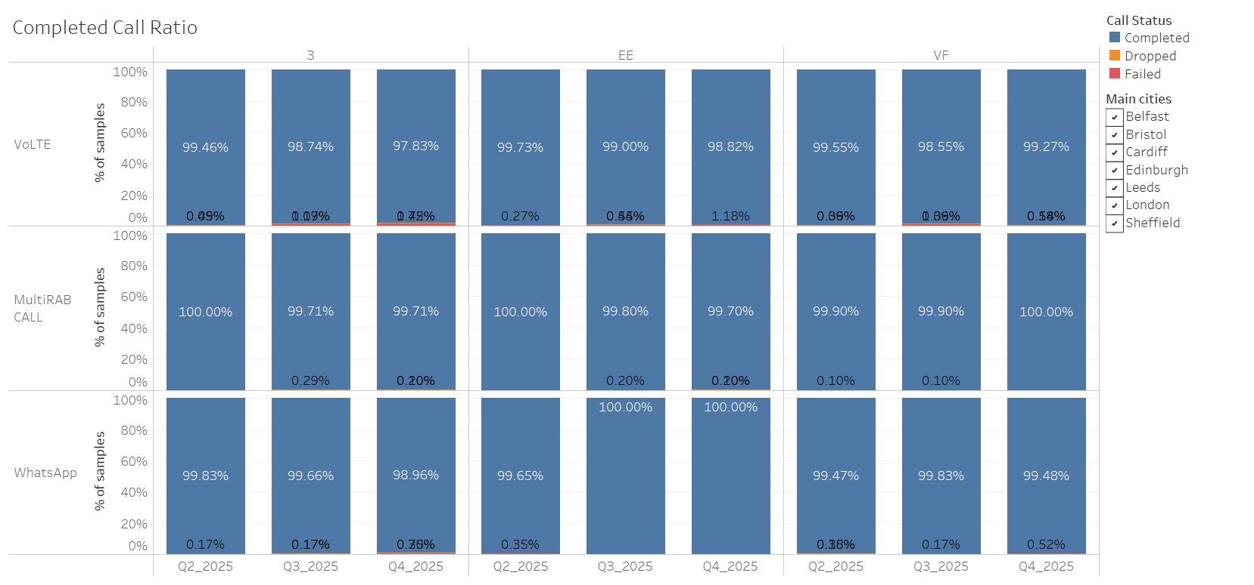
Completed Call Ratio

Slide 9
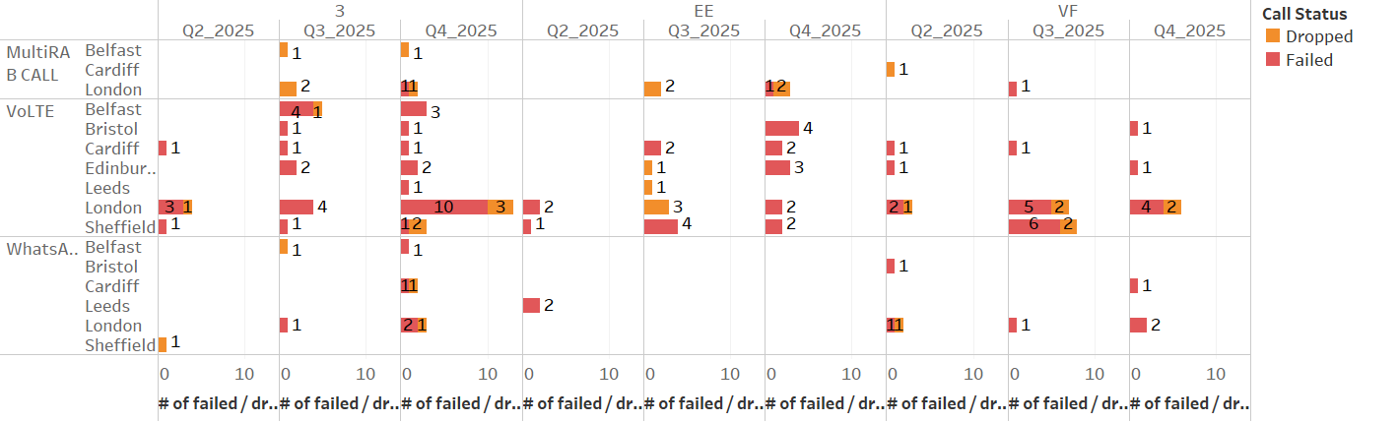
Voice failures per Q/city

Slide 10
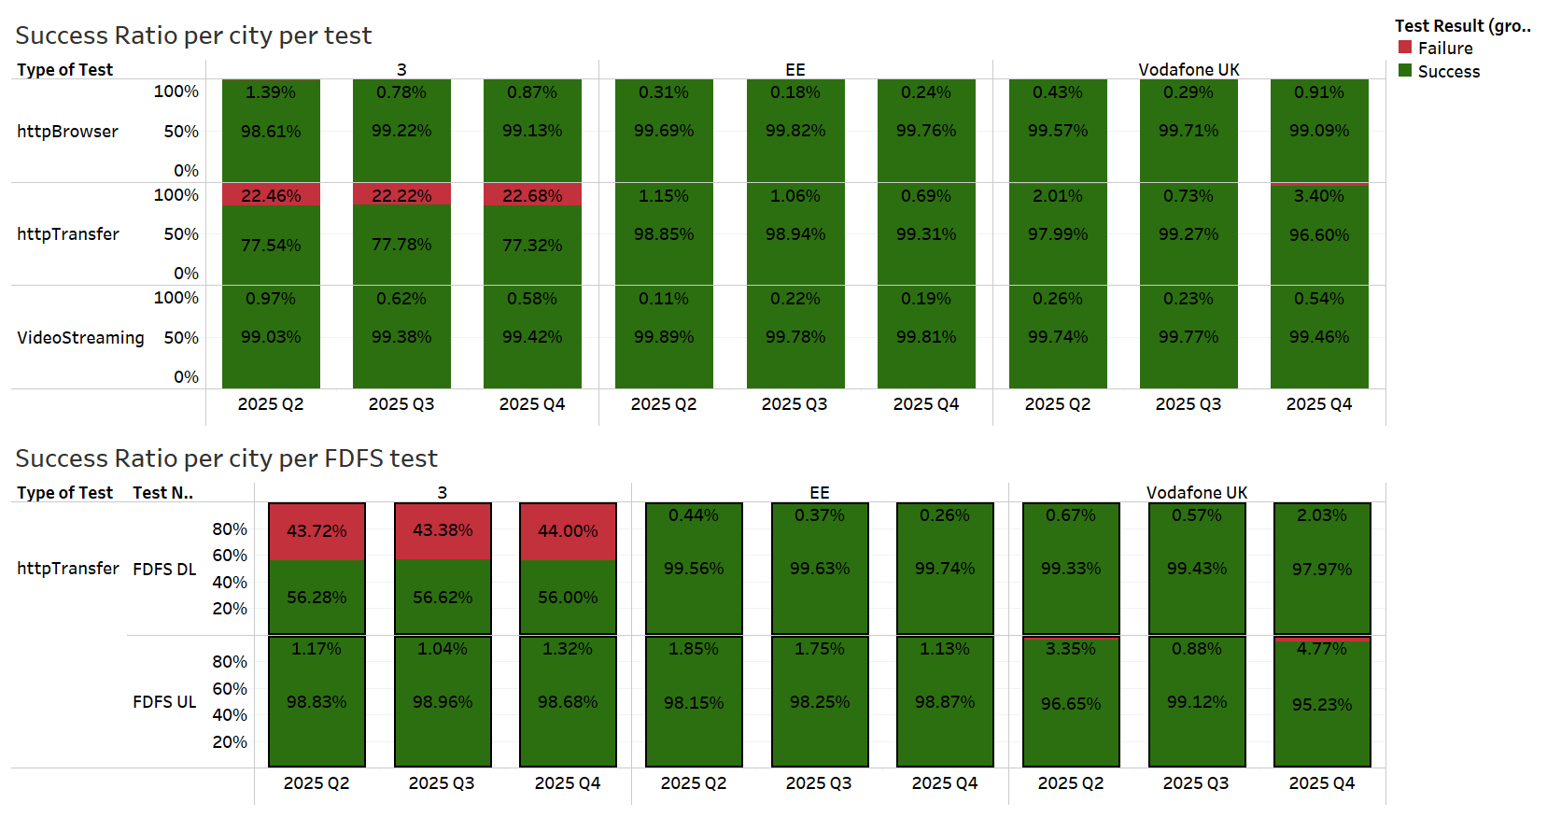
Data failure

Slide 11
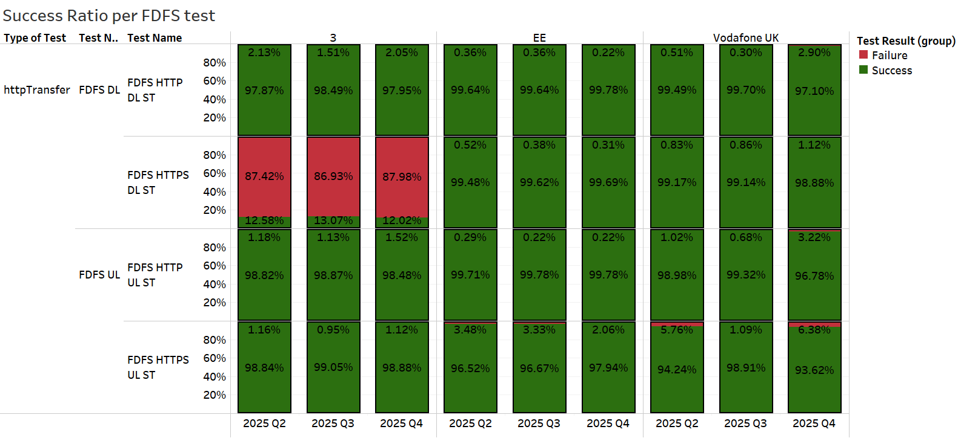
Data failures - FDFS test

Slide 12
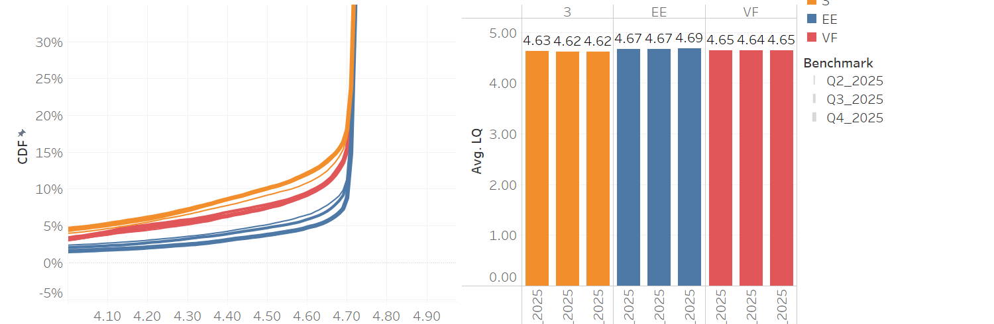
POLQA AVG MOS (Multirab&volte)

Slide 13
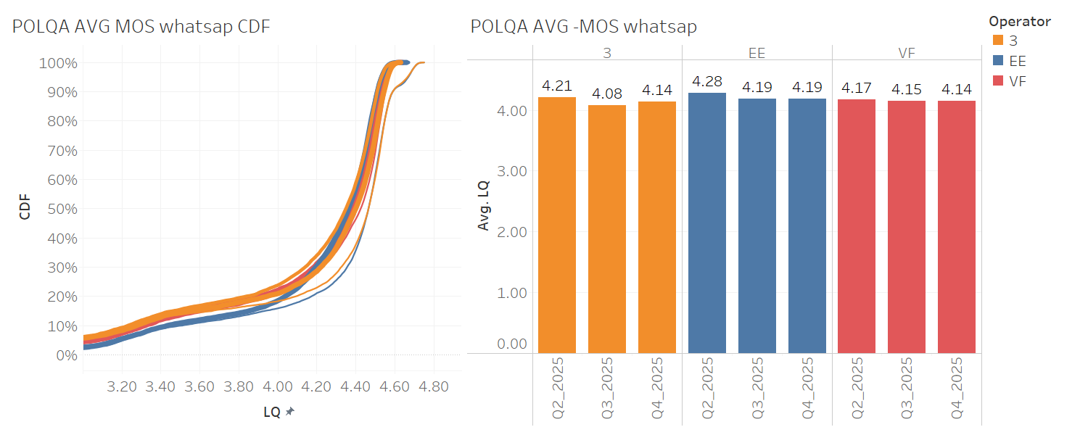

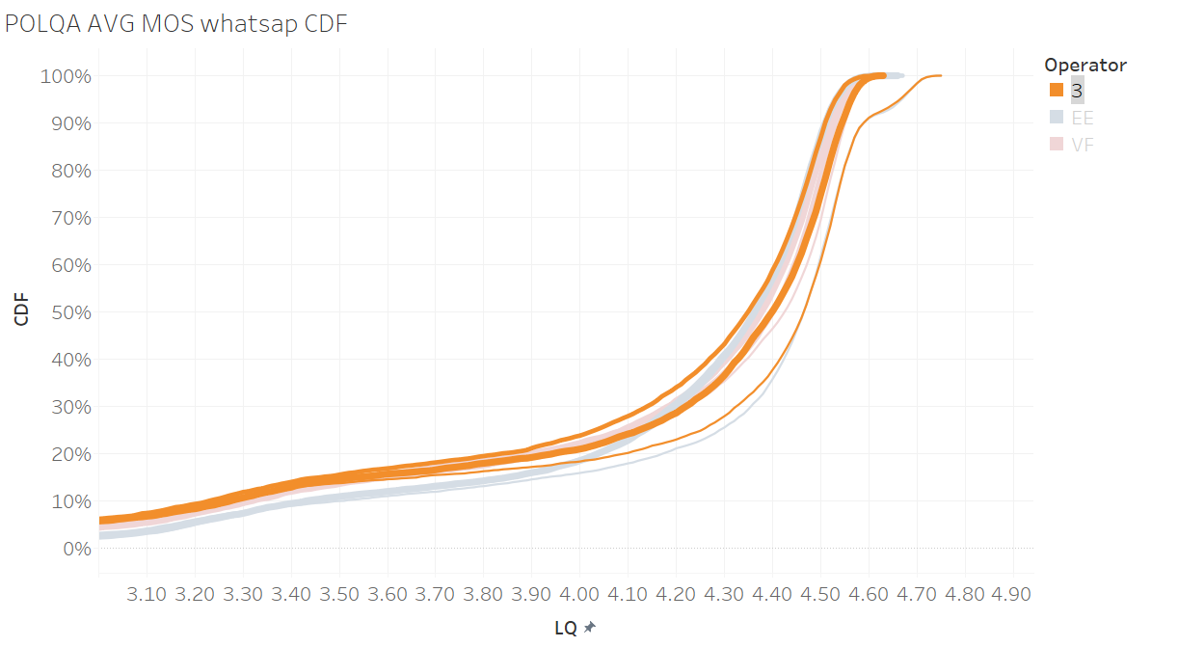
POLQA AVG MOS (WhatsApp)

Slide 14
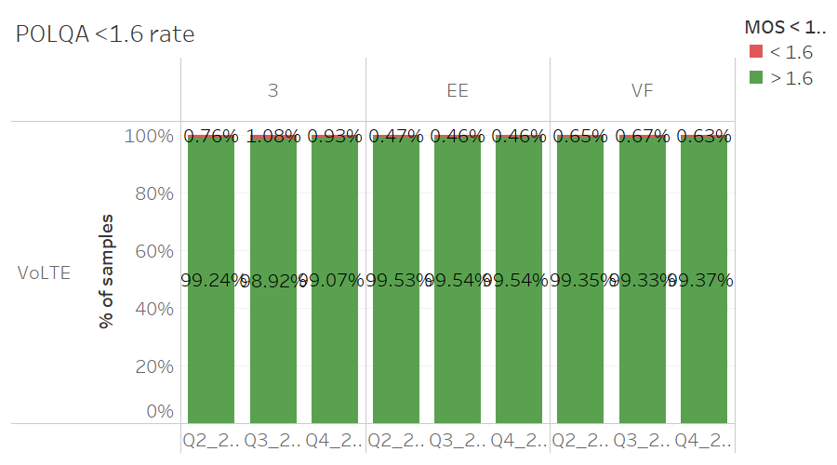
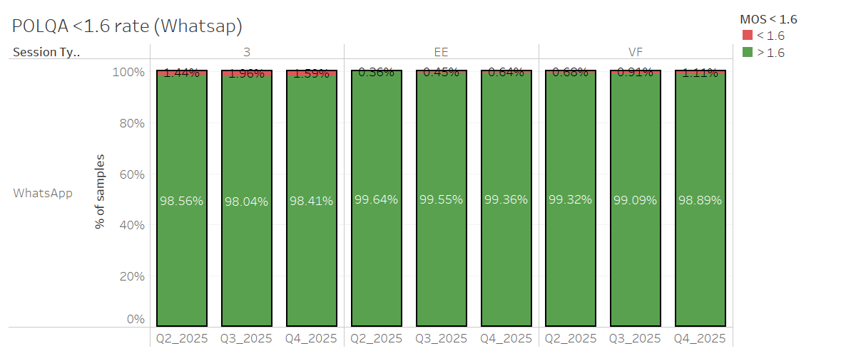
POLQA <1.6

Slide 15
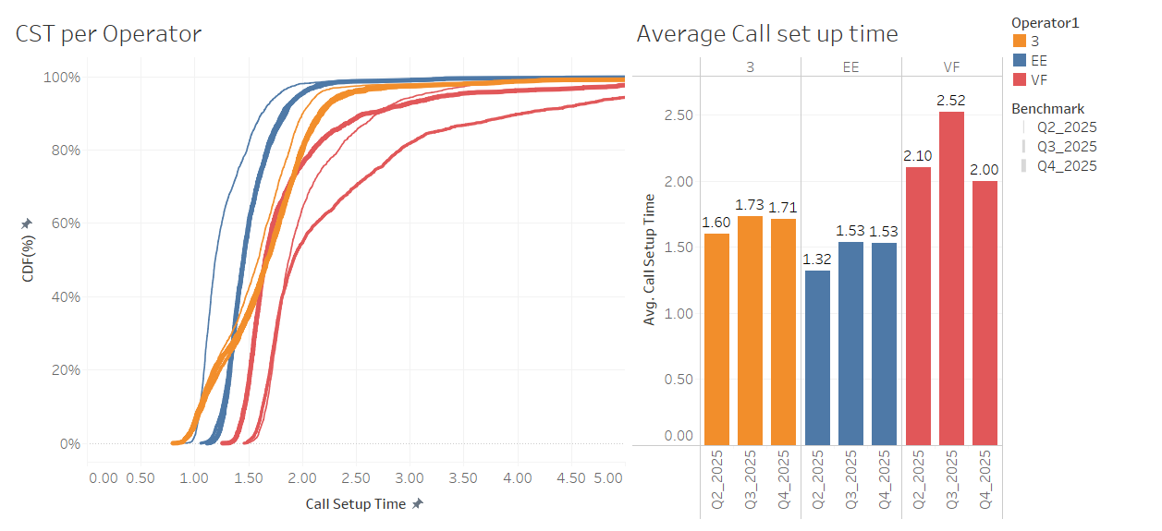
CST

Slide 16
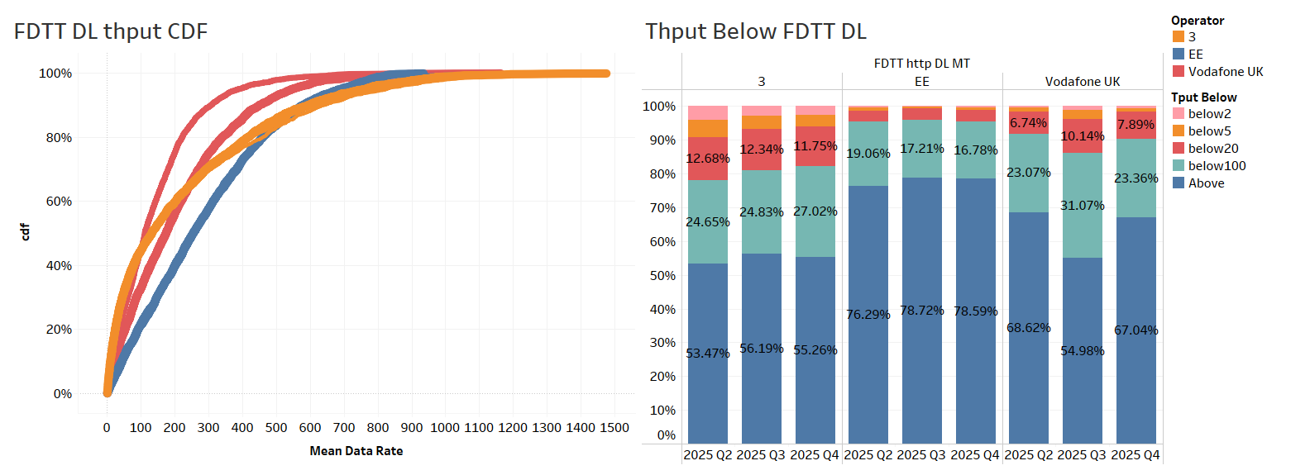
FDTT DL (7s)

Slide 17
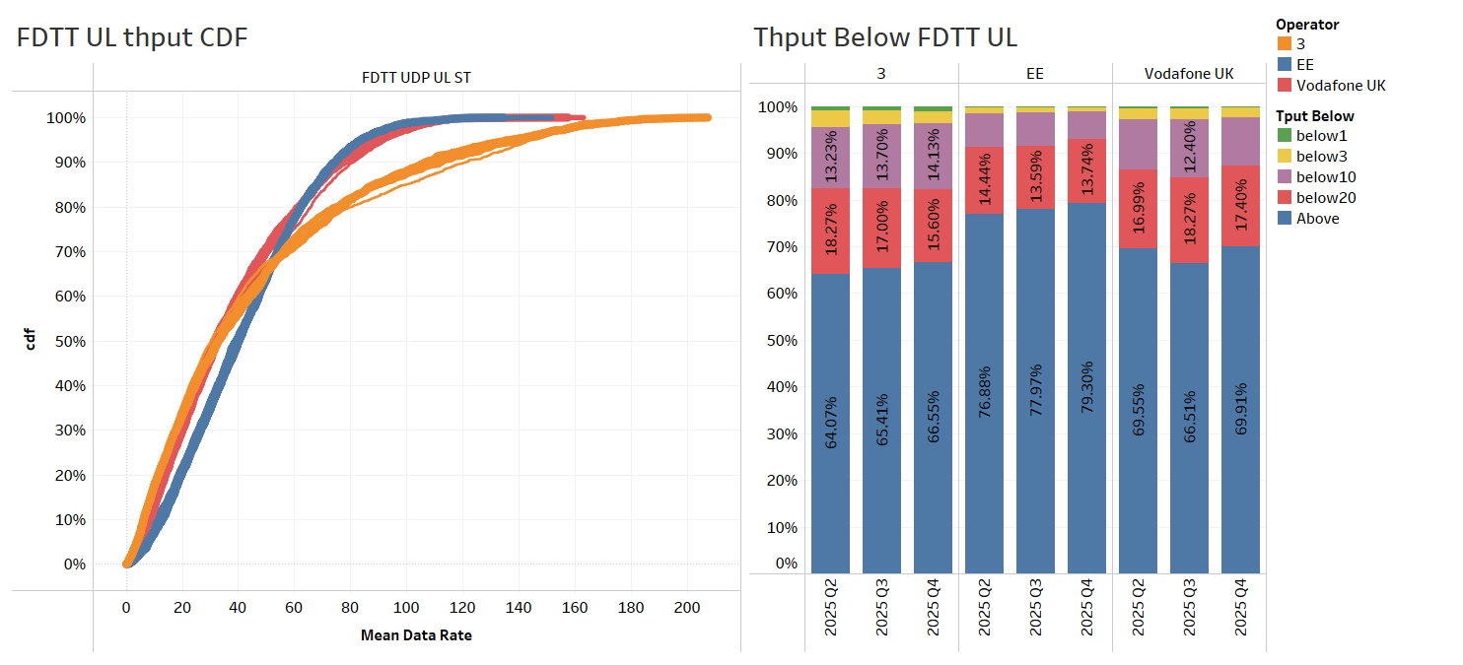
FDTT UL (7s)

Slide 18
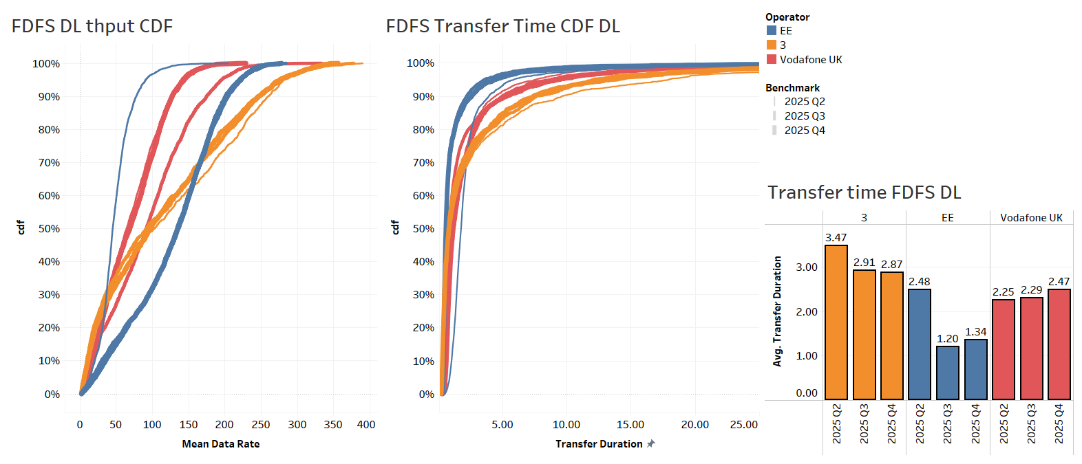
FDFS DL

Slide 19
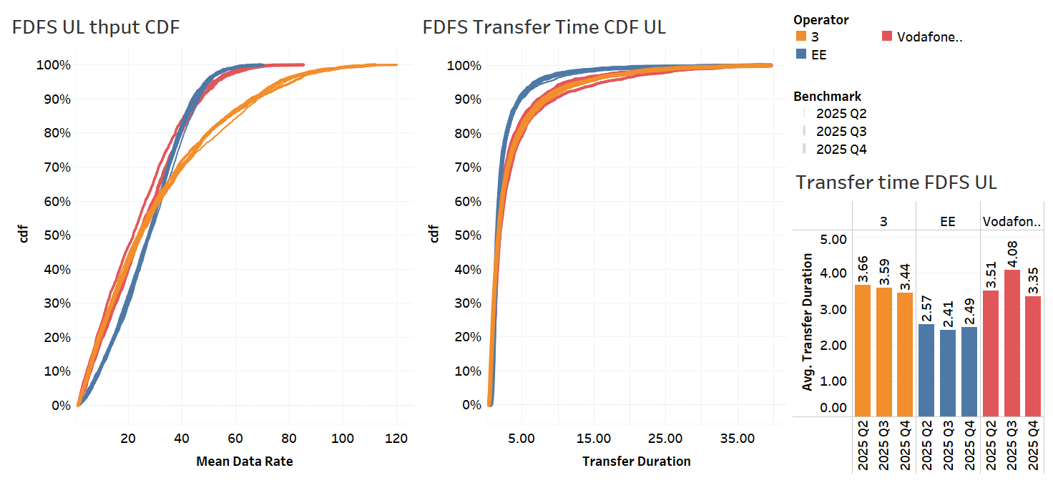
FDFS UL

Slide 20
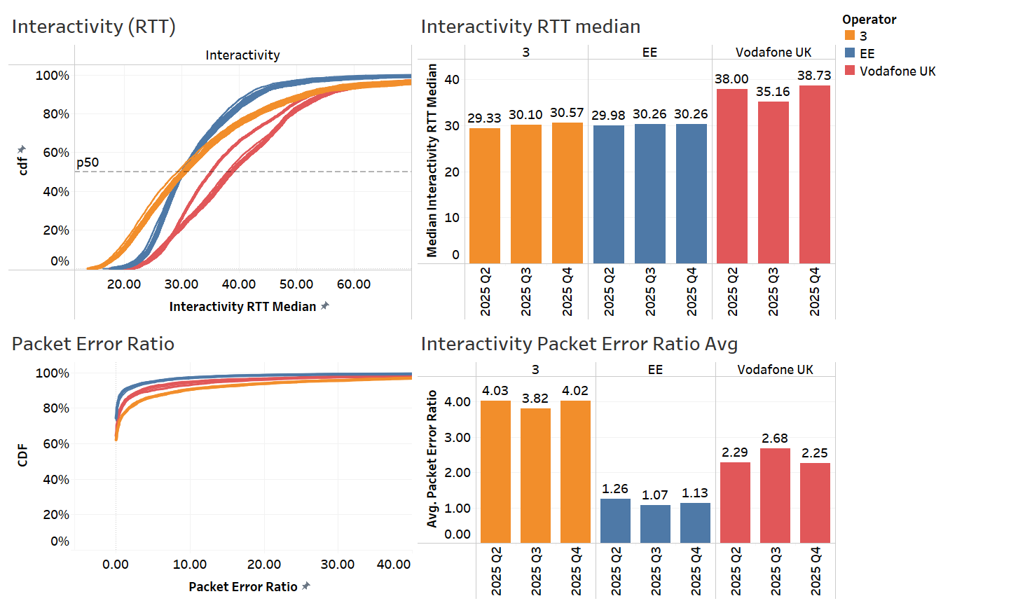
Interactivity

Slide 21
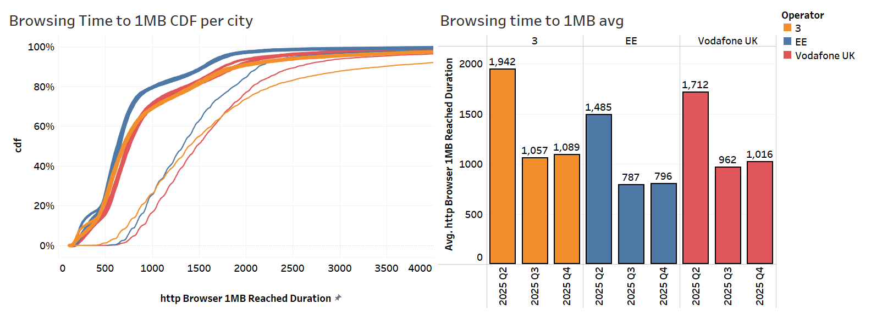
Browsing

Slide 22
Conclusions
Operator | Main Finding | Recommendation | Potential Scoring Impact
VFE | Higher data failure ratio in all data test, but specially in FDFS DL&UL in Q4 compared to Q3. | E2E analysis | Data services Success Ratio ('Most reliable’) (FDFS DL&UL, Browsing and Video)
 | Improvement in CST in Q4 compared to Q3 and Q2 |  | CALL SETUP TIME (‘Best Network’)
 | Improvement in FDTT DL throughput performance in Q4 vs Q3 (* due to change in the CORE), matching similar trends as in Q2 |  | FDTT DL Throughput
 | Degradation in FDFS DL throughput performance in Q4 vs Q3 (* due to change in the CORE), matching similar trends as in Q2 |  | FDFS DL Transfer Time
 | Higher Interactivity RTT in Q4 compared to Q3, similar figures as in Q2 (*). London showing poorer performance in Q4 compared to Q2. | E2E analysis | Interactivity RTT (‘Best Network’)
 | Throughput performance when connecting to 3UK MOCN nodes mimics the 3UK performance |  | FDTT and FDFS DL&UL Throughput
 | Better Throughput performance when connecting to VFUK MOCN nodes. This relates with the higher NR TDD utilization |  | FDTT and FDFS DL&UL Throughput
Three | High unqualified data sessions in FDFS DL HTTPS test (not RF related) still present in Q4 in NSA CDR. In SA CDR this problem is not present. | E2E analysis. E2E core tracing needed | FDFS DL Success Ratio ('Most reliable')
 | Lower Call Success ratio in Q4 in London compared to Q3 (higher number of VoLTE failures) | Detail Log analysis of failures cases | Call Success Ratio ('Most reliable')
 | Degradation observed in POLQA AVG MOS in Q4 compared to Q3 mainly in Belfast and Sheffield |  | POLQA Avg MOS
 | Throughput performance when connecting to VFUK MOCN nodes mimics the VFUK performance |  | FDTT and FDFS DL&UL Throughput
 | Better Throughput performance when connecting to 3UK MOCN nodes. This relates with the higher NR TDD utilization |  | FDTT and FDFS DL&UL Throughput
(*) In 2025 Q4 Vodafone core is CISCO CORE (as in 2025 Q2) and in 2025 Q3 it was COSMOS ERICSSON

