Slide 1
NPPI Tech Forum VodafoneThree & Ericsson 2026-08-06
2026 Q2 Net check 5G SA Campaign
Final Scoring and Gap Analysis
CDR KPI Analysis

Slide 2
Agenda
NRSA CDR Scoring and GAP analysis (7 cities, London) for Best Network and Most Reliable Network
NRSA CDR Voice failures and KPIs analysis (7 cities, London)
3UK Low Whatsapp POLQA issue update during 5GSA campaign
NRSA CDR Data KPIs analysis (7 cities, London)

Slide 3
Actions Tracker
Ref | Action | Date Raised | Raised by | Date Closed | Owner | Status | Comments
1 | Further analysis about the Call Setup Time degradation observed for Vodafone in 2026Q2 | 10/06 | VF3 |  | Ericsson | Open
2 | To further analyze the POLQA in WhatsApp in 2026Q2 mainly for Threeuk | 10/06 | VF3 |  | Ericsson | Open

Slide 4

Netcheck CDR Scoring and Gap Analysis 2026 Q2 NSA vs SA Campaign 7 Cities and London

Slide 5
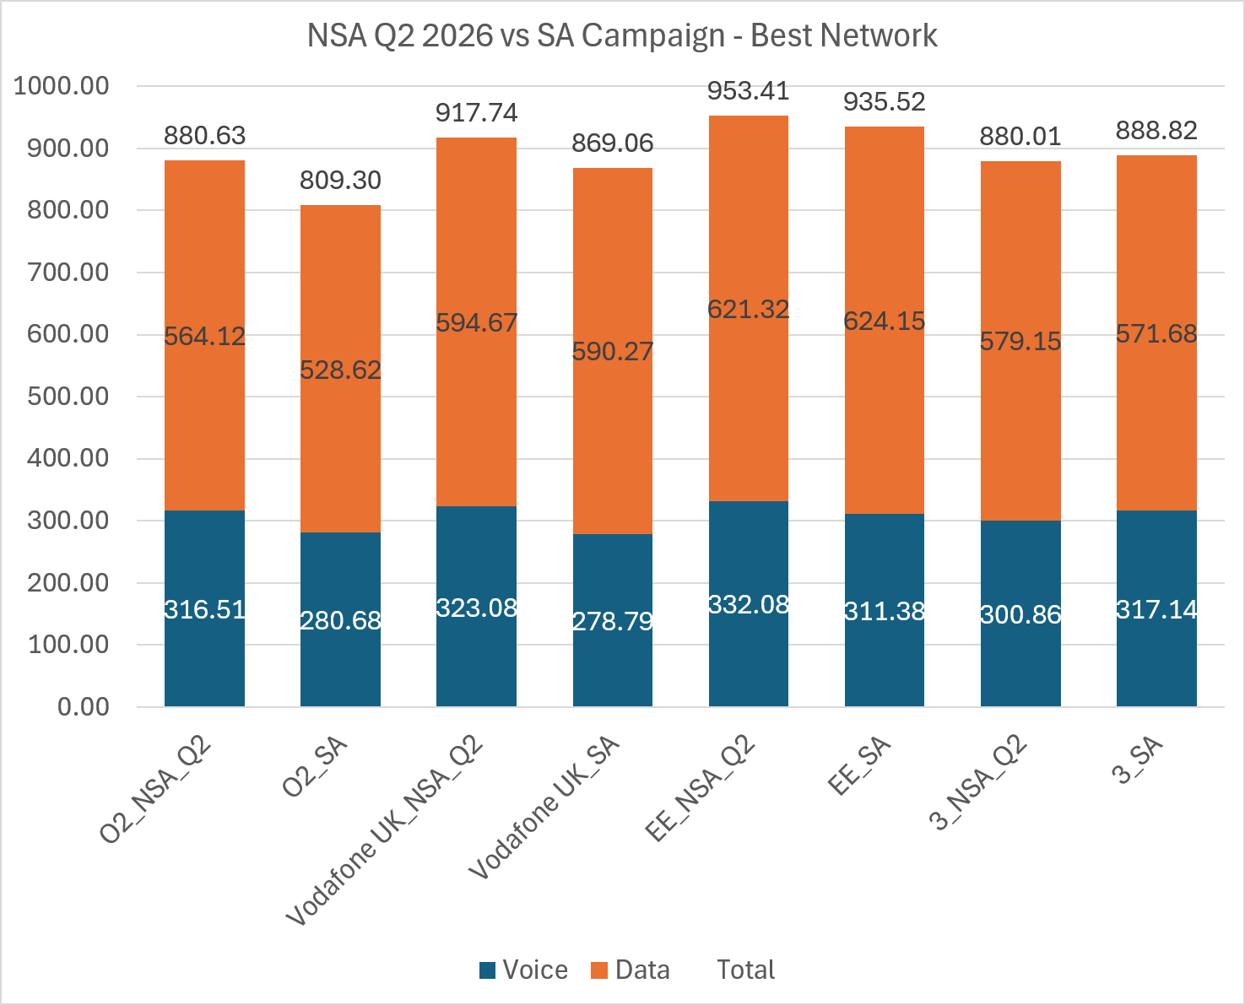
Netcheck 5G SA Best Network Scoring 7 Cities

Slide 6
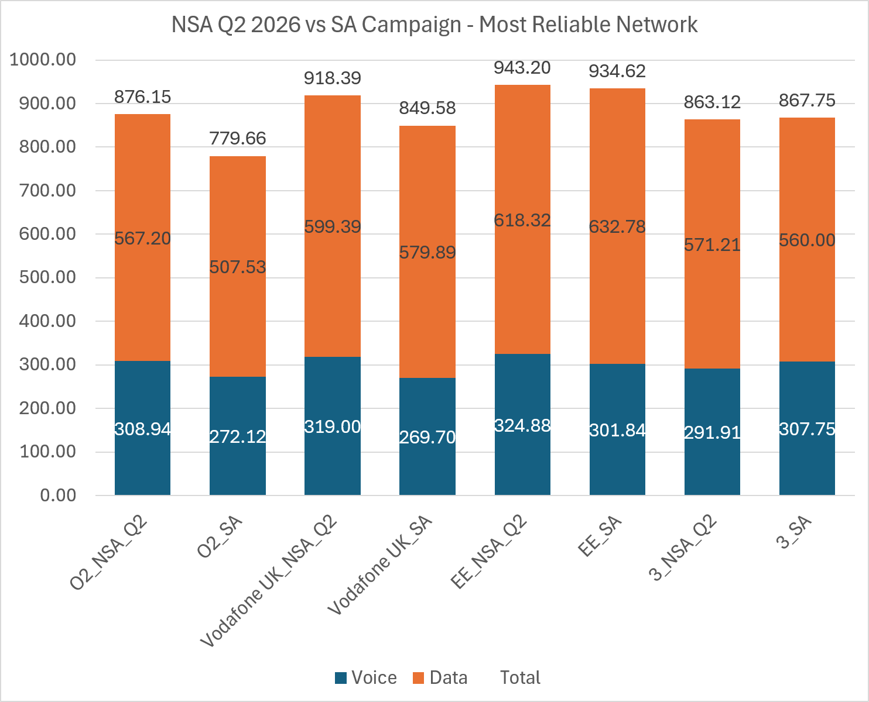
Netcheck 5G SA Most Reliable Network Scoring 7 Cities

Slide 7
Q2 2026 vs SA Campaign – Delta Scoring 7 Cities
 | Q2 2026 |  | 2026 5G SA Campaign |  | GAPs
KPI Name | Vodafone UK_NSA_Q2 | 3_Q2 | Vodafone UK_SA | 3UK_SA | GAP_SAvsNSA_VodafoneUK | GAP_SAvsNSA_ThreeUK
CALL SUCCESS RATIO [%] | 107.86 | 97.42 | 86.53 | 103.42 | -21.34 | 6.00
CALL SETUP TIME [s] | 12.39 | 13.24 | 11.69 | 13.28 | -0.70 | 0.04
CALL SETUP TIME > 10 s [%] | 6.07 | 6.50 | 5.28 | 6.51 | -0.79 | 0.01
POLQA < 1.6 [%] | 27.55 | 27.24 | 26.71 | 27.15 | -0.84 | -0.09
POLQA [MOS | 11.53 | 11.48 | 11.42 | 11.48 | -0.12 | 0.00
DISTURBED & IMPAIRED CALL [%] | 20.27 | 19.64 | 18.21 | 21.63 | -2.06 | 1.98
CALL SUCCESS RATIO [%] (Whatsapp) | 86.62 | 85.74 | 74.23 | 86.68 | -12.39 | 0.95
POLQA < 1.6 [%] (Whatsapp) | 18.25 | 12.02 | 14.48 | 15.76 | -3.77 | 3.74
POLQA [MOS] (Whatsapp) | 6.73 | 6.46 | 6.49 | 6.59 | -0.24 | 0.13
DISTURBED & IMPAIRED CALL [%] (Whatsapp) | 12.00 | 7.11 | 10.47 | 10.63 | -1.53 | 3.52
MULTI RAB DATA TRANSFER SUCCESS RATIO [%] | 13.81 | 14.00 | 13.29 | 14.00 | -0.52 | 0.00
FDFS DL SUCCESS RATIO [%] | 42.50 | 39.04 | 39.56 | 37.72 | -2.95 | -1.32
FDFS DL TRANSFER TIME [s] | 30.13 | 25.42 | 30.76 | 25.70 | 0.63 | 0.28
FDFS UL SUCCESS RATIO [%] | 20.87 | 19.39 | 21.18 | 19.09 | 0.31 | -0.30
FDFS UL TRANSFER TIME [s] | 12.19 | 13.48 | 12.72 | 13.16 | 0.53 | -0.33
FDTT DL THROUGHPUT > 2Mbit/s [%] | 27.72 | 26.28 | 26.98 | 25.53 | -0.73 | -0.76
FDTT DL THROUGHPUT > 5Mbit/s [%] | 34.34 | 34.11 | 34.49 | 33.62 | 0.15 | -0.48
FDTT DL THROUGHPUT > 20Mbit/s [%] | 30.48 | 30.68 | 32.85 | 30.31 | 2.37 | -0.38
FDTT DL THROUGHPUT > 100Mbit/s [%] | 20.03 | 19.71 | 20.69 | 19.67 | 0.66 | -0.04
FDTT DL THROUGHPUT P90 [Mbit/s] | 20.72 | 23.33 | 23.40 | 23.39 | 2.68 | 0.06
FDTT UL THROUGHPUT > 1Mbit/s [%] | 14.75 | 14.00 | 14.34 | 13.68 | -0.41 | -0.32
FDTT UL THROUGHPUT > 3Mbit/s [%] | 18.00 | 17.70 | 17.61 | 16.72 | -0.39 | -0.99
FDTT UL THROUGHPUT > 10Mbit/s [%] | 15.18 | 15.26 | 15.28 | 14.81 | 0.09 | -0.45
FDTT UL THROUGHPUT > 20Mbit/s [%] | 10.52 | 10.53 | 10.43 | 10.42 | -0.09 | -0.11
FDTT UL THROUGHPUT P90 [Mbit/s] | 11.10 | 11.70 | 11.02 | 11.70 | -0.08 | 0.00
BROWSING TIME TO 1MB [ms] | 51.68 | 50.98 | 51.63 | 50.90 | -0.05 | -0.08
BROWSING SUCCESS RATIO [%] | 73.99 | 72.81 | 71.81 | 70.48 | -2.18 | -2.33
VIDEO STREAMING SUCCESS RATIO [%] | 78.73 | 75.92 | 75.67 | 76.82 | -3.06 | 0.91
VIDEO STREAMING TTFP >= 10 s [%] | 4.70 | 4.34 | 4.49 | 4.24 | -0.21 | -0.10
VIDEO STREAMING IRRITATING EXPERIENCE [%] | 40.93 | 39.54 | 40.21 | 38.91 | -0.72 | -0.63
INTERACTIVITY PACKET ERROR RATIO [%] | 6.89 | 5.60 | 6.78 | 5.57 | -0.11 | -0.02
INTERACTIVITY MEDIAN RTT [MS] | 29.21 | 29.32 | 28.39 | 29.16 | -0.83 | -0.17
Most Reliable KPI

Slide 8
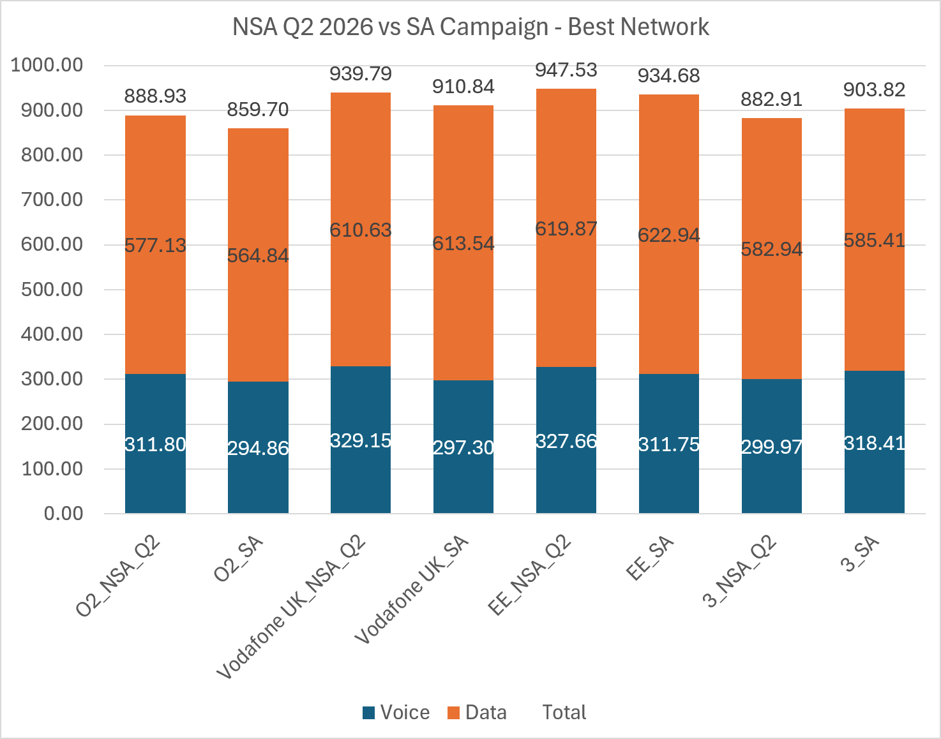
Netcheck 5G SA Best Network Scoring London

Slide 9

Netcheck 5G SA Most Reliable Network Scoring London
The plot compares the NC 2026 Q2 NSA campaign vs the latest 5G SA campaign
O2 and Vodafone UK have a scoring gap between SA and NSA
EE also has a gap, but it is smaller
3UK network does not have 5G SA for 3UK UE

Slide 10
Q2 2026 vs SA Campaign – Delta Scoring London
 | Q2 2026 |  | 2026 5G SA Campaign |  | GAPs
KPI Name | Vodafone UK_NSA_Q2 | 3_Q2 | Vodafone UK_SA | 3UK_SA | GAP_SAvsNSA_VodafoneUK | GAP_SAvsNSA_ThreeUK
CALL SUCCESS RATIO [%] | 108.84 | 97.58 | 98.90 | 102.76 | -9.94 | 5.18
CALL SETUP TIME [s] | 12.57 | 13.30 | 12.07 | 13.30 | -0.49 | 0.00
CALL SETUP TIME > 10 s [%] | 6.10 | 6.65 | 4.62 | 6.40 | -1.48 | -0.25
POLQA < 1.6 [%] | 28.40 | 27.24 | 26.35 | 27.71 | -2.05 | 0.47
POLQA [MOS | 11.58 | 11.50 | 11.36 | 11.53 | -0.22 | 0.03
DISTURBED & IMPAIRED CALL [%] | 21.01 | 18.69 | 16.96 | 21.21 | -4.05 | 2.52
CALL SUCCESS RATIO [%] (Whatsapp) | 85.86 | 84.19 | 79.90 | 87.50 | -5.95 | 3.31
POLQA < 1.6 [%] (Whatsapp) | 20.30 | 12.39 | 16.10 | 16.38 | -4.20 | 3.99
POLQA [MOS] (Whatsapp) | 6.82 | 6.47 | 6.57 | 6.61 | -0.25 | 0.14
DISTURBED & IMPAIRED CALL [%] (Whatsapp) | 14.03 | 7.94 | 11.44 | 11.01 | -2.59 | 3.06
MULTI RAB DATA TRANSFER SUCCESS RATIO [%] | 13.64 | 14.00 | 13.02 | 14.00 | -0.62 | 0.00
FDFS DL SUCCESS RATIO [%] | 45.38 | 37.49 | 45.52 | 38.88 | 0.14 | 1.39
FDFS DL TRANSFER TIME [s] | 31.20 | 25.88 | 31.20 | 26.71 | 0.00 | 0.84
FDFS UL SUCCESS RATIO [%] | 20.56 | 19.24 | 21.47 | 19.21 | 0.91 | -0.02
FDFS UL TRANSFER TIME [s] | 12.66 | 13.74 | 13.19 | 13.85 | 0.53 | 0.11
FDTT DL THROUGHPUT > 2Mbit/s [%] | 29.33 | 26.72 | 29.50 | 26.86 | 0.16 | 0.14
FDTT DL THROUGHPUT > 5Mbit/s [%] | 36.55 | 34.68 | 36.44 | 34.55 | -0.11 | -0.13
FDTT DL THROUGHPUT > 20Mbit/s [%] | 33.11 | 30.93 | 35.00 | 30.49 | 1.89 | -0.44
FDTT DL THROUGHPUT > 100Mbit/s [%] | 20.72 | 19.91 | 21.07 | 19.91 | 0.35 | 0.00
FDTT DL THROUGHPUT P90 [Mbit/s] | 20.63 | 23.40 | 23.40 | 23.28 | 2.77 | -0.12
FDTT UL THROUGHPUT > 1Mbit/s [%] | 14.64 | 13.75 | 14.59 | 13.88 | -0.05 | 0.13
FDTT UL THROUGHPUT > 3Mbit/s [%] | 18.00 | 18.05 | 17.61 | 16.57 | -0.39 | -1.48
FDTT UL THROUGHPUT > 10Mbit/s [%] | 15.31 | 15.43 | 15.47 | 15.19 | 0.16 | -0.23
FDTT UL THROUGHPUT > 20Mbit/s [%] | 10.61 | 10.64 | 10.52 | 10.58 | -0.09 | -0.06
FDTT UL THROUGHPUT P90 [Mbit/s] | 11.02 | 11.70 | 10.99 | 11.70 | -0.02 | 0.00
BROWSING TIME TO 1MB [ms] | 51.91 | 50.95 | 51.91 | 51.11 | 0.00 | 0.16
BROWSING SUCCESS RATIO [%] | 76.12 | 73.49 | 73.76 | 72.76 | -2.37 | -0.74
VIDEO STREAMING SUCCESS RATIO [%] | 79.86 | 76.33 | 80.93 | 80.87 | 1.07 | 4.54
VIDEO STREAMING TTFP >= 10 s [%] | 5.04 | 4.55 | 5.06 | 4.18 | 0.01 | -0.37
VIDEO STREAMING IRRITATING EXPERIENCE [%] | 40.85 | 39.27 | 40.00 | 38.56 | -0.84 | -0.70
INTERACTIVITY PACKET ERROR RATIO [%] | 7.26 | 6.17 | 7.04 | 5.63 | -0.22 | -0.55
INTERACTIVITY MEDIAN RTT [MS] | 29.86 | 30.62 | 28.87 | 30.49 | -0.99 | -0.13
Most Reliable KPI

Slide 11
Netcheck CDR Voice and Speech Analysis 2026 Q2 NSA vs SA Campaign 7 Cities and London

Slide 12
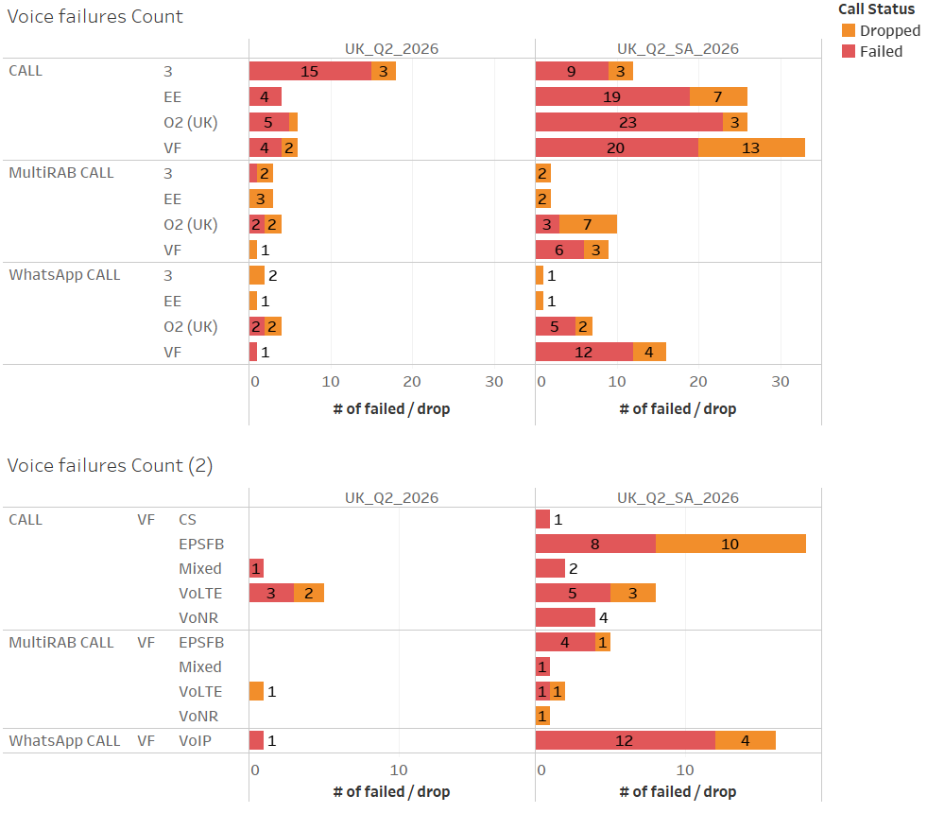
Voice Failures 7 Cities
Vodafone UK has higher number of failures in Multi-RAB, standard call and Whatsapp during SA session
Most of the Vodafone Multi-RAB and classic call failures come from EPS Fallback

Slide 13
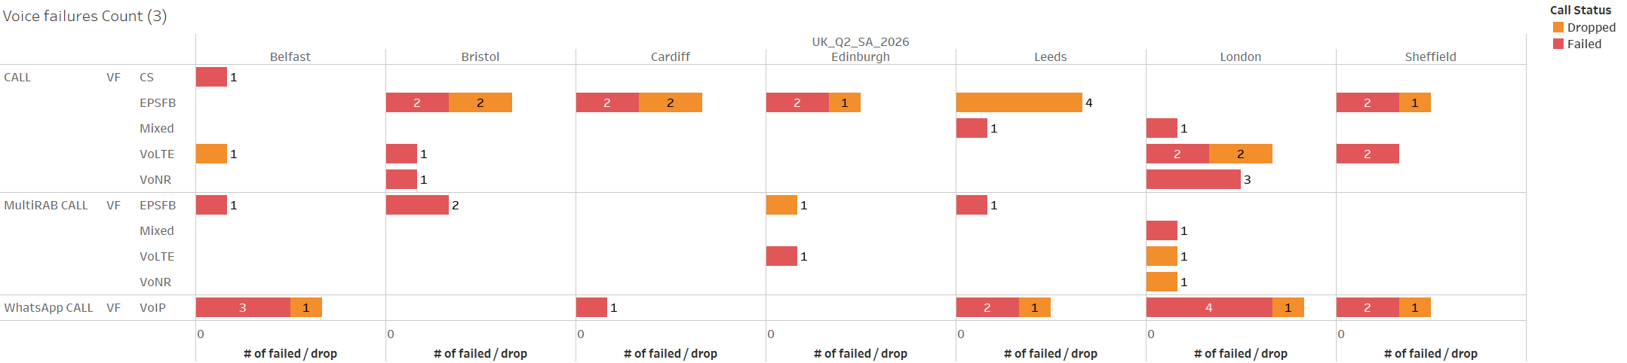
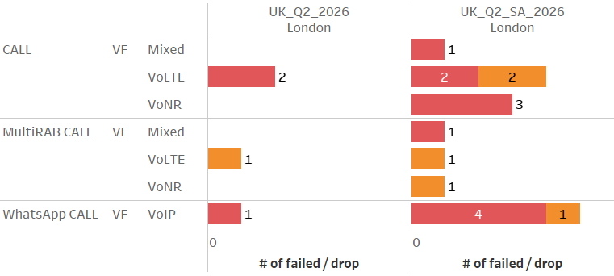
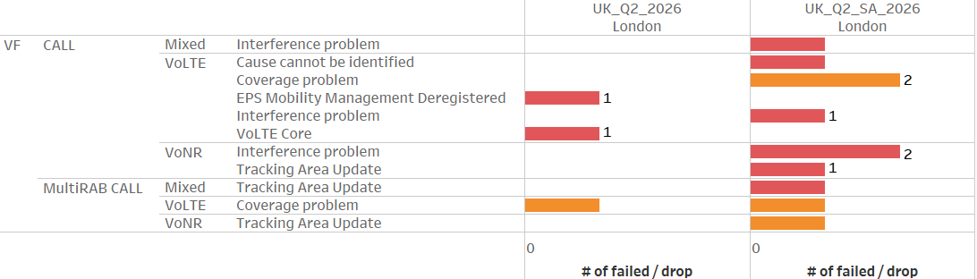
Voice Failures (Vodafone UK) 7 Cities
Vodafone does not have EPSFB failures in London, having continuous VoNR deployment in the city. Most of the classic/Multi-RAB failures happening in London are due to VoLTE/VoNR
Quarterly failures comparison in London

Slide 14
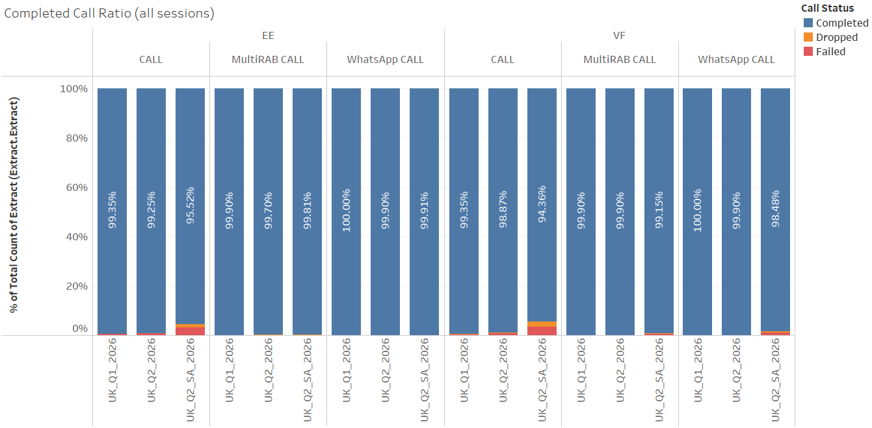
Completed Call Ratio 7 cities
Vodafone UK mostly shows degradation in classic calls, similarly to the other operators

Slide 15
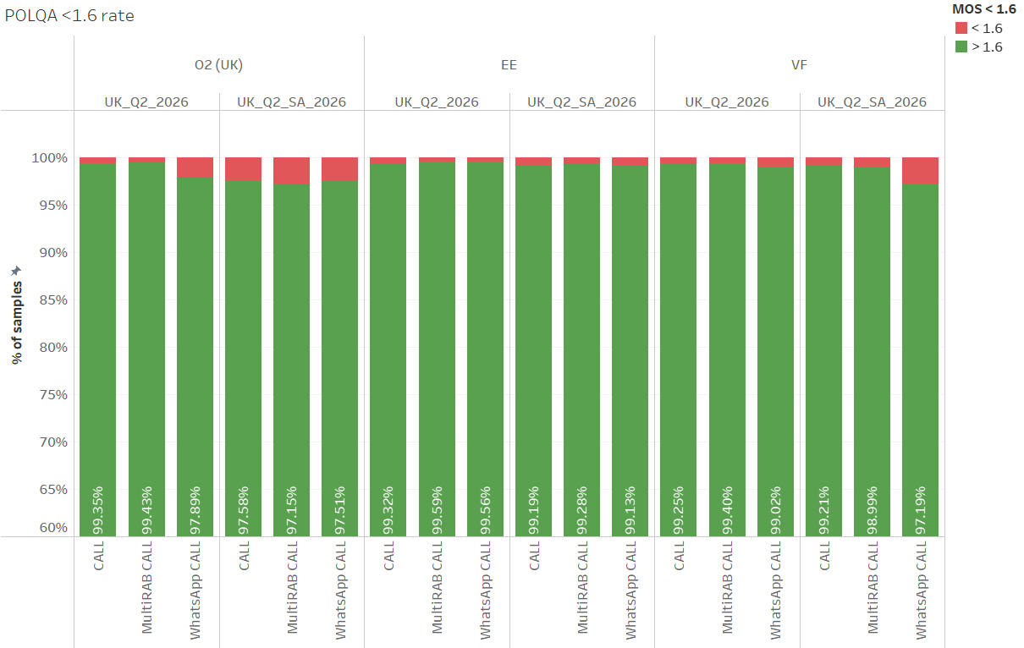
POLQA <1.6 Rate 7 cities
Vodafone UK has a gap in low POLQA samples in whatsapp
The high low POLQA samples come from all the cities, not only one single specific

Slide 16
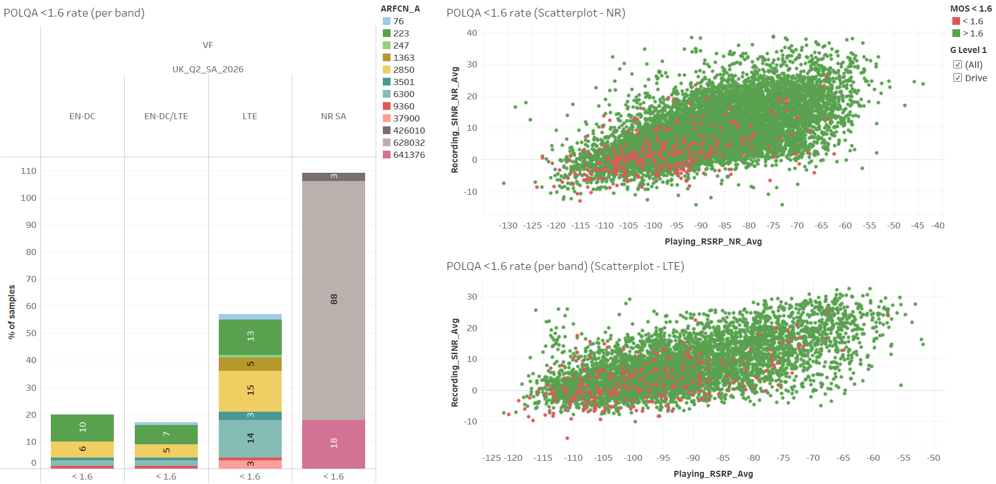
POLQA <1.6 Rate Vodafone (Whatsapp) 7 cities
Most of the Whatsapp Low POLQA samples come from NR SA using TDD N78 band
Many of the low POLQA samples happen at low SINR (interference issues), but there are also samples in better RF

Slide 17
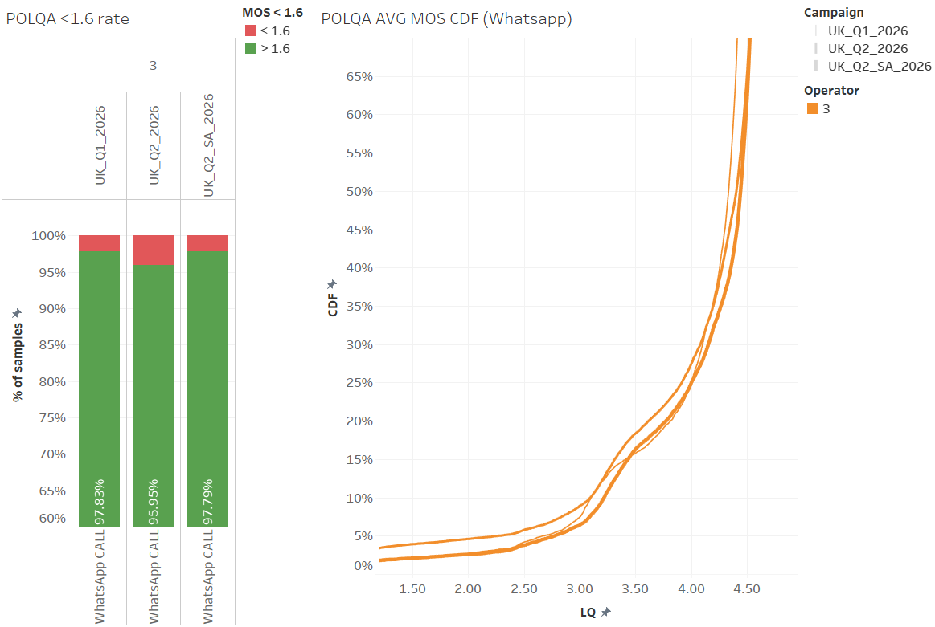
POLQA <1.6 Rate Three UK (Whatsapp) 7 cities
3UK looks to be improved in low whatsapp POLQA samples, compared to the previous Q2 NSA campaign

Slide 18
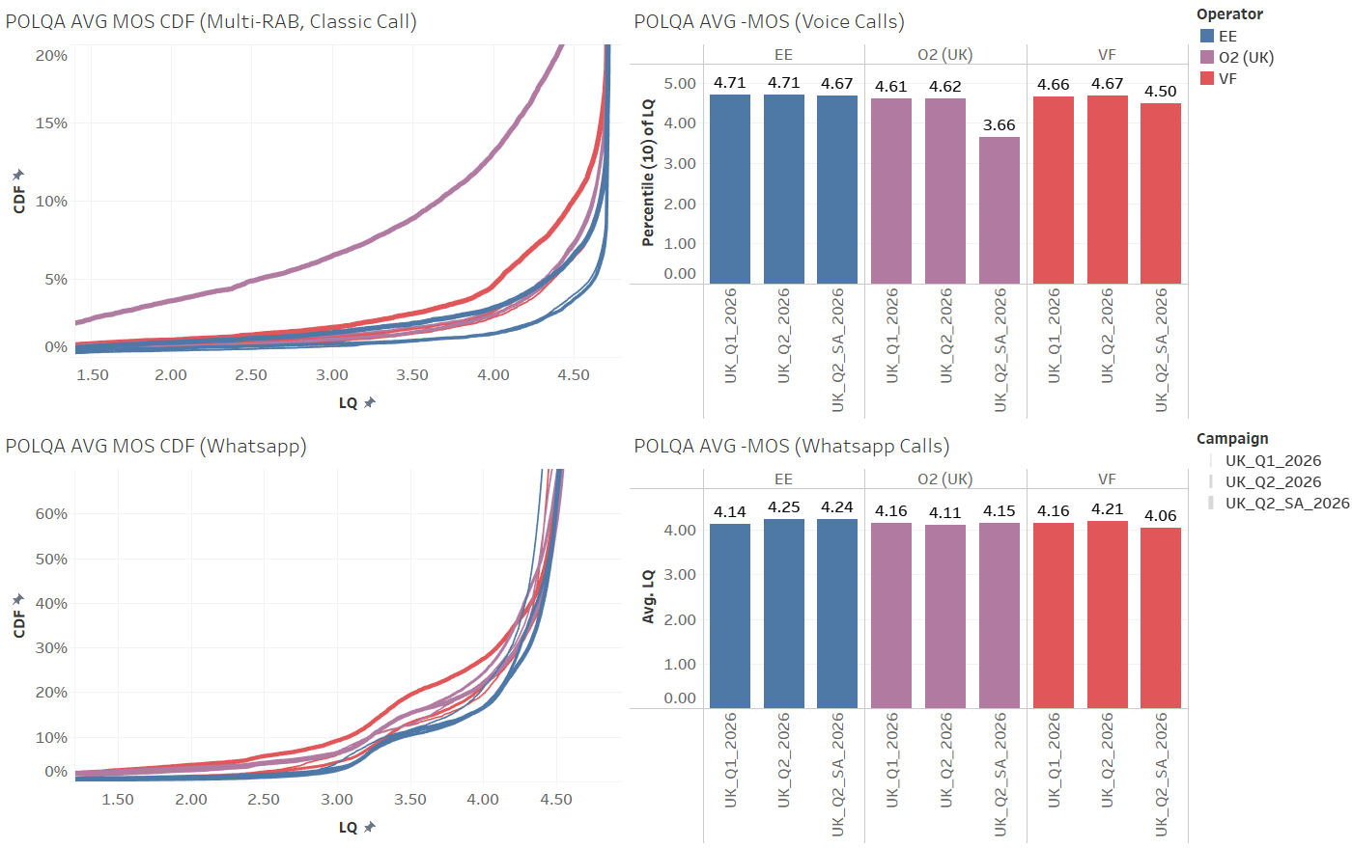
POLQA Avg MOS 7 cities
All of the operators have a gap in POLQA AVG MOS between NSA and SA
EE has the lowest SA vs NSA gap

Slide 19
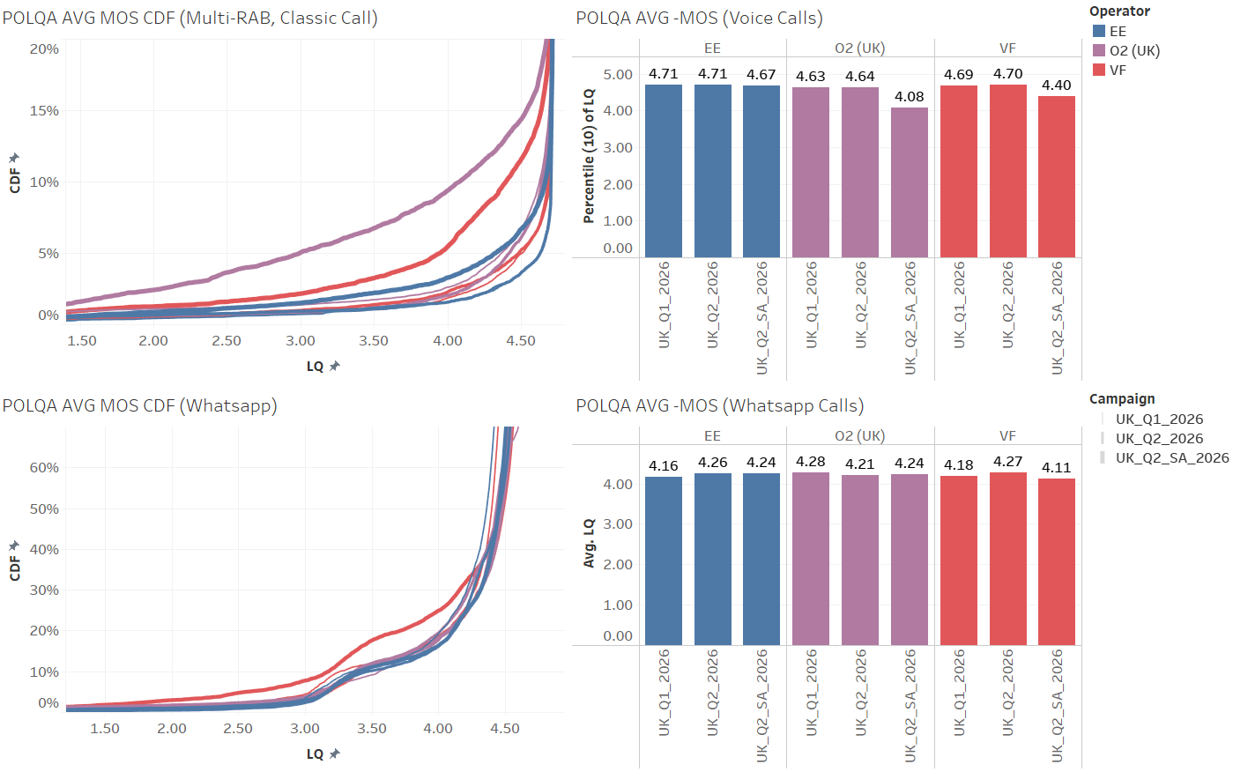
POLQA Avg MOS London
All of the operators have a gap in POLQA AVG MOS between NSA and SA
EE has the lowest SA vs NSA gap

Slide 20
Netcheck CDR Data Analysis 2026 Q2 NSA vs SA Campaign 7 Cities and London

Slide 21
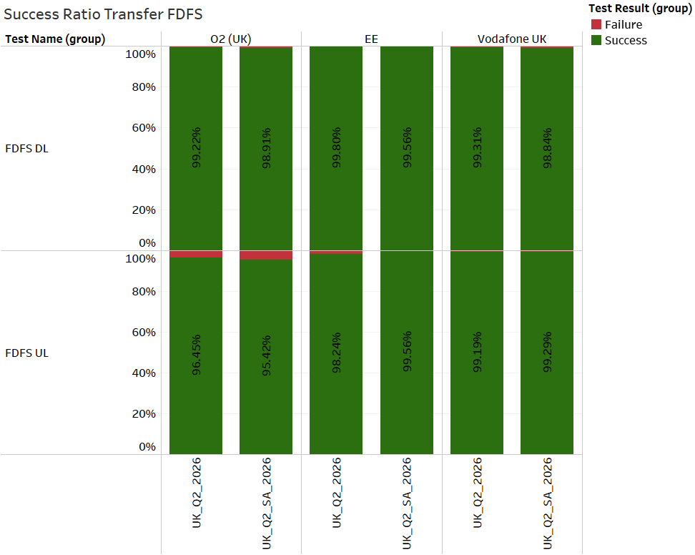
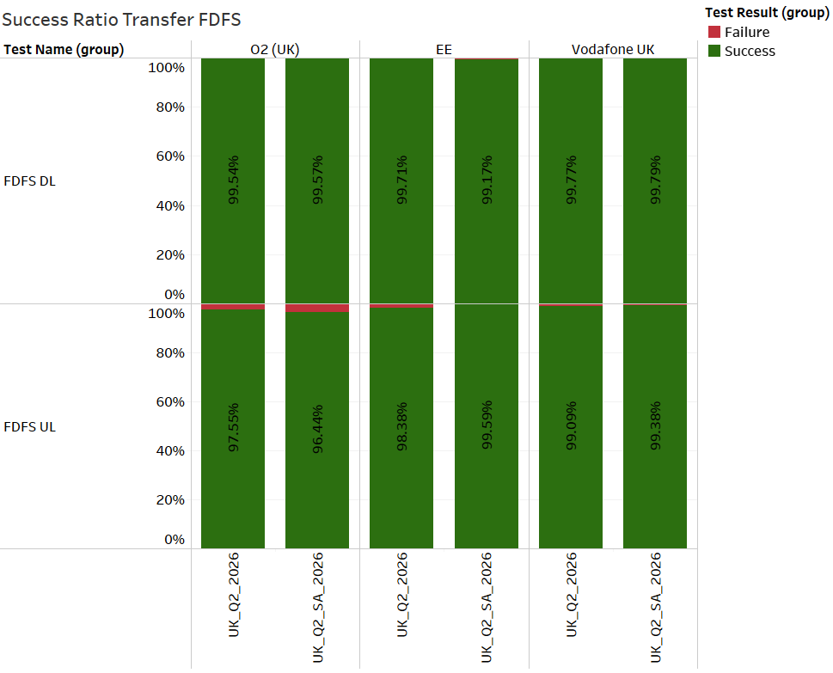
FDFS Success Ratio
7 cities
London
Vodafone UK improves both FDFS UL and DL SR
EE is stable or improving as well

Slide 22
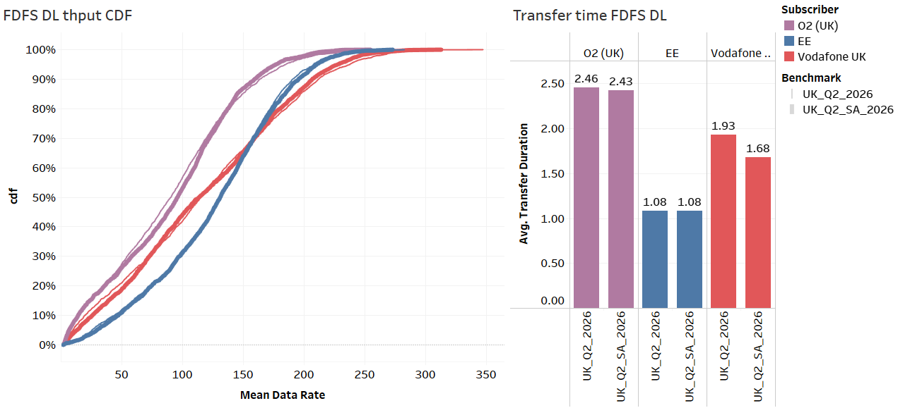
FDFS DL Throughput 7 Cities
The operators are mostly stable in FDFS DL Throughput
Vodafone UK improves the transfer time, while the other operators are stable

Slide 23
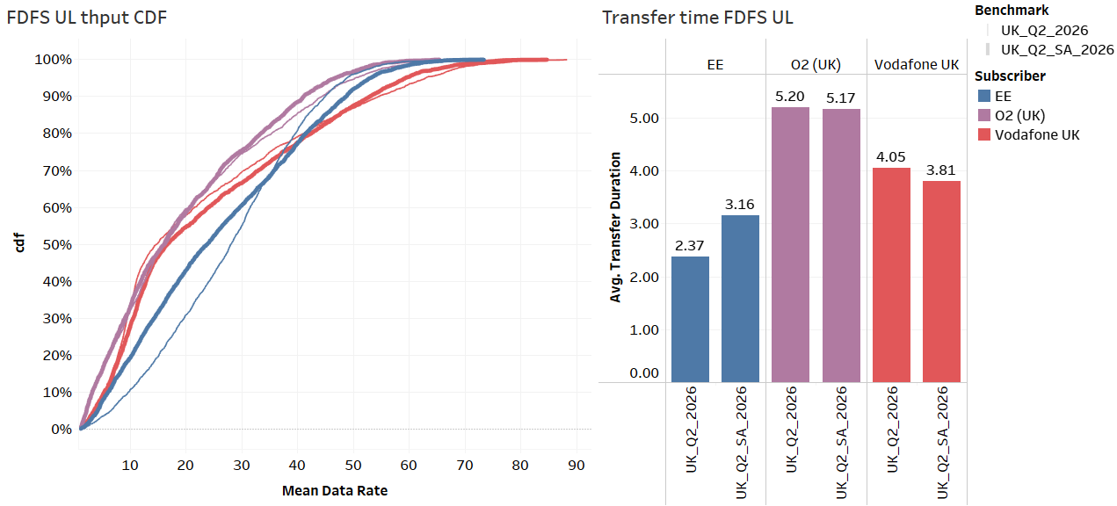
FDFS UL Throughput 7 Cities
EE shows degradation in FDFS UL Throughput and transfer time, especially in the lower Ps
Vodafone UK improves the FDFS UL Throughput and transfer time

Slide 24
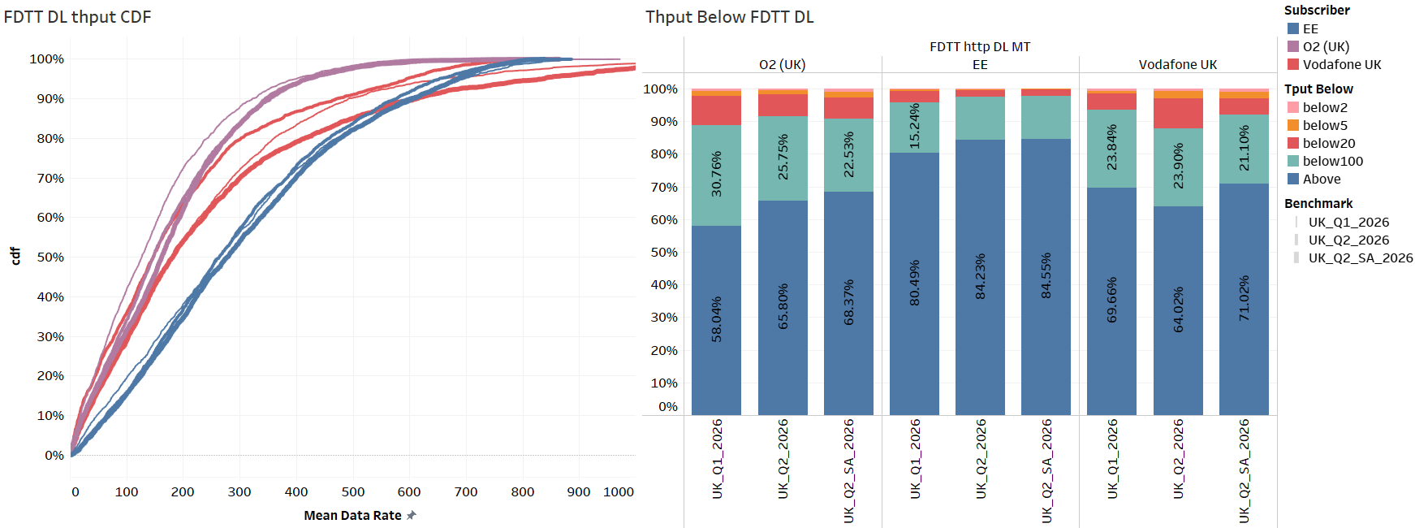
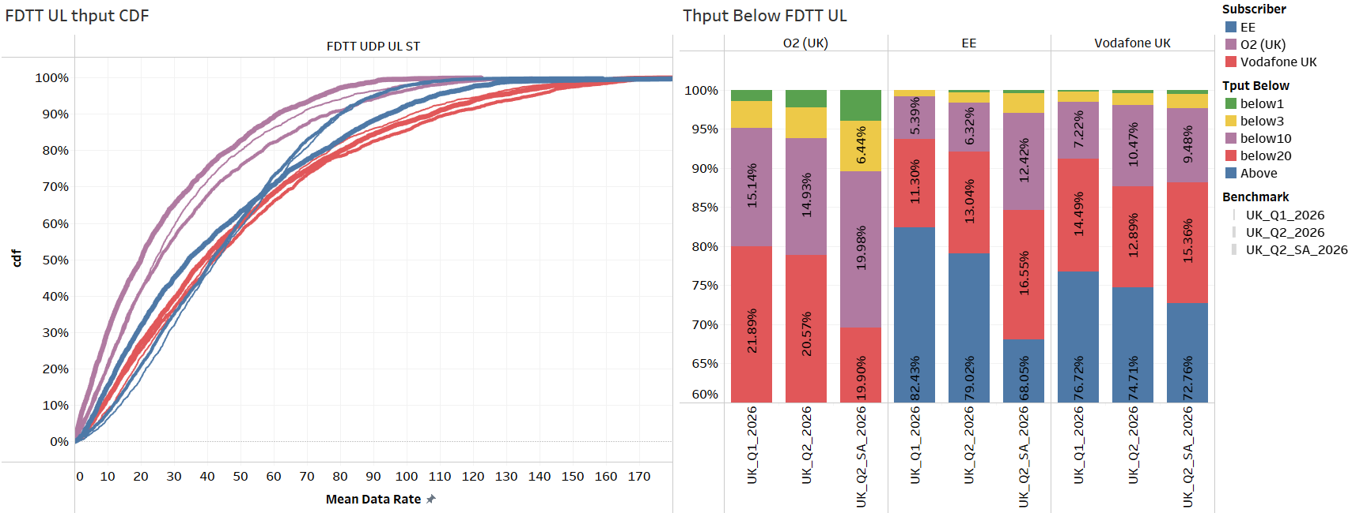
FDTT DL and UL Throughput 7 Cities
Vodafone UK improves all of the DL Throughput samples in SA, compared to Q2 2026 NSA
EE performs better at lower Ps, but Vodafone UK and 3UK can reach higher peak throughput values
EE shows a degradation in SA compared to NSA
Vodafone UK shows similar below1 and below3, lower below10 and higher below100 samples

Slide 25
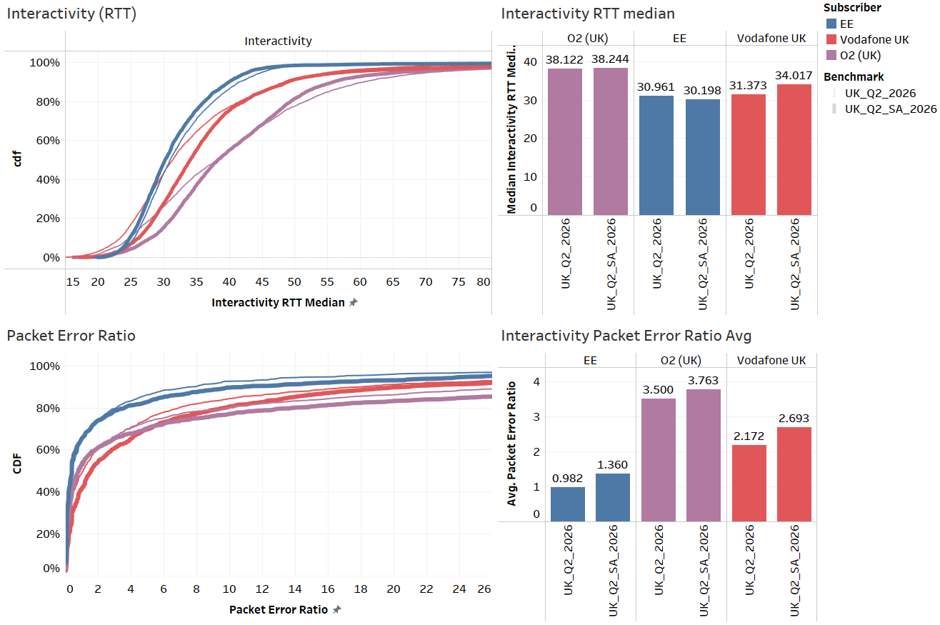
Interactivity KPIs 7 Cities
Vodafone UK shows higher interactivity RTT during the SA campaign, while EE is stable or slightly improving
Both Vodafone UK and EE slightly increase their Interactivity Packet Error Ratio

Slide 26
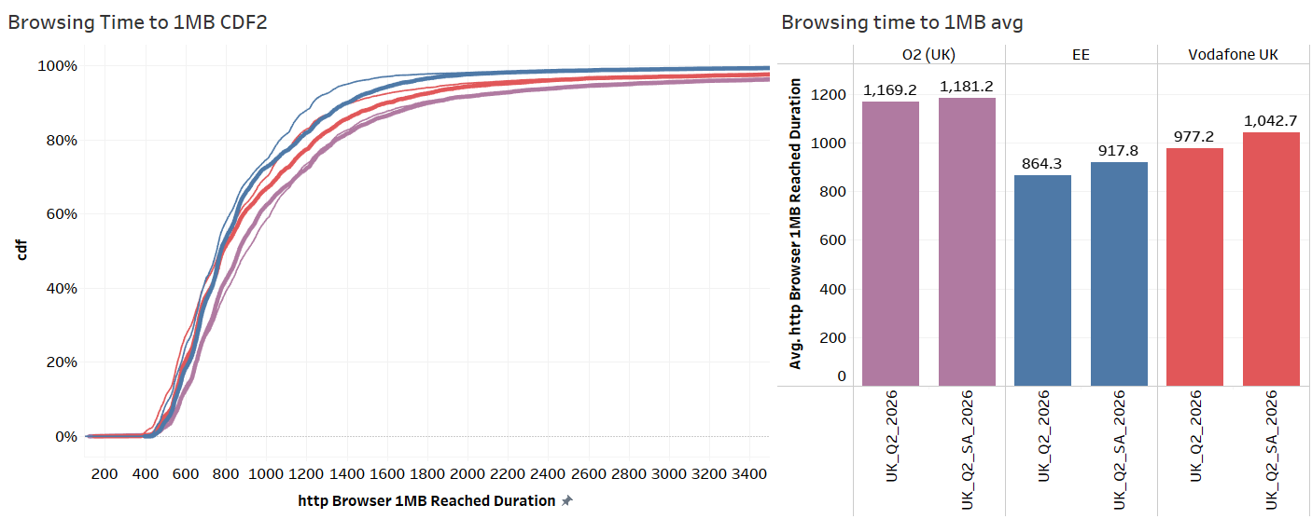
Browsing Time to 1MB 7 cities
All of the operators have increased their Browsing Time to 1MB

Slide 27
Conclusions
Most of the scoring gap in Vodafone UK between NSA and SA come from voice KPIs
Vodafone UK has a better scoring in many of the data KPIs (especially FDTT DL throughput samples)
Scoring
Vodafone UK has many voice failures in 5G SA, due to 2 main factors:
EPSFB failures issue, outside London → London has continuous VoNR deployment, so no need for EPSFB
Whatsapp failures → many of the failures are in bad RF or high Interference conditions
Vodafone UK shows higher number of low POLQA samples in Whatsapp, many of the samples being in bad RF or high interference conditions
3UK (NSA) improves the whatsapp POLQA compared to the former Q2 campaign
Voice
Vodafone UK shows improved FDTT DL throughput, mainly due to 2 main factors:
Being 5G SA allows for higher throughput compared to NSA
TCPO2 settings rollout in the COSMOS core network (Jul 16th )
Data

