Slide 1
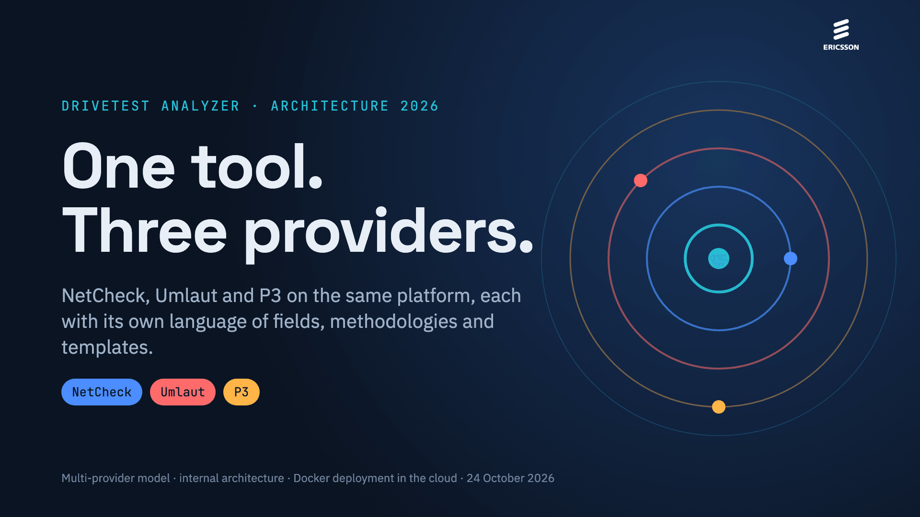
Notes:
DriveTest Analyzer is no longer a tool for NetCheck CDRs only. This deck covers the multi-provider model (NetCheck, Umlaut and later P3), how the tool is built inside, and how it is deployed as a Docker container in the cloud, on AWS or in the Ericsson cloud.

Slide 2
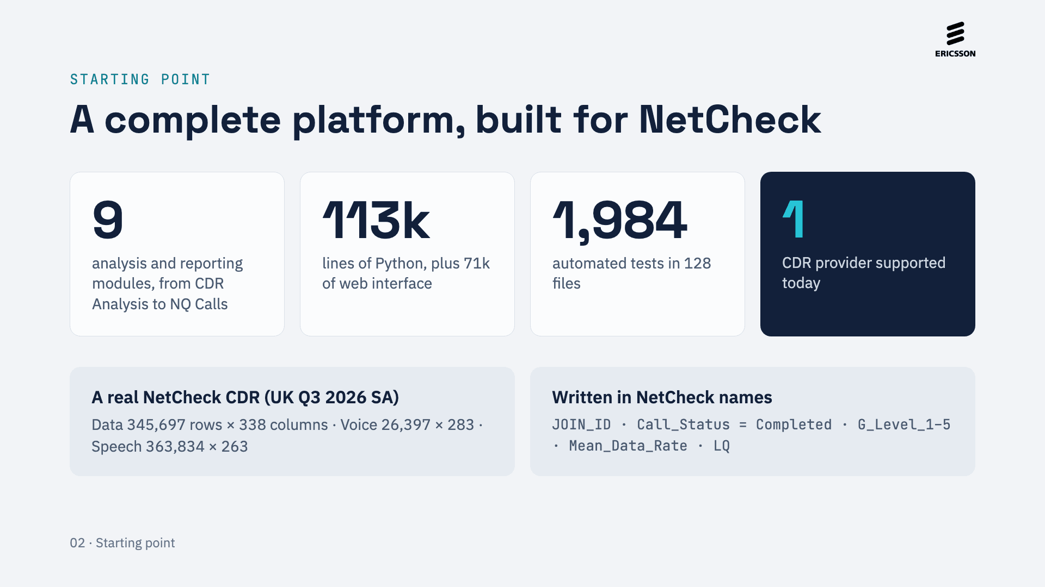
Notes:
Today the tool is complete, but everything is written in NetCheck names and values: ingestion, the Scoring formulas, the PPT templates, the NQ definition and the radio tables of Network Insights. The figures come from the repository (branch 0.9.0) and the UK workspace.

Slide 3
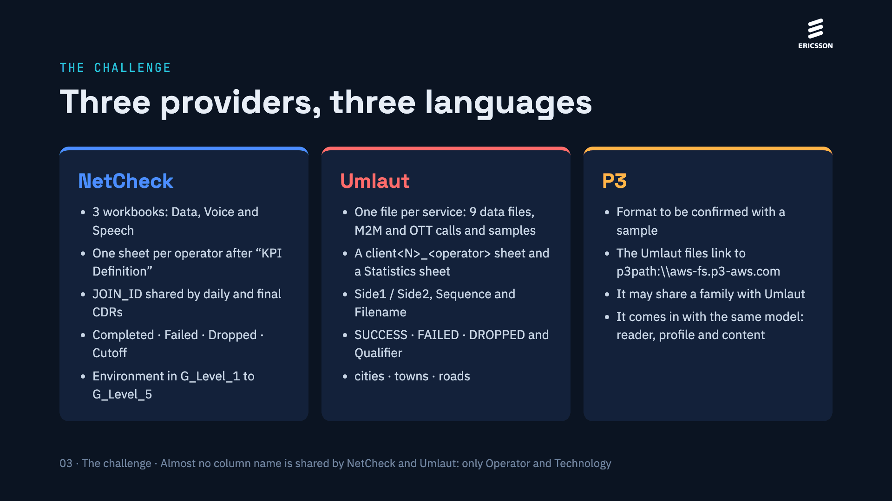
Notes:
Each provider delivers its CDRs differently. NetCheck groups them by CDR type and operator; Umlaut splits them by service and by side of the call, and adds its own Qualifier. We have no P3 sample yet; the Umlaut files themselves link to a P3 path, which suggests the formats may be related.

Slide 4
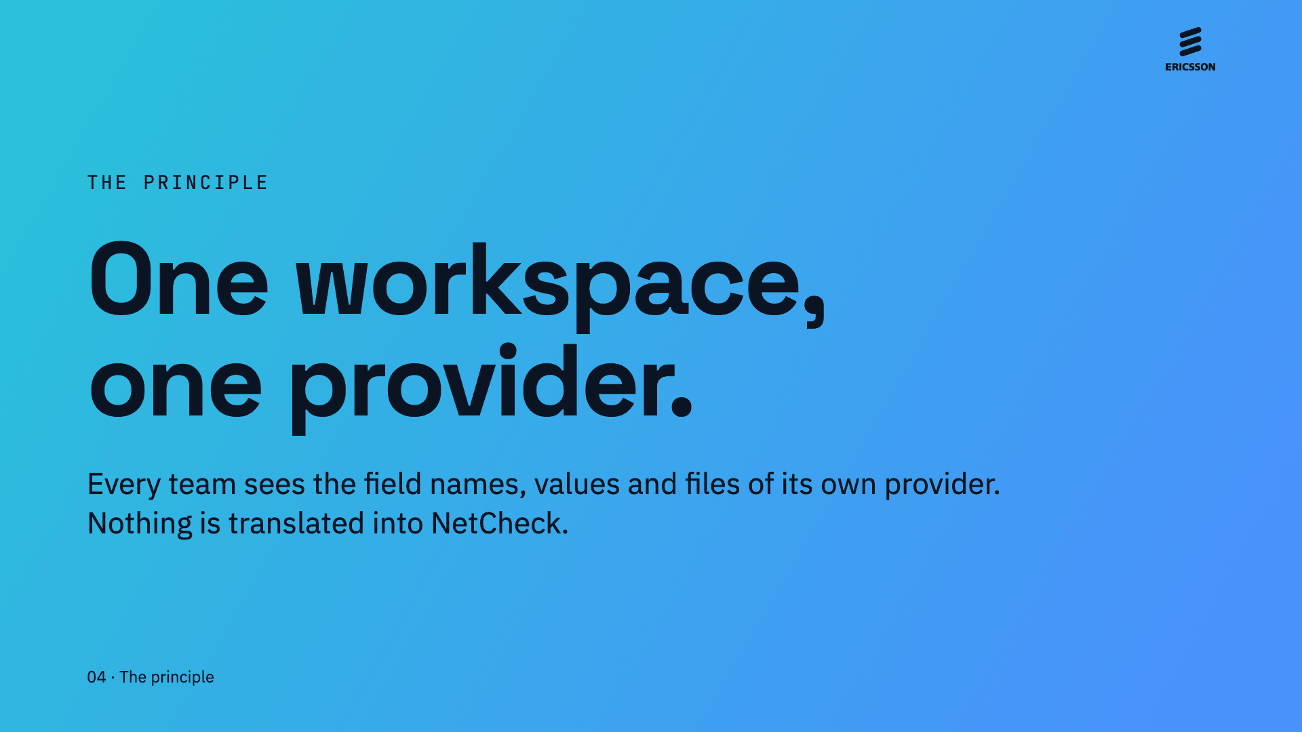
Notes:
Decision made: the CDRs of different providers are never mixed in one workspace. Every module therefore works with a single vocabulary, one Scoring methodology and one set of templates, and people who know Umlaut recognise its fields and files.

Slide 5
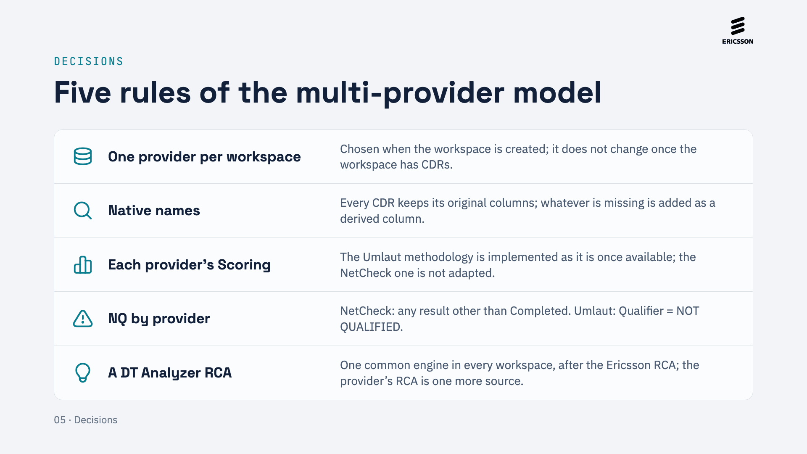
Notes:
The five agreed rules: one provider per workspace, native names visible, Scoring with each provider’s methodology, each provider’s NQ definition, and the DT Analyzer RCA as the common engine, available in every workspace beside the NetCheck and Ericsson RCAs.

Slide 6
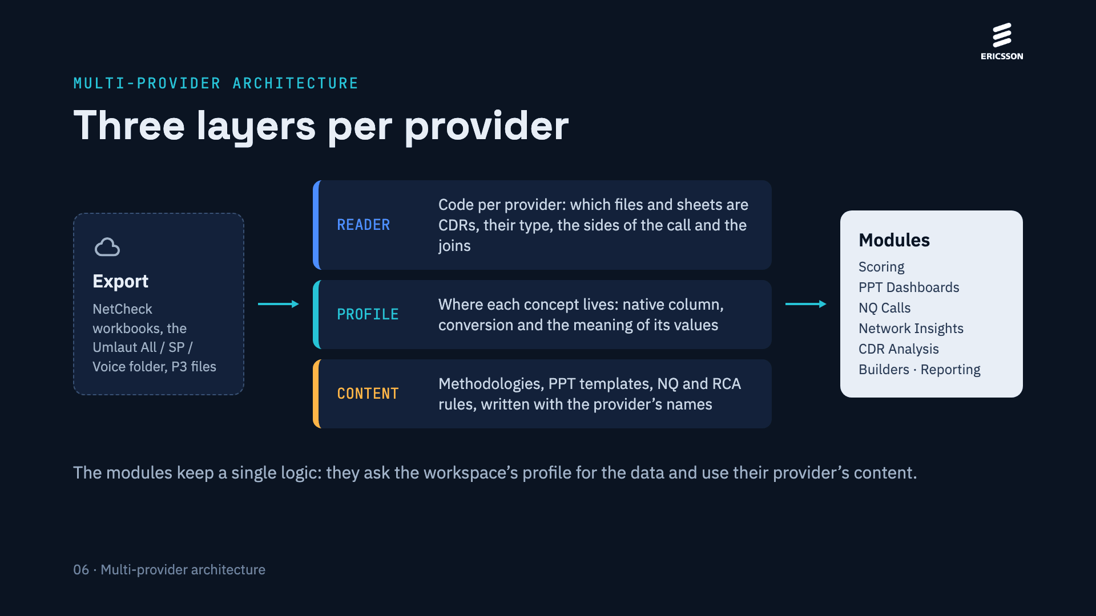
Notes:
The reader understands the structure of each provider’s export. The profile tells every module where each piece of data is and how to read it. The content is the provider’s own methodologies, templates and rules. The modules are not duplicated: the same logic serves the three providers.

Slide 7
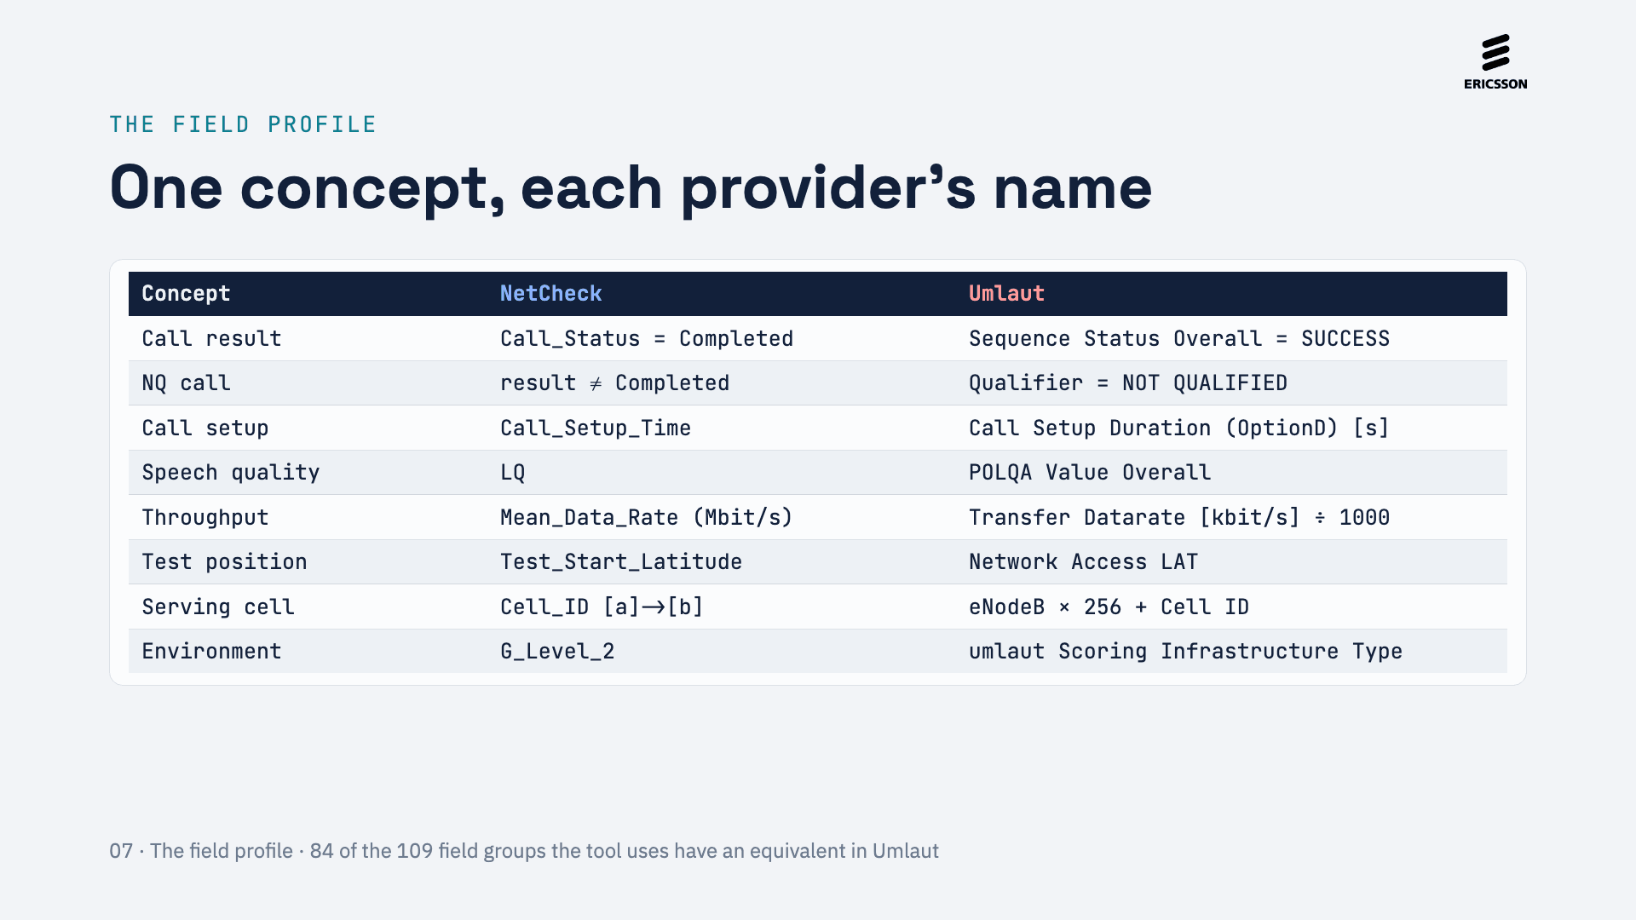
Notes:
The profile is the central piece. For each provider, every concept a module needs has its native column, its conversion (for example kbit/s to Mbit/s) and the meaning of its values (SUCCESS stands for Completed). Users keep seeing the native column; the module reads the concept. The 84 of 109 figure comes from the compatibility analysis.

Slide 8
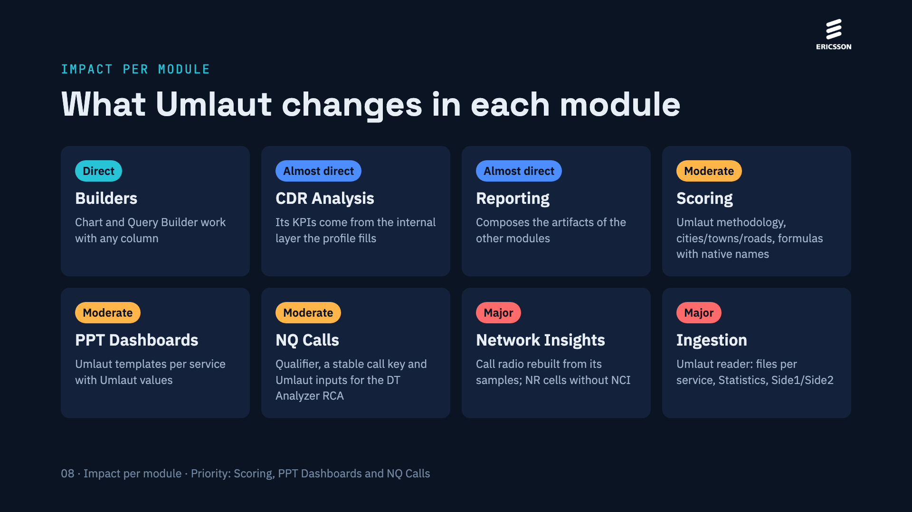
Notes:
Builders work as soon as the CDR can be loaded. CDR Analysis and Reporting barely change. Scoring, PPT Dashboards and NQ Calls need their Umlaut content. The major changes are in ingestion (the Umlaut reader) and Network Insights, because Umlaut only gives the radio of a call at its start and end and has no identity for NR cells.

Slide 9
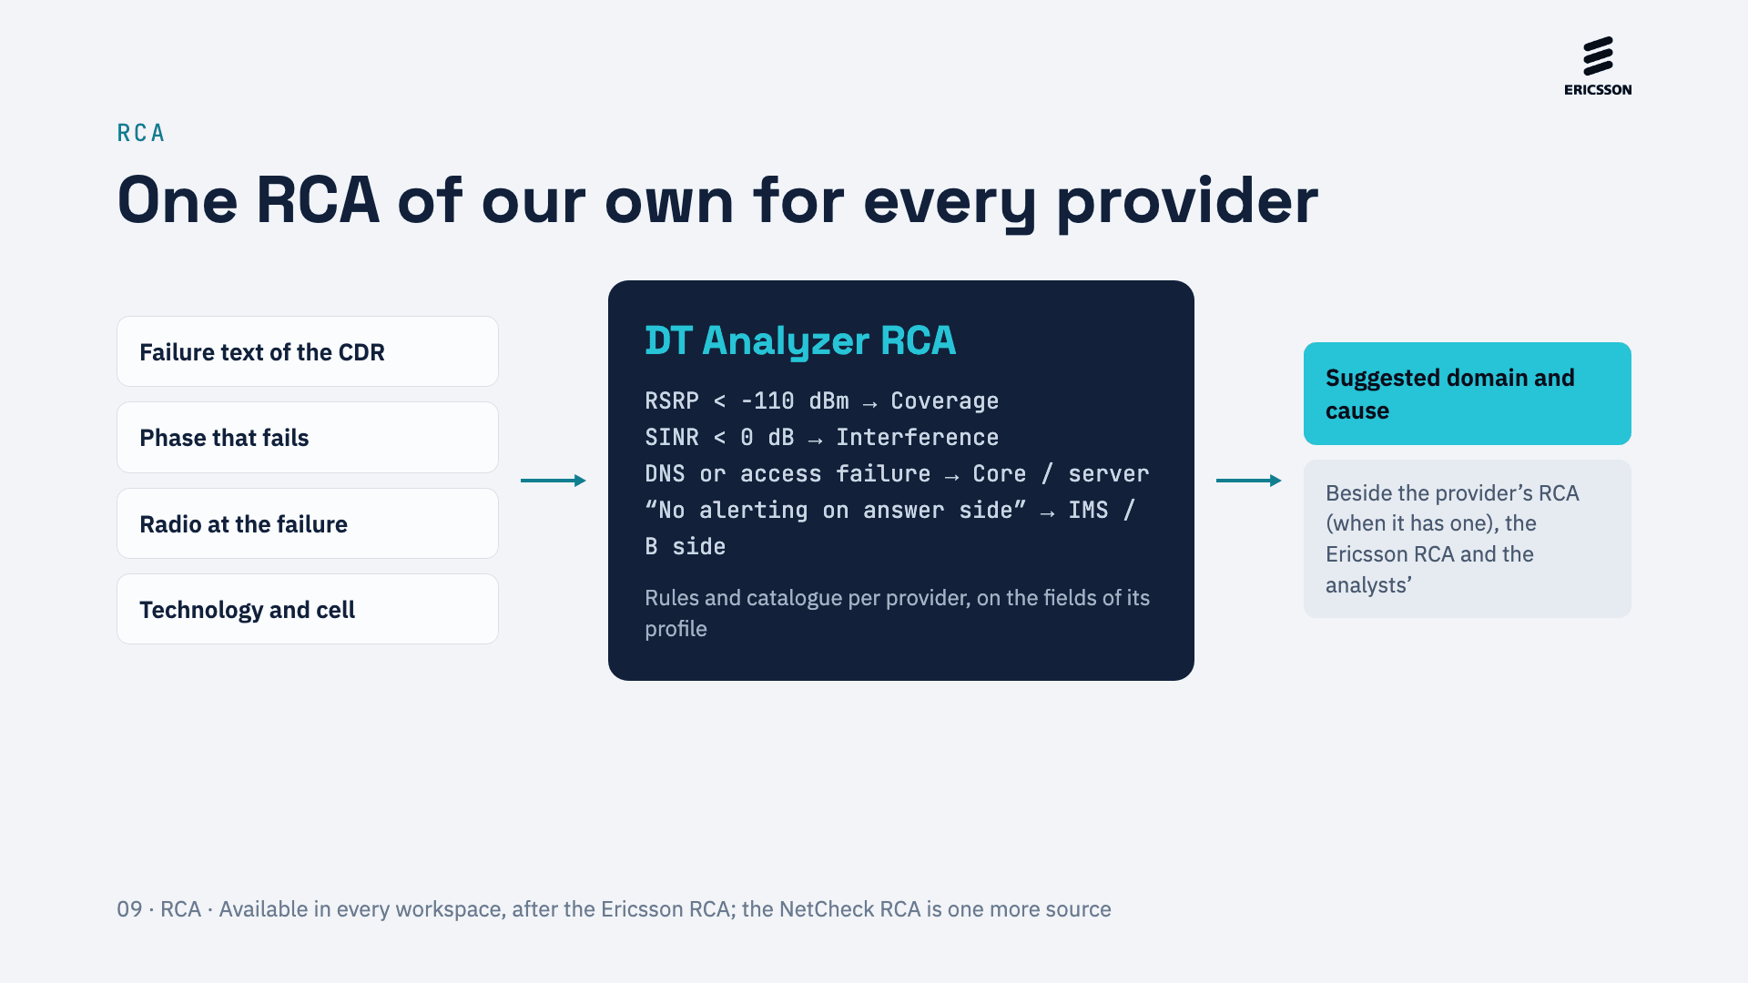
Notes:
Today the NetCheck RCA section suggests a domain and a cause with keywords on the NetCheck failure classification. The DT Analyzer RCA, available in every workspace with rules that can be edited, combines the failure description with the phase that fails and the radio at the time of the failure; Umlaut, which only brings a failure text, and P3 still need their own inputs. The rules shown are examples of the kind of condition, not a closed catalogue.

Slide 10
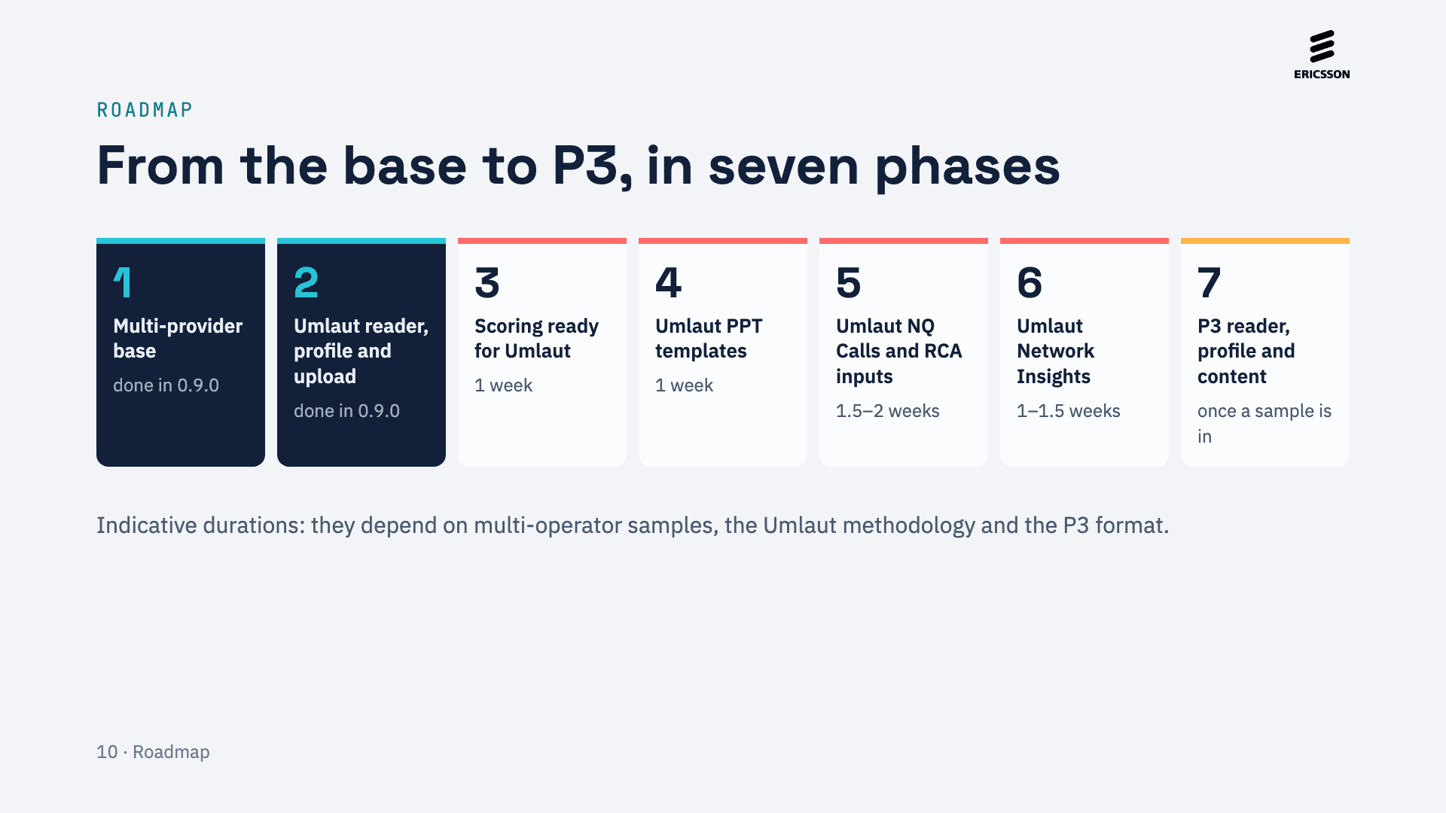
Notes:
Phases 1 and 2 are done in version 0.9.0: the multi-provider base and the Umlaut reader, profile and upload. Phases 3 to 6 bring Umlaut to the priority modules, Scoring, PPT Dashboards and NQ Calls, and to Network Insights. P3 comes last with the same model, as soon as there is a sample.

Slide 11
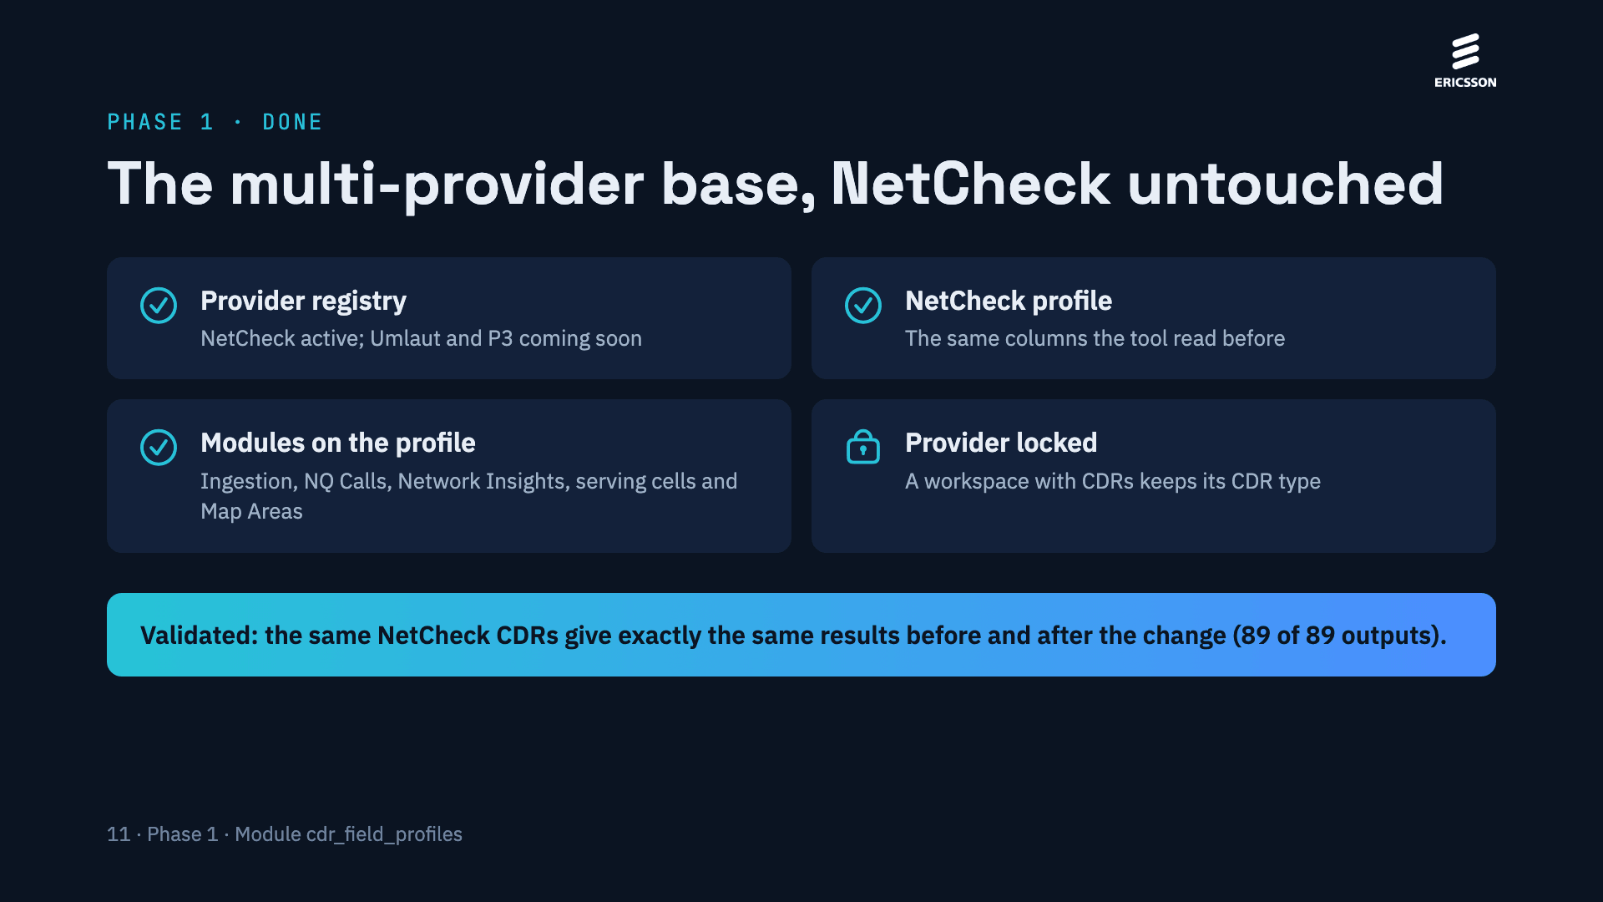
Notes:
Phase 1 prepares the tool without changing anything for NetCheck users. The modules no longer hold NetCheck names inside; they ask the workspace’s profile for them. The NetCheck profile reproduces exactly the previous columns, and the validation proved it: processing the same real NetCheck CDRs before and after the change gave 89 of 89 identical outputs, and every related test passes.

Slide 12
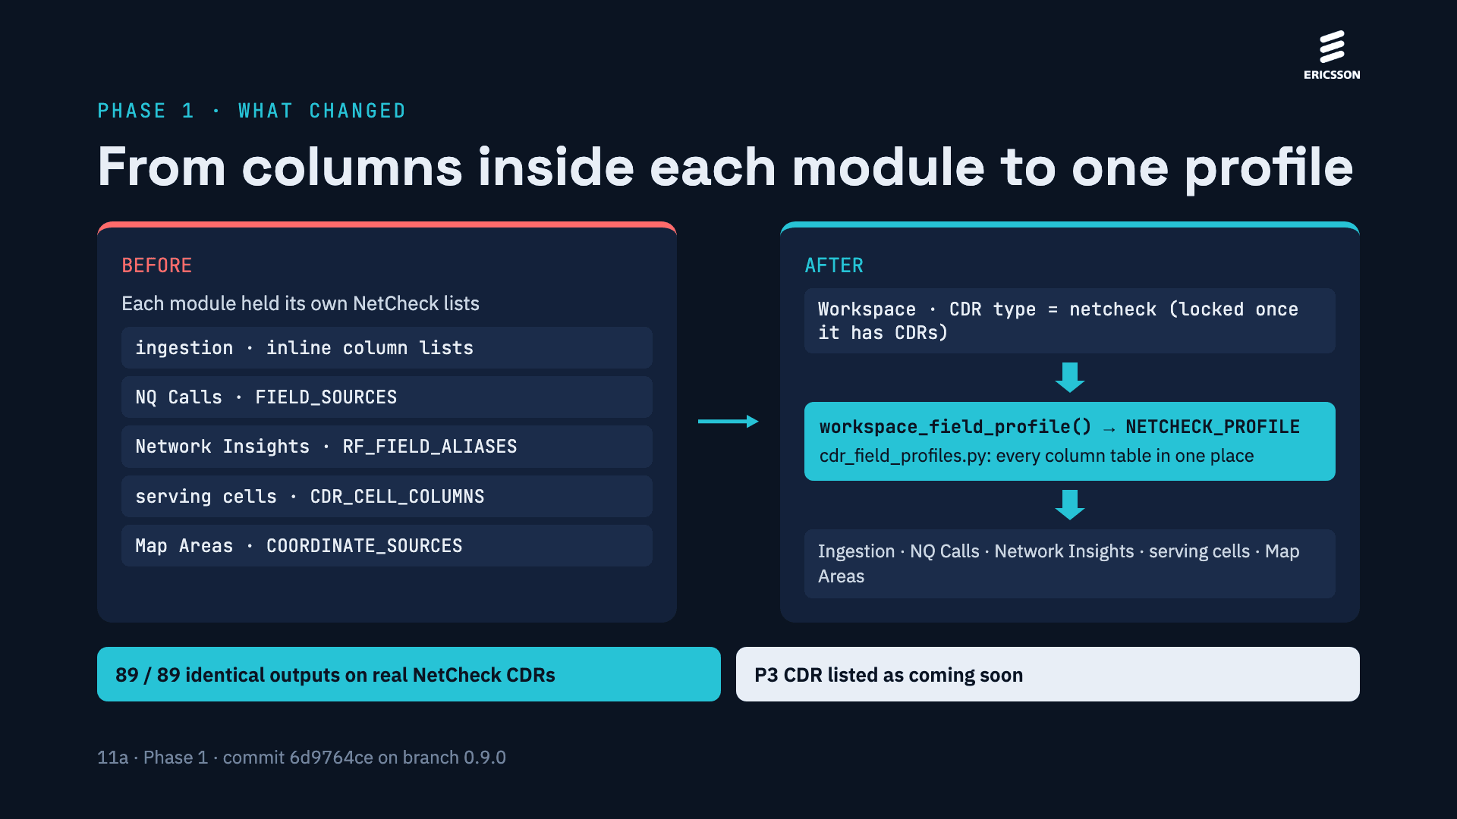
Notes:
Before phase 1, each module carried its own lists of NetCheck column names. Now they all live in one field profile per CDR type, in cdr_field_profiles.py, and every module asks for the profile of its workspace. For NetCheck the profile holds exactly the previous columns, so the same CDRs give the same results: 89 of 89 outputs were identical on a real sample of the UK workspace. A workspace with CDRs can no longer change its CDR type, and P3 now appears beside Umlaut as coming soon.

Slide 13
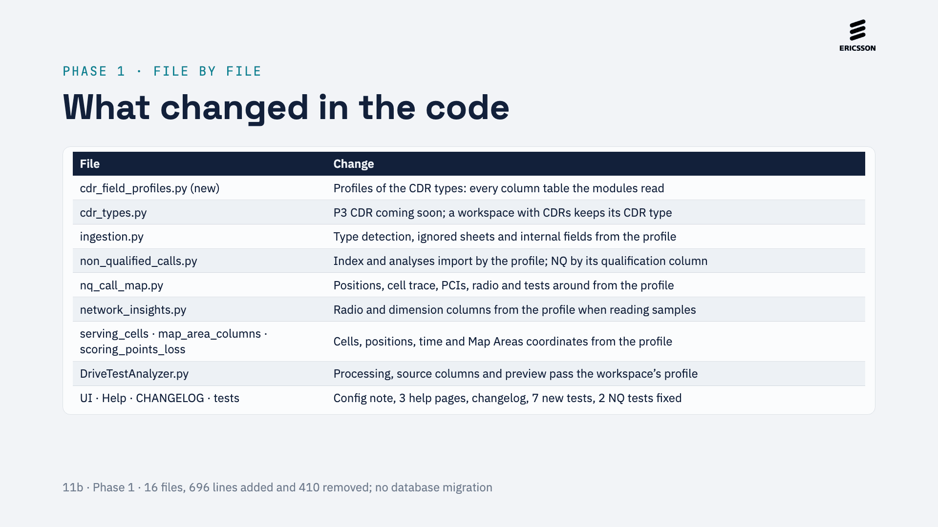
Notes:
File by file: a new module with the profiles; the CDR type registry with P3 and the lock; and the modules that read CDR columns, which now take them from the workspace’s profile instead of their own NetCheck lists. The app passes the profile when it processes a CDR. There is no database migration, so restarting the application changes nothing in existing workspaces. The second commit only updates two NQ tests that already failed before phase 1.

Slide 14
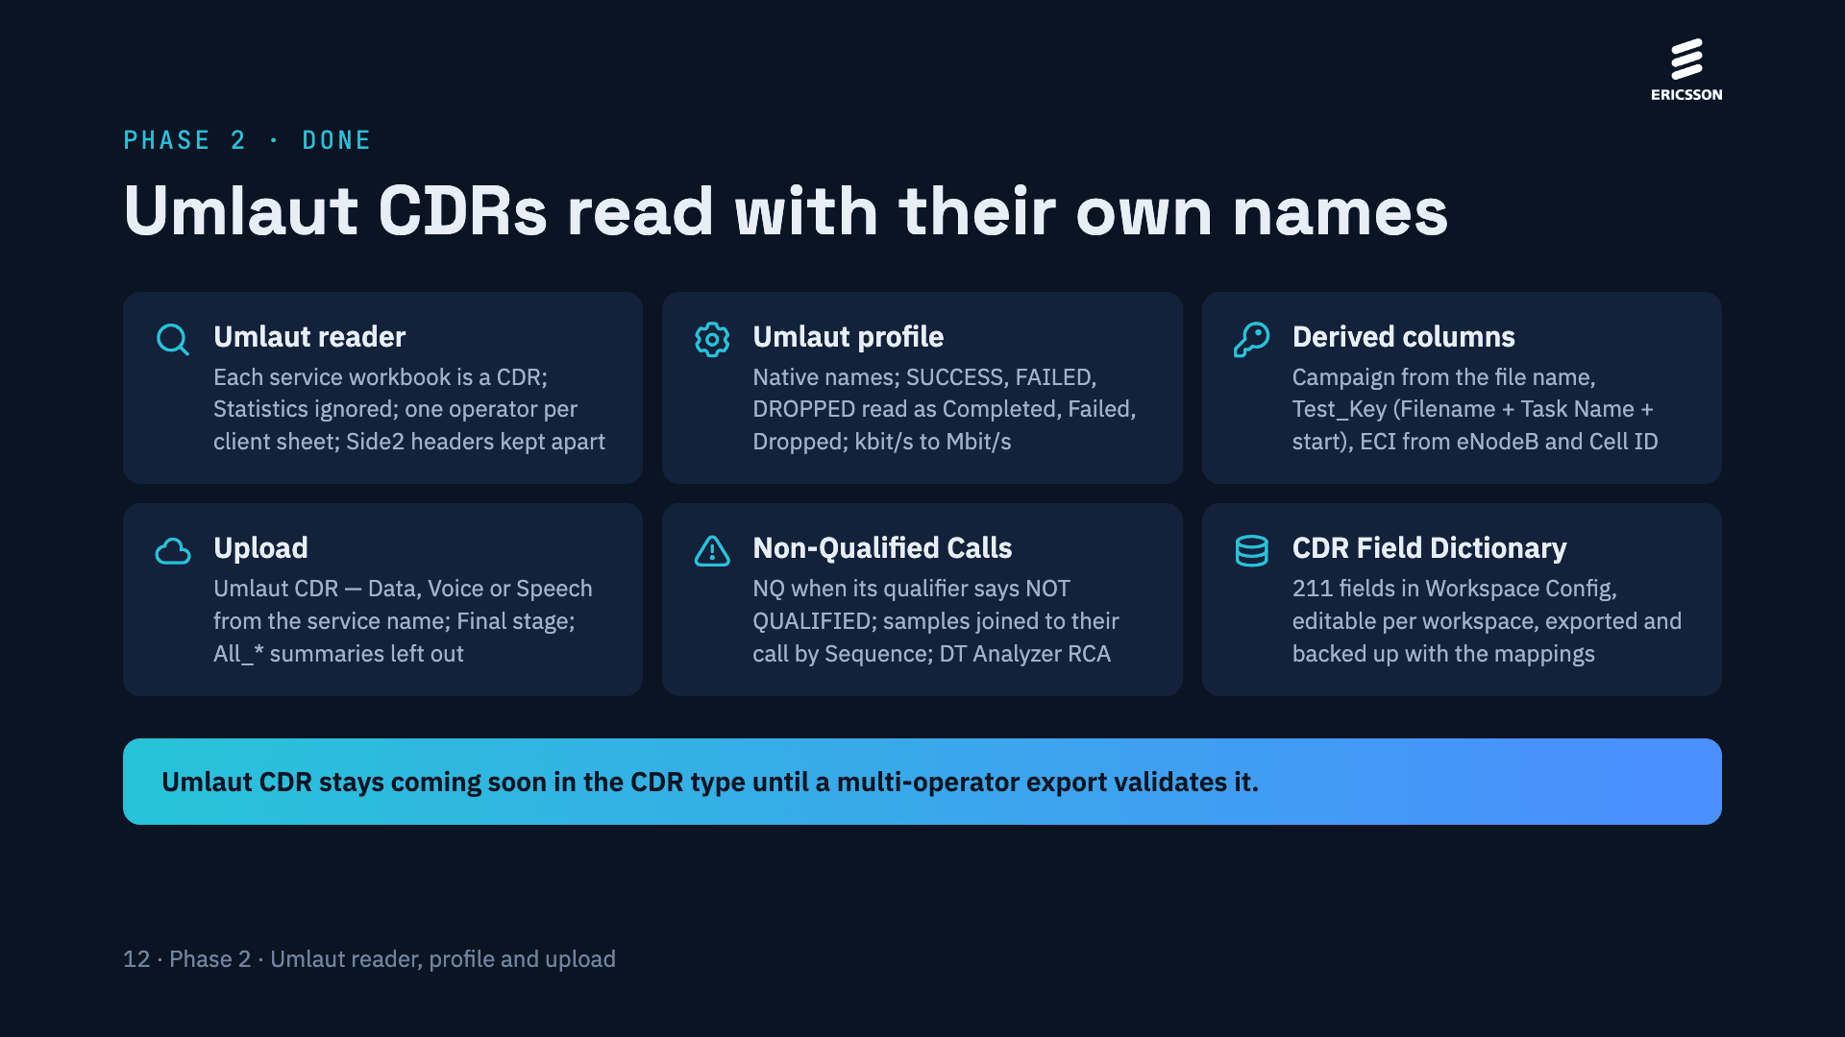
Notes:
Phase 2 reads Umlaut CDRs with their own names. The Umlaut reader takes every service workbook as a CDR, ignores the Statistics sheet, reads one operator per client sheet and keeps the headers of the second side of a call apart; All_Data and All_Voice are summaries, not CDRs. The Umlaut profile keeps the native names, reads SUCCESS, FAILED and DROPPED as Completed, Failed and Dropped, converts kbit/s to Mbit/s and measures call setup up to Alerting by default (Option D through the dictionary). Derived columns add the Campaign from the benchmark of the file name, a Test_Key for the data tests and the ECI of the serving cell. On upload each file takes its type from its service name, as a Final CDR. In Non-Qualified Calls a call or test is NQ when its qualifier says NOT QUALIFIED, with the DT Analyzer RCA. The CDR Field Dictionary of Workspace Config shows and edits the 211 fields per workspace. Umlaut CDR stays coming soon until a multi-operator export validates it.

Slide 15
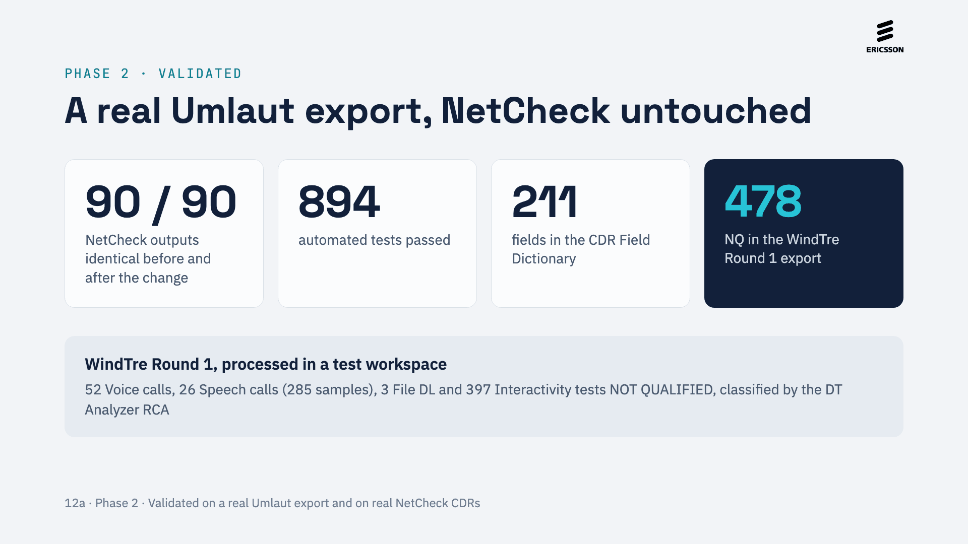
Notes:
Phase 2 was validated in three ways. The same real NetCheck CDRs give exactly the same results before and after the change (90 of 90 outputs). The automated tests pass (894). And the real WindTre Round 1 Umlaut export was processed in a test workspace: 478 NQ (52 Voice calls, 26 Speech calls with 285 samples, 3 File DL and 397 Interactivity tests), classified by the DT Analyzer RCA. Ping and DNS have no qualifier, so they have no NQ.

Slide 16
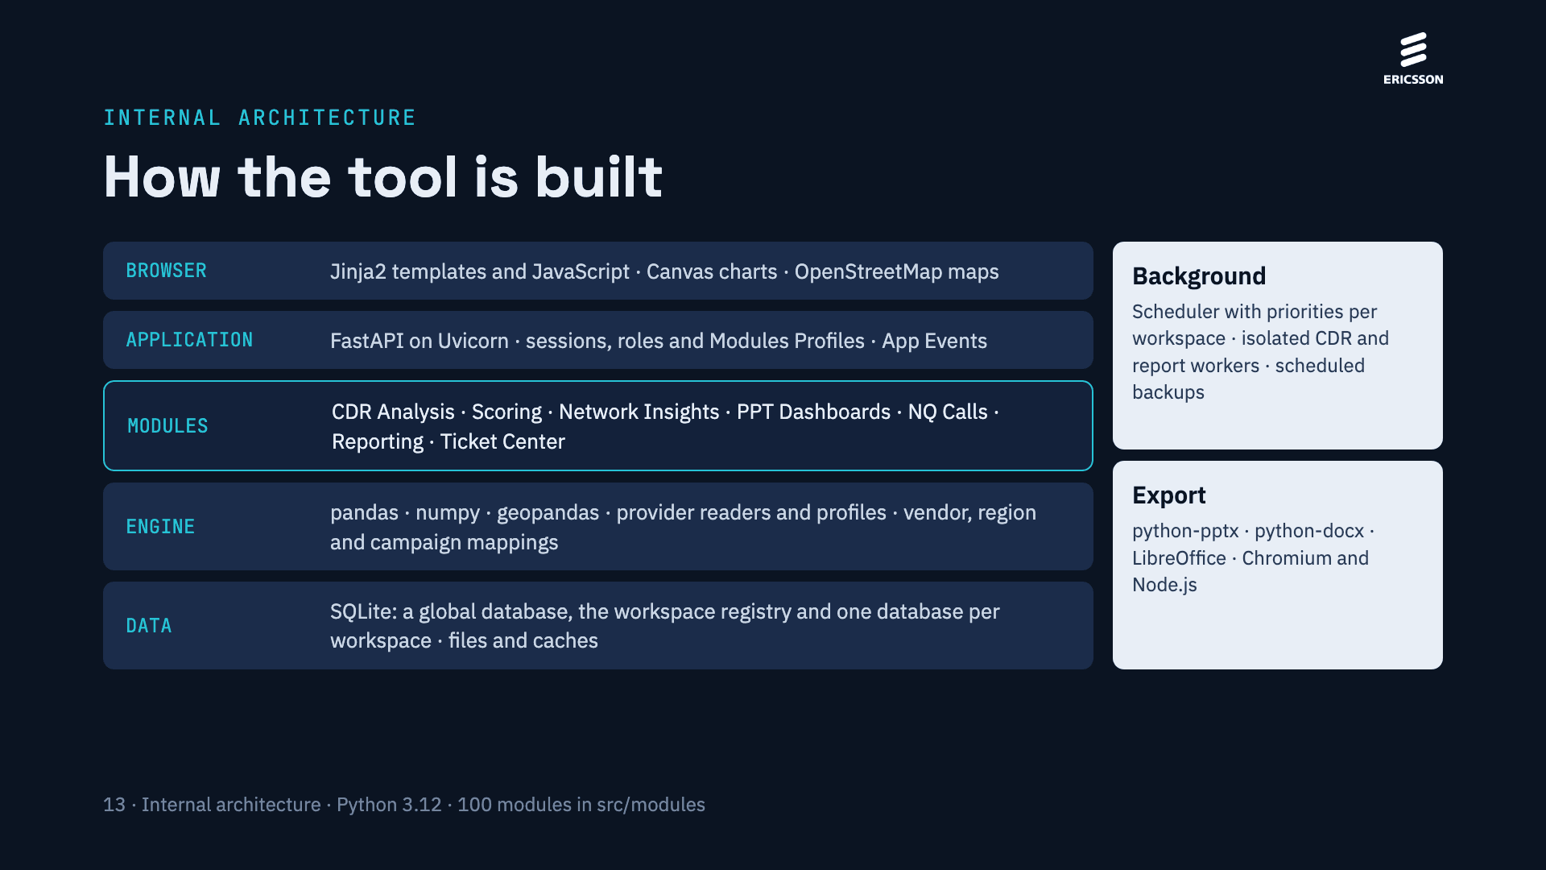
Notes:
A single FastAPI application serves the web interface (Jinja2 templates and JavaScript) and the API. Each analysis module is a Python module that reads the CDRs materialised in the workspace’s SQLite database. Heavy work, such as processing a CDR or generating a report, runs in the background: a scheduler with priorities per workspace and isolated workers, so the interface stays responsive. Exports use python-pptx and python-docx, LibreOffice for previews and Chromium with Node.js to draw the charts.

Slide 17
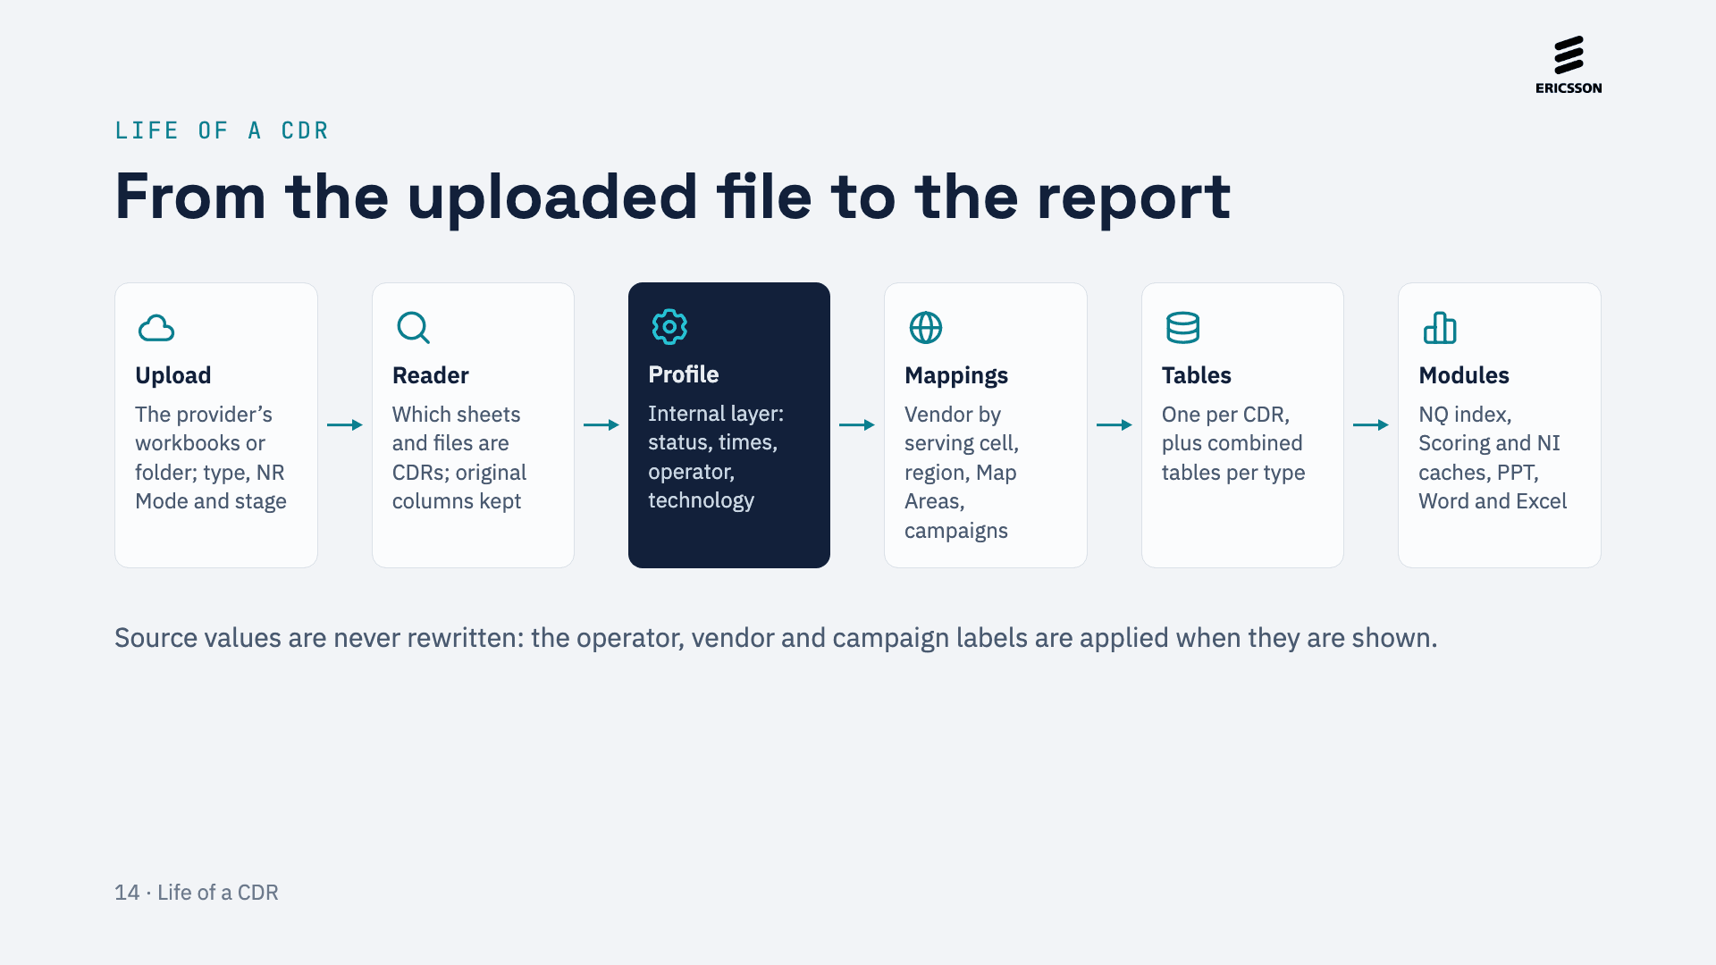
Notes:
This is how the tool walks a CDR. It is uploaded and its type, NR Mode and stage are confirmed. The provider’s reader decides what is CDR. The profile fills the internal layer the modules use. Then the mappings are applied and the CDR is materialised in per-CDR and combined tables, which the modules read with their indexes and caches.

Slide 18
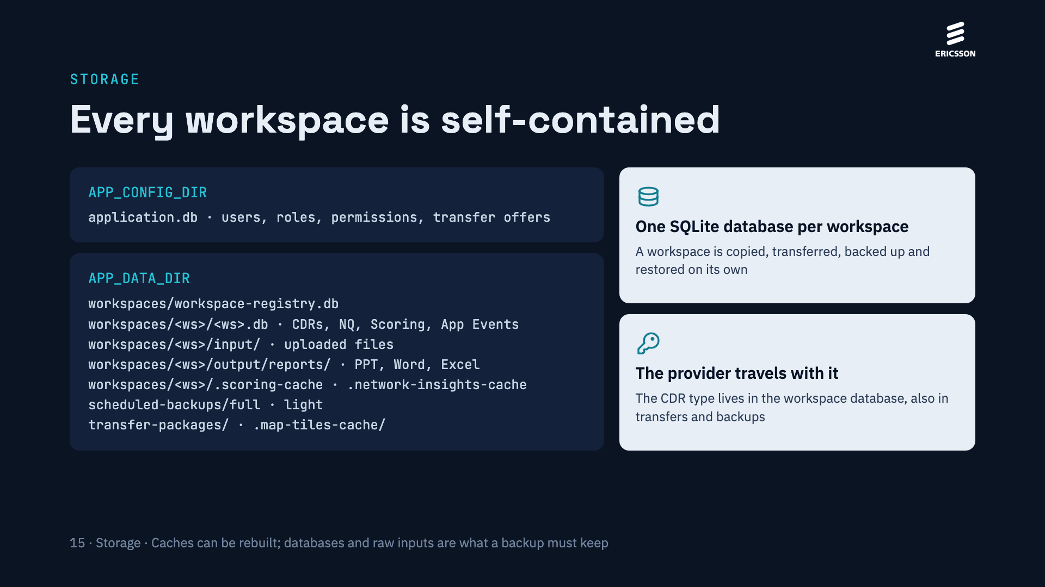
Notes:
Global configuration lives in APP_CONFIG_DIR and everything that belongs to a workspace in its own folder under APP_DATA_DIR: its database, uploaded files, generated output and caches. That is why a workspace can be transferred to another server or restored on its own, and why the CDR type of a workspace travels with it.

Slide 19
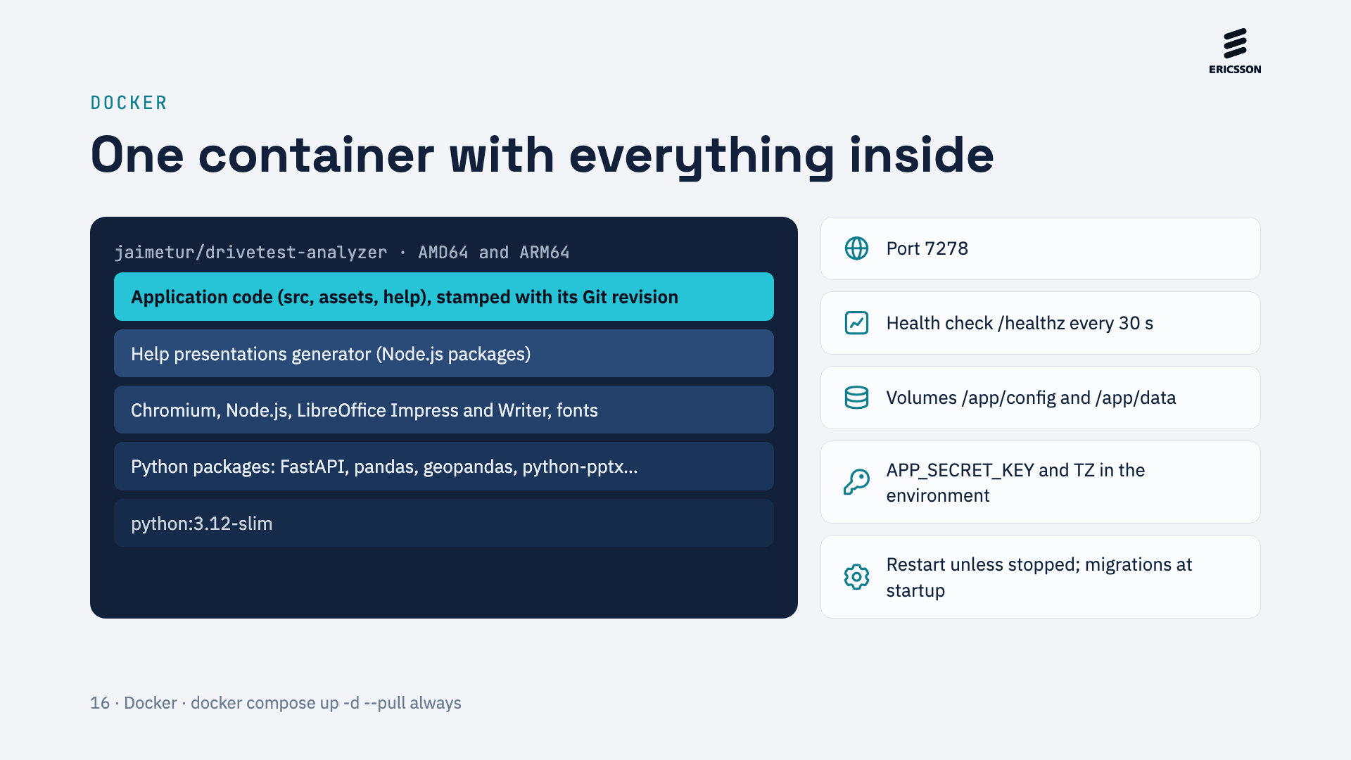
Notes:
The production image is built from python:3.12-slim with the Python packages, then the tools the exports need (Chromium and Node.js to draw charts, LibreOffice for previews), the Help presentations generator and finally the application code, stamped with its Git revision. Compose publishes port 7278, checks /healthz every 30 seconds, restarts the container unless it is stopped and mounts the config and data volumes, which is where all state lives.

Slide 20
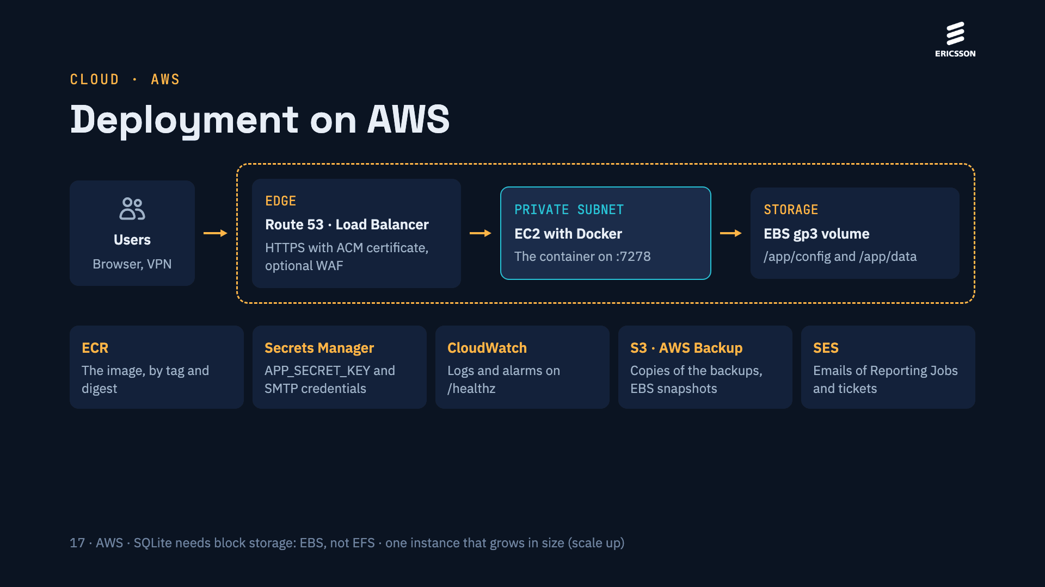
Notes:
A proposed AWS layout. Users reach a load balancer with an HTTPS certificate; the container runs on an EC2 instance in a private subnet and keeps all its state on an EBS volume mounted as /app/config and /app/data. Because the tool uses SQLite, its databases need block storage (EBS) rather than a network file system such as EFS, and today it runs as a single instance that is scaled up. Around it: the image in ECR, the secret key in Secrets Manager, logs and alarms in CloudWatch, backup copies in S3 or AWS Backup snapshots, and email through SES.

Slide 21
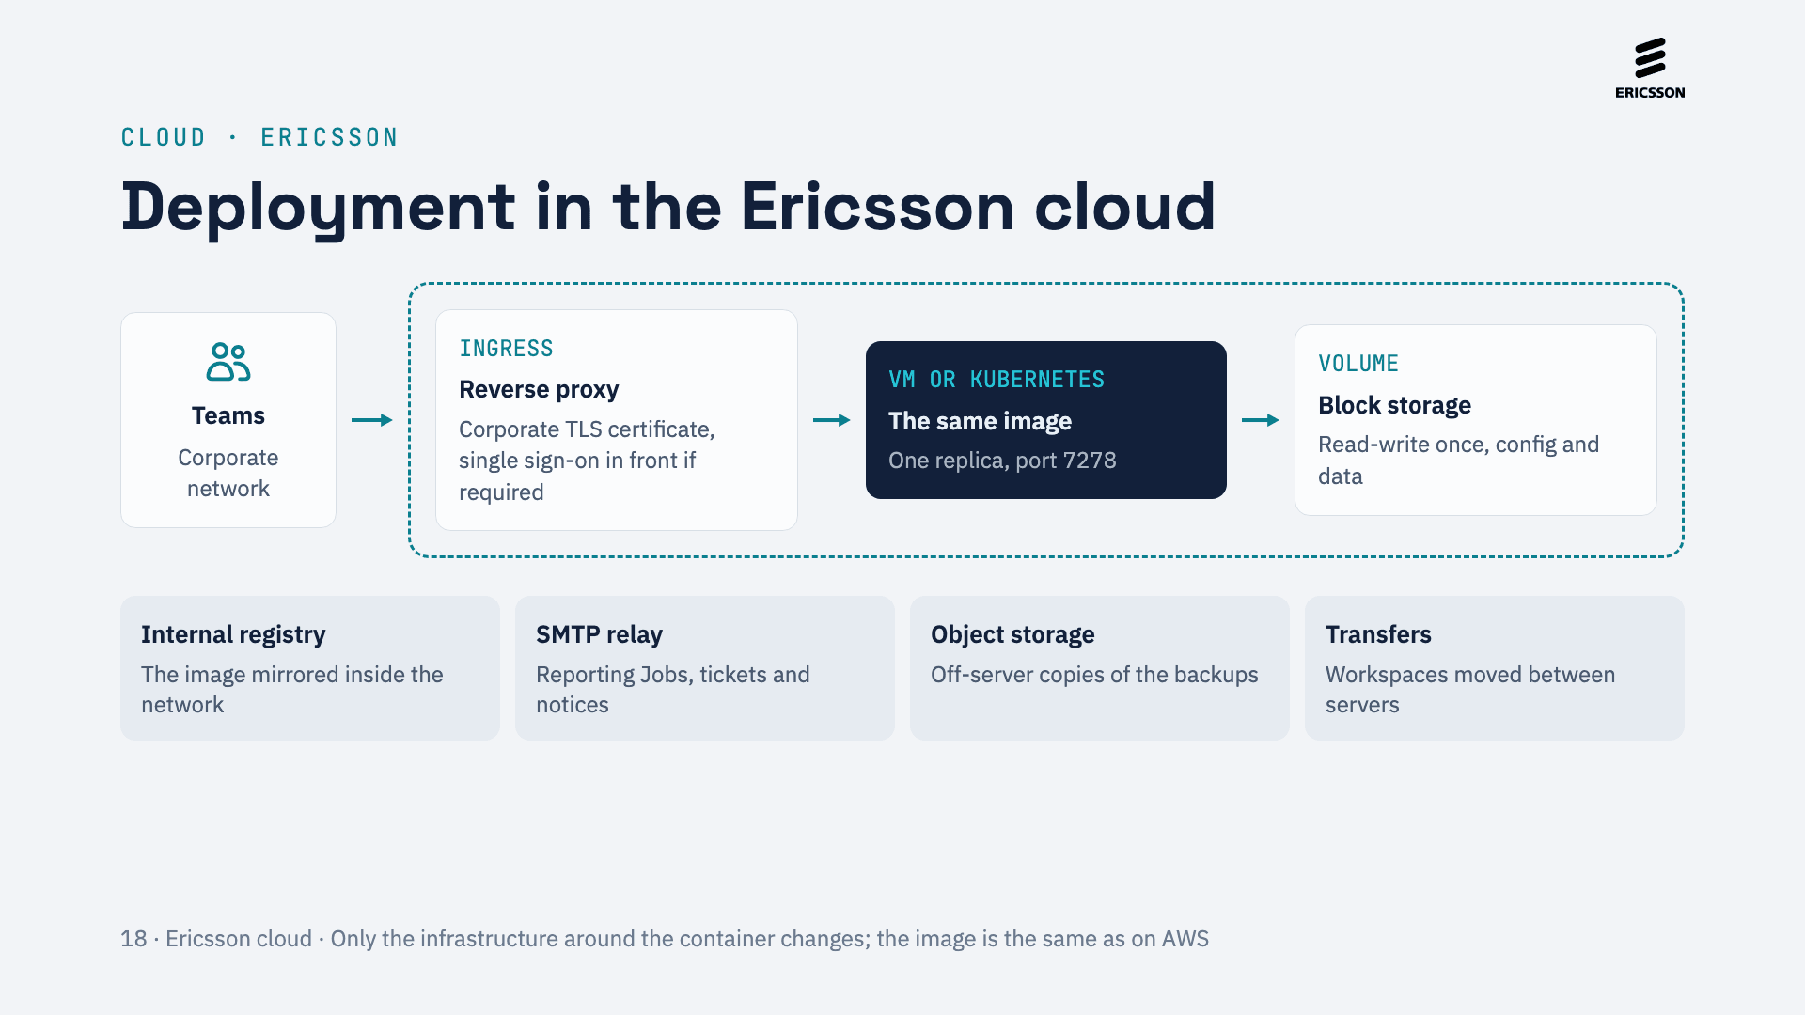
Notes:
Inside the Ericsson cloud the same image runs on a virtual machine or as a single Kubernetes replica with a read-write-once block volume, behind the corporate reverse proxy with its TLS certificate and, if required, single sign-on. The image can be mirrored in an internal registry, email goes through the corporate SMTP relay, backup copies go to object storage, and workspaces can be moved between servers with the transfer feature, for example between an AWS and an Ericsson instance.

Slide 22
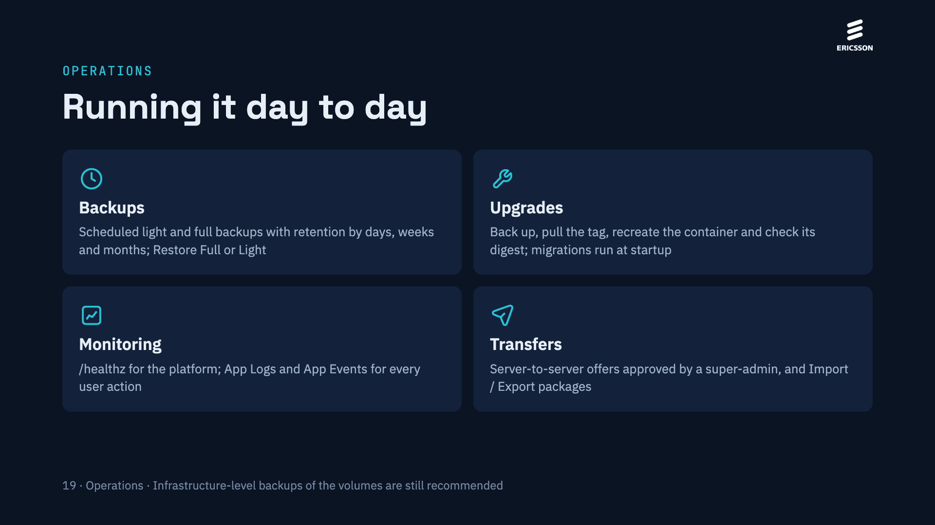
Notes:
Operating the tool needs little: scheduled backups written below the data volume, upgrades by pulling and recreating the container (database migrations run at startup), the /healthz endpoint for the platform and App Logs and App Events for traceability, and transfers to move workspaces between servers.

Slide 23
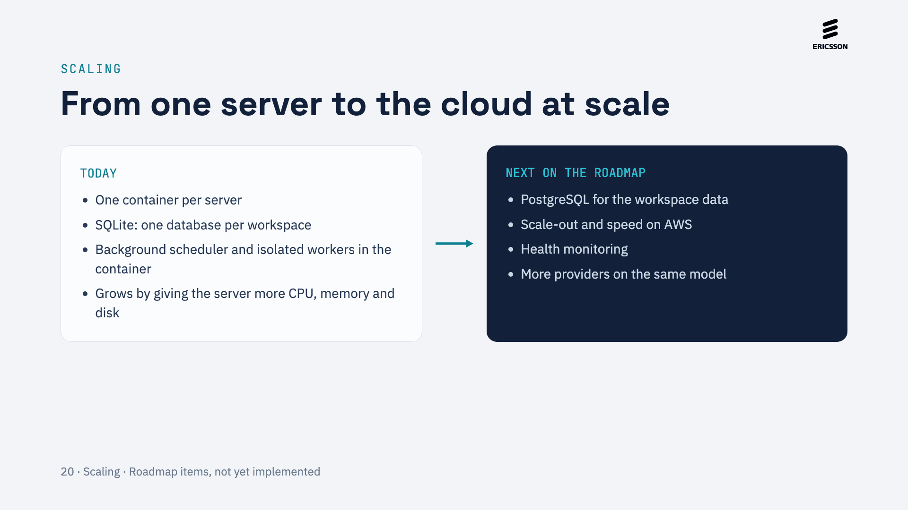
Notes:
Today the tool scales up: one container per server, one SQLite database per workspace and the background work inside the container. The roadmap of the tool already plans PostgreSQL, scale-out and speed on AWS, and health monitoring; the multi-provider model adds providers without new copies of the modules.

Slide 24
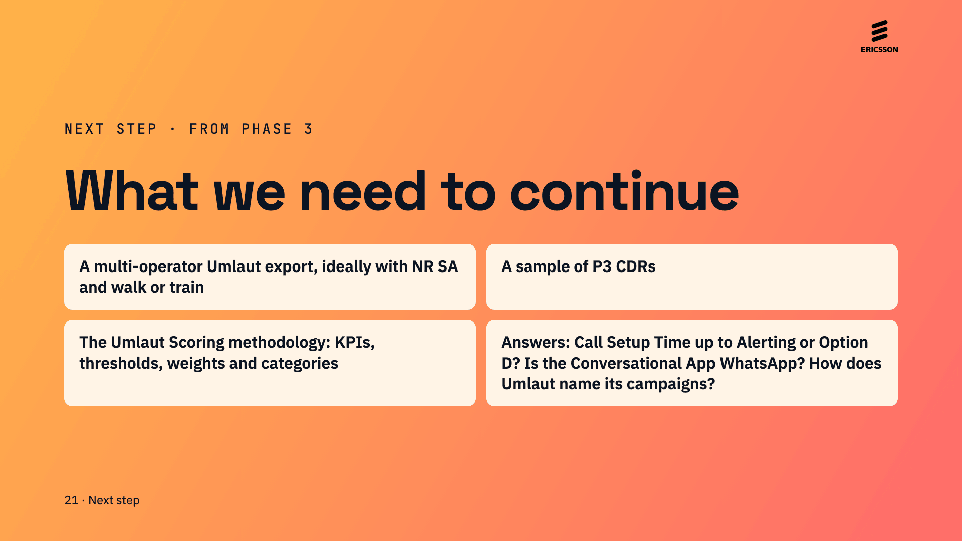
Notes:
To continue from phase 3 we need a representative multi-operator Umlaut export (ideally with NR SA and walk or train tests), which also validates the Umlaut reader so that Umlaut CDR stops being coming soon; a sample of P3 CDRs; the Umlaut Scoring methodology; and answers to the open questions: whether Call Setup Time is measured up to Alerting or up to Option D, whether the Conversational App is WhatsApp, and how Umlaut names its campaigns.

