Slide 1
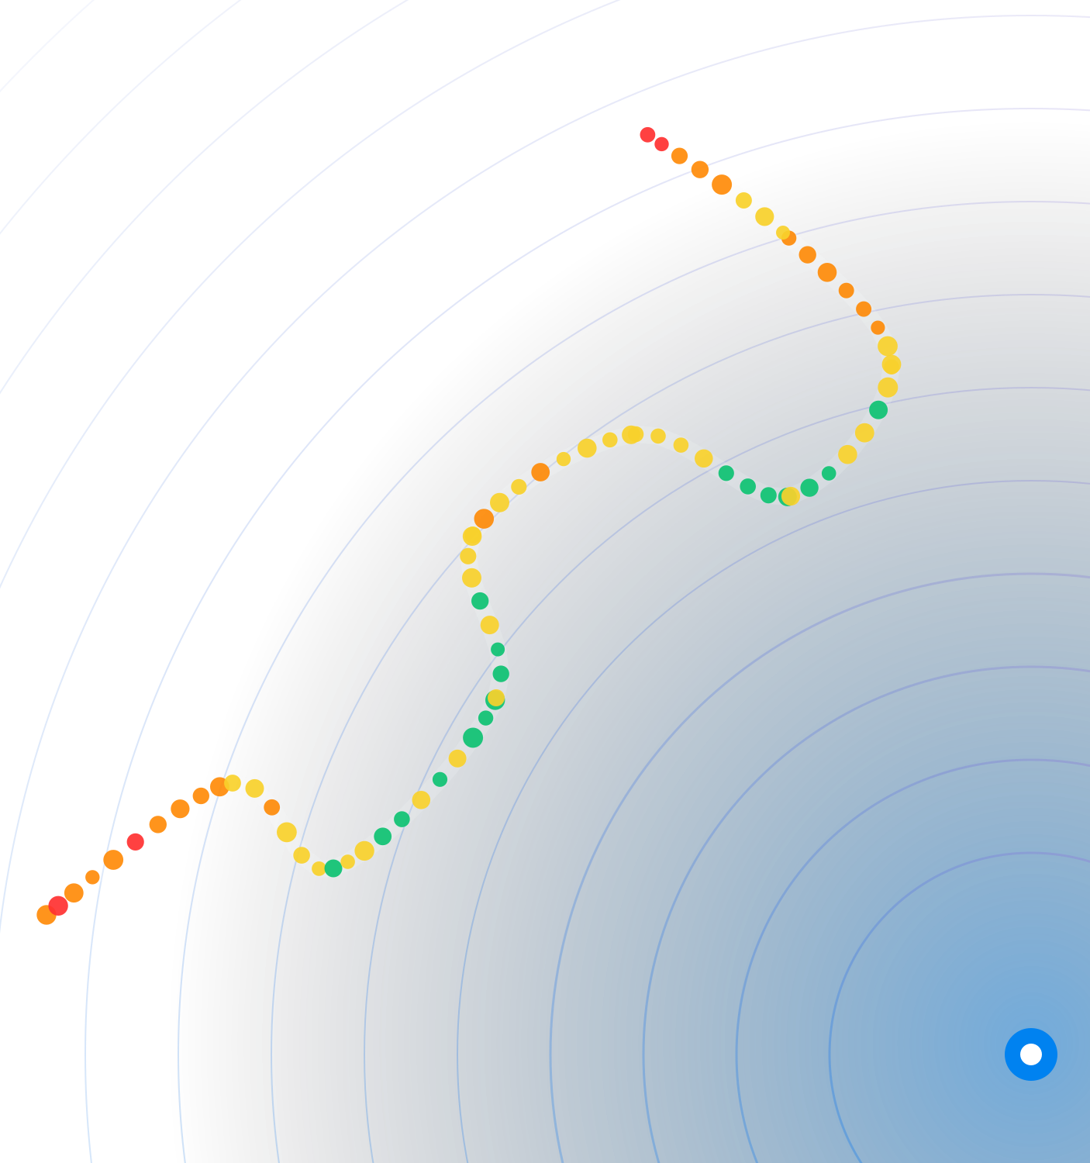

DRIVE-TEST ANALYTICS PLATFORM
DriveTest
Analyzer
From drive-test CDRs to network decisions, in one platform
Benchmarking
NQ Calls
Troubleshooting
Reporting
October 2026
Notes:
DriveTest Analyzer turns the drive-test CDRs of every campaign into benchmarking scores, network insights, follow-up of every failed call and ready-to-share reports, for every team, in one web platform.

Slide 2









One platform, from CDRs to decisions
Ingest once, analyse in every module, report and act, all in the same workspace
Ingest
Process
Analyse
Report
Act
Data, Voice & Speech
Maps & inventories
Normalise, map, enrich
Auto-calculated fields
Scoring · NI · NQ · KPIs
Ad-hoc charts & SQL
PowerPoint & Word
Scheduled & emailed
Root cause & follow-up
Tickets to closure
DATASETS IT INGESTS
CDRs
Network Inventories
Vendor Mappings
Geographical
Data, Voice & Speech, NSA & SA, by campaign
Cells of any operator, tables or KMZ cell configuration
Multivendor VFUK & 3UK, and vendor polygons
Regions & Clusters as polygons, for splits and maps
7.5 M rows in 27 CDRs
519 k inventory rows
1.1 M mapping rows
2 levels Region & Cluster
Live figures of the UK workspace, 9 campaigns, October 2026
Notes:
Five steps: upload the CDRs once; the platform normalises them, maps vendors and regions and adds calculated fields; every module analyses the same data; reports come out as PowerPoint and Word, on demand or on schedule; and teams act on them with the NQ follow-up and the Ticket Center. It ingests CDRs, Network Inventories, Vendor Mappings and Geographical polygons; the figures are live from the UK workspace.

Slide 3







Eight modules, one shared workspace
Every module reads the same processed CDRs, mappings and inventories
CDR Analysis
Deep dive into one CDR
PPT Dashboards
Template-driven KPI decks
Ticket Center
Bugs & requests, tracked
Scoring & GAP
Scores & GAP to reference
Workspace
CDRs · maps · inventories
Builders
Ad-hoc charts & SQL
Network Insights
Coverage, cells & spectrum
Reporting
Bundle reports, scheduled
Non-Qualified Calls
Root cause & follow-up
Notes:
Eight modules around one workspace, in the order of the tool: CDR Analysis, the template-driven PPT Dashboards, the scores and GAPs of Scoring & GAP Analysis, the radio and network view of Network Insights, the follow-up of every Non-Qualified Call, Reporting, the Chart and Query Builders and the Ticket Center. They all read the same processed CDRs.

Slide 4


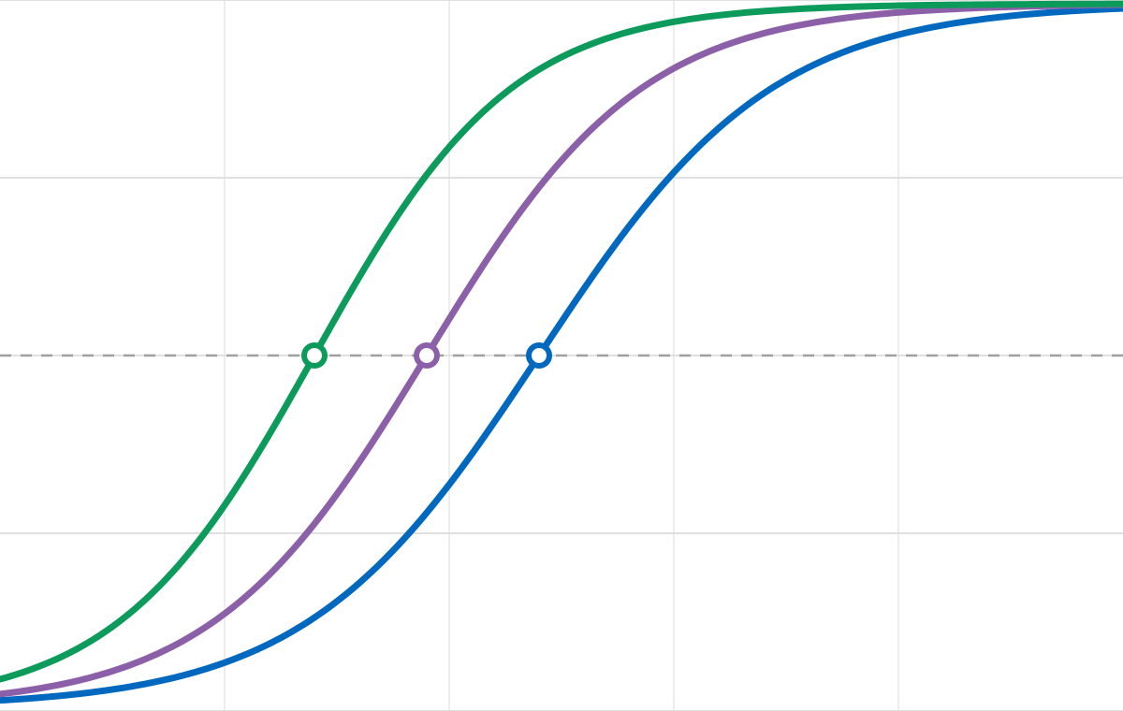




CDR Analysis — every KPI of one CDR, in depth
On-demand KPI analysis of one processed Data, Voice or Speech CDR, exported to PowerPoint and Word
Global CDF comparison · DL throughput (Mbps)
CDF curves
Group benchmark
100%
Up to eight, by operator, vendor or city
Bars of the aggregation you choose
75%
Scorecards
Processed metrics
50%
Metric cards and percentiles
Every calculated record, checked
1
2
3
4
25%
Pick a CDR
Metrics & filters
Update Analysis
Export
0%
EXPORTS
0
50
100
150
200
250
PowerPoint and Word of the analysis on screen, in seven themes
Operator A
Operator B
Operator C
Illustrative data
Notes:
CDR Analysis studies one processed CDR at a time: choose its metrics and filters, update the analysis and read the CDF curves (up to eight, by operator, vendor or city), the group benchmark, the metric cards and percentiles and every processed record; then export it to PowerPoint or Word, in seven themes. The chart uses illustrative data.

Slide 5





PPT Dashboards — the KPI deck, live and in PowerPoint
A saved Report Template becomes an interactive Dashboard of every slide, then a PowerPoint in one click
1
Report Template
2
Interactive Dashboard
3
PowerPoint
Slide | Chart | KPI | Split
3 | CDF | DL throughput | Operator
4 | Bars | Call setup time | City
5 | Map | RSRP | Region
6 | Table | POLQA LQ | Vendor
Slides, charts, KPIs and splits, validated as you edit
Every slide live, with its scope, filters and comments
The whole deck in your template, in one click
Scope & filters
Cached preparation
Slide comments
Presentation mode
Filtered chart data
Notes:
PPT Dashboards turns a saved Report Template, its slides, charts, KPIs and splits, into an interactive Dashboard of every slide, prepared in the background and cached, with its scope, filters and comments, a presentation mode and the dataset behind every chart; then the whole deck becomes a PowerPoint in one click, in your template.

Slide 6




Scoring & GAP Analysis — who wins, and by how much
Best Network and Most Reliable scores of every operator, place and campaign, with the GAP to the reference
Voice
Data
WHERE EACH OPERATOR STANDS · 26-Q3
POSITION PER ENVIRONMENT · OPERATOR B
Voice
Data
Overall
1
Operator A
402
498
900.4
REF
Drive - City
#2 88%
#1 93%
#2 90%
▲ 12.6 vs 26-Q2
Connecting Roads
#4 74%
#2 85%
#3 81%
2
Operator B
381
476
857.2
−43.2
All Environments
#2 84%
#2 90%
#2 86%
▲ 4.1 vs 26-Q2
3
Operator C
352
451
803.2
−97.2
SCORING TREND · LAST FIVE CAMPAIGNS
▼ 6.3 vs 26-Q2
A 900.4
Operator D
B 857.2
4
312
402
713.2
−187.2
C 803.2
▲ 9.8 vs 26-Q2
D 713.2
Illustrative data · points of 1,000 · GAP to Operator A, the reference
25-Q3
25-Q4
26-Q1
26-Q2
26-Q3
SEVEN VIEWS OF EVERY RESULT, ALSO IN POWERPOINT AND WORD
Summary
Scoring Charts
Scoring Tables
Geographical Areas
Scoring Trends
GAP Analysis
Points Lost
Notes:
Scoring & GAP Analysis scores every operator with the NetCheck Best Network methodology, and Most Reliable when the methodology has it, in NSA, SA or NSA vs SA, per environment, city, region and campaign. Each result shows where every operator stands with its Voice and Data points, its change since the previous campaign and its GAP to the reference; its position in every environment and service; and the trend of the last campaigns. Seven views of every result, from the Summary to the Points Lost, all exported to PowerPoint and Word in seven themes. The figures are illustrative.

Slide 7
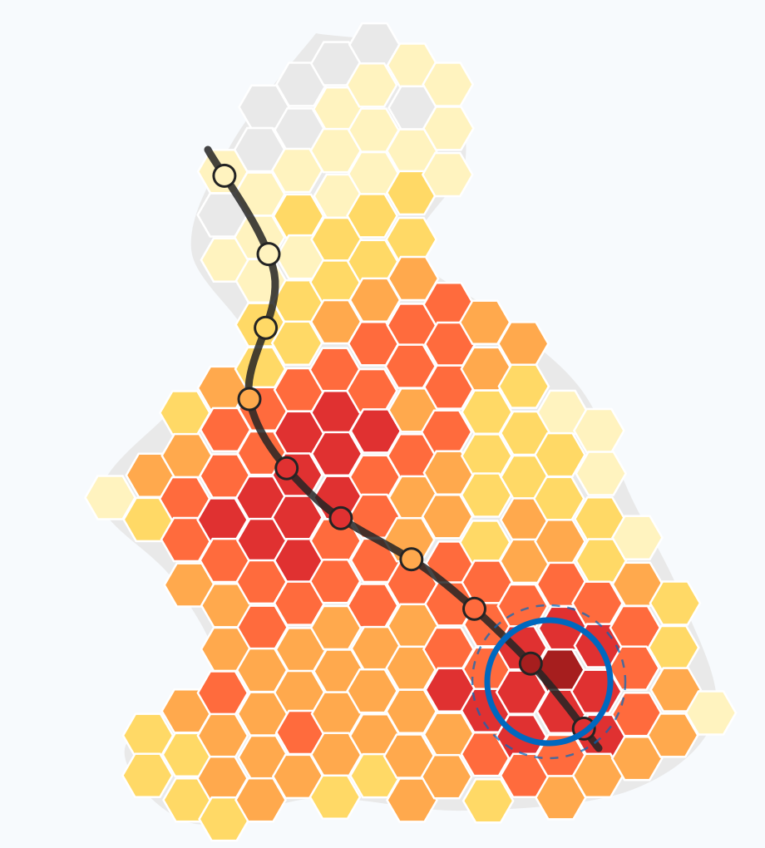
Scoring & GAP Analysis — where to win the points back
Every point lost, traced to its KPI, area, owner and site, with what to fix first
POINTS LOST MAP · OPERATOR B
BIGGEST LEVERS · POINTS TO WIN
WHERE TO ACT, BY OWNER
Call setup success
+4.2
North
South
DL throughput P10
+3.4
−48.2 pts
−39.5 pts
Voice calls
Failed data tests
POLQA MOS
+2.6
Video start time
+1.7
Vendor A
Vendor B
−31.4 pts
−23.7 pts
Web page load time
+1.1
Below-par data
Voice calls
WHERE THE POINTS GO
SITES TO REVIEW
−38.6 pts
Failed tests
Below threshold
Quality shortfall
Site
Vendor
Points
Priority
Operator A
−99.6
Site 0421
Vendor A
−3.8
High
Operator B
−142.8
Site 1877
Vendor B
−2.9
High
Site 3508
Vendor A
−1.6
Medium
Operator C
−196.8
Fewer
More points lost
Up to 25 per operator, with earlier campaigns
Notes:
Every point an operator loses is traced: to the KPIs where matching the reference wins most (the biggest levers), to how it is lost (failed tests, tests below a threshold, quality shortfall), to the areas of the Points Lost Map, to the performance owners of Where to act, to the RAN vendor and kind of the serving sites, to the sites to review and to the stretches of each Connecting Roads route. The figures and the map are illustrative.

Slide 8
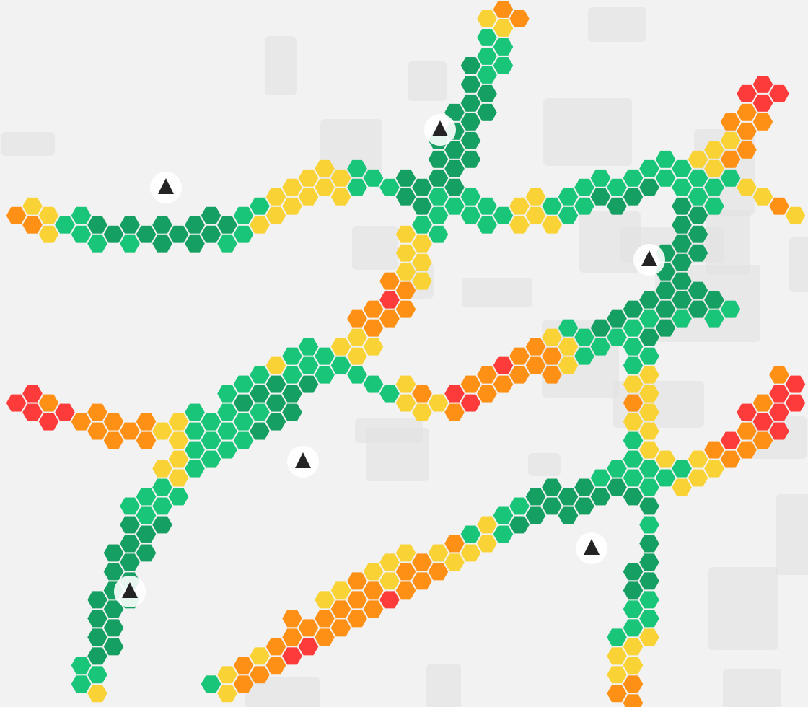











Network Insights — the network behind the KPIs
Radio quality, serving cells, 5G availability, spectrum and deployment, from the CDRs alone
SUMMARY
Overview
Key Findings
RADIO PERFORMANCE
Coverage & Interference Maps
RSRP & SINR Quality
Latency & Interactivity
Serving Cells
5G Availability
NETWORK & SPECTRUM
Network Snapshot
Deployment: NNS & eMOCN
Cluster Sites Density
RSRP
Excellent
Good
Fair
Poor
Bad
Spectrum: licensed & observed
Notes:
Network Insights shows the network behind the measured performance: RSRP and SINR, weak-coverage and high-interference areas on a map, the serving cells, 5G availability, the network snapshot, NNS and eMOCN deployment and the spectrum. Radio views come from the CDRs alone; inventories, KMZ cell configuration and licensed spectrum complete the rest. The map is an illustration.

Slide 9







NQ Calls — every failure, followed to closure
The NQ Analysis Center: one shared follow-up of every call and test that did not complete
48,138
2,357
2,129
3,371
NQ calls in 9 campaigns
calls with their follow-up
Ericsson RCA results imported
analyst comments and decisions
NetCheck RCA
Summary by campaign & operator
Root Category
+ Root Cause
decided from three sources
Status, Team
& Assignee
by Status Rules or by hand
Ericsson RCA
Excel export with your layout
Previous analyses imported
Analysts
Comments & full history
Six sections per call
General
RCA
Failure details
Analysis
Implementation
Planning
Notes:
Every Voice, Speech and Data CDR is indexed in the background: 48,138 Non-Qualified calls in 9 campaigns of the UK workspace, out of 4.0 M calls and tests. Each call keeps its follow-up by its NetCheck JOIN_ID through six sections; the root cause comes from the NetCheck RCA, the Ericsson RCA and the analysts; status, team and assignee follow rules or are set by hand.

Slide 10



Reporting — from technical detail to executive story
Compose once, generate PowerPoint and Word, schedule and email, automatically
CDR Analysis
PowerPoint
PPT Dashboards
Bundle Report Template
Reporting Jobs
Scoring & GAP Analysis
One PowerPoint or Word with the sections you choose, in your order
Word
On demand
Daily
Network Insights
Weekly
Monthly
1
2
3
4
5
Email to recipients
Run History with Stop and Rerun
Non-Qualified Calls
Sections, filters and campaigns per report
7
themes, one click: from the operator brand to the boardroom
NetCheck
Umlaut
Ericsson
Vodafone
Midnight
Paper
Heatmap
Notes:
A Bundle Report Template composes one PowerPoint or Word document from the sections of PPT Dashboards, Scoring, Network Insights, NQ Calls and CDR Analysis. Reporting Jobs run it, or any artifact, on demand or on a schedule and email it; the Run History stops, reruns and resumes runs. Seven themes take the same report from the operator brand to the boardroom.

Slide 11






Builders — ad-hoc charts and SQL, in seconds
Chart Builder and Query Builder explore any KPI or field of the CDRs, without changing a template
Chart Builder
Query Builder
Any KPI as a chart, split by rows and columns
Read-only SQL on the CDRs, assisted or by hand
Median DL throughput (Mbps) by city
SELECT operator, COUNT(*) AS samples,
MEDIAN(dl_throughput) AS median_dl
FROM cdr_data WHERE campaign = 'Q3_2026'
GROUP BY operator
162
148
152
141
131
139
126
118
operator | samples | median_dl
Operator A | 41,203 | 148.9
Operator B | 39,877 | 137.6
Operator C | 38,512 | 121.3
London
Leeds
Glasgow
Cardiff
Operator A
Operator B
Illustrative data
Filter Builder
Rows & columns
Legend & title
Assistance Mode
SQL Mode
Saved · CSV
Notes:
The Builders explore the CDRs without changing any template. Chart Builder draws any KPI of the chosen CDRs as a chart, split by rows and columns, with the Filter Builder, its legend and title. Query Builder runs read-only SQL on them, built with Assistance Mode or written in SQL Mode; queries are saved, exported and their results copied or downloaded as CSV. Charts and results use illustrative data.

Slide 12









Ticket Center — every bug and idea, tracked to closure
Report bugs, improvements and new features with their screenshots, and follow each one until it is resolved
New
In Progress
Waiting for Info
Resolved
Closed
Rejected
TYPES
PRIORITIES
Bug
Something does not work as it should
P1 · Critical
P2 · High
Improvement
Something that works could work better
P3 · Medium
P4 · Low
New Feature
Something the tool cannot do yet
P5 · Trivial
Open, resolved & mine tiles
Created vs resolved per week
Age of the oldest open ticket
Timeline of comments & changes
Screenshots in every ticket
Version it was opened with
Notes:
The Ticket Center collects the bugs, improvements and new features of the users, with their screenshots and the version they were opened with, from New to Resolved, Closed or Rejected, each with its priority from P1 to P5 and a timeline of comments and changes; its dashboard counts the open tickets, those created and resolved every week and the age of the oldest one.

Slide 13



Built for every team
Each team starts where it adds value, on the same data
Core
Supporting
CDR Analysis
PPT Dashboards
Scoring & GAP
Network Insights
NQ Calls
Reporting
Builders
Benchmarking
Who wins, by how much, city by city
NQ Calls
Every failed call root-caused and closed
Troubleshooting
Where coverage and cells hurt the KPIs
Technical reporting
Template-driven KPI decks in minutes
Executive reporting
One scheduled story for the leadership
Notes:
Benchmarking scores operators with Scoring & GAP Analysis and shares PPT Dashboards and reports; the NQ team follows every failed call; troubleshooting reads coverage, interference and serving cells in Network Insights with CDR Analysis and the Builders; technical and executive reports come from the same modules, scheduled in Reporting.

Slide 14












Enterprise-ready: secure, governed, backed up
Cloud deployment, role-based access, isolated workspaces, automated backups and built-in support
Cloud deployment
Users, roles & access
Automated backups
AWS cloud
Super Admin · 2
F
L
L
L
L
L
L
Admin · 1
Full + Light, hourly to monthly, smart retention
Docker · AMD64 & ARM64
Editor · 12
DriveTest Analyzer
web app + background workers
Viewer · 1
Ticket Center
Modules Profiles · Workspace Groups · access requests
Bug
Improvement
New Feature
Configuration at every level
P1 to P5, dashboard of open, resolved and ageing tickets
UK
9 campaigns
DE
1 campaign
Help & quality
App Config
Workspace Config
Admin
Super Admin
Isolated workspaces · persistent volumes
25
1,895
24
Email, themes, templates, mappings, methodologies
Help chapters
automated tests
releases
Notes:
DriveTest Analyzer runs on AWS as a Docker container, with images for AMD64 and ARM64 and persistent volumes. Each workspace keeps its own database and files. Four roles, Modules Profiles and Workspace Groups decide who sees and changes what, from App Config up to Super Admin. Backups run on a schedule, full and light, with retention by day, week and month. The Ticket Center collects bugs, improvements and requests, and the Help has 25 chapters.

Slide 15













Roadmap — what comes next
Intentions, not commitments, shaped by the teams that use the tool
TODAY
SOON
8 modules live
Scalability on AWS
UK, 9 campaigns
Worker queue, scale-out processing
Germany pilot
Fast at any size
First DE test campaign
Durable analytical caches
LATER
NEXT
PostgreSQL database
Umlaut CDR adaptation
Hundreds of concurrent users
Ingest & score Umlaut CDRs
Smart Orchestrator Logs
Active Tests community
A new source and its reports
Builds their KPI & Scoring reports
Health monitoring
NQ Calls out of Alpha
Alerts & checks after each deploy
From Alpha to every team
Notes:
Today: eight modules in production on the UK workspace, and a first pilot campaign in Germany. Next: adapt the ingestion and scoring to Umlaut CDRs, support the Active Tests community, so that the tool builds the KPI and Scoring reports they produce today, and take Non-Qualified Calls out of Alpha. Soon: scale out on AWS with an external worker queue, and durable analytical caches. Later: PostgreSQL instead of SQLite, a database for hundreds of concurrent users, Smart Orchestrator Logs, and health monitoring: alerts on runs that take too long and automatic checks after every deployment. These are intentions, not dated commitments.

Slide 16






DriveTest Analyzer — CDRs to decisions, in one platform
Benchmarking, NQ Calls, troubleshooting and reporting for every team, on the same data
DATA IN
CDR Analysis
KPIs per CDR
PPT Dashboards
Template KPI decks
BUILT FOR EVERY TEAM
CDRs
Benchmarking
7.5 M rows · 27 CDRs
Ticket Center
Bugs & requests
Scoring & GAP
Best Network · GAP
Scores & GAP to the reference, city by city
Network Inventories
NQ Calls
519 k cell rows
Workspace
8 modules
9 campaigns
Every failed call root-caused and closed
Vendor Mappings
Troubleshooting
1.1 M mapping rows
Coverage, interference & serving cells
Builders
Charts · SQL
Network Insights
RSRP · SINR · 5G
Geographical
Technical & executive
2 levels Region & Cluster
PowerPoint & Word in seven themes, scheduled
Reporting
PPT · Word · email
NQ Calls
48 k NQ calls
ENTERPRISE PLATFORM
ROADMAP
AWS · Docker
4 roles · 16 users
Modules Profiles
Isolated workspaces
TODAY
NEXT
SOON
LATER
Automated backups
Ticket Center
25-chapter Help
1,895 tests
8 modules live
Umlaut CDRs, Active Tests
AWS scale-out, speed
PostgreSQL, health
Notes:
DriveTest Analyzer in one slide. Data in: CDRs (7.5 M rows in 27 CDRs of 9 campaigns of the UK workspace), network inventories, vendor mappings and regions and clusters. On one shared workspace, eight modules: CDR Analysis, PPT Dashboards, Scoring & GAP Analysis, Network Insights, Non-Qualified Calls (48,138 NQ calls), Reporting, the Builders and the Ticket Center. They serve benchmarking, the NQ team, troubleshooting and technical and executive reporting, on an enterprise platform on AWS with roles, isolated workspaces, automated backups, a Ticket Center, a 25-chapter Help and 1,895 automated tests. Roadmap: Umlaut CDRs and the Active Tests community next, then scale-out on AWS and speed, then PostgreSQL for hundreds of concurrent users and health monitoring.

