Slide 1
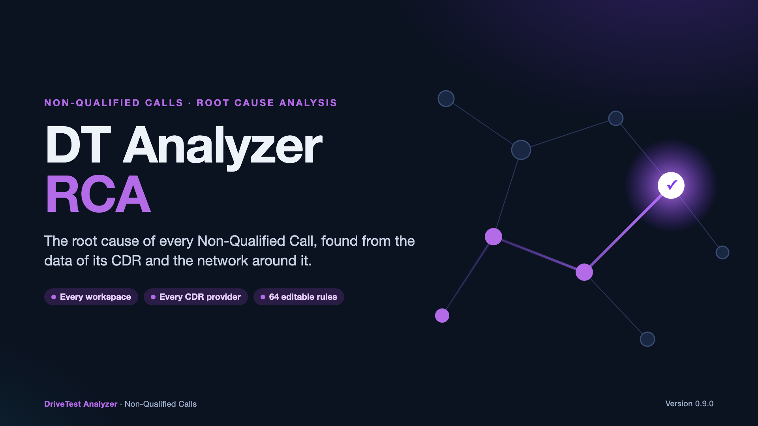
Notes:
The DT Analyzer RCA finds the root domain, Root Category and Root Cause of every Non-Qualified Call, test and Speech sample from the data of its CDR and, with a Network Inventory, from the network around it. It works in every workspace, whatever its CDR provider, with 64 default rules that every workspace can change.

Slide 2
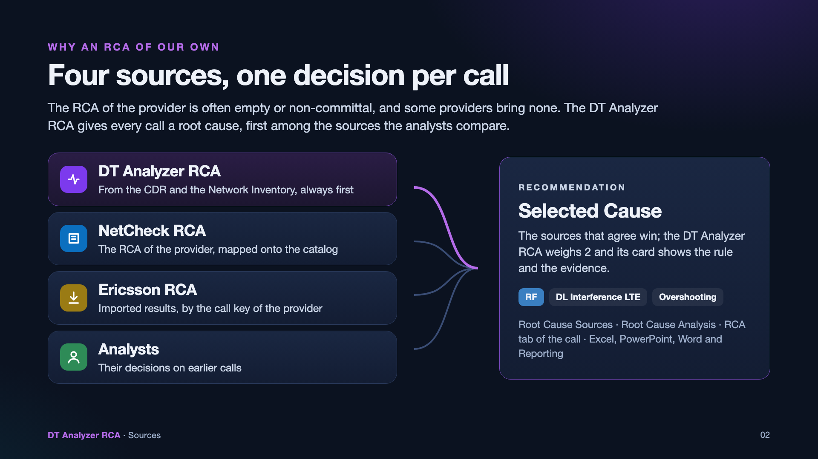
Notes:
The RCA of the provider is often empty or non-committal, and providers such as Umlaut bring no hierarchy at all. The DT Analyzer RCA gives every call a root cause and comes first wherever the sources are listed, beside the NetCheck RCA, the imported Ericsson RCA and the decisions of the analysts. The recommendation combines them; the DT Analyzer RCA weighs 2 and its card shows the rule and the evidence.

Slide 3
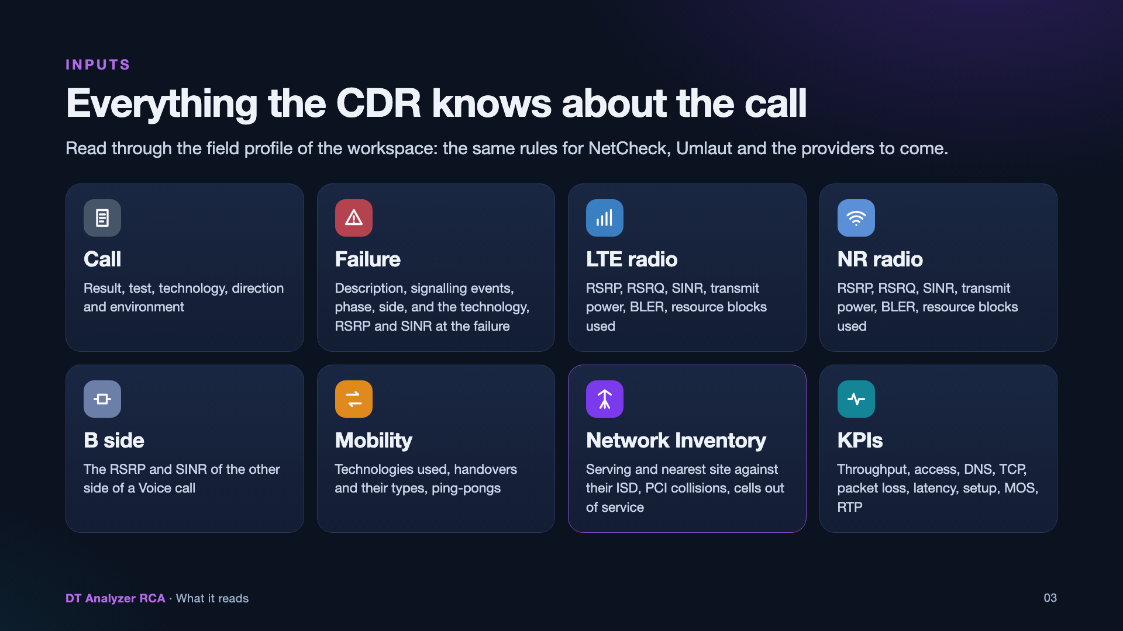
Notes:
Every value is read through the field profile of the CDR type of the workspace, so the same rules serve NetCheck, Umlaut and the providers to come. The failure description joins the RCA of the provider with the signalling events of the CDR; the signalling events alone let rules ignore the RCA of the provider. The Network Inventory adds the serving and nearest sites against their inter-site distance, PCI collisions and cells out of service.

Slide 4
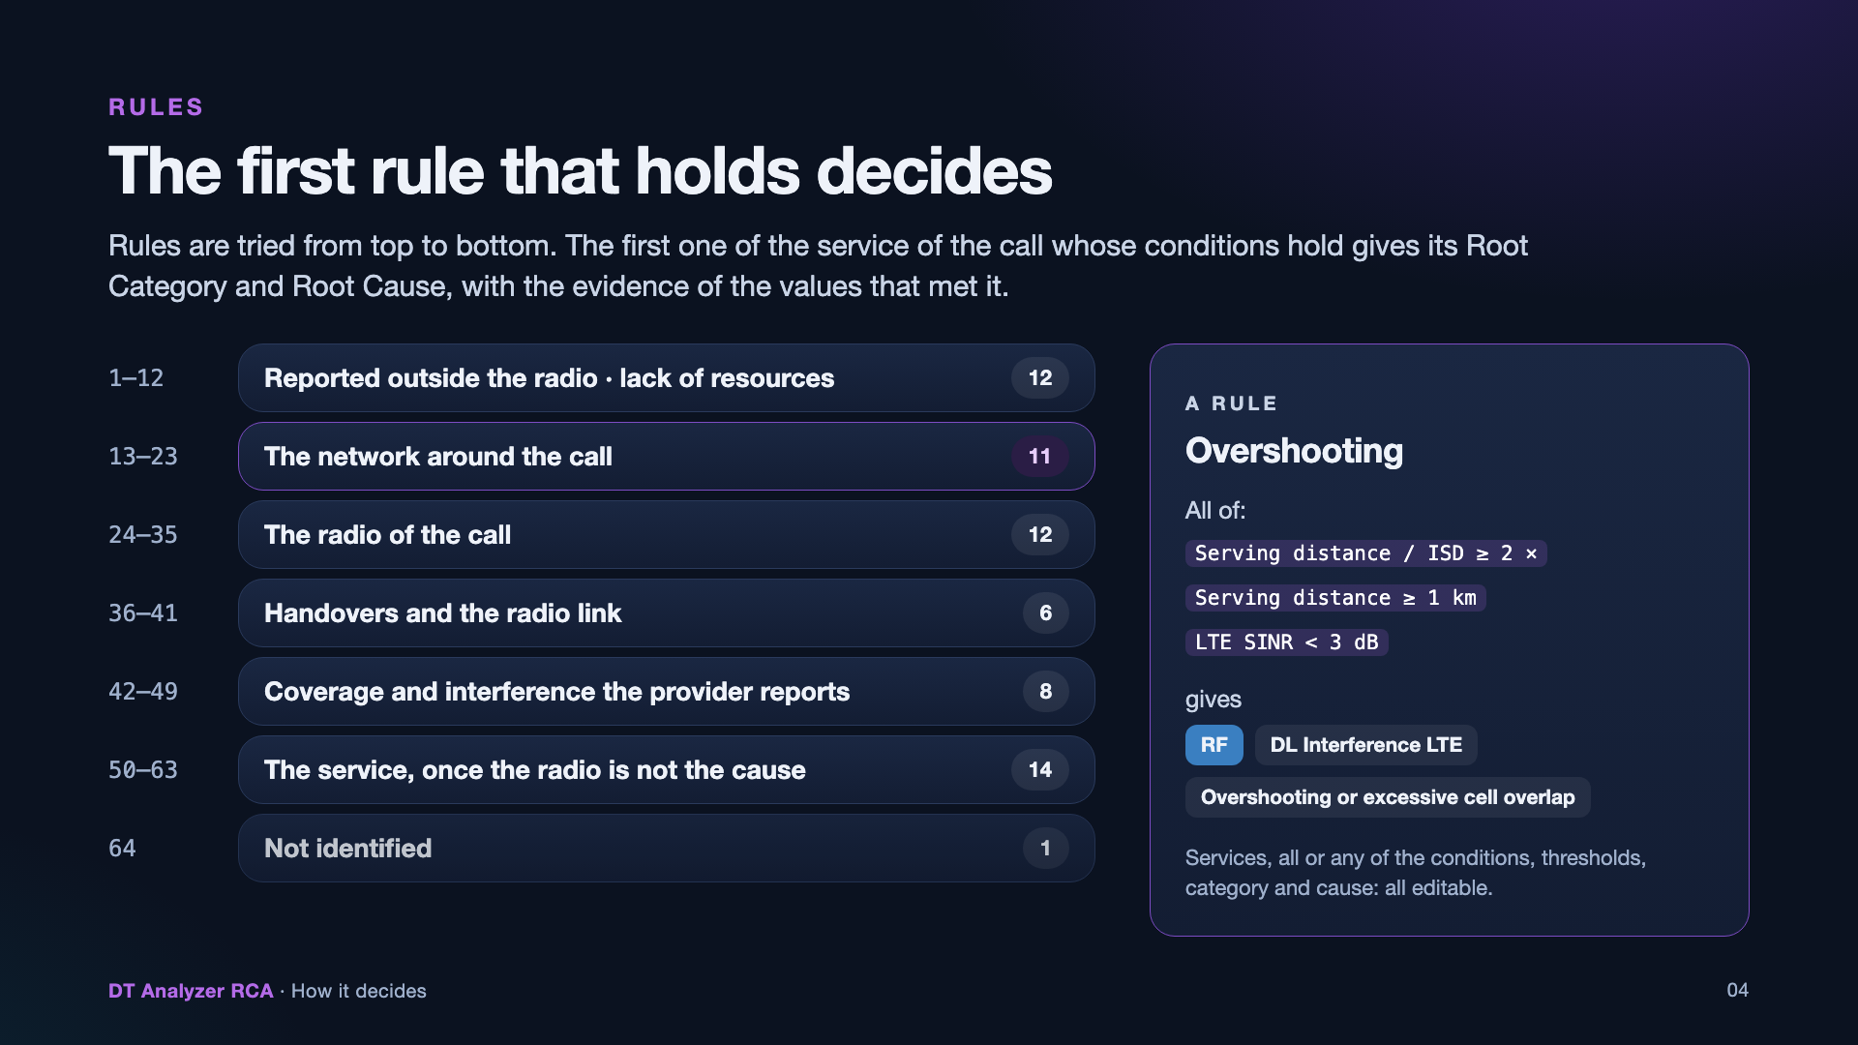
Notes:
The rules are tried from top to bottom and the first one of the service of the call whose conditions hold decides. They are grouped in blocks: what the provider reports outside the radio and the lack of resources, the network around the call, the radio, handovers and the radio link, the coverage and interference the provider reports, the service, and Not identified for the rest. The order matters: a broad rule high in the list hides those below it.

Slide 5
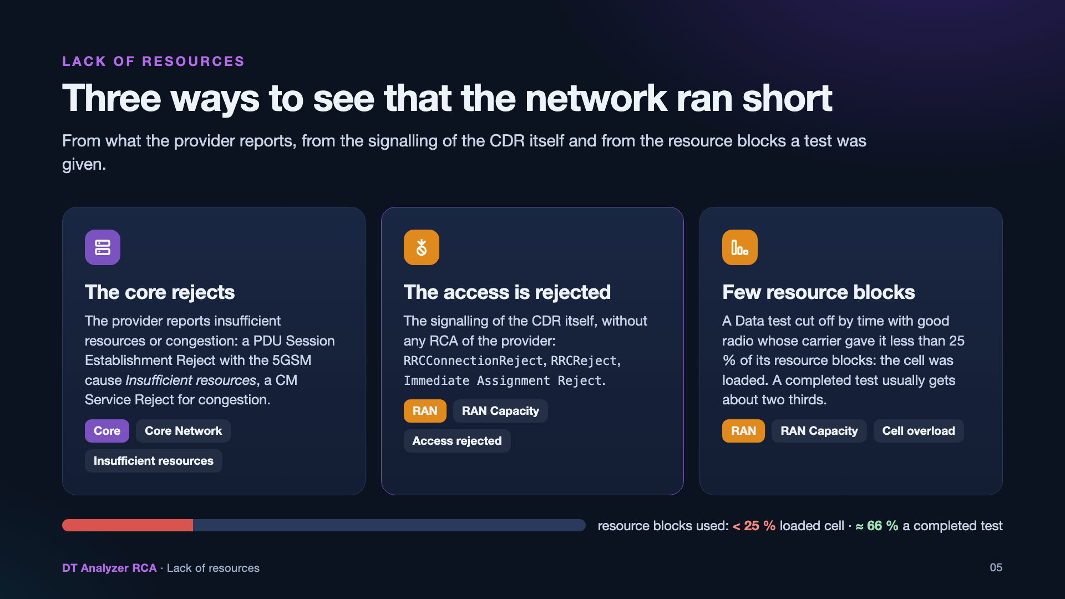
Notes:
Insufficient resources of the core, such as a PDU Session Establishment Reject with the 5GSM cause Insufficient resources, only the RCA of the provider tells: the CDR has no NAS cause of its own. The access the network rejects is in the signalling of the CDR itself (RRCConnectionReject, RRCReject, Immediate Assignment Reject). A Data test cut off with good radio while its carrier gave it less than a quarter of its resource blocks points at a loaded cell; a server that sends little also leaves blocks unused, so these rules come after the protocol rules.

Slide 6
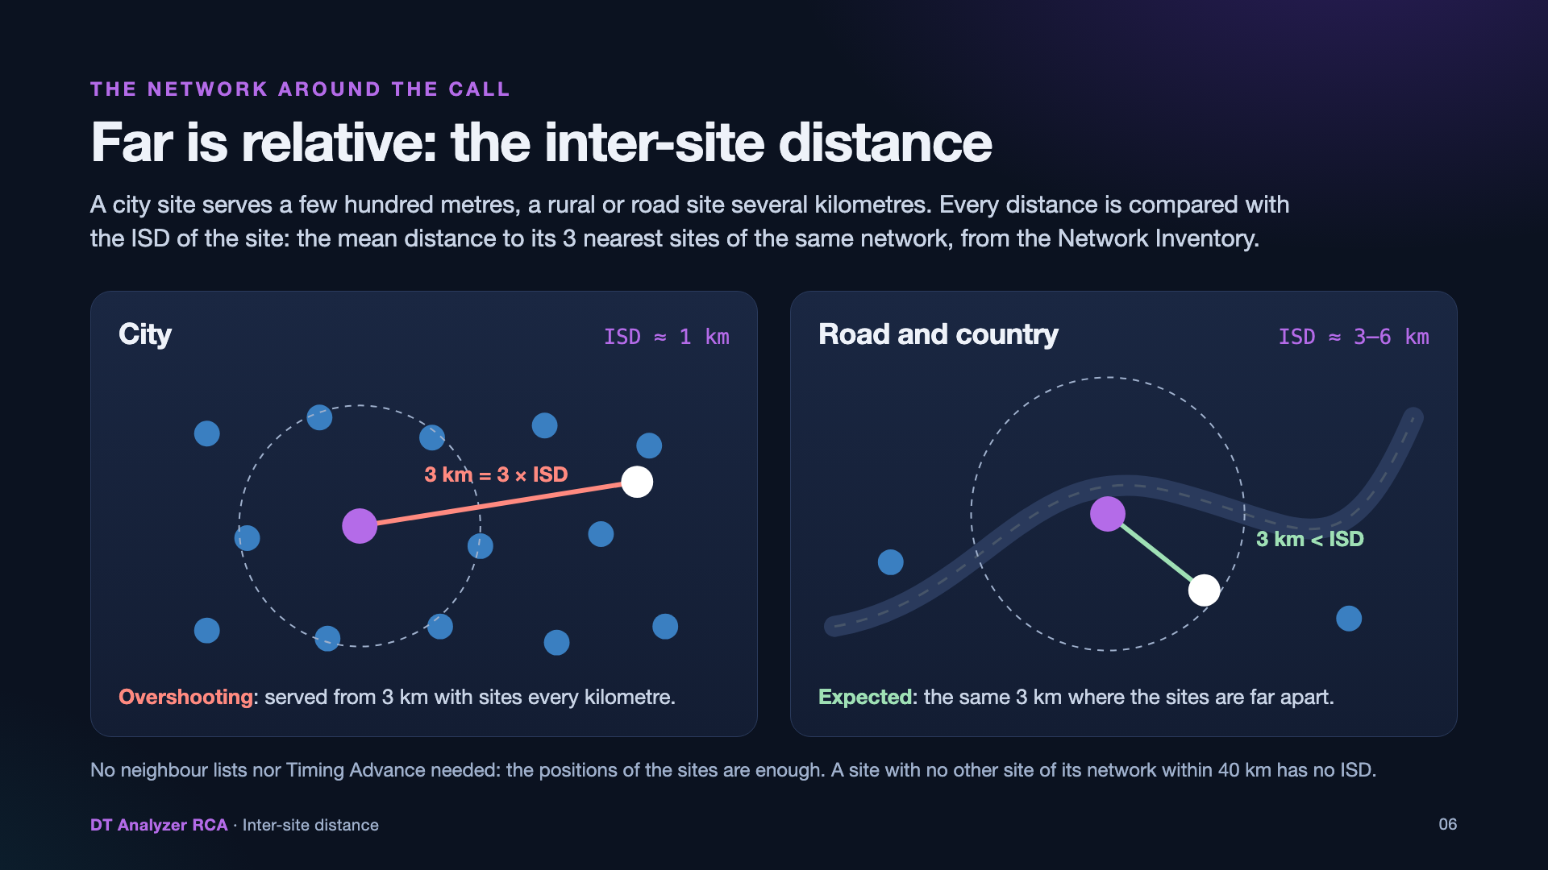
Notes:
Serving from three kilometres is overshooting in a city whose sites are one kilometre apart and normal on a rural road. So every distance is compared with the inter-site distance of the site: the mean distance to its three nearest sites in service of the same network, from the positions of the Network Inventory. Neither neighbour lists nor the Timing Advance are needed.

Slide 7
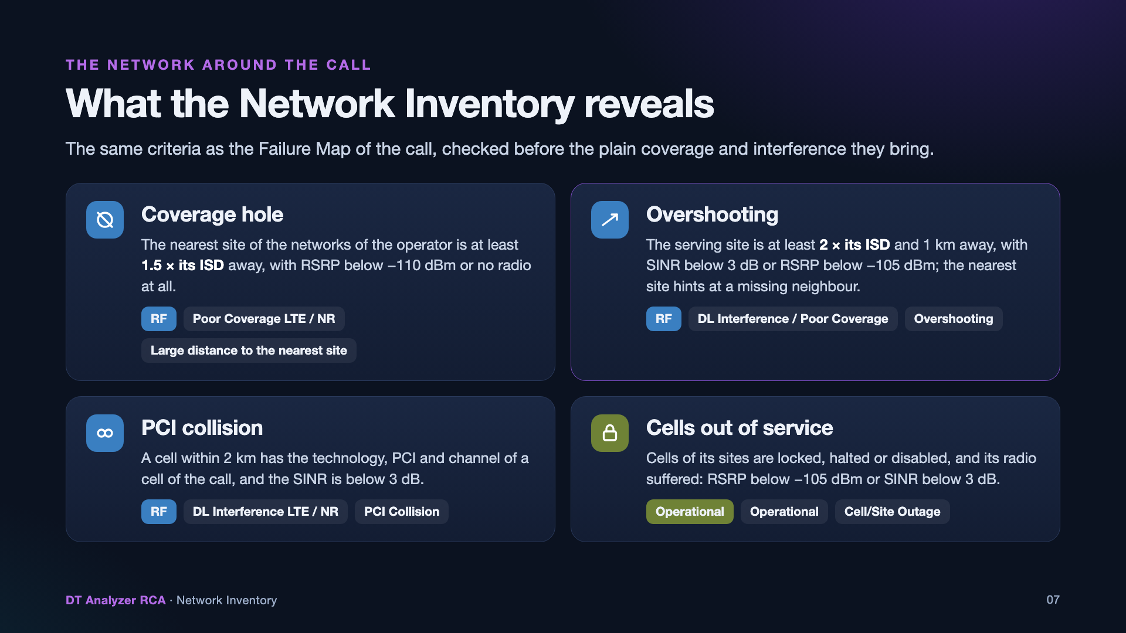
Notes:
A coverage hole: the nearest site of the networks serving the operator is beyond one and a half times its own ISD, with weak coverage or no radio. Overshooting: the serving site is beyond twice its ISD and one kilometre, with interference or weak coverage. A PCI collision: a cell within two kilometres shares the technology, PCI and channel of a cell of the call. Cells out of service: cells of its sites are locked, halted or disabled while its radio suffered. The Failure Map of the call uses the same criteria.

Slide 8
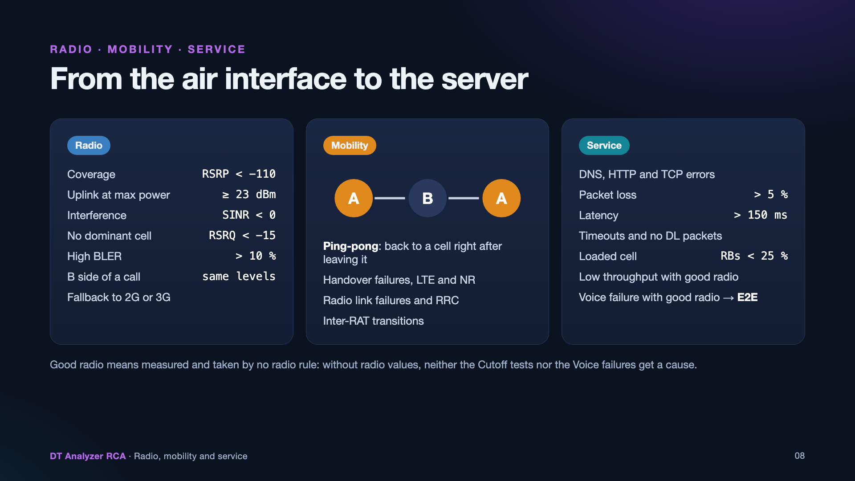
Notes:
The radio rules use the levels of Network Insights: coverage below −110 dBm, interference below 0 dB, no dominant cell below −15 dB of RSRQ, a BLER above 10 % and the uplink at its maximum power. Ping-pong handovers are the call going back to a cell right after leaving it. The service rules come once the radio is not the cause, down to the Voice failures with good radio, a potential end-to-end issue.

Slide 9
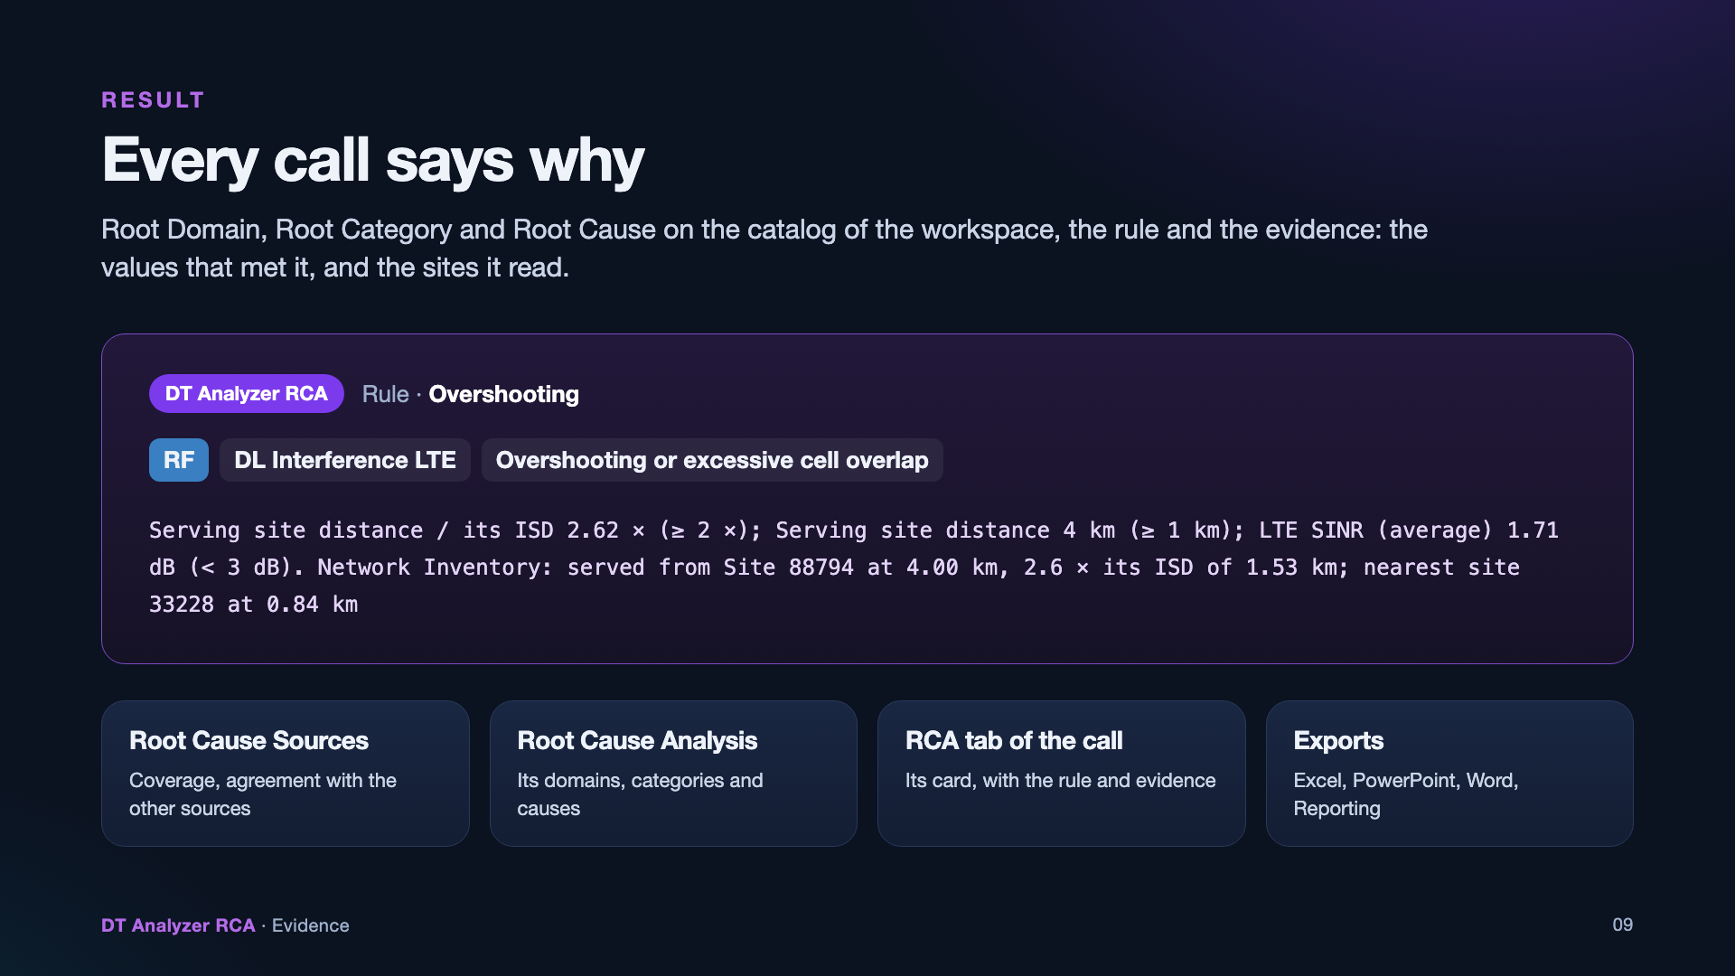
Notes:
Each call gets its root domain, Root Category and Root Cause on the catalog of the workspace, the rule and the evidence: the values that met the rule and, for the rules of the network around the call, the serving and nearest sites it read. They show in the Root Cause Sources and Root Cause Analysis panels, the RCA tab of the call and every export.

Slide 10
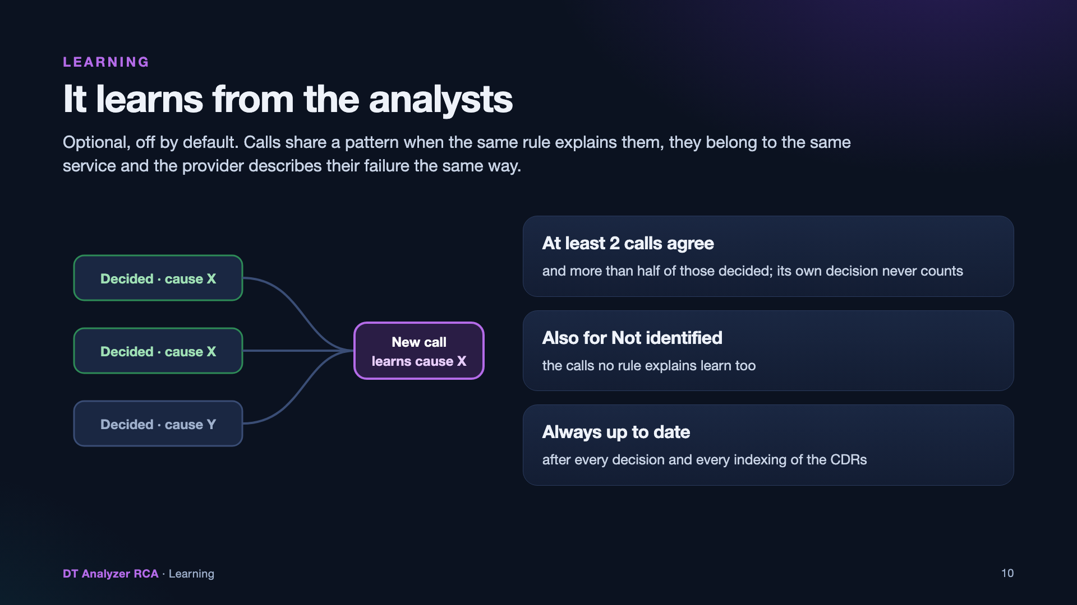
Notes:
Learning is optional and off by default. A call takes the Root Category and Cause the analysts gave most of the other calls of its pattern (the same rule, service and failure of the provider) when at least two of them, and more than half of those decided, agree. It also learns for the calls the rules leave Not identified, and it follows every decision and every indexing of the CDRs.

Slide 11
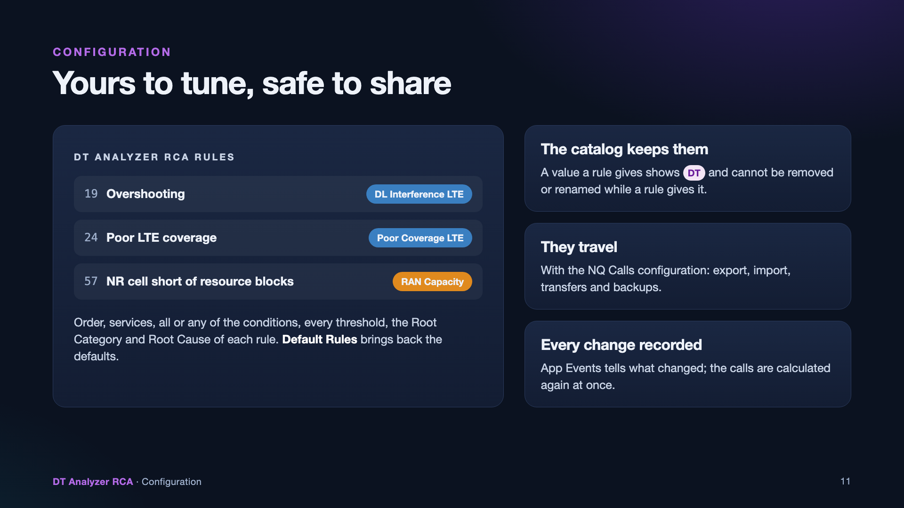
Notes:
Admins change the rules in DT Analyzer RCA Rules: their order, services, conditions, thresholds, Root Category and Root Cause; Default Rules brings back the defaults. The Root Cause Catalog keeps the values a rule gives, the rules travel with the NQ Calls configuration in exports, imports, transfers and backups, and App Events records every change.

Slide 12
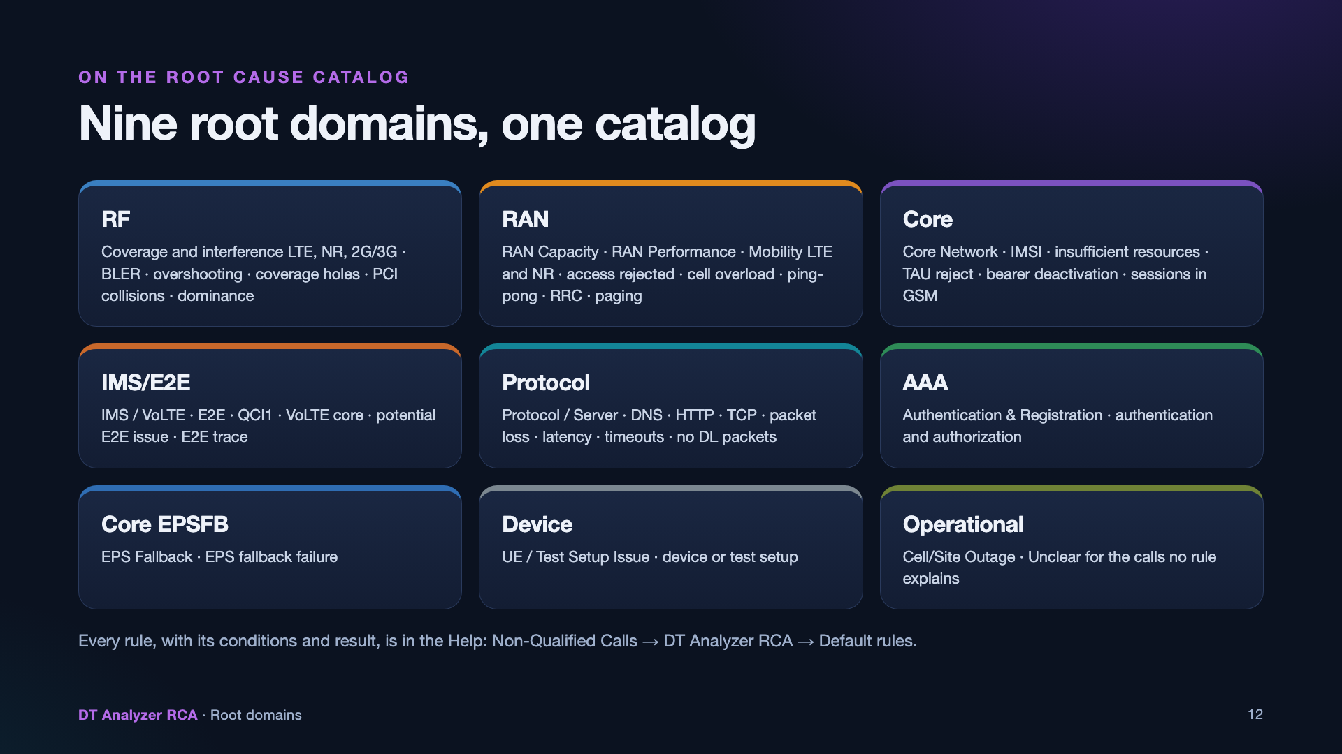
Notes:
The default rules give values of nine root domains of the Root Cause Catalog. The Help lists every rule with its conditions and result, and every root domain with the categories and causes it gives: Non-Qualified Calls, DT Analyzer RCA, Default rules.

