Slide 1
Image Maps

Slide 2
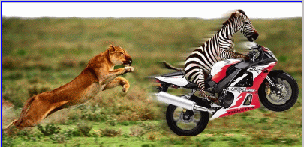
Image Maps
An image map is a single image that can be used to link to several different URLS
Hot Spots

Slide 3
Image Maps
Server-Side Image Maps
Client-Side Image Maps
Summary: Image Maps

Slide 4
Server-Side Image Maps
Image Maps
Image used as image map
Map file defines areas of image and corresponding URLs
Image map program runs on server as part of its server software
Map file and image map program reside on server
Web server performs calculations

Slide 5
Client-Side Image Maps
HTML document contains map information
Browser performs calculations
Better performance that server-side image maps
Can test and implement locally
URL of hyperlink will display in browser status bar when mouse hovers over image

Slide 6
Four Steps to Create a Client-Side Image Map
Select image to use
Define areas of image map
  Three shapes: circle, rectangle, polygon
  X and Y coordinates in pixels
  Get coordinates from a graphics program such as Paint Shop Pro or Photoshop

Slide 7
Four Steps to Create a Client-Side Image Map
Include map information in HTML document:
  <MAP></MAP> - NAME attribute names the map
  <AREA> tags identify shapes in map
    SHAPE attribute – circle, rect, poly
    HREF attribute – URL to load
    COORDS – x and y coordinates of shape
Connect image with map information
  USEMAP attribute in <IMG> tag
  USEMAP value is map name with a # symbol before it

Slide 8
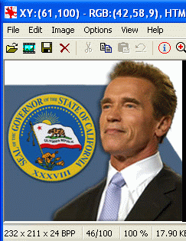
Finding Coordinates
Open image in Irfanview or some other graphics program
Point to the locations of interest and click to see the X, Y coordinates in the title bar

Slide 9
Circle
<AREA SHAPE=“circle”
COORDS=“x,y,r”
HREF=“url”>
Replace x,y,r with three numbers: horizontal and vertical position of the circle’s center, and the radius of the circle in pixels
Replace url with the Web address of the link target
x,y
x+r,y

Slide 10
Rectangle
<AREA SHAPE=“rect”
COORDS=“x1,y1,x2,y2”
HREF=“url”>
Replace x1,y1 with two numbers: horizontal and vertical position of one corner of the rectangle
Replace x2,y2 with the horizontal and vertical position of the opposite corner of the rectangle
Replace url with the Web address of the link target
x1,y1
x2,y2

Slide 11
Polygon
x1,y1
x2,y2
<AREA SHAPE=“poly”
COORDS=“x1,y1,x2,y2,x3,y3,x4,y4,…”
HREF=“url”>
Replace x1,y1 with two numbers: horizontal and vertical position of a point on the edge of the polygon
Add more x,y pairs until you have traced around the desired shape
x6,y6
x3,y3
x5,y5
x4,y4

