Slide 1
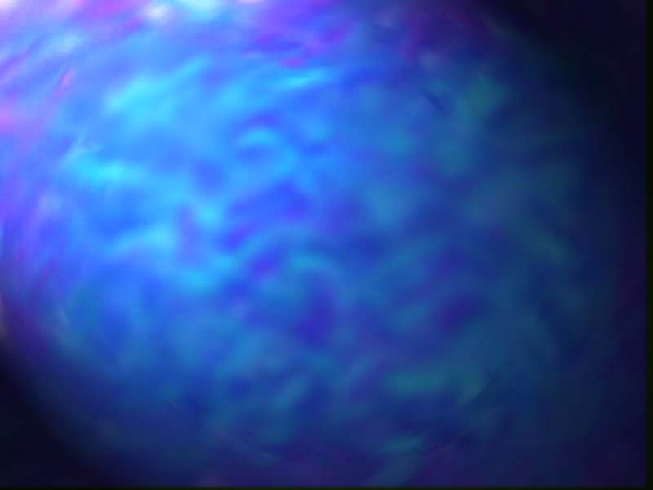
Image Maps

Slide 2
What it Does
Different parts of the image activate different hyperlinks

Slide 3
Server-Side Image Maps
Image displayed by client
Program runs on server
  Client browser sends program the (x,y) coordinates of the mouse click
  Program refers to map file which corresponds regions to URLs and invokes appropriate one

Slide 4
Server-Side Image Maps
Program runs on server
  Disadvantages
    Cannot test page without server running
    Slow
    When you move mouse over hyperlink, you don't see the URL since the web browser doesn't know it; you see URL of the map program itself and an (x,y) coordinate

Slide 5
Client-Side Image Maps
No program which runs on server
All processing occurs in browser
Supported by very few browsers

Slide 6
Creating Server-Side Image Maps
Map file
  Statements
    default URL
    circle URL x,y radius (radius in pixels)
    rect URL x,y x,y
    poly URL x1,y1 x2,y2 … xn,yn
    point URL x,y
  Upper lefthand corner is (0,0)

Slide 7
Creating Server-Side Image Maps
Map file
  If cursor not in region, than nearest point is used, if there are any
  Can have overlapping regions
    First statement in map file which covers point is used
  If default is used, then you shouldn't have any points

Slide 8
Creating Server-Side Image Maps
In your HTML page, include the following,
  <a href="/cgi.bin/imagemap/ ~xyz/myimage.map">
  <img src="image.gif" ismap></a>

Slide 9
Creating Server-Side Image Maps
If you don't have an image editor to get coordinates, create the following HTML page
  <html><head><title>Coordinates</title>
  </head>
  <body>
  <a href="nowhere"><img src="image.gif" ismap>

Slide 10
Creating Client-Side Image Maps
All information is part of HTML document
<map>…</map>
  <map name="mapname">
  coordinates and links
  </map>

Slide 11
Creating Client-Side Image Maps
<area>-tag
  <area shape="poly" coords="x1,y1,…,xn,yn" href="file.html">
  <area shape="rect" coords="x1,y1,x2,y2"
  href="file.html">
  <area shape="circle" coords="x,y,radius"
  href="file.html">

Slide 12
Creating Client-Side Image Maps
Can use target=window_name for frames
    <map name="books">
    <area shape="poly" coords="70,0, 0,37, 0,183, 27,192, 27,48, 103, 9" href="file.html">
    </map>
    <img src="image.gif" usemap="#books">

Slide 13
Creating Client-Side Image Maps
Can use both types of image maps\
    <a href="cgi.bin/imagemap/~xyz/myimage.map">
    <img src="image.gif" usemap="#books" ismap>
    </a>
  Install myimage.map on server
  Include <map name="books">…</map> somewhere on page
  Client-side tried first, else does server-side

