Slide 1


Ek Swasthya
“One Identity. One Health. Everywhere.”
MADE BY :- Unknown Yoddha
Unknown Yoddha :-
Jaimin Patel ( Leader and Solo Member)

Slide 2


Problem Statement Healthcare is Fragmented and Emotionally Disconnected
Patients often forget or fail to communicate their complete medical history to new doctors.
Switching doctors or hospitals
leads to loss of crucial medical data.
Medical expenses are rarely tracked
or organized for patients.
Insurance claims often fail due to missing or uncovered medical records, causing last-minute financial stress.
Mental health conditions are usually overlooked during clinical visits because of time constraints.

Slide 3

Proposed Solution
Ek Swasthya creates a unique digital health ID for every patient.
All medical records, prescriptions, and test reports are securely stored and accessible anytime, anywhere.
Doctors can easily update new visits, including a quick mental health rating (1–10) using a standard protocol.
Patients gain a centralized dashboard to track both physical and mental health over time.
Integrated billing and expense tracking helps patients manage their finances.
Future integration with insurance and home healthcare services ensures complete wellness coverage.

Slide 4
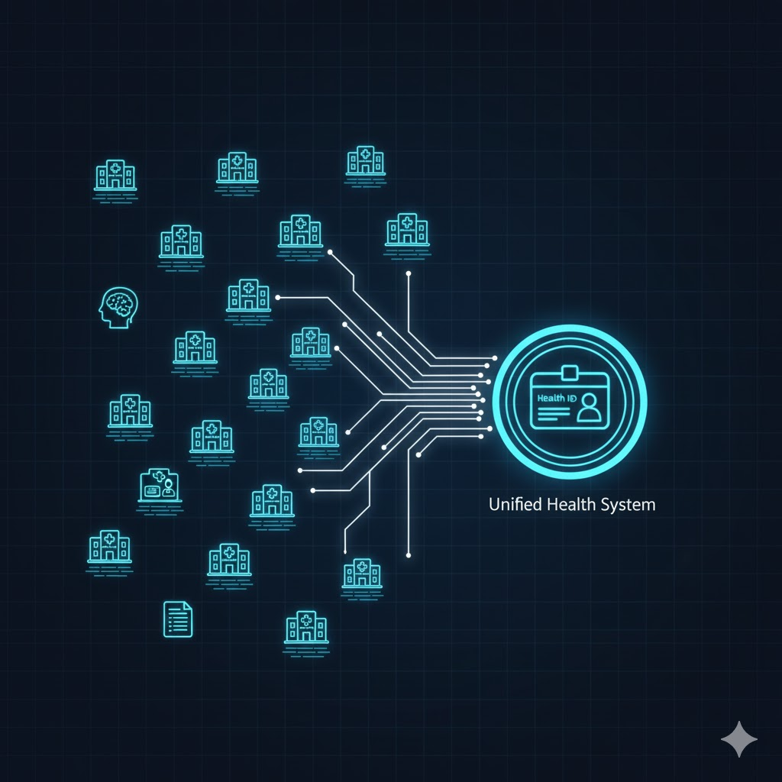
Research Insights
Over 60% of patients in India face issues when switching hospitals due to missing or incomplete records.
Doctors spend up to 35% of consultation time reviewing fragmented medical histories.
Mental health issues affect 1 in 5 adults, yet are rarely tracked in general medical visits.
Insurance claims often get delayed or denied because of incomplete medical documentation .
Lack of centralized digital storage increases stress and financial uncertainty for patients.

Slide 5
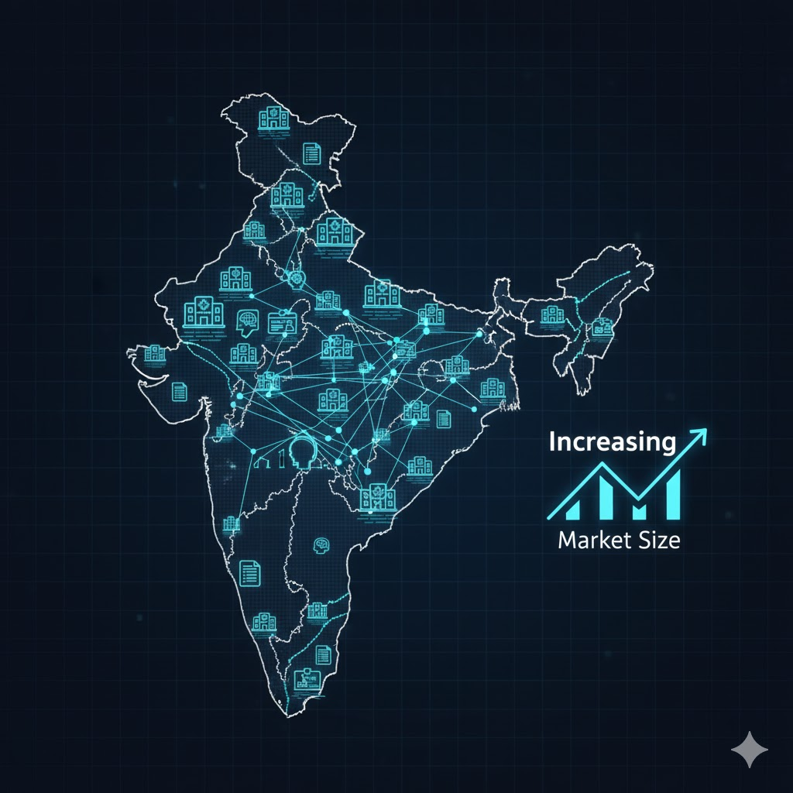
Market Overview
Primary Users: Hospitals, Clinics, Doctors, and Patients
Secondary Users: Insurance Companies, Diagnostic Labs, Home Healthcare Providers
Market Scope:
India’s digital health market projected to reach $37 billion by 2030.
Growing government support for digital health ID initiatives (like Ayushman Bharat Digital Mission).
Increasing demand for mental health monitoring and data-based treatment.
Opportunity: A platform like Ek Swasthya can partner with both private hospitals and government programs for secure data management.

Slide 6
Core Features
Unique Patient ID
One ID stores all medical history securely.
Doctor Portal
Patient Dashboard
View all records, track physical and mental health trends, and manage expenses.
Billing & Spending Tracker
Patients can monitor medical expenses and insurance readiness.
Cross-Hospital Data Sharing
Doctors in other hospitals can access records with patient consent.
Upload reports, prescriptions, and mental health rating (1–10) quickly.
Home Service & Insurance Integration
Tie-ups with medicine delivery, lab tests, nurse services, and insurance verification.

Slide 7
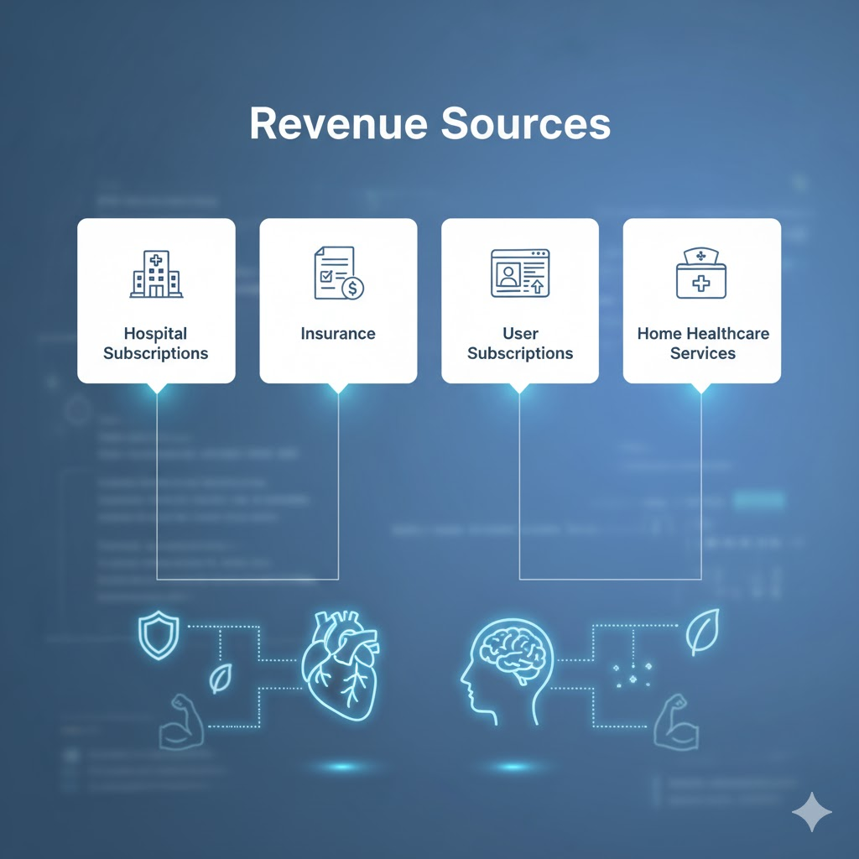
Business Model & Revenue Sources
Revenue Sources:
Hospital Subscription Model – Hospitals pay a fee to integrate records.
Insurance Partnerships – Verified patient data for smoother claims.
User Subscription (Freemium) – Premium features: personalized dashboards and analytics .
Home Healthcare Tie-ups – Commissions from medicine delivery, lab tests, and nurse services.

Slide 8
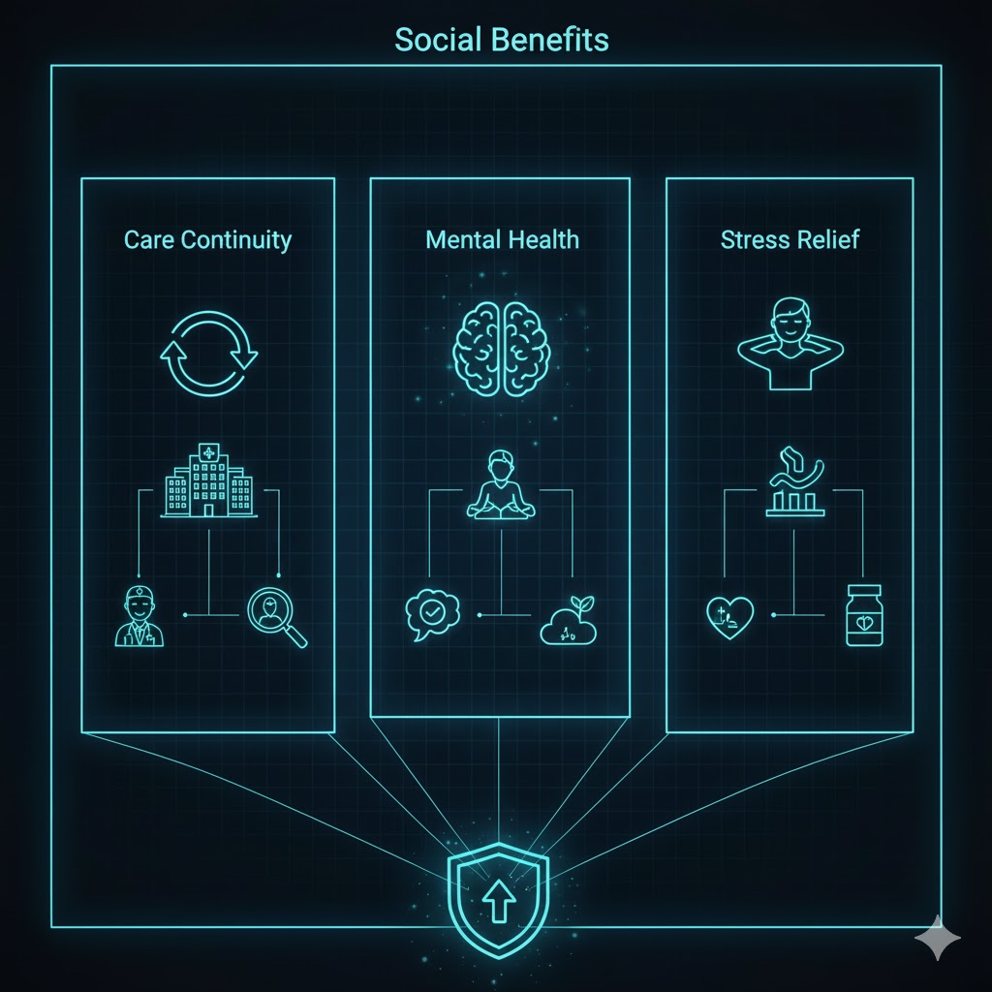
Social & Healthcare Impact
Ensures continuity of care between hospitals and doctors.
Integrates mental health tracking in standard medical visits.
Reduces stress, time, and paperwork for both doctors and patients .
Improves insurance claim transparency and accuracy.

Slide 9
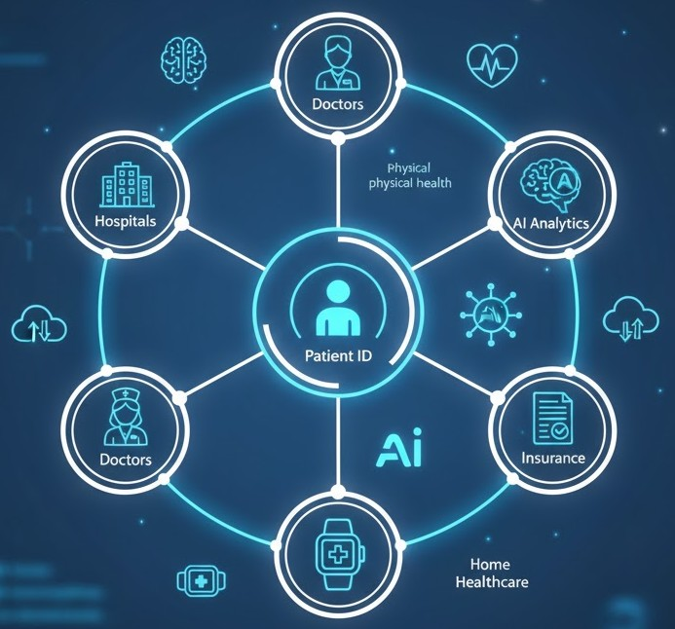
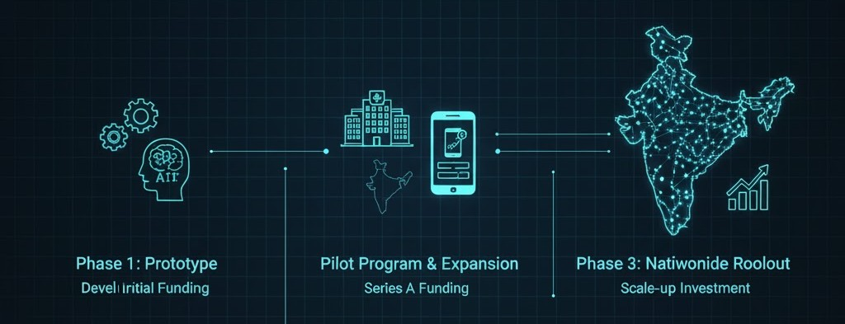
“Ek Swasthya aims to empower patients, streamline healthcare processes, and bring mental and physical health together under one secure, accessible, and scalable system.”
Future Scope & Roadmap
AI & Predictive Health Analytics: Use patient data to predict risks and suggest preventive measures.
Wearable Device Integration: Track vitals like heart rate, BP, sugar, and activity levels in real-time .
National Health Integration: Potential to connect with government health initiatives (like digitized health IDs).
Expanded Mental Health Features: Detailed monitoring, reminders, and virtual support options .
Scalable Cloud Deployment: Full cloud integration for nationwide accessibility.

