Slide 1
American International University-Bangladesh
Department of Computer Science
Introduction to Database
Project: Criminal Face Detection System
Section: [T]
Group No: 04 [CRUD Riders]
Semester: Spring 23-24
Course Teacher: JUBAYER AHAMED

Slide 2
CRUD Boy’s:
SL. | Members Name | ID
1. | JOY, MD. HOSNE JAIM | 23-50947-1
2. | BHUIYAN, KAMRUL HASAN | 23-50831-1
3. | RAKIB, MD SANUAR ALAM | 23-50982-1
4. | SHAHADOUT, MD. EFAT AL KHALID | 23-50823-1
5. | SINA, MD. ABDULLA IBNA | 23-50331-1

Slide 3
Outline
Introduction
Case Study & ER Diagram
Database Structure
How the System works & Java connection
Challenges & Future Objective
Conclusion

Slide 4
Outline
Introduction
Case Study & ER Diagram
Database Structure
How the System works & Java connection
Challenges & Future Objective
Conclusion

Slide 5
Outline
Introduction
Case Study & ER Diagram
Database Structure
How the System works & Java connection
Challenges & Future Objective
Conclusion

Slide 6
Outline
Introduction
Case Study & ER Diagram
Database Structure
How the System works & Java Connection
Challenges & Future Objective
Conclusion

Slide 7
Outline
Introduction
Case Study & ER Diagram
Database Structure
How the System works & Java connection
Challenges & Future Objectives
Conclusion

Slide 8
Outline
Introduction
Case Study & ER Diagram
Database Structure
How the System works & Java connection
Challenges & Future Objective
Conclusion

Slide 9
Criminal Face Detection System
What does it mean?
Stores pictures of known criminals' faces.
Find suspects by matching their faces with the ones in the database.
Prevent crimes before they occur.
Intro

Slide 10
Case Study
Destinations
The Vatara Police Department implemented the Criminal Face Detecting System (CFDS) to address rising crime rates. CFDS integrates advanced facial recognition with real-time surveillance. It stores criminal information and captures images through CCTV for analysis. Each image contains unique details and is associated with facial features for precise comparison. Detection records instances of a criminal's face identified within images. This system streamlines tracking and identification of criminals through facial recognition technology.
Case
Study

Slide 11
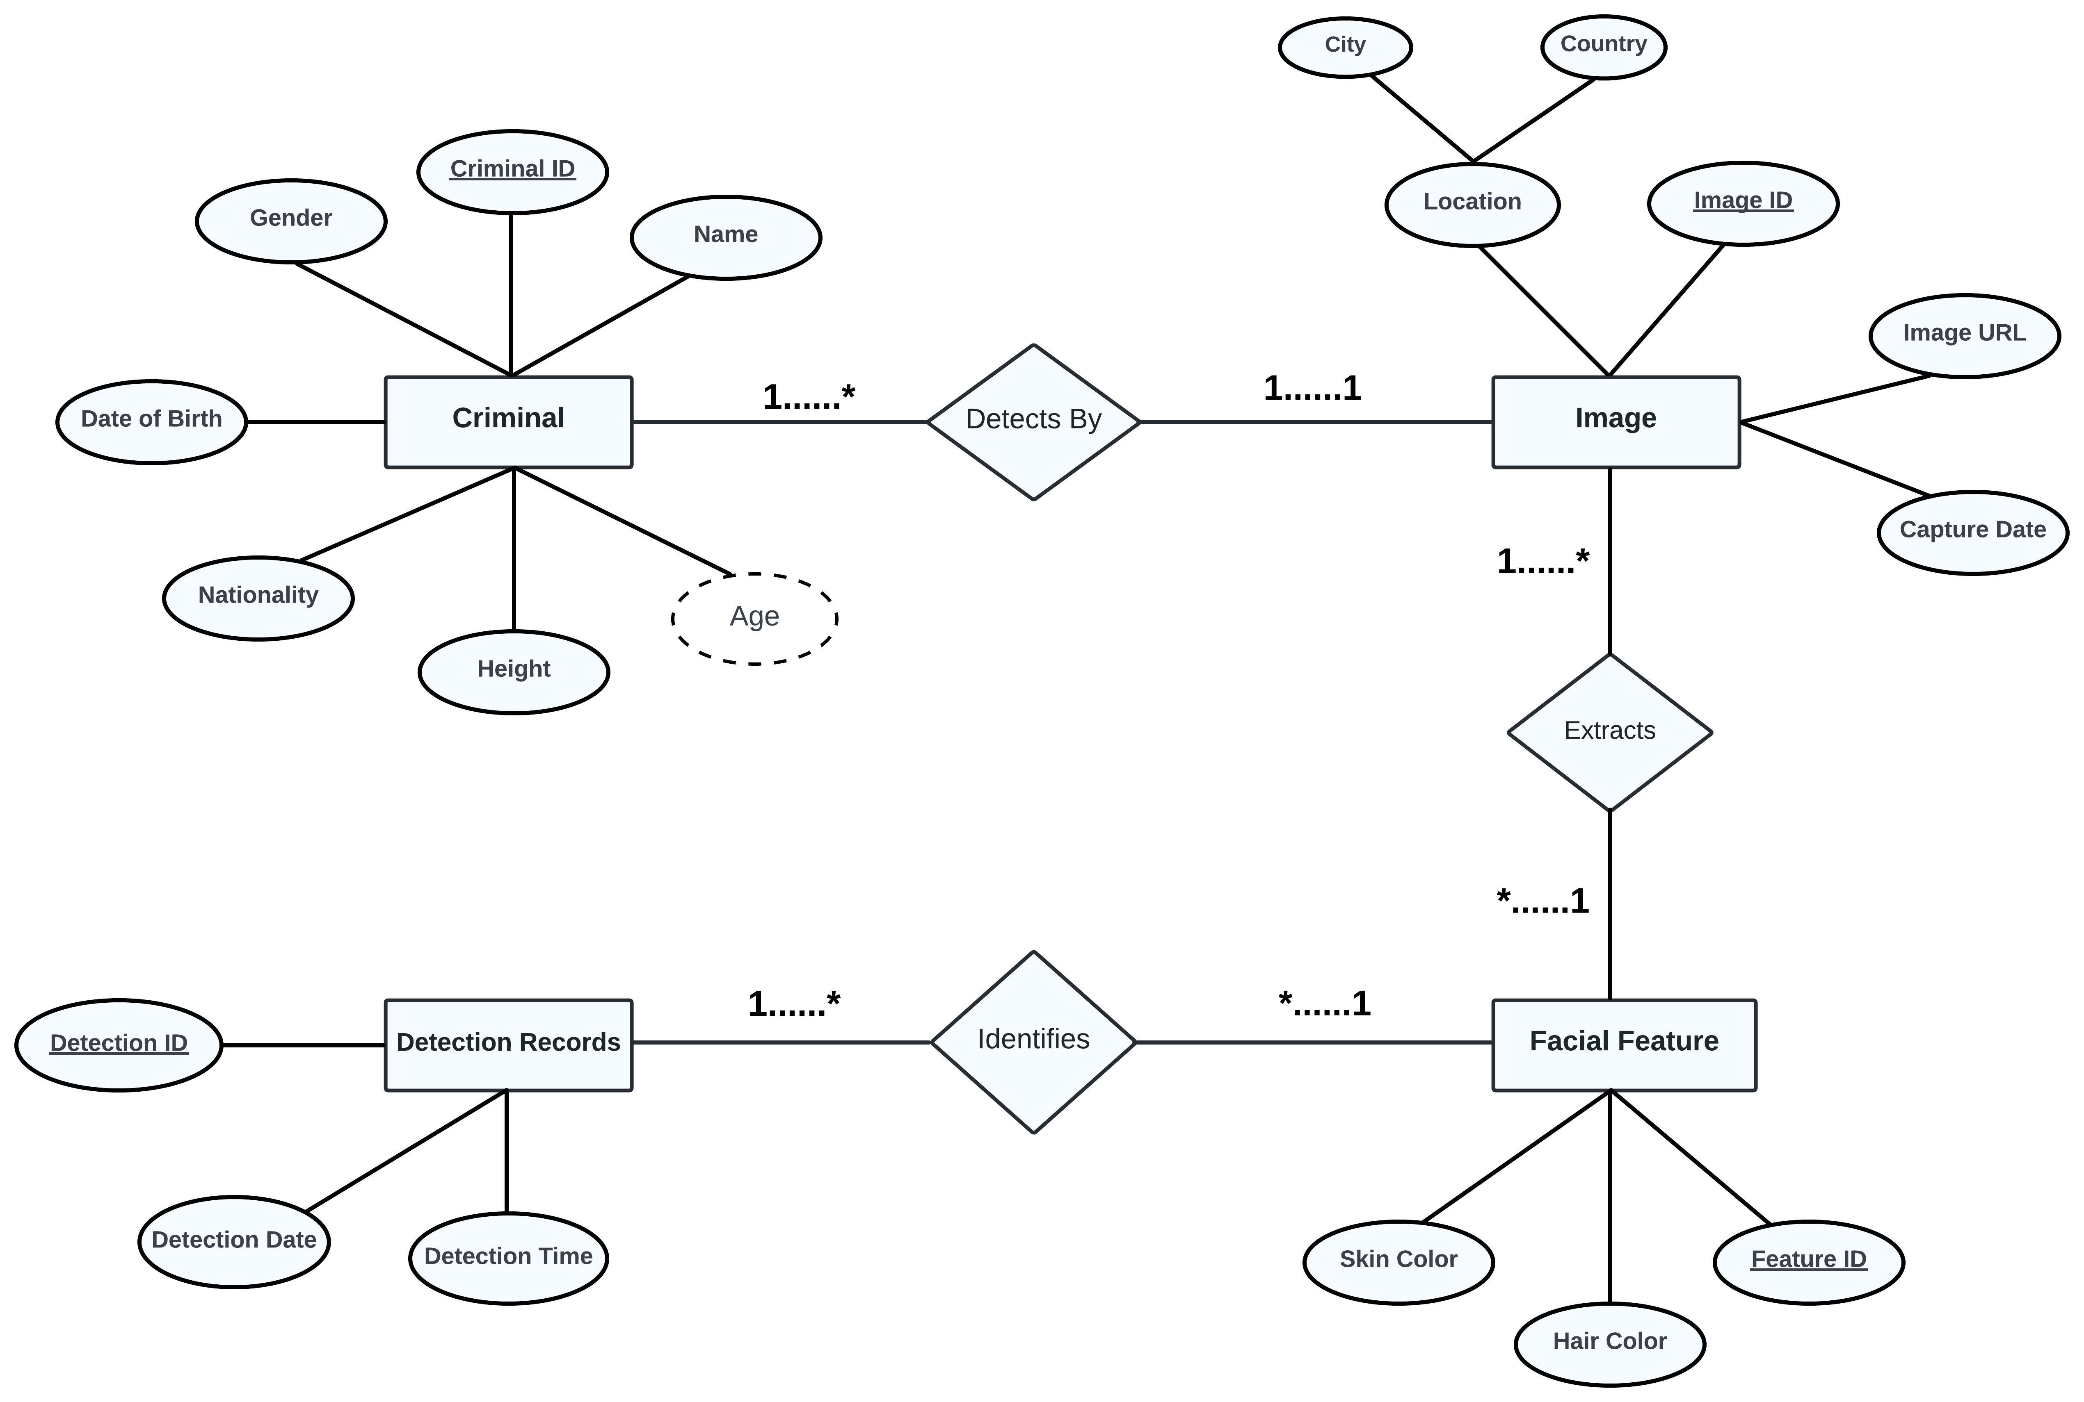
Destinations
ER
Diagram

Slide 12
Project Structure
5 Tables:
Criminal Information
Image Information
Feature Information
Address
Detection Information
Struct

Slide 13
Project Structure
Project Structure
Data Organization:
Data are organized hierarchically.
Tables are linked through unique identifiers.
Relational structure enables efficient data retrieval and management.
Finalization:
Criminal_ID (pk), Image_ID (fk), Name, Date_of_Birth, Gender, Height, Nationality, Age.
2) Image_ID (pk), Feature_ID(fk), Image_URL, Capture_Date, City.
3) Feature_ID (pk), Detection_ID(fk), Hair_Color, Skin_Color.
4) Detection_ID (pk), Detection_Time, Detection_Date.
5) City, Country.
Struct

Slide 14

Working Process of The CFDS
Capture and Analysis:
The system captures facial images from various sources like CCTV footage or photographs.
Then analyzes these images to extract facial features like eyes, nose, and mouth.
Facial Recognition:
Using sophisticated algorithms like Convolutional Neural Networks (CNNs), the system compares extracted features against a database of known criminals. If a match is found, it alerts law enforcement.
Process

Slide 15
Database Connection through ‘Java’
Acquired the necessary Connector/JAR file from MySQL's official website for connecting Java with MySQL.
Installed "Xampp" for essential server needs.
Downloaded MySQL Shell and followed installation instructions.
et up the database structure using concise SQL commands.
Organized project components in IntelliJ IDEA.
Enhanced connection capabilities by adding the appropriate library.
Registered the MySQL JDBC driver to enable communication with the database.
Java conn.

Slide 16

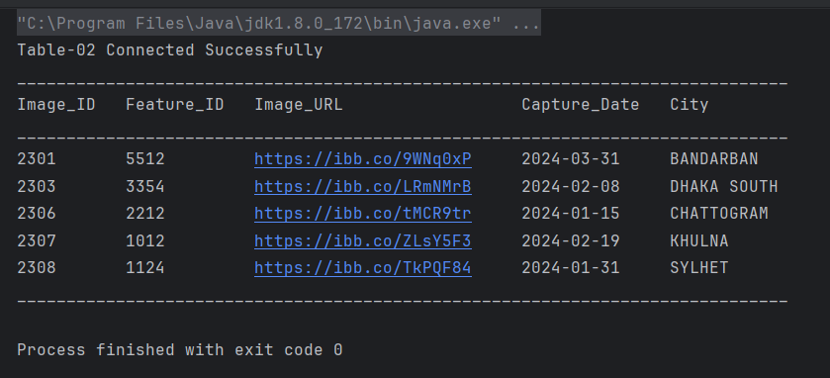
Database Connection through ‘Java’
Code:
Output:
Java conn.

Slide 17
Challenges
Compatibility Issues
Security Concerns
Scalability
Performance Optimization
Error Handling and Debugging
Data Integrity
Concurrency Control
Regulatory Compliance
Challenge

Slide 18
Future Objectives
Advancements: We're working on making our technology even better at recognizing faces in tricky situations.
Applications: Besides catching bad guys, we might use this tech in stores or banks to help with security.
Ethical Implications: We need to keep talking about how to use this tech responsibly and make sure it's fair for everyone.
Future

Slide 19
Conclusion
“Criminal Face Detection System” represents a significant advancement in law enforcement technology.
Integrates facial recognition with real-time surveillance for identifying and tracking criminals.
Despite challenges like compatibility issues and security concerns, the project successfully implemented robust solutions.
The system's implementation holds promise for improving public safety through swift suspect identification and apprehension.
Moving forward, ongoing optimization and adaptation will further enhance its effectiveness in combating crime.
Conclusion

Slide 20
THANK YOU

