Slide 1
Presenters
Benji
Marvin
Todd

Slide 2
Character Superclass

Slide 3
Overview
Variables
Setters and Getters
Methods
  Movement

Slide 4
Variables
_health
_speed
_is_playing
_is_moving
_is_attacking
_is_dead
_name
_team
_character
_atk_buff
_def_buff

Slide 5
Setters and Getters
Used for interacting with private variables.
Mostly used by Axeman and Swordman subclasses.

Slide 6
Methods
basic_attack and special_attack
  Overridden by the subclasses
move
  Same for both characters. Only speed will change.
  Defines the movement for the player's character
moveActor
  Moves other player's characters based on information gotten from the server.

Slide 7
move method
Parameters
  move(fw, bw, lf, rt, delta)
    Input if you're walking up, down, left, or right.
    The difference in time since last task tick.
How it works
  Chooses angle based on input.
  Faces character to that angle and moves it in that direction at the character's speed.

Slide 8
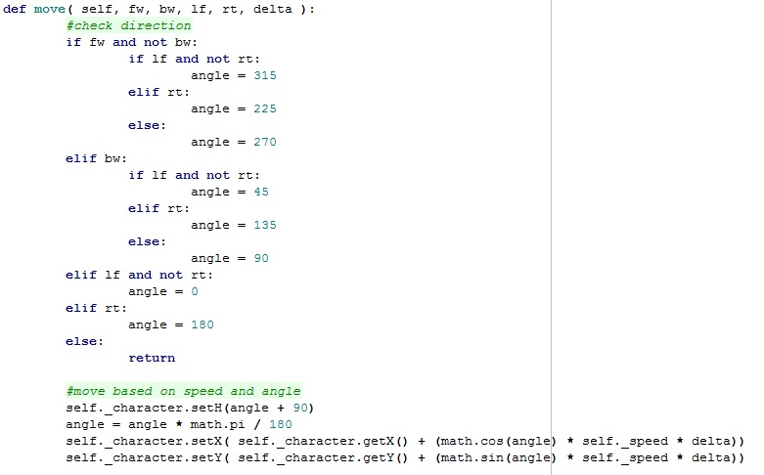
move method

Slide 9
moveActor method
Parameters
  moveActor(x, y, z, rotation, isMoving, heartbeat)
    x, y, z comes from server and positions character
    rotation comes from server and orients character
    isMoving comes from server and determines animation
    heartbeat is based on how often the heartbeat task occurs.

Slide 10
moveActor method
How it works
  Based on isMoving and self._is_moving determines whether to start run animation or to stop it at the end of the movement.
  Creates an interval for both turning and moving and runs them in parallel.

Slide 11
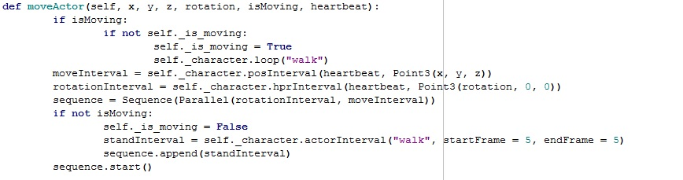
moveActor method

Slide 12
Swordsman Subclass

Slide 13
Constants and Variables
Inherited from Character class:
Constants:
_health
_speed
_is_playing
_is_moving
_is_attacking
_is_dead
_name
_team
_character
_atk_buff
_def_buff
ATK_RANGE
BASIC_ATK_DMG
SPECIAL_ATK_DMG
MOVE_SPEED
CHARGE_SPEED
MAX_HEALTH

Slide 14
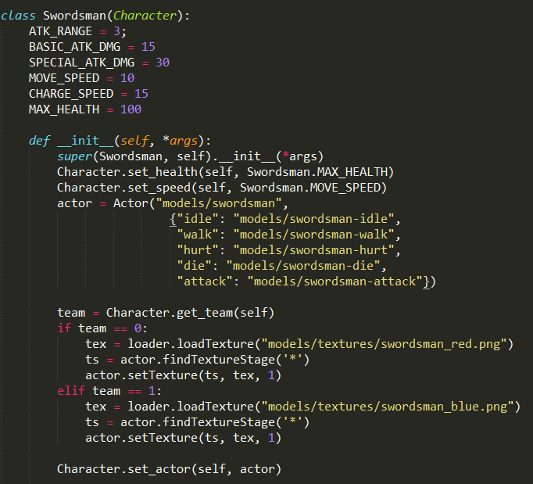
Swordsman Class

Slide 15
Methods
basic_attack and special_attack:
  Calculates damage to apply to a target
  Animates character’s attacks
take_damage:
  Changes character health based on damage given
  Plays appropriate animations: “hurt” and “die”
apply_def_buff and unapply_def_buff:
  Applies the appropriate decrease or increase to health

Slide 16
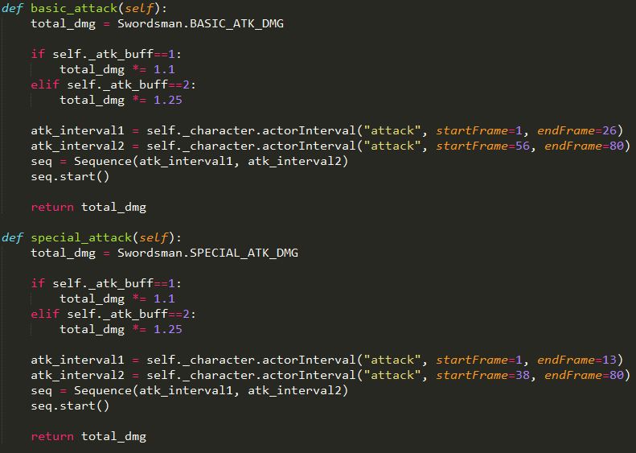
basic_attack and special_attack

Slide 17
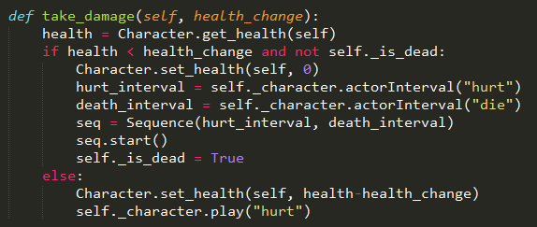
take_damage

Slide 18
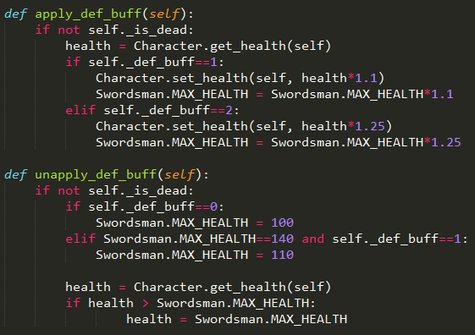
apply/unapply_def_buff methods

Slide 19
Axeman Subclass
(Virtually identical to the swordsman)

