Slide 1
Networking Template Code
Todd Matsuzaki
Daanyaal Syed

Slide 2
Protocol
A set of standard rules used to communicate across a network
Requests
  Client → Server
Responses
  Server → Client
Event ID (Short Int) | Message
RAND_INT | 11203

Slide 3
Event IDs
Lets the recipient of a message know what type of message has been received
Server and client use the same constants
RAND_INT 1
RAND_STRING 2
RAND_SHORT 3
RAND_FLOAT 4

Slide 4
ConnectionManager
Sets up the Panda3D classes necessary for connecting and listening to a server
Has methods for sending requests to and receiving responses from the server
updateRoutine continuously listens to server for messages

Slide 5
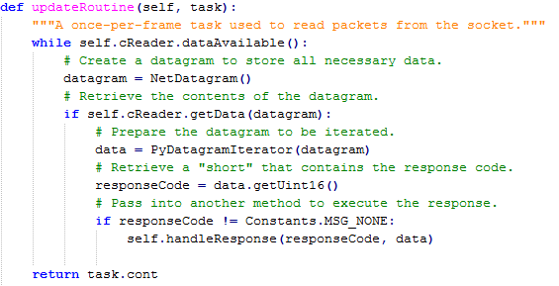
updateRoutine

Slide 6
RequestTable and ResponseTable
Dictionaries that have an event ID for a key and the name of a message handling method for a value
  Ex. { RAND_INT: requestRandomInt,
    RAND_STRING: requestRandomString}
Replaces if/else statements

Slide 7
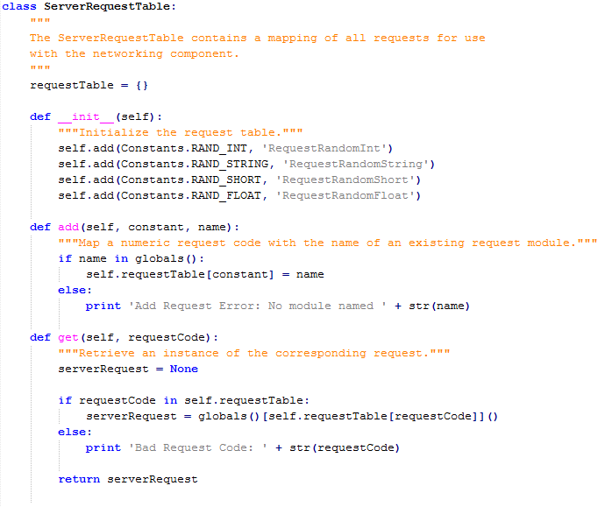
Add each type of message to the table
Look up the class that handles requestCode using the table

Slide 8
Requests/Responses
Implement ServerRequest or ServerResponse
  Provides a logging function
Need to create a separate module for each type of message being sent between client and server
  For most messages, this means separate request and response modules
    Counterexample: Heartbeat

Slide 9
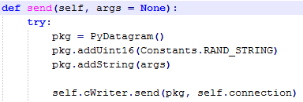
Requests/Responses
Example: RequestRandomString

Slide 10
Steps to Add a New Request/Reponse (Clientside)
Add request and response event IDs to Constants.py
Duplicate an existing request module, replacing the event ID (e.g. Constants.RAND_INT) and the message type (e.g. addInt32)
Modify ServerRequestTable
  Add the new module to the requestTable using self.add()
  Import the new module
Duplicate an existing response module, replacing the message type
Modify ServerResponseTable
  Add the new module to the responseTable using self.add()
  Import the new module

Slide 11
Steps to Add Networking Code to Your Own Modules
Start a connection to the server with:
self.cManager = ConnectionManager()
self.startConnection()
Send a message to the server using:
self.cManager.sendRequest(EVENT ID, MESSAGE)

Slide 12
Network Server Side
Responding to Requests from Clients

Slide 13
Overview
Utilities
GameRequest
GameResponse
GameRequestTable
Request/Response codes
Running Order

Slide 14
Utilities
DataReader
  Reads data from datagrams
  Need to know the order of datagram or you'll read it wrong.
GamePacket
  Writes the datagram to be sent to the client.
  Order must be right or the client will get bad information.

Slide 15
GameRequest
GameRequest is an abstract class
Make classes that extend this class to handle requests sent by the clients.
Must @override parse() and doBusiness
Creates a list of responses for the client.

Slide 16
GameRequest
parse()
  Use DataReader's static functions to read off the datagrams data and store them into variables.
doBusiness()
  Set variables for the response datagram and make any additional responses for clients to be put in their queues.

Slide 17
GameResponse
GameResponse is an abstract class
Make classes that extend this to create responses to be sent to client side.
Have setters for the variables that may have to change.
Must @override constructResponseInBytes()

Slide 18
GameResponse
constructResponseInBytes()
  Start with instance of GamePacket
    Constructor takes responseCode as a parameter
  Use public methods to add additional data
    addFloat()
    addInt32()
    Etc.
  Returns instance of GamePacket.getBytes()

Slide 19
GameRequestTable
This class allows the server to know which GameRequest subclass to use with regard to the request code.
Whenever you create a new GameRequest subclass add its request code and the subclass name to the hash table.

Slide 20
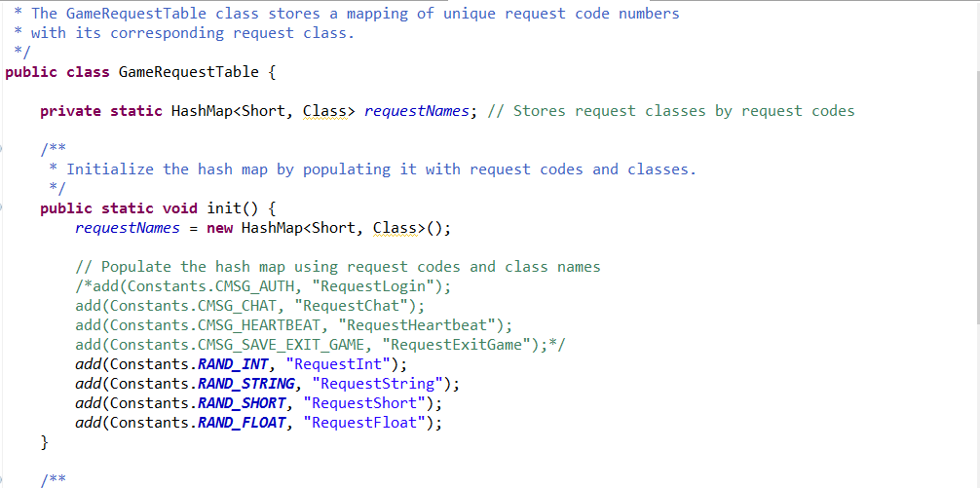
GameRequestTable

Slide 21
Request/Response Codes
Constants Class holds all the request and response codes. Whenever you create a new subclass you should add its request or response code to the Constants.

Slide 22
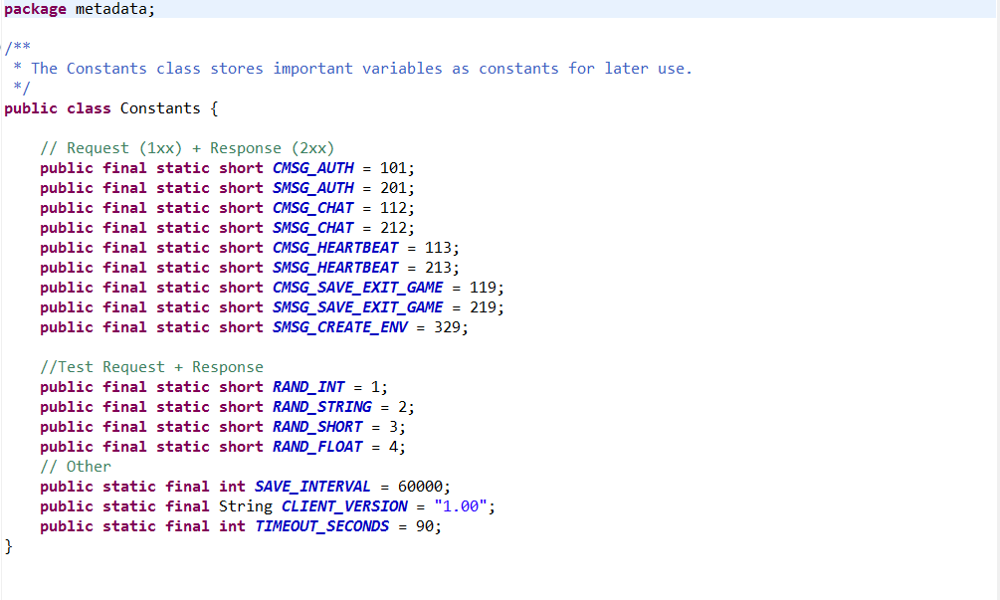
Request/Response Codes

Slide 23
Running Order
Start GameServer
When connection is made creates instance of GameClient
GameClient listens to connection for datagrams
After receiving datagram takes request code and matches it to GameRequest subclass
GameRequest object gets the data stream then uses parse()

Slide 24
Running Order
After data is parsed GameClient runs GameRequest's doBusiness method
GameResponses are created and put into either the response list of the GameRequest or the update queue of other GameClients.

Slide 25
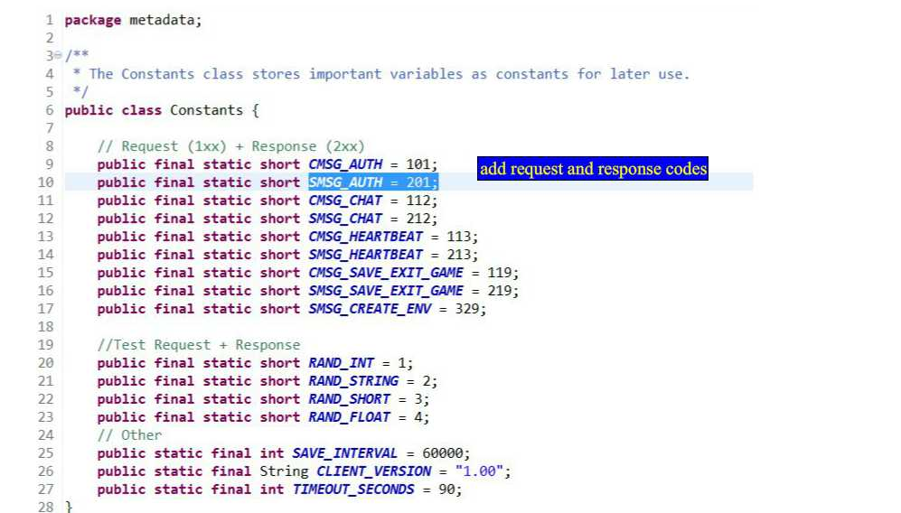

Slide 26
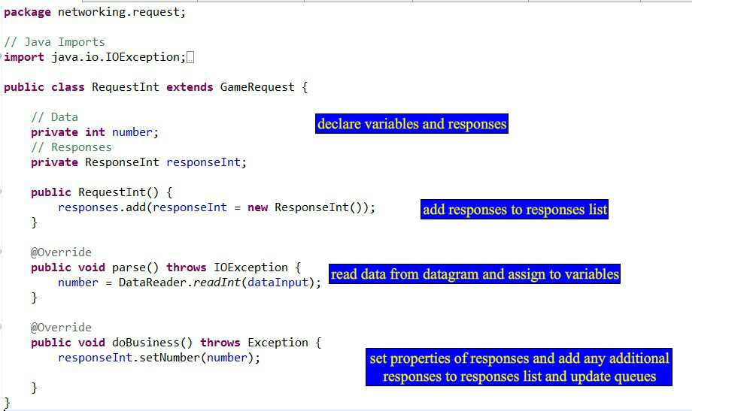

Slide 27
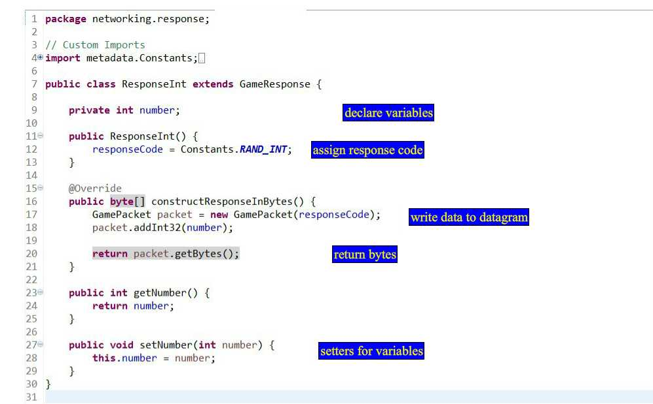

Slide 28
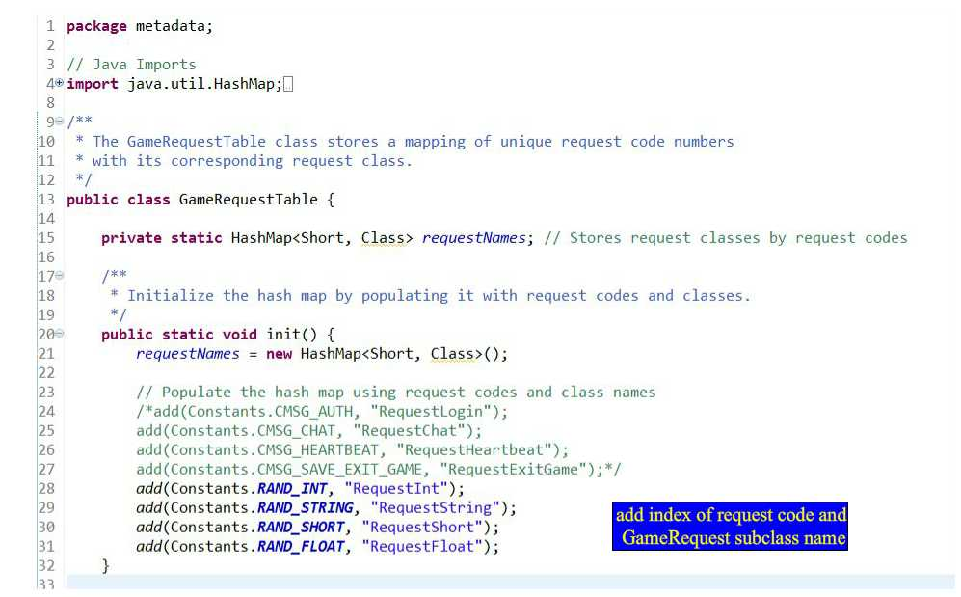

Slide 29
Happy Coding!
When creating a GameRequest subclass
  Add request code to Constants class
  Add request code and subclass name to GameRequestTable
When creating a GameResponse subclass
  Add response code to Constants class

