Slide 1







Class – Power Point Presentation
Group - 01
COORDINATING TEACHER
Dr. Akanksha Shukla
STUDENTS
Ashish Kumar Raj Kumar Verma Rajat Raj
Chandra Bhan Rupesh kumar
Jatin Gambhir Zeno Sonal
Management – as Art or Science

Slide 2









Contents
Introduction to Management
Management as an Art
Management as a Science
Comparison
Conclusion
Bibliography

Slide 3




















What is Management
The verb 'manage'
comes from the Italian
maneggiare (to handle, especially tools), which derives from the Latin word manus (hand).
Management is often included as a factor of
production along with machines, materials and money.

Slide 4















Management as an Art
According to Mary Parker
Follett, Harold Koontz
and several others management authors called management “An Art of getting things done through people”.

Slide 5




Management is an art due to the following reasons:
Practical knowledge
Personal skill
Creativity

Slide 6


Perfection through practice
Goal Oriented

Slide 7



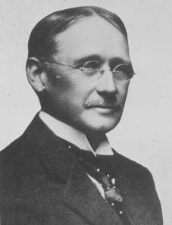
Management as a Science
Science is a systematic body of knowledge which is universally accepted.
F.W. Taylor father of scientific management was perhaps the first person to consider management as a science.

Slide 8












Sciences can be broadly
divided into two groups:
Physical Sciences
Social Sciences
Management is a social science because it deals with human beings.

Slide 9





























Frederick W. Taylor’s principles of
scientific management
Managers must:
Study the way that workers perform their tasks
Understand the job knowledge that workers have
Find ways to improve how tasks are performed
Give written work rules
Hire workers who have skills and abilities needed for the tasks to be completed
Train workers to perform according to the established procedures
Establish a level of performance acceptable and fair linked to a good pay system

Slide 10

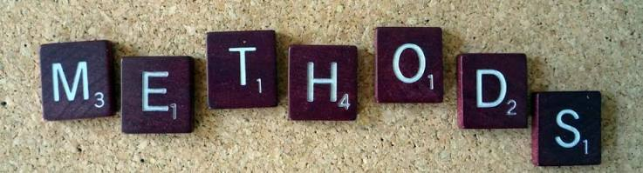

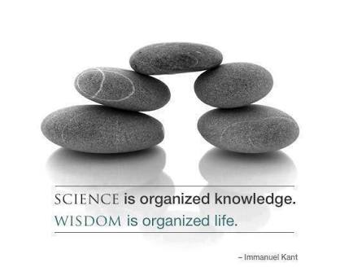

Management is a science due to the following reasons:
Concepts
Methods and Principles
Theories
Organized Knowledge
Practice

Slide 11






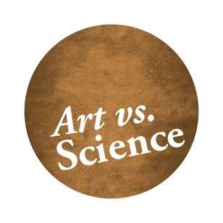
as an Art vs. as a
Science
Art:
based on practice and creativity.
It is a theoretical body of knowledge.
Has personalized application.
Science:
based on experimentation.
It is a systemized body of knowledge.
Has universal application.

Slide 12





Conclusions
From the study above, we say that:
management is both, art and science.
According to ASME (American Society of
Mechanical Engineers):
“Management is the art and the science of preparing, organizing and directing human efforts to control the forces and utilize the material of nature for the benefit of men.”
Management has got two faces like a coin; on one side it is art and on the other side it is science.
“Management is a mixture of an art and science – the present ratio is about 80% art and 20% science.” – Dean Stanley.

Slide 13





Bibliography
www.enotes.com
www.wikipedia.org www.classle.net www.google.ro

