Slide 1
Prediction of heart diseases using classification Mentor - Dr Tanupriya Chowdhury Prepared by - Rahul Jain Shweta Rawat Adarsh Mundra

Slide 2
An Introduction
Classification is a classic data mining technique based on machine learning. Basically, classification is used to classify each item in a set of data into one of a predefined set of classes or groups.
Classification method makes use of mathematical techniques such as decision trees, KNN, neural network, and statistics.

Slide 3
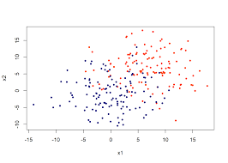
Classification is all about plotting the data points and finding out the line that best fits the data so that for a new input variable we can predict the output for that.

Slide 4

Motivation
We are in the era of “Information age” where terabytes of data are produced and stored everyday because of fast growth in “Information Technology”.
Huge amount of data is being generated by hospitals such as heart paining results, x-ray, chest pain results, blood pressure etc.

Slide 5
Motivation
The motivation of this project is to predict heart diseases using data mining techniques like KNN, Naive Bayes etc. and visualizing the results using one of the famous analysis tool ‘MS Excel’..

Slide 6
Proposed method (an overview)
Getting a good dataset is the completion of 70% of your work. The work starts from gathering a good dataset and loading it in our work space followed by data preprocessing. Below are the steps or modules to be followed in the work.
Load the Dataset
2. Data Preprocessing
Splitting the data into train and test sets
Build the Classifier
Prediction and visualization

Slide 7
Algorithm
Let number of training data samples = n
new observation = m
1. Data points are stored in arr[]
2. for i= 0 to n calculate euclidean distance between m and other data points
sqrt((arr[i].x -m.x)*(arr[i].x - m.x) + (arr[i].y - p.y) * (arr[i].y - m.y));
3. Make set A of K smallest distances obtained.
4. Return the majority label among A.

Slide 8
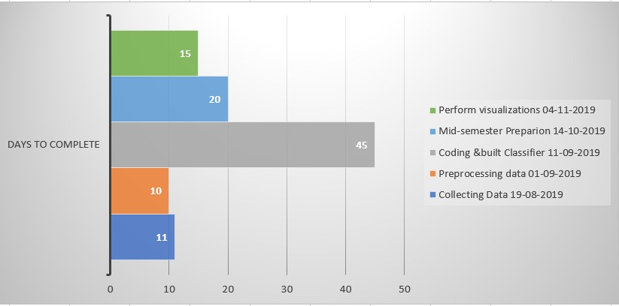
Plan of work

Slide 9

Objective
Our objective being effectively using the important data that is generated from the hospitals to find patterns using a well known Data mining algorithm known as KNN . Heart disease is no doubt has the largest proportions of deaths in the world and researchers are continuously working in this field to find a way out to solve this problem. We discovered some new methods to load the data sets, pre process the data and build the classifier in C language and also tried to minimize the time complexity of our code.

Slide 10
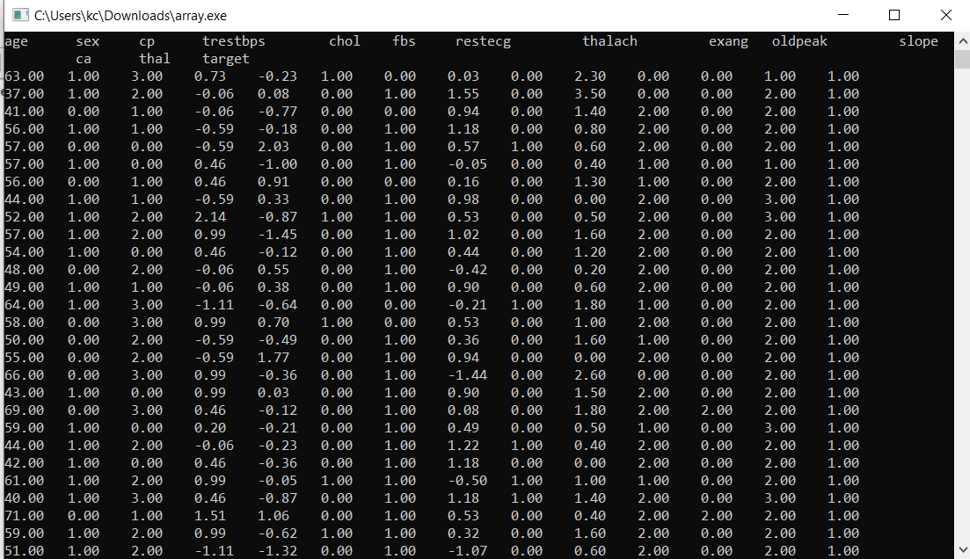
Output

Slide 11
References
1. C. Ordonez, “Association rule discovery with the train and test approach for heart disease prediction,” IEEE transactions on Information technology in biomedicine: a publication of the IEEE Engineering in Medicine and Biology Society, vol. 10, no. 2,pp.334–43,Apr.2006.
2. Klosgen W and Zytkow J M (eds.), Handbook of data mining and knowledge discovery, OUP, Oxford, 2002
3. Vikas Chaurasia, and Saurabh Pal, Data Mining Approach to Detect Heart Dieses, International Journal of Advanced Computer Science and Information Technology, Vol. 2, No. 4, pp. 56- 66, 2013.

Slide 12
Thank you

