Slide 1
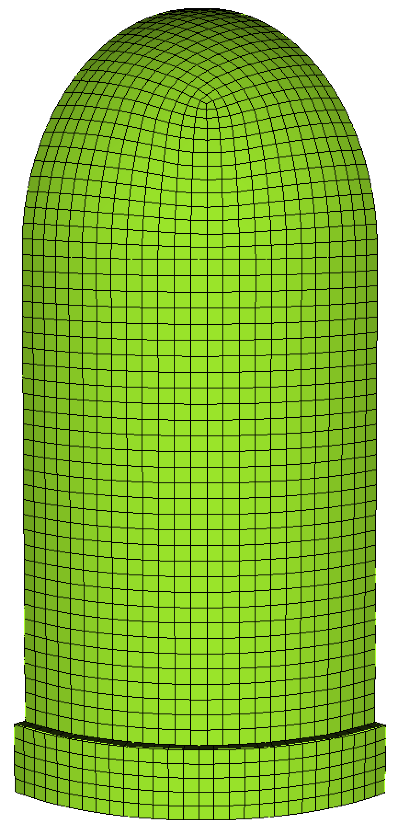
Dome tangential
Dome vertical
Cylinder tangential
Cylinder vertical

