Slide 1
Travel ai agent
IBM ACITE PROJECT
Student Name: Arihant Jain
Collage Name: Kanpur Institute Of Technology
Department: Computer Science (Aiml)

Slide 2
OUTLINE
Problem Statement
Technology used
Wow factor
End users
Result
Conclusion
Git-hub Link
Future scope
IBM Certifications

Slide 3
Problem Statement
Organizing travel can be overwhelming with so many details like costs, climate, getting around, places to stay, and sights to see.
An intelligent travel assistant powered by AI can take the hassle out by crafting tailored trip plans based on the latest information.
This system should capture what the traveler wants, recommend spots and schedules, suggest lodging and transport options, and quickly adjust for delays or weather — all while sticking to the traveler’s schedule and budget.

Slide 4
Technology used
IBM cloud lite services
Natural Language Processing (NLP)
Retrieval Augmented Generation (RAG)
IBM Granite model

Slide 5
IBM cloud services used
IBM Cloud Watsonx AI Studio
IBM Cloud Watsonx AI runtime
IBM Cloud Agent Lab
IBM Granite foundation model

Slide 6
Wow factors
AI-Crafted Travel Plans Powered by IBM Granite LLM, the system creates intelligent, customized itineraries based on what users provide. No need for tedious searching — the assistant handles the planning automatically.
Up-to-the-Minute Updates The planner integrates live data such as weather conditions, transportation options, and local happenings, allowing the itinerary to adjust in real time. Travelers receive current information throughout their trip.
Interactive Conversation Interface With a chatbot driven by Watson Assistant, users can organize their trips through natural dialogue. No complicated forms or menus—just simple, intuitive conversations.
Manages Complex Requirements The system takes into account user preferences like budget, timing, and accessibility needs, delivering practical and feasible travel plans that fit within these limits.

Slide 7
End users
Solo Explorers
Families and Travel Parties
Corporate and Business Visitors
Travel Professionals and Tour Companies
Adventure Seekers and Specialty Travelers

Slide 8
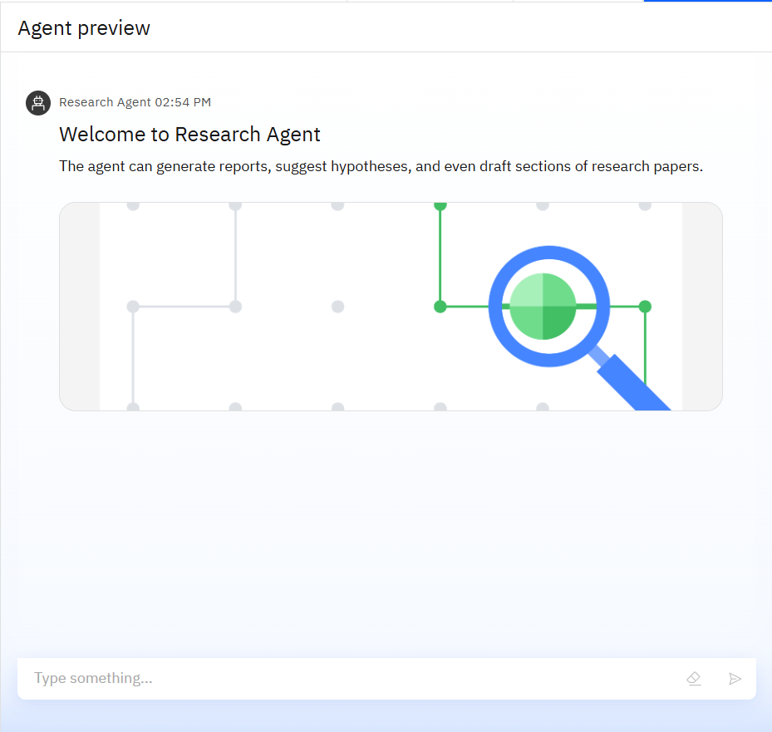
Results

Slide 9
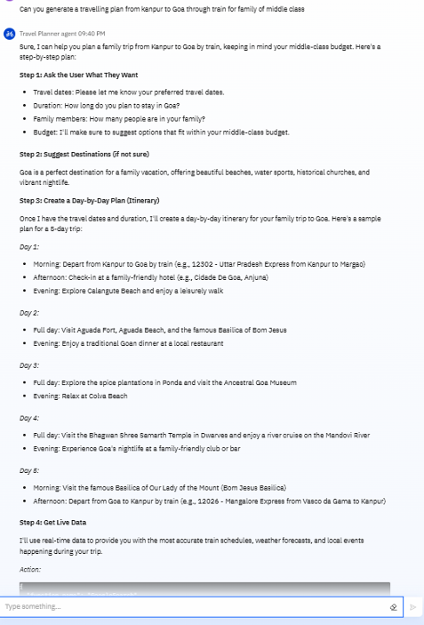
Results

Slide 10
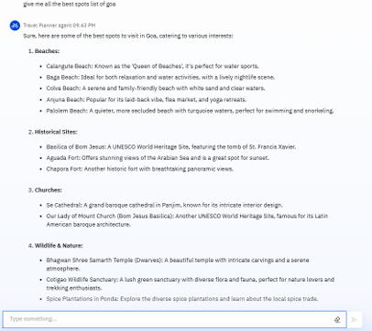
Results

Slide 11
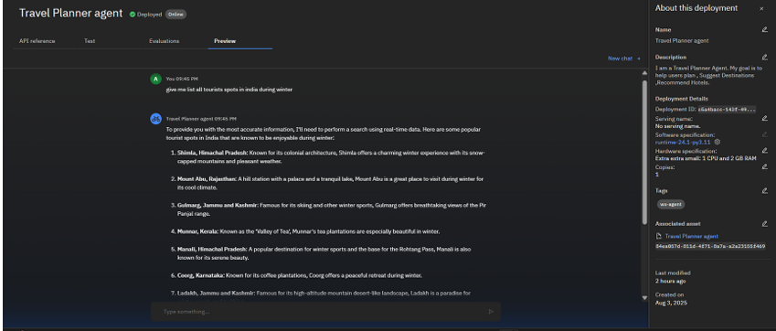
Results
Deployed AI Agent

Slide 12
Conclusion
The Travel AI Agent illustrates how artificial intelligence can transform travel planning and experiences.
By merging individual preferences with up-to-date information on weather, transportation, lodging, and nearby attractions, the agent creates fully customized, efficient, and flexible travel itineraries.
Built using IBM Cloud Lite services and the Granite foundation model, this solution highlights the power of agent-based AI to streamline complicated and time-intensive tasks.
It not only alleviates the hassle of manual planning but also enhances the journey through intelligent suggestions and real-time assistance.

Slide 13
GitHub Link
https://github.com/jainArihant12/TripWise.git

Slide 14
Future scope
Hands-Free Interaction: Incorporate voice input and output capabilities for effortless trip planning on the go.
Multilingual Capabilities: Support a variety of languages to cater to an international audience.
Live GPS Tracking: Enable real-time navigation updates and offer suggestions based on the traveler’s current whereabouts.
Adaptive Recommendation Engine: Improve future travel advice automatically by learning from user feedback and usage patterns.
Integrated Travel Solutions: Connect with APIs for essential services like visa applications, insurance, and currency exchange.
Mobile Platform: Launch a comprehensive mobile app to enhance accessibility for all users.

Slide 15
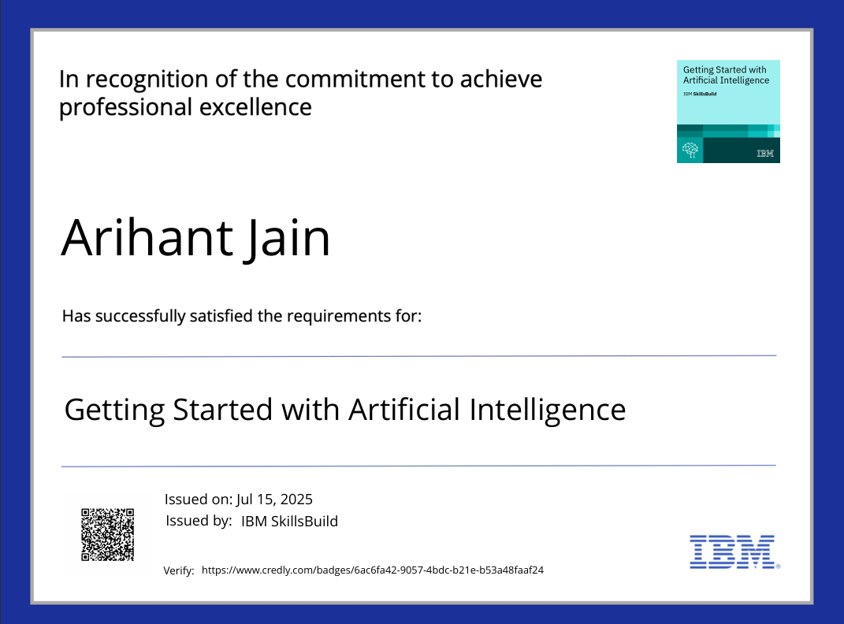
IBM Certifications

Slide 16
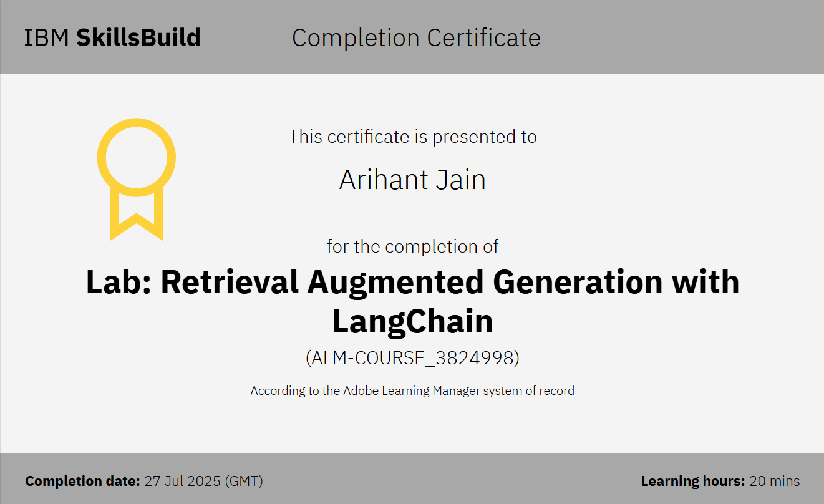

Slide 17
THANK YOU

