Slide 1

Lending Club Case Study:

Slide 2



Group: Individual Name: Vishal Jain

Slide 3
Agenda
Problems: I have lending loan data of consumer finance company which are providing various type of loan to urban customers. When the company receives a loan application, the company has to make a decision for loan approval based on the applicant’s profile. Two types of risks are associated with the bank’s decision.
If the applicant is likely to repay the loan, then not approving the loan results in a loss of business to the company.
If the applicant is not likely to repay the loan, i.e. he/she is likely to default, then approving the loan may lead to a financial loss for the company.
The data given contains the information about past loan applicants and whether they ‘defaulted’ or not. The aim is to identify patterns which indicate if a person is likely to default, which may be used for taking actions such as denying the loan, reducing the amount of loan, lending (to risky applicants) at a higher interest rate, etc.
I will use EDA to understand how consumer attributes and loan attributes influence the tendency of default.
When a person applies for a loan, there are two types of decisions that could be taken by the company:
1. Loan accepted: If the company approves the loan, there are 3 possible scenarios described below:
1. Fully paid: Applicant has fully paid the loan (the principal and the interest rate)¶
2. Current: Applicant is in the process of paying the instalments, i.e. the tenure of the loan is not yet completed. These candidates are not labelled as 'defaulted'.
3. Charged-off: Applicant has not paid the instalments in due time for a long period of time, i.e. he/she has defaulted on the loan
2. Loan rejected: The company had rejected the loan (because the candidate does not meet their requirements etc.). Since the loan was rejected, there is no transactional history of those applicants with the company and so this data is not available with the company (and thus in this dataset)

Slide 4
Agenda
I have bank loan history data in csv format where I have to do the analysis on approved loan on the behalf of many features.
I have done analysis on the behalf of below process:
Data Cleaning
Data sanity Testing
Binning
Deciding Target Frames
Univariate Analysis
Multivariate Analysis
Conclusion

Slide 5
Lending Club: EDA Case Study
Data Cleaning
I removed attached irrlevant-variables-removed.txt file features from loan data frames
I imputed emp_length feature from median that needs to be imputed since its low number to drop these values.
I have handled data type conversion for features: emp_length, term, int_rate etc.
I have dropped some records due to missing values into emp_title etc.

Slide 6
Lending Club: EDA Case Study
Sanity Check
I have filtered data and do some sanity testing like funded amount should not be equal or less than zero etc.
eg: loandf.funded_amnt_inv > 0
Deciding Target Frames
I am extracting 2 target frames using below loan status:
Fully Paid
Charged off

Slide 7
Lending Club: EDA Case Study
Binning
I have created binning for interest rate, funded amount, annual amount to identify the relation with deciding factor.
Univariate Analysis
I have done univariate analysis on the behalf of some of the important fields like Annual Income, Funded Income Inv, Verification Status, Grade, Interest rate etc.
I can achieve univariate analysis with the help of boxplot, pie chart, bar plot etc.
I am using univariate analysis to identify the frequency order, outliers etc.

Slide 8
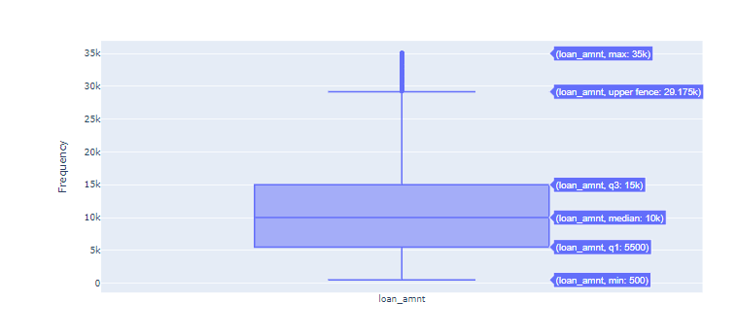
Lending Club: EDA Case Study
Loan Amount
Loan Amount
Please have a look below stats:
count 37057.000000
mean 11230.901044
std 7383.178753
min 500.000000
25% 5500.000000
50% 10000.000000
75% 15000.000000
max 35000.000000
Name: loan_amnt, dtype: float64

Slide 9
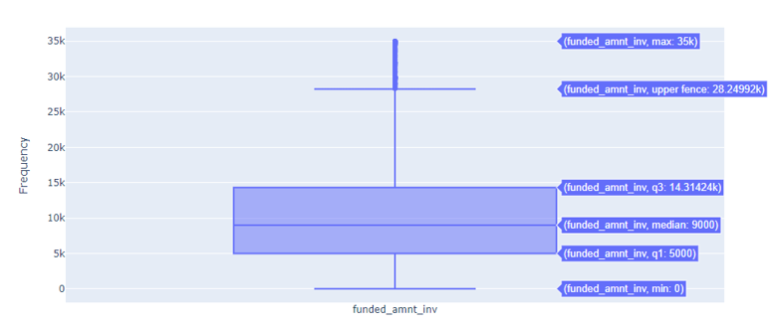
Lending Club: EDA Case Study
Loan Amount
Funded Amount Inv
Please have a look below stats:
count 36844.000000
mean 10357.971056
std 7017.898541
min 0.000000
25% 5000.000000
50% 9000.000000
75% 14313.362500
max 35000.000000
Name: funded_amnt_inv, dtype: float64

Slide 10
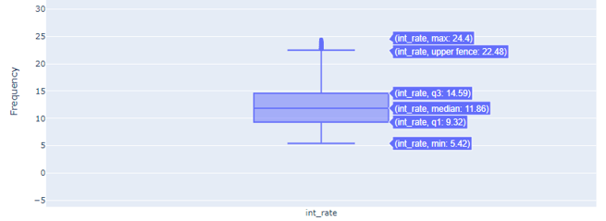
Lending Club: EDA Case Study
Loan Amount
Interest rate
Please have a look stats:
count 36844.000000
mean 12.039300
std 3.709402
min 5.420000
25% 9.320000
50% 11.860000
75% 14.590000
max 24.400000
Name: int_rate, dtype: float64

Slide 11
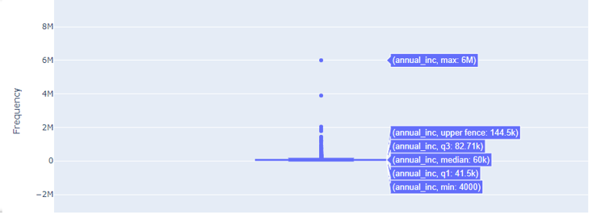
Lending Club: EDA Case Study
Loan Amount
Annual Income
Please have a look stats:
count 36844.000000
mean 65592.048841
std 34142.373826
min 4000.000000
25% 41000.000000
50% 59000.000000
75% 81000.000000
max 224000.000000
Name: annual_inc, dtype: float64

Slide 12
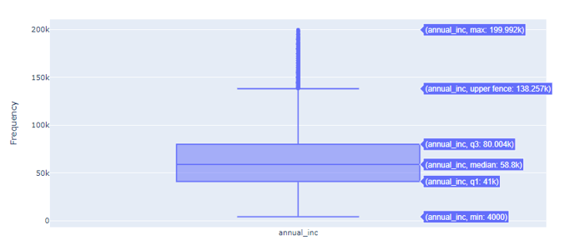
Lending Club: EDA Case Study
Loan Amount
Annual Income
Annual income after removing the outliers. Please have a look stats:
count 36634.000000
mean 64792.179819
std 32555.369624
min 4000.000000
25% 41000.000000
50% 58800.000000
75% 80004.000000
max 199992.000000
Name: annual_inc, dtype: float64

Slide 13
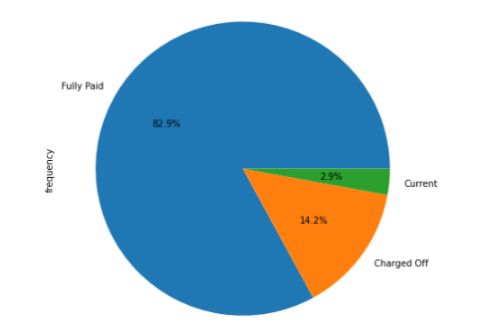
Lending Club: EDA Case Study
Loan Amount
Loan Status Frequency
We can see here stats of Loan status:
Fully Paid: 82.9%
Current: 2.9%
Charged Off: 14.%

Slide 14
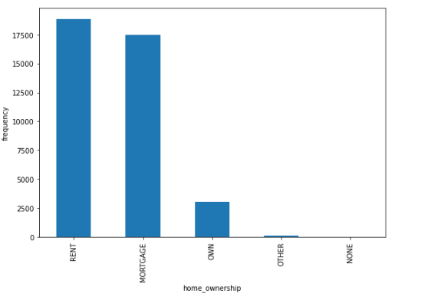
Lending Club: EDA Case Study
Loan Amount
Home Ownership Frequency
We can see here stats of Loan status:
count 39494
unique 5
top RENT
freq 18848
Name: home_ownership, dtype: object

Slide 15
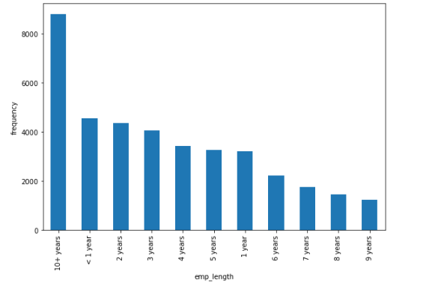
Lending Club: EDA Case Study
Loan Amount
Emp Length Frequency
We can see here stats of Loan status:
count 38422
unique 11
top 10+ years
freq 8796
Name: emp_length, dtype: object

Slide 16
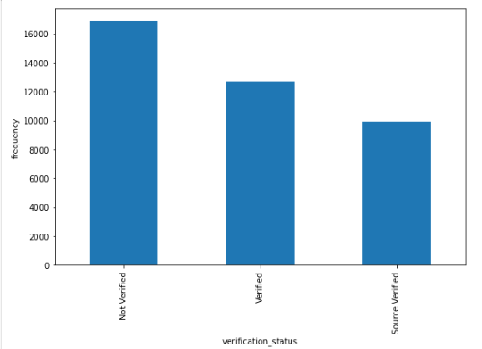
Lending Club: EDA Case Study
Loan Amount
Verification Status Frequency
We can see here stats of Loan status:
count 39494
unique 3
top Not Verified
freq 16860
Name: verification_status, dtype: object

Slide 17
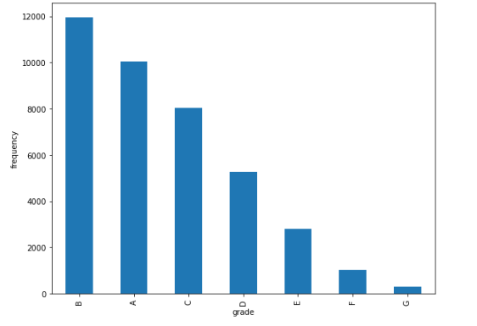
Lending Club: EDA Case Study
Loan Amount
Grade Frequency
We can see here stats of Loan status:
count 39494
unique 7
top B
freq 11967
Name: grade, dtype: object

Slide 18
Lending Club: EDA Case Study
Loan Amount
Multivariate Analysis
We are performing multivariate analysis to identify the correlation status among the features.
Create the Heatmap identify the correlation
Observation
We are creating the heatmap to identify the correlation.
We can see Loan Amount is highly correlated with Funded Amount Inv

Slide 19
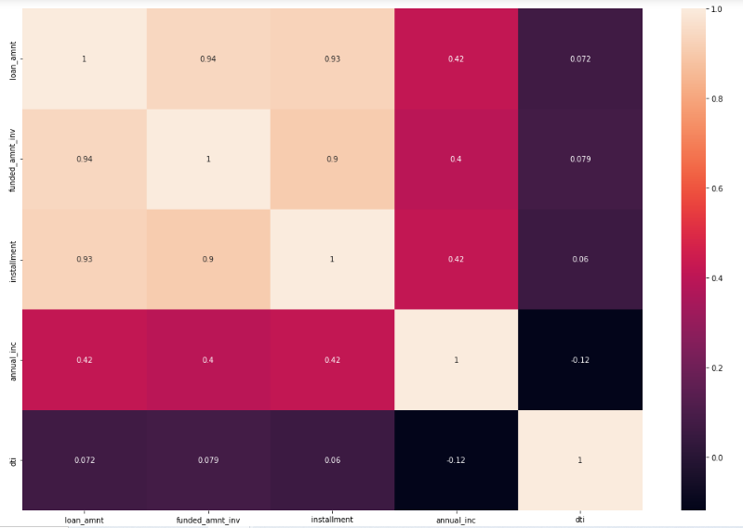
Lending Club: EDA Case Study
Loan Amount

Slide 20
Lending Club: EDA Case Study
Loan Amount
Identify Purpose Of Loan VS Loan Amount per loan status: Boxplot
Observation:
Small Business: We can not see any clear indication of outliers for Small Business. So Bank should do more analysis while giving the loan.
We can see that Others and Major Purchase categories have lots of outliers which can be contribute more losses.

Slide 21
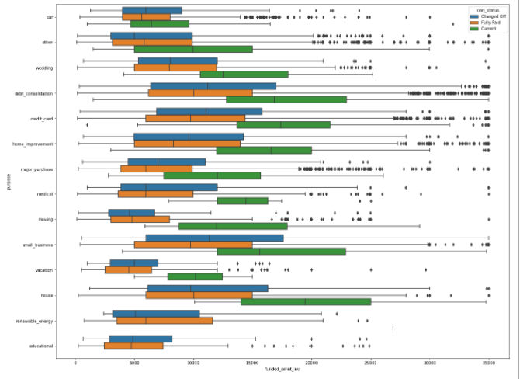
Lending Club: EDA Case Study
Loan Amount

Slide 22
Lending Club: EDA Case Study
Employee Length VS Loan Status: Bar plot
Observation
Loan taken in maximum number whose employee length is >= 10 Years. 18 % Loan has been taken.
Loan taken in minimum number whose employee length is 1 year as compared to others[0 to 5 years] and has low defaulting rate.

Slide 23
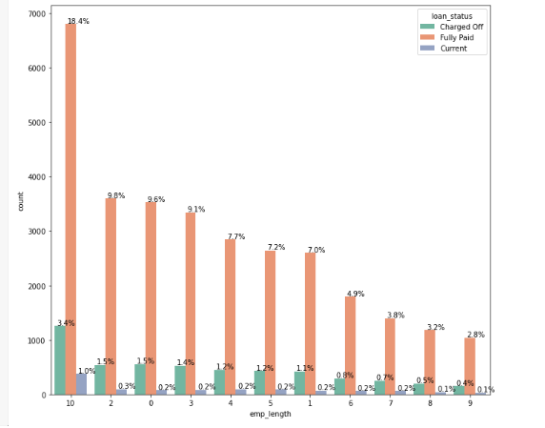
Lending Club: EDA Case Study
Loan Amount

Slide 24
Lending Club: EDA Case Study
Loan Amount
Employee Length V/S Funded Amount For Loan Purpose: Boxplot
Observation
Loan taken in maximum number whose employee length is >= 10 Years. 18 % Loan has been taken.
Loan taken in minimum number whose employee length is 1 year as compared to others[0 to 5 years] and has low defaulting rate.

Slide 25
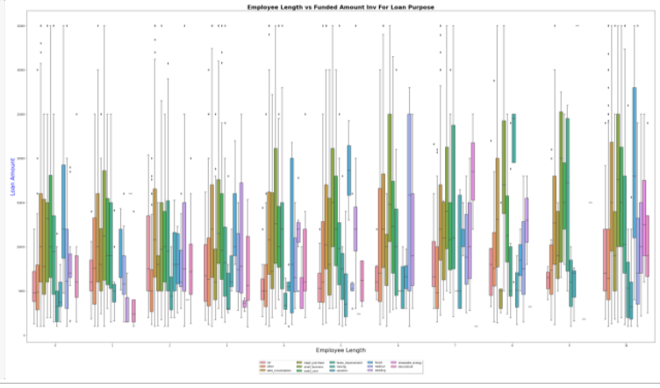
Lending Club: EDA Case Study
Loan Amount

Slide 26
Lending Club: EDA Case Study
Loan Amount
Driving Variables Contributing to Loan Default
Observation:
Identifying probability of risky applicants through variables that are responsible for triggering defaulters
Below Variables might trigger "Charged-Off":
1. employment length -----> Categorical Variable
2. grades ------> Categorical Variable
3. purpose ------> Categorical Variable
4. loan_amnt -----> Categorical Variable ( After Conversion )
5. int_rate -----> Categorical Variable ( After Conversion )
6. annual_inc -----> Categorical Variable ( After Conversion )

Slide 27
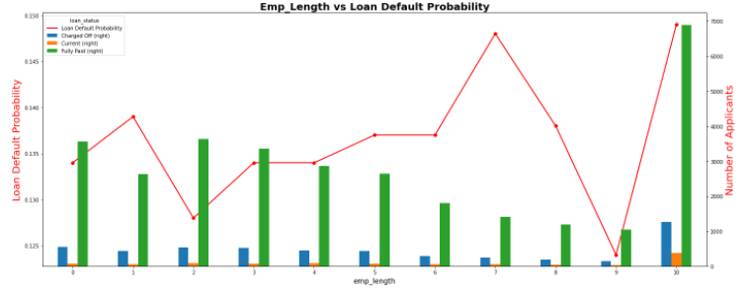
Lending Club: EDA Case Study
Loan Amount
Employee length vs Default Probability

Slide 28
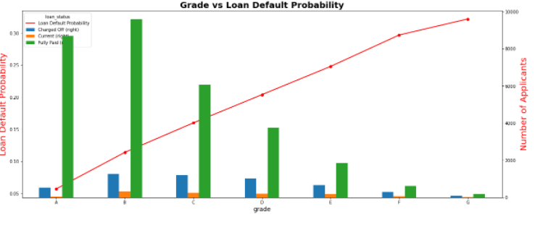
Lending Club: EDA Case Study
Loan Amount
Grade vs Default Probability

Slide 29
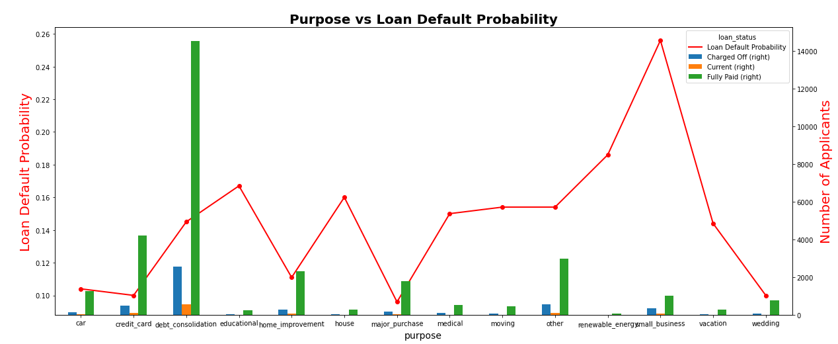
Lending Club: EDA Case Study
Loan Amount
Purpose vs Default Probability

Slide 30
Lending Club: EDA Case Study
Loan Amount
Driving Variables Contributing to Loan Default
We have observed many things from above 3 slides:-
1. Employee length vs Default Probability Observation:
Less Defaulter rate when your employee length is 9 years
Higher Defaulter rate for employee length >= 10 years
2. Grades with default chances Observation :-
From grade A to G , Loan Probability Defaulter increasing
3. Purpose With Default Chances Observation :-
We can see that , most of the loan default probability is seen for small_business, so bank should be extra careful while approving the loan for such businesses
Minimum defaulter rate showing for Major Purchase

Slide 31
Lending Club: EDA Case Study
Loan Amount
BINNING AS WE FOUND OUTLIERS EARLIER IN ANNUAL INCOME
Annual Income range vs Loanda default Probability
We can see, as annual income is increasing , probabality of being defaulter is also increasing , reaching up to 19%
Interest Rate vs Loan Defaulter Probability
We can see that , as interest rate is increasing , chance of being defaulter is also increasing , when the interest rate touches more than 15% , risk of default rate is increasing
funded_amnt_range vs Loan Defaulter Probability
We can see that default rate is increasing , when the loan amount/funded amount is increasing at the alarming rate

Slide 32
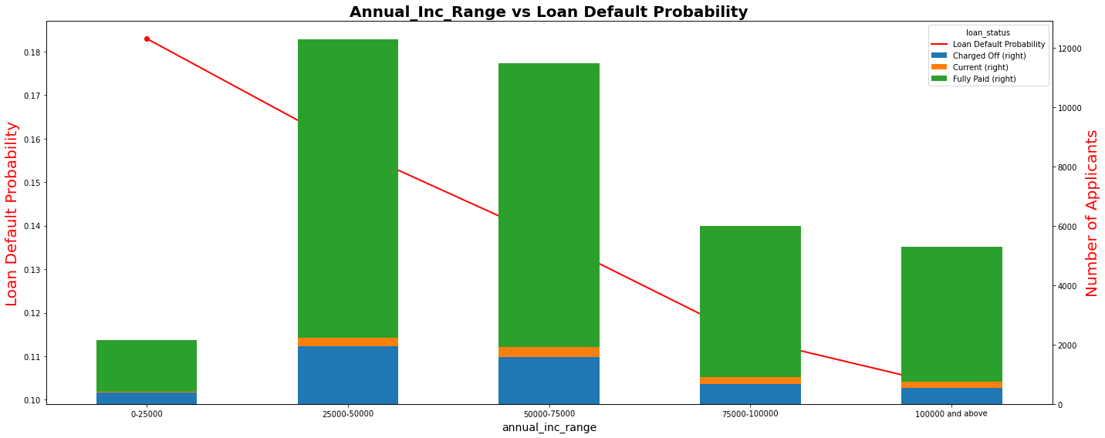
Lending Club: EDA Case Study
Loan Amount
Annual Income Range chance to be defaulter

Slide 33
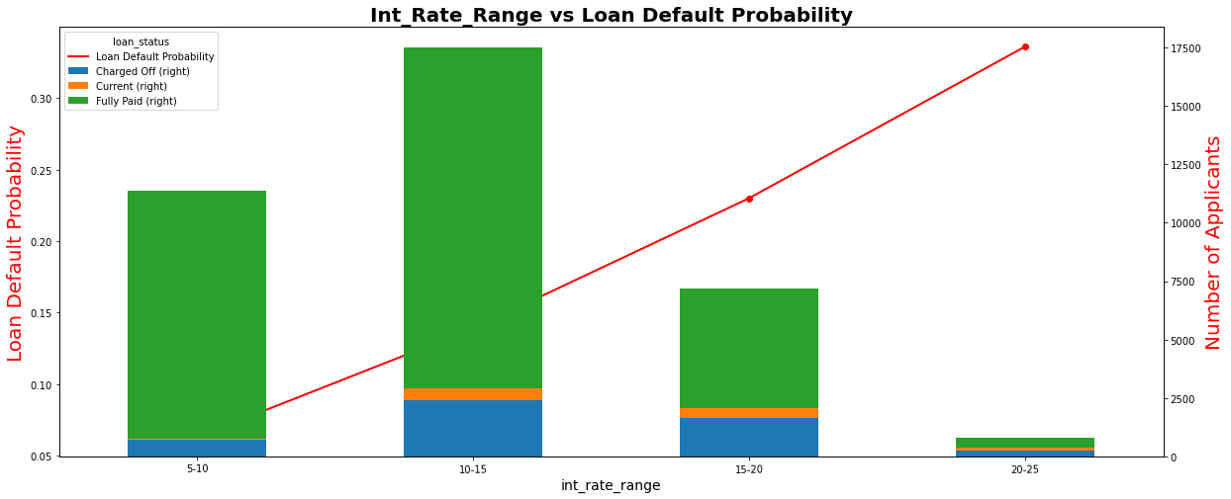
Lending Club: EDA Case Study
Loan Amount
Interest Range and chance to be defaulter

Slide 34
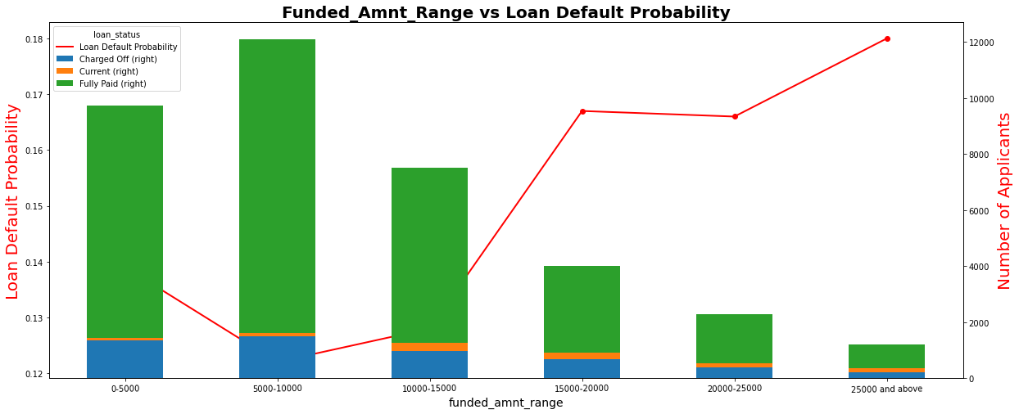
Lending Club: EDA Case Study
Loan Amount
Loan Amount ( Approved Amount ) and chance of being defaulter

Slide 35
Lending Club: EDA Case Study
Loan Amount
Case Study Conclusion
1. Defaulter rate is higher when employee length are 1 year, 7 years, and >=10 years.
2. Minimum defaulter rate exist for 9 years employee length.
3. Maximum defaulter rate for employee length >=10 years.
4. Grade is proportional to Loan Defaulter Probability.
5. We can see that , most of the loan default probability is seen for small_business,so bank should be extra careful while approving the loan for such businesses
6. Minimum defaulter rate showing for Major Purchase purpose.
7. We can see, as annual income is @[proportional to] probability of being defaulter. It is reaching up to 19%
8. We can see that as interest rate is increasing chance of being defaulter is also increased. when the interest rate touches more than 15% , risk of default rate is increasing
9. We can see that default rate is increasing , when the loan amount/funded amount is increasing at the alarming rate

Slide 36
#LifeKoKaroLift
Thank You!

