Slide 1
Welcome to the (ISC)2 Certified Information Systems Security Professional (CISSP) Training Course

Slide 2
Course Agenda
Domain 1: Security and Risk Management
Domain 2: Asset Security
Domain 3: Security Architecture and Engineering
Domain 4: Communication and Network Security
Domain 5: Identity and Access Management (IAM)
Domain 6: Security Assessment and Testing

Slide 3
Course Agenda (continued)
Domain 7: Security Operations
Domain 8: Software Development Security

Slide 4
Communication and Network Security
Domain 4

Slide 5
^{Domain Objectives}
Name the layers of the Open Systems Interconnection (OSI) and Transport Control Protocol/Internet Protocol (TCP/IP) network models.
Compare the differences and similarities between the Open Systems Interconnection (OSI) and Transport Control Protocol/Internet Protocol (TCP/IP) network models.
List the concepts and architecture that define the associated technology and implementation systems and protocols at Open Systems Interconnection (OSI) model layers 1–7.

Slide 6
^{Domain Objectives (continued)}
Define related threats and select appropriate countermeasures for systems and protocols operating at Open Systems Interconnection (OSI) model layers 1–7.
Identify technological implementations that provide services to support mobility and collaboration.
Describe various network services that abstract and virtualize underlying components and infrastructure and associate service benefits.
Recognize relevant network components used to secure communications and differentiate use based upon requirements.

Slide 7
^{Domain Objectives (continued)}
Demonstrate use of secure network components as countermeasures in response to specific threats associated with the Open Systems Interconnection (OSI) model layers 1–7.
Define secure communications channels that support remote access services and collaboration.

Slide 8
Domain Agenda
Secure Design Principles in Network Architectures
OSI Layer 2: Data Link Layer
OSI Layer 3: Network Layer
OSI Layer 4: Transport Layer
OSI Layer 1: Physical Layer
OSI Layer 5: Session Layer

Slide 9
Domain Agenda (continued)
OSI Layer 6: Presentation Layer
Service Considerations
Secure Network Components
Secure Communication Channels According to Design
Domain Review
OSI Layer 7: Application Layer

Slide 10
Secure Design Principles in Network Architectures
Module 1

Slide 11
Module Objectives
Name the layers of the Open Systems Interconnection (OSI) and Transport Control Protocol/Internet Protocol (TCP/IP) network models.
Compare the differences and similarities between the Open Systems Interconnection (OSI) and Transport Control Protocol/Internet Protocol (TCP/IP) network models.

Slide 12
Architecture and Design
ISO/IEC 7498 consist of the following parts:
Part 1: The Basic Model
Part 2: Security Architecture
Part 3: Naming and Addressing
Part 4: Management Framework

Slide 13
Open Systems Interconnection (OSI) Model

Slide 14
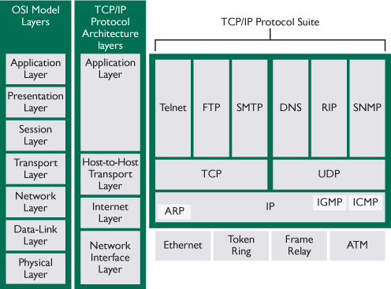
TCP/IP Model Compared to OSI Model

Slide 15
OSI Layer 1: Physical Layer
Module 2

Slide 16
Module Objectives
List the concepts and architecture that define the associated technology and implementation systems and protocols at Open Systems Interconnection (OSI) model layers 1–7. (Physical Layer)
Define related threats and select appropriate countermeasures for systems and protocols operating at Open Systems Interconnection (OSI) model layers 1–7. (Physical Layer)

Slide 17
Concepts and Architecture
OSI Layer 1: Physical Layer
Bits are encoded and decoded
Signals include light, radio, and electrical
Baseband or broadband

Slide 18
Concepts and Architecture (continued)
Network Topologies
Bus
Tree
Ring
Mesh
Star

Slide 19
Concepts and Architecture (continued)
Carrier Sense Multiple Access (CSMA)
Carrier Sense Multiple Access with Collision Detection (CSMA/CD)
Wired Technology
Carrier Sense Multiple Access with Collision Avoidance (CSMA/CA)
Wireless Technology

Slide 20
Technology and Implementation
Wired (LAN/WAN)
Concentrators, multiplexers, hubs, and repeaters
Token Ring (IEEE 802.5)
Fiber Distributed Data Interface (FDDI)
Twisted pair
Coaxial cable
Fiber optic

Slide 21
Technology and Implementation (continued)
Wired (internet)
Digital Subscriber Lines (DSLs):
Asymmetric Digital Subscriber line (ADSL)
Rate-Adaptive DSL (RADSL)
Symmetric Digital Subscriber Line (SDSL)
Very High Bit Rate DSL (VDSL)

Slide 22
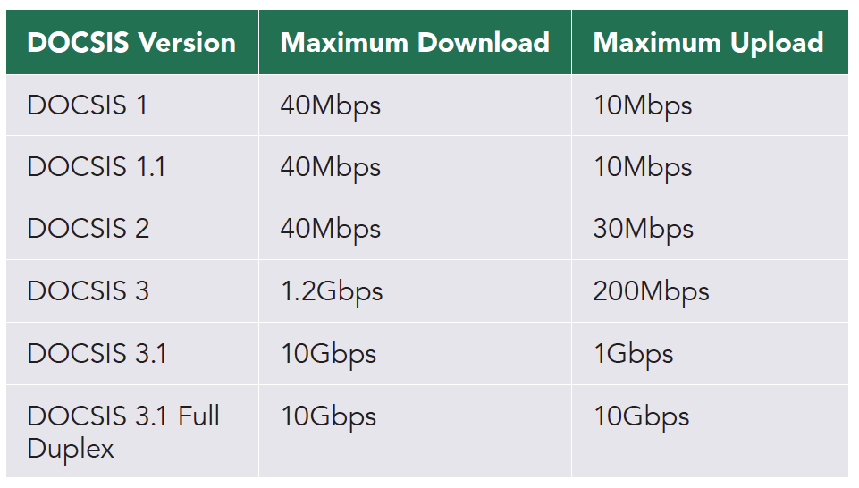
Technology and Implementation (continued)
Wired (internet)
Cable modem

Slide 23
Technology and Implementation (continued)
Wired (internet)
Broadband over Powerline (BPL)
Broadband over med–low electrical power
Speeds comparable to DSL
Significant potential improbable implementation

Slide 24
Technology and Implementation (continued)
Wireless (LAN/WAN)
Wi-Fi (Wireless LAN IEEE 802.11x)
Bluetooth (Wireless Personal Area Network IEEE 802.15)
WiMAX (Broadband Wireless Access IEEE 802.16)
Satellite

Slide 25
Technology and Implementation (continued)
Wireless (cellular)
Code-division multiple access (CDMA)
Global System for Mobiles (GSM)

Slide 26
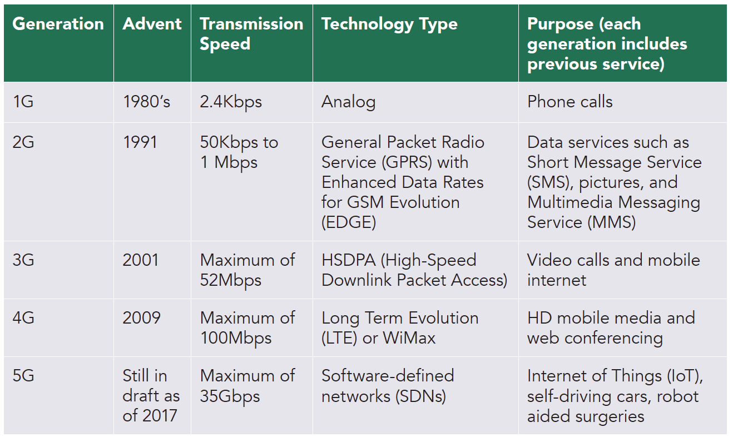
Technology and Implementation (continued)

Slide 27
Threats and Countermeasures
Physical Layer Technology
Unshielded Twisted Pair (UTP)
Shielded Twisted Pair (STP)
Coaxial Cable
Cellular
Fiber Optic Cable
Bus Topology
Ring Topology
Mesh Topology
Bluetooth
Note: Please refer to Table 4.2 on pages 351 and 352 in the Student Guide.

Slide 28
OSI Layer 2: Data-Link Layer
Module 3

Slide 29
Module Objectives
List the concepts and architecture that define the associated technology and implementation systems and protocols at Open Systems Interconnection (OSI) model layers 1–7. (Data-Link Layer)
Define related threats and select appropriate countermeasures for systems and protocols operating at Open Systems Interconnection (OSI) model layers 1–7. (Data-Link Layer)

Slide 30
Concepts and Architecture
Open Systems Interconnection (OSI) Layer 2: Data-Link Layer
Transmits data as frames
Media Access Control (MAC) Layer
Logical Link Control (LLC) Layer

Slide 31
Technology and Implementation
Protocols
Address Resolution Protocol (ARP)
Fibre Channel over Ethernet (FCoE)
Multiprotocol Label Switching (MPLS)

Slide 32
Technology and Implementation (continued)
Devices
Bridges
Switches
Virtual local area networks (VLANs)

Slide 33
Threats and Countermeasures
Data-Link Layer Technology
VLAN
Address Resolution Protocol (ARP)
Multicast
Spanning Tree Protocol
Note: Please refer to Table 4.3 on page 358 in the Student Guide.

Slide 34
OSI Layer 3: Network Layer
Module 4

Slide 35
Module Objectives
List the concepts and architecture that define the associated technology and implementation systems and protocols at Open Systems Interconnection (OSI) model layers 1–7. (Network Layer)
Define related threats and select appropriate countermeasures for systems and protocols operating at Open Systems Interconnection (OSI) model layers 1–7. (Network Layer)

Slide 36
Concepts and Architecture
OSI Layer 3: Network Layer
Transmits packets by logical address schemes
Unicast
Multicast
Broadcast

Slide 37
Technology and Implementation
Protocols
Internet Protocol (IPv4)/Internet Protocol (IPv6)
Internet Control Message Protocol (ICMP)
Internet Group Management Protocol (IGMP)
Open Shortest Path First (OSPF)

Slide 38
Technology and Implementation (continued)
Devices
Routers
Firewalls
Next-generation firewalls (NGFWs)

Slide 39
Threats and Countermeasures
Network Layer Technology
Firewall
Router
ICMP
IP Fragmentation
Note: Please refer to Table 4.4 on page 364 in the Student Guide.

Slide 40
OSI Layer 4: Transport Layer
Module 5

Slide 41
Module Objectives
List the concepts and architecture that define the associated technology and implementation systems and protocols at Open Systems Interconnection (OSI) model layers 1–7. (Transport Layer)
Define related threats and select appropriate countermeasures for systems and protocols operating at Open Systems Interconnection (OSI) model layers 1–7. (Transport Layer)

Slide 42
Concepts and Architecture
OSI Layer 4: Transport Layer
Transmits segments with end-to-end service delivery
Addresses quality of service (QoS) needs

Slide 43
Technology and Implementation
Protocols
Transmission Control Protocol (TCP)
User Datagram Protocol (UDP)
Well-Known Ports: Ports 0–1023
Registered Ports: Ports 1024–49151
Dynamic or Private Ports: Ports 49152–65535

Slide 44
Threats and Countermeasures
Transport Layer Technology
Transport Control Protocol (TCP) connection
UDP broadcast
Note: Please refer to Table 4.5 on page 367 in the Student Guide.

Slide 45
OSI Layer 5: Session Layer
Module 6

Slide 46
Module Objectives
List the concepts and architecture that define the associated technology and implementation systems and protocols at Open Systems Interconnection (OSI) model layers 1–7. (Session Layer)
Define related threats and select appropriate countermeasures for systems and protocols operating at Open Systems Interconnection (OSI) model layers 1–7. (Session Layer)

Slide 47
Concepts and Architecture
OSI Layer 5: Session Layer
Maintains persistent connections between hosts
Creates and tears down sessions.

Slide 48
Technology and Implementation
Protocols
PAP – password authentication protocol
PPTP – Point-to-Point Tunneling Protocol
RPC – remote procedure call protocol

Slide 49
Threats and Countermeasures
Session Layer
ISO 7498 -2 specifies that no security services are provided in the session layer.
Secure risky protocols that are still needed by means of encryption.

Slide 50
OSI Layer 6: Presentation Layer
Module 7

Slide 51
Module Objectives
List the concepts and architecture that define the associated technology and implementation systems and protocols at Open Systems Interconnection (OSI) model layers 1–7. (Presentation Layer)
Define related threats and select appropriate countermeasures for systems and protocols operating at Open Systems Interconnection (OSI) model layers 1–7. (Presentation Layer)

Slide 52
Concepts and Architecture
OSI Layer 6: Presentation Layer
Manages common encoding methods that include:
ASCII
EBCIDIC
Unicode (UTF 8)

Slide 53
Technology and Implementation
“Not only are people using UTF-8 for their pages, but Unicode encodings are the basis of the Web itself. All browsers use Unicode internally, and convert all other encodings to Unicode for processing. As do all search engines. All modern operating systems also use Unicode internally. It has become part of the fabric of the Web.” –W3C

Slide 54
Threats and Countermeasures
Presentation Layer Technology
Unicode
Note: Please refer to Table 4.6 on page 372 in the Student Guide.

Slide 55
OSI Layer 7: Application Layer
Module 8

Slide 56
Module Objectives
List the concepts and architecture that define the associated technology and implementation systems and protocols at Open Systems Interconnection (OSI) model layers 1–7. (Application Layer)
Define related threats and select appropriate countermeasures for systems and protocols operating at Open Systems Interconnection (OSI) model layers 1–7. (Application Layer)

Slide 57
Concepts and Architecture
OSI Layer 7: Presentation Layer
Network-based application communication
Human supported messaging and systems control

Slide 58
Technology and Implementation
Protocols
Dynamic Host Configuration Protocol (DHCP/DHCPV6)
Domain Name System (DNS)
Simple Network Management Protocol (SNMP)
Lightweight Directory Access Protocol (LDAP)
Hypertext Transfer Protocol (HTTP)

Slide 59
Threats and Countermeasures
Application Layer Technology
DHCP
DNS
HTTP
LDAP
SNMP
Note: Please refer to Table 4.7 on page 377 in the Student Guide.

Slide 60
Service Considerations
Module 9

Slide 61
Module Objectives
Identify technological implementations that provide services to support mobility and collaboration.
Describe various network services that abstract and virtualize underlying components and infrastructure and associate service benefits.

Slide 62
Mobility and Collaboration
Remote Meeting Technology
Structure
Setup
Vulnerabilities

Slide 63
Virtualized Networks
Permanent Virtual Circuits (PVCs)
Switched Virtual Circuits (SVCs)
Circuit-Switched Networks
Packet-Switched Networks

Slide 64
Virtualized Networks (continued)
Software-defined network (SDN) is defined by three separate planes or layers:
Application Layer
Control Layer
Infrastructure Layer
Software-defined wide area network (SD-WAN)

Slide 65
Virtualized Networks (continued)
Content Distribution Networks (CDNs)
Origin servers
Edge servers

Slide 66
Secure Network Components
Module 10

Slide 67
Module Objectives
Recognize relevant network components used to secure communications and differentiate use based upon requirements.
Demonstrate use of secure network components as countermeasures in response to specific threats associated with the Open Systems Interconnection (OSI) model layers 1–7.

Slide 68
Firewalls
Static packet filtering
Stateful inspection and dynamic packet filtering
Next-generation firewalls (NGFWs)

Slide 69
Intrusion Detection and Prevention Systems (IDS/IPS)
Host-based intrusion detection system (HIDS)
Network-based intrusion detection system (NIDS)
Host-based intrusion prevention system (HIPS)
Network-based intrusion prevention system (NIPS)
Signature or pattern-matching systems
Protocol-anomaly-based systems
Statistical-anomaly-based systems

Slide 70
Whitelisting/Blacklisting
Whitelist
Blacklist
Greylist

Slide 71
Network Access Control (NAC) Devices
Port Address Translation (PAT)
Proxy firewall
Proxy types
Endpoint security

Slide 72
Secure Communications Channels According to Design
Module 11

Slide 73
Module Objectives
Define secure communications channels that support remote access services and collaboration.

Slide 74
Voice
Voice over Internet Protocol (VoIP)
Session Initiation Protocol (SIP)
Quality Issues
Packet loss
Jitter
Sequence errors

Slide 75
Multimedia Collaboration
Peer-to-peer (P2P)
Instant messaging
Internet Relay Chat (IRC)

Slide 76
Remote Access Tunneling/VPNs
Virtual private network (VPN)
Layer 2 Tunneling Protocol (L2TP)
IP security (IPSec)
SSL/VPN

Slide 77
Case Network Security Incident Mitigation
INSTRUCTIONS
To accomplish the next exercise, we will work in small groups.
Part I Each person will briefly (1 min or less) relate a current event incident related to a lack of communication and network security of a system they are familiar with. The team should choose a single critical incident from the events related to use for Part II.
Part II The group will take the critical event and produce two or three threats executed on a vulnerability from the case and the appropriate countermeasure to mitigate it. Reference Modules 2-9. [Use the blank Threat/Countermeasure charts in your CBK guide.]

Slide 78
Domain Review
Module 12

Slide 79
Domain Summary
Solid understanding of the elements that comprise communication and network security coupled with an accurate measure of business needs leads to a meaningful approach to protection. Keeping abreast of ever changing attack surfaces and continuous monitoring of emerging threats will enhanced the approach to communication and network security.

Slide 80
Domain Review Questions
A system user is sending an instruction from their source node to a destination node. The instruction tells the receiving station to create space for coming incoming fragments that are not equivalent to the actual fragment size. What is happening?
A normal process of fragmentation
Anvil attack
Teardrop attack
Level attack

Slide 81
Answer
The correct answer is C.
The teardrop attack exploits the fragmentation process at the destination station to place corrupt data into the fragmentation space.

Slide 82
Domain Review Questions
At what layer of the Open Systems Interconnection (OSI) model does the Address Resolution Protocol (ARP) resolve?
Layer 2 Data-Link Layer
Layer 3 Network Layer
Layer 4 Transport Layer
Layer 5 Presentation Layer

Slide 83
Answer
The correct answer is A.
ARP resolves IP addresses to MAC addresses at Layer 2.

Slide 84
Domain Review Questions
A remote workstation is attempting to probe your workstation by means of port 79 (finger), what is the minimum technology that can be used to block this incursion?
Access control list (ACL)
Dynamic packet filtering
Next generation firewall
Web application firewall

Slide 85
Answer
The correct answer is A.
Access control lists define if an IP address or port can be allowed or denied into a network. Dynamic packet filtering and next generation firewalls are beyond the minimum technology necessary to prevent the attack.

Slide 86
Domain Review Questions
Which Lightweight Directory Access Protocol (LDAP) attribute defines a portion of a directory access protocol name that can resolve by Domain Name Service (DNS)?
Relative domain
Domain component
Organizational systems
Distinguished unit

Slide 87
Answer
The correct answer is B.
A domain component is the only item that is an attribute of LDAP and that can be resolved by DNS.

Slide 88
Domain Review Questions
You have inherited a version 1 Simple Network Management Protocol (SNMP) system. What is the primary risk associated with utilizing this version?
Unencrypted traffic
Routers rejecting “gets”
Switches rejecting “not”
Connecting to systems without authentication

Slide 89
Answer
The correct answer is D.
A rogue user can simply connect to an SNMP v1 system by means of a public or private community string without need for authentication.

Slide 90
Domain Review Questions
A Smurf attack exploits the spoofed address of _____.
an attacker and an ICMP echo request
a victim and a UDP port 7 message
a victim and an ICMP echo request
a victim and an IGMP echo request

Slide 91
Answer
The correct answer is C.
A Smurf attack is Internet Control Message Protocol (ICMP) echo request sent to the network broadcast address of a spoofed victim, causing all nodes to respond to the victim with an echo reply.

Slide 92
Domain Review Questions
A malicious insider has accessed a workstation’s host file and after pinging the website of www.124.com takes the IP address that is resolved and maps it with www.abz.com. What will happen when the user of the workstation attempts to resolve www.abz.com in their browser?
No website will resolve
www.124.com will resolve
www.abz.com will resolve
None of the above

Slide 93
Answer
The correct answer is B.
Mapping any IP address to any domain name in the host file will cause a workstation to resolve that IP address to that name in the workstation’s browser.

Slide 94
Domain Review Questions
How is distance-vector different from link-state routing protocols?
Distance-vector uses a more complex algorithm than link-state.
Link-state has a cost of zero only; distance-vector has a cost of one.
Distance-vector calculates cost based upon hop count; link-state can use bandwidth.
Distance-vector can use bandwidth to calculate cost; link-state uses hop count only.

Slide 95
Answer
The correct answer is C.
Distance-vector calculates cost based upon hop count; link-state can use bandwidth, availability, congestion, and hop count.

Slide 96
Domain Review Questions
Internet Group Management Protocol (IGMP) is used to ______.
send unicast messages
send multicast messages
send broadcast messages
send one to all messages

Slide 97
Answer
The correct answer is B.
IGMP is a multicast protocol.

Slide 98
Domain Review Questions
At what plane can you locate routers and switches in a software-defined network (SDN)?
Data-link and network plane
Data plane
Control plane
Application plane

Slide 99
Answer
The correct answer is B.
Routers and switches are in the data plane.

