Slide 1
Welcome to the (ISC)2 Certified Information Systems Security Professional (CISSP) Training Course

Slide 2
Course Agenda
Domain 1: Security and Risk Management
Domain 2: Asset Security
Domain 3: Security Architecture and Engineering
Domain 4: Communication and Network Security
Domain 5: Identity and Access Management (IAM)
Domain 6: Security Assessment and Testing

Slide 3
Course Agenda (continued)
Domain 7: Security Operations
Domain 8: Software Development Security

Slide 4
Security Operations
Domain 7
Notes:
Introduce the participants to the “Cloud Data Security” domain.

Slide 5
^{Domain Objectives}
Describe the characteristics of fundamental information security practices, such as need-to-know, job rotation, separation of duties, and least privilege.
Differentiate between methods used to secure privileged accounts and regular user accounts.
Describe the facets of each phase of the information lifecycle, in order.
Describe the purpose and usage of a service-level agreement (SLA).
Describe the purpose and practice of asset inventory/asset management.

Slide 6
^{Domain Objectives (continued)}
Detail the reasons for and use of configuration management/change management, to include the composition of a Change Management Board (CMB).
List the benefits, challenges, and best ways to implement patch management.
Describe techniques for securing media (and the data it contains), including physical, logical, and administrative practices.
List typical threats/risks associated with protecting hardware and software assets, and common practices for countering those threats/risks.

Slide 7
^{Domain Objectives (continued)}
Discuss comprehensively the common aspects of organizational security that can be tasked to third-party vendors and best practices for securing those relationships.
Describe the benefits and challenges of common security practices including the use of sandboxing, honeypots/honeynets, and anti-malware solutions.
List phases of a common incident management model, and detail the benefits/challenges associated with each phase.
Describe the characteristics commonly associated with various types of investigations (administrative, civil, criminal, and regulatory), and demonstrate familiarity with popular investigatory standards.

Slide 8
^{Domain Objectives (continued)}
Describe the challenges and common practices associated with evidence collection and handling, including the chain of custody.
List the desired characteristics (for reporting purposes) of evidence.
Describe common evidence handling techniques, including digital forensics practices.
Name the characteristics and purpose of intrusion detection systems/intrusion prevention systems (IDS/IPS).
Describe the purpose and challenges associated with the employment of a security information and event management (SIEM) system.

Slide 9
^{Domain Objectives (continued)}
Describe, in detail, the purpose of continuous monitoring practices and the tools currently in common use for achieving that purpose, specifically data leak protection (DLP).
Describe the benefits and challenges associated with various common backup strategies and techniques.
List the characteristics of common alternate operating site strategies.
Describe the technologies and techniques associated with high-availability environments, including differentiating between various redundant array of independent disks (RAID) levels.

Slide 10
^{Domain Objectives (continued)}
Describe, in detail, the essential elements of the business continuity and disaster (BCDR) process, including response actions, the personnel involved, communications strategies, the practice and risks associated with assessment and recovery, and proper training and awareness for BCDR purposes.
Describe the facets and challenges of business continuity and disaster recovery (BCDR) planning and exercises.
Describe the characteristics of common types of business continuity and disaster recovery (BCDR) tests.
List common security aspects of operational concerns associated with personnel.

Slide 11
Domain Agenda
Foundational Security Operations Concepts
Resource Protection Techniques
Detective and Preventative Measures
Incident Management
Securely Provisioning Resources

Slide 12
Domain Agenda (continued)
Requirements for Investigation Types
Logging and Monitoring Activities
Recovery Strategies
Disaster Recovery (DR) Processes
Investigations

Slide 13
Domain Agenda (continued)
Business Continuity (BC) Planning and Exercises
Test Disaster Recovery Plans (DRPs)
Personnel Safety and Security Concerns
Domain Review

Slide 14
Foundational Security Operations Concepts
Module 1
Notes:
Introduce participants to the “Understand Cloud Data Lifecycle” module.

Slide 15
Module Objectives
Describe the characteristics of fundamental information security practices, such as need-to-know, job rotation, separation of duties, and least privilege.
Differentiate between methods used to secure privileged accounts and regular user accounts.
Describe the facets of each phase of the information lifecycle, in order.
Describe the purpose and usage of a service-level agreement (SLA).
Notes:
Introduce the module topics.

Slide 16
Foundational Security Operations Concepts
Need-to-know
Least privilege
Separation of duties
Job rotation
Notes:
Introduce the module topics.

Slide 17
Privileged Account Management
Increase logging
Advanced access control
Temporary access
Deeper verification
More extensive audit
Notes:
Introduce the module topics.

Slide 18
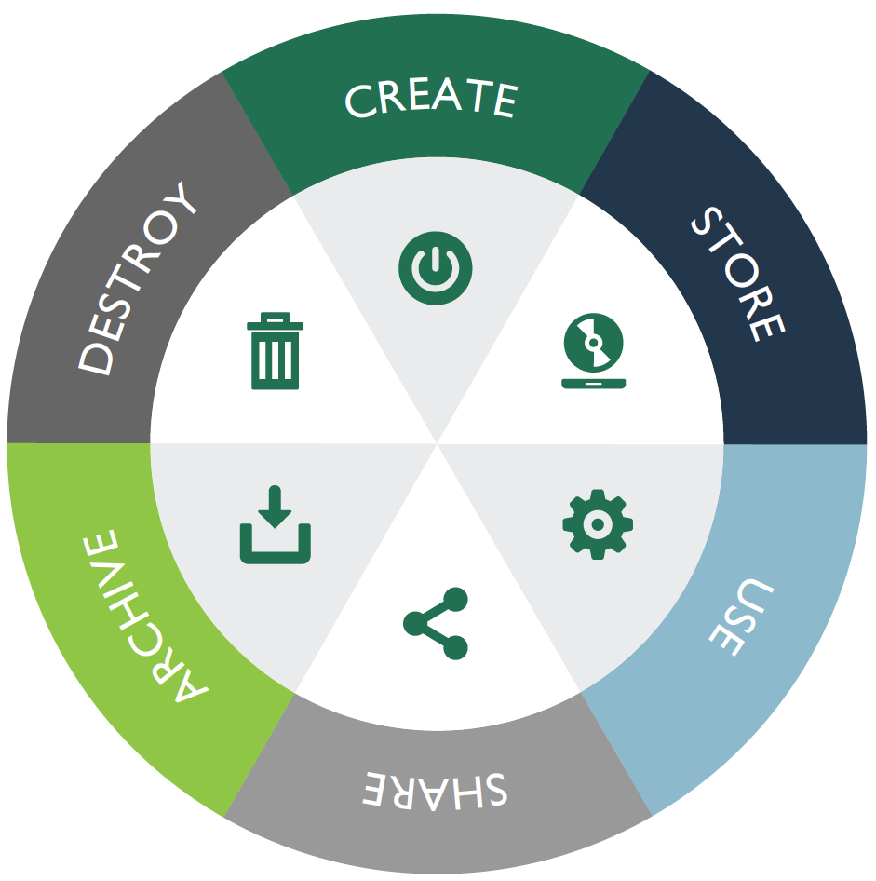
Information Lifecycle
Figure 7.1: The Data Lifecycle Phases
Notes:
Introduce the module topics.

Slide 19
Service-Level Agreements (SLAs)
For situations where the organization contracts with an external provider for a particular service (often referred to as a “managed service”), a service-level agreement (SLA) is a preferred mechanism for ensuring both parties are satisfied with the arrangement.
SLA performance metric example
SLA enforcement mechanism
Notes:
Introduce the module topics.

Slide 20
Securely Provisioning Resources
Module 2
Notes:
Introduce participants to the “Understand Cloud Data Lifecycle” module.

Slide 21
Module Objectives
Describe the purpose and practice of asset inventory/asset management.
Describe the reasons for and use of configuration management/change management, to include the composition of a Change Management Board (CMB).
List the benefits, challenges, and best ways to implement patch management.
Notes:
Introduce the module topics.

Slide 22
Asset Inventory/Asset Management
Determining what assets the organization possesses
Determining the value of each asset (to assign appropriate protection)
What the inventory includes
What it reflects
Notes:
Introduce the module topics.

Slide 23
Configuration Management and Change Management
The Change/Configuration Management Board (CMB) typically handles both kinds of CM activity.
Typical CMB process:
Request
Review
Recommend
Implement
Monitor/administration
Disposal
Notes:
Introduce the module topics.

Slide 24
Configuration Management and Change Management (continued)
Typical CMB composition:
IT department
Senior management
Security office
User community
General counsel
Accounting/finance
Human resources (in some cases)
Notes:
Introduce the module topics.

Slide 25
Configuration Management and Change Management (continued)
Role of the security practitioner in the CMB
Best CMB practices for security practitioners
Notes:
Introduce the module topics.

Slide 26
Patch and Vulnerability Management
Routine/reactive
Patching challenges:
Interoperability
Poorly crafted patches
Required downtime
Added expense
Virtualization-specific concerns
Timing
Notes:
Introduce the module topics.

Slide 27
Patch and Vulnerability Management (continued)
Typical formal patch process:
Receive notice
Determine applicability
Determine potential impact
Test
Perform full backup
Apply patch
Confirm installation
Solicit/receive user feedback
Prepare for rollback
Document
Notes:
Introduce the module topics.

Slide 28
Patch and Vulnerability Management (continued)
Vulnerability management
Manual/automated
Definition-based challenges
Notes:
Introduce the module topics.

Slide 29
Resource Protection Techniques
Module 3
Notes:
Introduce participants to the “Understand Cloud Data Lifecycle” module.

Slide 30
Module Objectives
Describe techniques for securing media (and the data it contains), including physical, logical, and administrative practices.
List typical threats/risks associated with protecting hardware and software assets, and common practices for countering those threats/risks.
Notes:
Introduce the module topics.

Slide 31
Media Management
Technical/logical
Physical
Administrative – backup policy,
Notes:
Introduce the module topics.

Slide 32
Hardware and Software Asset Management
Hardware protection similar to media management
Software management
Inventory and tracking
Licensing
Vulnerability scans
Patching and updating
Notes:
Introduce the module topics.

Slide 33
Detective and Preventative Measures
Module 4
Notes:
Introduce participants to the “Understand Cloud Data Lifecycle” module.

Slide 34
Module Objectives
Discuss comprehensively the common aspects of organizational security that can be tasked to third-party vendors and best practices for securing those relationships.
Describe the benefits and challenges of common security practices including the use of sandboxing, honeypots/honeynets, and anti-malware solutions.
Notes:
Introduce the module topics.

Slide 35
Third-Party Provided Security Services
Common third-party services:
Threat intelligence
Network monitoring
Physical security
Network management
Audit
Notes:
Introduce the module topics.

Slide 36
Third-Party Provided Security Services (continued)
Best practices for third-party arrangements:
Review of governance
Service-level agreements (SLAs)
Nondisclosure agreements (NDAs)
Insurance/bonding
Audit/testing
Strong contract language
Regulator approval
Notes:
Introduce the module topics.

Slide 37
Sandboxing
Hardware sandboxing
Software sandboxing
Notes:
Introduce the module topics.

Slide 38
Honeypots/Honeynets
Purpose
Placement
What to avoid
Policy language
Hackback
Notes:
Introduce the module topics.

Slide 39
Anti-Malware
Installation location
Common characteristics
Notes:
Introduce the module topics.

Slide 40
Incident Management
Module 5
Notes:
Introduce participants to the “Understand Cloud Data Lifecycle” module.

Slide 41
Module Objective
List phases of a common incident management model, and detail the benefits/challenges associated with each phase.
Notes:
Introduce the module topics.

Slide 42
Incident Management
A standard approach to incident management involves these phases:
Detection
Response
Mitigation
Reporting
Recovery
Remediation
Lessons learned
Notes:
Introduce the module topics.

Slide 43
Detection
Mechanisms:
IDS/IPS systems
Anti-malware solutions
Log analysis
Firewalls
Vulnerability scan results
DAMs
Data leak protection/DLP tools
DRM solutions
Users
Overreporting versus underreporting
Notes:
Introduce the module topics.

Slide 44
Response
Determining whether the reported activity is an actual incident, including use of:
Other security team members
Personnel from other departments
Devices
Data
Notes:
Introduce the module topics.

Slide 45
Mitigation
These are the main variables affecting how an incident is initially addressed:
Time
Risk
Impact
Can involve a team with members from:
Security practitioners
IT administrators/architects
General counsel
Human resources (HR)
Public relations
Management
Notes:
Introduce the module topics.

Slide 46
Reporting
Stakeholders:
Customers
Vendors
The public
Regulators
Users/employees
Law enforcement
Notes:
Introduce the module topics.

Slide 47
Recovery
Often entails appreciable expense
All efforts made by personnel in this phase, and any interruption to personnel productivity, need to be documented and assessed financially
Notes:
Introduce the module topics.

Slide 48
Remediation
Root cause analysis
Senior management decides ultimate solution
Notes:
Introduce the module topics.

Slide 49
Lessons Learned
Allows the organization to better deal with the same type of incident if it ever happens again
Allows the organization to improve the overall incident management process for use in all future incident management activity
Notes:
Introduce the module topics.

Slide 50
Requirements for Investigation Types
Module 6
Notes:
Introduce participants to the “Understand Cloud Data Lifecycle” module.

Slide 51
Module Objective
Describe the characteristics commonly associated with various types of investigations (administrative, civil, criminal, and regulatory), and demonstrate familiarity with popular investigatory standards.
Notes:
Introduce the module topics.

Slide 52
Requirements for Investigation Types
Administrative
Criminal
Civil
Regulatory
Industry standards
Notes:
Introduce the module topics.

Slide 53
Investigations
Module 7
Notes:
Introduce participants to the “Understand Cloud Data Lifecycle” module.

Slide 54
Module Objectives
Describe the challenges and common practices associated with evidence collection and handling, including the chain of custody.
List the desired characteristics (for reporting purposes) of evidence.
Describe common evidence handling techniques, including digital forensics practices.
Notes:
Introduce the module topics.

Slide 55
Evidence Collection and Handling
All material associated with an incident could be pertinent to an investigation and used as evidence:
Data that may have been compromised.
Systems (hardware, software, and media) that may have been compromised.
Data about the incident (all monitoring data from assets reviewing the data/systems that may have been compromised).
Information from people with knowledge of the incident.
Information about the incident scene.
Notes:
Introduce the module topics.

Slide 56
Evidence Collection and Handling (continued)
Some common practices for handling evidence that the security professional should be aware of:
Chain of custody
Copies of all data/system states
Analyze copies instead of originals where possible
Appointment of evidence custodian
Notes:
Introduce the module topics.

Slide 57
Reporting and Documentation
Evidence will be presented to the following:
Court
Regulators
Insurance adjusters
Investors/shareholders
Other stakeholders
Notes:
Introduce the module topics.

Slide 58
Reporting and Documentation (continued)
Evidence should adhere to these tenets:
Admissibility
Accuracy
Comprehensibility
Objectivity
Notes:
Introduce the module topics.

Slide 59
Investigative Techniques
Automated capture
Interviews
Manual capture
External requests
Notes:
Introduce the module topics.

Slide 60
Digital Forensics Tools, Tactics, and Procedures
Document everything
Avoid unrecorded/unintended modification
Collection is a sensitive process
No amateur involvement
Notes:
Introduce the module topics.

Slide 61

CASE
Notes:
Introduce the module topics.

Slide 62
Logging and Monitoring Activities
Module 8
Notes:
Introduce participants to the “Understand Cloud Data Lifecycle” module.

Slide 63
Module Objectives
Name the characteristics and purpose of intrusion detection systems/intrusion prevention systems (IDS/IPS).
Describe the purpose and challenges associated with the employment of a security information and event management (SIEM) system.
Describe, in detail, the purpose of continuous monitoring practices and the tools currently in common use for achieving that purpose, specifically data leak protection (DLP).
Notes:
Introduce the module topics.

Slide 64
Intrusion Detection and Prevention
Intrusion detection system/intrusion prevention system (IDS/IPS)
Placement
Detection
Tradeoffs
Notes:
Introduce the module topics.

Slide 65
Security Information and Event Management (SIEM)
Benefits:
Aggregation
Normalization
Correlation
Secure storage
Analysis
Reporting
Notes:
Introduce the module topics.

Slide 66
Continuous Monitoring
Ingress monitoring
Egress monitoring
DLP
Detection
Deployment
Protection effort
Discovery
Monitoring
Enforcement
Notes:
Introduce the module topics.

Slide 67
Recovery Strategies
Module 9
Notes:
Introduce participants to the “Understand Cloud Data Lifecycle” module.

Slide 68
Module Objectives
Describe the benefits and challenges associated with various common backup strategies and techniques.
List the characteristics of common alternate operating site strategies.
Describe the technologies and techniques associated with high-availability environments, including differentiating between various redundant array of independent disks (RAID) levels.
Notes:
Introduce the module topics.

Slide 69
Backup Storage Strategies
Onsite
Offsite
Full
Differential
Incremental
Versioning
Validation
Notes:
Introduce the module topics.

Slide 70
Activity: How Many Versions?
Alice is in charge of orchestrating backups for Ostrich, Inc., her midsize retail company. Employees at Ostrich work between the hours of 7:00 a.m. and 8:00 p.m. (individual employees each work eight-hour days, but they are spread across several time zones), Monday through Friday. Backups are made on Saturday night to allow for integrity checks and repetition on Sunday if the process was faulty or interrupted. Alice has decided to augment the weekly full backups with partial backups Monday through Friday, at the end of each workday, to capture data that has changed between full backups.
Notes:
Introduce the module topics.

Slide 71
Activity: How Many Versions? (continued)
INSTRUCTIONS
As a group, work through the following thought problems. You have 10 minutes.
If Alice opts to do differential backups during the week, which data would be captured on Wednesday night?
If Alice opts to do incremental backups during the week, which data would be captured on Thursday night?
If Alice opts to do differential backups during the week, and the backup copy made Tuesday night is corrupt, which data would be lost?
Notes:
Introduce the module topics.

Slide 72
Activity: How Many Versions? (continued)
ANSWERS
All data created/modified during the workdays of Monday, Tuesday, and Wednesday.
All data created/modified during the workday Thursday.
All data created/modified during the workdays Monday and Tuesday.
Notes:
Introduce the module topics.

Slide 73
Recovery Site Strategies
Redundant
Hot
Warm
Cold
Mobile
Cloud
Joint operating agreement (JOA)/memorandum of understanding (MOU)
Notes:
Introduce the module topics.

Slide 74
Multiple Processing Sites
Some organizations that seek to minimize downtime and enhance BCDR capabilities utilize multiple processing sites to obviate the effects of an impact to any single site.
This can be perceived as a JOA/MOU between internal bodies within the organization.
Geographically separated branches can serve as alternate production sites for each other in the event of a contingency.
Notes:
Introduce the module topics.

Slide 75
System Resilience, High Availability, Quality of Service (QoS), and Fault Tolerance
Sufficient spare components
Clustering
Power
RAID
Centralized data storage:
Storage area network (SAN)
Network-attached storage (NAS)
Notes:
Introduce the module topics.

Slide 76
Disaster Recovery Processes
Module 10
Notes:
Introduce participants to the “Understand Cloud Data Lifecycle” module.

Slide 77
Module Objectives
Describe in detail, the essential elements of the business continuity and disaster recovery (BCDR) process, including response actions, the personnel involved, communications strategies, the practice and risks associated with assessment and recovery, and proper training and awareness for BCDR purposes.
Notes:
Introduce the module topics.

Slide 78
Response
The organization must determine:
Criteria for initiating the response action
Personnel authorized to initiate the BCDR action
Information stream/chain to provide sufficient data
Notes:
Introduce the module topics.

Slide 79
Personnel
Specifically task participants
Critical path personnel
Responders
IT
Security
Legal
Human resources (HR)
Finance/accounting
PR/communications
Management
Notes:
Introduce the module topics.

Slide 80
Communications
Internal
External
Law enforcement/first responders
Regulators
Public/news
Business partners
Principles:
Single voice
Trained professionals
Immediacy versus accuracy
Notes:
Introduce the module topics.

Slide 81
Assessment
Enumeration can be used in:
Criminal prosecution
Civil litigation
Investor reporting
Informing regulators
Notes:
Introduce the module topics.

Slide 82
Restoration
Ultimate goal: resuming full normal operations:
Returning to original primary site
Restoring data to the production environment
Notes:
Introduce the module topics.

Slide 83
Training and Awareness
Personnel specifically tasked (participating in response)
All personnel in the organization
Notes:
Introduce the module topics.

Slide 84
Business Continuity Planning and Exercises
Module 11
Notes:
Introduce participants to the “Understand Cloud Data Lifecycle” module.

Slide 85
Module Objectives
Describe the facets and challenges of business continuity and disaster recovery (BCDR) planning and exercises.
Notes:
Introduce the module topics.

Slide 86
Business Continuity Planning and Exercises
Continuity methods and resources must be tested.
When testing both a failover process and a backup procedure, some fundamental concepts should be considered:
Test can result in actual contingency
Test can be scaled down
Tests involve costs
Tests may be mandatory
Notes:
Introduce the module topics.

Slide 87
Test Disaster Recovery Plans
Module 12
Notes:
Introduce participants to the “Understand Cloud Data Lifecycle” module.

Slide 88
Module Objectives
Describe the characteristics of common types of business continuity and disaster recovery (BCDR) tests.
Notes:
Introduce the module topics.

Slide 89
Test Disaster Recovery Plans
Read-through/Tabletop
Walk-through
Simulation
Parallel
Full interruption
Notes:
Introduce the module topics.

Slide 90
Personnel Safety and Security Concerns
Module 13
Notes:
Introduce participants to the “Understand Cloud Data Lifecycle” module.

Slide 91
Module Objectives
List common security aspects of operational concerns associated with personnel.
Notes:
Introduce the module topics.

Slide 92
Travel
Encryption
Secure remote access
Additional jurisdictional concerns
Personnel protection
Condition monitoring
Notes:
Introduce the module topics.

Slide 93
Security Training and Awareness
Location-specific orientation for travelers
Emergency procedures
Incident reporting procedures
Users’ role(s) in incident detection and response
How to recognize attack attempts directly targeting individuals
Notes:
Introduce the module topics.

Slide 94
Emergency Management
Elements of the security program specific to personnel safety should include:
Fire detection/suppression systems
Evacuation practice
Coordination with external entities
Localized threats (climate, civil unrest, etc.)
Asset protection secondary
Relocation strategies
Notes:
Introduce the module topics.

Slide 95
Duress
Personnel should have a means to report to the organization if they are ever put under duress (threatened or hindered in movement).
This is especially true for travelers, senior management, and critical personnel, all who may be subject to crimes that target those roles (kidnapping, terror attacks, etc.).
Subtle/covert
Training and practice
Regular schedule change
Notes:
Introduce the module topics.

Slide 96
Domain Review
Module 14
Notes:
Introduce the module topics.

Slide 97
Domain Summary
The organization’s operations incur considerable security risks; it is important for the security practitioner to remember that the security effort supports operations and production and that every security decision comes with an associated tradeoff in productivity.
Notes:
Introduce the module topics.

Slide 98
Domain Review Question
All of the following are types of alternate operating sites except:
Joint operating agreement
Mobile site
Cloud
Full interruption

Slide 99
Answers
The correct answer is D.
Full interruption is a type of BCDR exercise; all the other answers are types of alternate operating sites.

Slide 100
Domain Review Question
Which of the following is paramount in all emergency actions/responses?
Asset protection
Health and human safety
Regulatory compliance
Confidentiality

Slide 101
Answers
The correct answer is B.
Health and human safety is always the most important aspect of security.

Slide 102
Domain Review Question
A duress code should be ______.
reusable
immediately recognizable
covert
complex

Slide 103
Answers
The correct answer is C.
The duress code should be something subtle and unrecognizable to anyone outside the organization, simple enough to remember in times of stress, and of limited duration.

Slide 104
Domain Review Question
The organization should provide specific BCDR plan training to ________.
all members of the security team
critical personnel and response team members
all stakeholders
members of external first response teams (fire, police, medical, etc.)

Slide 105
Answers
The correct answer is B.
Organizational personnel who will be involved in an actual BCDR response should receive specific training from the organization. External responders will be trained by their agencies. Not all members of the security team will be involved in BCDR actions.

Slide 106
Domain Review Question
Honeypots/honeynets are intended to _____ attackers.
deter
attract
distract
prevent

Slide 107
Answers
The correct answer is C.
A honeypot/honeynet is meant to occupy the attacker’s time, attention, and efforts while the organization collects information about the attack. Honeypots/honeynets will not deter or prevent attacks and should not be construed as attractive.

Slide 108
Domain Review Question
Which of the following backup methods requires the most number of data versions to conduct restoration?
Full
Incremental
Differential
Composite

Slide 109
Answers
The correct answer is B.
Incremental backups copy all data changed since the last full or incremental backup; this would, on average, require more versions for restoration than full backup (requires one version) and differential (requires two). There is no such thing as composite backup.

Slide 110
Domain Review Question
Which of the following is not true about emergency response testing?
Tests involve cost
Tests might result in actual emergencies
Tests may be mandatory
Tests are performed by the security department

Slide 111
Answers
The correct answer is D.
Emergency response testing should include all affected parties (which can include all personnel in the organization) and is not limited to the security department.

Slide 112
Domain Review Question
Which of the following is true about evidence?
Evidence is useless if the original version has been changed in any way
Evidence can expire
Electronic evidence is inadmissible
Evidence should be believable

Slide 113
Answers
The correct answer is D.
Evidence is material supporting an argument; it must be believable to be effective.

Slide 114
Domain Review Question
Which of the following is true about incident detection?
It is better to have overreporting than underreporting
It is better to have underreporting than overreporting
Incidents must be ended within 24 hours of detection
Detection of incidents should be limited to the IT and security departments

Slide 115
Answers
The correct answer is A.
In general, responding to possible incidents that turn out to be harmless is preferable to not knowing when an actual incident occurs (even though false responses still do incur some cost).

Slide 116
Domain Review Question
Which of the following is true about vulnerability scans?
They prevent attacks
They deter attacks
They are all automated
They typically don’t detect zero-day exploits

Slide 117
Answers
The correct answer is D.
Vulnerability scans typically can only detect known vulnerabilities (which is how they work) but cannot detect zero-day exploits, which are based on attacks unknown to the industry to that point in time.

