Slide 1
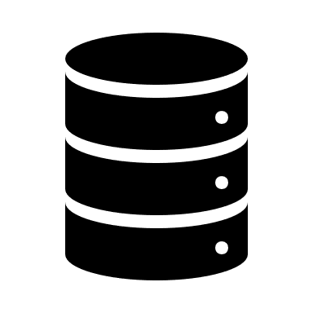
Big Data Analytics for Healthcare Industry: Impact, Applications, and Tools
Sunil Kumar
Mahinder Singh
Notes:
jainam shah

Slide 2
Introduction
Every day data is generated by a range of different applications, devices and research activities for many purposes.
Big data is associated with core technologies which extracts valuable information from the huge volumes of data collected.
Big data is being generated rapidly in every field including healthcare.
Healthcare shareholders are promised new knowledge from the data.
Most data in healthcare system is unstructured and is not stored electronically.

Slide 3
Big Data Analytics in Health Informatics
The main difference between traditional health analysis and big data health analysis is the execution of computer programming.
Today, the healthcare industry is faced with the challenge of handling rapidly developing big healthcare data.
The diverse origins and forms of big data are challenging the healthcare informatics community to develop methods for data processing.

Slide 4
Frameworks available for the analysis of healthcare data
Predictive Analysis in Healthcare
Machine Learning in Healthcare
Electronic Health Records

Slide 5
Four Vs of Big Data in Healthcare
Volume
Big Data is a term to referring to huge volumes of collected data.
There is no fixed threshold for the volume of this data.
Velocity
Velocity which represents primary reason for the exponential growth of data, refers to how fast data is collected.
Healthcare system are generating data at incresingly higher speeds.

Slide 6
Four Vs of Big Data in Healthcare
Variety
Variety refers to the form of the data.
Structured data which must simply be collected, stored and processed.
Veracity
The veracity of data is the degree of assurance that the meaning of data is consistent.
Different data sources vary in their levels of data reliability.

Slide 7
Impact of Big Data on the Healthcare System
Right Living
Right Care
Right Innovation

Slide 8
Hadoop-Based Applications for Health Industry
In light of the fact that healthcare data exists primarily in printed form, there is a need for the active digitization of print form data.
The majority of this data is also unstructured, so it is a major challenge for this industry to extract meaningful information regarding patient care, clinical operations, and research.
Hadoop ecosystem can help the healthcare sector to manage this vast amount of data.

Slide 9
Applications of Hadoop ecosystem
Treatment of Cancer and Genomics
Monitoring of Patient Vitals
Hospital Network
Healthcare Intelligence
Prevention and Detection of Frauds

Slide 10
Hadoop’s Tools and Techniques for Big Data
To manage unstructured big data that does not fit into any database, special tolls are needed.
To examine this type of big dataset, the IT sector uses the Hadoop platform.
Most of the tools are implemented in the Apache Hadoop architecture including MapReduce, Mahout, Hive, and others.

Slide 11
Apache Hadoop
Open-source tools, libraries, and methodologies for “big data” analysis in which several data sets are collected from different sources, i.e. audios, videos, and sensor records as both structured and unstructured data to be processed.
HDFS (Hadoop Distributed File System)
HDFS is designed for data streaming by which large amounts of data are read from disk in bulk. Metadata is stored in name node and application data is stored in data node.

Slide 12
MapReduce
The MapReduce computation model is a very powerful tool used in many health applications.
Map takes a set of data and converts it into another set of data, where individual elements are broken down into tuples (key/value pairs).
Reduce task, which takes the output from a map as an input and combines those data tuples into a smaller set of tuples.
Apache Sqoop
Apache Sqoop is a powerful tool that performs the functionality of extracting the data from Relational Database Management System (RDMS) and inputting it into Hadoop architecture for query processing.

Slide 13
Conclusion
The combination of big data and healthcare analytics can lead to treatments that are effective for specific patients by providing the ability to prescribe appropriate medications for everyone, rather than those that work for most people.
Data analytics is in the early stage of development and current tools and methods cannot solve the problems associated with big data.
Big data may be viewed as big systems, which present huge challenges.
A great deal of research in this field will be required to solve the issues faced by the healthcare system.

Slide 14
Implementation Strategy
Use Apache Spark for machine learning analysis on the given dataset.
Apache Spark is the platform for large-scale SQL, stream processing, and machine learning on large datasets.
Dataset https://www.dropbox.com/s/sqskokt2kswi59t/train_2v.csv?dl=0

Slide 15

Thank You

