Slide 1
INTERNAL · EQUITY RESEARCH
Perplexity Enterprise
What's possible in our workflow — features, prompts, real examples
PRESENTED BY Aman Jain
FOR Equity Research — analysts & associates

Slide 2
SETUP
PROMPTING
AUTOMATION
FINANCE
SPACES
LIMITS
AGENDA
What we'll cover — six buckets of capability
Each bucket is something I'm doing today. The rest of the deck shows how, with screenshots and the actual prompts.
01
02
03
Setup
Prompting
Automation
Two switches to know — search mode, model choice. Affects every prompt.
How to write a prompt that returns research-grade output. Three worked examples.
Scheduled searches, personalization, price alerts with custom analyst queries.
04
05
06
Finance
Spaces
Limits
Watchlist + daily market view. Earnings tab with transcript, highlights, documents.
Purpose-built rooms with uploaded filings and custom rephrasing in our voice.
Where Perplexity falls short and AlphaSense is the better tool. Use with caution.

Slide 3
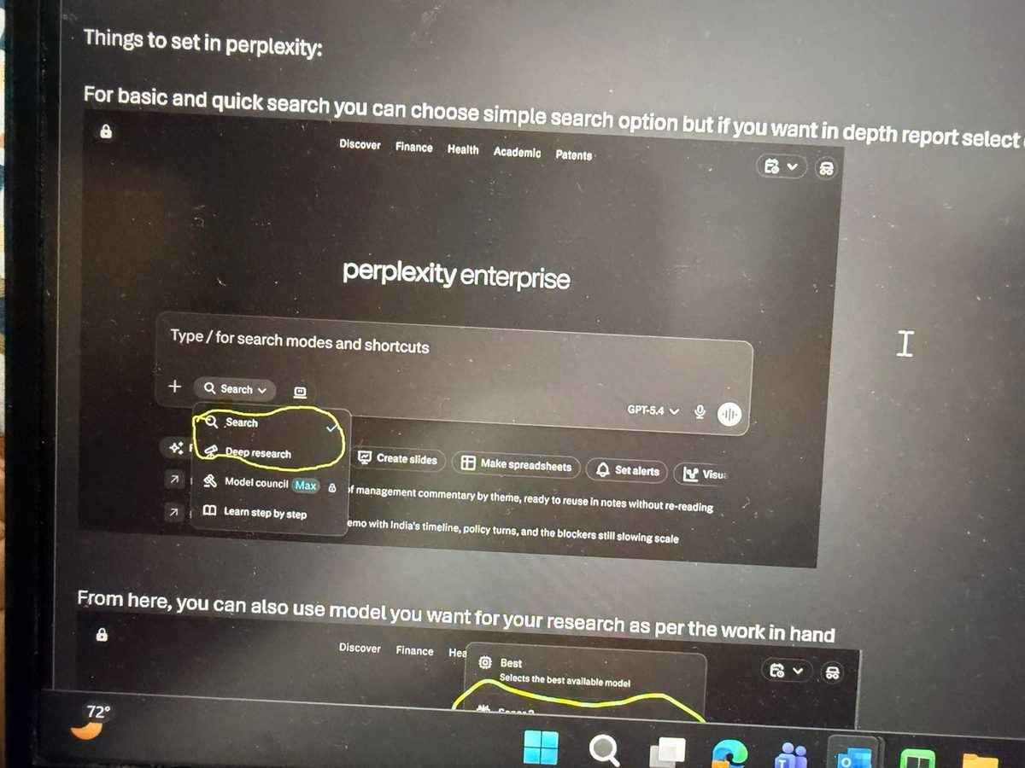
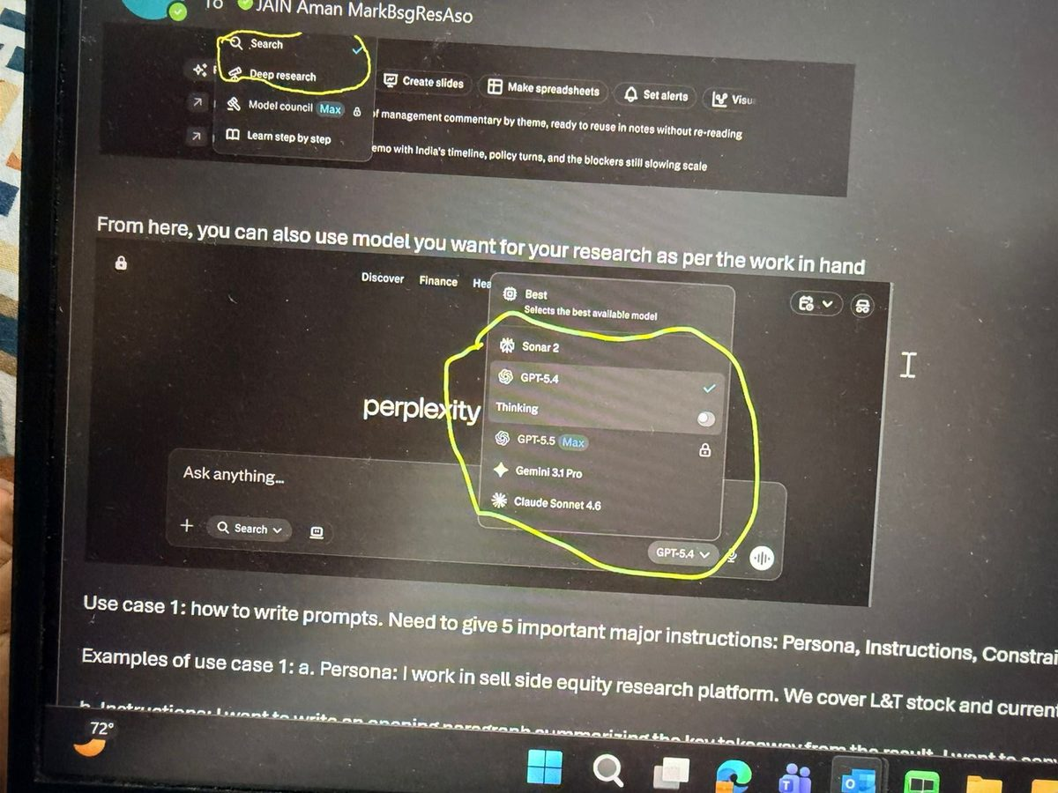
SETUP
PROMPTING
AUTOMATION
FINANCE
SPACES
LIMITS
SETUP
Two switches to know before you start
Behaviour of every prompt depends on these two settings. Set them deliberately.
SWITCH 1
SWITCH 2
Search vs Deep Research
Pick the right model for the job
Default to Search for daily work. Switch to Deep Research when you need a multi-source brief and can wait 5–10 minutes.
GPT-5.4 default for general work. Claude Sonnet 4.6 for synthesis and writing. Thinking / GPT-5.5 Max for multi-step reasoning over long documents.

Slide 4
SETUP
PROMPTING
AUTOMATION
FINANCE
SPACES
LIMITS
SETUP
Which model for which job
Perplexity is model-agnostic — pick the engine that fits the task.
MODEL | BEST FOR | EXAMPLE PROMPTS
Sonar | Fast web answers, latest-info lookups, quick summaries | “What changed in India’s power demand this week?” “Latest news on US utility-scale battery storage.” “Source-backed overview of SMR adoption.”
GPT | Complex reasoning, coding, structured writing | “Build a scenario framework under different tariffs.” “Debug this Python valuation script.” “Turn these call notes into an investment memo.”
Gemini | Multimodal analysis, document + image workflows | “Compare these two charts, explain the differences.” “Turn this screenshot into structured notes.” “Spec + image → an implementation outline.”
Claude | Long-form analysis, reasoning, polished writing | “Pull the 7 key takeaways from this report.” “Explain this market design for clients.” “Make this note sharper and more professional.”
Best | When you want Perplexity to auto-route for you | “Explain this simply, with strong sources.” “Is this investment risk overdone?” “Get me up to speed on this quickly.”

Slide 5
SETUP
PROMPTING
AUTOMATION
FINANCE
SPACES
LIMITS
PROMPTING
How to write a prompt — the PICOE framework
Most people type questions. Power users write prompts. The difference is structure.
P
Persona
Who you are. "I work in sell-side equity research at Bernstein, covering Indian financials."
I
Instructions
What you want done. Be specific about the topic, the angle, and the inputs to use.
C
Constraint
What to avoid. Style, length, jargon level, tone — anything that's a hard no.
O
Output format
Shape of the answer. One paragraph / table / bullets / 1-page brief.
E
Examples
What good looks like. Paste 2–3 examples of past notes, paragraphs, or output styles.
The more constrained the prompt, the better the output.

Slide 6
SETUP
PROMPTING
AUTOMATION
FINANCE
SPACES
LIMITS
PROMPTING · EXAMPLES
Three worked examples coming up
To show what PICOE actually delivers, three real prompts I've run — each a different shape of problem.
EXAMPLE 01
EXAMPLE 02
EXAMPLE 03
Result note opening paragraph
Tricky internal email
Use AI to write prompts for AI
CORE ANALYST WORKFLOW
QUICK PERSONAL WIN
THE MULTIPLIER
L&T Q4 — give it the brief, three prior paragraphs as style examples, and ask for one impactful opening paragraph in our voice.
Asking for leave during earnings season, to a boss 15 years senior. Short, effective, gets the tone right.
Ask Perplexity to generate a high-quality prompt for any other AI tool — reusable across companies and analysts.

Slide 7
SETUP
PROMPTING
AUTOMATION
FINANCE
SPACES
LIMITS
PROMPTING · EXAMPLE 1
L&T result note — the brief I gave Perplexity
EXAMPLE 01
P PERSONA
I INSTRUCTIONS
C CONSTRAINT
Sell-side equity research. Covering L&T. Writing result note.
Opening paragraph. Order inflow beat (Middle East). Revenue & earnings miss (~₹50bn Q4). Near-term risks. Guidance: 10–12% inflow vs consensus ~17%. New 5-yr plan. Maintain Outperform.
Impactful, no beating around the bush. Match the example style. Simple precise language, minimal jargon.
O OUTPUT FORMAT
E EXAMPLES
One paragraph.
Three prior L&T opening paragraphs from past notes, pasted in full.
→ Output on the next slide

Slide 8
SETUP
PROMPTING
AUTOMATION
FINANCE
SPACES
LIMITS
PROMPTING · EXAMPLE 1
L&T result note — the output Perplexity returned
EXAMPLE 01
“
L&T reported a quarter with a meaningful miss on revenue and earnings — ₹50bn of headwinds from Middle East project disruptions and India water sector delays weighed on execution — but the order inflow story more than held up, with inflows beating expectations on the back of strong international demand. The near-term read-through is mixed: execution delays, supply chain disruptions, and higher insurance costs remain live risks, and consensus will need to reset revenue growth expectations from ~17% closer to the company's own guidance of 10–12%. What keeps us constructive is the demand backdrop — Middle East capex pipeline remains robust, and management's new 5-year plan articulates a credible expansion into industrial electronics, nuclear, data centers, and green hydrogen, with targets of 10–12% order inflow CAGR, 12–15% revenue growth, and 16–17% ROE. Near-term execution headwinds are real, but the long-term structural story remains firmly intact — we maintain Outperform.
THE POINT Same length, same hedging, same Bernstein voice. The structure does the work.

Slide 9
SETUP
PROMPTING
AUTOMATION
FINANCE
SPACES
LIMITS
PROMPTING · EXAMPLE 2
A tricky internal email
EXAMPLE 02
THE SITUATION
WHAT CAME BACK
Leave request during earnings season
"…I'm aware this falls during earnings season, so I'll ensure all my key deliverables are covered in advance and remain available on call for any critical items if needed. Please let me know if this works, or if you'd prefer any adjustments…"
To a boss 15 years senior. PICOE handles the diplomacy: persona (junior analyst), constraint (busy season, may not approve), output (short, effective email).
→ Same logic for difficult client emails, pushback to a PM, escalations.

Slide 10
SETUP
PROMPTING
AUTOMATION
FINANCE
SPACES
LIMITS
PROMPTING · EXAMPLE 3
Use AI to write prompts for AI — the multiplier
EXAMPLE 03
WHAT I ASKED
WHAT CAME BACK
"I need research on HDFC Bank. Give me a strong prompt I can use in other AI platforms."
A 1,500-word structured analyst prompt with 8 scope sections:
01 Investment snapshot
02 Business model & franchise quality
WHY IT'S A MULTIPLIER
03 Financial performance
Reusable across every name. Reusable across any AI tool — ChatGPT, Claude, Gemini. Build the prompt once, use it everywhere.
04 Strategy & medium-term guidance
05 Competitive positioning
06 Valuation & market expectations
07 Key risks & monitoring framework
08 Actionable takeaways

Slide 11
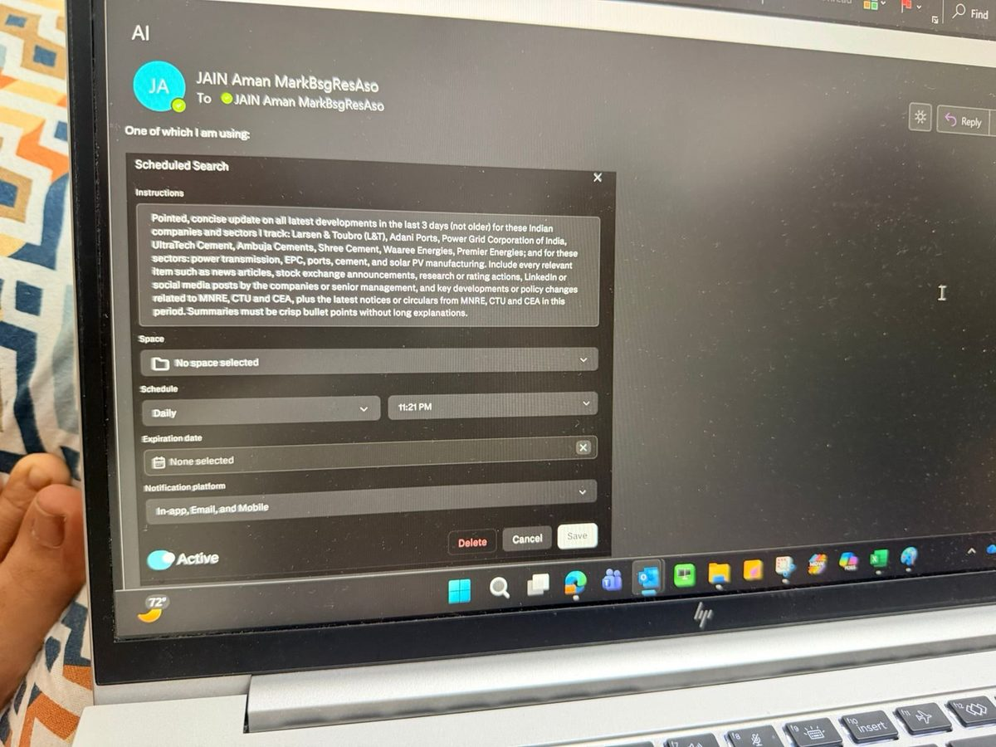
SETUP
PROMPTING
AUTOMATION
FINANCE
SPACES
LIMITS
AUTOMATION
Scheduled searches — daily intelligence on autopilot
MY SCHEDULED SEARCH
OUTPUT — DAILY DIGEST
WHAT WE'RE DOING
Set a recurring search at a fixed time on covered names and sectors. Output arrives by email, app, and in-product.
⎘
WHY IT MATTERS
Daily digest screenshot
News flow on 10+ names is impossible to track manually each morning. Important moves slip through.
To be added
Daily at 11:21 PM — L&T, Adani Ports, Power Grid, UltraTech, Ambuja, Waaree, Premier Energies + MNRE / CTU / CEA.
The actual digest that lands in my inbox each morning.
WHAT IT SOLVES
The "what did I miss overnight?" tax at the start of every working day. Replaces 30 minutes of triage with a 2-minute scan.

Slide 12
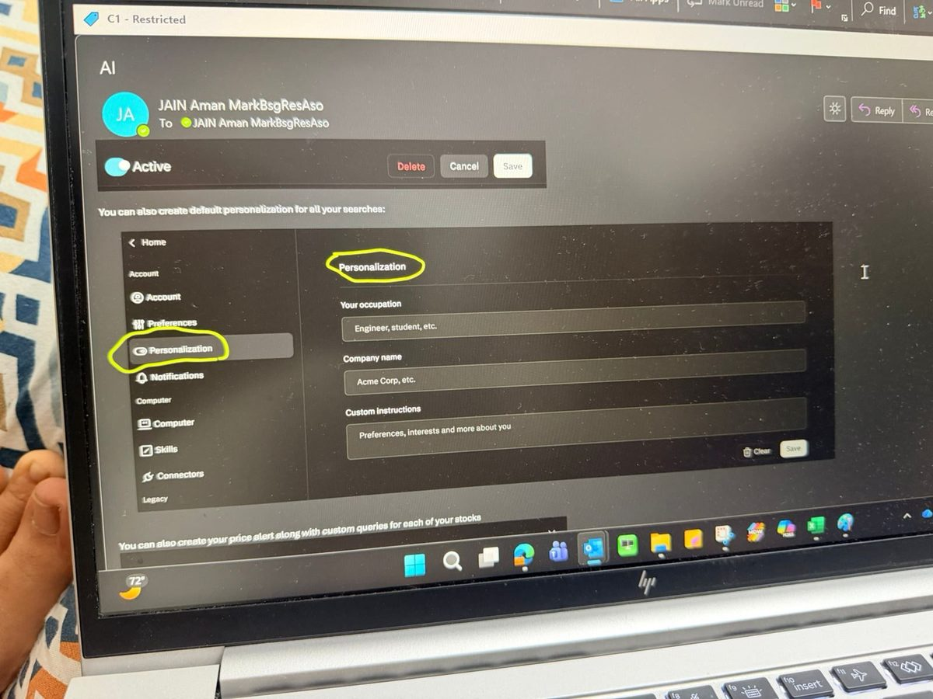
SETUP
PROMPTING
AUTOMATION
FINANCE
SPACES
LIMITS
AUTOMATION
Personalization — tell Perplexity who you are, once
SETTINGS
OUTPUT — A PROMPT WITH IT ON
WHAT WE'RE DOING
Fill in occupation, firm, and custom instructions (preferred jargon level, tone, sectors covered) in settings.
⎘
WHY IT MATTERS
Before / after example
Without it, every prompt is doing two jobs: re-establishing who you are AND asking the actual question.
To be added
One-time setup. Persists across every search going forward.
A simple prompt run with personalization on vs off.
WHAT IT SOLVES
Generic, retail-tone outputs from a tool that should be writing for analysts. Saves a sentence of context per prompt.

Slide 13
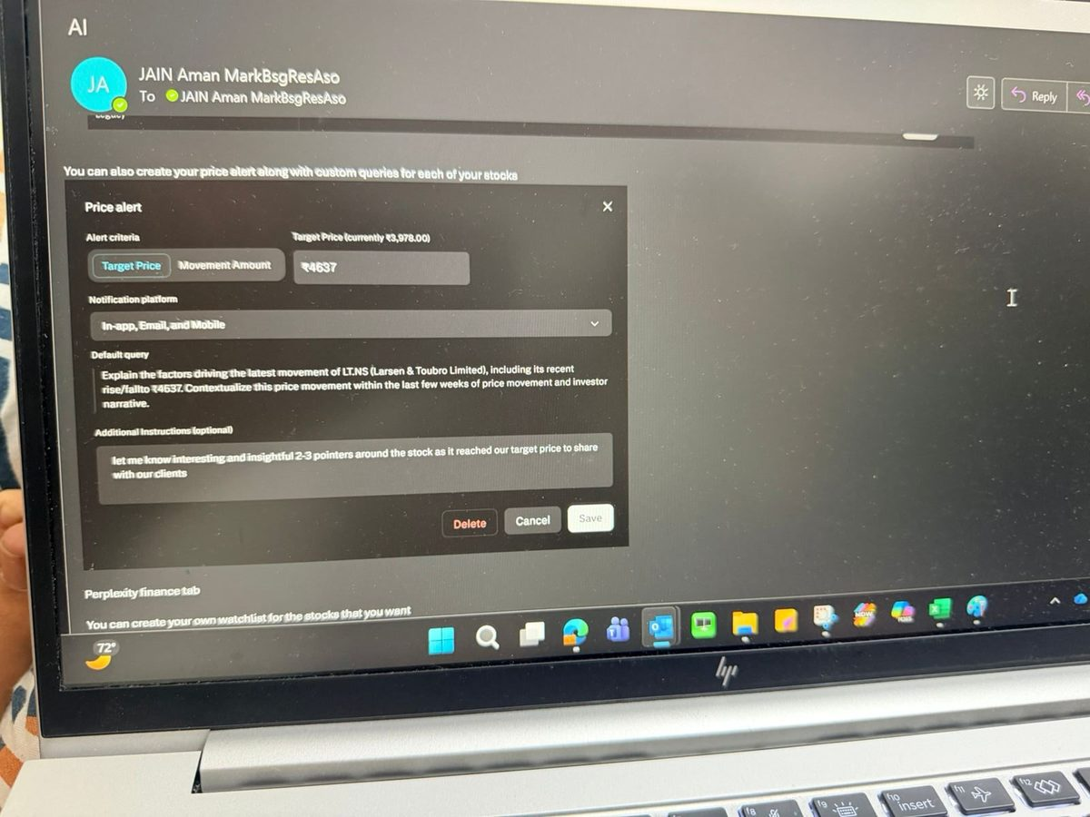
SETUP
PROMPTING
AUTOMATION
FINANCE
SPACES
LIMITS
AUTOMATION
Price alerts with a custom analyst query
ALERT SETUP
OUTPUT — THE ALERT IT SENDS
WHAT WE'RE DOING
Set a target price on a covered name. Attach a default analyst query that auto-runs when the target is hit.
⎘
WHY IT MATTERS
Alert email screenshot
When a stock moves, clients want a fast take — and I'm usually mid-something-else. Reactive scrambling is the norm.
To be added
L&T set to ₹4,637 with a custom 2–3 pointer query attached.
The alert + auto-generated client-ready insight when target hits.
WHAT IT SOLVES
The 10–15 minutes of writing a 2–3 line client note on the fly when a name moves. Arrives client-ready in my inbox.

Slide 14
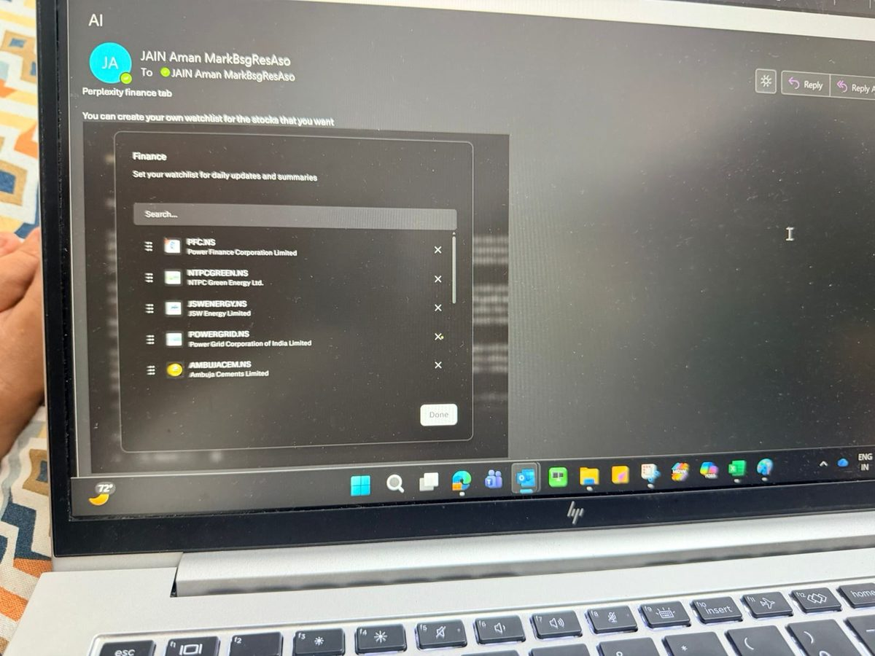
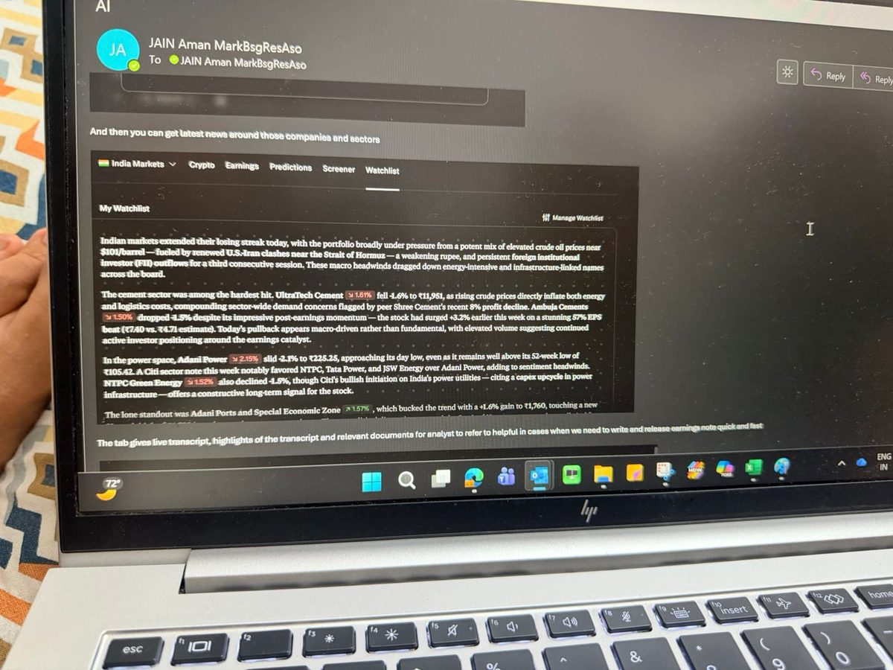
SETUP
PROMPTING
AUTOMATION
FINANCE
SPACES
LIMITS
FINANCE TAB
Daily market view + watchlist of covered names
WATCHLIST
DAILY COMMENTARY
WHAT WE'RE DOING
Add covered names to a Finance-tab watchlist. Get a daily market summary written for analyst-level context.
WHY IT MATTERS
Mainstream financial news is written for retail investors. My morning briefing needs to assume domain knowledge.
PFC, NTPC Green, JSW Energy, Power Grid, Ambuja — the names I care about.
Sector-level synthesis with peer moves, sell-side calls, and macro context.
WHAT IT SOLVES
The first 30 minutes spent triaging which sector moves matter and why. The synthesis is done for me.

Slide 15
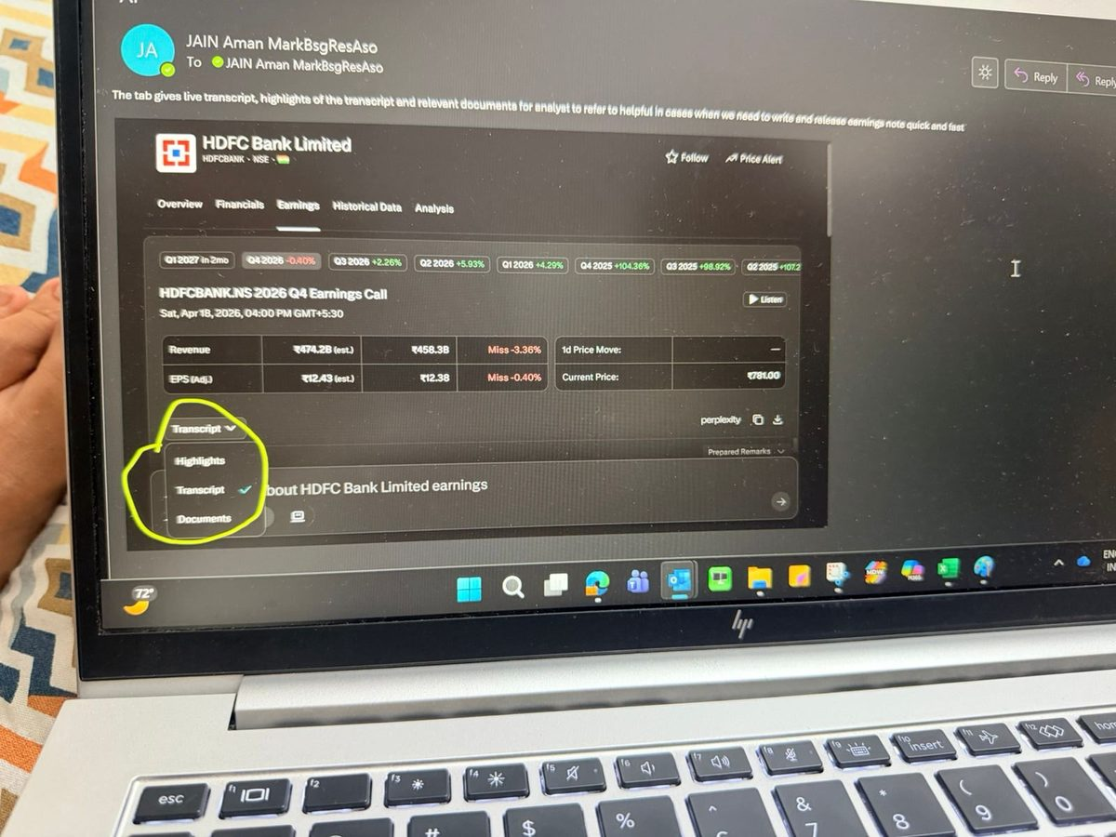
SETUP
PROMPTING
AUTOMATION
FINANCE
SPACES
LIMITS
FINANCE TAB
Earnings tab — three things in one place
EARNINGS TAB — HDFC BANK
OUTPUT — HIGHLIGHTS VIEW
WHAT WE'RE DOING
Live transcript, AI-summarized highlights, and source documents for any covered name, in a single view.
⎘
WHY IT MATTERS
Highlights view screenshot
Earnings days are a sprint — multiple calls back-to-back, every minute counts. Tab-switching is a tax.
To be added
Revenue / EPS estimates vs actual, with three sub-tabs shown.
Click into Highlights for the AI-summarized commentary by theme.
WHAT IT SOLVES
Switching between Bloomberg, the IR webcast, the deck, and our note system mid-call. All in one tab.

Slide 16
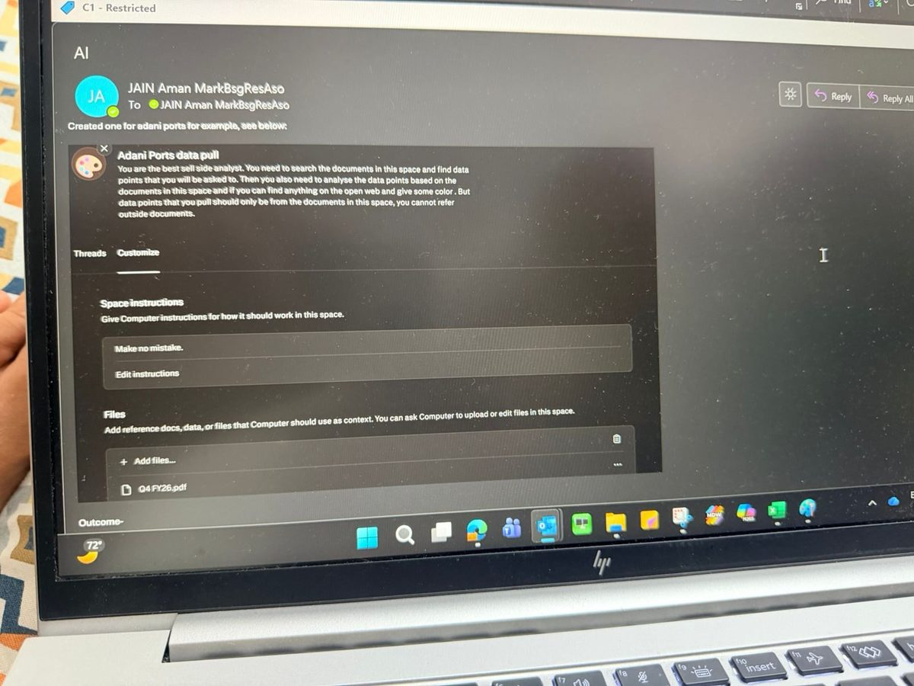
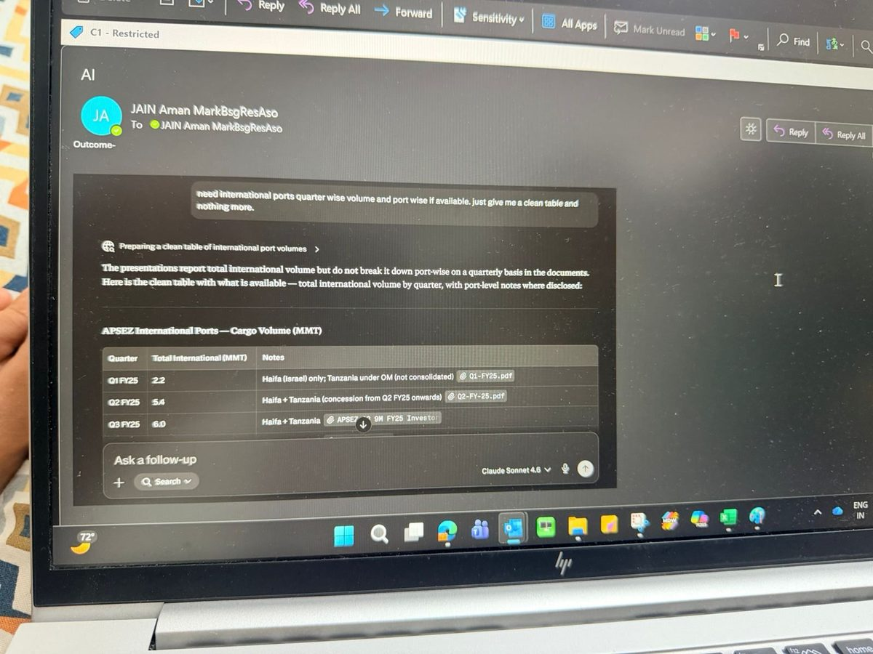
SETUP
PROMPTING
AUTOMATION
FINANCE
SPACES
LIMITS
SPACES
Spaces — purpose-built rooms for repeated data pulls
SETUP — ADANI PORTS
OUTPUT — A CLEAN TABLE
WHAT WE'RE DOING
Create a Space, upload relevant filings, give it custom instructions. Ask precise questions across them.
WHY IT MATTERS
The same data pulls (volumes, segment breakouts, capex) come up every quarter on the same names.
Custom instructions + uploaded filings define a guarded scope.
Quarter-wise international cargo volume, sourced from my uploaded filings.
WHAT IT SOLVES
Re-opening 5 PDFs and Ctrl-F'ing every time I need a number. Output cites only the docs I uploaded.

Slide 17
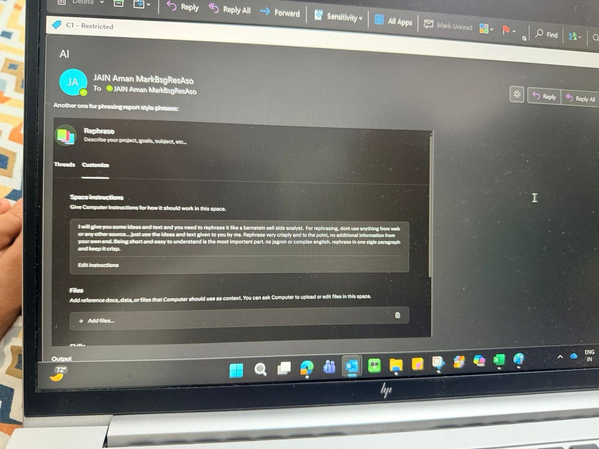
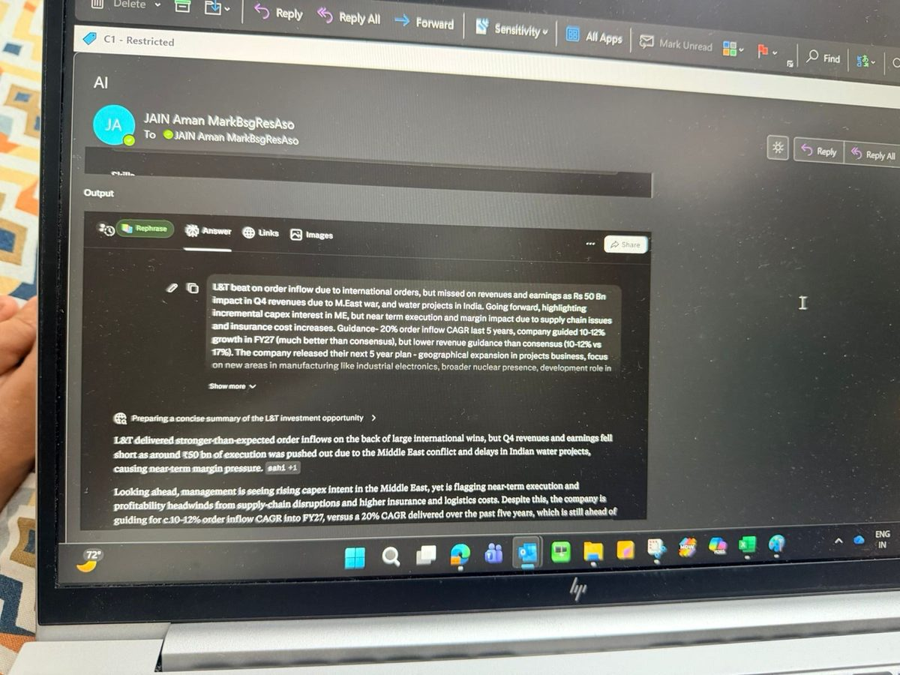
SETUP
PROMPTING
AUTOMATION
FINANCE
SPACES
LIMITS
SPACES
Spaces — capture our house voice for rephrasing
SETUP — REPHRASE SPACE
OUTPUT — POLISHED PARAGRAPH
WHAT WE'RE DOING
A Space configured with style instructions: rephrase anything I paste in to sound like a published Bernstein note.
WHY IT MATTERS
AI drafts are fast but generic. The tone shows up immediately in published research and undermines credibility.
Instructions: "Rephrase like a Bernstein sell-side analyst. No jargon. One paragraph. Crisp."
Raw bullets in. Result-note opening paragraph out. Reusable for every result.
WHAT IT SOLVES
Spending 10 minutes rewording every AI draft to make it sound like us. The speed without the AI tell.

Slide 18
SETUP
PROMPTING
AUTOMATION
FINANCE
SPACES
LIMITS
SPACES · WORKED EXAMPLE
Turn cumulative filings into clean quarterly numbers
Japanese issuers report cumulative figures — a Space does the period subtraction.
OUTPUT — DERIVED QUARTERLY P&L
THE INSTRUCTION I GAVE
Kawasaki Heavy Industries · ¥ millions
Company reports cumulative financials each quarter (H1 → 9M → full year).
I want discrete quarterly numbers — subtract across periods (9M − 1H = Q3).
Source: the Condensed Quarterly Consolidated P&L.
Output: a clean quarterly table + a segment-revenue table.
Line item | 9M FY25 | Q4 FY25* | FY25 | Q4 FY24 | FY24
Revenue | 1,561,403 | 749,864 | 2,311,267 | 721,959 | 2,129,321
Cost of Sales | 1,260,414 | 595,935 | 1,856,349 | 584,286 | 1,697,784
Gross Profit | 300,988 | 153,929 | 454,917 | 137,674 | 431,537
SG&A Expenses | 233,492 | 95,267 | 328,759 | 80,727 | 306,963
Share of Profit (equity) | 17,232 | 6,909 | 24,141 | 9,636 | 23,174
* Q4 FY25 = full year (Apr–Mar) minus 9M (Apr–Dec).

Slide 19
SETUP
PROMPTING
AUTOMATION
FINANCE
SPACES
LIMITS
LIMITS
Where Perplexity falls short — use AlphaSense instead
Perplexity earns its keep on the open web. For curated finance content, AlphaSense remains the better tool.
DON'T USE PERPLEXITY FOR
USE ALPHASENSE INSTEAD FOR
✕
Quant data — margins, growth rates, financial statements
✓
Filing-level keyword search across years and peers
✕
Direct quotes in published notes — citation drift is real
✓
Transcript search across many calls — themes, mentions, sentiment
✕
Niche topics — small geos, micro-caps, thin web coverage
✓
Broker research aggregation and consensus views
✕
Anything MNPI or potentially-MNPI
✓
Expert call libraries — verbatim primary-source colour
Rule of thumb — Perplexity for the open web. AlphaSense for the curated finance corpus. Bloomberg for the numbers.

Slide 20
SETUP
PROMPTING
AUTOMATION
FINANCE
SPACES
LIMITS
LIMITS
Use with caution — second-order risks
Not bans. Just things that bite if you forget.
⚠
Citation drift
⚠
Numerical confidence ≠ correctness
The cited URL is sometimes only loosely related to the quoted line. Open every link you intend to use externally.
A clean-looking number with two decimals is still a guess if it wasn't sourced from a filing. Spot-check against Bloomberg.
⚠
Model mismatch
⚠
No firm-wide compliance policy yet
Wrong model for the task = poor output. Multi-doc synthesis on the default model is the most common failure mode.
We don't have explicit guardrails on prompts and uploads. Until we do, default to the hard rules.
→ Treat it as a research accelerator, not as a citation. Your name is on the note.

Slide 21
PART 2 · THE CURATED-FINANCE TOOL
AlphaSense
Where Perplexity stops, AlphaSense starts — verifiable answers across a curated corpus of filings, transcripts, and broker research.
RULE OF THUMB Perplexity → open web · AlphaSense → curated finance corpus · Bloomberg → the numbers
IN THIS SECTION Enhance · Generative Search · Agents · Generative Grid · Custom Dashboards

Slide 22
ENHANCE
GEN SEARCH
AGENTS
GEN GRID
DASHBOARD
ALPHASENSE · ENHANCE
One click to a research-grade prompt
The Enhance button rewrites a vague ask into a structured, parameterised prompt — portable to any AI tool.
→
BEFORE — RAW QUERY
AFTER — ENHANCED PROMPT
list of recent data center acquisition deals in US
Identify recent US data-center acquisitions — buyer, seller / target, transaction value, location, and rationale.
Portable by design. Not locked to AlphaSense — paste the enhanced prompt straight into ChatGPT, Claude, or Gemini.
⎘
Enhance button — before / after screenshots
To be added

Slide 23
ENHANCE
GEN SEARCH
AGENTS
GEN GRID
DASHBOARD
ALPHASENSE · GENERATIVE SEARCH
Answers you can verify — every line linked to its source
Each statement carries a citation, and clicking it jumps to the exact spot in the source — so hallucination risk drops sharply.
Inline citations on every claim
Each statement is tagged to a specific filing, deck, or transcript.
One-click verification
⎘
Click a citation — land on the exact highlighted passage, not just the doc.
Cited-snippet view
Lower hallucination risk
To be added
Grounded in a closed, verified corpus: the number you quote is the filed number.
vs Perplexity: first-party sources + jump-to-location make every number checkable in seconds.
Coal-reserves example — each highlighted line links to its filing.

Slide 24
ENHANCE
GEN SEARCH
AGENTS
GEN GRID
DASHBOARD
ALPHASENSE · AGENTS
Pre-built agents — financial research on any name, on tap
A library of ready agents runs structured research workflows on whatever stock or sector you point them at.
Company Primer
Earnings Analysis
Key Themes
Full deep-dive on a company
Guidance, growth drivers, summary
Themes impacting a name & its sector
Industry Read-Through
M&A Idea Generation
Tariff Impact
Peer transcripts, curated group
Acquisition strategies & targets
Cross-company commentary on tariffs
Precedent Transaction Review
Channel Check
Expert Interview Synthesizer
Comparable deals on set criteria
Market-participant interviews
Insights across many expert calls
Supply Chain Mapping
Sentiment Deep Dive
Major Investors
Upstream / downstream segments
Sentiment on earnings calls
Sector investors & deal history
… plus Industry Primer, Macro Takeaways, Company Guidance, Top Investor Questions, Weekly News Roundup and more.

Slide 25
ENHANCE
GEN SEARCH
AGENTS
GEN GRID
DASHBOARD
ALPHASENSE · GENERATIVE GRID
Any parameter, across a stack of documents
Rows are documents, columns are parameters — the grid fills itself per column.
Documents down the side
A curated set — e.g. every Power Grid earnings transcript.
Parameters across the top
Columns: sentiment, guidance, concerns, evasive answers.
⎘
Auto-synthesis per column
Generative Grid view
Per-doc answers plus a “Summary of Trends” roll-up.
To be added
EXAMPLE COLUMNS — POWER GRID
Recurring Questions
Analyst Sentiment
Guidance Questions
Analyst Concerns
Power Grid earnings calls — documents × parameters, with trend summaries.
Evasive Responses

Slide 26
ENHANCE
GEN SEARCH
AGENTS
GEN GRID
DASHBOARD
ALPHASENSE · DASHBOARD
Custom dashboards — track only what you choose
Pick parameters from a list to build a standing dashboard, so the signals you care about are always one glance away.
Pick from a parameter list
Choose the signals to monitor — guidance, sentiment, KPIs, deal flow.
Always-on view
⎘
Renders on a personal dashboard, refreshed as new documents land.
Custom dashboard builder
One surface per coverage
To be added
A dashboard per name or sector, tuned to how you track it.
Choose parameters from a list to assemble a refreshed dashboard.

