Slide 1
Curriculum Intelligence Engine
Overlap, redundancy, missing prerequisites and industry gaps in NMIMS B.Tech syllabi
Group 9 · J048, J049, J050, J052, J053 · AI University NLP Course Project 2026
Notes:
Introduce the group and the one-line purpose: a tool for curriculum committees that reads NMIMS syllabus booklets and answers which courses overlap, which prerequisites are missing, and what industry asks for that we do not teach.

Slide 2
The committee's three questions
1
2
3
Which courses teach the same thing?
Which prerequisites are missing?
What does industry ask that we do not teach?
Overlap and redundancy between courses, programmes and years
A declared prerequisite that no earlier semester teaches
Skills in job descriptions compared with what the syllabi cover
Output: structured JSON with evidence and a confidence score, for a human decision
Notes:
Who uses it: the Board of Studies and programme chairs, who revise syllabi every year by reading booklets by hand. The engine answers three questions with evidence, and never decides on its own.

Slide 3
Data: NMIMS semester syllabus booklets
2,413
531
non-exam PDFs in the archive
with a text layer, parsed (no OCR)
2,366
645
course versions after deduplication
course families, 13 programmes
Academic years 2020-21 to 2026-27 · split by course family 60/20/20 (hash 4763325fd5)
Notes:
Only text-layer PDFs are parsed: 531 of 2,413 non-exam PDFs. The rest are scanned and need OCR, which is future work. Exam papers are skipped. The parsed data never goes to the public repository.

Slide 4
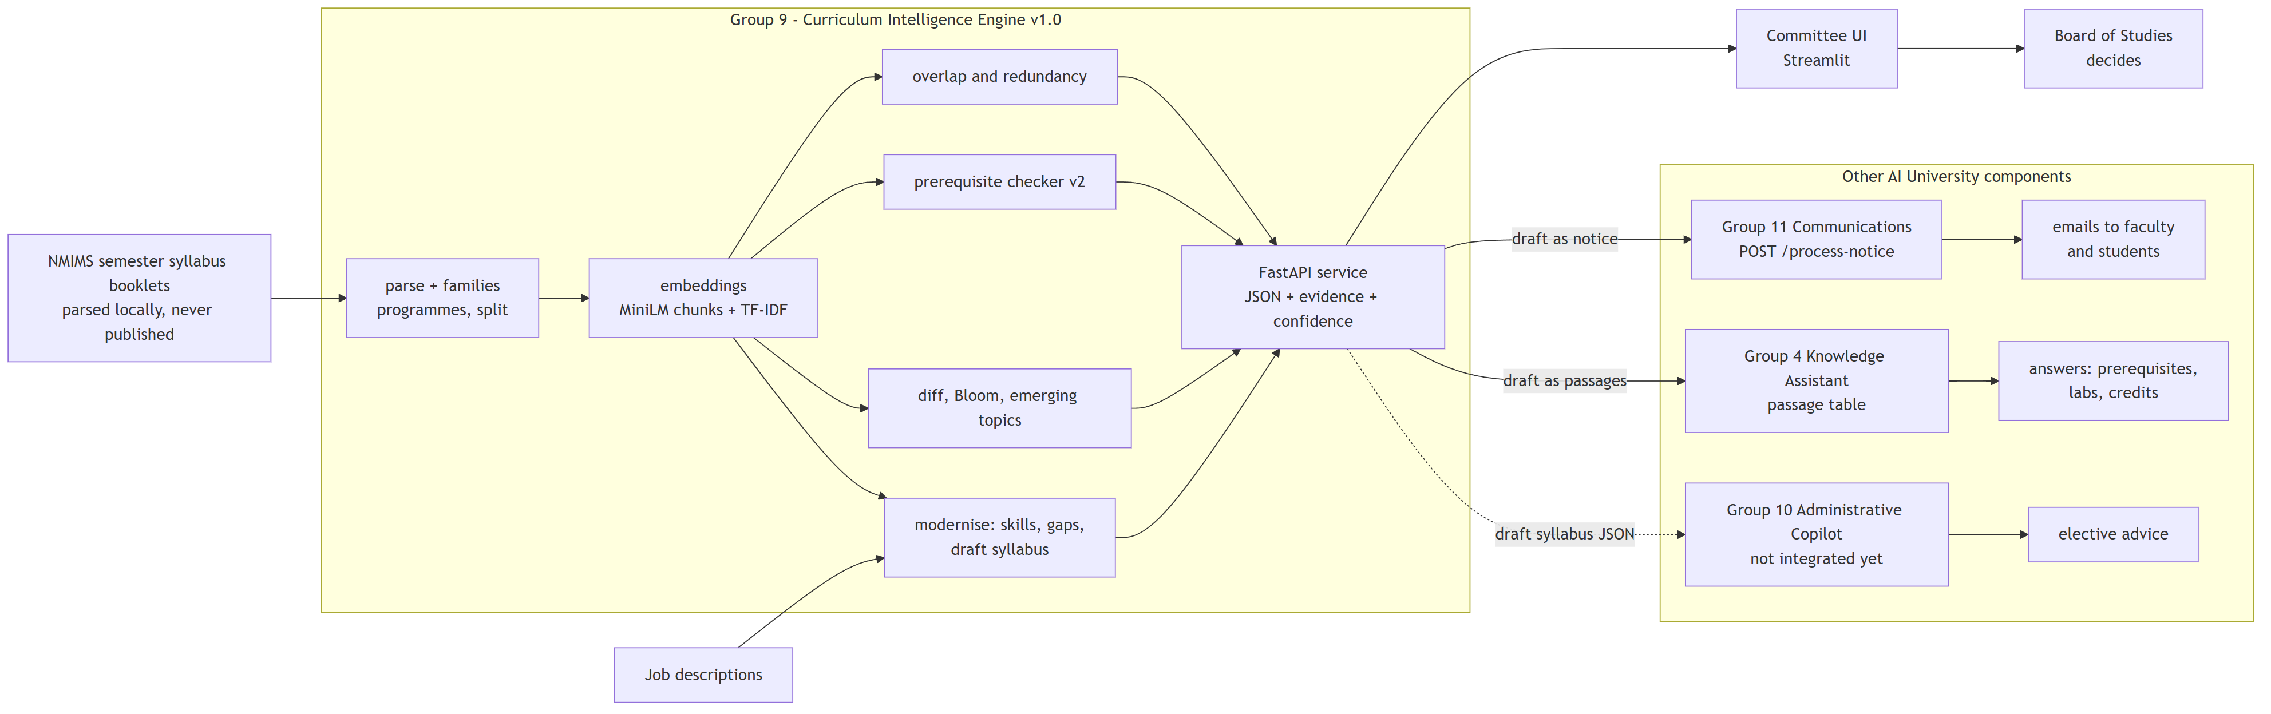
Architecture
Runs offline
Evidence with every answer
9 API endpoints
no cloud services; data never on GitHub
matched units, sources, confidence
one JSON for the UI and peers
Notes:
Left to right: booklets are parsed locally into course records and families; embeddings and TF-IDF feed the analysis modules; the FastAPI service returns JSON with evidence and confidence to the committee UI and to the other groups. Group 10 is a planned consumer, not integrated yet.

Slide 5
How we measured quality
502
Label set | Items | Passes 1 and 2 agree | Settled by pass 3
course pairs (overlap 0/1/2) | 200 | 171 | 28
detector flags (Week 3) | 187 | 182 | 5
prerequisite v2 flags (Week 6) | 45 | 45 | 0
JD skill coverage (Week 7) | 70 | 68 | 2
LLM-annotated reference labels
35
settled by a third pass, 1 left uncertain
No human annotators were used; results are indicative.
Second labeller: Phi-3 for part of the pairs, otherwise a second Claude prompt, so agreement there is not independent.
Notes:
The test split is held out by course family, so versions of one course never sit in two splits. Reference labels come from LLM passes with different wordings; disagreements went to a third pass. Say clearly: no human annotators were used, so results are indicative. A human spot-check sheet is ready but not filled in.

Slide 6
Results against our success criteria
12 / 14
Capability | Metric | Final | Target | Met?
Overlap | Spearman | 0.717 | ≥ 0.6 | yes
Redundancy | precision of top flags (reference labels) | 0.800 | ≥ 0.7 | yes
Prerequisites | removal recall | 0.711 | ≥ 0.8 | no
Prerequisites | precision of flags (reference labels) | 0.500 | ≥ 0.6 | no
Curriculum diff | precision (real year pairs) | 0.998 | ≥ 0.85 | yes
Bloom | accuracy vs faculty tags | 0.776 | ≥ 0.7 | yes
Emerging topics | precision of flagged gaps | 0.915 | ≥ 0.7 | yes
Topic labels | share accepted | 0.700 | ≥ 0.7 | yes
Curriculum modernisation | taught / gap accuracy on JD skill themes (reference labels) | 0.857 | no target set | –
success targets met on the test split
2
missed: both on prerequisite flags
Notes:
Targets were fixed in Proposal v2 before any result existed and are measured on the held-out test split. 12 of 14 are met. The two misses are both about prerequisite flags: checker v2 traded recall for precision.

Slide 7
Overlap and redundancy work
0.717
0.965
0.800
Spearman with reference labels (target 0.6)
ROC-AUC, any overlap (target 0.85)
precision of top redundancy flags (target 0.7)
e.g.
3 of 10 NLP-course pairs are identical
Natural Language Processing is taught with the same units in AI, COMP / CSE-DS / IT and EXTC; Speech and NLP overlaps it strongly; Generative AI hardly overlaps. A committee can merge these into one course.
Notes:
Overlap fuses TF-IDF with MiniLM chunk MaxSim. Spearman against the reference labels and ROC-AUC for any overlap are on the test split. Redundancy flags near-duplicate units inside a programme. The demo example: the same NLP syllabus is taught in several programmes.

Slide 8
Prerequisites: an honest trade-off
Fewer false alarms
rename false alarms 0.120 → 0.000
Higher precision
0.100 → 0.500 (n = 14); target 0.6 still missed
Lower recall
0.880 → 0.711; below the 0.8 target
Notes:
Our Week 5 error analysis showed most missing-prerequisite flags were wrong: umbrella names, fragments, non-subjects. Checker v2 removed false alarms and lifted precision, but removal recall fell below the target. Precision samples are small, so the intervals are wide.

Slide 9
Demo: from JDs to a new syllabus
1
Input
2
Overlap
3
Skills
4
Draft
5 JDs + 5 current NLP syllabi
3 of 10 syllabus pairs identical
15 demanded: 6 taught, 9 gaps
11 units: 5 shared, 2 kept, 4 new
Group 11 · Communications
Group 4 · Knowledge Assistant
Group 10 · Admin Copilot
Notice in their /process-notice schema → one email per audience (this run: mock; live once their service runs)
17 passages in their schema; our stand-in answered 4 of 5 student questions
Can read the same draft syllabus JSON for elective advice (not integrated yet)
Notes:
This is our step in the 31 October demo chain. Input: five job descriptions on fine-tuning LLMs (synthetic samples) and the current NLP syllabi of several programmes. Output: overlaps, demanded skills and a draft syllabus where every unit names its source. Then the draft goes to Group 11 as a notice and to Group 4 as passages.

Slide 10
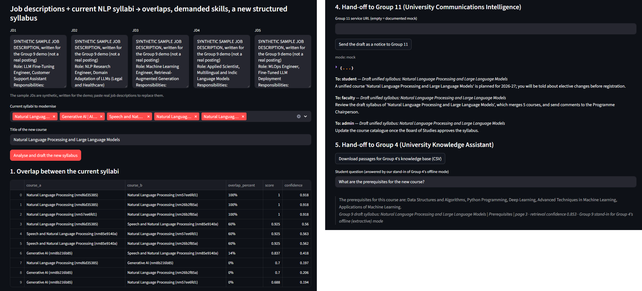
Committee UI
Left: JDs, selected syllabi, overlaps. Right: Group 11 emails (marked mock), a Group 4 answer with its source.
Notes:
Streamlit over the API. Demo tab: paste JDs, pick syllabi, see overlaps and skills, download the draft as Word, Markdown or JSON, send the notice to Group 11, export passages for Group 4. Other tabs compare two courses, two years, prerequisites, redundancy and emerging topics. The sidebar always says outputs are drafts.

Slide 11
Responsible AI
1
Privacy
2
No invented content
Booklets and parsed text stay local; only ids, metrics and labels are public
Draft syllabi are copied or templated, never generated; every unit names its source
3
Human in the loop
4
Fairness
Outputs are drafts for the Board of Studies; the UI warns against automatic course cuts
Bloom accuracy ranges 0.692 (COMP) to 0.857 (MECHATRONICS); small programmes excluded from prerequisite checks
Notes:
Four risks and what the system does about each. Fairness: quality is not equal across programmes; programmes with too little parsed data get no prerequisite checks at all, instead of unreliable ones.

Slide 12
Limitations and next steps
Limitation | Today | Next step
Scanned booklets | 531 of 2,413 PDFs parsed | Add OCR, then re-run coverage
Labels | LLM-annotated, no human annotators | Fill the 50-pair human spot check
Prerequisite flags | precision 0.500, removal recall 0.711 | Faculty-confirmed prerequisite map
Job descriptions | synthetic samples in the demo | Real postings; Group 10 integration
Every number in the reports and these slides is generated from results/*.json; skipped analyses are reported as not run.
Notes:
Be direct about the limits: coverage of scanned booklets, LLM labels, prerequisite precision, synthetic job descriptions. Each one has a concrete next step.

Slide 13
Thank you · Questions?
github.com/jainamsethia/Curriculum-Intelligence-Engine (tag v1.0)
36 tests pass; a clean clone reproduces all 62 result files
Code and text written with AI assistance (Claude); reference labels are LLM-annotated.
Notes:
Close with where to find the code and how it was tested. Invite questions; the live demo follows.

