Slide 1

Mining Customer Survey Data for SFO Airport Authority
December 6th, 2012
Ankit Jain (5009 7432)
Deepak Veerupapuram (5009 8125)
Milky Sahu (5009 6350)

Slide 2
To understand what features have a direct influence on Overall Satisfaction level of customers
Business Problem
Stakeholder
San Francisco Airport Authorities
Business decisions can be made to improve overall customer satisfaction
Objective
Benefit
Use Case
Customers using airport facilities
To visualize what influence features have on overall customer satisfaction.

Slide 3







Data Preparation
• 68 Feature Columns
Initial
• 3872 Customer Survey Responses
• Identifying key features.
• Using understanding of customer preferences
Reduce
Features
• 14 Features x 3872 Customers
• Essentials: Airport Parking, Rental Cars, Screen Information, Retail Shops,
Cleanliness, Signs and Directions, Information Booth
Final
Final

Slide 4

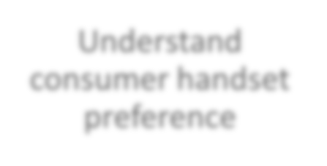


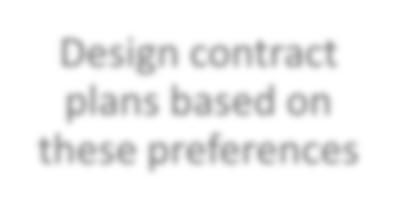
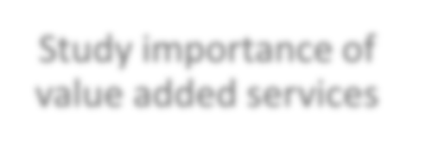


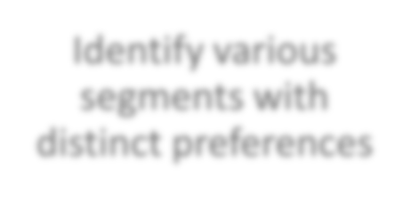
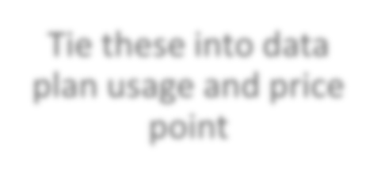
Dependency patterns can be extracted from data by using data mining techniques.
Idea
Understand
Customer survey
data
Data clean up and reduction
Visualize output
Applying Bayesian Networks, Decision Trees and k means algorithms
Study of impact of
features on customer satisfaction

Slide 5
Target Feature: Overall Satisfaction with Airport Facilities
Other Features:
Restaurants
Retail Shops
Signs and Directions
Escalators
Screen Information
Information Booth
Airport Parking
AirTran
Rental Car
Cleanliness
Safety
Finding Way
Security Screening

Slide 6
ALGORITHM 1:
BAYESIAN NETWORK
Why Bayesian Model (BN) ?
Implement graphical model structure (DAG).
2. Cause-and-effect diagram and is easy to interpret.
3. Various possible improvement scenarios can be easily simulated
and evaluated.
A BN is an innovative approach to support strategic decisions.

Slide 7
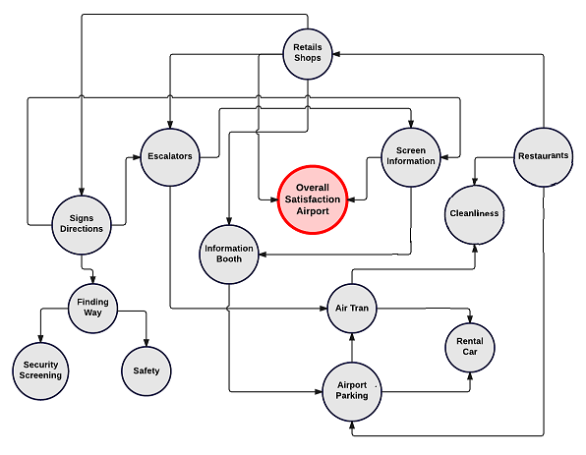
Edge from node A → B represents a statistical dependence between the corresponding variables. Arrow indicates that a value taken by B depends on the value taken by A.
Overall Customer Satisfaction is directly influenced by Screen Information and Retail Shops.

Slide 8
ALGORITHM 2:
TREE BASED METHODS (Optimal CART Tree)
Classification Algorithms and Regression Trees (CART) model is applied on this dataset.
Dichotomization of target variable is obtained by aggregating the two highest levels on the one hand and the other lower ones on the other hand. The categories thus obtained are labeled
‘yes’ and ‘no’, respectively.

Slide 9
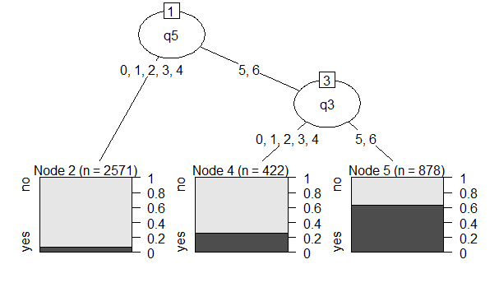
Node 5 contains customers with high or very high levels of satisfaction with
both screen information and signs and directions; in this group the percentage
of customers satisfied with SFO Airport is 61% (against 22.05% in the dataset
as a whole)
Q5: Screen Information at SFO Airport
Q3: Signs and Directions at SFO Airport
Dependent Variable: Overall Satisfaction at SFO Airport

Slide 10
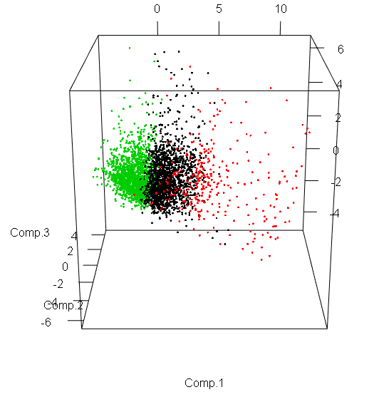
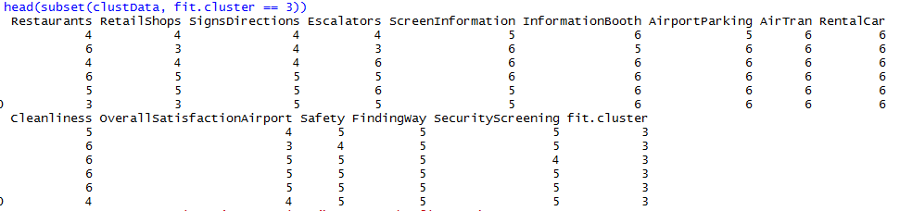
ALGORITHM 3: k-Means Clustering
1. Clustering on full dataset to determine if the customers are satisfied or not.

Slide 11
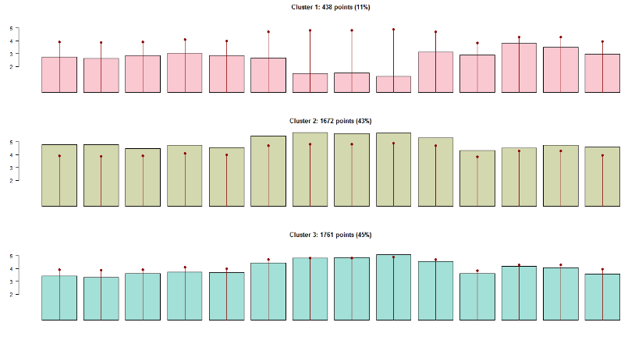
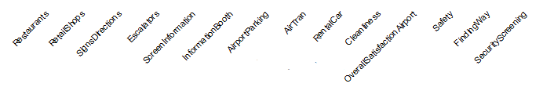
k-Means Clustering

Slide 12
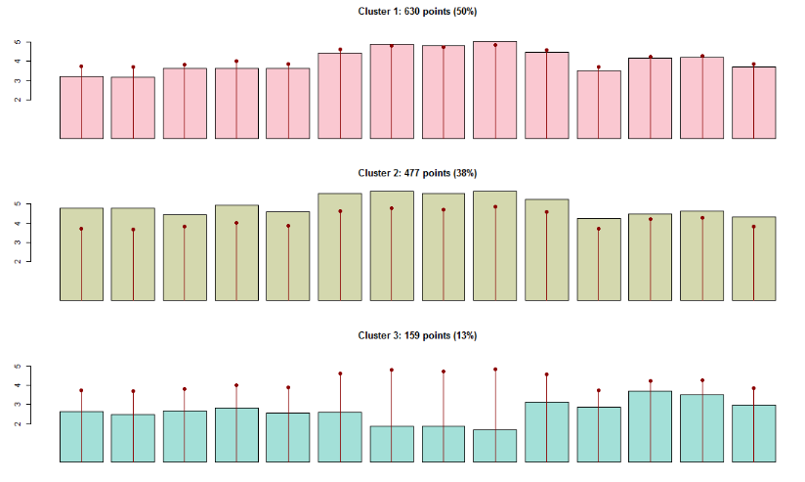
2. Clustering on dataset for different terminals to determine which terminal needs
improvement and on which feature. (Terminal 1)

Slide 13
CONCLUSION AND FUTURE WORK
1. Overall Customer Satisfaction is directly influenced by Screen Information and
Retail Shops. (BN)
2. Signs and directions can be further improved at SFO Airport to further increase the
satisfaction level with airport facilities. (Tree Based)
3. Customers are least satisfied with AirTran connectivity at Terminal 1. (K Means)
4. On the basis of estimated network, we can perform various simulations and
assess various scenarios.
As an example, we can change the satisfaction profile of screen information and
show how the overall satisfaction level changes.

Slide 14
THANK YOU

