Slide 1
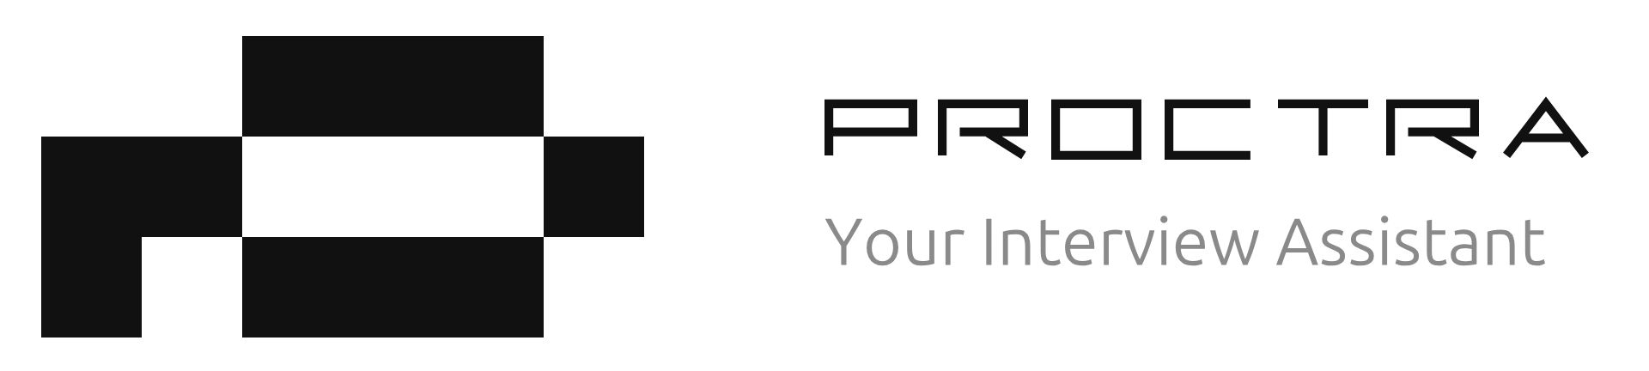
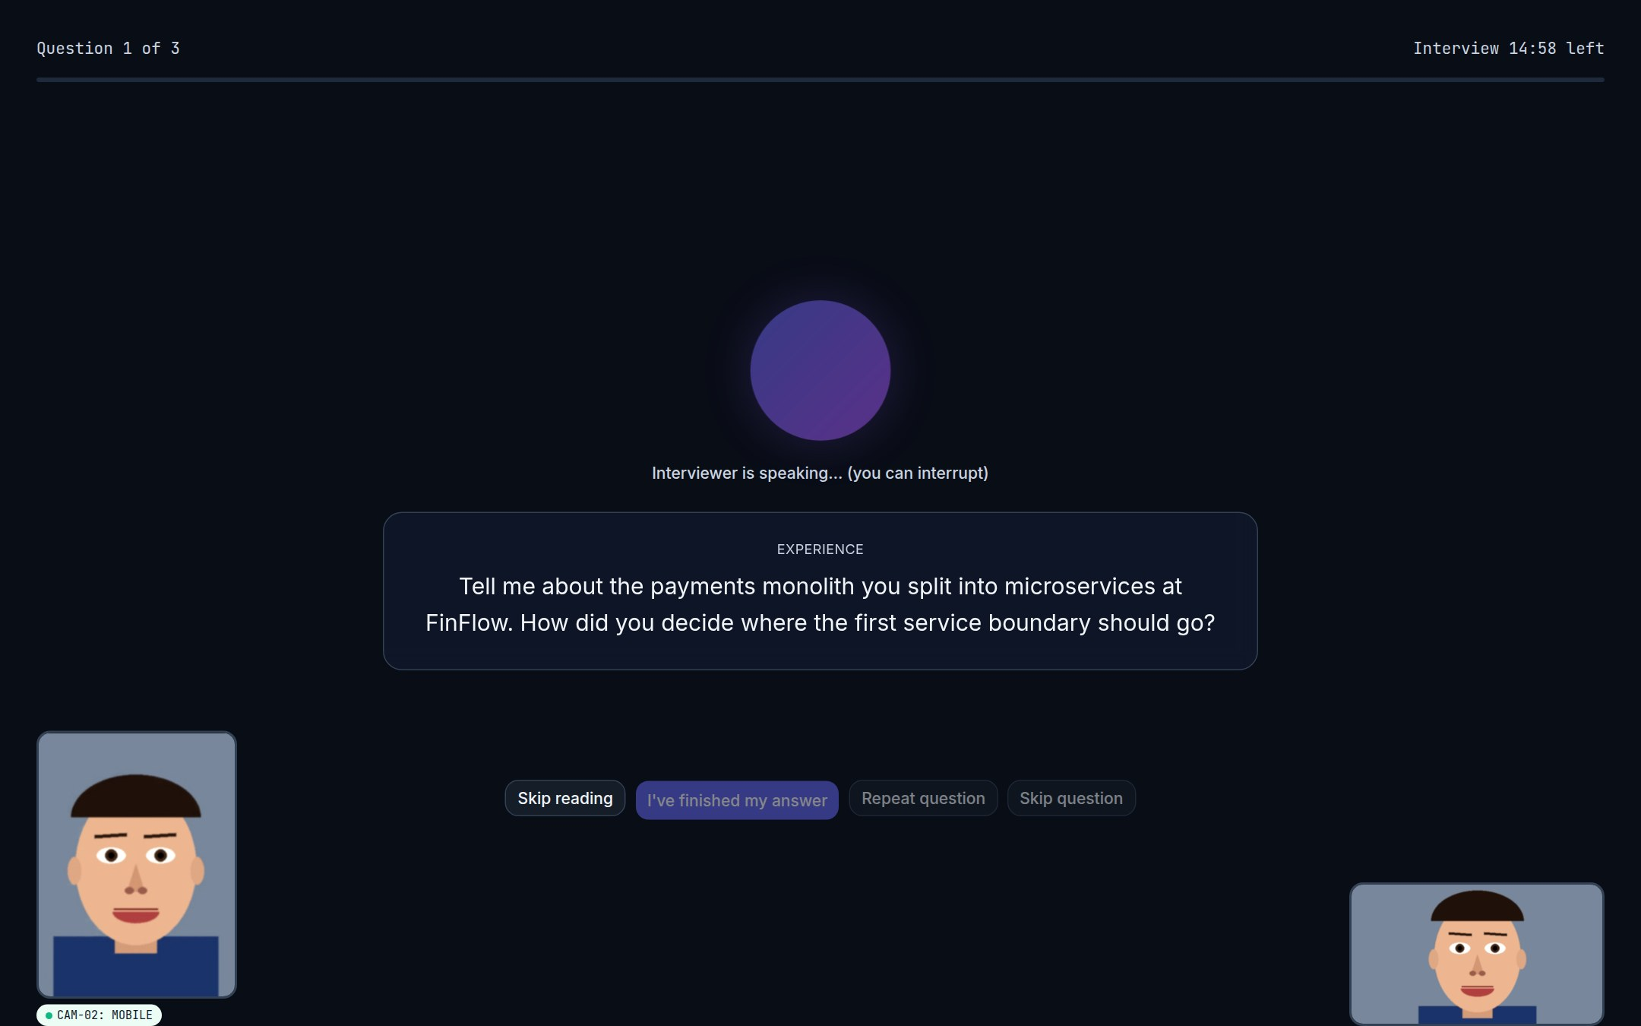
AI interviews, human decisions
An AI voice interviewer with dual-camera, browser-side proctoring. Every score is backed by evidence; every hiring decision is made by a person.
TEAM
Live interview: the AI asks while camera and phone views stay on screen
[Team name]
[Member 1] · [Member 2] · [Member 3] · [Member 4]
Live demo: proctra-two.vercel.app
Notes:
Proctra is an AI video-interview agent. It runs a real voice interview tailored to the job and the candidate's resume, records camera, screen and a phone side-view, and hands the recruiter an evidence-backed review. The AI never decides who gets hired.

Slide 2
Remote hiring can't trust what it sees, or scale screening
Who experiences it
6%
1 in 4
Recruiters and hiring managers running remote first-round interviews, and the candidates stuck in slow, inconsistent screens.
of ~3,000 candidates admitted to interview fraud
candidate profiles could be fake by 2028 (forecast)
Why it matters
Gartner survey, via HR Dive (2025)
Gartner, via HR Dive (2025)
First rounds are the slowest, costliest part of hiring.
AI tools make scripted or impersonated answers cheap; 59% of hiring managers suspected a candidate of AI misrepresentation (Checkr).
Teams either over-trust what they see or spend hours re-checking it.
1 in 5
44 days
professionals admitted secretly using AI in interviews
median time to fill a role; about $5,475 per hire
Blind survey (2025)
SHRM 2025 benchmarks
Notes:
Gartner's survey of about 3,000 candidates found 6% admitted interview fraud, and Gartner forecasts that by 2028 one in four candidate profiles could be fake. A 2025 Blind survey found one in five professionals secretly used AI during interviews. SHRM's 2025 benchmarks put time-to-fill at about 44 days and cost per hire at about $5,475.

Slide 3
Who it's for, and what today's tools miss
Users & stakeholders
Current solutions and their limits
Still unsolved
Recruiters and talent teams (primary)
Hiring managers
Candidates
Org admins, compliance and legal
1
One-way video interviews
A real, adaptive conversation, integrity evidence and explainable scoring in one flow, with a person making the call.
No real conversation or follow-ups; answers are easy to script with AI
2
Exam-style proctoring tools
Built to auto-flag and auto-fail; one camera; opaque verdicts
Why a new solution
AI assistants defeat static questions. Questions must adapt to each candidate's own resume and answers.
3
Human phone screens
Inconsistent, hard to scale, and leave little evidence behind
Notes:
Existing tools pick one piece: async video has no conversation, exam proctoring auto-fails people, and phone screens don't scale. Nobody combines an adaptive interview, integrity evidence and explainable scores while keeping a human in charge.

Slide 4
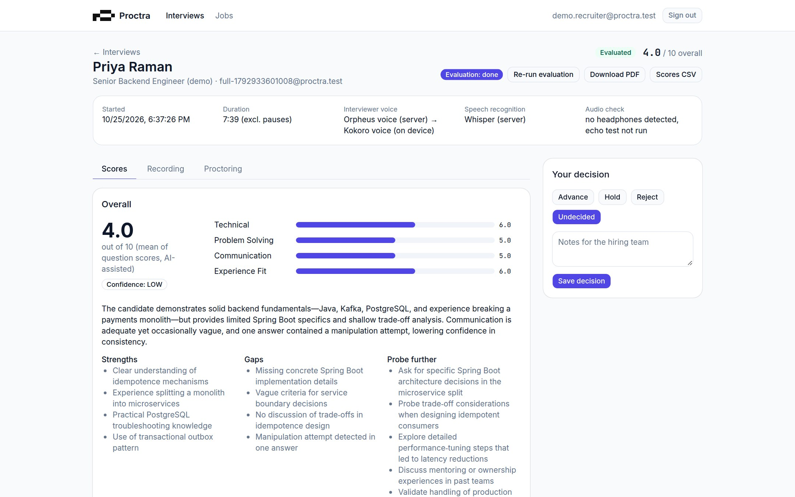
Proctra: an AI interviewer that brings evidence, not verdicts
1
Adaptive voice interview
Resume- and job-specific questions, follow-ups, "repeat" and interruptions handled naturally
2
Camera, screen and phone evidence
All three are recorded and replayed in sync; signals become observations with harmless explanations
3
Explainable scores
Every rubric score cites verbatim quotes, verified against the transcript
4
People decide
Recruiters override scores with a reason and choose Advance, Hold or Reject
Recruiter review: scores with evidence, synced recordings, and the decision panel
What's new: proctoring never feeds the score (enforced in code and tested), and perception and fallback voice run in the browser: private and free.
Notes:
Proctra plans questions from the job description and resume, runs the voice interview, records three streams, and evaluates with verified quotes. Proctoring is shown to the recruiter as observations but is never used in scoring.

Slide 5
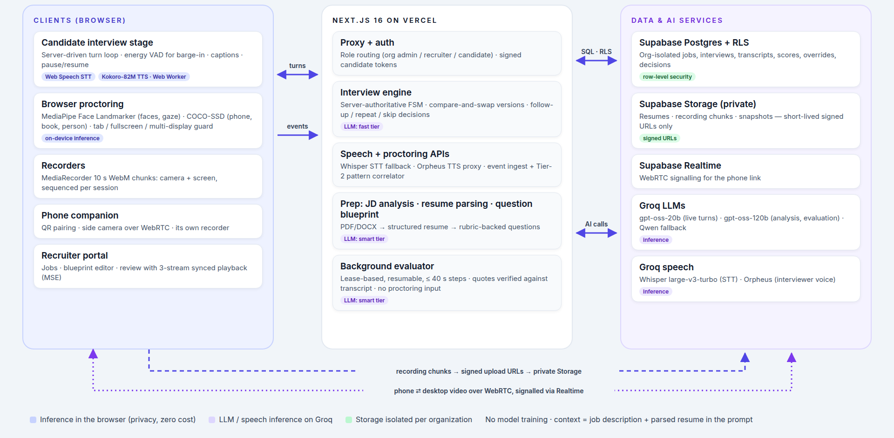
System architecture
Notes:
Perception (MediaPipe, COCO-SSD) and the fallback voice (Kokoro in a Web Worker) run in the candidate's browser. Next.js on Vercel holds the server-authoritative interview engine, speech and proctoring APIs and the background evaluator. Supabase stores data with row-level security and private storage; Groq runs the language and speech models. No model training; the context is the job description plus the parsed resume.

Slide 6
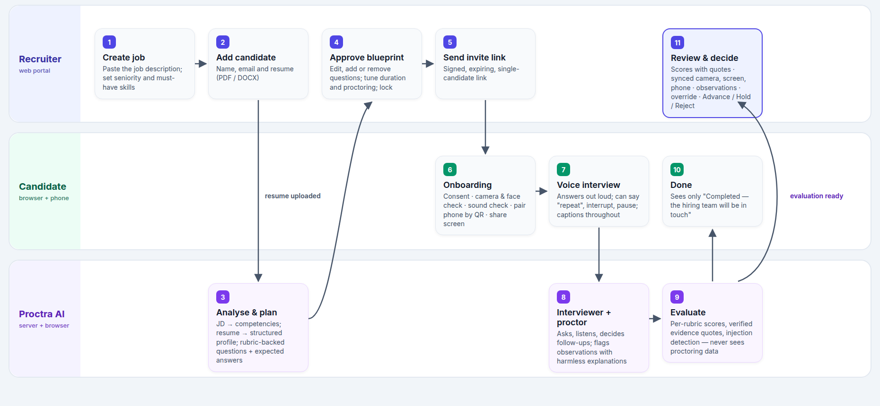
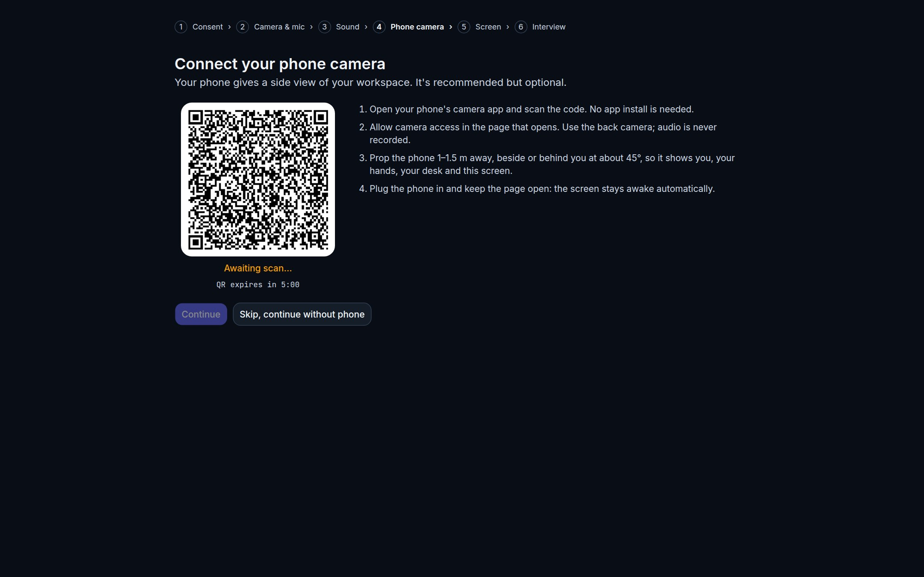
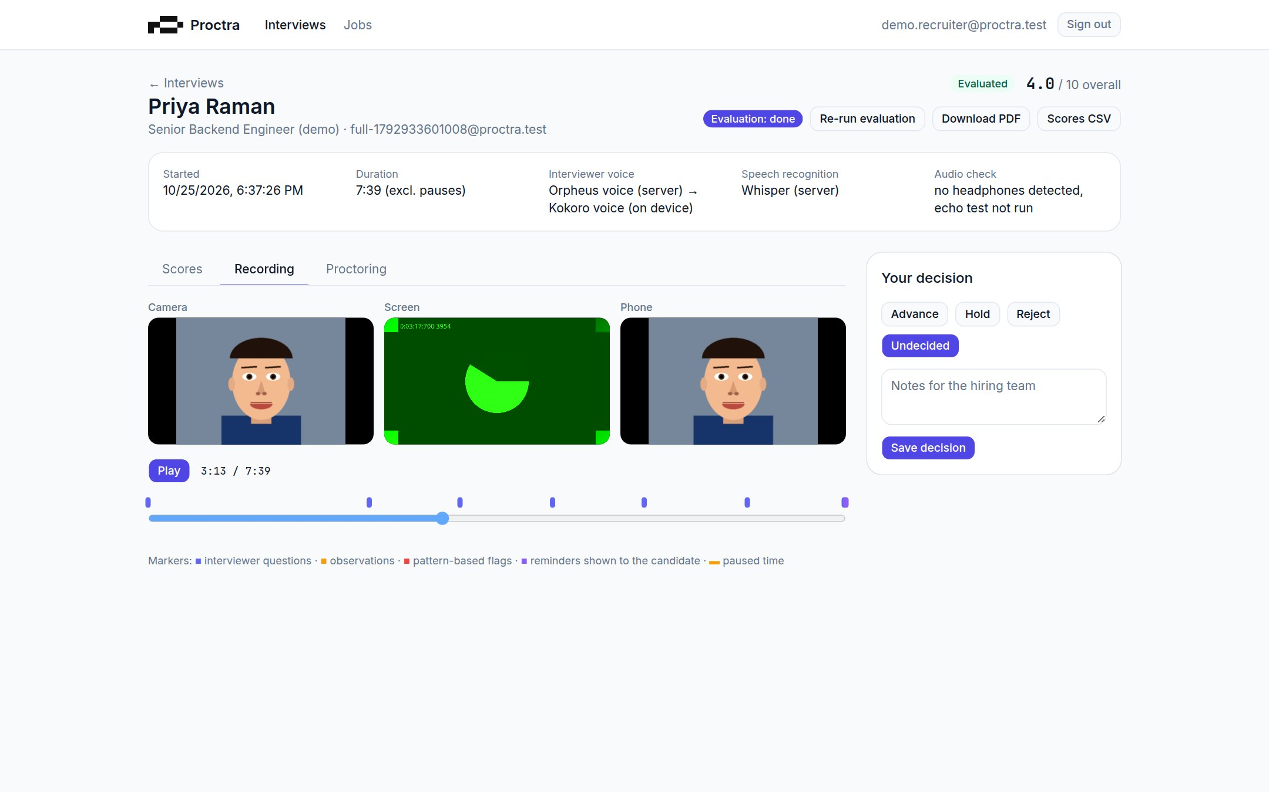
Workflow and user journey
Candidate pairs a phone by QR
Example: Senior Backend Engineer. The recruiter adds the resume, approves 3 AI questions about the candidate's real projects and sends the link. The ~8-minute voice interview includes follow-ups and one interruption; the evaluation is ready ~30 s later.
Recruiter replays 3 synced streams
Notes:
Recruiter: create job, add candidate and resume, approve the AI blueprint, send the link. Candidate: consent, camera and face check, sound check, phone pairing, screen share, then the voice interview. Proctra evaluates in the background; the recruiter reviews and decides.

Slide 7
Implementation: what we built during the hackathon
Stack
Challenge | What we did | Result
Voice silent ~25 s before speaking | Moved voice inference to a Web Worker with a priority queue | Follow-ups start in 5–10 s
Serverless time limits | Evaluation split into resumable 40 s steps | No timeouts; safe retries
Prompt injection in answers | Transcript fenced as untrusted data; attempts flagged | Injection answer scored 3–4/10
Browsers without system voices | Browser voice → Orpheus → Kokoro failover | A voice is always available
PDF parsing failed on Vercel | Bundled the pdf.js worker | Resume parsing works in production
Next.js 16 + TypeScript
Supabase: Postgres + RLS
Storage + Realtime
Groq: gpt-oss-20b / 120b
Groq: Whisper + Orpheus
MediaPipe + COCO-SSD
Kokoro-82M (ONNX)
WebRTC · Vercel
Engineering approach
Server-authoritative interview state machine
Voice-activity barge-in; 3-engine voice failover
10 s recording chunks, stitched for synced playback
Resumable background evaluator; row-level security
Notes:
Everything runs on free tiers with Apache/MIT components. The biggest challenge was the on-device voice blocking the page; moving it to a Web Worker cut the silence from about 25 s to 5–10 s on follow-ups.

Slide 8
Results: measured, not estimated
Full voice interviews pass all 11 end-to-end checks, locally and on the live Vercel site. 49 unit tests.
55/55
21/21
100%
3–4/10
data-isolation checks
review playback and seek checks
evidence quotes verified
score for a prompt-injection answer, flagged
Limitations and known failures
Phone camera needs the same network until a TURN relay is added
Cloud voice limited to 100 requests/day (~4 interviews); then on-device voice
Not yet tested with real candidate cohorts, Safari or Firefox
Webcam gaze is approximate: flags are observations, never verdicts
On-device voice, headless Chromium, after the 5 s answer wait. Cloud voice: 0.34 s.
Notes:
All numbers on this slide are measured from automated end-to-end runs against the real stack. Evaluation takes about 11–30 s and 8.5k–11.8k Groq tokens per three-question interview. User testing with real candidates has not happened yet.

Slide 9
Impact and next steps
Expected impact
Scalability and deployment
Recruiters review a structured, evidence-backed interview instead of running every first-round call. Scoring is consistent, and accent and appearance are never scored.
Stateless serverless backend on Vercel; heavy perception runs on the candidate's device; managed Postgres, storage and realtime.
Feasibility, cost and risks
Next steps
Runs today on free tiers, using ~10–20k LLM tokens per interview (measured). Risks: false-positive flags, privacy, bias and AI-in-hiring rules, mitigated by human review, consent and private storage.
TURN relay for phones on any network · pilot with recruiting teams · ATS integrations · multilingual interviews · bias and accessibility audits.
Try it: proctra-two.vercel.app
Notes:
Impact figures are expectations, not measurements. The cost figure is measured token usage; prices depend on the provider tier. Next we add a TURN relay and run a pilot with real recruiting teams.

