Slide 1
Wireframe – ICAP Management UI
https://github.com/filetrust/program-icap/wiki/Abridged-Amendment-3
3.2 | Management UI | Requirements pertaining to the delivery of UI features
3.2.1 | Performance Display | UI shall display statistics concerning the operating status of the GW Engine to include file processing performance, processing rates, priority findings, trend analysis and other information as determined by the Enhancement 4 Technical Exchange Meeting and subsequently documented in the Enhancement 4 Design Document.
3.2.2 | Policy Management | UI shall allow administrative users to configure and update ICAP proxy file inspection. This feature shall also allow users to see which policies were applied to non- compliant files.
3.2.3 | Non-compliant File Routing | UI shall include a file routing feature that allows users to route files that do not comply with stated management policies for passage onto separate file systems. Specified file systems and routing mechanism(s) will be determined at the Enhancement 4 Technical Exchange Meeting and subsequently documented in the Enhancement 4 Design Document.
3.2.4 | Risk and File Extension-based Views | UI shall allow administrative users to view and filter file’s processing results based on risk level and detected file extension.
3.2.5 | File Drop Service* | UI shall allow administrative and non-administrative users to upload supported file types via browser for GW Engine inspection and subsequent report generation of priority findings. Reports shall be delivered to users through the UI and minimally allow for XML and PDF export. Report content will be determined at the Enhancement 4 Technical Exchange Meeting and subsequently documented in the Enhancement 4 Design Document.

Slide 2
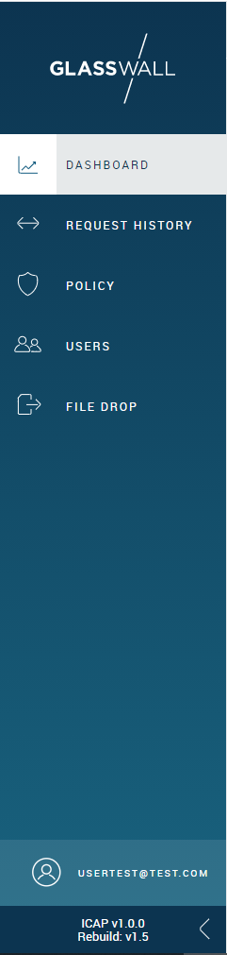
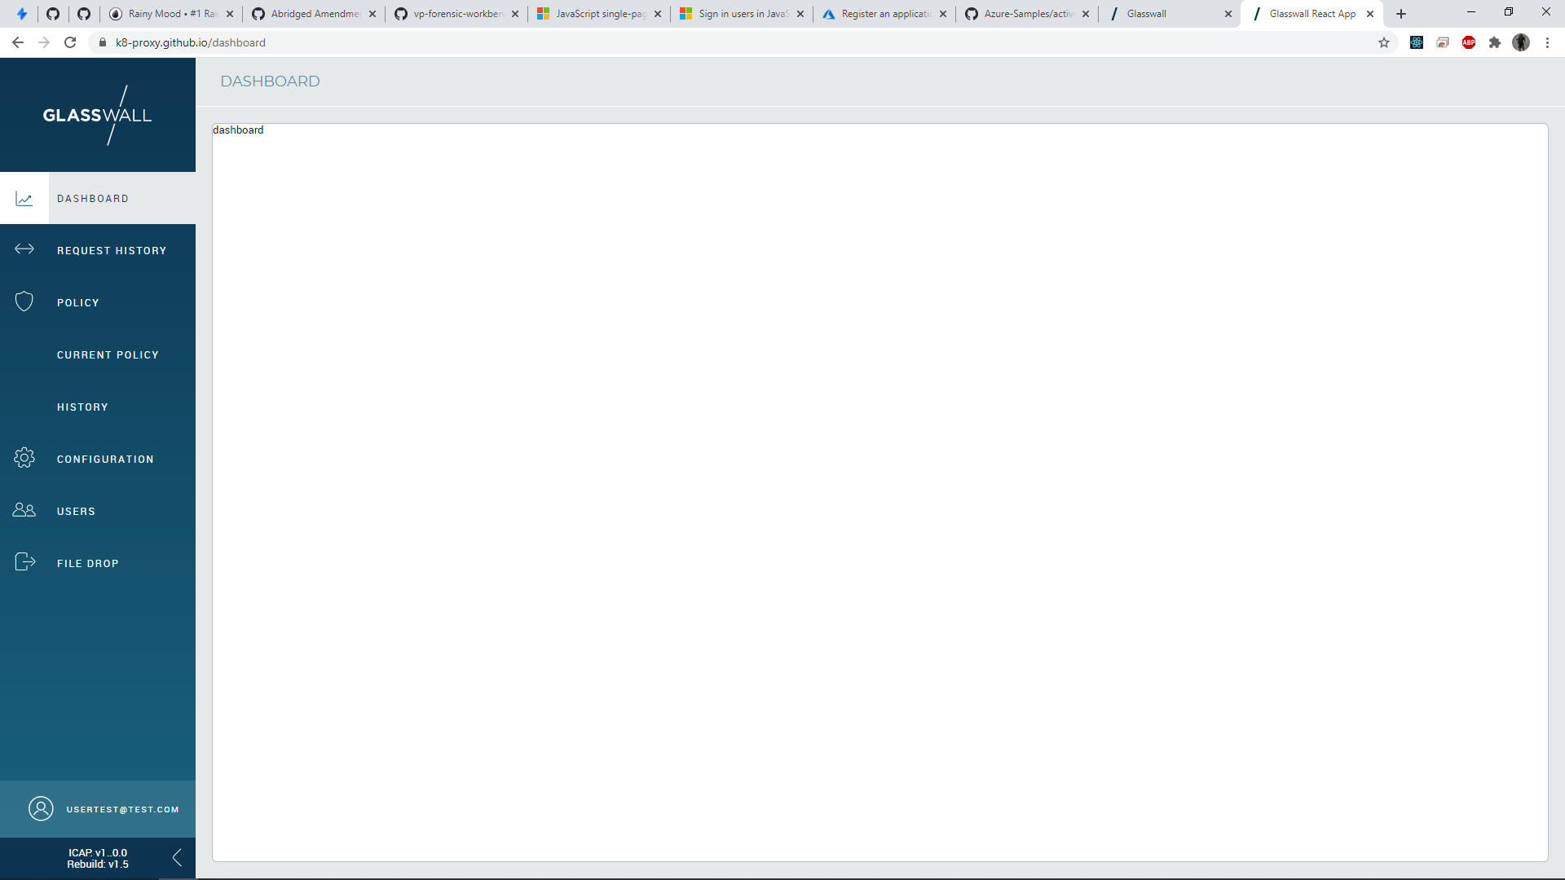
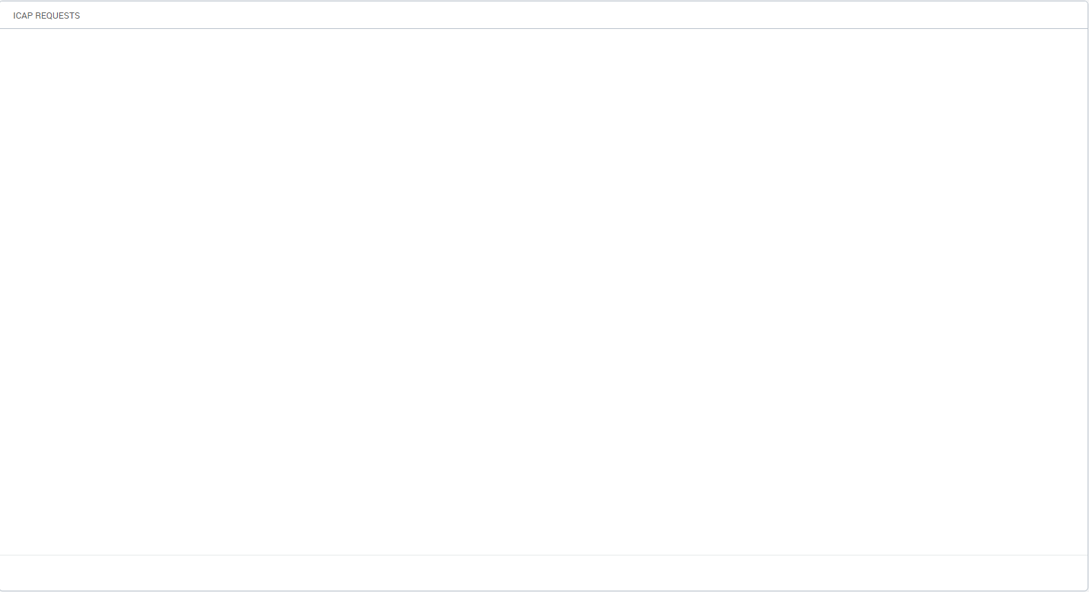


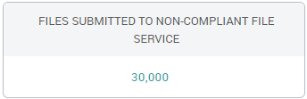
3.2.1 – Performance Display

Slide 3
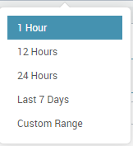
3.2.1 – Performance Display – Date Picker Presets

Slide 4
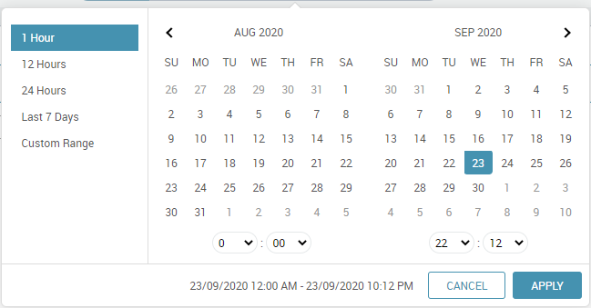
3.2.1 – Performance Display – Date Picker Custom Range

Slide 5
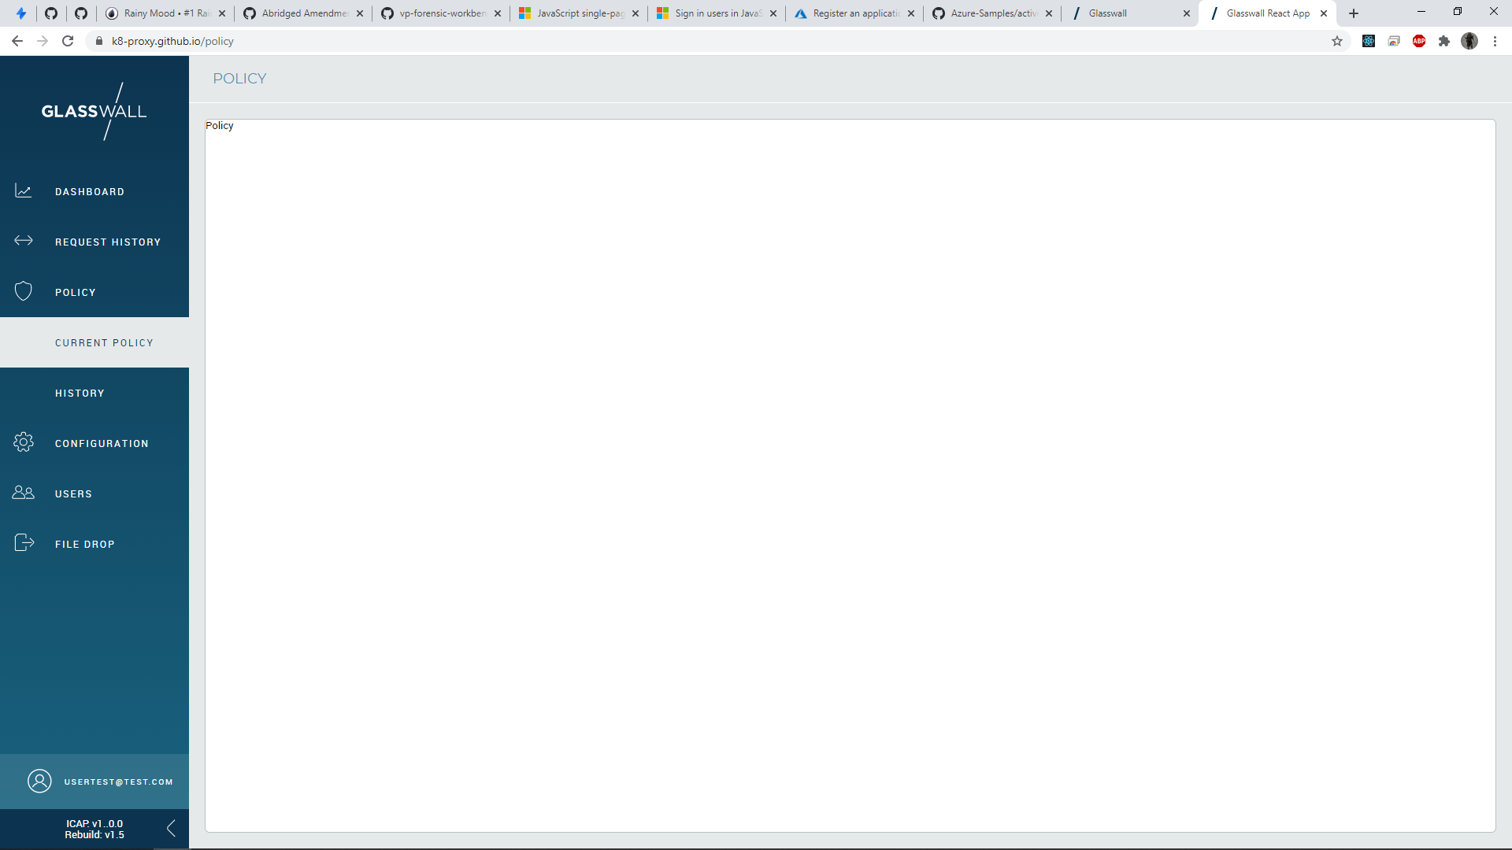
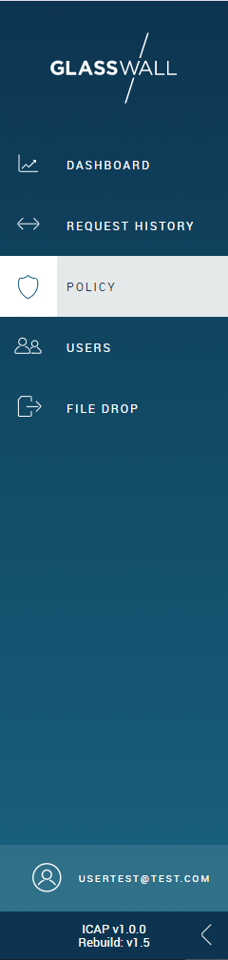
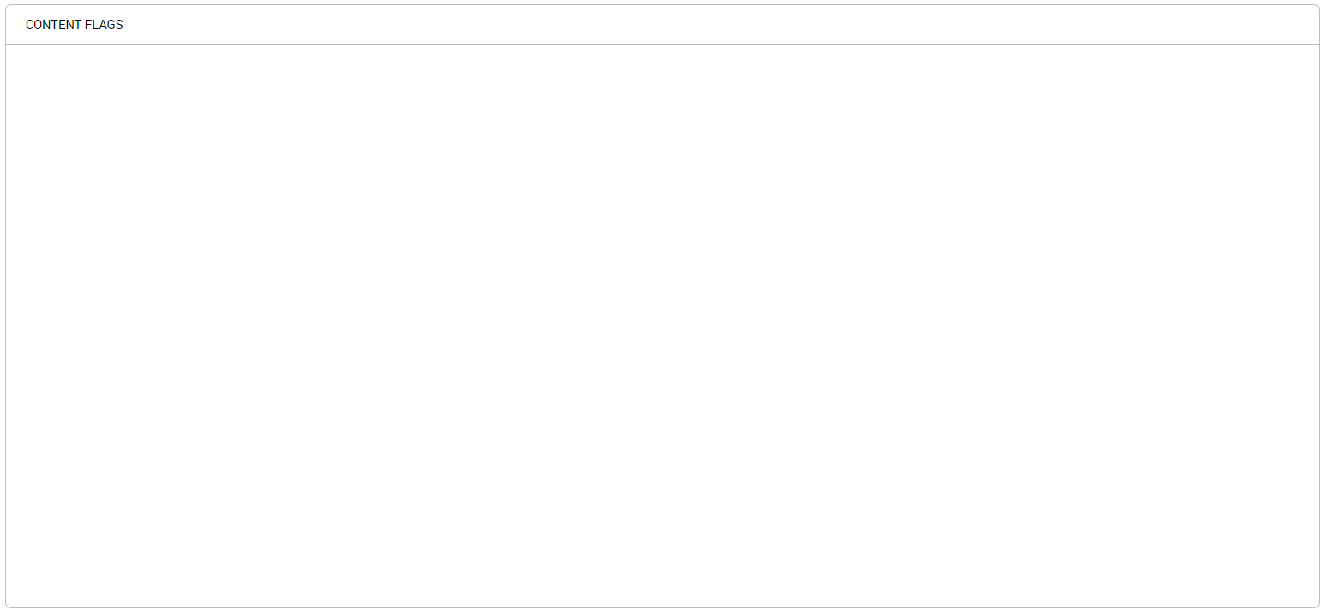
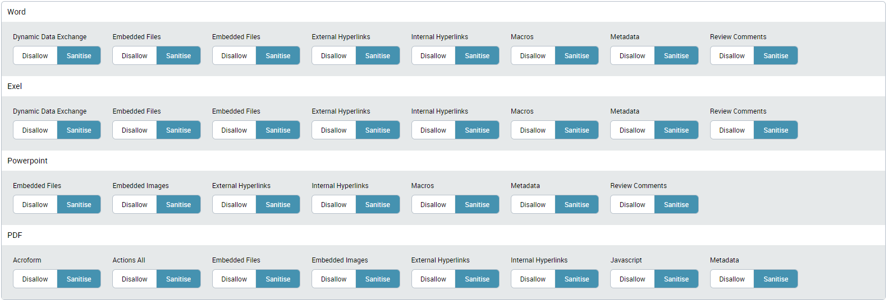
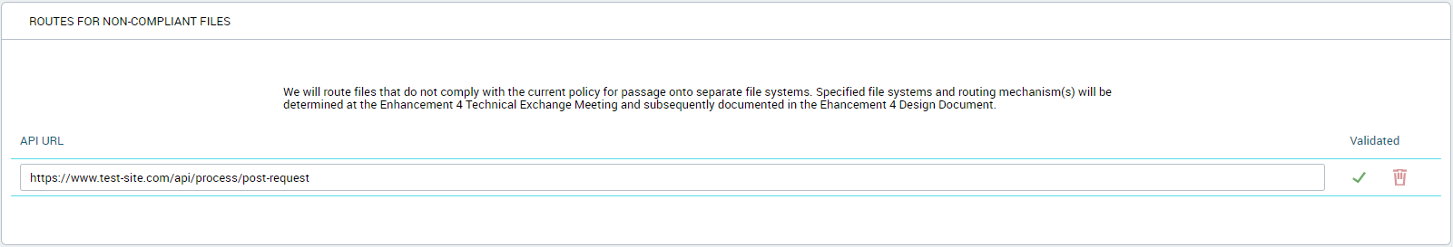
3.2.2 – Policy Management

Slide 6
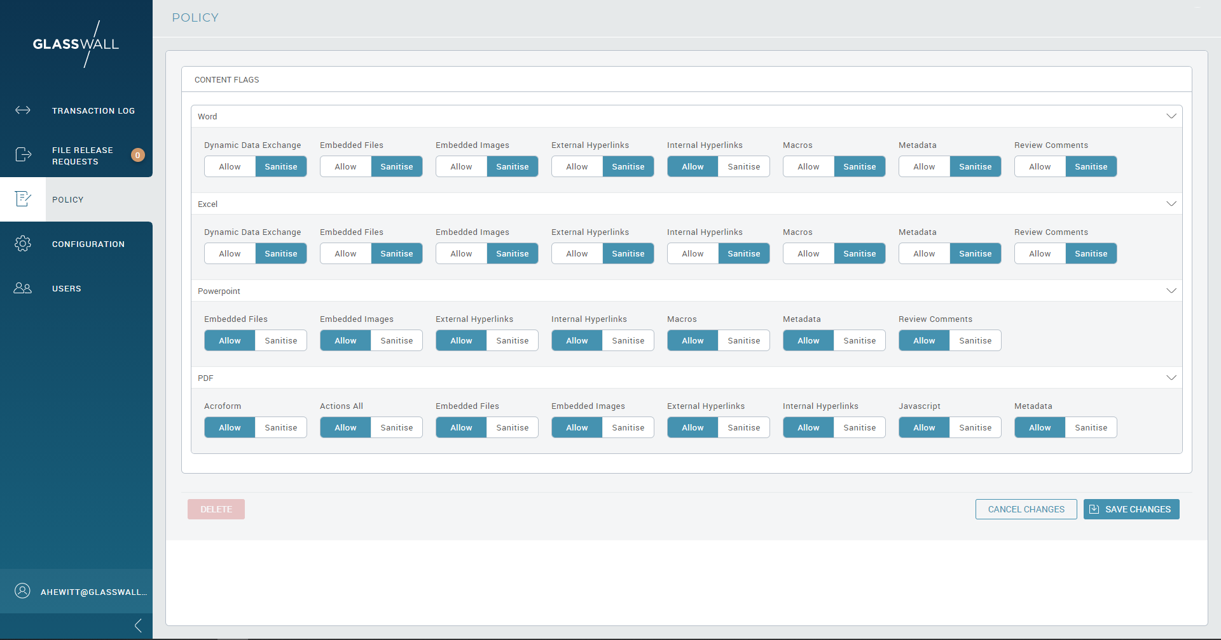
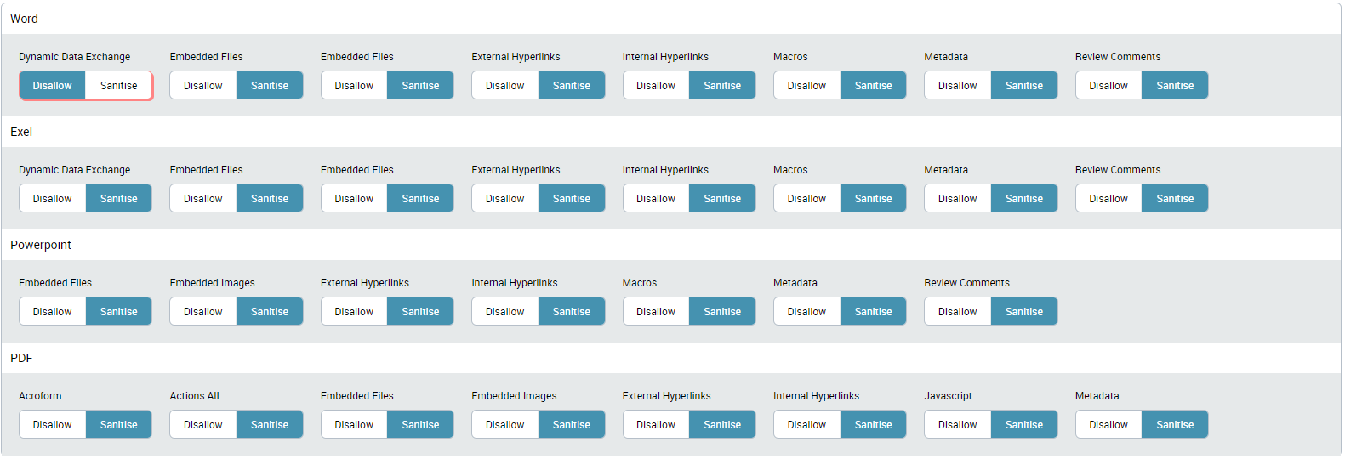
3.2.2 – Policy Management –Policy Edit

Slide 7
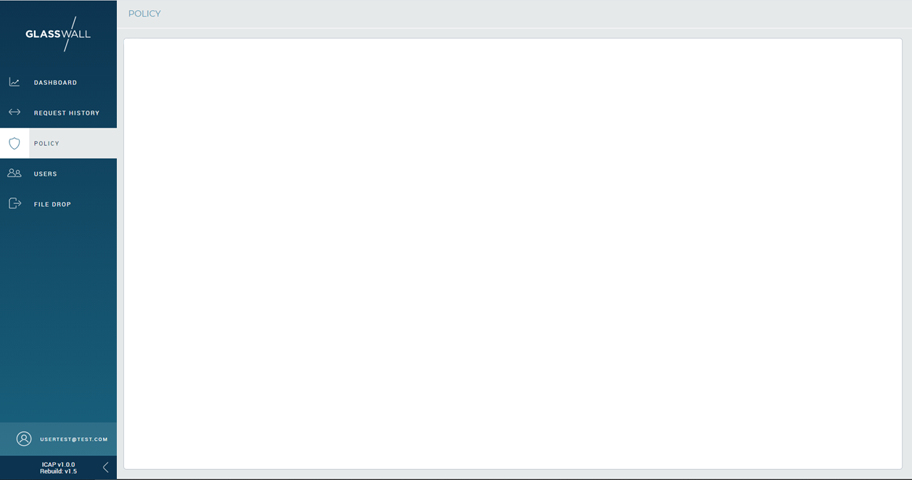
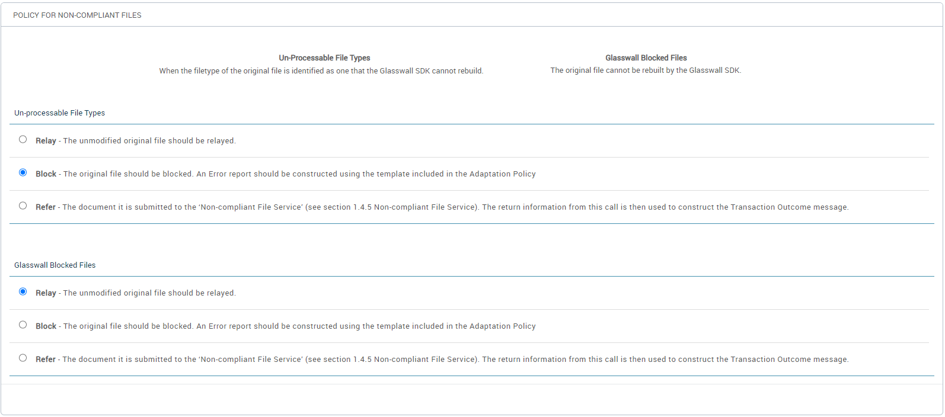
3.2.2 – Policy Management – Non Compliant Files 1

Slide 8
3.2.2 – Policy Management – Non Compliant Files 2

Slide 9
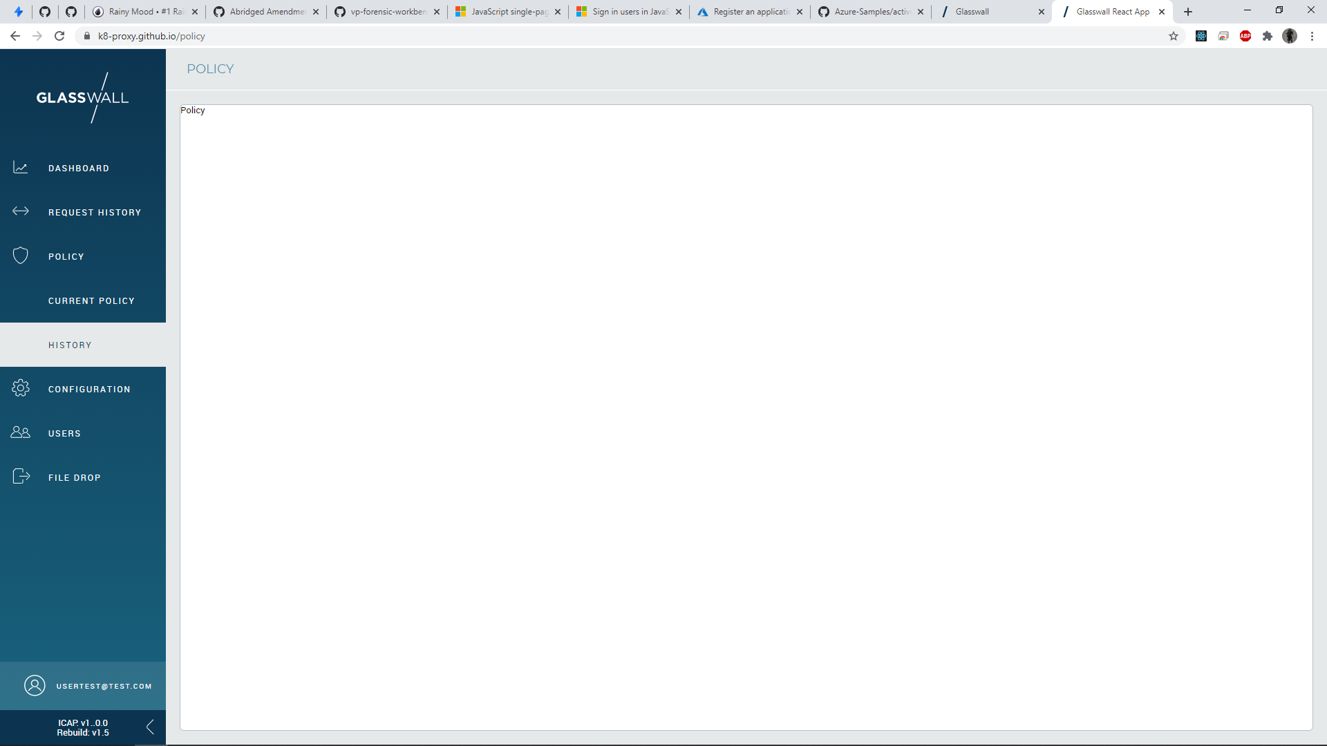
3.2.2 – Policy Management – Policy History

Slide 10
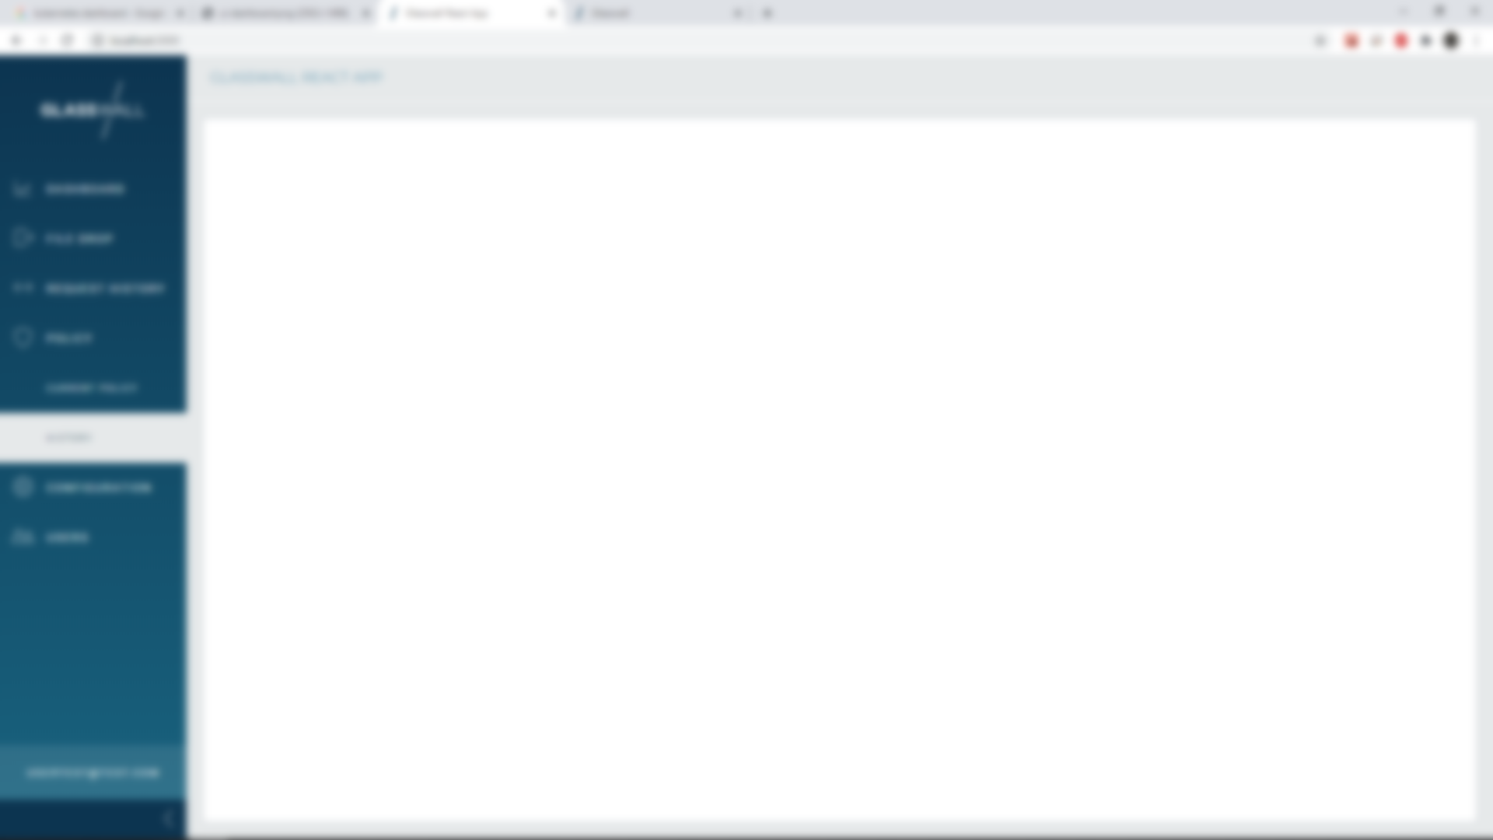
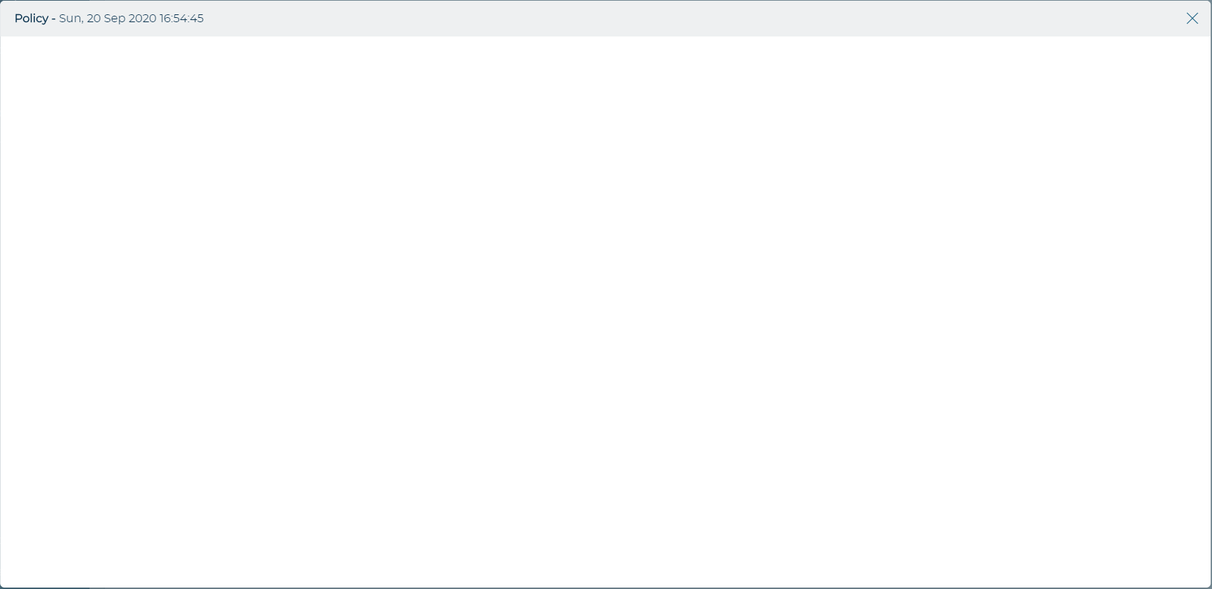
3.2.2 – Policy Management – View a Previous Policy

Slide 11
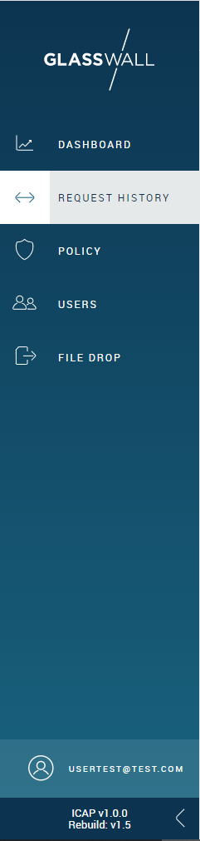
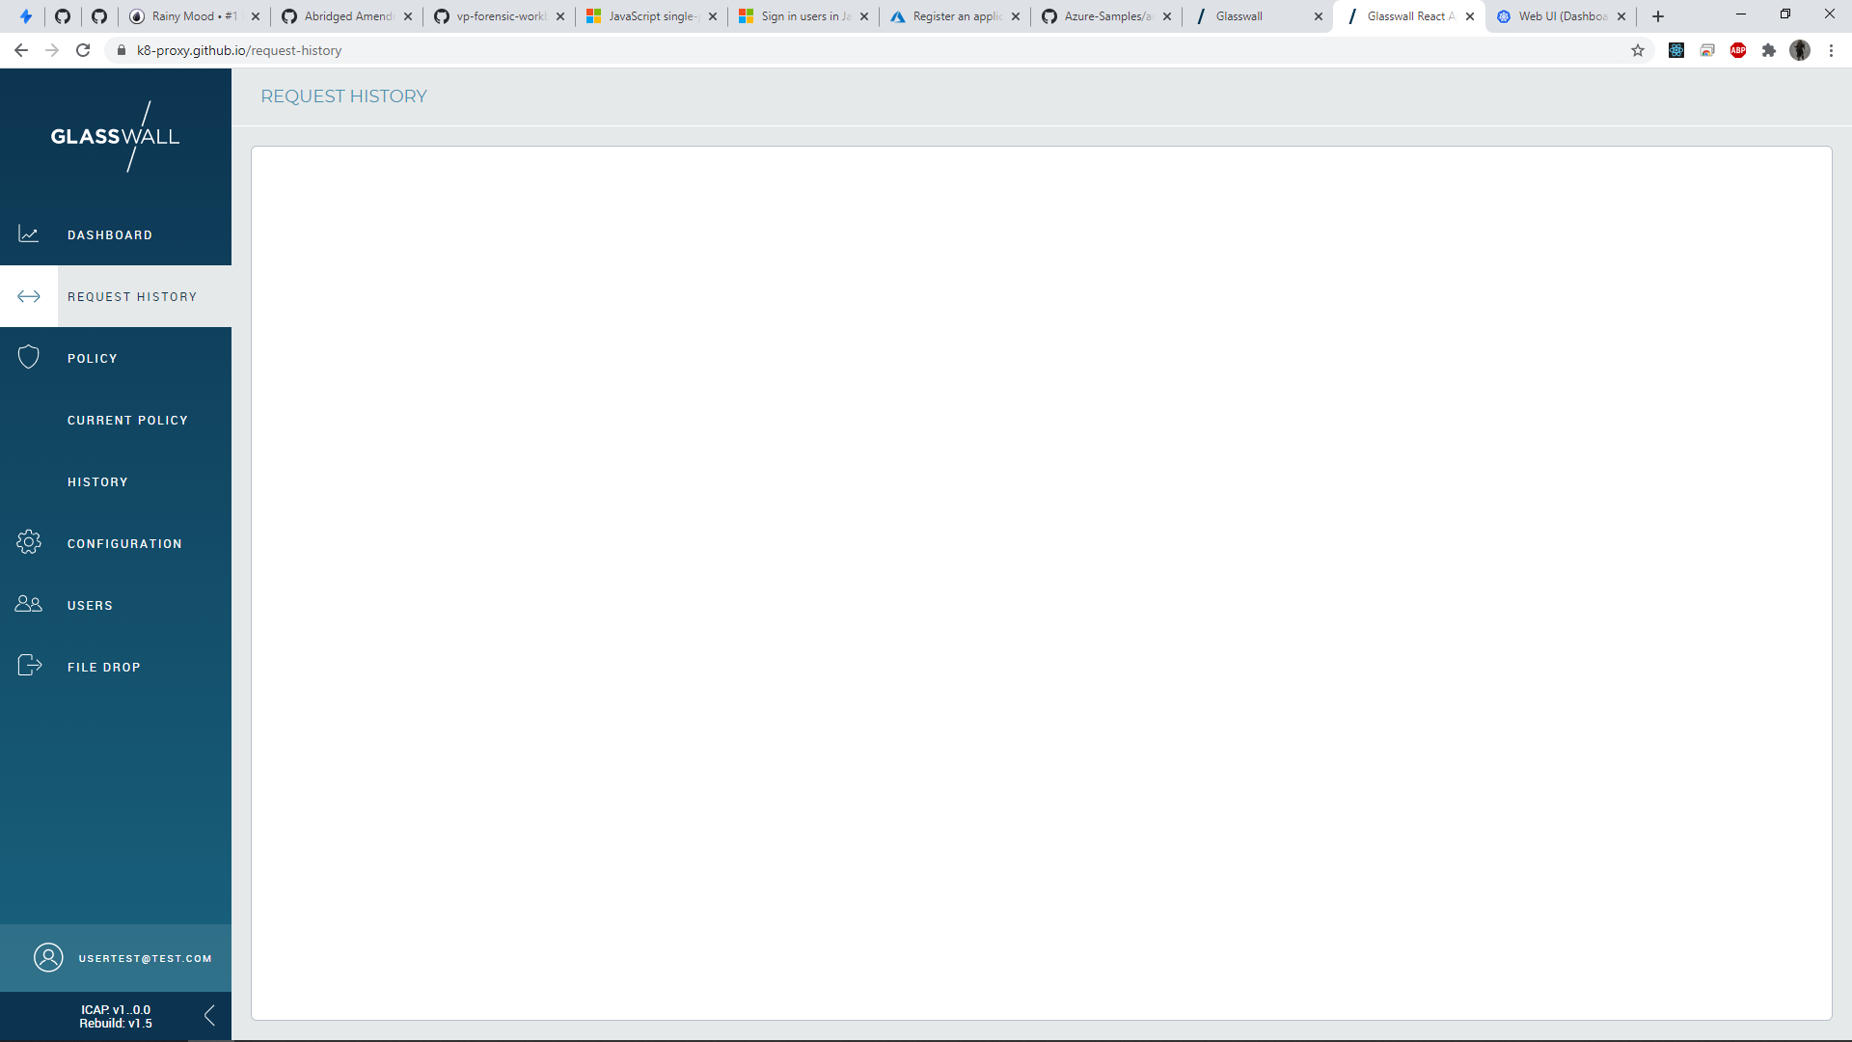
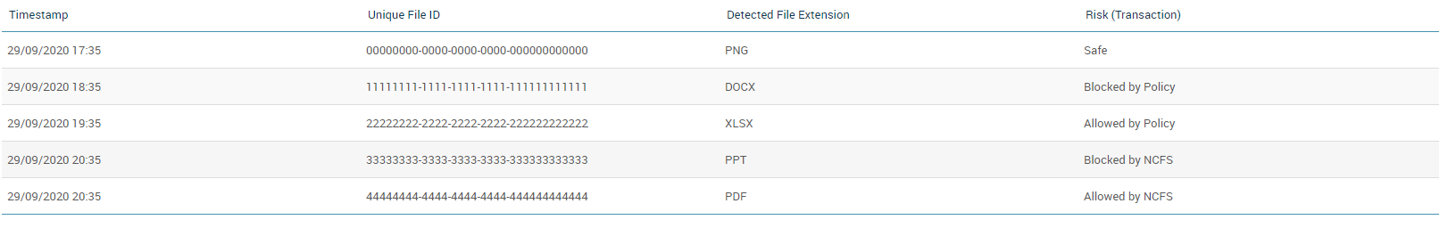
3.2.4 – Risk and File Extension-based Views

Slide 12
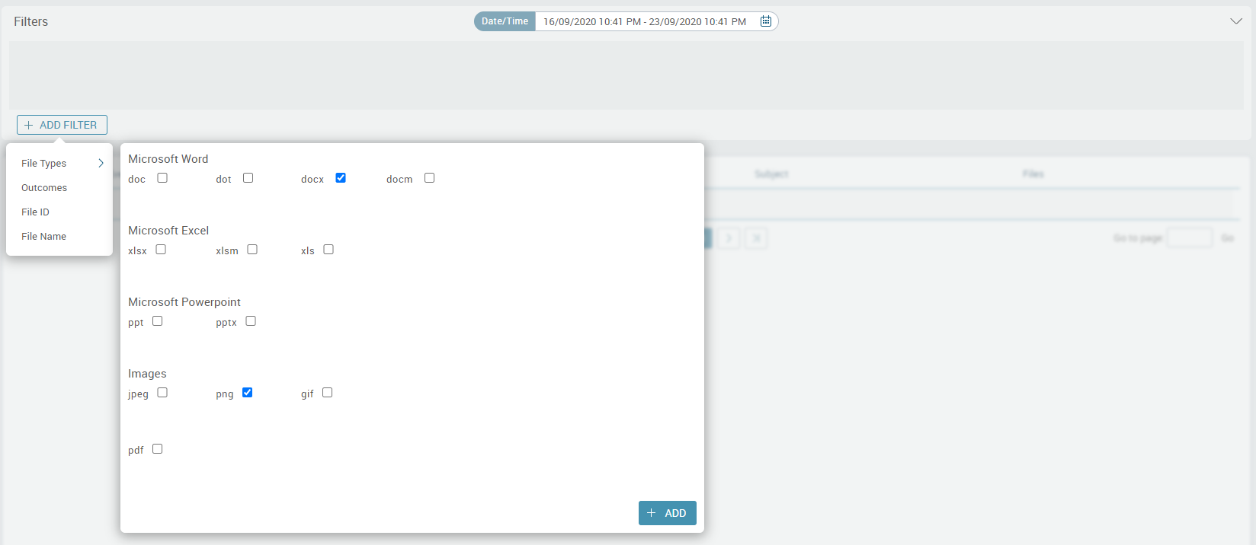
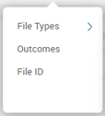
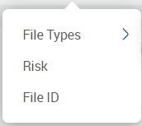
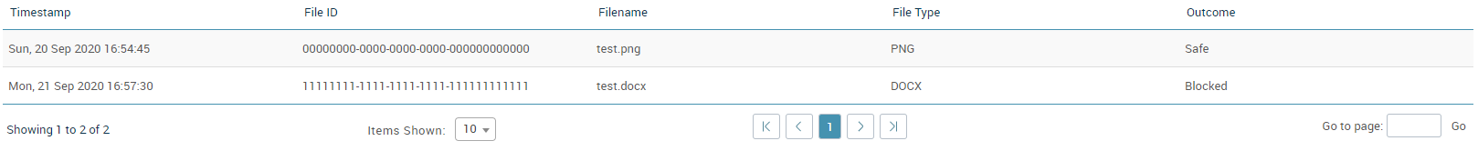
3.2.4 – Risk and File Extension-based Views – Selecting a File Type Filter

Slide 13
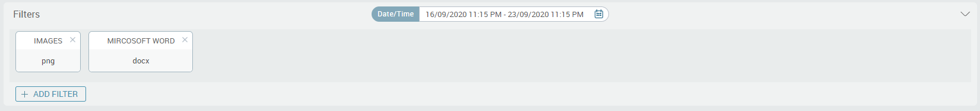
3.2.4 – Risk and File Extension-based Views – Adding a File Type Filter

Slide 14
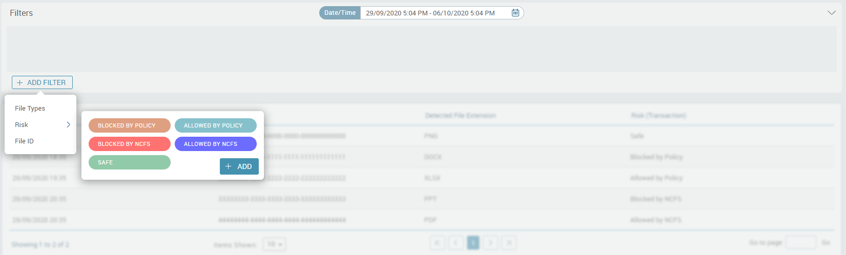
3.2.4 – Risk and File Extension-based Views – Selecting an Outcome Filter

Slide 15
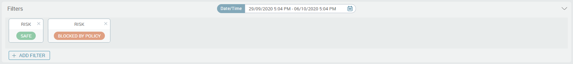
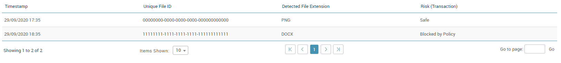
3.2.4 – Risk and File Extension-based Views – Adding an Outcome Filter

Slide 16
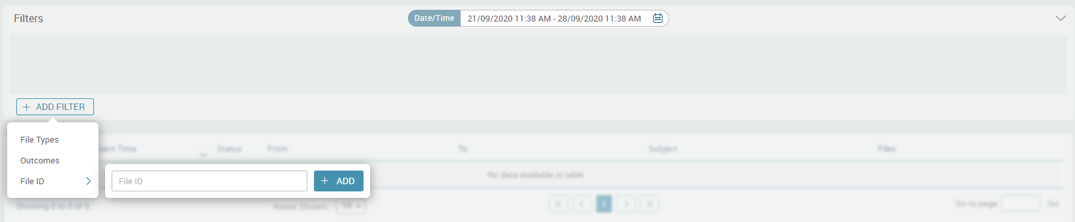
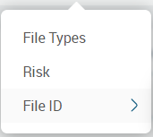
3.2.4 – Risk and File Extension-based Views – Selecting a File ID Filter

Slide 17
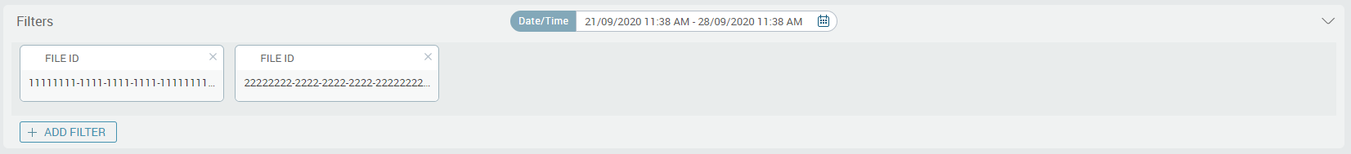
3.2.4 – Risk and File Extension-based Views – Adding a File ID Filter

Slide 18

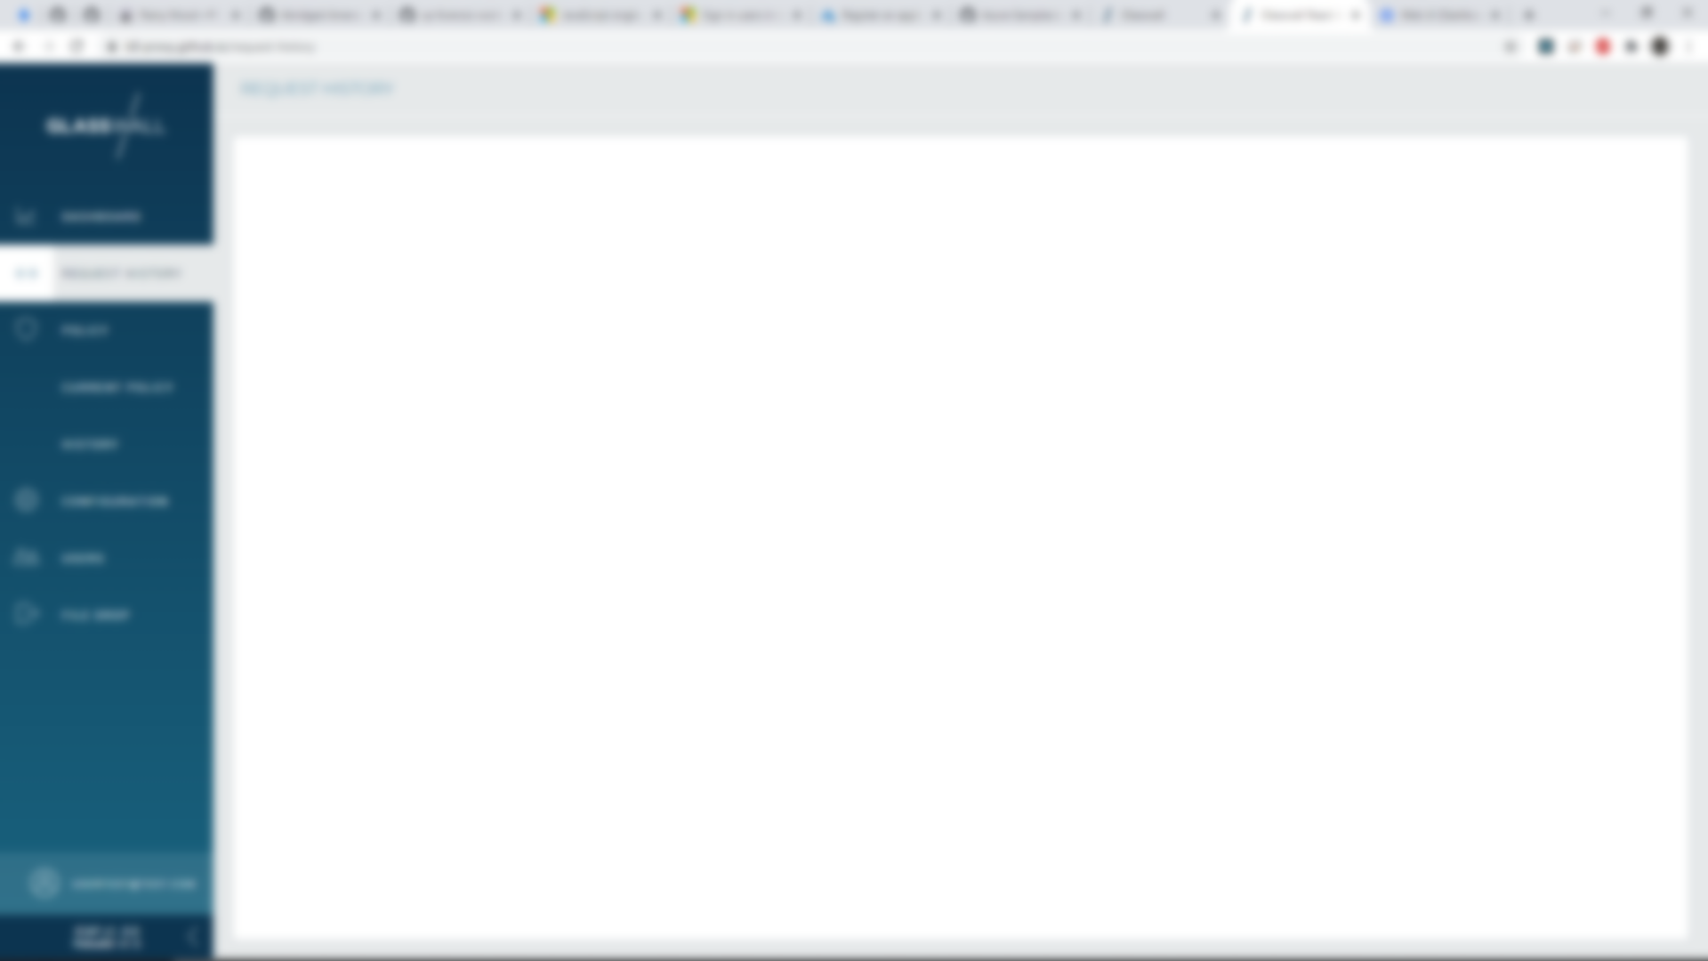
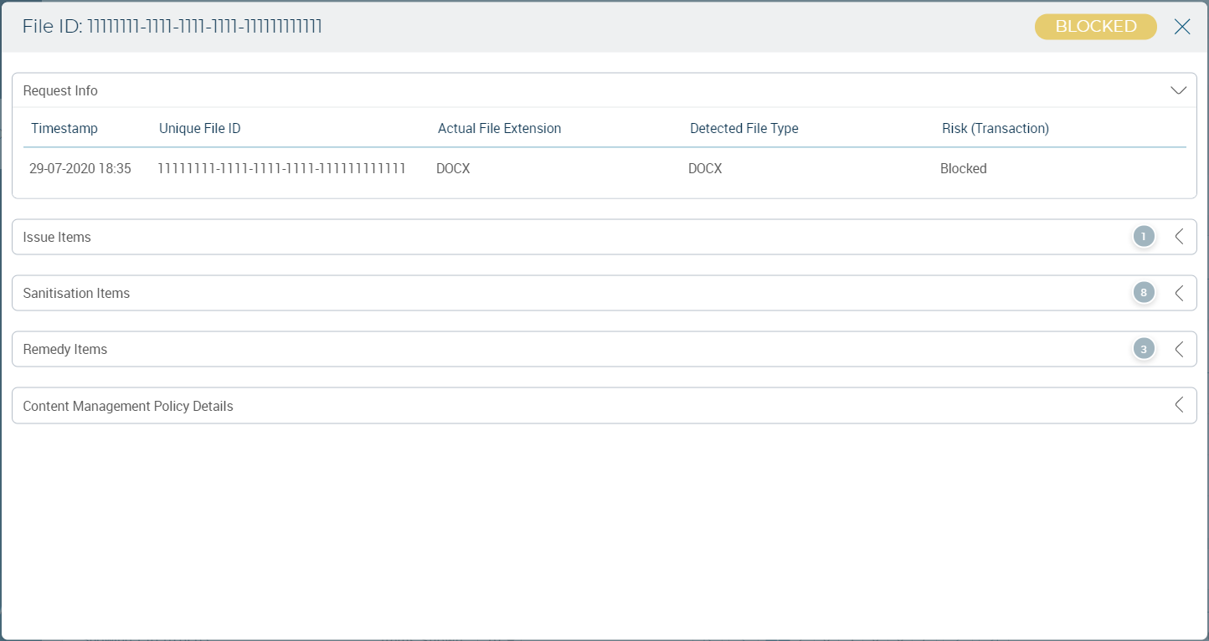
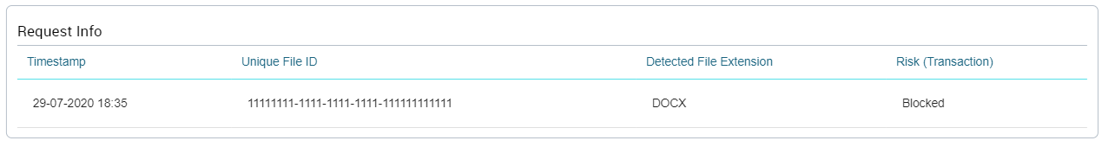
3.2.4 – Risk and File Extension-based Views – Clicking a Row in the Table
Blocked by Policy

Slide 19
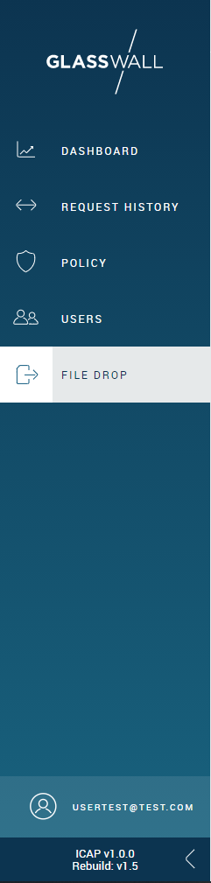
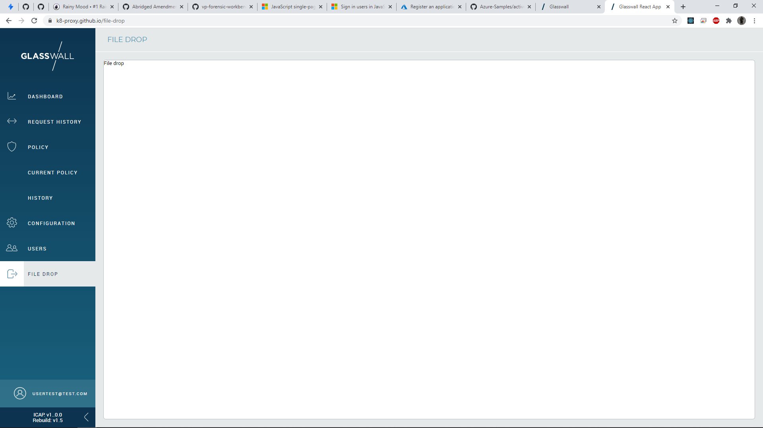
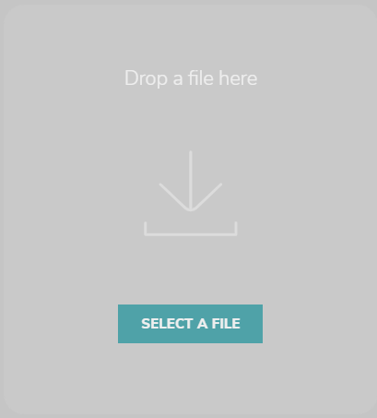
3.2.5– File Drop Service
Once the file has been uploaded, it is passed through the Analysis API of the Glasswall
SDK. The applied content management policy has all content flags set to ‘Sanitise’.

Slide 20
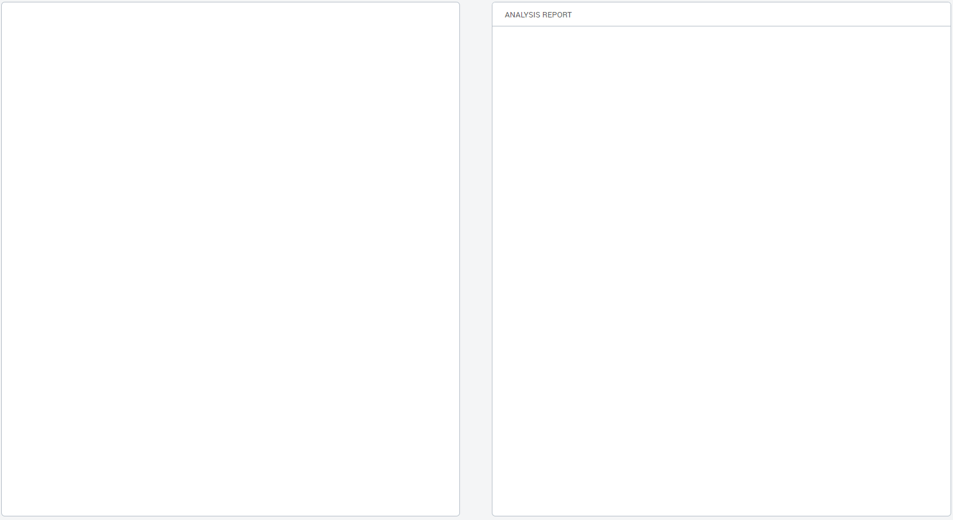
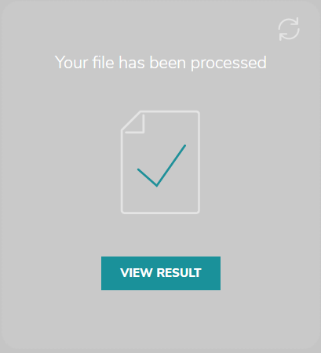
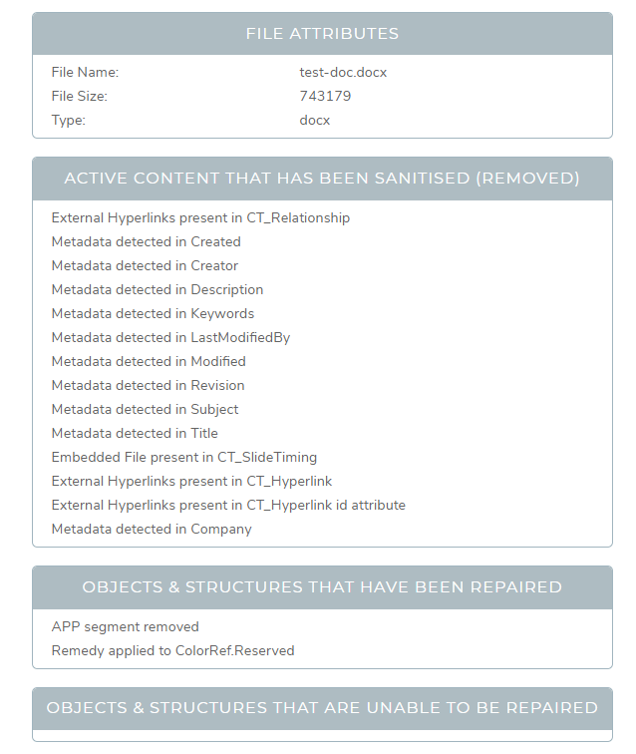
3.2.5– File Drop Service
PDF
XML

Slide 21
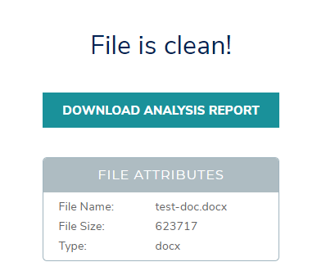
3.2.5– File Drop Service

Slide 22
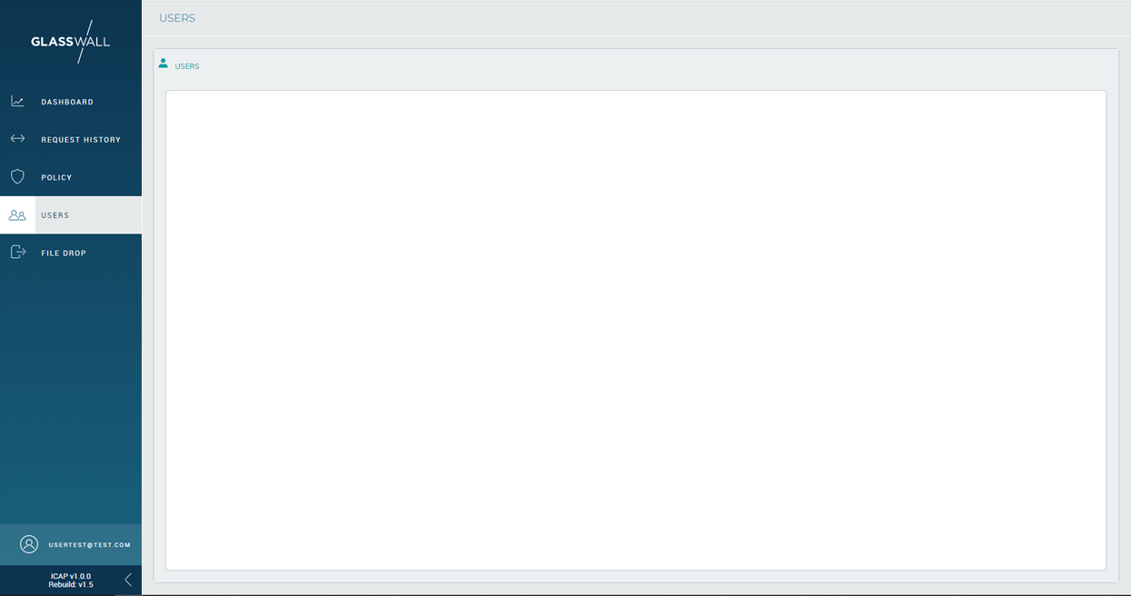
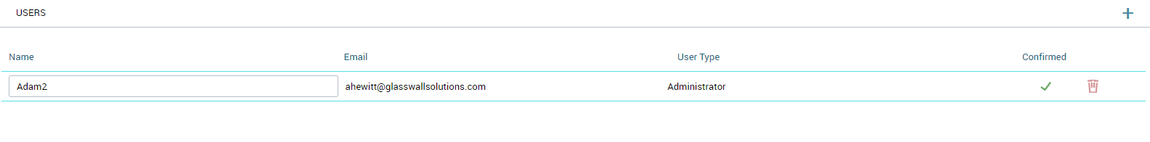
User Management

