Slide 1
Modeling Cognitive-Affective Processes
with Appraisal and Reinforcement Learning
Extending the Baseline: DQN + 6D Appraisal | Distributional RL + Calibrated SVM
Presenter: Sweta Rana, Dev Shrut Jain, Krish Rathod
Supervisor: Sudhakar Mishra
Artificial Intelligence ·
2 Methods
4 Experiments
5 Seeds
DQN + Distrib. RL
7 & 4 emotions
Multi-seed protocol

Slide 2
Motivation — Why This Research Matters
Emotions are not noise , they are structured cognitive responses to environmental events.
The Gap in AI
Appraisal Theory
The Bridge
RL agents treat reward numerically - no link to human-interpretable emotional states
Scherer's CPM: emotions arise from appraisal checks (Suddenness, Goal Relevance, etc.)
Connecting RL reward signals to appraisal vectors enables emotion-aware AI agents
Real-World Impact
Mental health AI: agents that recognise distress patterns in interaction data
Human-robot interaction: emotionally coherent robots that adapt behaviour to user state
Personalised education systems: tracking learner frustration or confidence in real time
2 / 12

Slide 3
Problem Statement & Research Question
⚠ The Problem
Research Question
Scalar reward signals lack uncertainty / affect information
Appraisal space in baseline is 4D under-specified
Single SVM classifier no uncertainty quantification
Tabular Q-learning cannot scale to complex emotion scenarios
Exp3 (4-emotion free setting) achieves only R² = 0.29 in the baseline
Can extending the RL backbone (DQN / Distributional RL) and the appraisal feature space (6D) improve alignment between model-generated and human emotion-appraisal patterns?
Sub-Questions
Does DQN yield richer appraisal vectors than tabular Q-learning?
Do 2 extra appraisal dimensions (entropy + TD-error) help?
Does an MLP ensemble outperform a single SVM?
Overarching Goal: Build an RL-to-emotion pipeline that achieves human-level appraisal alignment (R² ≥ 0.8) across all experimental conditions.
Cognitive-Affective RL | [Your Name] | [Your University]
3 / 12

Slide 4
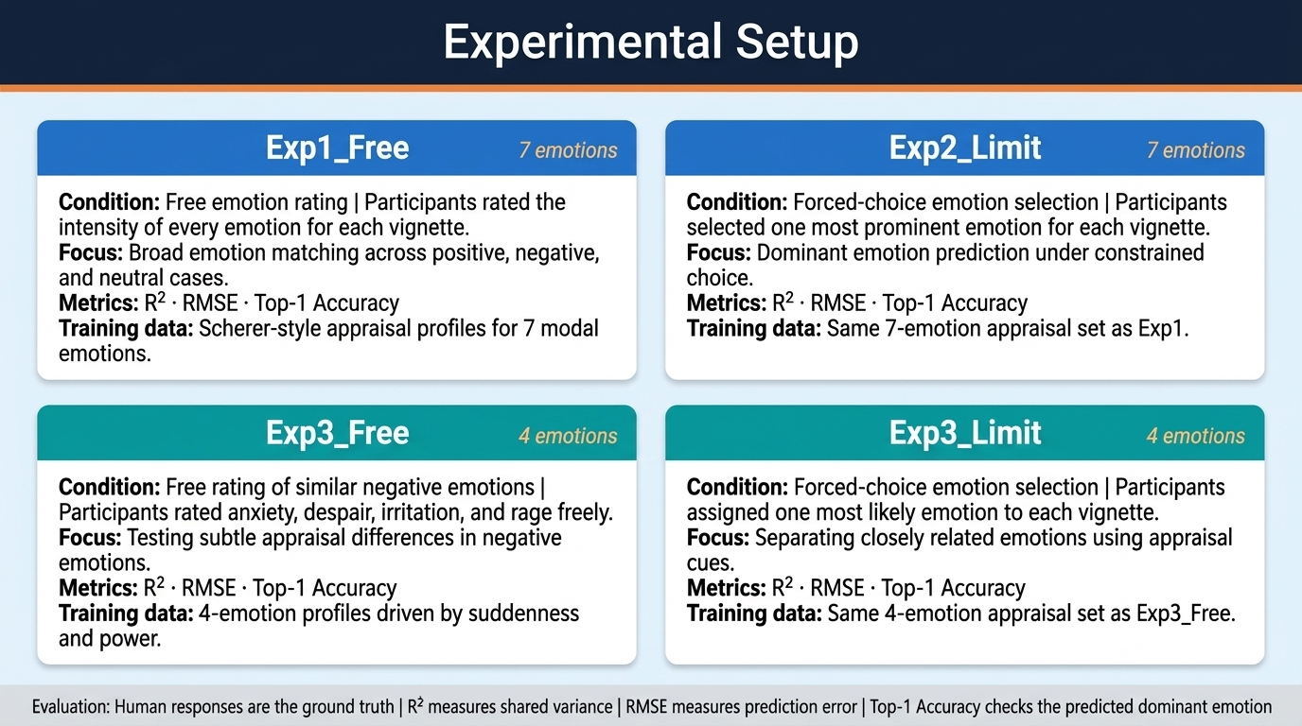
Experimental Setup
Exp1_Free
7 emotions
Exp2_Limit
7 emotions
Condition: Free / unconstrained
Condition: Limit / forced choice
Human rates any emotion freely
Human selects from fixed list
Metrics: R² · RMSE · Top-1 Accuracy
Metrics: R² · RMSE · Top-1 Accuracy
Training data: Scherer-style appraisal patterns
Training data: Scherer-style appraisal patterns
Exp3_Free
4 emotions
Exp3_Limit
4 emotions
Condition: Free / unconstrained
Condition: Limit / forced choice
Reduced emotion space, free rating
Reduced emotion space, forced choice
Metrics: R² · RMSE · Top-1 Accuracy
Metrics: R² · RMSE · Top-1 Accuracy
Training data: Scherer-style appraisal patterns
Training data: Scherer-style appraisal patterns
Evaluation: R² = 1 − [Σ(yᵢ − ŷᵢ)² / Σ(yᵢ − ȳ)²] | RMSE = √(1/n · Σ(yᵢ − ŷᵢ)²) | Human data used as ground truth
Cognitive-Affective RL | [Your Name] | [Your University]
8 / 12

Slide 5
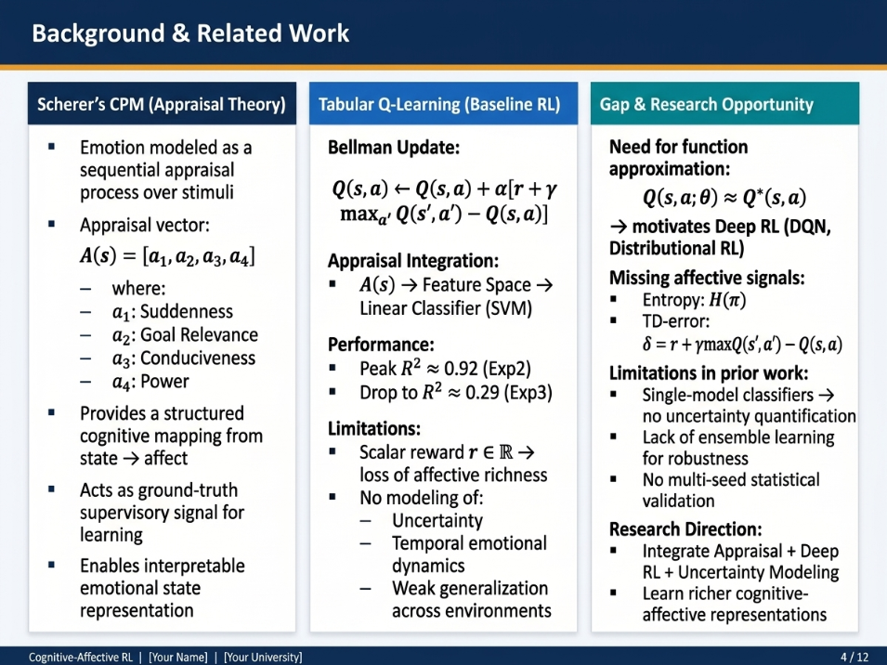
Background & Related Work
Scherer's CPM
Tabular Q-Learning
Gap & Opportunity
Emotions = sequential appraisal checks
4 key dimensions: Suddenness, Goal Relevance, Conduciveness, Power
Provides structured ground-truth appraisal patterns
Used here to generate classifier training data
Bellman update:
Q(s,a) ← Q(s,a) + α[r + γ maxₐ′ Q(s′,a′) − Q(s,a)]
Baseline paper: 4D appraisal → linear SVM
Peak R² = 0.92 (Exp2 Limit)
Low R² = 0.29 (Exp3)
Weakness: scalar reward, no uncertainty modelling
Richer RL (DQN, Distributional) could encode more signal
Additional appraisal dimensions (entropy, TD-error) are under-explored
Ensemble classifiers may capture uncertainty better than a single SVM
Multi-seed robustness testing is largely absent in prior work
4 / 12

Slide 6
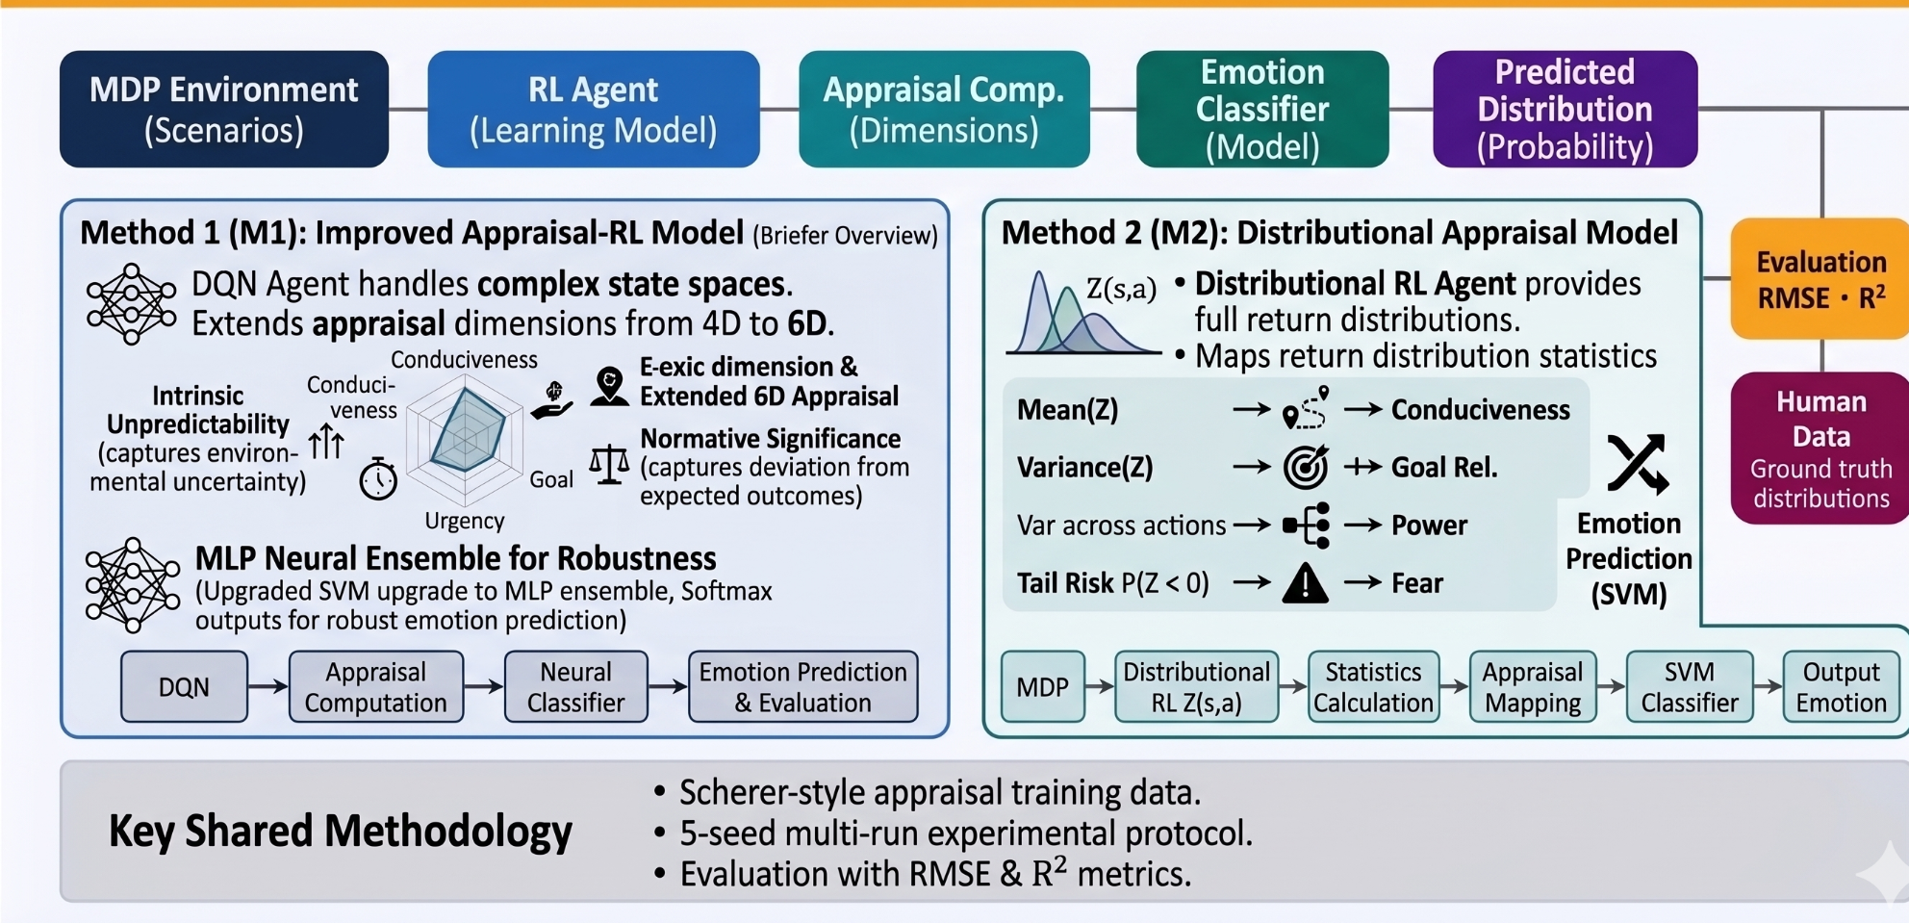
Method Overview — End-to-End Pipeline
MDP
Environment
RL Agent
Appraisal
Features
Classifier
Emotion
Distribution
7 emotion scenarios
Tabular Q / DQN / Distrib. RL
4D → 6D vector
Linear SVM / MLP Ensemble
Probability over 4 or 7 emotions
Method 1:
Evaluation
RMSE · R²
Human
Data
DQN + 6D Appraisal + MLP Ensemble
Ground truth distributions
Method 2:
Distributional RL + Calibrated SVM
Both methods share: Scherer-style appraisal training data · 5-seed multi-run protocol · RMSE & R² evaluation · Human participant comparison
5 / 12

Slide 7
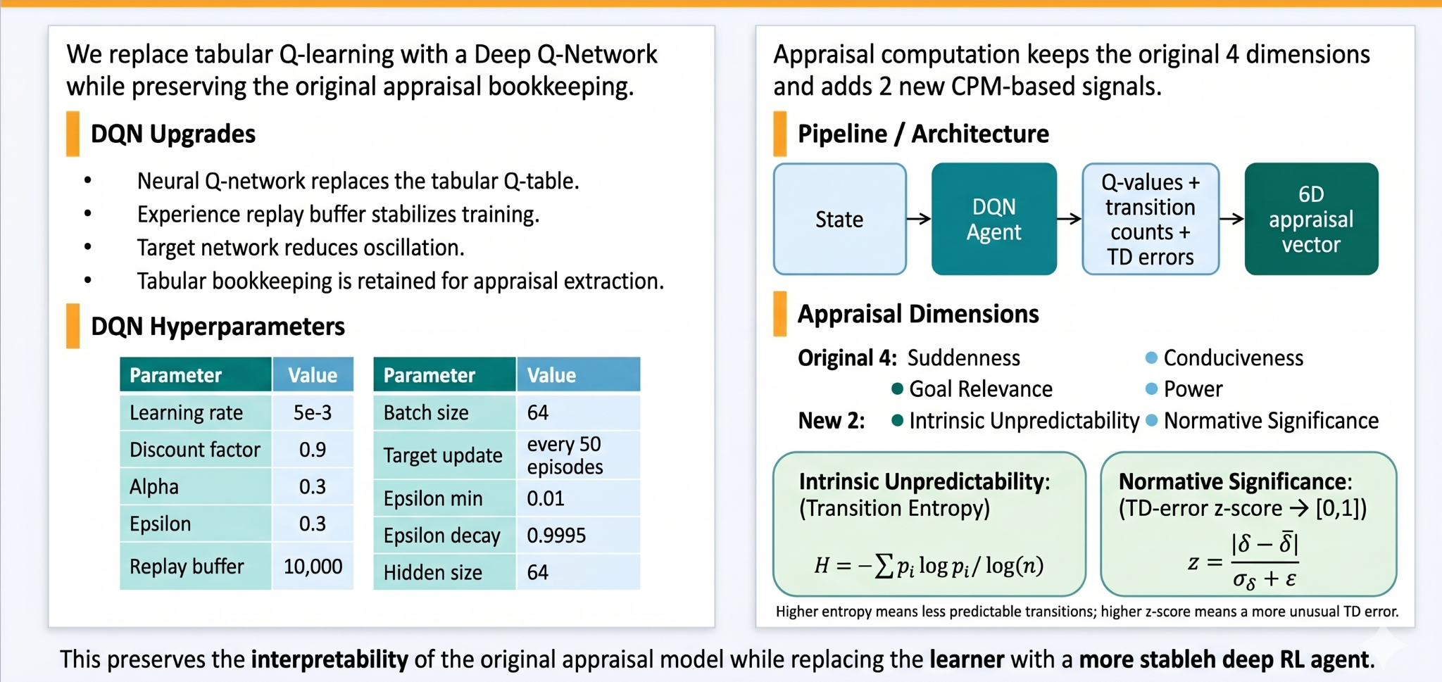
Method 1 — DQN + 6D Appraisal + MLP Ensemble
DQN Backbone + 6D Appraisal
Neural Classifier Ensemble
DQN Upgrades
Ensemble Architecture
Neural Q-network replaces tabular Q-table
Experience replay buffer + target network for stable training
Tabular bookkeeping retained for appraisal extraction
Input
(6D vec)
Linear
+ ReLU
Dropout
Softmax
Output
× 10 independent MLPs → averaged softmax probabilities
Original 4 Dimensions (kept)
Suddenness · Goal Relevance · Conduciveness · Power
Experimental Settings
+ 2 New Appraisal Dimensions
Exp1_Free + Exp2_Limit: 7-emotion classification
Exp3_Free + Exp3_Limit: 4-emotion classification
Metrics: R², RMSE, Top-1 Accuracy
SVM baseline retained for direct comparison
Intrinsic Unpredictability (Transition Entropy):
H = −Σ pᵢ log pᵢ / log(n)
Normative Significance (TD-error z-score → [0,1]):
z = |δ − δ̄| / (σ_δ + ε)
6 / 12

Slide 8
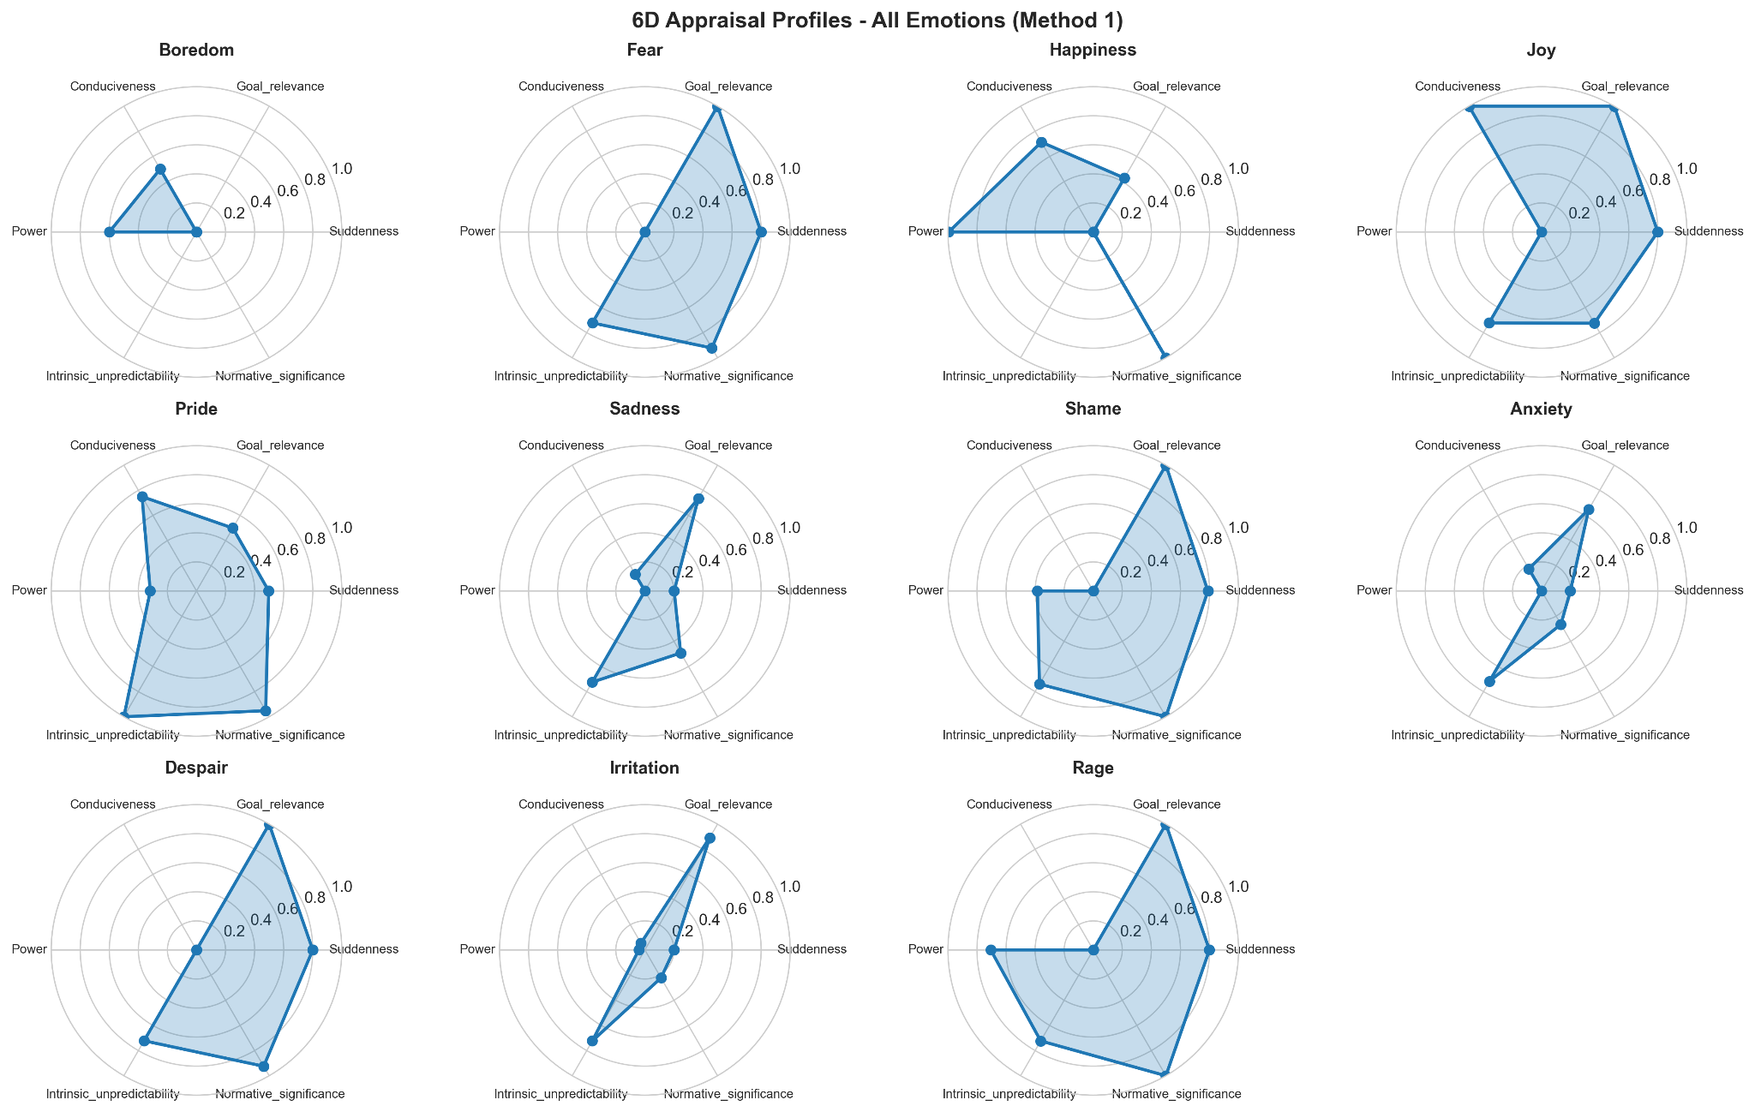
Method 1: DQN + 6D Appraisal Profiles
9 / 12

Slide 9
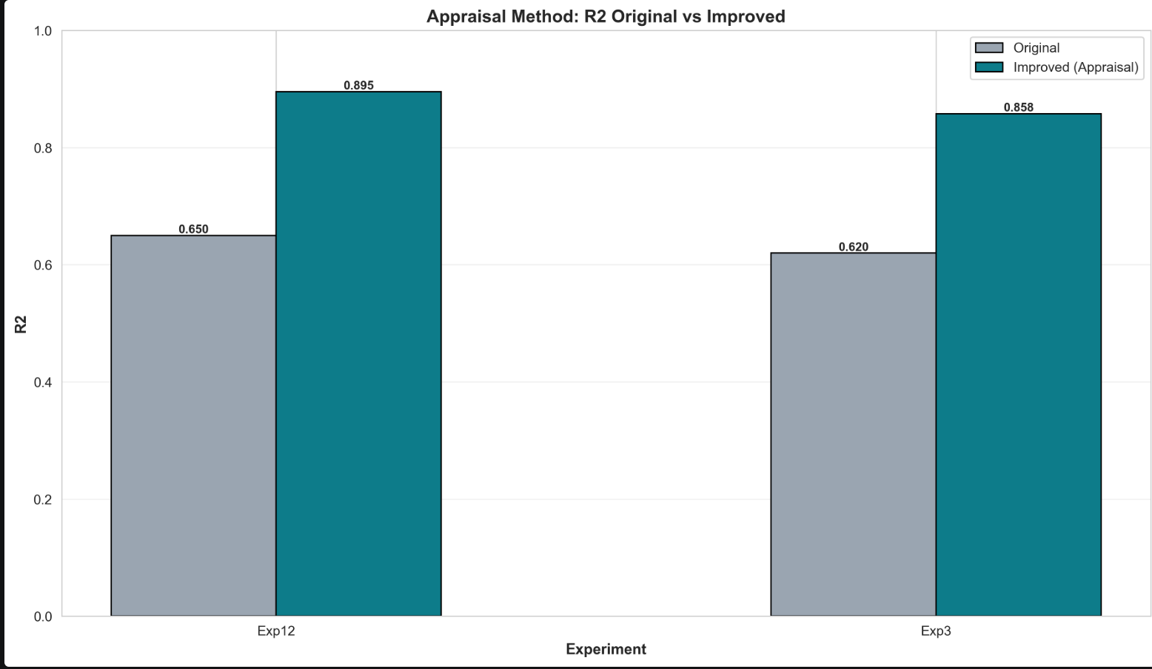
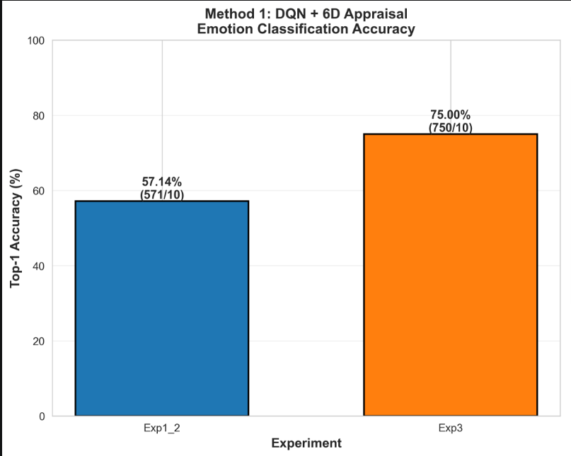
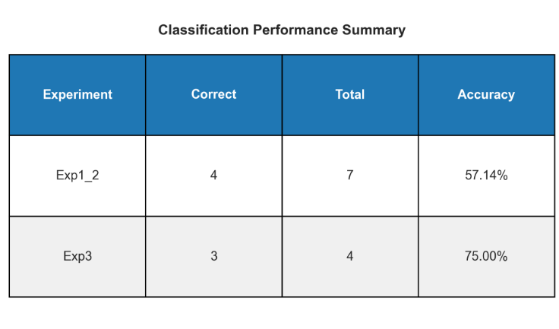
Results — Method 1: DQN + 6D Appraisal
9 / 12

Slide 10
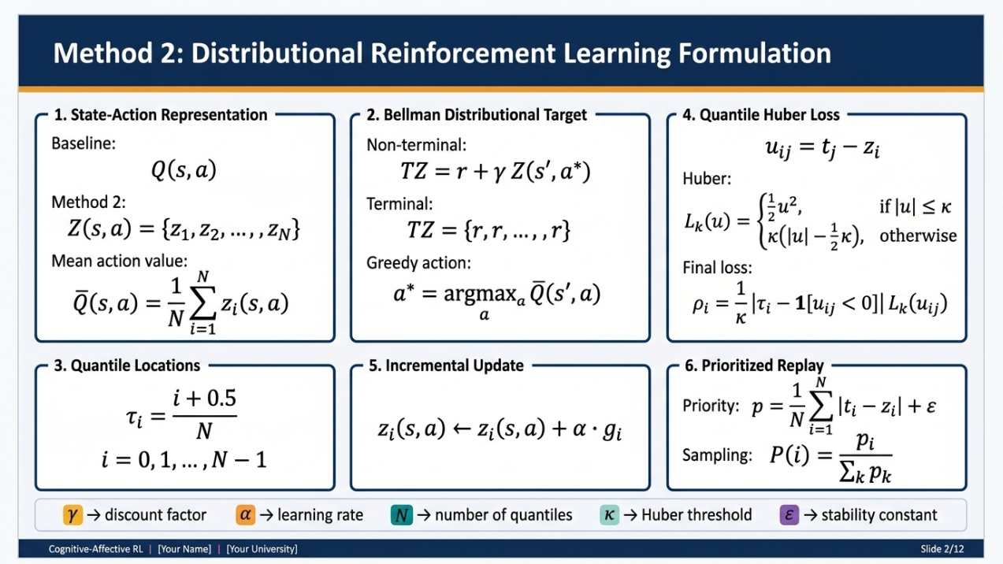
Method 2 — Distributional RL + Calibrated SVM
Distributional RL Backbone
SVM Calibration + Protocol
Replaces scalar Q(s,a) with a full return distribution Z(s,a) using N = 64 quantiles.
C Tuned to Human Precision Behaviour
Free Condition
Target Return Distribution:
C = 0.0032
Z_target = r + γ · Z(s′, a*)
Limit / Forced Condition
Quantile Huber Loss (κ = 1.0):
C = 0.014
L = (1/N²) ΣᵢΣⱼ ρ_τᵢ^κ (zⱼ_tgt − zᵢ_pred)
Multi-Seed Protocol
Seeds: {42, 123, 999, 2024, 7} — 5 independent runs
7 emotion scenarios per seed (Boredom, Fear, Happiness, Joy, Pride, Sadness, Shame)
Per-seed results aggregated → mean ± variance reported
Baseline Q-Update (reference):
Q(s,a) ← Q(s,a) + α[r + γ max Q(s′,a′) − Q(s,a)]
7 / 12

Slide 11
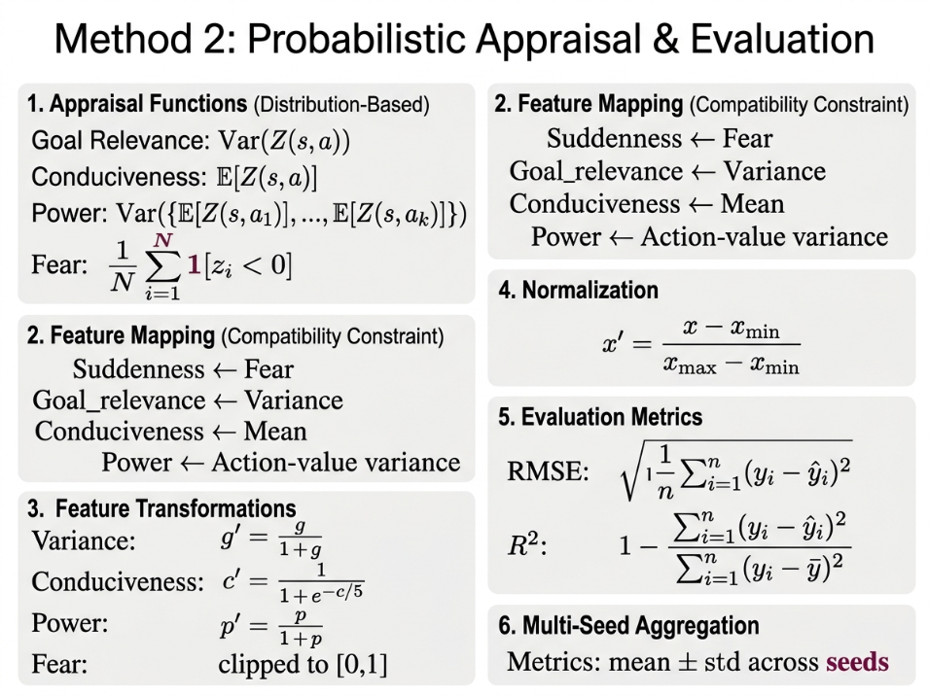
Method 2 — Distributional RL + Calibrated SVM
Distributional RL Backbone
SVM Calibration + Protocol
Replaces scalar Q(s,a) with a full return distribution Z(s,a) using N = 64 quantiles.
C Tuned to Human Precision Behaviour
Free Condition
Target Return Distribution:
C = 0.0032
Z_target = r + γ · Z(s′, a*)
Limit / Forced Condition
Quantile Huber Loss (κ = 1.0):
C = 0.014
L = (1/N²) ΣᵢΣⱼ ρ_τᵢ^κ (zⱼ_tgt − zᵢ_pred)
Multi-Seed Protocol
Seeds: {42, 123, 999, 2024, 7} — 5 independent runs
7 emotion scenarios per seed (Boredom, Fear, Happiness, Joy, Pride, Sadness, Shame)
Per-seed results aggregated → mean ± variance reported
Baseline Q-Update (reference):
Q(s,a) ← Q(s,a) + α[r + γ max Q(s′,a′) − Q(s,a)]
7 / 12

Slide 12
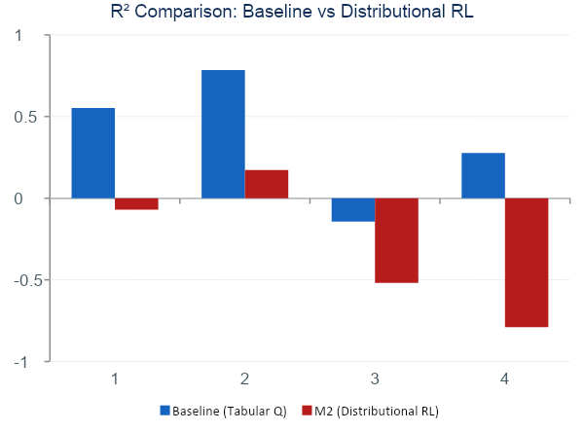
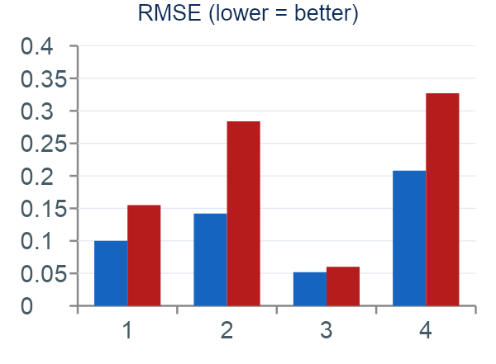
Results — Method 2: Distributional RL vs Baseline
0.501
−0.326
40.7%
Baseline Agg. R²
M2 Agg. R²
RMSE worse (M2)
10 / 12

Slide 13
Insights & Interpretation
Distributional RL ≠ Better Appraisals
6D Appraisal Helps — But Only in Constrained Settings
01
Quantile return distribution is collapsed to scalar features → critical information loss → negative R² in 3 of 4 conditions
02
Entropy and TD-error dimensions add signal when human labels are constrained. Free-condition variance overwhelms the new features.
Constrained > Free Condition Across All Models
Exp3 (4-Emotion) Remains the Hardest
03
Limit/forced condition consistently produces higher R² — lower human variance makes model fitting tractable.
04
Sparse reward in 4-emotion MDP yields low-entropy transitions that mis-represent appraisal. MDP redesign is needed.
Best configuration: Exp1_2 Baseline (Tabular Q) → R² = 0.741 · RMSE = 0.123
Cognitive-Affective RL | [Your Name] | [Your University]
11 / 12

Slide 14
Limitations, Future Work & Conclusion
Limitations
Future Work
5 Key Takeaways
Small human participant pool
MDP scenarios hand-crafted
Scherer table = fixed ground truth (cultural variation ignored)
SVM C-tuning manual, not jointly optimised
M2 scalar projection loses quantile information
Map quantile distribution → appraisal via learned projection (fix M2)
Learn MDP parameters from human behavioural data
Cross-cultural validation on multilingual emotion datasets
End-to-end joint training: RL + appraisal extractor + classifier
1
Tabular Q > Distrib. RL (ΔR² = 0.827)
2
6D appraisal helps in constrained conditions
3
MLP ensemble ≈ SVM; neither dominates all
4
Exp3 free condition needs new MDP design
5
SVM C calibration is condition-critical
Conclusion
Appraisal-grounded RL can approximate human emotion distributions, but richer RL objectives require richer appraisal bridges — not scalar projections. The tabular baseline remains the strongest model. Future work should close the loop end-to-end, learn MDPs from human data, and validate cross-culturally.
Thank You · Questions Welcome ·
12 / 12

