Slide 1
An Appraisal-Augmented Dueling Double DQN with a Bootstrap Ensemble for Cognitively Grounded Affective Modelling in Reinforcement Learning Agents
Dev Shrut Jain | Sweta Rana | Krish Rathod
Department of Artificial Intelligence, SVNIT Surat
B.Tech. Project | Year 3

Slide 2
Motivation
Why couple Scherer's CPM with reinforcement learning?
Emotion is not a layer painted on top of cognition — it shares machinery with attention, action selection, and learning.
Scherer's Component Process Model (CPM) decomposes emotion into a hierarchy of cognitive checks. Most of those checks already read quantities an RL agent maintains: TD error, Q-spread, transition counts.
Zhang, Broekens, Jokinen (arXiv:2309.06367, 2023) operationalise four such checks — suddenness, goal relevance, conduciveness, power — on a tabular Q-learning agent.
Limitation: three of those four checks ride the same TD signal. The 4-D vector cannot, by construction, distinguish emotions that differ on something other than TD magnitude (e.g. boredom vs neutral, hope vs joy).
Our question: can the appraisal vector be enriched with channels whose informativeness is empirically verifiable, not asserted?
B.Tech. Project | SVNIT Surat | 2026

Slide 3
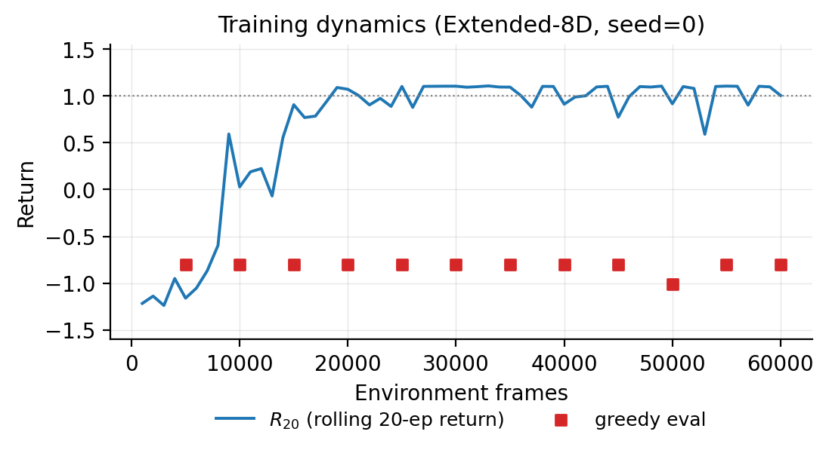
Method 1 — Dueling Double DQN with Bootstrap Ensemble
The headline backbone (chosen configuration)
Dueling head: Q(s,a) = V(s) + (A(s,a) − mean_a A). Exposes V(s) and the centred advantage as named outputs.
Bootstrap ensemble: K = 3 independently-initialised value heads share a feature trunk. Cross-head dispersion σ_K(s) is a clean epistemic-uncertainty signal.
Double-DQN target removes max-operator bias from the TD error.
These three architectural pieces feed three appraisal channels directly: V → anticipation, advantage spread → power, σ_K → predictability.
Trained for 60,000 frames on a 7×7 key-and-lava grid world; the appraisal vector is a read-out, the policy is unaffected.
src/networks/dueling_dqn.py | src/agent.py | src/train.py

Slide 4
Method 2 — Quantile-Regression DQN
A controlled comparison (Dabney et al., AAAI 2018)
Replaces the dueling V-head and the K-ensemble with a single QR-DQN head producing N = 51 quantile atoms per action.
Trained with the asymmetric quantile Huber loss (eq. 19 of the paper).
Same seed, same env, same 60k-frame budget, same eight-dim appraisal vector — only the value head and loss are swapped.
Three input substitutions: Q = mean over atoms; V(s) = max_a Q(s,a); predictability uses the within-distribution spread σ_Z of the greedy action's atoms.
Why we ran it: to test whether Method 1's gains are specific to its representation. Result: yes, they are. Method 2 trails Method 1 on every appraisal-derived metric.
src/networks/qr_dqn.py | src/agent_qrdqn.py | src/train_qrdqn.py

Slide 5
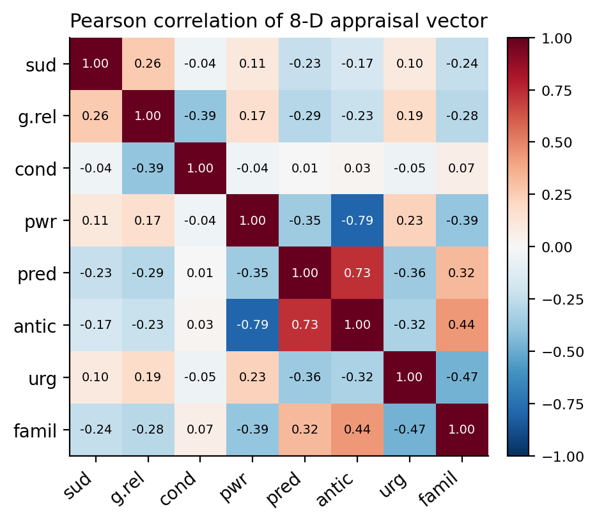
The 8-Dimensional Appraisal Vector
Four CPM checks reproduced + four orthogonal extensions
x1 suddenness — 1 − P(s' | s, a) [transition counts]
x2 goal relevance — |TD| / running max
x3 conduciveness — tanh(TD / scale)
x4 power — centred Q-range / max|Q|
x5 predictability★ — 1 − σ_K / running max [ensemble dispersion]
x6 anticipation★ — tanh(V(s) / scale) [absolute value level]
x7 urgency★ — t / T_max [within-episode time index]
x8 familiarity★ — log(N(s)+1) / log(N_max+1) [state-visit count]
★ = newly proposed; each computed from a statistic that is algebraically disjoint from the original four.
src/appraisal/extractor.py

Slide 6
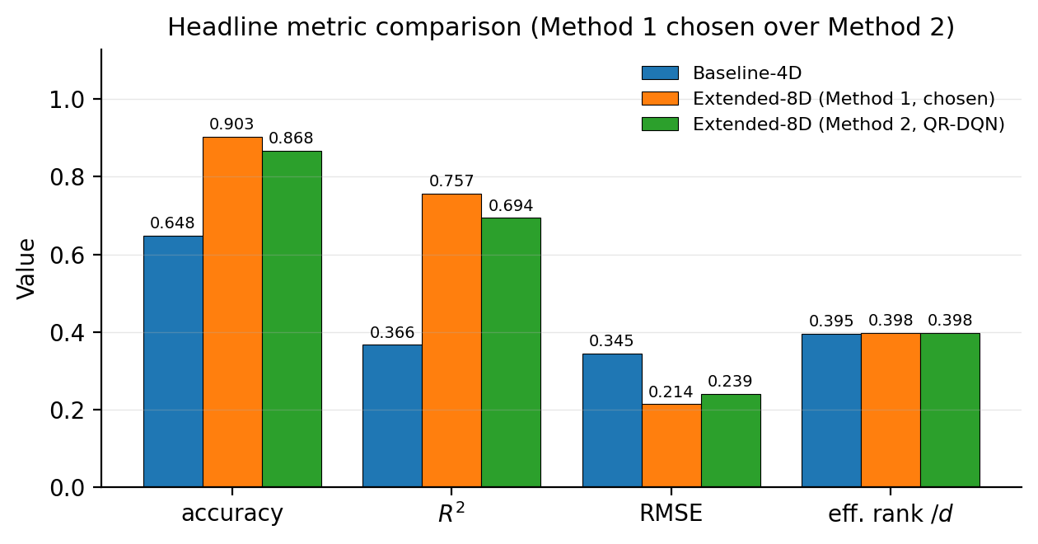
Results — Master Conclusion Table
60,000 frames, identical seed, three configurations
Exp. | Configuration | Backbone | Acc. | R² | RMSE
Exp 1 | Baseline-4D | Method 1 | 0.648 | 0.366 | 0.345
Exp 2 | Extended-8D | Method 1 | 0.903 | 0.757 | 0.214
Exp 3 | Extended-8D | Method 2 | 0.868 | 0.694 | 0.239
• Extended-8D (Method 1) leads on every metric — the chosen configuration.
• Method 2 (QR-DQN) is competitive but trails by 3.5 pp accuracy, 0.063 R², 0.025 RMSE.
• Effective rank of the appraisal covariance roughly doubles from 1.58/4 to 3.18/8.
• Greedy task return identical between Baseline-4D and Method 1 (seed=0); appraisal layer is a read-out, not a policy modifier.
runs/rmse_r2_summary.json | analysis/rmse_r2.py

Slide 7
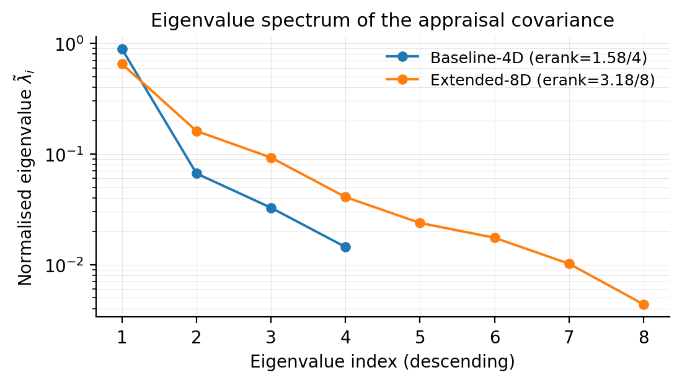
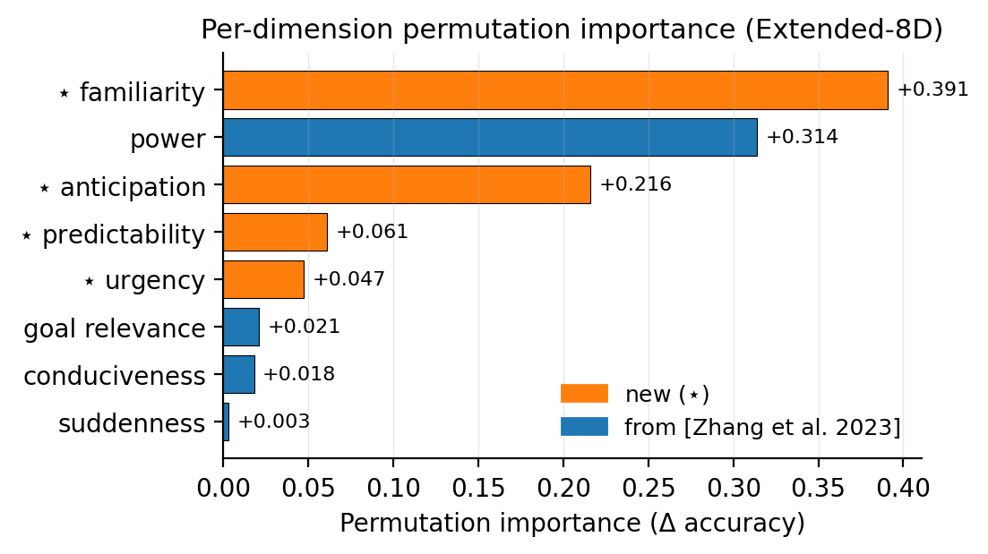
Decorrelation Evidence
The new dimensions carry genuinely independent information
• Eigenvalue spectrum (left): Baseline-4D collapses onto its first eigenvector (erank = 1.58/4); Extended-8D spreads mass over a longer tail (erank = 3.18/8).
• Permutation importance (right): four of the five most discriminative dimensions in Extended-8D are the newly-introduced ones (familiarity, power, anticipation, predictability).
• Per-dimension VIF: every channel except anticipation sits below 5; anticipation reaches 7.4 — reported transparently as a world-driven coupling, not a modelling oversight.
analysis/correlation_analysis.py | analysis/explainability.py

Slide 8
Conclusion and Future Scope
What we showed, what we did not, what comes next
Replacing the tabular Q-learning backbone with a Dueling Double DQN + bootstrap ensemble lets us define four new appraisal channels, each from a statistic algebraically disjoint from the original four.
Extended-8D (Method 1): accuracy 64.8% → 90.3%, R² 0.366 → 0.757, RMSE 0.345 → 0.214. Effective rank doubles. Greedy task return unchanged.
QR-DQN (Method 2) is competitive but underperforms — this confirms the dueling V-head and the ensemble are doing real work rather than being incidental.
Limitations: emotion labels are task-event proxies, not human vignette ratings; predictability is uninformative very early in training; tested on one grid world only.
Future work: port to the vignette protocol of [Zhang et al. 2023]; joint train classifier and value network; close the loop by feeding appraisal back as intrinsic reward; replace count tables with hash-based pseudo-counts for high-dim envs.
Code & paper: github.com/jaindevshrut/RL-Research-Project

