Slide 1
IIIDEM Certification LMS
Moodle-based learning platform
Live Webex classes · MCQ assessments · Teacher dashboard
iiidem-certification.ddev.site

Slide 2
Project overview
Public marketing site & course catalogue
Student & teacher dashboards (theme_iiidem2)
Live Webex virtual classroom pages
Live class MCQ during sessions (local_iiidem_livequiz)
Quiz assessments & teacher reporting
Payment gateway (PNB) for course enrolment

Slide 3
Technology stack
Moodle 4.5 LMS (core platform)
Custom theme: theme/iiidem2
Local plugins: coursereviews, iiidem_livequiz, PNB payment gateway, Faq
Activities: Page (Webex), Quiz, Attendance, Certificate
DDEV local environment for development

Slide 4
What is Moodle
Moodle ➔ Modular Object-Oriented Dynamic Learning Environment It is a free and open-source Learning Management System (LMS)
Used to create, manage, deliver, and track online learning, training programs, and certification courses.Built on PHP.

Slide 5
Why Use Moodle?
1. Cost Effective
Open-source software
No license fees
Lower total cost compared to many commercial LMS platforms
2. Course Management
Create unlimited courses
Organize courses into categories
Upload videos, PDFs, presentations, and documents
Support self-paced and instructor-led learning
3. Online Assessments
Create quizzes and examinations
Question banks
Multiple question types
Automatic grading
4. Certification
Generate certificates automatically after course completion
Define completion criteria
Useful for training and certification programs

Slide 6
5. Learning Tracking
Monitor learner progress
Track course completion
View grades and performance reports
6. User Management
Different roles can be assigned:
Administrator
Manager
Teacher
Student
Guest
7. Communication & Collaboration
Discussion forums
Announcements
Messaging
Feedback and surveys
8. Integration Capabilities
Can integrate with:
Payment gateways (PNB)
Video conferencing (Webex, Zoom, Teams)
9. Mobile Learning
Accessible from mobile devices
Dedicated mobile app available
Learn anytime, anywhere
10. Security & Scalability
Role-based access control
Secure authentication
Suitable for small organizations as well as large-scale deployments with thousands of users

Slide 7
Benefits for moodle
Online course enrolment
Paid course registration via payment gateway
Weekend training programs
Automated certificates
Student progress tracking
Attendance management
Online examinations
Dashboard for students and administrators
Reporting and analytics
Foreign and domestic learner support

Slide 8
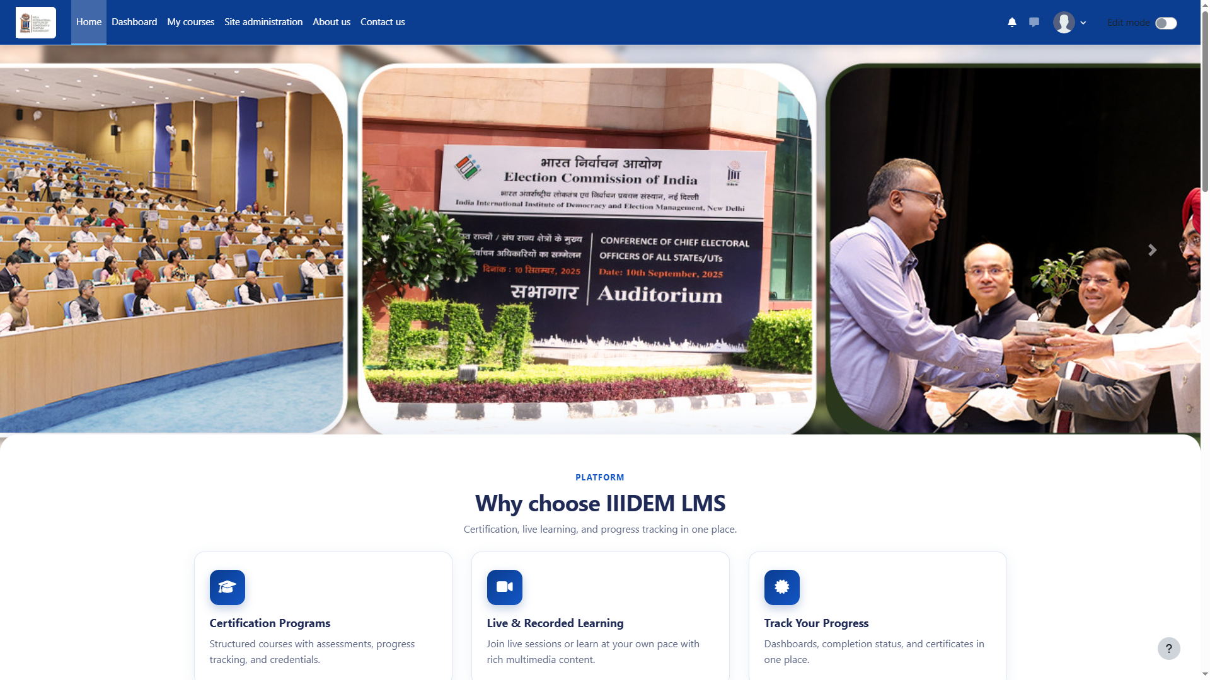
Home page
Marketing front page with course catalogue and IIIDEM branding.

Slide 9
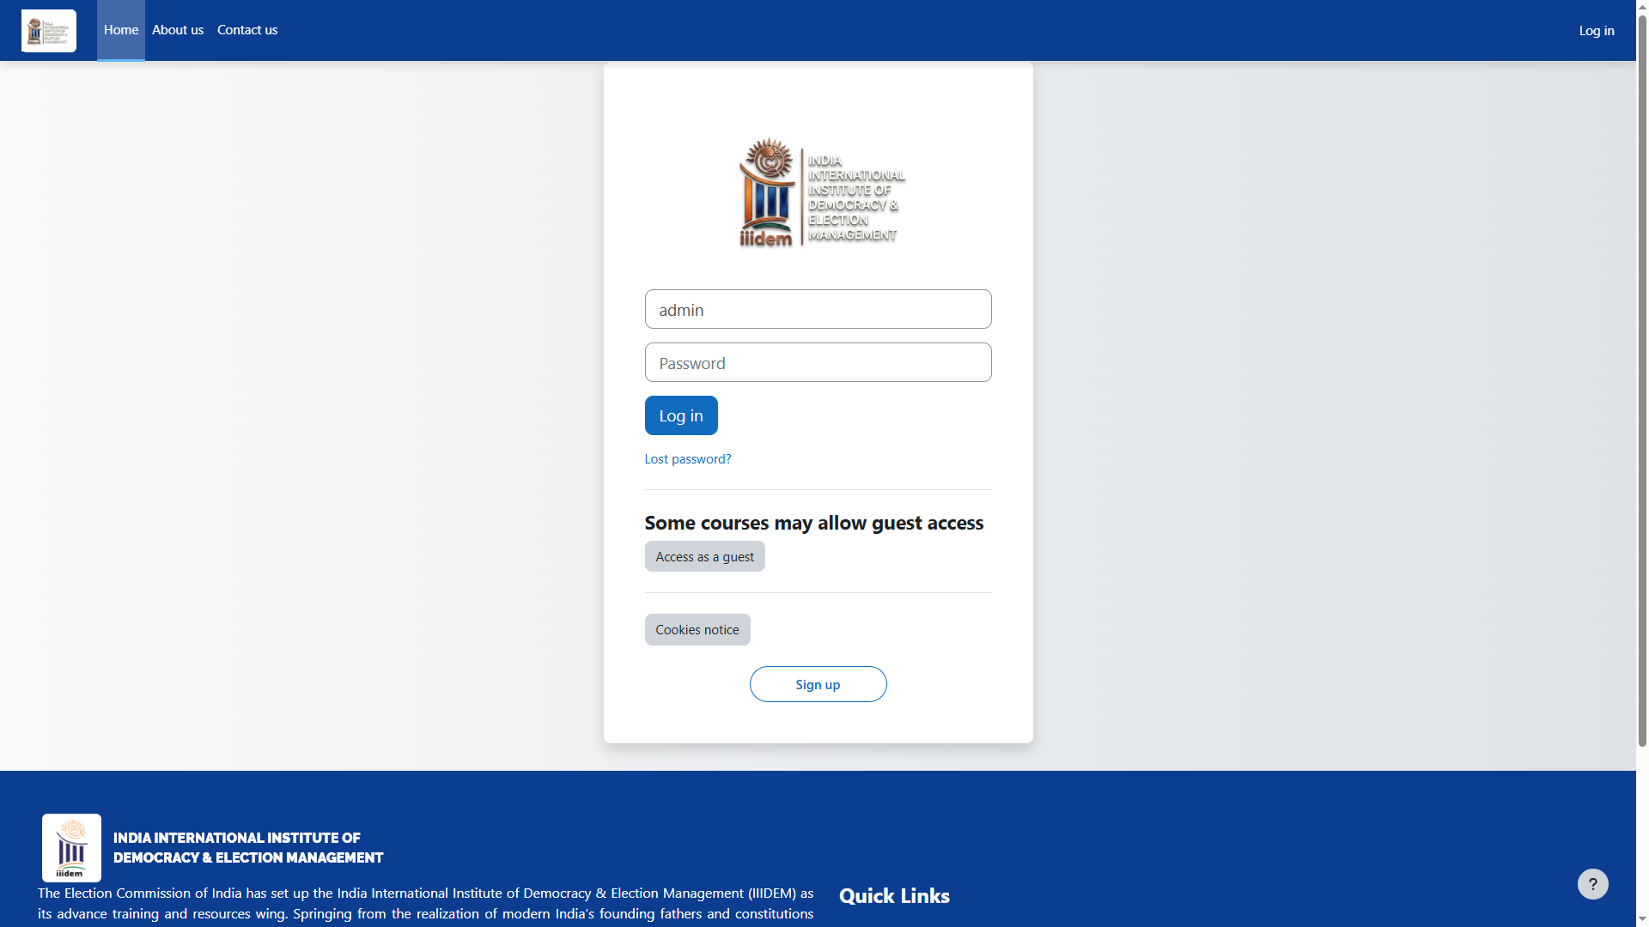
Login
Secure login for students, teachers, and administrators.

Slide 10
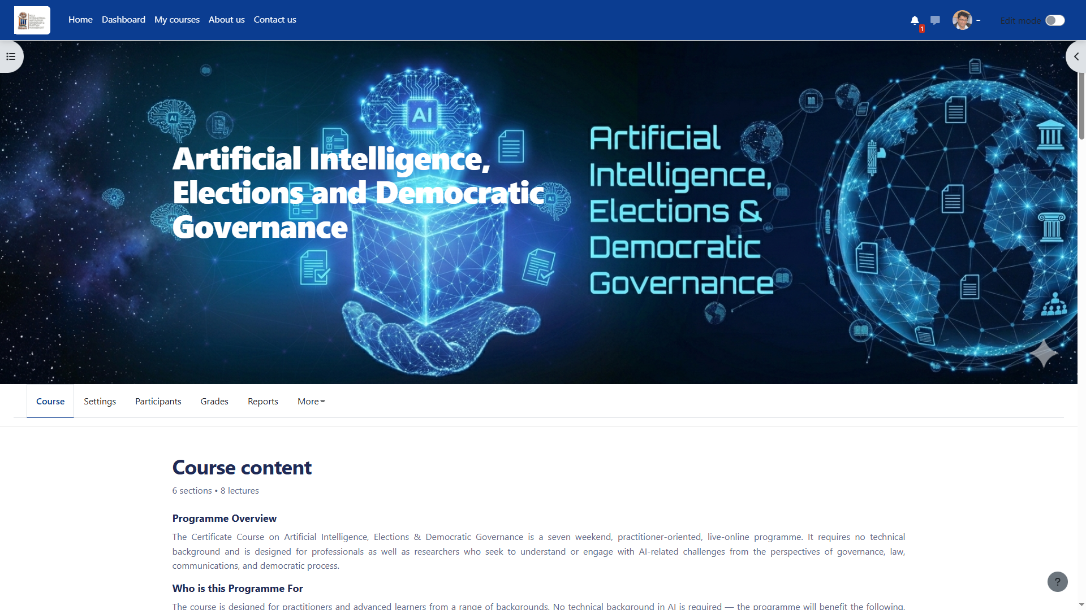
Course page
Certificate course: AI, Elections & Democratic Governance (POB101).

Slide 11
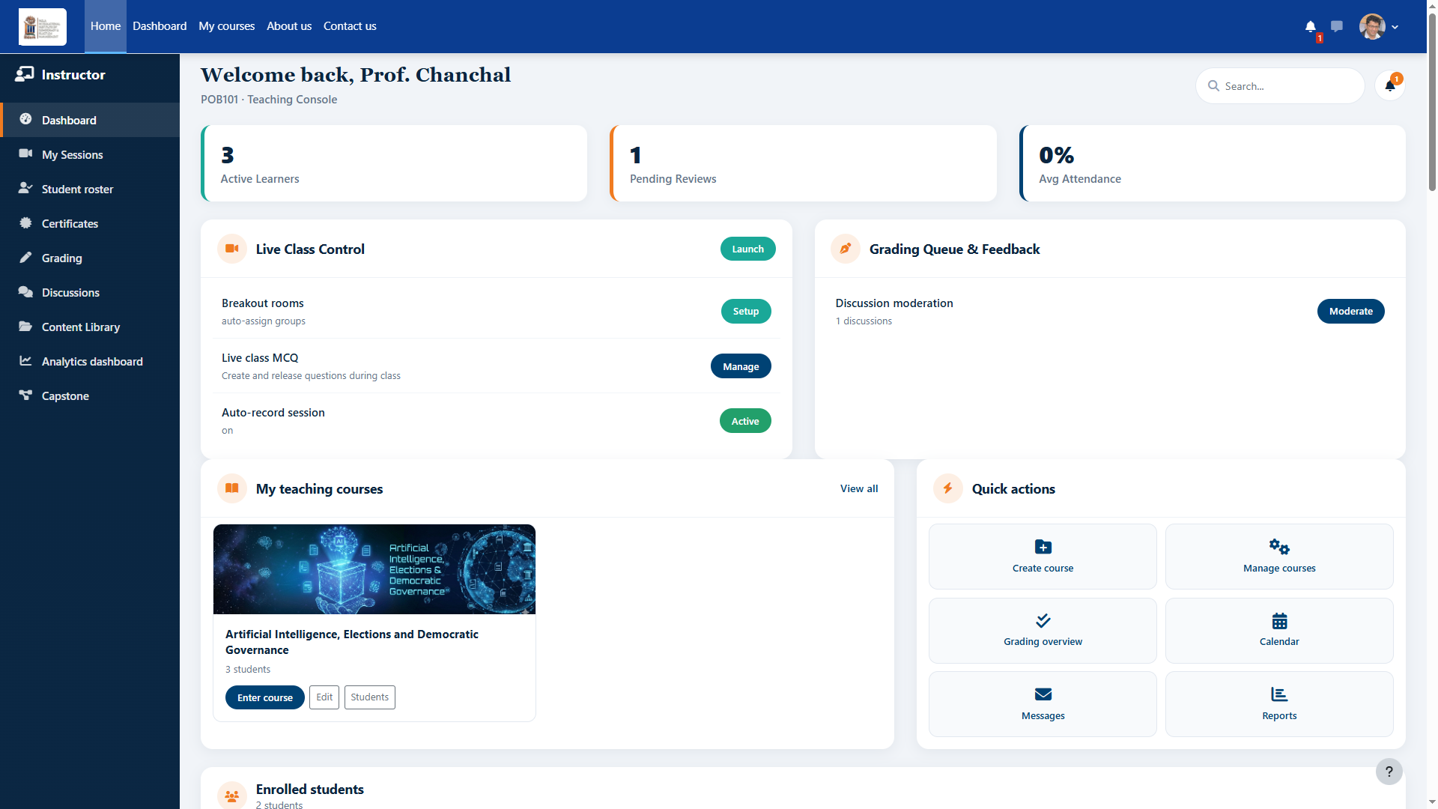
Teacher dashboard
Instructor console: live class control, roster, assessments, attendance.

Slide 12
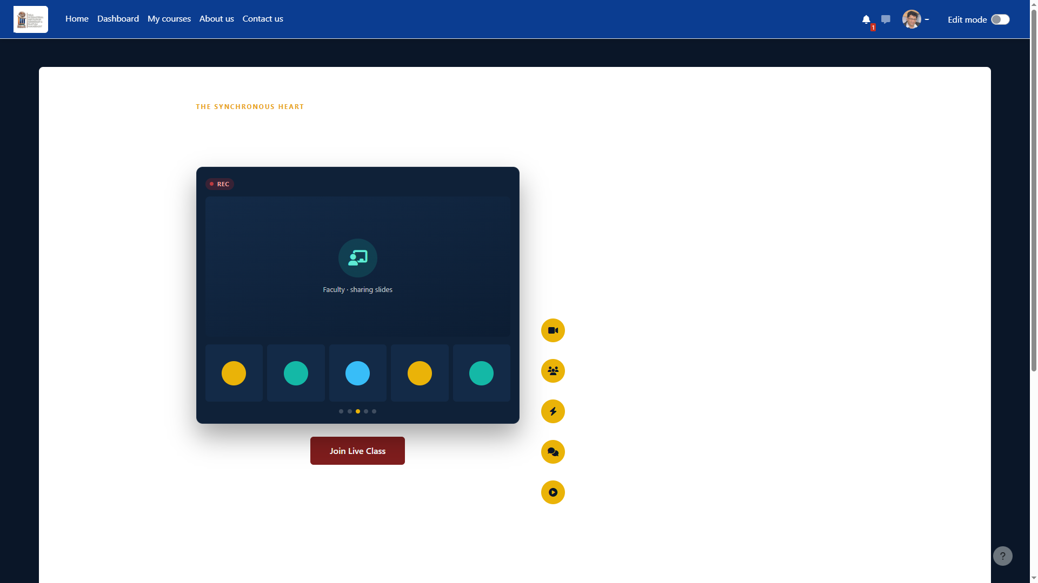
Live Webex class
Students join Webex while keeping the Moodle live class page open.

Slide 13
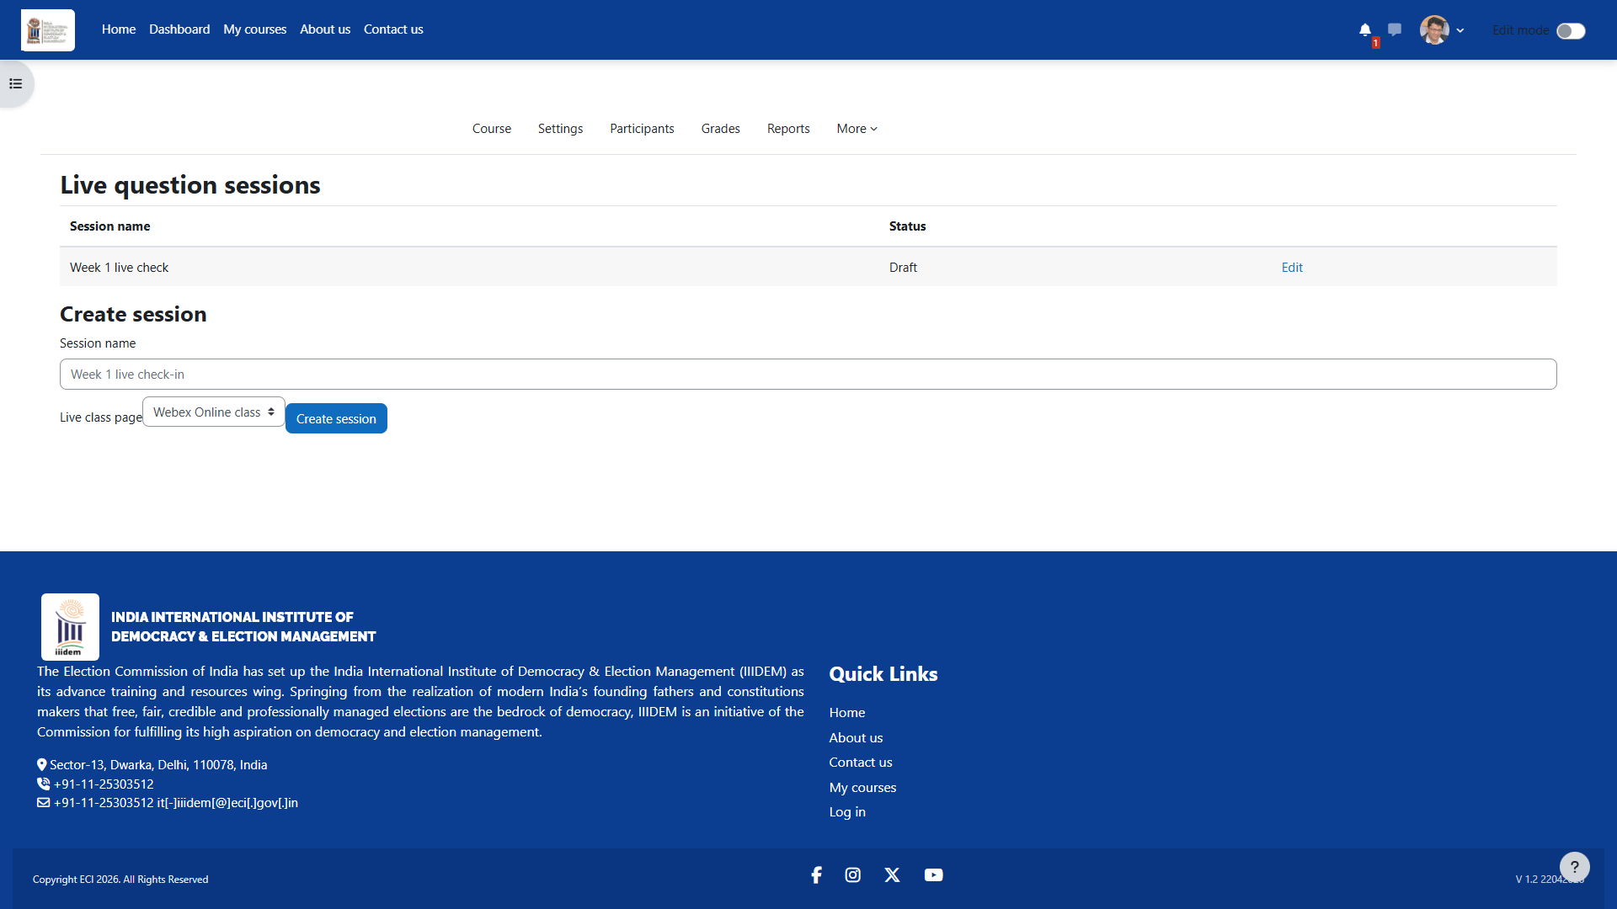
Live class MCQ
Teachers create & release MCQ questions during live sessions.

Slide 14
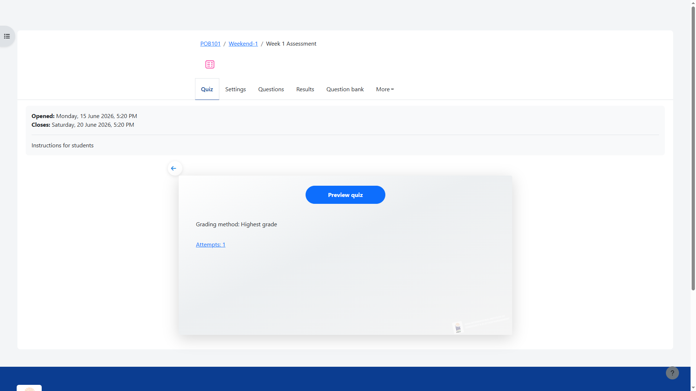
Week 1 quiz
Structured Moodle quiz for weekend assessments.

Slide 15
Live class + MCQ workflow
1. Teacher opens Dashboard → Live class MCQ → Manage
2. Add questions → Release to students
3. Students open Live class page → answer in Live questions panel
4. Teacher sees submissions & scores in real time
5. Video/audio stays in Webex; answers stored in Moodle

Slide 16
Key features delivered
Custom teacher dashboard with assessment summary & per-student quiz tracking
Live virtual classroom UI with Join Webex button
Full-screen custom MCQ quiz attempt experience
Student course reviews & testimonials
Course fee payment via PNB gateway
Attendance & certificate management

Slide 17
Thank you
IIIDEM · Election Commission of India
Moodle LMS Project Demo

