Slide 1
Team 6 AI Friday
Title: AI Solution for Banking Applications Subtitle: Enhancing Customer Experience using Bank Buddy

Slide 2
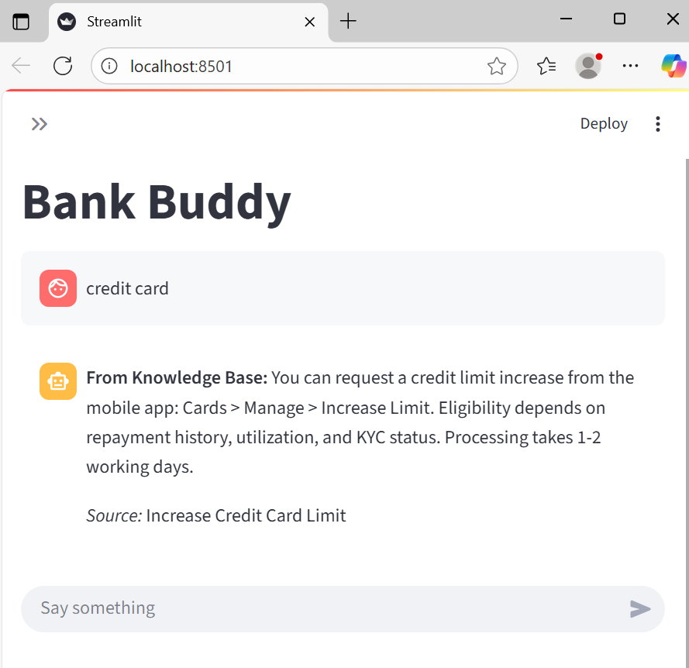

Slide 3
Customer Challenges
Long wait times for account, loan, and transaction queries
Frustrating user experience
Business Impact
Increased support costs
Reduced customer satisfaction

Slide 4
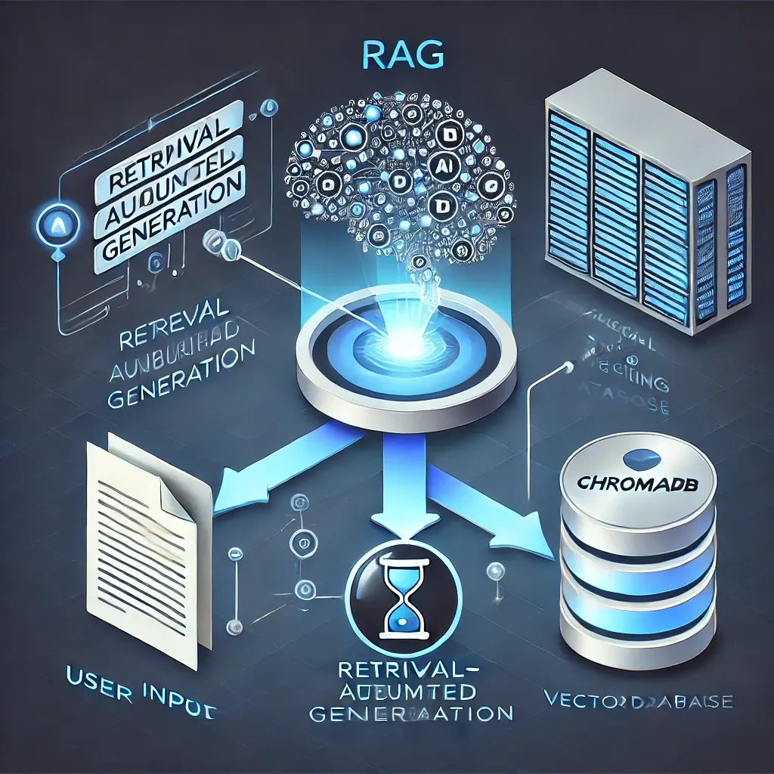
The Solution — AI RAG
What is RAG?
Combines retrieval of relevant data with generation of natural language responses
Uses Streamlit for UI and Ollama for local LLM inference
Why RAG?
- Context-aware answers
- Fast response times
- Scalable and secure

Slide 5
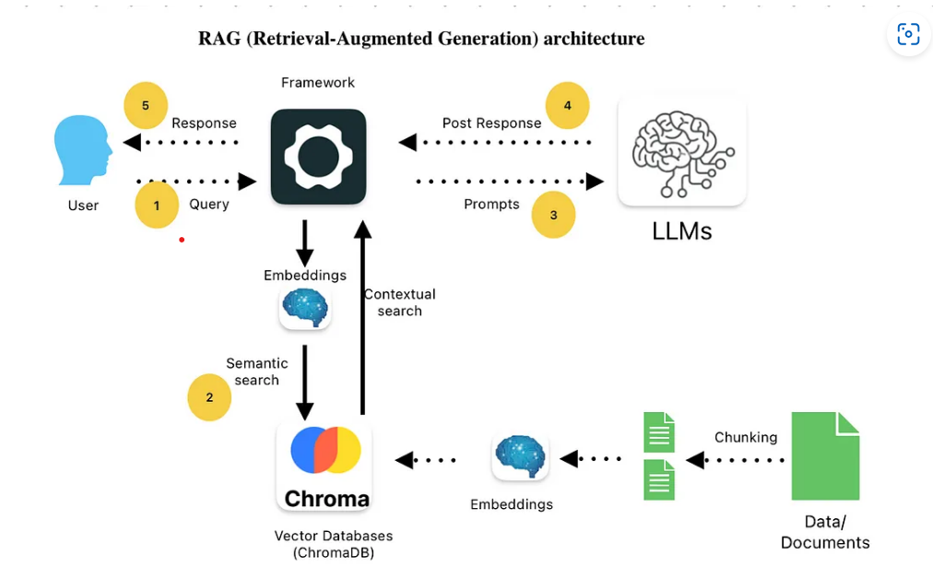
Architecture Overview

Slide 6
RAG Architecture workflow
- Streamlit: Interactive front-end
- Ollama: Lightweight LLM engine
- Vector DB: ChromaDB
- Knowledge Base: Banking documents-PDF, FAQs- csv file
Workflow
- User submits query
- Query embedded → vector search
- Retrieve relevant documents
- Generate response with LLM
- Display via Streamlit

Slide 7
Benefits of RAG for Banking
| Benefit | Description |
| 🚀 Speed | Responses in seconds, not minutes |
| 🎯 Accuracy | Contextual answers reduce misinformation |
| 📈 Scalability | Handles thousands of queries without backend strain |
| 🔐 Security | Local inference with Ollama ensures data privacy |
| 💬 Conversational UX | Natural language responses improve customer engagement |
| 🧠 Intelligent Retrieval | Pulls from curated banking knowledge, not just static templates |

Slide 8
Security & Compliance
No sensitive data stored externally
On-prem deployment possible
Audit logs for compliance
GDPR-ready architecture

Slide 9
Future Enhancements
- Multilingual support
- Voice-based queries
- Integration with core banking APIs
- Real-time analytics dashboard

Slide 10
Future Enhancements
- Multilingual support
- Voice-based queries
- Integration with core banking APIs
- Real-time analytics dashboard

