Slide 1

“Secure Coding AI”
Department of Computer Engineering
TERNA ENGINEERING COLLEGE
Nerul (W), Navi Mumbai 400706
Group ID : A10
Under the Guidance of :
Prof. Mohini Misale
Group Members: Harsh Jain A-58
Atharav Kadam A-54
Sayli Vekhande A-63
Arya Ratnakar A-47

Slide 2
Sr. No | Table Of Contents | Page. No
1. | Abstract | 3
2. | Introduction | 4
3. | Literature Survey | 5
4. | Research Gap | 6
5. | Problem Statement | 7
6. | Objective | 8
7. | Scope | 9
8. | SRS | 10
9. | Proposed Architecture | 12
10. | Activity Diagram | 13
11. | Use case Daigram | 14
12. | Software And Hardware Requirements | 15
13.. | Conclusion | 22
14. | Reference | 23

Slide 3
Abstract
Software vulnerabilities are a major cause of security breaches in modern applications, highlighting the need for developers to understand secure coding practices during software development. However, existing coding platforms primarily focus on algorithmic problem-solving, while security tools mainly focus on detecting vulnerabilities rather than teaching developers how to prevent them. To address this gap, this project proposes SecureCode AI, a secure coding education platform that enables learners to practice secure software development through hands-on vulnerability-based coding challenges.
The platform evaluates submitted solutions for both functional correctness and security correctness using automated code execution and multiple security analysis mechanisms, including static analysis tools and AI-generated guidance. Learners receive security feedback, evidence, submission history, and learning analytics to understand their mistakes and improve across multiple attempts. The platform is designed to support different vulnerability categories and promote practical learning of secure coding principles. Ultimately, SecureCode AI aims to bridge the gap between conventional programming practice and cybersecurity education by helping developers learn to write functionally correct and secure code.

Slide 4
Introduction
With the rapid growth of web applications, cloud services, and digital systems, secure software development has become an essential requirement for modern software engineers. Despite continuous advancements in cybersecurity, software vulnerabilities remain a major cause of data breaches, system compromise, and cyberattacks. While various platforms provide coding practice, cybersecurity training, and vulnerability scanning, there is limited focus on teaching developers to develop secure code through practical programming experience.
Existing learning platforms often emphasize algorithmic problem-solving, while security-focused platforms primarily concentrate on vulnerability detection or offensive security. This creates a gap between programming skills and secure software development practices. To address this gap, our project proposes SecureCode AI, an interactive secure coding platform that enables learners to practice programming through security-focused coding challenges. The platform evaluates submitted solutions for both functional correctness and security correctness, using automated testing and security analysis tools, while providing feedback and learning analytics. The platform aims to bridge programming and cybersecurity education by helping learners develop the ability to write correct, secure, and reliable software.

Slide 5
Literature Survey
Sr No. | Paper (Authors) | Key Findings | Vulnerabilities Addressed | Limitations
1 | Secure Coding with AI – From Detection to Repair (Vladislav Belozerov, Peter J. Barclay, Ashkan Sami, 2026) | Evaluated GPT-4.1, GPT-5 and Claude for real-world vulnerability detection and repair. Modern LLMs repaired around 75–80% of detected vulnerabilities. | SQL Injection, Command Injection, Buffer Overflow, Path Traversal, Hardcoded Secrets, Integer Overflow, Memory Corruption, Input Validation flaws | Focuses only on evaluating LLMs for vulnerability detection and repair. Does not provide an interactive secure coding practice platform, coding challenges, learner progress tracking, or AI-assisted educational feedback.
2 | An Empirical Study on LLM-Driven Secure Code Generation (Hao Yan, Swapneel S. Vaidya, Xiaokuan Zhang, Ziyu Yao, 2025) | Demonstrated that self-generated vulnerability hints significantly improve secure code generation and vulnerability repair by LLMs. | SQL Injection, Command Injection, Buffer Overflow, Path Traversal, Hardcoded Credentials, Weak Input Validation | Focuses on improving LLM code generation rather than building a learning platform. Does not support secure coding exercises, user assessment, or personalized developer learning.
3 | Design of Secure Coding Challenges for Cybersecurity Education in the Industry (Tiago Gasiba, Ulrike Lechner, Maria Pinto-Albuquerque, Alae Zouitni, 2021) | Introduces Capture-the-Flag (CTF) challenge structures to improve developers' secure coding skills. | SQL Injection, XSS, Buffer Overflow, Authentication flaws, Secure Coding Practices | Provides challenge design only. Does not include automated code evaluation, AI-generated explanations, adaptive learning, or progress tracking.

Slide 6
Sr No. | Paper (Authors) | Key Findings | Vulnerabilities Addressed | Limitations
4 | The Role of Generative AI in Strengthening Secure Software Coding Practices (Hathal S. Alwageed, Rafiq Ahmad Khan, 2025) | Reviews how GenAI improves secure coding, vulnerability detection and developer productivity. | SQL Injection, Cross-Site Scripting (XSS), Buffer Overflow, Input Validation issues | Provides theoretical discussion only. No implementation of a secure coding platform, coding challenges, AI feedback, or vulnerability assessment workflow.
5 | Secure Coding with AI Coding Assistants: From Preventive to Reactive Security (Faisal Haque Bappy et al., 2026) | Shows AI coding assistants shift developers from writing secure code proactively to reviewing security after code generation. | General secure coding awareness for OWASP Top 10 vulnerabilities | Focuses on developer behaviour rather than developing a secure coding education platform with automated vulnerability detection, scoring, and learning analytics.
6 | Is Secure Coding Education in the Industry Needed? (Tiago Espinha Gasiba, Ulrike Lechner, Maria Pinto-Albuquerque, Daniel Mendez, 2021) | Large-scale survey reveals many developers lack awareness and compliance with secure coding guidelines. | General secure coding issues including SQL Injection, XSS, Authentication, Secure Coding Standards | Identifies the need for secure coding education but does not propose or implement an AI-assisted secure coding learning platform.
7 | SoK: AI Secure Code Generation – Progress, Pitfalls and Paths Forward (Rupam Patir, Keyan Guo, Haipeng Cai, Hongxin Hu, 2026) | Comprehensive survey introducing KAUGE framework for evaluating secure code generation using secure coding principles. | SQL Injection, Command Injection, Path Traversal, Weak Cryptography, Security Misconfiguration, Dependency Vulnerabilities | Survey paper only. Does not implement an AI-powered secure coding environment, automated code evaluation, or practical learning modules.

Slide 7
Sr No. | Paper (Authors) | Key Findings | Vulnerabilities Addressed | Limitations
8 | Using Real-World Bug Bounty Programs in Secure Coding Course (Kamil Malinka et al., 2024) | Demonstrates that integrating bug bounty programs into education improves practical vulnerability discovery skills. | Real-world Web Vulnerabilities (SQLi, XSS, Access Control, Misconfigurations depending on targets) | Depends on external bug bounty programs. Does not offer a structured AI-based learning environment with predefined secure coding exercises and automated assessment.
9 | A Systematic Mapping Study on Teaching Security Concepts in Programming Courses (Alina Torbunova, Adnan Ashraf, Ivan Porres, 2024) | Reviews approaches for teaching secure programming and identifies gaps in university-level cybersecurity education. | General Secure Coding Concepts, Common Vulnerabilities, Secure Programming Practices | Reviews existing teaching methods but does not propose an intelligent adaptive learning platform with AI-assisted vulnerability analysis and coding practice.
10 | Secure Coding Education Through Gamification and CTF Challenges (Tiago Gasiba et al., 2021) | Shows gamified secure coding exercises improve developer engagement and secure programming awareness. | SQL Injection, XSS, Buffer Overflow, Secure Authentication | Uses gamification but lacks AI-powered code analysis, automated vulnerability detection, personalized feedback, and secure coding performance analytics.

Slide 8
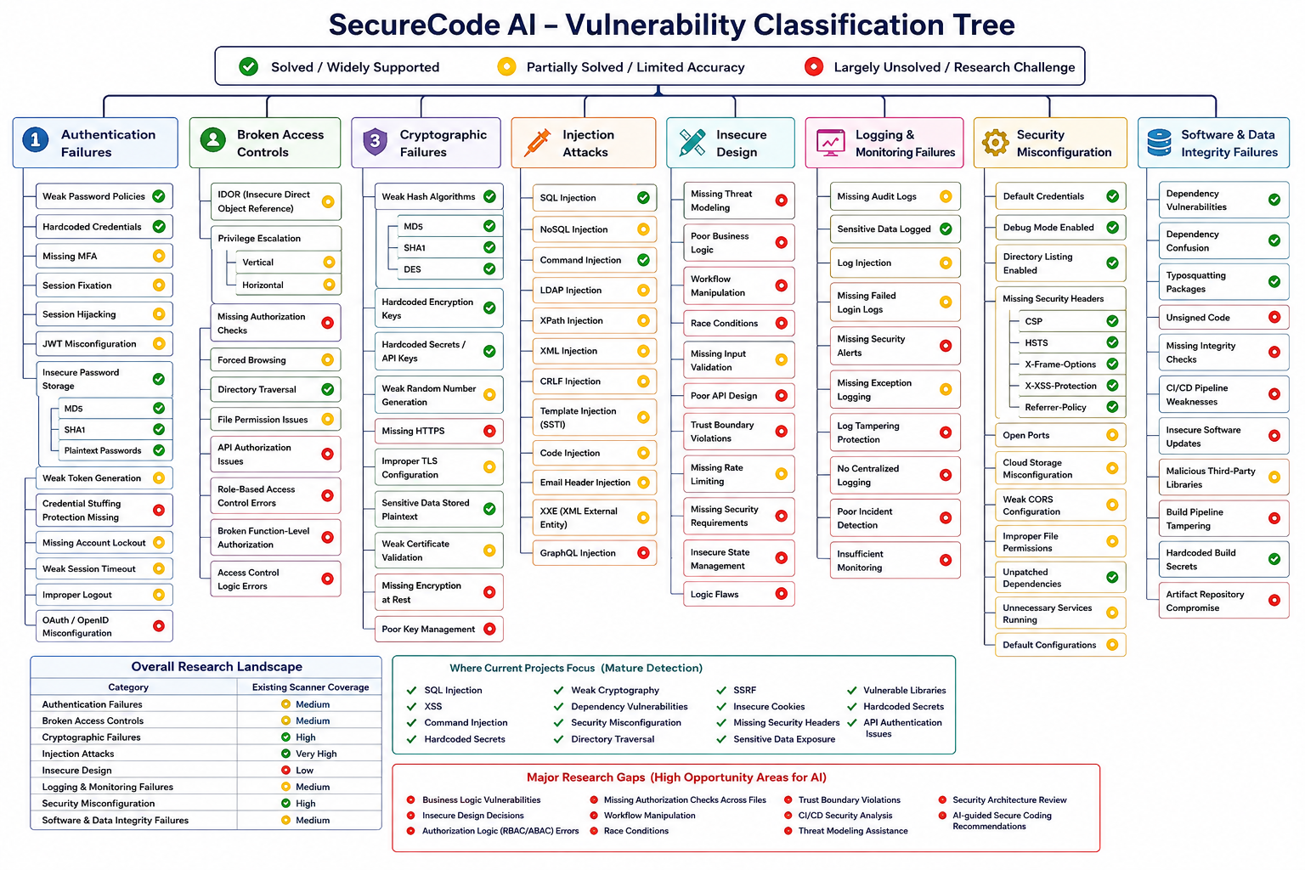

Slide 9
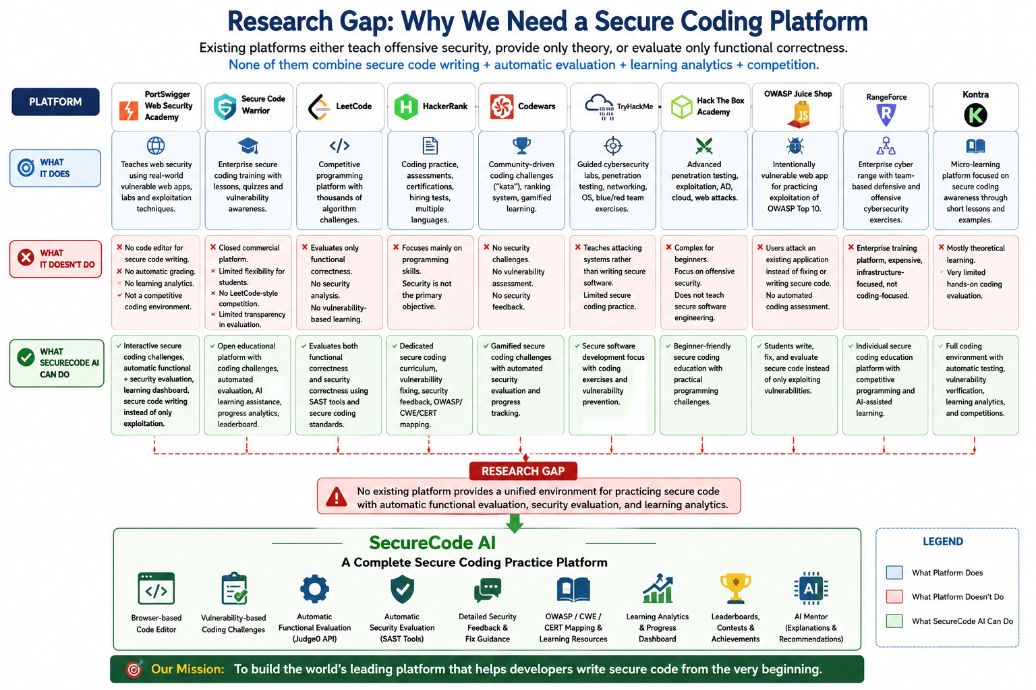

Slide 10
Research Gap
Most studies focus on AI-based vulnerability detection and repair, but do not provide an interactive platform for practicing secure coding.
Existing research emphasizes secure code generation using LLMs rather than developing developers' secure coding skills through hands-on programming exercises.
Survey papers discuss secure coding techniques and frameworks but lack practical implementation of an intelligent secure coding learning environment.
Current approaches provide theoretical discussions or developer assistance but do not integrate automated functional evaluation and security evaluation within a single platform.
Existing secure coding education methods and CTF-based challenges do not offer AI-assisted explanations, adaptive learning, personalized feedback, or learner progress tracking.
Bug bounty and cybersecurity training platforms depend on external environments and do not provide structured, curriculum-based secure coding exercises.
Most secure coding education research lacks a competitive programming environment where users can practice, evaluate, and improve secure coding skills through vulnerability-based coding challenges.
Therefore, there is a need for a unified platform that combines secure coding practice, automated code evaluation, AI-assisted educational feedback, learning analytics, and challenge-based learning to improve secure software development skills.

Slide 11
Problem Statement
Modern software applications are increasingly vulnerable to security flaws due to the lack of practical secure coding skills among developers. Existing educational platforms primarily focus on algorithmic programming, cybersecurity awareness, penetration testing, or vulnerability detection, but they provide limited opportunities to practice secure software development through real coding exercises. As a result, many developers are able to write functionally correct programs but struggle to implement secure coding practices that prevent vulnerabilities during development. There is a need for an interactive learning platform that enables developers to practice secure coding through vulnerability-based programming challenges, evaluate both functional and security correctness, and receive educational feedback to improve their secure software development skills.

Slide 12
Objectives
To develop an interactive platform for learning and practicing secure software development.
To improve developers' secure coding skills through vulnerability-based programming challenges.
To evaluate submitted code for both functional correctness and security correctness while providing AI-assisted educational feedback to help users understand, identify, and fix security vulnerabilities.
To promote hands-on secure coding practice through challenge-based learning while tracking user progress, strengths, and areas for improvement in secure software development.
To build a scalable platform that can support multiple vulnerability categories and programming languages in future versions.

Slide 13
Scope
1. Secure Coding Learning Platform
Develop an interactive platform for learning and practicing secure software development.
Provide hands-on and challenge-based learning for secure coding concepts.
2. Vulnerability Coverage
Initially focus on the Injection Attack category and its major subtypes as a proof of concept.
Design the platform to support additional OWASP vulnerability categories in future versions.
3. Programming Challenges
Provide vulnerability-based programming challenges.
Enable users to identify, prevent, and fix security vulnerabilities through practical coding exercises.
4. Automated Code Evaluation
Evaluate submitted solutions for functional correctness.
Evaluate submitted solutions for security correctness.
Identify security issues present in submitted code.
addition of new challenges, security rules, vulnerability categories, and learning resources.

Slide 14
5. Secure Coding Guidance and Feedback
Provide AI-assisted educational feedback to help users understand and fix vulnerabilities.
Provide secure coding guidance based on recognized standards such as OWASP, CWE, and CERT.
6. Target Users
Students learning software development and cybersecurity.
Software developers interested in improving secure coding practices.
Learners interested in practical secure software development.
7. Progress Tracking
Track users' performance across secure coding challenges.
8. Modular and Scalable Design
Design the system with a modular and scalable architecture.
Allow continuous

Slide 15
SRS
Functional Requirements
1. User Management
User Registration
Secure Login
Profile Management
Role Management
4. Functional Evaluation
Code Compilation
Test Execution
Result Evaluation
Error Detection
6. Feedback System
Vulnerability Explanation
Secure Recommendations
Code Improvement
Learning Hints
2. Challenge Management
Browse Challenges
Search Challenges
Filter Challenges
Challenge Details
5. Security Evaluation
Static Analysis
Vulnerability Detection
Security Findings
Risk Identification
7. Learning Analytics
Progress Tracking
Attempt History
Performance Analysis
Learning Dashboard
3. Code Editor
Online Editor
Language Selection
Code Submission
Attempt Management
8. Admin Module
User Management
Challenge Management
Content Management
System Monitoring

Slide 16
Non-Functional Requirements
1. Usability
User-Friendly Interface
Responsive Design
Simple Navigation
Clear Feedback
2. Performance
Fast Compilation
Quick Evaluation
Resource Management
Response Optimization
3. Security
Secure Authentication
Data Protection
Access Control
Code Isolation
4. Scalability
Modular Expansion
New Vulnerabilities
New Languages
Additional Evaluators
5. Reliability
Error Handling
Data Consistency
Service Recovery
Result Accuracy
6. Maintainability
Modular Architecture
Clean Code
Component Reusability
Easy Testing
7. Compatibility
Browser Support
API Integration
Cross-Platform Access
External Tool Support
8. Availability
Service Availability
Failure Recovery
Backup Support
Continuous Operation

Slide 17
RMMM
https://docs.google.com/spreadsheets/d/1r0BP8sPD6LdUCPx33Lrx146MKIuvlqJ_/edit?usp=drive_link&ouid=115278546865658572613&rtpof=true&sd=true

Slide 18
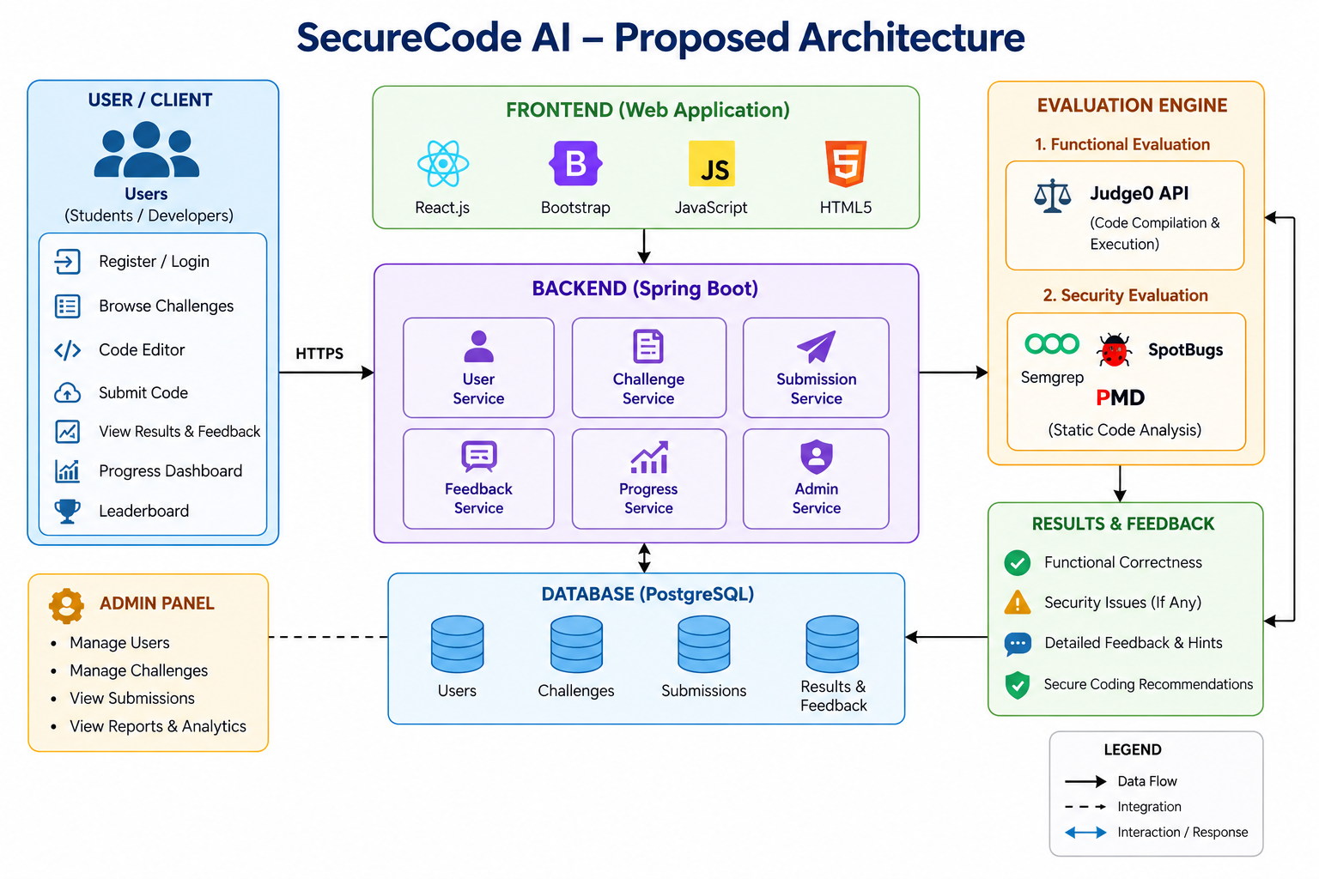

Slide 19
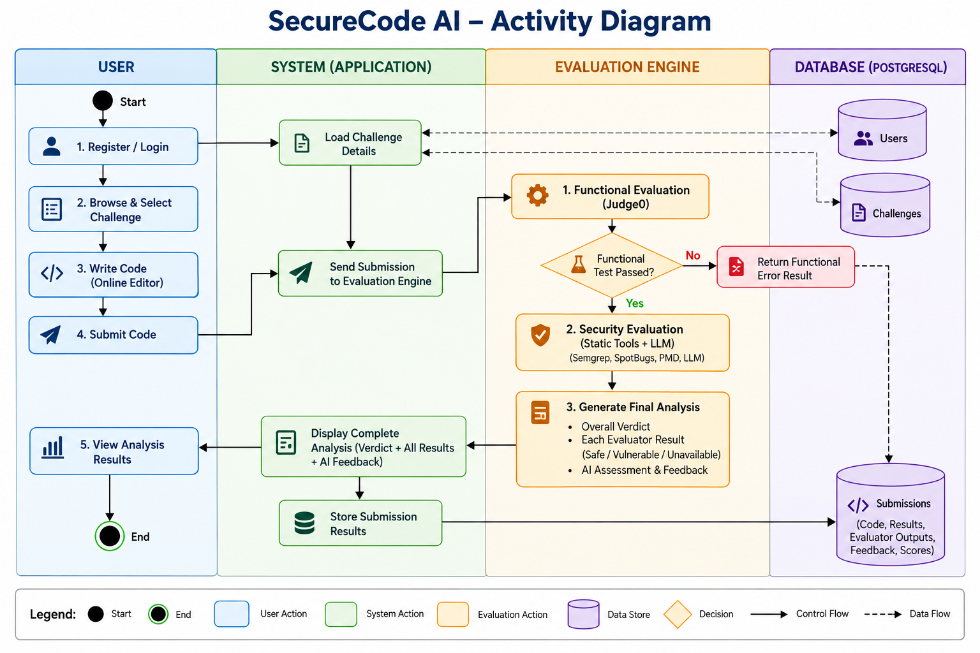

Slide 20
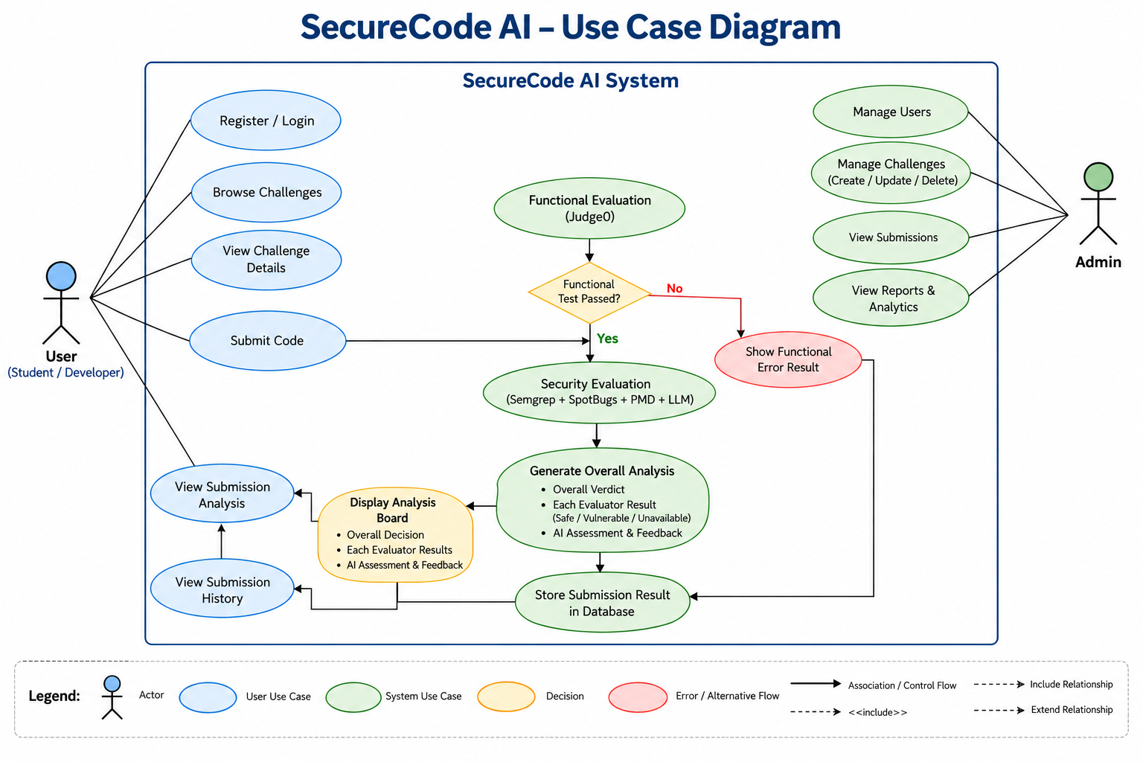

Slide 21
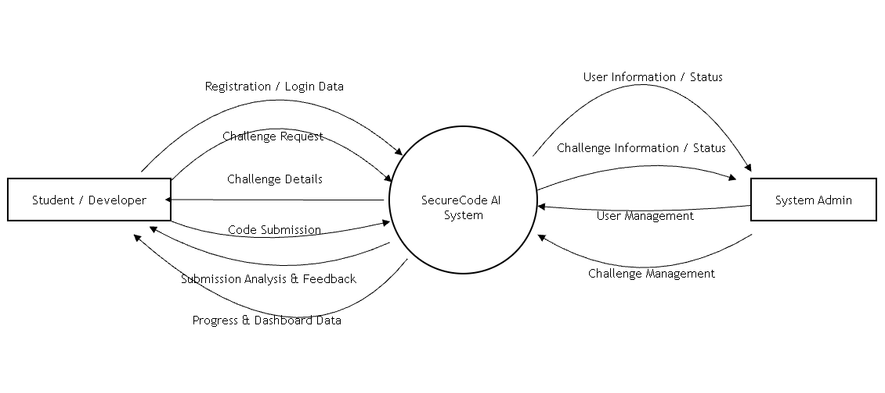
DFD LEVEL 0
SecureCode AI System – Data Flow Diagram(Level 0)

Slide 22
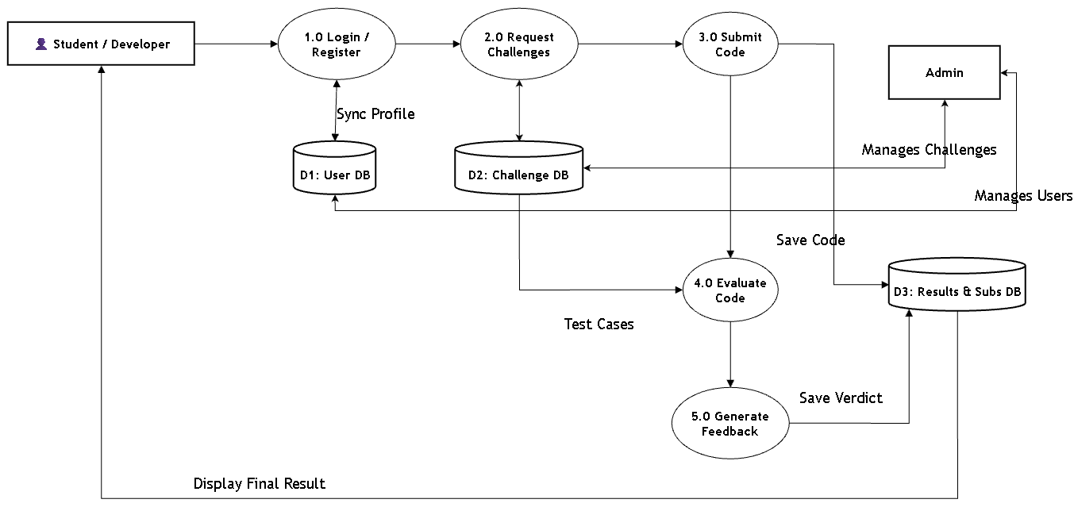
DFD LEVEL 1
SecureCode AI System – Data Flow Diagram(Level 1)

Slide 23
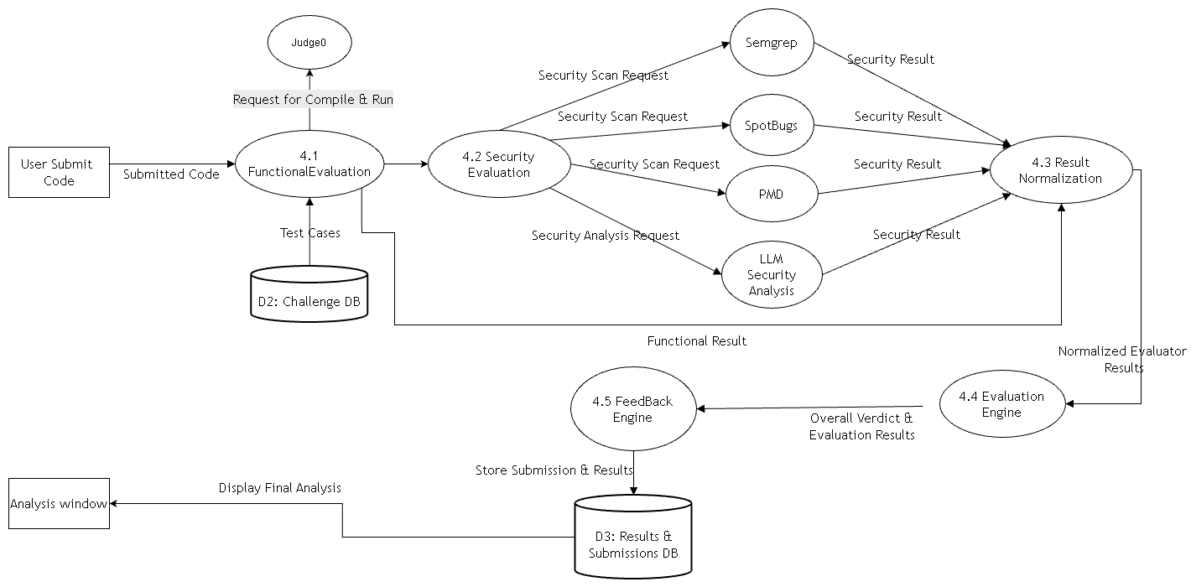
DFD LEVEL 2
SecureCode AI System – Data Flow Diagram(Level 2)

Slide 24
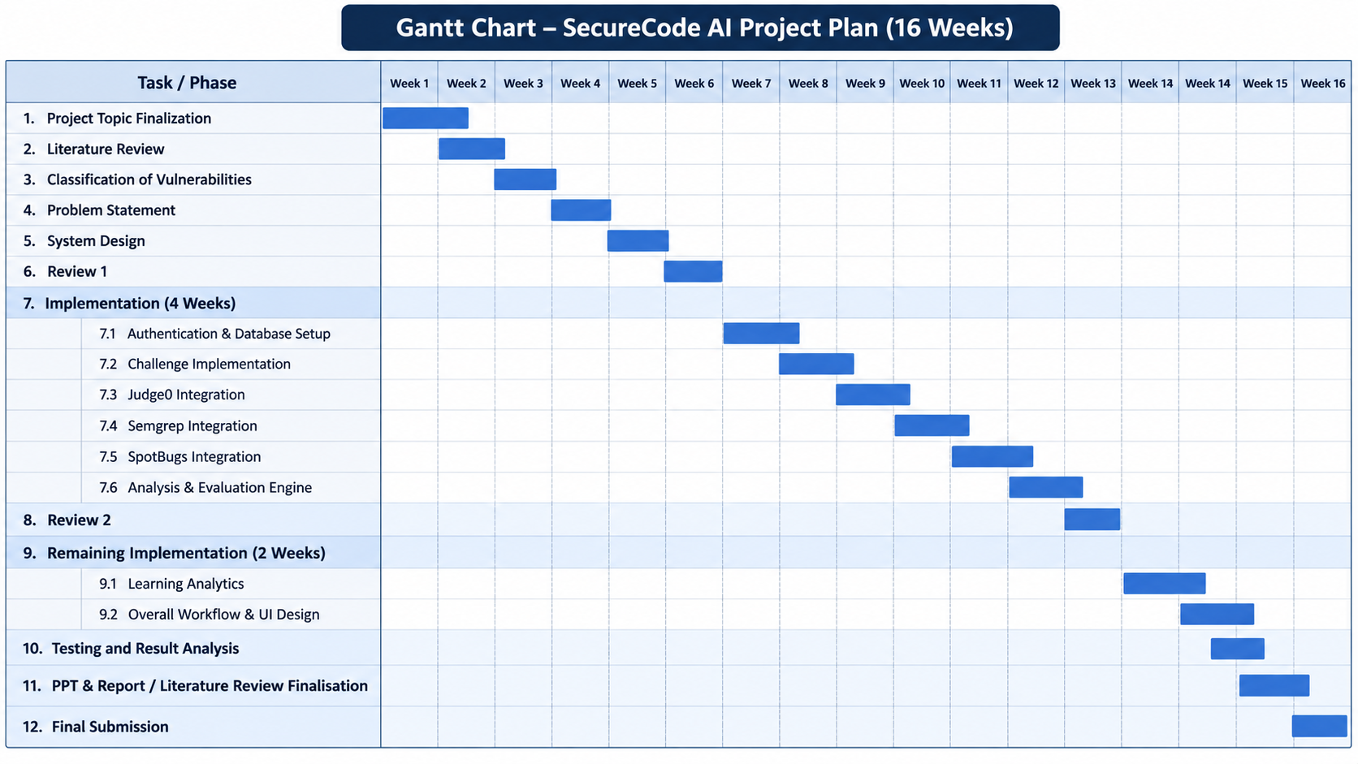

Slide 25
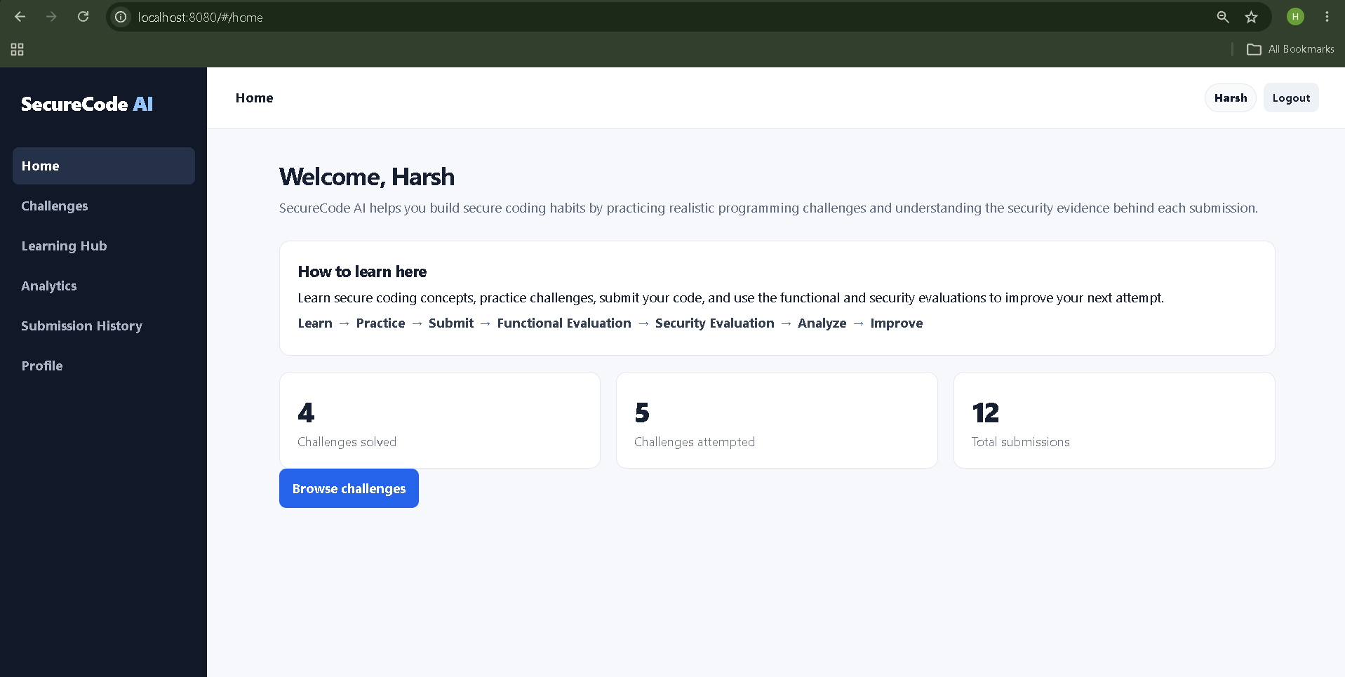

Slide 26
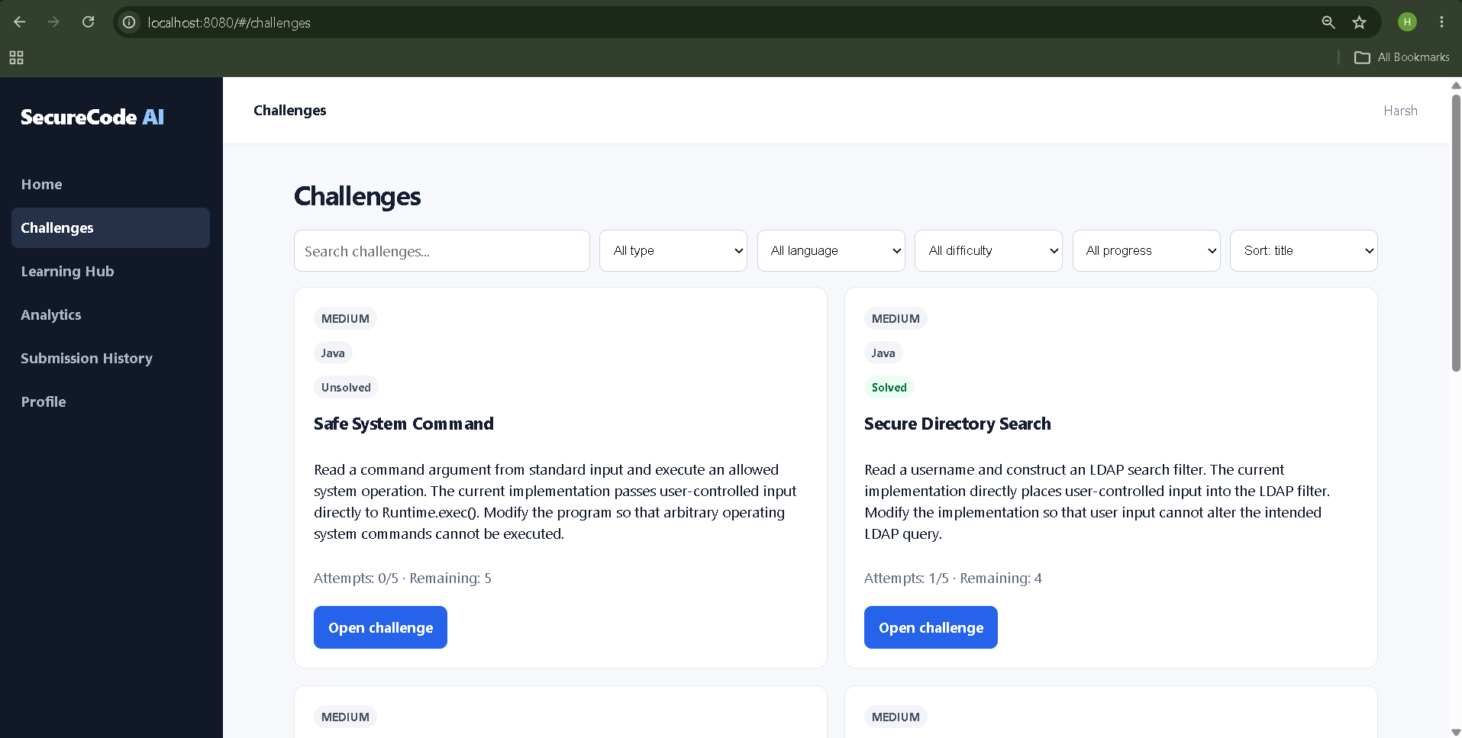

Slide 27
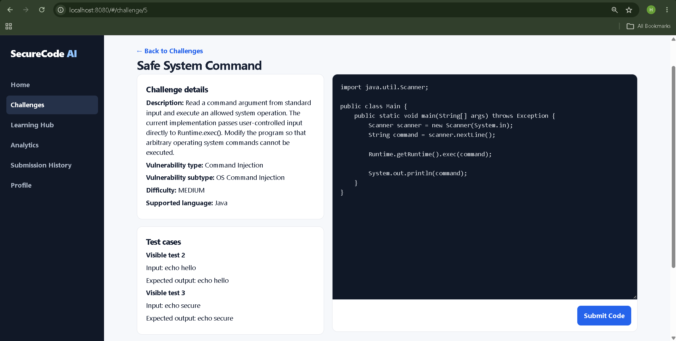

Slide 28
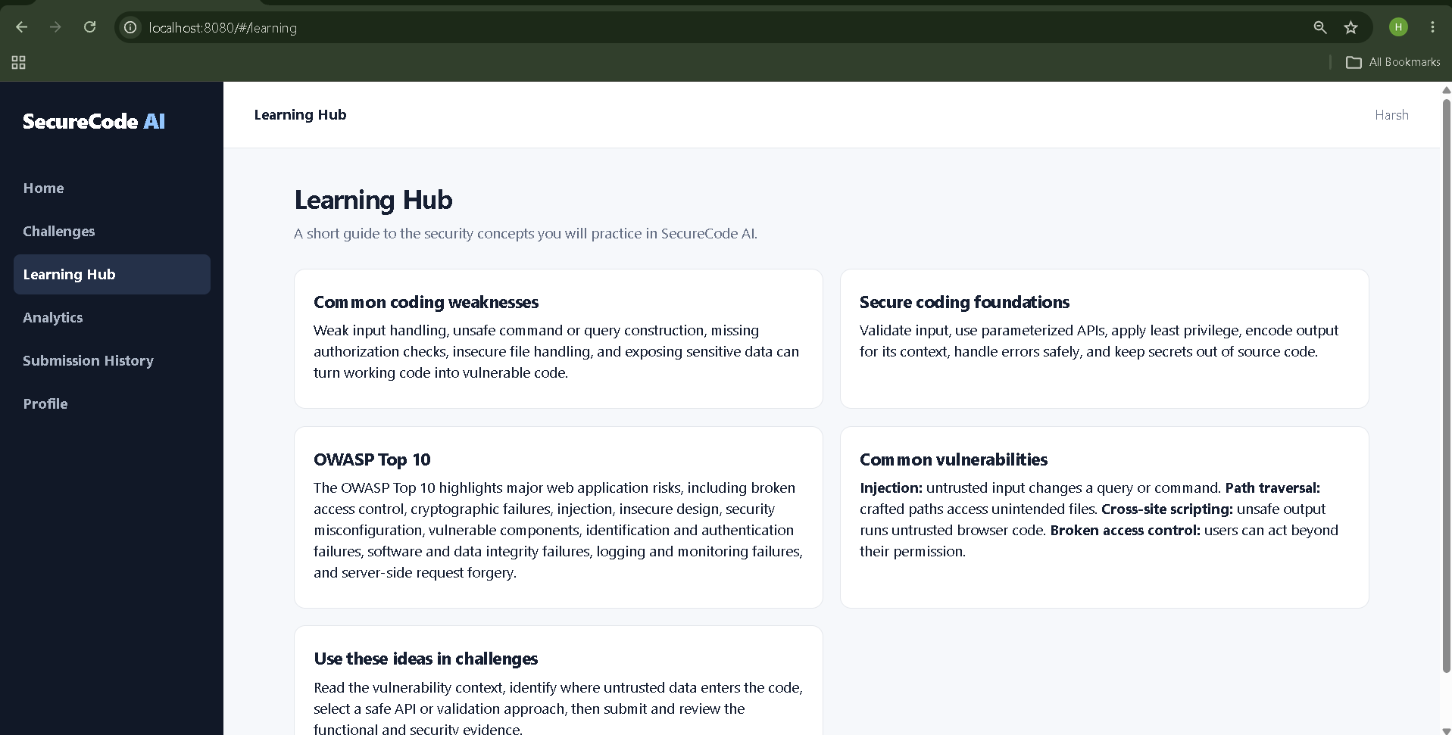

Slide 29
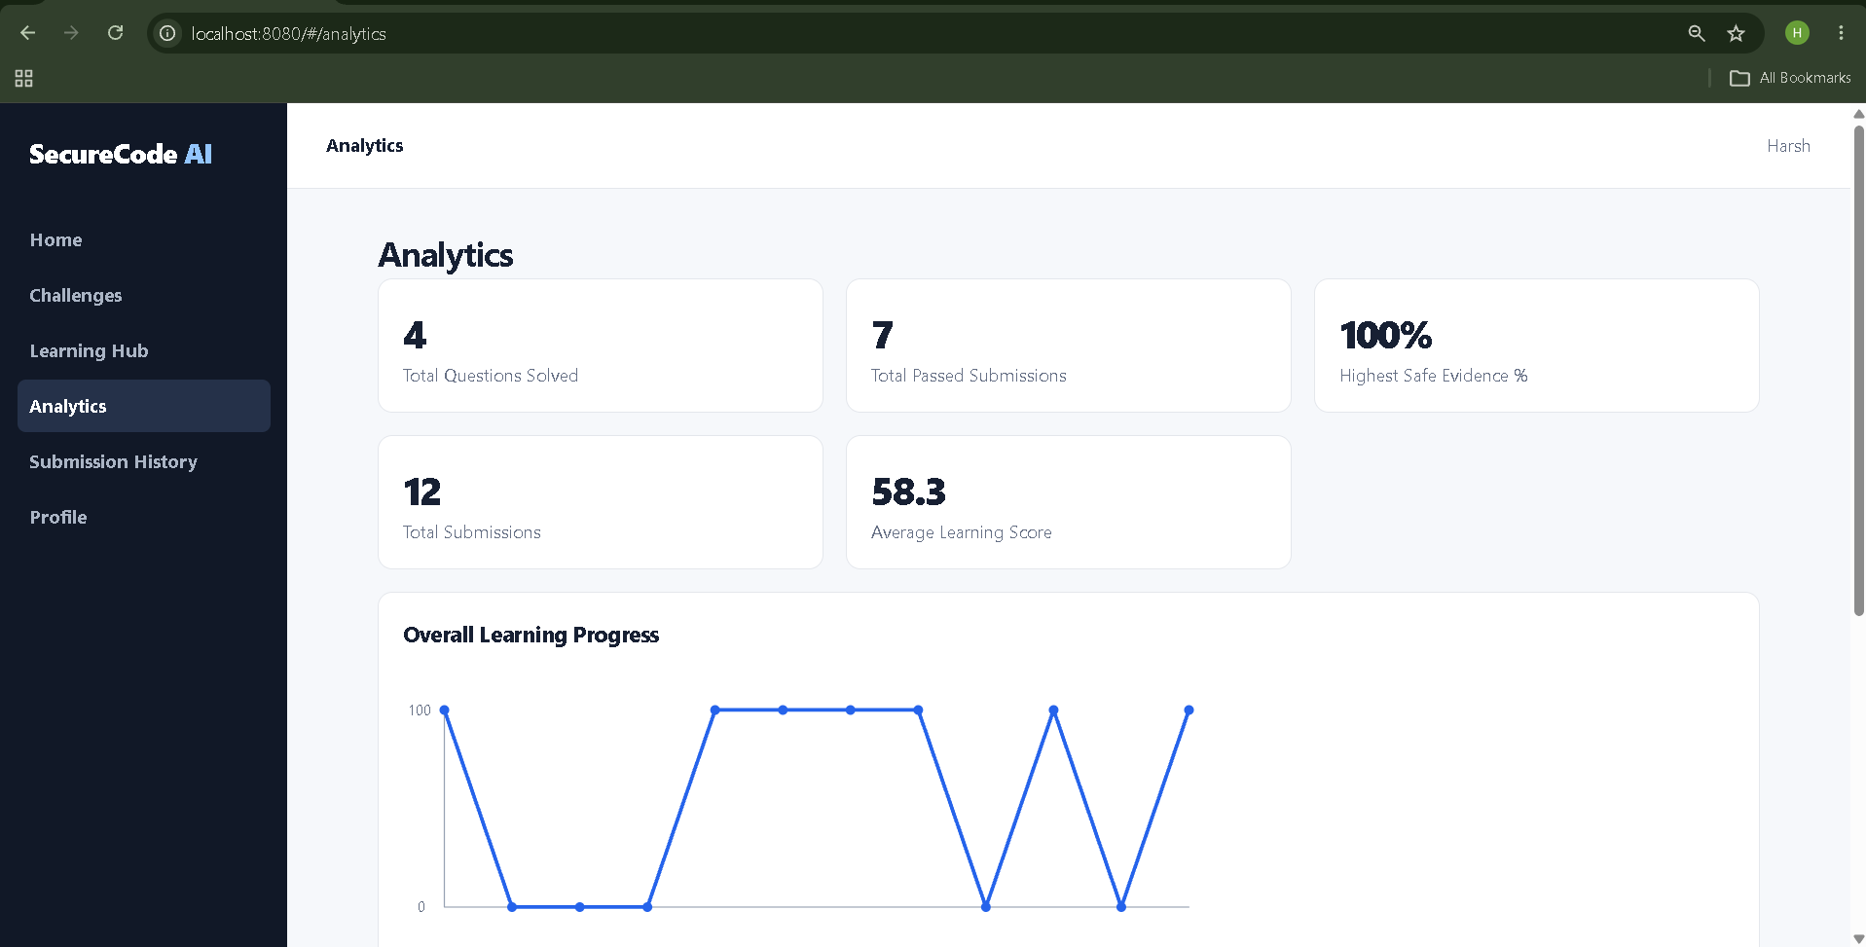

Slide 30
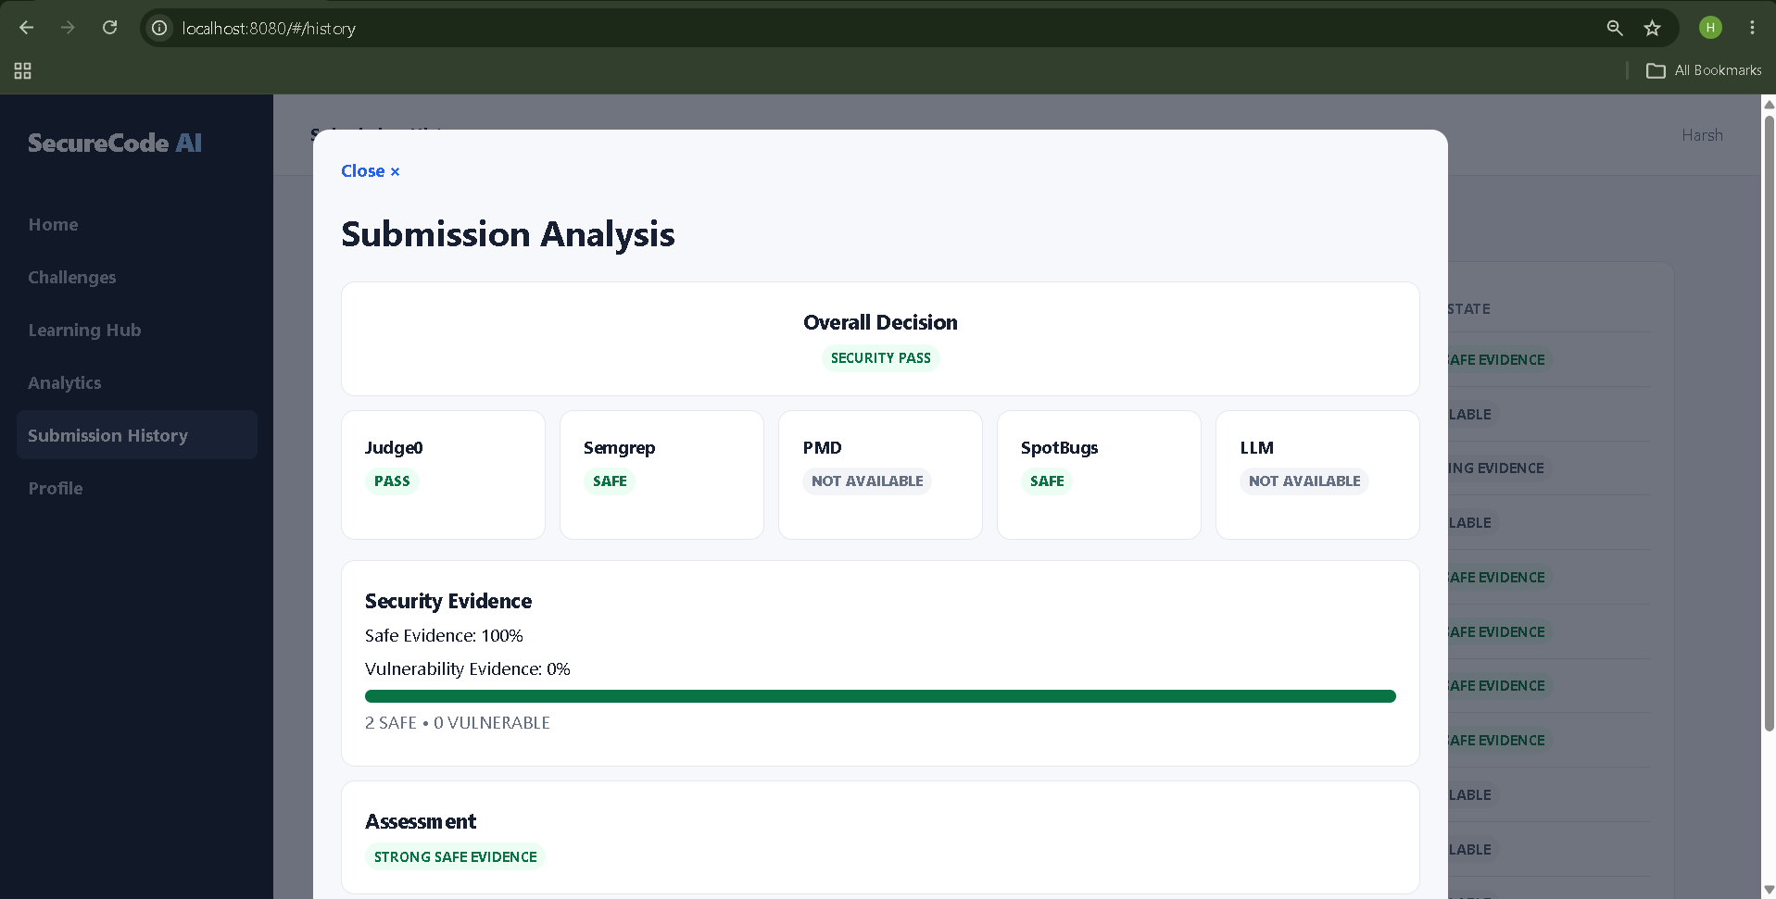

Slide 31
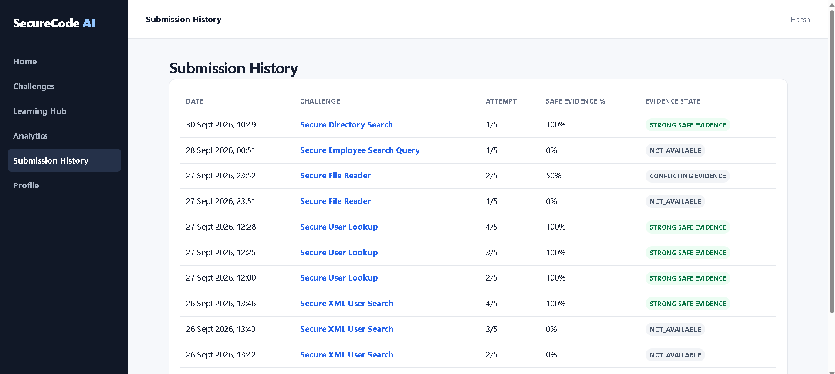

Slide 32
Conclusion
Existing coding platforms focus mainly on functionality, while secure coding practice remains limited.
SecureCode AI bridges this gap through vulnerability-based challenges and automated code evaluation.
The platform focuses on practical secure coding education through challenge-based learning.
The functional and security evaluation workflow has been implemented with the Analysis Engine.
Feedback Engine and LLM integration are currently remaining for further development.
The initial scope focuses on Injection Attacks, with future expansion to additional OWASP vulnerabilities.

Slide 33
References
[1] V. Belozerov, P. J. Barclay, A. Sami, et al., "Secure Coding with AI – From Detection to Repair," 2026.
[2] H. Yan, S. S. Vaidya, X. Zhang, and Z. Yao, "Guiding AI to Fix Its Own Flaws: An Empirical Study on LLM-Driven Secure Code Generation," 2025.
[3] R. Patir, K. Guo, H. Cai, and H. Hu, "Systematization of Knowledge (SoK): AI Secure Code Generation – Progress, Pitfalls and Paths Forward," 2026.
[4] H. S. Alwageed and R. A. Khan, "The Role of Generative AI in Strengthening Secure Software Coding Practices," 2025.
[5] F. H. Bappy, et al., "Secure Coding with AI Coding Assistants: From Preventive to Reactive Security," 2026.
[6] T. E. Gasiba, U. Lechner, M. Pinto-Albuquerque, and D. Mendez, "Is Secure Coding Education in the Industry Needed?," 2021.
[7] T. Gasiba, U. Lechner, M. Pinto-Albuquerque, and A. Zouitni, "Design of Secure Coding Challenges for Cybersecurity Education in the Industry," 2021.
[8] K. Malinka, et al., "Using Real-World Bug Bounty Programs in Secure Coding Course," 2024.
[9] A. Torbunova, A. Ashraf, and I. Porres, "A Systematic Mapping Study on Teaching Security Concepts in Programming Courses," 2024.
[10] T. Gasiba, et al., "Secure Coding Education Through Gamification and CTF Challenges," 2021.

