Slide 1

TERNA ENGINEERING COLLEGE, NAVI MUMBAI
DEPARTMENT OF COMPUTER ENGINEERING • ACADEMIC YEAR 2026-27
MAJOR PROJECT FINAL PRESENTATION
SECURECODE-AI
A Hands-On Secure Coding Practice and Multi-Engine Evaluation Platform
Group ID: A10 | BE - Computer Engineering (Comps A)
Under the Guidance of: Prof. Mohini Misale
Project Team Members:
Harsh Jain (A-58) • Atharva Kadam (A-54) • Sayli Vekhande (A-63) • Arya Ratnaker (A-47)

Slide 2
INDEX
Sr.No | Table of Contents | Page No.
1 | Abstract | 3
2 | Introduction | 4
3 | Literature Survey | 5
4 | Research Gap | 6
5 | Problem Statement | 7
6 | Objective | 8
7 | Scope | 9
8 | SRS | 10
9 | Proposed Architecture | 11
10 | Use Case Diagram | 12
11 | Activity Diagram | 13
12 | Hardware and Software used | 14
13 | Conclusion | 15
14 | References | 16

Slide 3
Abstract
SecureCode AI is a web-based secure coding practice platform designed to help students learn how to identify and fix security vulnerabilities through hands-on coding challenges.
Unlike traditional coding platforms, it evaluates both functional correctness (whether the code works correctly) and security correctness (whether the code follows secure coding practices).
The platform uses Judge0 for code execution, Semgrep and SpotBugs/FindSecBugs for static security analysis, and Groq AI for additional security advice.
It provides 45 injection-based challenges covering SQL, NoSQL, Command, LDAP, XPath, and other injection vulnerabilities, with four difficulty levels.
Features include an interactive code editor, tiered hints, conceptual understanding quizzes, submission history, and learning analytics.
A four-pillar learning score measures functional correctness, security correctness, conceptual understanding, and independent problem-solving.
The main goal is to help learners develop practical secure coding skills and build applications that are both functional and resistant to common vulnerabilities.

Slide 4
Introduction
Modern applications are widely used in banking, healthcare, e-commerce, education, and other important sectors. Protecting their data and functionality is essential.
Software vulnerabilities such as SQL Injection and Command Injection can allow attackers to access sensitive information, modify data, or execute unauthorized commands.
Traditional coding platforms mainly evaluate program output and functional correctness. They may accept a solution even when its implementation contains security weaknesses.
Existing cybersecurity learning platforms often focus on penetration testing and exploiting vulnerabilities, while learners also need practical experience in writing and fixing secure source code.
SecureCode AI addresses this gap by combining coding practice, automated functional testing, multi-engine security analysis, and understandable remediation feedback in one platform.
Students can solve challenges, receive hints, review security findings, answer conceptual questions, and track their progress through learning analytics.
The platform follows a shift-left security approach, encouraging developers to identify and prevent vulnerabilities during coding rather than waiting until an application is deployed.
Overall, SecureCode AI aims to develop a security-focused programming mindset and help learners write code that is both functionally correct and secure.

Slide 5
Literature Survey
Sr No. | Paper (Authors) | Key Findings | Vulnerabilities Addressed | Limitations
1 | Secure Coding with AI – From Detection to Repair (Vladislav Belozerov, Peter J. Barclay, Ashkan Sami, 2026) | Evaluated GPT-4.1, GPT-5 and Claude for real-world vulnerability detection and repair. Modern LLMs repaired around 75–80% of detected vulnerabilities. | SQL Injection, Command Injection, Buffer Overflow, Path Traversal, Hardcoded Secrets, Integer Overflow, Memory Corruption, Input Validation flaws | Focuses only on evaluating LLMs for vulnerability detection and repair. Does not provide an interactive secure coding practice platform, coding challenges, learner progress tracking, or AI-assisted educational feedback.
2 | An Empirical Study on LLM-Driven Secure Code Generation (Hao Yan, Swapneel S. Vaidya, Xiaokuan Zhang, Ziyu Yao, 2025) | Demonstrated that self-generated vulnerability hints significantly improve secure code generation and vulnerability repair by LLMs. | SQL Injection, Command Injection, Buffer Overflow, Path Traversal, Hardcoded Credentials, Weak Input Validation | Focuses on improving LLM code generation rather than building a learning platform. Does not support secure coding exercises, user assessment, or personalized developer learning.
3 | Design of Secure Coding Challenges for Cybersecurity Education in the Industry (Tiago Gasiba, Ulrike Lechner, Maria Pinto-Albuquerque, Alae Zouitni, 2021) | Introduces Capture-the-Flag (CTF) challenge structures to improve developers' secure coding skills. | SQL Injection, XSS, Buffer Overflow, Authentication flaws, Secure Coding Practices | Provides challenge design only. Does not include automated code evaluation, AI-generated explanations, adaptive learning, or progress tracking.

Slide 6
Sr No. | Paper (Authors) | Key Findings | Vulnerabilities Addressed | Limitations
4 | The Role of Generative AI in Strengthening Secure Software Coding Practices (Hathal S. Alwageed, Rafiq Ahmad Khan, 2025) | Reviews how GenAI improves secure coding, vulnerability detection and developer productivity. | SQL Injection, Cross-Site Scripting (XSS), Buffer Overflow, Input Validation issues | Provides theoretical discussion only. No implementation of a secure coding platform, coding challenges, AI feedback, or vulnerability assessment workflow.
5 | Secure Coding with AI Coding Assistants: From Preventive to Reactive Security (Faisal Haque Bappy et al., 2026) | Shows AI coding assistants shift developers from writing secure code proactively to reviewing security after code generation. | General secure coding awareness for OWASP Top 10 vulnerabilities | Focuses on developer behaviour rather than developing a secure coding education platform with automated vulnerability detection, scoring, and learning analytics.
6 | Is Secure Coding Education in the Industry Needed? (Tiago Espinha Gasiba, Ulrike Lechner, Maria Pinto-Albuquerque, Daniel Mendez, 2021) | Large-scale survey reveals many developers lack awareness and compliance with secure coding guidelines. | General secure coding issues including SQL Injection, XSS, Authentication, Secure Coding Standards | Identifies the need for secure coding education but does not propose or implement an AI-assisted secure coding learning platform.
7 | SoK: AI Secure Code Generation – Progress, Pitfalls and Paths Forward (Rupam Patir, Keyan Guo, Haipeng Cai, Hongxin Hu, 2026) | Comprehensive survey introducing KAUGE framework for evaluating secure code generation using secure coding principles. | SQL Injection, Command Injection, Path Traversal, Weak Cryptography, Security Misconfiguration, Dependency Vulnerabilities | Survey paper only. Does not implement an AI-powered secure coding environment, automated code evaluation, or practical learning modules.

Slide 7
Sr No. | Paper (Authors) | Key Findings | Vulnerabilities Addressed | Limitations
8 | Using Real-World Bug Bounty Programs in Secure Coding Course (Kamil Malinka et al., 2024) | Demonstrates that integrating bug bounty programs into education improves practical vulnerability discovery skills. | Real-world Web Vulnerabilities (SQLi, XSS, Access Control, Misconfigurations depending on targets) | Depends on external bug bounty programs. Does not offer a structured AI-based learning environment with predefined secure coding exercises and automated assessment.
9 | A Systematic Mapping Study on Teaching Security Concepts in Programming Courses (Alina Torbunova, Adnan Ashraf, Ivan Porres, 2024) | Reviews approaches for teaching secure programming and identifies gaps in university-level cybersecurity education. | General Secure Coding Concepts, Common Vulnerabilities, Secure Programming Practices | Reviews existing teaching methods but does not propose an intelligent adaptive learning platform with AI-assisted vulnerability analysis and coding practice.
10 | Secure Coding Education Through Gamification and CTF Challenges (Tiago Gasiba et al., 2021) | Shows gamified secure coding exercises improve developer engagement and secure programming awareness. | SQL Injection, XSS, Buffer Overflow, Secure Authentication | Uses gamification but lacks AI-powered code analysis, automated vulnerability detection, personalized feedback, and secure coding performance analytics.

Slide 8
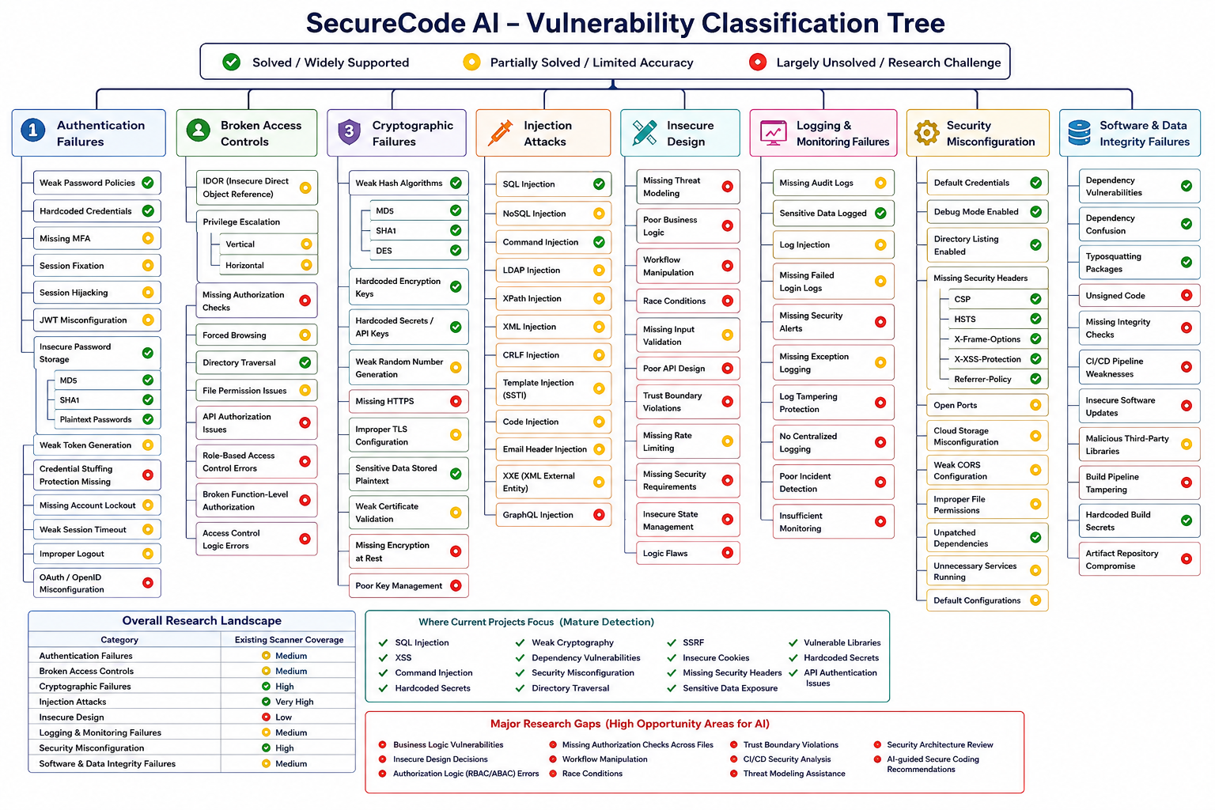

Slide 9
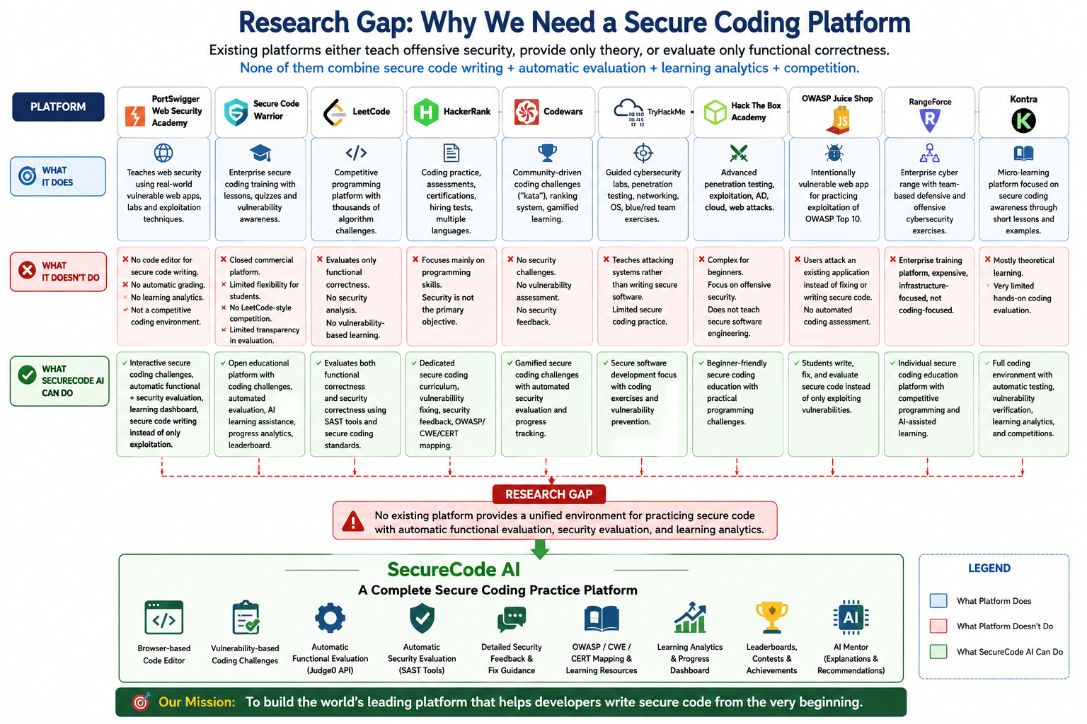

Slide 10
Research Gap
Most existing studies focus on AI-based vulnerability detection and repair rather than providing an interactive platform for secure coding practice.
Research on Large Language Models (LLMs) mainly explores secure code generation and vulnerability detection, with less focus on improving developers’ practical security skills.
Existing secure coding surveys explain security techniques and frameworks but do not implement a complete, hands-on learning environment.
Current coding platforms mainly evaluate functional correctness, while security training platforms often focus on vulnerability exploitation. Both lack a unified approach to evaluating functional and security correctness.
Many learning systems lack integrated AI-assisted explanations, actionable remediation feedback, conceptual understanding assessments, and personalized learning progress tracking.
Bug bounty and CTF-based platforms emphasize finding or exploiting vulnerabilities rather than following a structured curriculum for writing secure code.
Existing approaches often lack a unified environment combining vulnerability-based coding challenges, automated multi-engine security analysis, learning scores, and progress analytics.
Identified Research Gap: There is a need for an integrated platform that combines hands-on secure coding practice, dual-stage code evaluation, AI-assisted feedback, conceptual assessment, and learning analytics to improve secure software development skills.

Slide 11
Problem Statement
Modern software applications are increasingly vulnerable to security flaws due to the lack of practical secure coding skills among developers. Existing educational platforms primarily focus on algorithmic programming, cybersecurity awareness, penetration testing, or vulnerability detection, but they provide limited opportunities to practice secure software development through real coding exercises. As a result, many developers are able to write functionally correct programs but struggle to implement secure coding practices that prevent vulnerabilities during development. There is a need for an interactive learning platform that enables developers to practice secure coding through vulnerability-based programming challenges, evaluate both functional and security correctness, and receive educational feedback to improve their secure software development skills.

Slide 12
Objectives
To develop an interactive web-based platform for learning and practicing secure software development through hands-on coding challenges.
To strengthen secure coding skills by providing vulnerability-based challenges across different difficulty levels.
To implement a dual-stage evaluation system that checks functional correctness first and security correctness after successful functional testing.
To integrate multiple security analysis tools, including Semgrep and SpotBugs/FindSecBugs, with AI-assisted feedback to help users understand and fix vulnerabilities.
To assess learners through conceptual understanding quizzes and a learning score based on functional correctness, security correctness, understanding, and independent problem-solving.
To provide structured learning through hints, challenge prerequisites, attempt history, and progress analytics.
To develop a scalable architecture that can be extended to support additional vulnerability categories and programming languages in future versions.

Slide 13
Scope
1. Secure Coding Learning Platform
Develop an interactive web-based platform for learning and practicing secure software development.
Provide hands-on, challenge-based learning for secure coding concepts.
2. Vulnerability Coverage
Initially focus on the Injection Attacks category and its major subtypes as a proof of concept.
Support future expansion to additional OWASP vulnerability categories.
3. Programming Challenges
Provide vulnerability-based coding challenges with different difficulty levels.
Enable users to identify, prevent, and fix security vulnerabilities through practical exercises.
4. Automated Code Evaluation
Evaluate submitted code for functional correctness and security correctness.
Identify potential security issues using automated testing and multiple security analysis tools.
Support the addition of new challenges, security rules, vulnerability categories, and learning resources.
5. Secure Coding Guidance and Feedback
Provide AI-assisted educational feedback to explain vulnerabilities and suggest fixes.
Align secure coding guidance with recognized standards such as OWASP, CWE, and CERT.

Slide 14
6. Target Users
Students learning software development and cybersecurity.
Software developers seeking to improve secure coding practices.
Learners interested in practical secure software development.
7. Progress Tracking
Track performance across coding challenges, including learning scores and submission history.
Help users identify strengths and areas for improvement.
8. Modular and Scalable Design
Use a modular architecture to simplify maintenance and future enhancements.
Allow continuous expansion of challenges, security rules, learning resources, and supported programming languages.

Slide 15
SRS:
Functional Requirements
1. User Management
User Registration
Secure Login
Profile Management
Role Management
2. Challenge Management
Browse Challenges
Search Challenges
Filter Challenges
Challenge Details
3. Code Editor
Online Editor
Language Selection
Code Submission
Attempt Management
4. Functional Evaluation
Code Compilation
Test Execution
Result Evaluation
Error Detection
5. Security Evaluation
Static Analysis
Vulnerability Detection
Security Findings
Risk Identification
6. Feedback System
Vulnerability Explanation
Secure Recommendations
Code Improvement
Learning Hints
7. Learning Analytics
Progress Tracking
Attempt History
Performance Analysis
Learning Dashboard
8. Admin Module
User Management
Challenge Management
Content Management
System Monitoring

Slide 16
Non-Functional Requirements
1. Usability
User-Friendly Interface
Responsive Design
Simple Navigation
Clear Feedback
2. Performance
Fast Compilation
Quick Evaluation
Resource Management
Response Optimization
3. Security
Secure Authentication
Data Protection
Access Control
Code Isolation
4. Scalability
Modular Expansion
New Vulnerabilities
New Languages
Additional Evaluators
5. Reliability
Error Handling
Data Consistency
Service Recovery
Result Accuracy
6. Maintainability
Modular Architecture
Clean Code
Component Reusability
Easy Testing
7. Compatibility
Browser Support
API Integration
Cross-Platform Access
External Tool Support
8. Availability
Service Availability
Failure Recovery
Backup Support
Continuous Operation

Slide 17
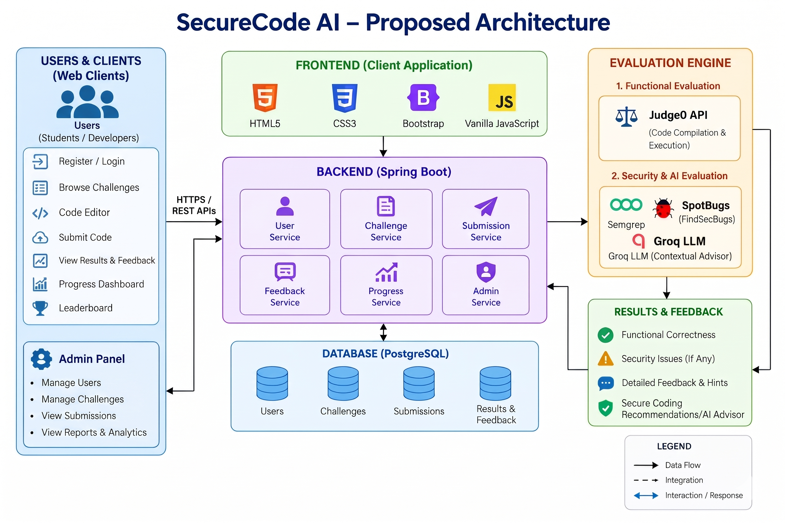

Slide 18
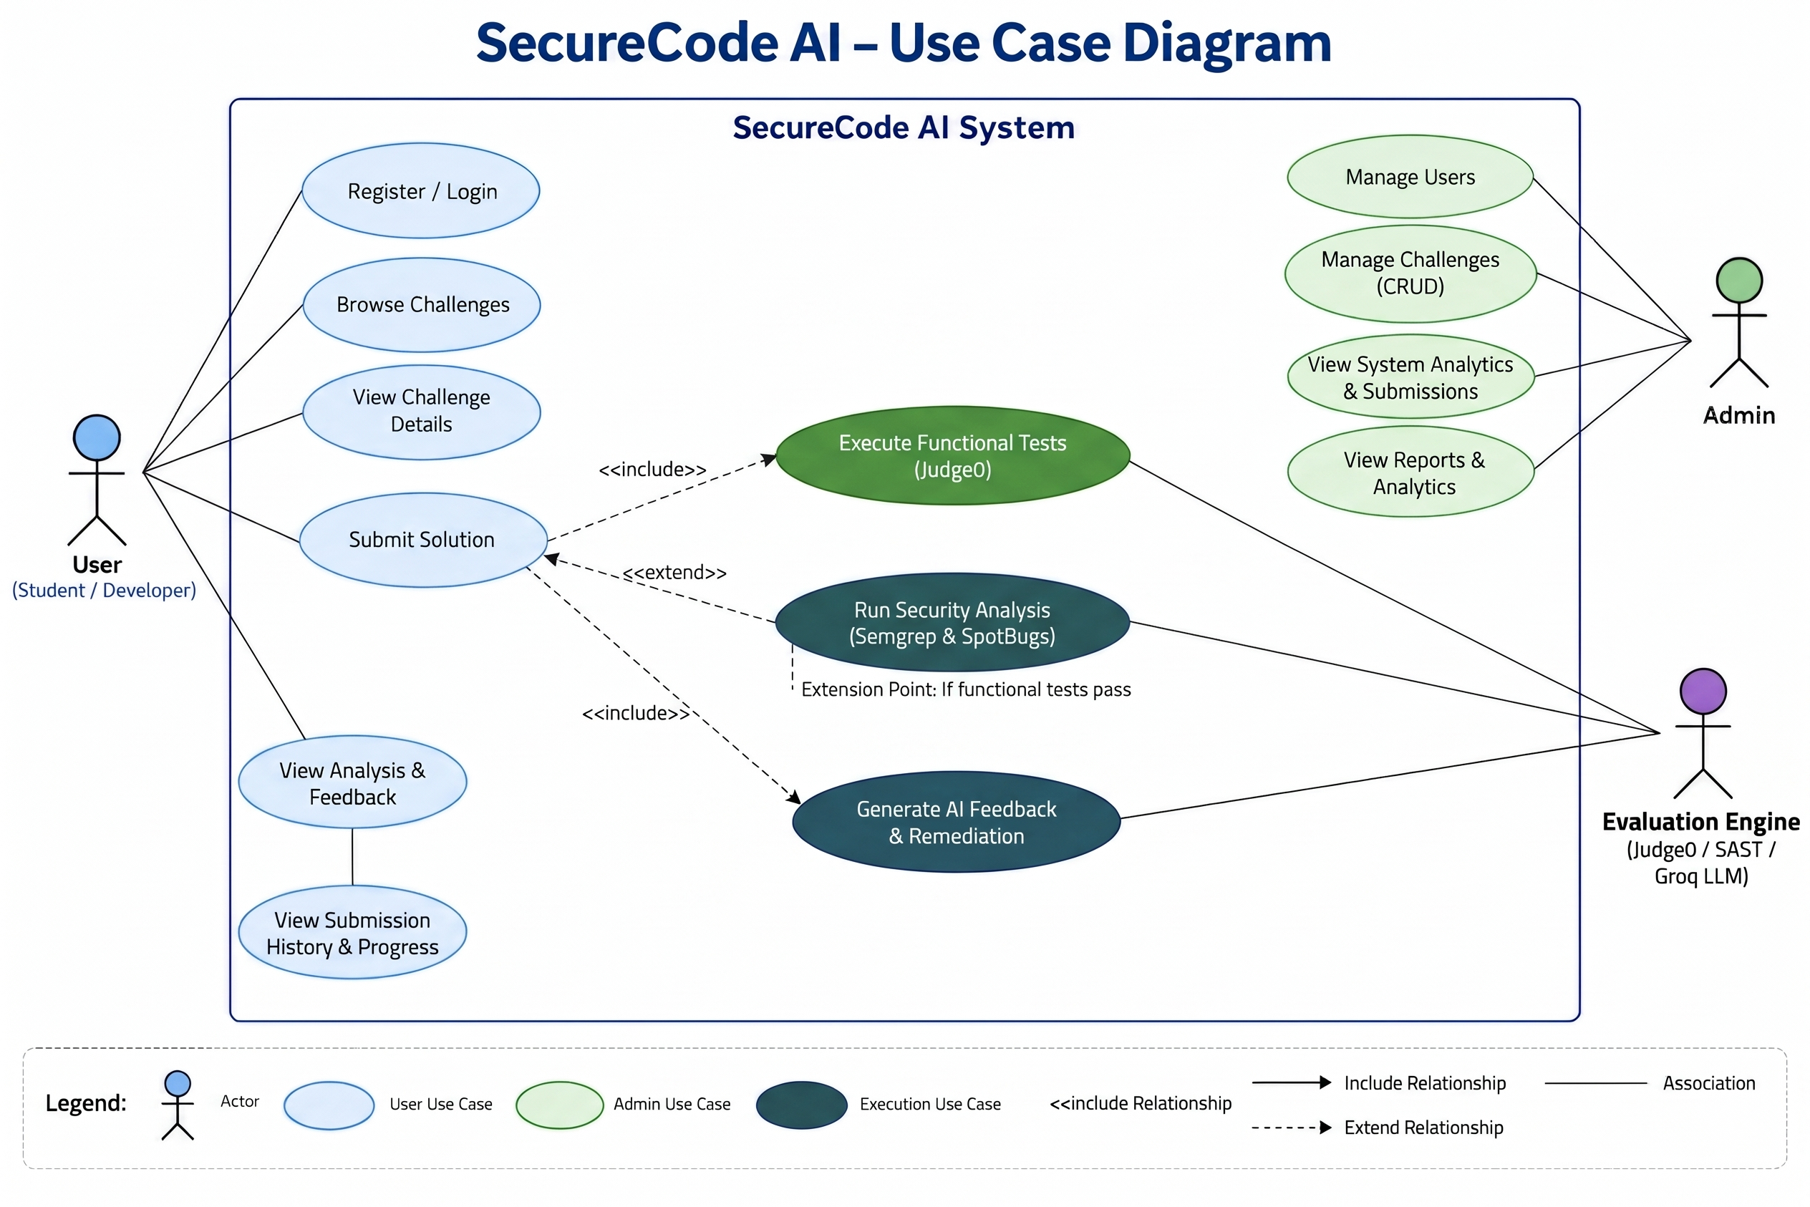

Slide 19
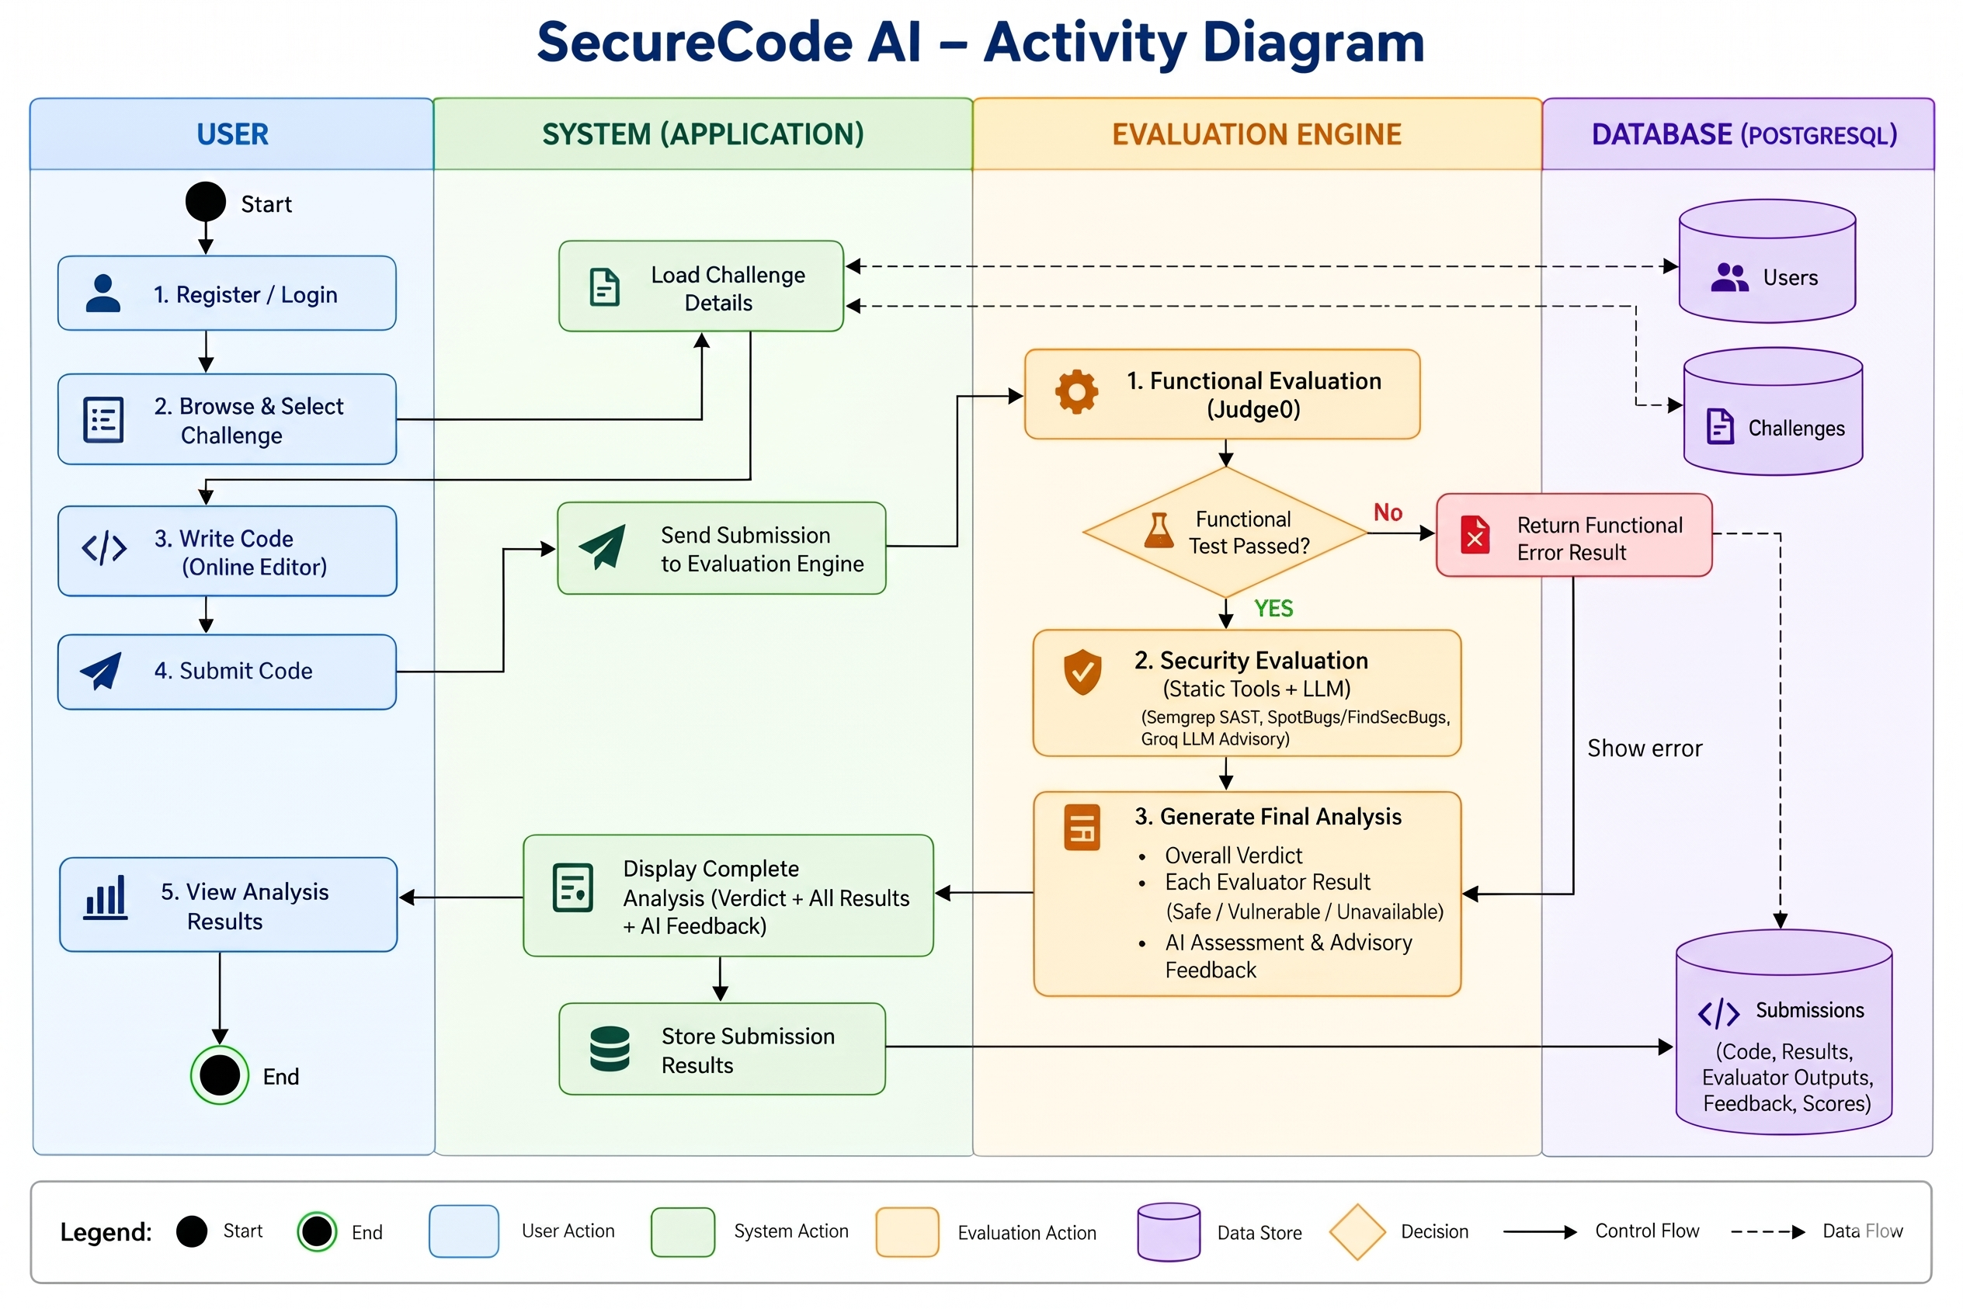

Slide 20
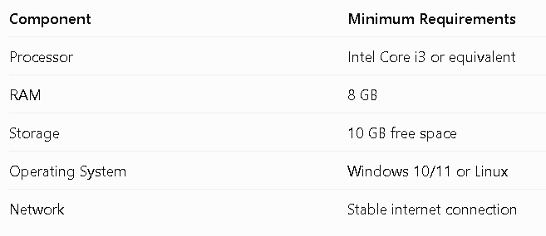
SOFTWARE AND HARDWARE REQUIREMENTS
1. Hardware Requirements

Slide 21
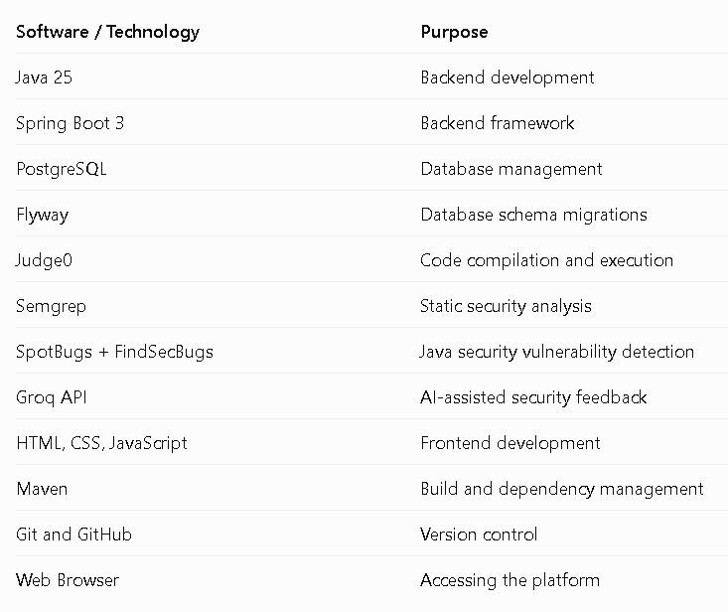
2. Software Requirements

Slide 22
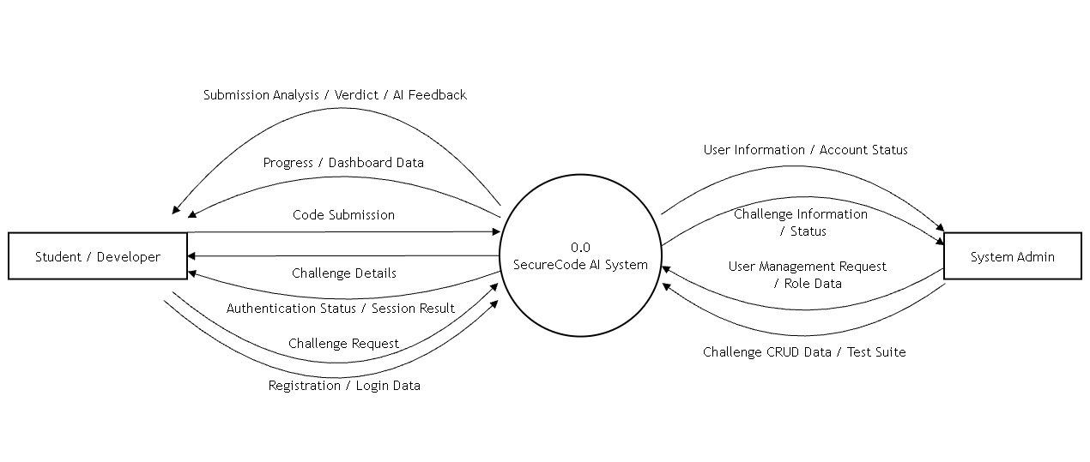
DFD LEVEL 0

Slide 23
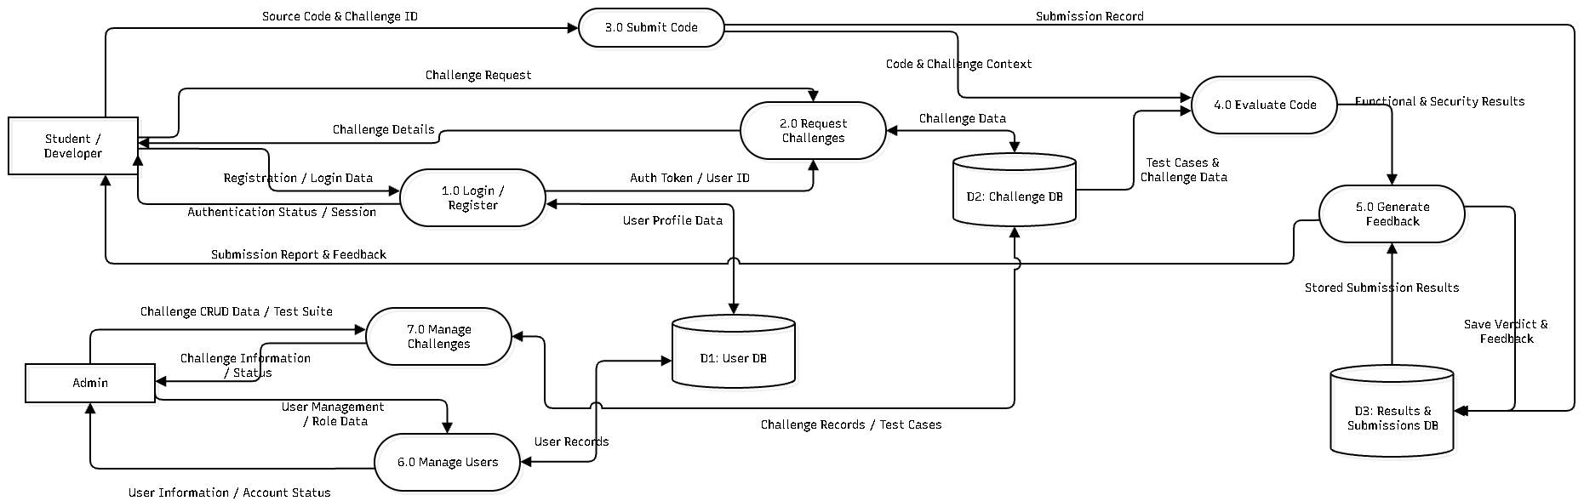
DFD LEVEL 1

Slide 24
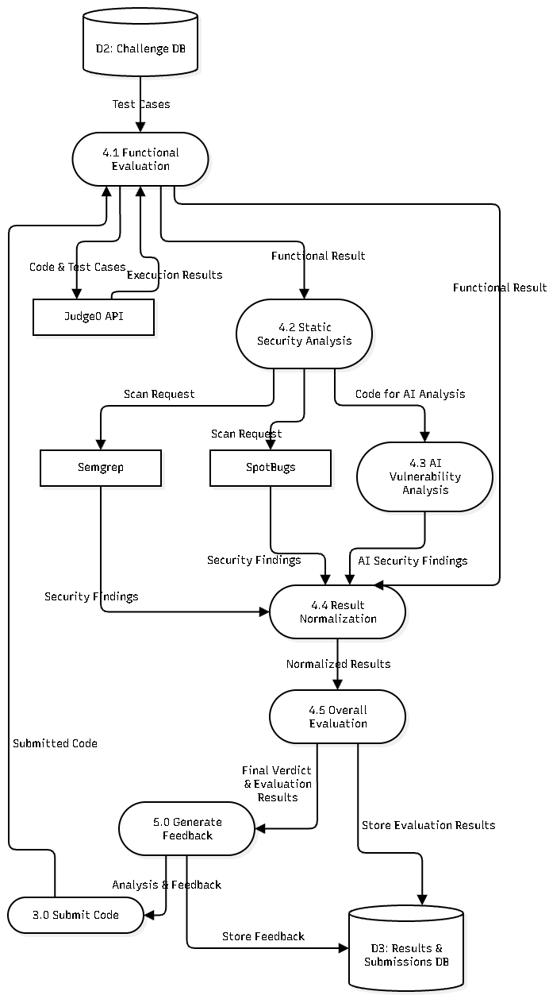
DFD LEVEL 2

Slide 25
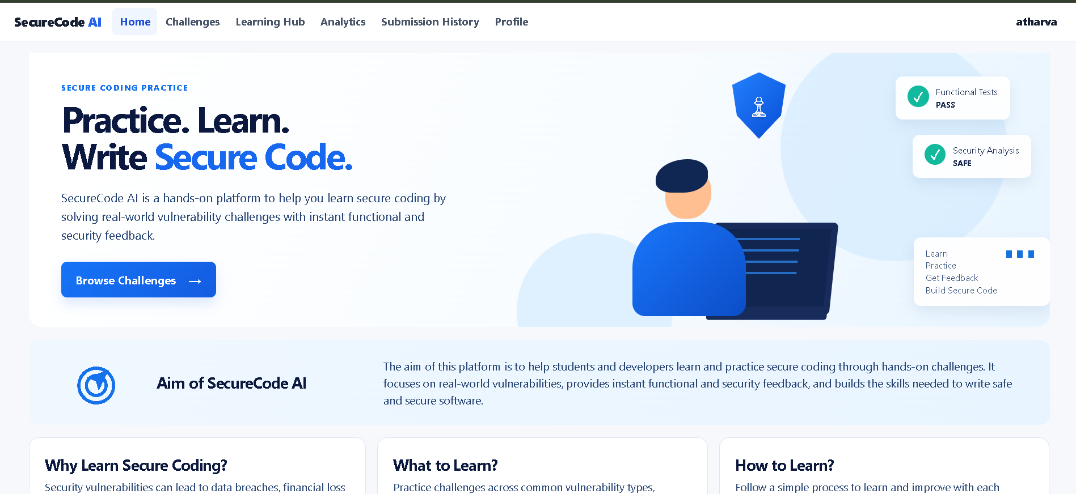
Home Page

Slide 26
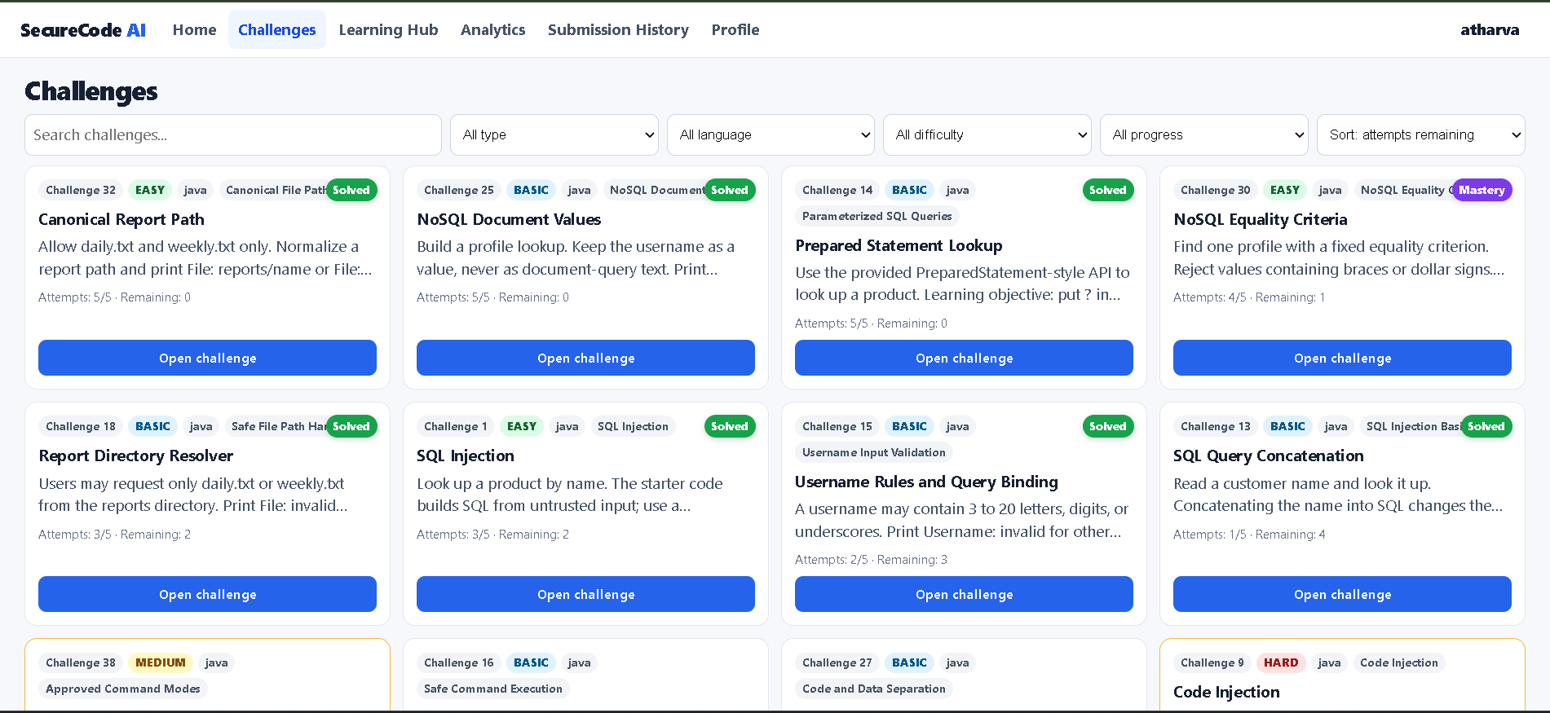
Challenges Page

Slide 27
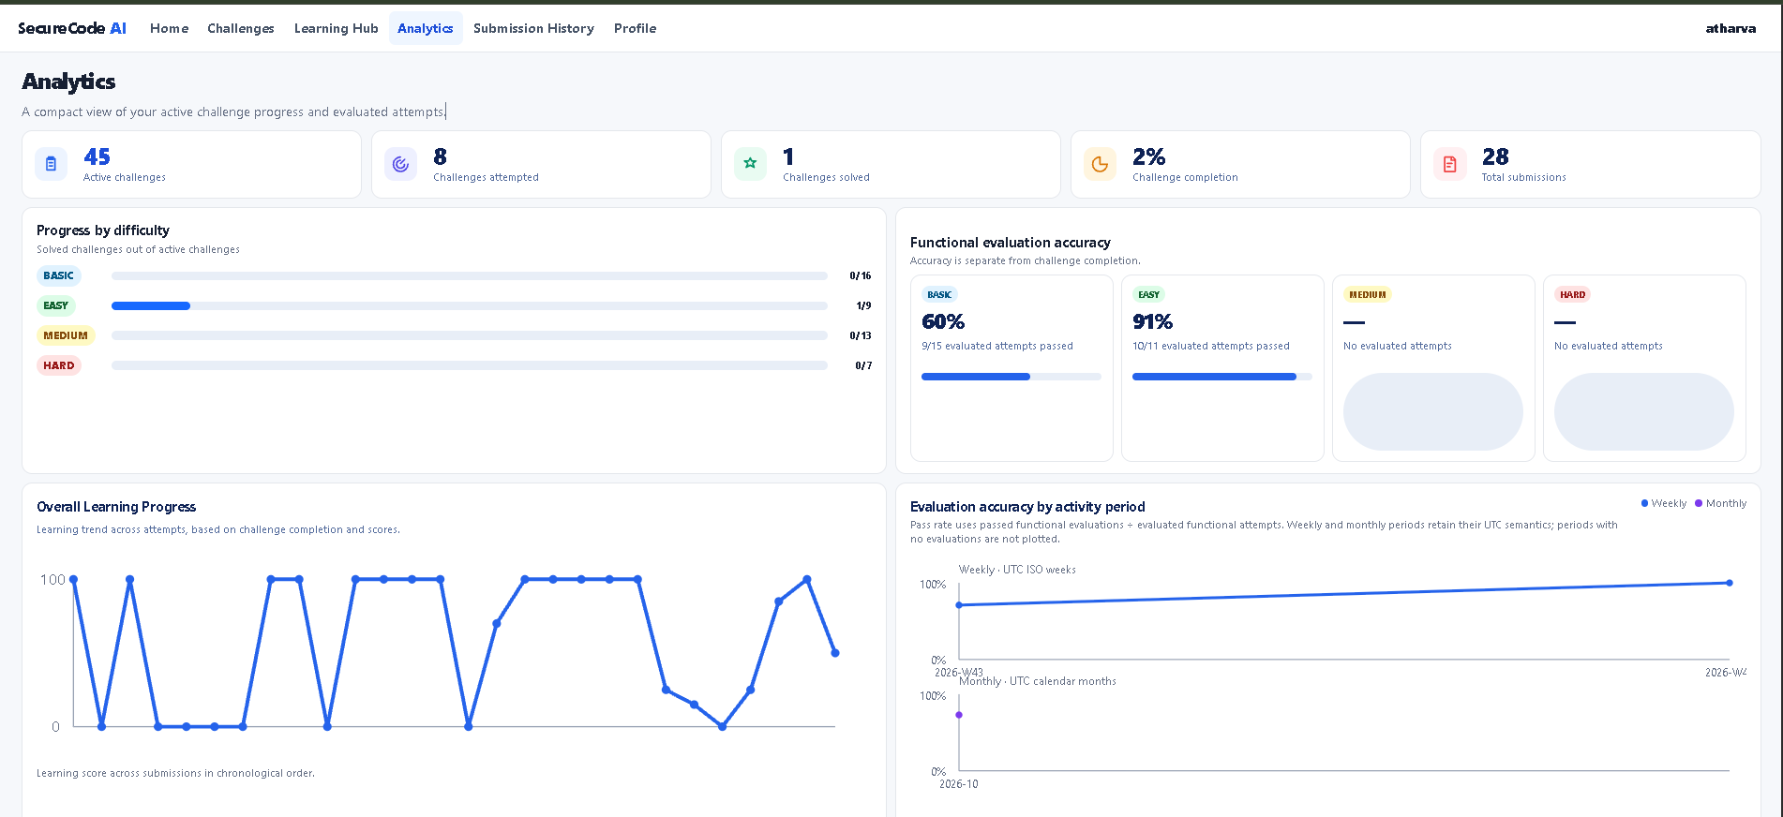
Analytics Page

Slide 28
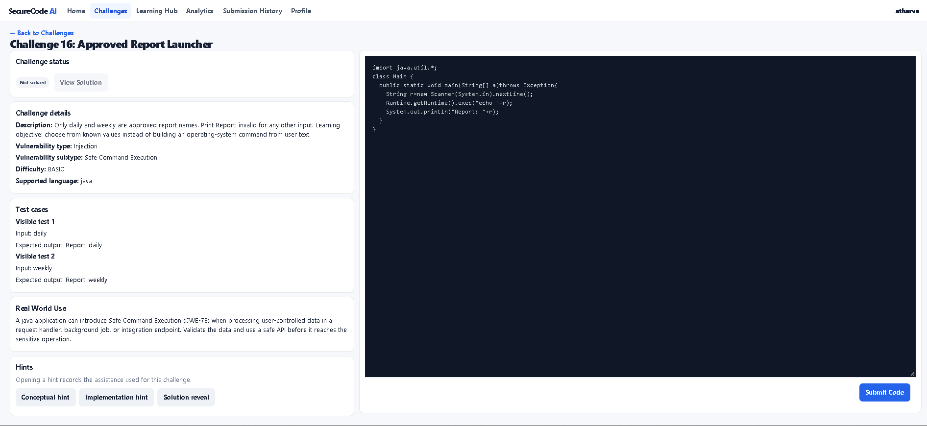
Code-Editor Page

Slide 29
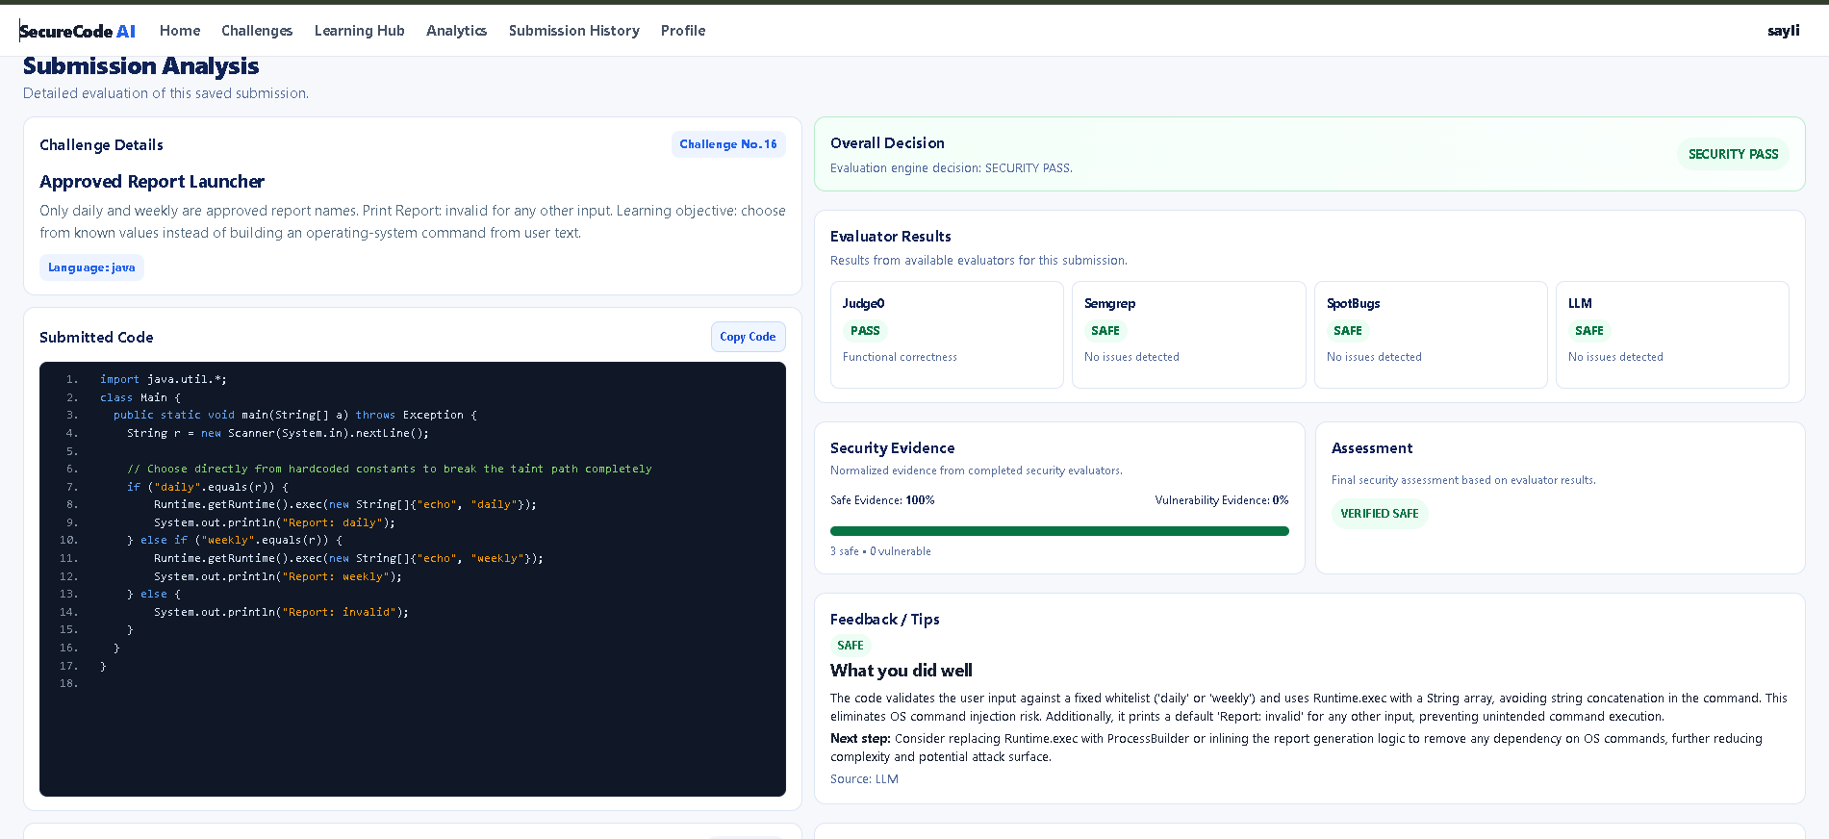
Submission Analysis Page

Slide 30
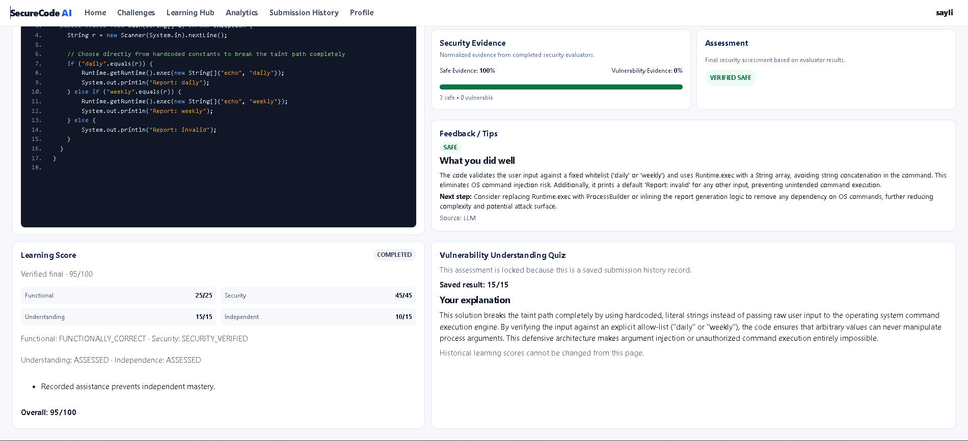
Learning Score Board

Slide 31
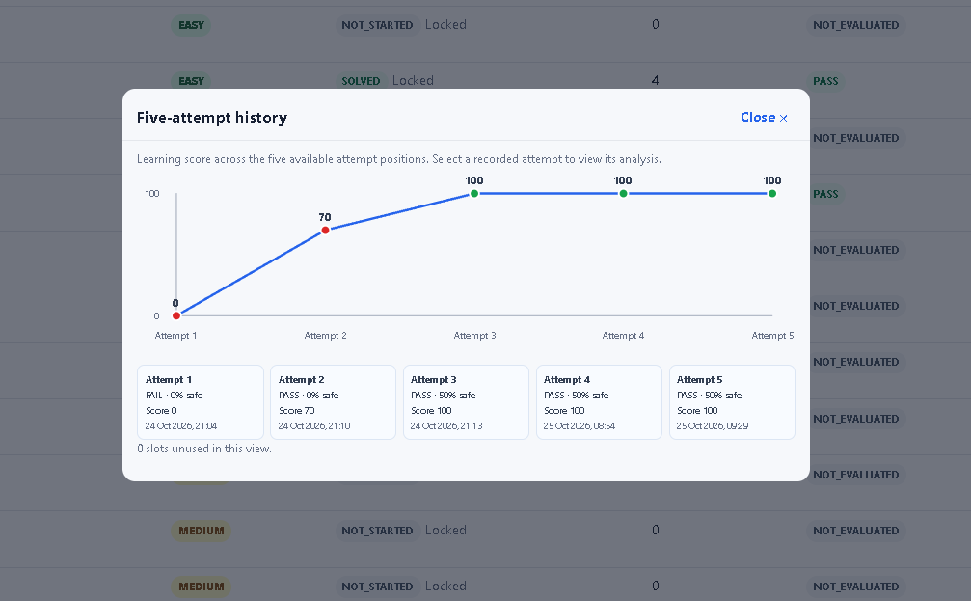
Five-Attempt Window

Slide 32
Conclusion
SecureCode AI provides an interactive platform for learning and practicing secure software development through hands-on coding challenges.
It evaluates both functional correctness and security correctness, helping learners develop code that works correctly and follows secure coding practices.
The platform combines Judge0, Semgrep, SpotBugs/FindSecBugs, and Groq AI to support code evaluation and security feedback.
Its learning features include vulnerability-based challenges, hints, conceptual assessments, learning scores, and progress analytics.
The multi-pillar scoring system encourages learners to improve their security knowledge and independent problem-solving skills.
Overall, SecureCode AI bridges the gap between traditional programming practice and secure coding education.

Slide 33
References
[1] Dai, S.-C., Xu, J., & Tao, G. (2026). Rethinking the evaluation of secure code generation. In 2026 IEEE/ACM 48th International Conference on Software Engineering (ICSE '26), April 12-18, 2026, Rio de Janeiro, Brazil. ACM.
[2] Patir, R., Guo, K., Cai, H., & Hu, H. (2026). SoK: AI secure code generation: Progress, pitfalls, and paths
forward. Preprint, University at Buffalo, SUNY. arXiv:2606.25195.
[3] Xin Zhou, Sicong Cao, Xiaobing Sun, David Lo. Large Language Model for Vulnerability Detection and Repair: Literature Review and the Road Ahead. 2024.
[4] Yan, H., Vaidya, S. S., Zhang, X., & Yao, Z. (2025). Guiding AI to fix its own flaws: An empirical study on LLM-driven secure code generation. Preprint, George Mason University. arXiv:2506.23034.
[5] Belozerov, V., Barclay, P. J., & Sami, A. (2026). Secure Coding with AI - From Detection to Repair. Empirical Software Engineering, 31, Article 93.

Slide 34
[6] Guo, Yuejun, and Seifeddine Bettaieb. "An Investigation of Quality Issues in Vulnerability Detection Datasets." arXiv preprint arXiv:2410.06030 (2024).
[7] Bi, Yingzhou, Jiangtao Huang, Peihui Liu, and Lianmei Wang. "Benchmarking Software Vulnerability Detection Techniques: A Survey." arXiv preprint arXiv:2303.16362 (2023).
[8] Alwageed, Hathal S., and Rafiq Ahmad Khan. "The Role of Generative AI in Strengthening Secure Software Coding Practices: A Systematic Perspective." (2025).
[9] Combéfis, S. (2022). Automated code assessment for education: Review, classification and perspectives on techniques and tools. Software, 1(1), 3-30. https://doi.org/10.3390/software1010002
[10] Rahman, Md. Mostafizer, Yutaka Watanobe, Atsushi Shirafuji, and Mohamed Hamada. "Exploring Automated Code Evaluation Systems and Resources for Code Analysis: A Comprehensive Survey." J. ACM 37, no. 4, Article 111 (2018).

