Slide 1
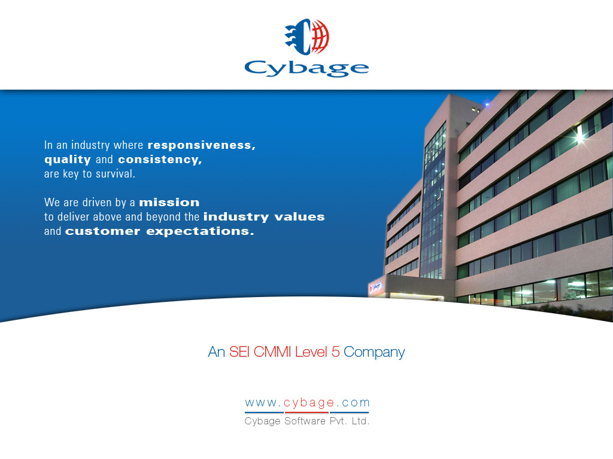

Slide 2
COMPASS
Slide <number>
Copyright © 2006. Cybage Software Pvt. Ltd. All Rights Reserved. Cybage Confidential.

Slide 3
What is compass
Open source CSS Authoring Framework
Compass uses SASS/SCSS
Slide <number>
Copyright © 2006. Cybage Software Pvt. Ltd. All Rights Reserved. Cybage Confidential.

Slide 4
Why to use compass
Cleaner markup without additional classes
Re-usable code
Creates Sprite images
Helpful for typography text
Slide <number>
Copyright © 2006. Cybage Software Pvt. Ltd. All Rights Reserved. Cybage Confidential.

Slide 5
Include compass
@import "compass“
@import "compass/css3“
@import "compass/typography“
@import "compass/utilities“
@import "compass/reset"
Slide <number>
Copyright © 2006. Cybage Software Pvt. Ltd. All Rights Reserved. Cybage Confidential.

Slide 6
http://compass-style.org/reference/compass/css3/
@import "compass/css3/transition";
@import "compass/css3/border-radius";
@import "compass/css3/images";
@import "compass/css3/box-shadow";
@import "compass/css3/opacity";
@import "compass/css3/box-sizing";
@import "compass/css3/inline-block";
Slide <number>
Copyright © 2006. Cybage Software Pvt. Ltd. All Rights Reserved. Cybage Confidential.

