Slide 1
SCSS
Slide <number>
Copyright © 2006. Cybage Software Pvt. Ltd. All Rights Reserved. Cybage Confidential.

Slide 2
CSS : Selectors
element>element | div>p | Selects all <p> elements where the parent is a <div> element
element+element | div+p | Selects all <p> elements that are placed immediately after <div> elements
[attribute] | [target] | Selects all elements with a target attribute
[attribute=value] | [target=_blank] | Selects all elements with target="_blank"
:link | a:link | Selects all unvisited links
:visited | a:visited | Selects all visited links
:active | a:active | Selects the active link
:hover | a:hover | Selects links on mouse over
Slide <number>
Copyright © 2006. Cybage Software Pvt. Ltd. All Rights Reserved. Cybage Confidential.

Slide 3
CSS : Selectors
:first-letter | p:first-letter | Selects the first letter of every <p> element
:first-child | p:first-child | Selects every <p> element that is the first child of its parent
:before | p:before | Insert content before the content of every <p> element
:after | p:after | Insert content after every <p> element
Slide <number>
Copyright © 2006. Cybage Software Pvt. Ltd. All Rights Reserved. Cybage Confidential.

Slide 4
Pre-processing
Stylesheets are getting larger, more complex, and harder to maintain.
This is where a preprocessor can help.
Sass lets you use features that don't exist in CSS yet like variables, nesting, mixins, inheritance.
Slide <number>
Copyright © 2006. Cybage Software Pvt. Ltd. All Rights Reserved. Cybage Confidential.

Slide 5
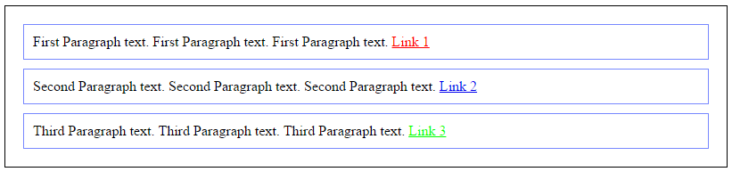
Create simple markup and SCSS
On hover of Link 3 it should of Red colored.
Slide <number>
Copyright © 2006. Cybage Software Pvt. Ltd. All Rights Reserved. Cybage Confidential.

Slide 6
Variables in SCSS
$font-stack: Helvetica, sans-serif;
$primary-color: #333;
body {
font: 100% $font-stack;
color: $primary-color;
}
When Sass is processed:
body {
font: 100% Helvetica, sans-serif;
color: #333;
}
Slide <number>
Copyright © 2006. Cybage Software Pvt. Ltd. All Rights Reserved. Cybage Confidential.

Slide 7
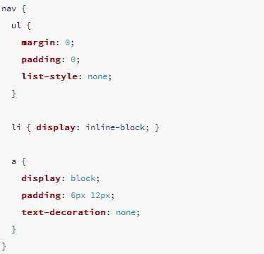
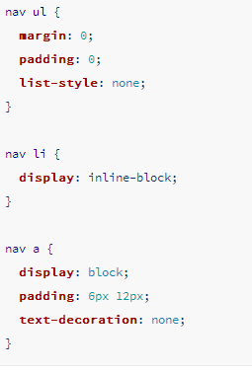
Nesting in SCSS
Slide <number>
Copyright © 2006. Cybage Software Pvt. Ltd. All Rights Reserved. Cybage Confidential.

Slide 8
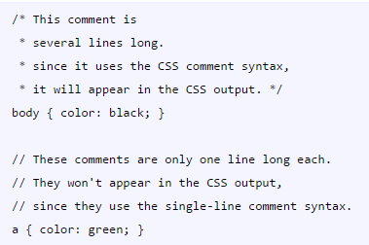
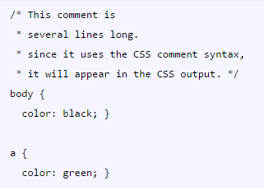
Comments: /* */ and //
Slide <number>
Copyright © 2006. Cybage Software Pvt. Ltd. All Rights Reserved. Cybage Confidential.

Slide 9
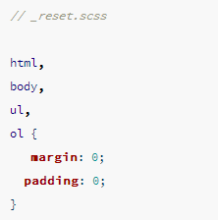
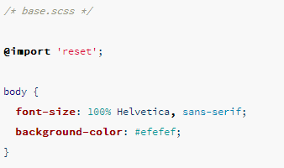
Import
Slide <number>
Copyright © 2006. Cybage Software Pvt. Ltd. All Rights Reserved. Cybage Confidential.

Slide 10
Mixins
Some things in CSS are a bit tedious to write, especially with CSS3 and the many vendor prefixes that exist.
A mixin lets you make groups of CSS declarations that you want to reuse throughout your site.
You can even pass in values to make your mixin more flexible. A good use of a mixin is for vendor prefixes.
Slide <number>
Copyright © 2006. Cybage Software Pvt. Ltd. All Rights Reserved. Cybage Confidential.

Slide 11
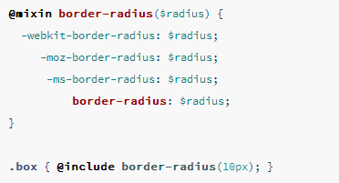
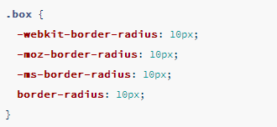
Mixins border-radius example
Slide <number>
Copyright © 2006. Cybage Software Pvt. Ltd. All Rights Reserved. Cybage Confidential.

Slide 12
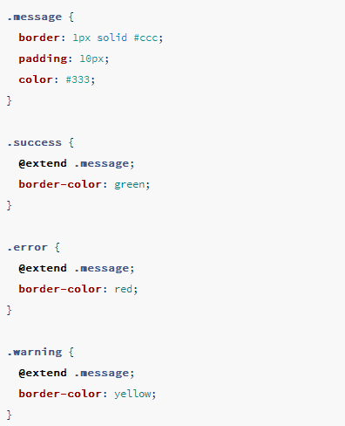
Extend/Inheritance
Slide <number>
Copyright © 2006. Cybage Software Pvt. Ltd. All Rights Reserved. Cybage Confidential.

Slide 13
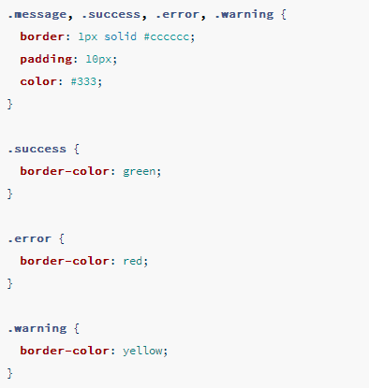
Extend/Inheritance
Slide <number>
Copyright © 2006. Cybage Software Pvt. Ltd. All Rights Reserved. Cybage Confidential.

Slide 14
Features of SASS
variables: instead of repeating #fce473 throughout your CSS file, just set $yellow: #fce473 once
nesting: CSS rules can be nested within each other
mixins: custom functions that can accept parameters and will prevent useless repetitions
extensions: an easy way to inherit the same properties of another selector
operators: adding/substracting/multiplying/dividing values, like 960px / 4 or $space * 2
Slide <number>
Copyright © 2006. Cybage Software Pvt. Ltd. All Rights Reserved. Cybage Confidential.

Slide 15
Installation of SASS
http://sass-lang.com/install
Slide <number>
Copyright © 2006. Cybage Software Pvt. Ltd. All Rights Reserved. Cybage Confidential.

Slide 16
Project setup on local
http://sass-lang.com/install
Slide <number>
Copyright © 2006. Cybage Software Pvt. Ltd. All Rights Reserved. Cybage Confidential.

Slide 17
Why SCSS
readability: the syntax is very similar to CSS
learning curve: it only adds a few additional features on top of CSS
compatibility; a CSS file is a valid SCSS file
resources: lots of online articles to read and open source libraries to use
expandability: it’s easy to go from SCSS to Sass
Slide <number>
Copyright © 2006. Cybage Software Pvt. Ltd. All Rights Reserved. Cybage Confidential.

Slide 18
SASS vs SCSS
Sass has 2 syntaxes available:
Sass itself (Syntactically Awesome StyleSheets) in .sass files
SCSS (Sassy CSS) in .scss files
Please note:
Sass is the name of the preprocessor
All features are available for both syntaxes
Everything in SCSS is available in Sass
We’re actually going to write SCSS but still we call it Sass.
Slide <number>
Copyright © 2006. Cybage Software Pvt. Ltd. All Rights Reserved. Cybage Confidential.

Slide 19
DRY Principle
Stands for Don’t repeat yourself.
Sass/Scss is to provide tools to prevent repeating yourself in your code
variables prevents repeating values
nesting prevents repeating selectors
mixins and extensions prevent repeating properties
WET: Write everything twice/We enjoy typing
Slide <number>
Copyright © 2006. Cybage Software Pvt. Ltd. All Rights Reserved. Cybage Confidential.

Slide 20
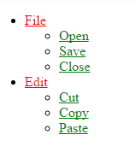
Example
https://gist.github.com/mrugeshp
Slide <number>
Copyright © 2006. Cybage Software Pvt. Ltd. All Rights Reserved. Cybage Confidential.

Slide 21
CSS and SASS Coding conventions
Do not overuse classes and ID’s
<div id="container" class="container">
<p class="heading"><strong class="extrastrong">Welcome</strong></p>
<p class="link1"><a href="#" class="link">Home</a></p>
<p class="link2"><a href="#" class="link">About</a></p>
<p class="link3"><a href="#"> class="link"Services</a></p>
<p class="link4"><a href="#"> class="link"Contact</a></p>
</div>
Slide <number>
Copyright © 2006. Cybage Software Pvt. Ltd. All Rights Reserved. Cybage Confidential.

Slide 22
CSS and SASS Coding conventions
<div class="container">
<h2>This is a heading</h2>
<ul>
<li><a href="#">Home</a></li>
<li><a href="#">About</a></li>
<li><a href="#">Services</a></li>
<li><a href="#">Contact</a></li>
</ul>
</div>
Slide <number>
Copyright © 2006. Cybage Software Pvt. Ltd. All Rights Reserved. Cybage Confidential.

Slide 23
CSS and SASS Coding conventions
Incorrect
<div id="container">
<div id="nav">
<ul id="navlist">
<li>Home</li>
<li>About</li>
<li>Services</li>
<li>Contact</li>
</ul>
</div>
<div id="heading"></div>
<div id="news">News</div>
<div id="stories">Stories</div>
</div>
Slide <number>
Copyright © 2006. Cybage Software Pvt. Ltd. All Rights Reserved. Cybage Confidential.

Slide 24
CSS and SASS Coding conventions
Correct
<div class="container">
<ul>
<li>Home</li>
<li>About</li>
<li>Services</li>
<li>Contact</li>
</ul>
<h2>Heading</h2>
<p class="news">News</p>
<p class="stories">Stories</p>
</div>
Slide <number>
Copyright © 2006. Cybage Software Pvt. Ltd. All Rights Reserved. Cybage Confidential.

Slide 25
CSS and SASS Coding conventions
DO NOT use inline styles and <head> tag <style>
Incorrect
<p style="color: #fff; font-size: 2em;">This is a sentence.</p>
Correct
<p>This is a sentence.</p>
/*External Style Sheet*/
p { color: #fff; font-size: 2em; }
Slide <number>
Copyright © 2006. Cybage Software Pvt. Ltd. All Rights Reserved. Cybage Confidential.

Slide 26
CSS and SASS Coding conventions
Use hyphens when naming mixins, extends, classes, functions & variables: span-columns not span_columns or spanColumns.
Use space between property and value: width: 20px not width:20px.
Use a blank line above selector that has styles.
.container {
  width: 50%;
  .text {
  color: #000;
  }
}
Slide <number>
Copyright © 2006. Cybage Software Pvt. Ltd. All Rights Reserved. Cybage Confidential.

Slide 27
CSS and SASS Coding conventions
Prefer hex color codes #000.
Use // for comment blocks not /* */.
.container {
width: 50%;
color: #000;
// text-align: center;
}
Use a space between selector and {.
Use double quotation marks for attribute selectors
Slide <number>
Copyright © 2006. Cybage Software Pvt. Ltd. All Rights Reserved. Cybage Confidential.

Slide 28
CSS and SASS Coding conventions
Attribute selector
Input[type=“text”]
Use only lowercase, including colors.
write all css property and values in lowercase only.
Don't add a unit specification after 0 values, unless required by a mixin.
.container {
padding-top: 0; // Correct
}
Slide <number>
Copyright © 2006. Cybage Software Pvt. Ltd. All Rights Reserved. Cybage Confidential.

Slide 29
Order
Declaration order
1. // Position property
position, z-index, top, right, bottom, left
2. // Display and Box model property
display, overflow, box-sizing, width, height, padding, border, margin
3. // Others
color, font-family, font-size, text-align
Slide <number>
Copyright © 2006. Cybage Software Pvt. Ltd. All Rights Reserved. Cybage Confidential.

Slide 30
CSS and SASS Coding conventions
Place @extends and @includes at the top of your declaration list.
Place media queries directly after the declaration list. (Project specific standard)
Slide <number>
Copyright © 2006. Cybage Software Pvt. Ltd. All Rights Reserved. Cybage Confidential.

Slide 31
Selector coding standard
Don't use ID's for style.
Use meaningful names: $visual-grid-color not $color or $vslgrd-clr.
Use ID and class names that are as short as possible but as long as necessary.
Append the prefix js- to ID's that are used by Javascript. (Project specific)
Avoid nesting more than 4 selectors deep.
Slide <number>
Copyright © 2006. Cybage Software Pvt. Ltd. All Rights Reserved. Cybage Confidential.

Slide 32
CSS and SASS Coding conventions
Don't nest more than 6 selectors deep.
Avoid using the HTML tag in the class name: section.news not section.news-section.
Avoid using HTML tags on classes for generic markup <div>, <span>: .widgets not div.widgets.
Avoid using comma delimited selectors. But write it when it required.
Slide <number>
Copyright © 2006. Cybage Software Pvt. Ltd. All Rights Reserved. Cybage Confidential.

Slide 33
Good or bad
button#backButton {…}
.menu-left#newMenuIcon {…}
treeitem[mailfolder=‘true’]
.container {
color: RED;
}
Slide <number>
Copyright © 2006. Cybage Software Pvt. Ltd. All Rights Reserved. Cybage Confidential.

