Slide 1
HTML5
Authored by : Rohit J Presented by : Rohit J

Slide 2
Agenda
Introduction to HTML5.
Difference between HTML4 and HTML5.
HTML5 tags.
HTML5 structure.
More about HTML5.
Examples & references

Slide 3
Introduction to HTML5
HTML5 is the latest and most enhanced version of HTML.
HTML5 is the next major revision of the HTML standard superseding
HTML 4.01, XHTML 1.0, and XHTML 1.1. HTML5 is a standard for
structuring and presenting content on the World Wide Web.
HTML5 is a cooperation between the World Wide Web Consortium
(W3C) and the Web Hypertext Application Technology Working
Group (WHATWG).

Slide 4
Introduction to HTML5
The new standard incorporates features like video playback and
drag-and-drop that have been previously dependent on third-party
browser plug-ins such as Adobe Flash, Microsoft Silverlight, and Google Gears.
The latest versions of Apple Safari, Google Chrome, Mozilla Firefox, and Opera all support many HTML5 features and Internet Explorer 9.0 will also have support for some HTML5 functionality.

Slide 5
Introduction to HTML5
HTML5 is coming with lots of flexibility and would support the followings-
Uppercase tag names.
Quotes are optional for attributes.
Attribute values are optional.
Closing empty elements are optional.

Slide 6
Difference between HTML 4 and HTML 5.
Simplified and Clear Syntax.
Multimedia Elements.
Accessing User Geographical location.
Client Side storage.
Client Server Communication.
JavaScript Threading Mechanism.
Browser Compatibility.

Slide 7
HTML 5 tags.
<section>
<article>
<aside>
<header>
<footer>
<nav>
<dialog>
<figure>

Slide 8
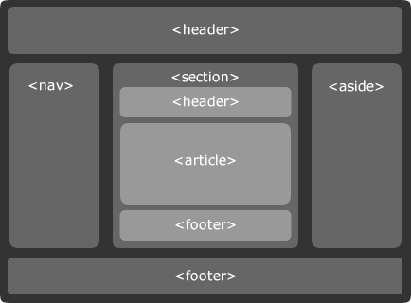
HTML 5 Structure.

Slide 9
HTML 5 Structure.
<!DOCTYPE html>
<html>
<head>
<meta charset="utf-8">
<title>...</title>
</head>
<body>
<header role="banner">
<h1>HTML5 Document Structure Example</h1>
<p>This page should be tried in safari, chrome or Mozila.</p>
</header>
<nav>
<ul>
<li><a href="#">HTML Tutorial</a></li> <li><a href="#">CSS Tutorial</a></li>
<li><a href="#">JavaScript Tutorial</a></li>
</ul>
</nav>
<article>
<section>
<p>Once article can have multiple sections</p>
</section>
</article>
<aside>
<p>This is aside part of the web page</p>
</aside>
<figure align="right"> <img src="/html5/images/logo.png" alt="TutorialPoint" width="200" height="100"> </figure>
<footer> <p>Created by <a href="#">Tutorials Point</a></p> </footer>
</body>
</html>

Slide 10
More about HTML5.
Web Forms
SVG
Web Storage
Canvas
Audio & Video
Geolocation

Slide 11
Examples & references
http://www.w3schools.com/html/html5_intro.asp
http://www.w3.org/TR/html5/
https://developer.mozilla.org/en-US/docs/Web/Guide/HTML/HTML5
http://www.html-5-tutorial.com/

Slide 12
Any Questions?

Slide 13
Thank you!

