Slide 1
HTML
Authored by : Rohit J Presented by : Rohit J

Slide 2
Agenda
Overview.
Basics.
Elements.
Attributes.
HTML Tags.
HTML Structure.
Examples & references

Slide 3
Overview.
HTML stands for Hyper Text Markup Language, which is the most widely used language on Web to develop web pages.
Technically, HTML is not a programming language, but rather a
mark up language.
HTML was created by Berners-Lee in late 1991. "HTML 2.0" was the first standard HTML specification which was published in 1995.
HTML 4.01 was a major version of HTML and it was published in late 1999. Though HTML 4.01 version is widely used but currently we are having HTML-5 version which is an extension to HTML 4.01, and this version was published in 2012.

Slide 4
Basics.
All HTML documents must start with a document type declaration.
The HTML document itself begins with <html> and ends with </html>.
The visible part of the HTML document is between <body> and </body>.
An HTML element usually consists of a start tag and end tag, with the content inserted in between <tagname>Content goes here...</tagname>.

Slide 5
Elements.
An HTML element is defined by a starting tag.
There are some HTML elements which don't need to be closed, such as <img.../>, <hr /> and <br /> elements. These are known as void elements.
Nested HTML Elements are also allowed.

Slide 6
Attributes.
Attributes provide extra bits of information.
An attribute is used to define the characteristics of an HTML element and is placed inside the element's opening tag.
All attributes are made up of two parts: a name and a value.
The four core attributes that can be used on the majority of HTML elements (although not all) are:
Id
Class
Title
Style.

Slide 7
HTML tags.
<div></div>
<h1>,<h2>,<h3>….
<p></p>
<span></span>
<img/>
<form></form>

Slide 8
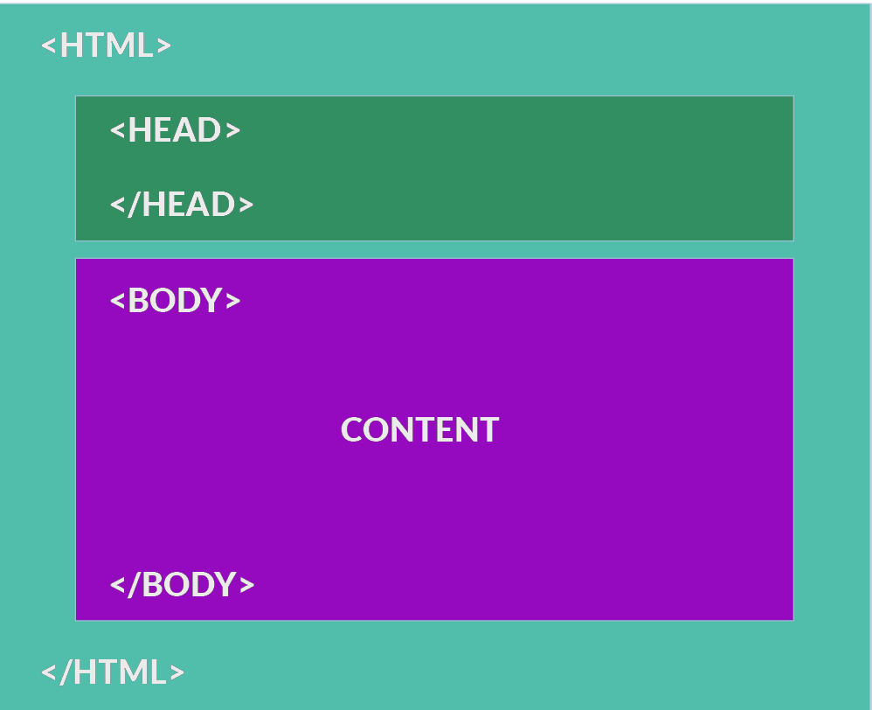
HTML Structure.

Slide 9
Examples & references
http://www.w3schools.com/html/default.asp
http://www.tutorialspoint.com/html/index.htm
https://www.codecademy.com/courses/web-beginner-en-HZA3b/0/1

Slide 10
Any Questions?

Slide 11
Thank you!

