Slide 1
Students Performance
INSIGHTVISTA-2026
Data Visualization using Microsoft Power BI
Subject code: 1IT508
TEAM | ENROLLMENT NUMBERS
240840116031
240840116044
240840116027
240840116066

Slide 2
Our data story: from raw data to action
1
Ask the question
Which factors move exam scores, and where should schools act first?
2
Clean the data
1,000 students, 8 columns, no missing values
3
Prepare and model
Added average score, performance bands and 11 DAX measures in Power BI
4
Visualize
One interactive dashboard: 4 slicers, 6 KPI cards and 6 charts
5
Tell the story
Test prep, lunch type and parental education stand out, so we recommend actions
The storyline: context > evidence > insight > action

Slide 3
Data preparation and model
8
4
11
Original columns
Columns we added
DAX measures
Gender, ethnic group, parental education, lunch type, test prep, math, reading and writing score
Student ID
Total Score
Average Score
Performance Band
Average score per subject
High Performer % and At-Risk %
Test prep, lunch and gender gaps
Bands (average of 3 scores): Excellent 85+ | Good 70-84 | Average 55-69 | Needs Support below 55. High Performer: 80+ At-Risk: below 50

Slide 4
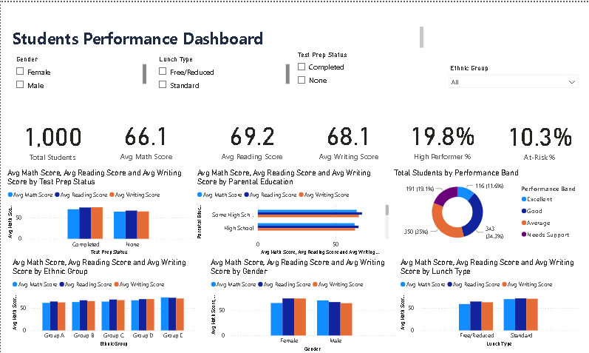
The Power BI dashboard
WHAT IS INSIDE
6
KPI cards
4
slicers to filter
6
charts by group

Slide 5
Dashboard KPIs: the numbers at a glance
1,000
66.1
69.2
Total students
Avg math score
Avg reading score
Full cohort, no missing values
Lowest of the three subjects
Highest of the three subjects
68.1
19.8%
10.3%
Avg writing score
High performers
At-risk students
Middle of the three subjects
Students averaging 80 or more
103 students average below 50
Insight: Math is the weakest subject, 3.1 points below Reading. About 1 in 5 students is a high performer and 1 in 10 is at risk.

Slide 6
Test prep and lunch type: access matters
+7.6
points for students who completed prep
+8.6
points for standard-lunch students
Biggest gain is in Writing (+9.9). Only 36% of students completed prep, so there is room to grow.
By subject: Math +11.1, Reading +7.0, Writing +7.8. 36% of students receive free/reduced lunch.

Slide 7
Family background and gender patterns
+10.5
points between top and bottom groups
M +NaN
largest gap: Math
Highest: Master'S Degree (73.6). Lowest: High School (63.1). A link, not proof of cause.
By subject: Math Male +NaN, Reading Male +NaN, Writing Male +NaN.

Slide 8
Performance bands and ethnic groups
19.1%
of students need support (average below 55)
+9.8
points between Group E and Group A
Excellent 116, Good 343, Average 350, Needs Support 191. Roughly 1 in 5 students needs support.
Highest: Group E (72.8). Lowest: Group A (63.0). Groups are labelled A to E in the dataset.

Slide 9
Combined effect: lunch type and test prep
COMBINED EFFECT
+16.6
points between the best and worst groups
Test prep adds 7.2 points for standard-lunch and 8.8 for free/reduced students.

Slide 10
Key takeaways and recommended actions
+7.6
+8.6
19%
Expand test prep
Support lower-income students
Intervene early
Prep completers outscore the rest in every subject. Make the course accessible to all students.
Standard-lunch students lead by this many points. Target tutoring and resources to free/reduced-lunch students.
of students average below 55. Use scores to flag them early and add parent-engagement programs.

Slide 11
Thank You
Students Performance | INSIGHTVISTA-2026
Data Visualization using Microsoft Power BI (1IT508)
TEAM | ENROLLMENT NUMBERS
240840116031
240840116044
240840116027
240840116066

