Slide 1

Go, change the world
RV College of
Engineering
Data Science and Machine Learning Essentials course with Nokia
Department of CSE,
RVCE

Slide 2

Go, change the world
RV College of
Engineering
Team Details
Team Members
Shreya Sahay 1RV17CS200
Jainil Viren parikh 1RV17CS063
Amisha 1RV17CS017
Karthik KS 1RV17CS071
Abhishek 1RV17CS005
Mentors
Mr. Karthik K Natarajan (NOKIA)

Slide 3
Go, change the world
RV College of
Engineering
Title
Comparative Analysis of Music Style Transfer

Slide 4
Go, change the world
RV College of
Engineering
Introduction
Observing the success of neural nets in other fields, the aim is to produce interesting results from music . Music is fundamentally a sequence of notes. A composer constructs long sequences of notes which are then performed through an instrument to produce music. Humans can easily identify the genre of a music by just listening to it .However it is quite difficult to parametrize the style of music as it is not dependent on any fixed metric such as pitch, vocal etc but depends on its composition and performance which need to be correlated.
Although the genre of music (Classical , Jazz etc )depends on the listener, there are certain distinguishing characteristics of each genre. Generative models can be applied to change properties of existing data in a principled way, even transfer properties between data samples. This project aims to understand the styles of the different music genres and transform one style of music to another through transfer of properties.
The result is a comparison between various approaches and the resulting musical pieces by means of Variational Autoencoders-Generative Adversarial networks (VAE-GANs) and Spectrogram Analysis.

Slide 5
Go, change the world
RV College of
Engineering
Problem Statement
The problem is to develop a system that can learn the features that define the genre of music and manipulate the parameters extracted from the music so as to bring about a change in the genre through two methodologies- a) Spectrogram Analysis and b) VAE-GAN method and output the two resultant music files to the user through a suitable interface and also to compare the performances of the two methods.

Slide 6
Go, change the world
RV College of
Engineering
Objectives
To generate notes sequences from midi files and transform it into the matrix input format for the model.
To generate music spectrogram from mp3 files for input to spectrogram analysis model.
Create a VAE-GAN model and identify the most suitable layers(architectures) for each component(i.e, the encoder, decoder/generator, discriminator)
Create a audio transfer network and transform one style of music to another.
Compare the results from both models in terms of complexity and accuracy.
Identify the causes of errors and propose possible solutions to address these.
An interactive Web application which allows users to work with the various models.

Slide 7
Go, change the world
RV College of
Engineering
Literature Review
Year, Name of the Journal/Conference | Paper | Authors of the paper | summary | Remarks | Limitations of the paper
CASSP 2018 - 2018 IEEE International Conference on Acoustics, Speech and Signal Processing (ICASSP), Apr 2018, Calgary, France. IEEE | AUDIO STYLE TRANSFER | Eric Grinstein, Ngoc Q. K. Duong, Alexey Ozerov and Patrick P ́erez | To convert a music file to spectrogram using STFT. To understand the features at each conv layer. | The paper provides three approaches for Audio Style TRansfer and compares the results from these approaches | Noise still remains in the transformed image.
Foundations and Trends in Machine Learning: Vol. 12 (2019): No. 4, pp 307-392 arXiv:1906.02691 | AN INTRODUCTION TO VARIATIONAL AUTOENCODERS | Diederik P. Kingma, Max Welling | Variational autoencoders provide a principled framework for learning deep latent-variable models and corresponding inference models.The work provides an introduction to variational autoencoders and some important extensions. | The paper provides a detailed review of the use of VAE’s in the field of machine learning and also provides us with an idea of using VAE’s as dimensionality reduction tools which can be used along with GAN’s. | The paper mainly deals VAE’s but does not provide a clear understanding of its use for audio style transfer.
CASSP 2017 - 2017 IEEE International Conference on Acoustics, Speech and Signal Processing (ICASSP), March 2017 | AUDIO TEXTURE SYNTHESIS AND STYLE TRANSFER | D. Ulyanov and V. Lebedev | To develop Audio Texture analysis in three frameworks and understand the preprocessing required to convert music to 2d Spectrogram, | The paper provides guidelines on using shallow nets for music style transfer. | The model performs well on noiseless music files but does not perform well on noisy music.
Sound (cs.SD); Neural and Evolutionary Computing (cs.NE) arXiv:1708.03535 | NEURAL TRANSLATION OF MUSICAL STYLE | Iman Malik, Carl Henrik Ek | Music is an expressive form of communication often used to convey emotion in scenarios where words are not enough. Part of this information lies in the musical composition where well-defined language exists. | This research concludes that the generated performances are indistinguishable from a human performance. | The paper deals with generating music but provides only a small idea regarding the implementation is style transfer which is the main focus of our work.
Review 15-20 papers on your project title.

Slide 8
Go, change the world
RV College of
Engineering
Literature Review
Year, Name of the Journal/Conference | Paper | Authors of the paper | summary | Remarks | Limitations of the paper
In Proceeding of International Workshop on Musical Metacreation (MUME), 2018, Salamanca, Spain | MUSIC STYLE TRANSFER: A POSITION PAPER | Shuqi Dai, Zheng Zhang, Gus G. Xia | This paper attempts to copy the performance gain that was achieved with Neural Art transfer with music style transfer. | The paper explains the various techniques used to perform music art transfer. | Although the paper works with MIDI files it does not explain the exact pre and post processing used for their work which leads to some noisy results .
19th International Society for Music Information Retrieval Conference (ISMIR) , 2018, Paris, France | MIDI-VAE: MODELLING DYNAMICS AND INSTRUMENTATION OF MUSIC WITH APPLICATION FOR STYLE TRANSFER | Gino Burner, Andres Konrad, Yuyi wang, Roger Wattenhofer | This paper models the dynamics of music using MIDI files and uses VAE to understand the style and later transfer in terms of instruments, style, pitches. | The paper deals with the MIDI format of music and attempts to style transfer entire pieces of music. | Although the paper claims to be the only available work that can transfer complete compositions, the interpolation method used is not reliable due to the presence of short pieces of a different style in between a music piece of another.
IEEE, International Conference on Tools for Artificial Intelligence(ICTAI), Vools,2018 | SYMBOLIC MUSIC GENRE TRANSFER WITH CYCLE-GAN | G Burner, Y Wang, S Zhao, R wattenhofer | This paper applies cycle-GAN for symbolic music domain transfer by changing note-pitches only. | This paper deals with only one parameter to bring about the change, i.e, Note-pitches. | The only parameter considered here is the note-pitch. Other parameters like velocity and duration are not considered.
IEEE International Conference on Multimedia and Expo(ICME) 2020 | STYLE CONDITIONED MUSIC GENERATION | Lu-Quan Lim, Chee Sheng Chang,, Fung Ling Yoo | This paper uses VAE to generate music that are inspired by certain styles. | This paper uses continuous style embedding rather than one-hot encoding for styles | The VAE generated music requires a separate genre classification for testing.
Review 15-20 papers on your project title.

Slide 9
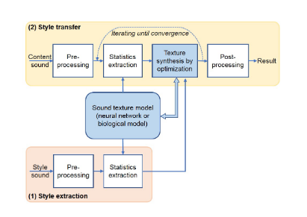
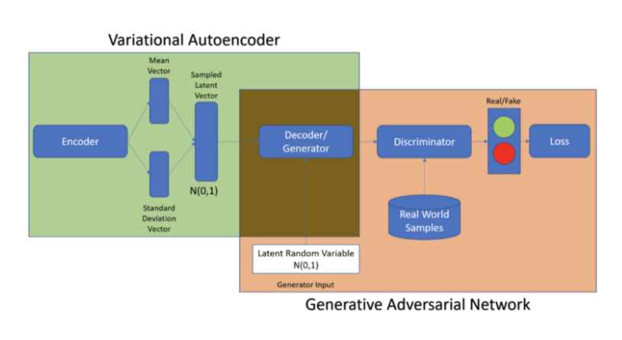
Go, change the world
RV College of
Engineering
Methodology
The music style transfer is being attempted through two approaches :
VAE-GANs
Here, the model is made to learn the features of a particular style and then convert any input music file into the trained style.
Spectrogram Analysis
Here, the model accepts two inputs and dynamically extracts the features to generate an output such that it preserves the input content and transforms its style to the input style music.
Fig 1: VAE-GAN architecture
Fig 2: Audio style transfer framework

Slide 10
Go, change the world
RV College of
Engineering
Methodology : Spectrogram Analysis
An audio texture extraction model is to be constructed.
Using VGG19 : An image can be viewed as a 2D Spectrogram and feature extraction can be implemented using a VGG Network.
Wide Shallow Random Nets: Shallow Neural Nets will be used to extract style statistics.The network will be a one layer CNN with randomly initialized kernels.

Slide 11
Go, change the world
RV College of
Engineering
Methodology : VAE-GAN approach
Obtain data
Filter files based on duration
Extract sequence of notes for each file and ignore other control information in data
Restructure this data into matrices with uniform shape (88x88 because piano has 88 notes/keys)
Dataset : piano dataset [Malik, Iman & Ek, Carl. (2017). Neural Translation of Musical Style. ]
Format of data files in dataset : midi files
Format of input data required for model : a matrix of timesteps x Notes
Format of data output from model : a sequence of notes
Format of data output required : midi or wav files
preprocessing
Build an encoder component
The output of this encoder to be an intermediate representation that encompasses the features of the input music
This form to be as input to a decoder which attempts to decode the intermediate form back to original form.
Training (supervised) :
Two similar VAE-GANs to be constructed.
Model 1 to be trained to generate jazz music
Model 2 to be trained to generate classical music
Testing and validation :
A jazz music to be input to Model2 (trained on classical). A high probability output from the model indicates that the generated form resulting from decoder/generator is close to the style that model2 was trained on(classical) and vice versa.
The decoder output is the resultant style transferred music.
VAE implementation
The VAE decoder to be used as the generator component.
The output of this generator will be a decoded intermediate form which tries to be close to initial input file.
This is input to the discriminator component which tries to classify whether the output generated by generator is similar (close) to the input genre
A high output value from discriminator indicates the reconstruction process was successful.
GAN implementation

Slide 12
Go, change the world
RV College of
Engineering
Software Requirements
The dataset to be used is The Piano Dataset which is distributed with a CC-BY 4.0 License as per the paper[6]. The models will be created and trained in python using tensorflow supported by relevant libraries like Music21, sklearn and others.

Slide 13
Go, change the world
RV College of
Engineering
Hardware Requirements
The computation heavy model will be trained on google Colab in order to leverage the GPUs made accessible for faster computations and learning.

Slide 14
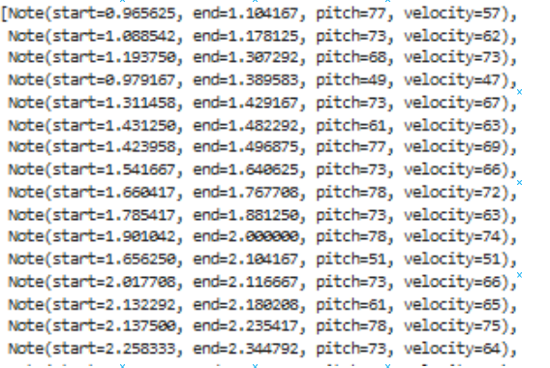
INPUT: Midi Dataset(Musical Instrument Digital Interface)
RV College of
Engineering
Go, change the world
Piano Roll :

Slide 15
Implementation (VAE –GAN approach)
RV College of
Engineering
Go, change the world
Variational autoencoder (VAE)
Input
Midi file
Preprocessing
88x88 matrix
Encoder
88x88 matrix
Discriminator
Decoder
Generative adversarial network(GAN)
Post processing
Output
Midi file

Slide 16

Implementation (spectrogram approach)
RV College of
Engineering
Go, change the world
Feature Extraction :
VGG Network
Random Shallow Network

Slide 17
Experimental Results & Analysis
RV College of
Engineering
Go, change the world
Evaluation
Both the models were evaluated by passing the resultant music files through a genre classifier trained on GTZAN dataset and the expected result was that the output music should have the target genre as its most likely genre as classified by the external classifier.
Dataset
The dataset used comprised of over 200 music files of classical and jazz genres in midi format distributed as cited in piano dataset , Malik, Iman & Ek, Carl. (2017). Neural Translation of Musical Style.

Slide 18
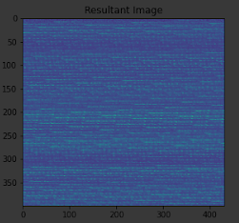
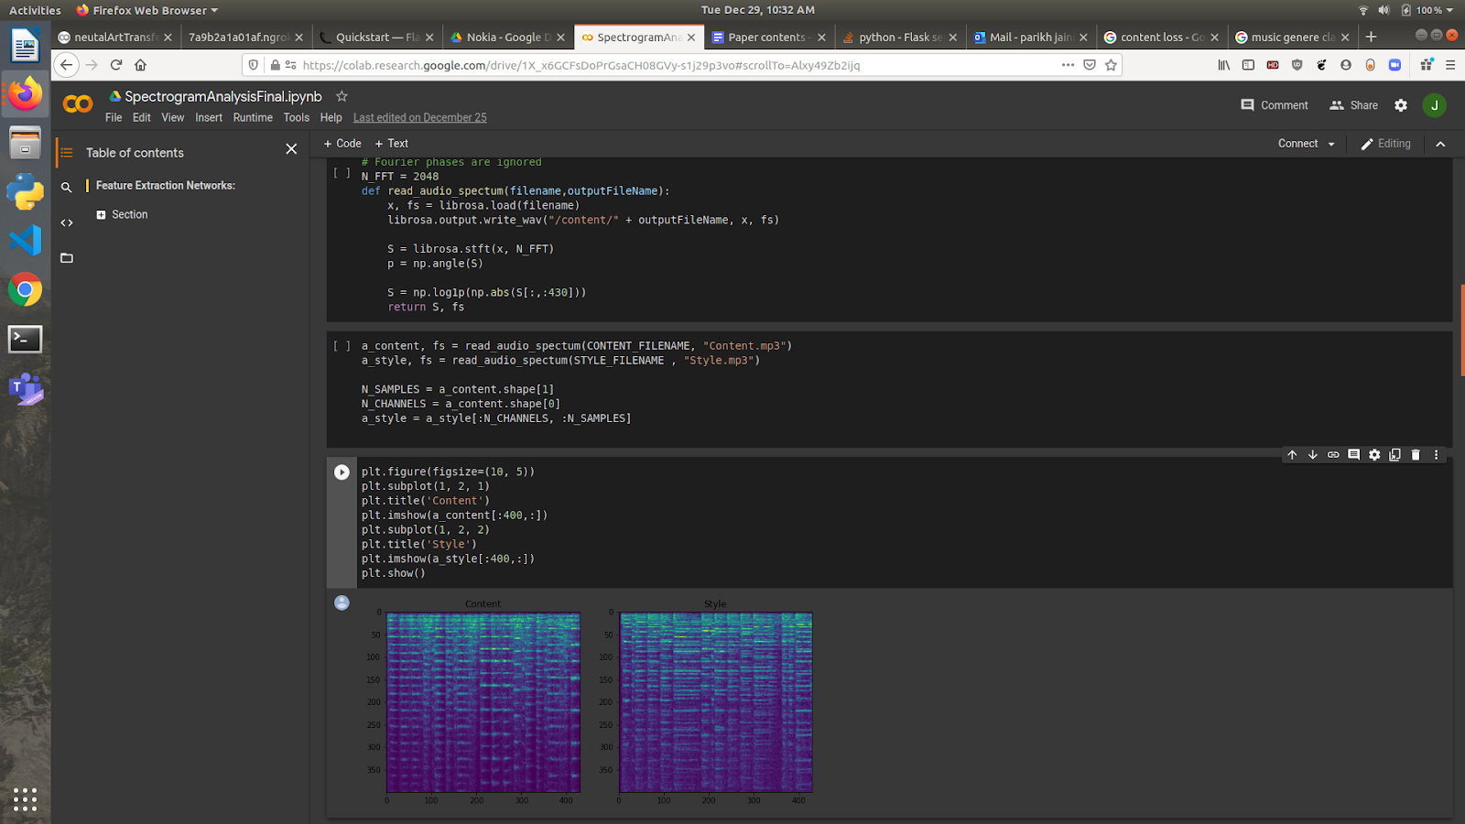
Output analysis Spectrogram Method
RV College of
Engineering
Go, change the world
VGG output:

Slide 19
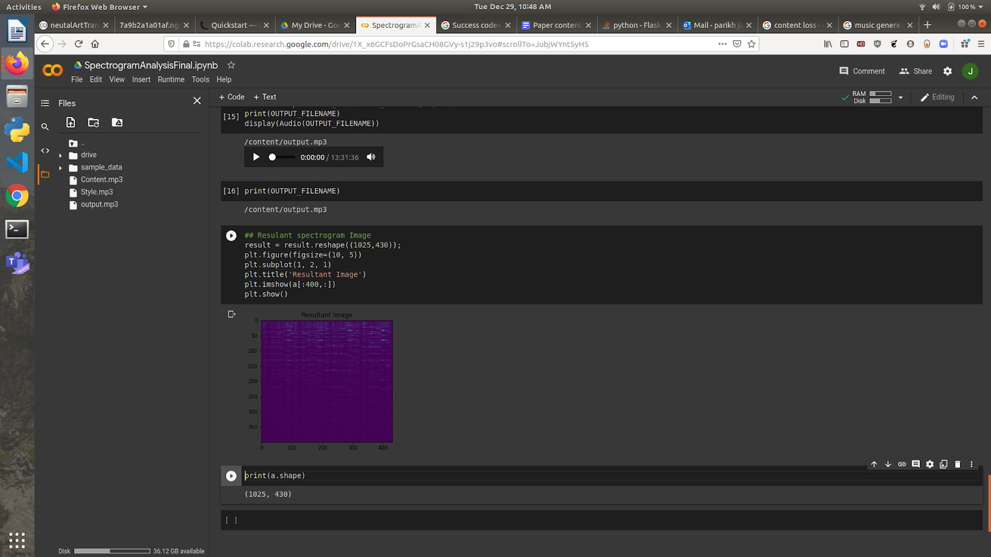
Output analysis Spectrogram Method
RV College of
Engineering
Go, change the world
Shallow Nets output :

Slide 20

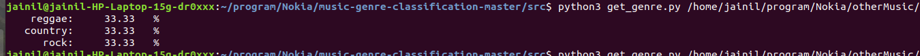
Demonstration of the Spectrogram model
RV College of
Engineering
Go, change the world
Content Music
Resultant Music
Style Music

Slide 21
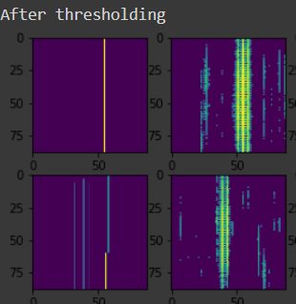
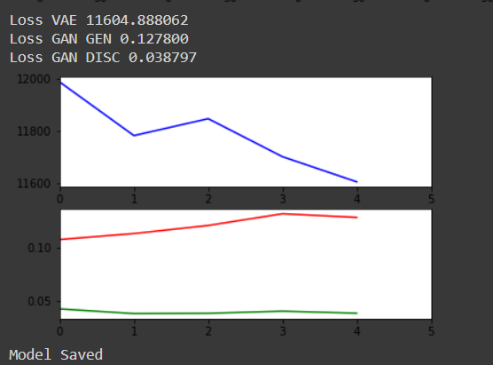
Output analysis VAE-GAN Method
RV College of
Engineering
Go, change the world
GAN output :

Slide 22
Gan Output
Input Music
Output Music

Slide 23

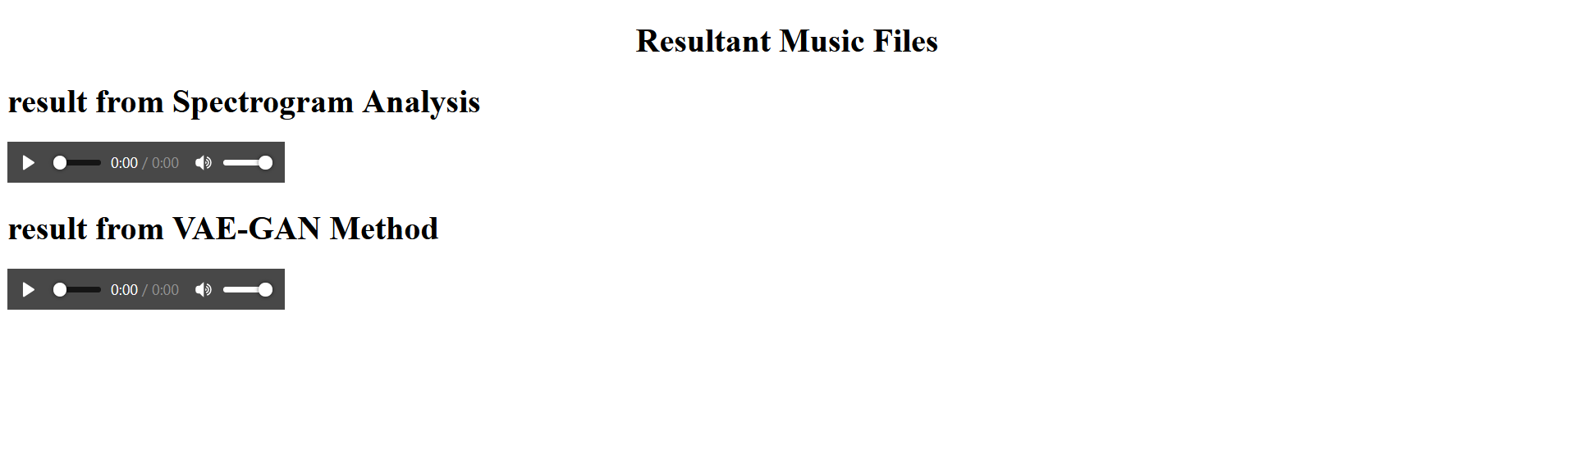
Interface Screenshots

Slide 24
Go, change the world
RV College of
Engineering
Limitations and issues identified
Although a VAE is used to provide a starting vector to GAN’s a complete control of the output style will remain outside the scope of this work.
The training time for audio style transfer will be high even after using Colab GPU this can only be improved by running on a faster computing engine.
All models cannot be shown on an interactive web application as the backend is written on colab and serving requests from colab will not be possible.
The output music file was found to be noisy and requires some post processing to be cleaned which will be outside the scope of this work.
Designing a metric to calculate the amount of style that is transferred will remain outside the scope of this work and will solely depend on the listeners judgement.

Slide 25
Conclusion & Future Work
RV College of
Engineering
Go, change the world
The experiments showed that the resultant audio files from the GAN model were more noisy than the spectrogram files but showed prospects for a much greater improvement in quality over a slightly more fine tuned training from the aspect of learning rates than the spectrogram results .
By comparing the results of both the models with a music genre classifier we come to a conclusion that generative models outperform spectrogram models.
Our research shows that spectrogram analysis has also paved the way for using pre trained networks which were meant for image related tasks to be used on audio files.

Slide 26
References
RV College of
Engineering
Go, change the world
[1] Gatys, Leon A., et al. “A Neural Algorithm of Artistic Style.” ArXiv:1508.06576 [Cs, q-Bio], Sept. 2015. arXiv.org, http://arxiv.org/abs/1508.06576.
[2] Y. Li, T. Zhang, X. Han and Y. Qi, "Image Style Transfer in Deep Learning Networks," 2018 5th International Conference on Systems and Informatics (ICSAI), Nanjing, 2018, pp. 660-664, doi: 10.1109/ICSAI.2018.8599501.
[3] G. Tzanetakis and P. Cook, "Musical genre classification of audio signals," in IEEE Transactions on Speech and Audio Processing, vol. 10, no. 5, pp. 293-302, July 2002, doi: 10.1109/TSA.2002.800560.
[4] Wundervald, Bruna D., and Walmes M. Zeviani. “Machine Learning and Chord Based Feature Engineering for Genre Prediction in Popular Brazilian Music.” ArXiv:1902.03283 [Cs, Eess, Stat], Feb. 2019. arXiv.org, http://arxiv.org/abs/1902.03283.
[5]Dai, Shuqi, et al. “Music Style Transfer: A Position Paper.” ArXiv:1803.06841 [Cs, Eess], July 2018. arXiv.org, http://arxiv.org/abs/1803.06841.
[6] Brunner, Gino, et al. “MIDI-VAE: Modeling Dynamics and Instrumentation of Music with Applications to Style Transfer.” ArXiv:1809.07600 [Cs, Eess, Stat], Sept. 2018. arXiv.org, http://arxiv.org/abs/1809.07600.
[7] Noam Mor, Lior Wolf, Adam Polyak, and Yaniv Taigman. A universal music translation network. CoRR, abs/1805.07848, 2018.
[8] Jesse Engel, Cinjon Resnick, Adam Roberts, Sander Dieleman, Mohammad Norouzi, Douglas Eck, and Karen Simonyan. Neural audio synthesis of musical notes with wavenet autoencoders. In Proceedings of the 34th International Conference on Machine Learning, ICML 2017, Sydney, NSW, Australia, 6-11 August 2017, pages 1068–1077, 2017.
[9] Yamshchikov, Ivan P., and Alexey Tikhonov. “Music Generation with Variational Recurrent Autoencoder Supported by History.” ArXiv:1705.05458 [Cs], Nov. 2018. arXiv.org, http://arxiv.org/abs/1705.05458.
[10]Goodfellow, Ian J., et al. “Generative Adversarial Networks.” ArXiv:1406.2661 [Cs, Stat], 1, June 2014. arXiv.org, http://arxiv.org/abs/1406.2661.

