Slide 1







Job analysis
Jainil patel
1-March-2024

Slide 2



OUTLINE
Executive Summary
Introduction
Methodology
Results
Visualization – Charts
Dashboard
Discussion
Findings & Implications
Conclusion
Appendix

Slide 3

EXECUTIVE SUMMARY
Desirable Programming Languages for Next Year:
1. JavaScript
2. Python
3. HTML/CSS
4. SQL
5. TypeScript
Most Desirable Databases for Next Year:
1. PostgreSQL
2. MongoDB
3. Redis
4. MySQL
5. ElasticSearch
Gender Gap in the IT Industry:
- Male: 93.7%
- Female: 6.3%

Slide 4

INTRODUCTION
In 2019, Stack Overflow, a renowned platform among developers, conducted a comprehensive survey to delve into prevailing technology trends.
This survey encompassed insights into various facets of the tech industry, including programming languages, databases, and demographics. The survey was targeted towards IT professionals and anyone intrigued by the dynamic landscape of the IT field.

Slide 5

METHODOLOGY
Data Sources:
Stack Overflow Developers Survey 2019: A comprehensive survey conducted by Stack Overflow, which provided insights into various aspects of the developer community, including programming languages, databases, and demographics.
GitHub Job Postings: Analysis of job postings on GitHub to discern trends in the demand for specific programming languages and skills within the industry.
Programming Language Annual Salary Data: Examination of annual salary data associated with different programming languages to understand their financial implications for professionals in the field.
Data Exploration and Cleaning:
Python: Utilized Python programming language for data exploration and cleaning tasks. Python's extensive libraries, such as Pandas and NumPy, facilitated efficient data manipulation and preprocessing.
Data Visualization:
IBM Cognos Analytics: Leveraged IBM Cognos Analytics for data visualization purposes. This powerful tool allowed for the creation of insightful visualizations, aiding in the interpretation and presentation of key findings extracted from the data.

Slide 6
RESULTS
Programming Language Trends:
JavaScript and Python emerge as the most popular programming languages, reflecting the dynamic nature of technological advancements driving demand fluctuations.
Python exhibits significant growth in popularity, suggesting its potential to surpass JavaScript in the future.
Database Trends:
PostgreSQL stands out as the most popular database, indicating its consistent demand and reliability.
MongoDB also experiences an increase in demand, highlighting the preference for open-source databases.
Gender Gap Implications:
Gender disparity within the IT field remains a concern, potentially influencing job hiring trends and workforce dynamics.
Skill Demand Insights:
Redis and ElasticSearch skills are increasingly desirable, while MySQL experiences a decrease in demand.
TypeScript gains traction as a preferred skill over Bash/Shell/PowerShell, reflecting evolving industry requirements.
Overall Implications:
Open-source technologies, such as PostgreSQL and MongoDB, maintain consistent demand, suggesting a preference for cost-effective and flexible solutions.
Web development skills, including JavaScript, Python, HTML/CSS, and SQL, remain consistently sought after, underlining the enduring relevance of web-based applications.
The volatile nature of technology trends underscores the need for IT professionals and companies to continually learn and adapt to evolving demands to capitalize on job opportunities and remain competitive in the market.

Slide 7
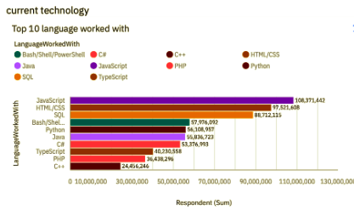
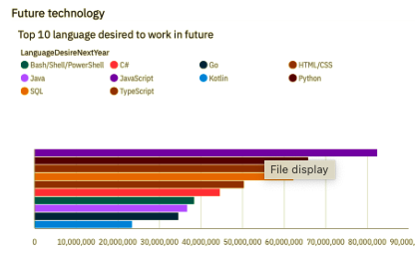
PROGRAMMING LANGUAGE TRENDS
Current Year
Next Year

Slide 8
PROGRAMMING LANGUAGE TRENDS - FINDINGS & IMPLICATIONS
Findings
JavaScript is the most in demand programming language.
Python, HTML/CSS, and SQL are other in demand programming languages.
Skills in TypeScript is more desirable than Bash/Shell/PowerShell for next year.
Implications
Python’s increase in demand may overtake JavaScript in the future.
JavaScript, Python, HTML/CSS, and SQL are consistently in demand.
Web development remains in high demand.

Slide 9
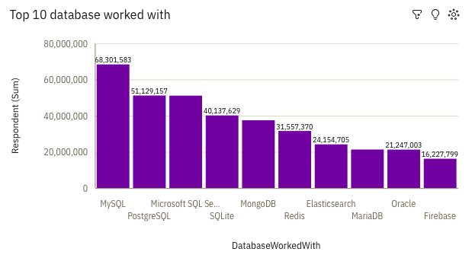
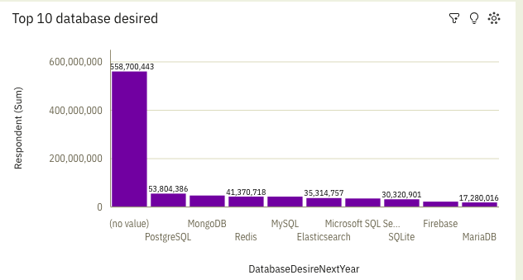
DATABASE TRENDS
Current Year
Next Year

Slide 10
DATABASE TRENDS - FINDINGS & IMPLICATIONS
Findings
PostgreSQL and MongoDB have an increase in demand.
MySQL has a decrease in demand for next year.
Skills in Redis and ElasticSearch are more desirable than Microsoft SQL Server and SQLite for next year.
Implications
PostgreSQL and MongoDB are the most consistent in demand databases.
Open source databases are preferred.
Demand is volatile.

Slide 11

DASHBOARD
https://us1.ca.analytics.ibm.com/bi/?perspective=dashboard&pathRef=.my_folders%2Fdata%2Banalytics%2Bsubmission&action=view&mode=dashboard&subView=model0000018dffbbfeab_00000000

Slide 12
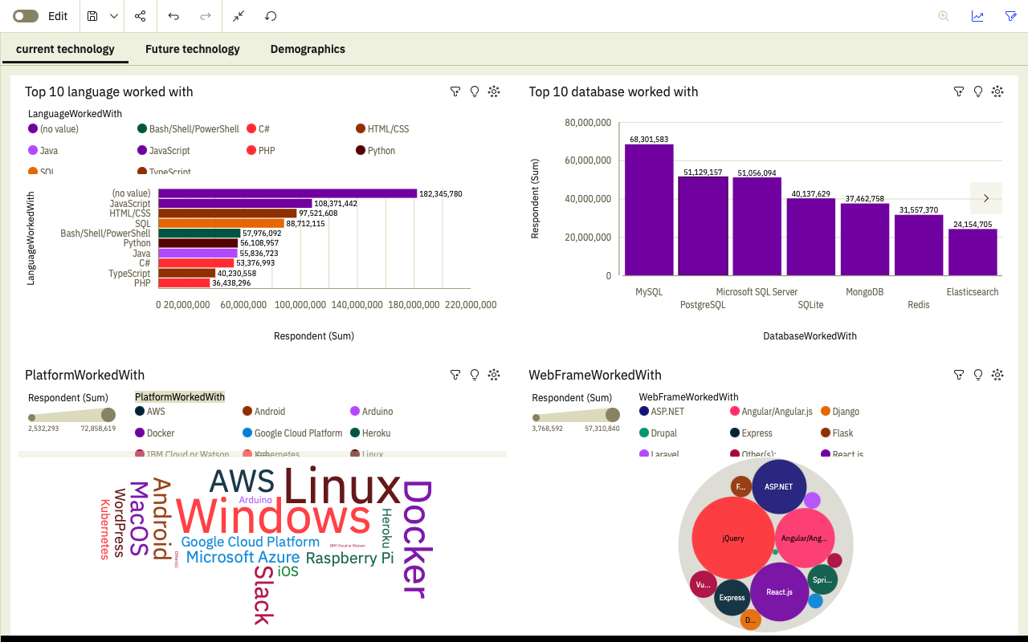
Current Trends

Slide 13
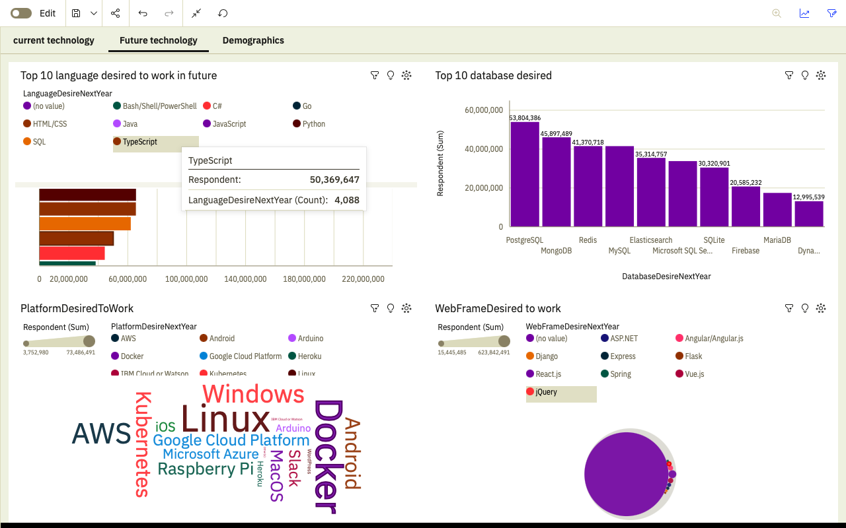
Future Trends

Slide 14
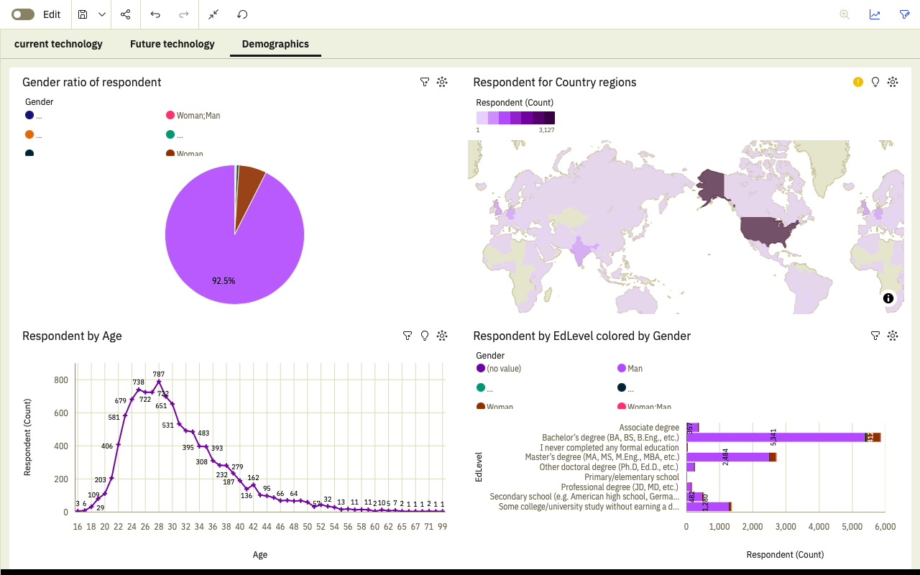
Demographics

Slide 15
DISCUSSION
Dynamic Technological Landscape:
The rapid pace of technological innovation continually reshapes the IT landscape, resulting in fluctuations in demand for programming languages and databases.
JavaScript and Python emerge as frontrunners in the programming language arena, reflecting the adaptability required in an ever-evolving industry.
PostgreSQL's consistent popularity underscores the importance of robust and reliable database solutions in meeting evolving business needs.
Addressing Gender Disparity:
Gender diversity remains a pressing issue within the IT sector, with implications for workforce inclusivity and innovation.
Efforts to diversify the industry through initiatives promoting gender equality are essential for fostering a more inclusive and equitable work environment.
Addressing the gender gap not only promotes social responsibility but also contributes to a broader talent pool and enhanced creativity within the IT workforce.

Slide 16
DISCUSSION
3. Adapting Skillsets to Industry Trends:
The findings highlight the need for IT professionals to continually update and diversify their skillsets to align with industry trends and market demands.
Skills such as Redis and ElasticSearch gain prominence, signaling shifts in technology preferences and project requirements.
Emphasizing the importance of staying abreast of emerging technologies, the results underscore the necessity for ongoing learning and professional development within the IT community.
4. Strategic Implications for Organizations:
Organizations must navigate the dynamic IT landscape by strategically investing in technologies that align with their business objectives and market trends.
Prioritizing diversity and inclusion initiatives can foster a more innovative and resilient workforce, better equipped to tackle the challenges of a rapidly evolving industry.
By embracing open-source solutions like PostgreSQL and MongoDB, companies can harness cost-effective and flexible tools to drive growth and innovation.

Slide 17
OVERALL FINDINGS & IMPLICATIONS
Findings
The IT landscape experiences fluctuations in trends and demands driven by emerging technologies.
JavaScript and Python stand out as the predominant programming languages in the industry.
PostgreSQL emerges as the favored database among IT professionals.
Gender disparity persists within the IT sector.
Implications
IT professionals and organizations must remain agile and responsive to evolving demands in the industry.
Possessing sought-after skills opens doors to increased job prospects for individuals.
Gender disparity within the sector is poised to impact hiring patterns in the job market.

Slide 18

CONCLUSION
In conclusion, the dynamic nature of new technologies shapes diverse trends and demands within the IT sector. JavaScript and Python emerge as the dominant programming languages, while PostgreSQL leads as the preferred database choice. Moreover, there is a pressing need for the IT industry to embrace diversity and broaden its scope.

Slide 19
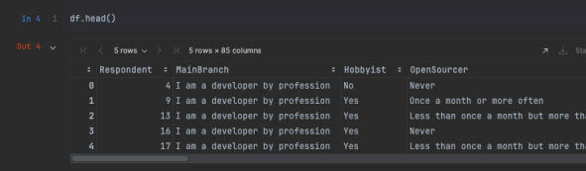
JOB POSTINGS

Slide 20
POPULAR LANGUAGES

