Slide 1


TEAM Cypher (G43)
Team Members:
-19CE127 Saheel Sapovadia
-19CE129 Aman Shah
-19CE135 Jainil Shah
Guided By: Prof. Ashwinkumar Makwana

Slide 2

“ALIVEZ – TO MAKE YOU FEEL MORE ALIVE”

Slide 3
PREAMBLE
Project Definition
Project Description
Motivation behind the project
Problems faced by the gym trainers in today’s situation
Problems in existing gym applications
Purpose and target users
Development Environment
Contribution
UI (Flow Chart)
Implementation Screenshots
Limitations and Future Enhancements
Challenges faced by us
References

Slide 4
Project definition:
This application aims at providing a solid platform for communication between a gym trainer and his/her clients.
Goal is to make your body as well as your soul healthier.
The need was to have a platform where customers can book personal gym training sessions with their Gym instructor according to their time and needs.
Clients need to be provided with diet charts and workout regimes on daily basis.
Two tiers of membership have been provided, SILVER and GOLD.
GOLD members will get some priority over the SILVER members and some other extra perks.
Through this platform both, the instructor and the clients can be in touch to solve the issues and queries.

Slide 5
Project Description:
Our Application consists of two modules : (i) Client Module and (ii) Trainer module.
The Client module comprises of components for viewing basic client information, detailed information of their trainers.
The client can view various other information like Workout charts assigned to them by their trainers, their BMI and their diet chart.
The client can also pay their membership fees and book their workout slot accordingly.
Trainer module would consist of the management side of the application.
Trainer would be able to modify the client data, Workout charts, BMI and Diet charts.
Gym sessions would be arranged by trainer according to the bookings.

Slide 6
Motivation behind this app:
Due to this lockdown many people were afraid of losing their shape and size.
Many people who were addicted to go to the gym were suffering from depression.
Even after the gyms have reopened most of the people do not prefer to there.
The beginners needed a better and efficient way to utilize their time, money and efforts.
There was a need for a platform that can provide a clean and a modern UI that can be easily used by the clients and trainers.
Our major motivation was to provide the facility of “Workout From Home”

Slide 7
Problems faced by the gym trainers in today’s situation:
Personal trainers were rendered jobless and thus they were facing monetary problems.
Keeping track of the client payments was a headache because every client follows a different payment cycle.
Assigning physical diet charts and workout plans to the clients individually is not possible and strictly not recommended .
The complete interaction between the trainer and their clients requires use of multiple platforms such as WhatsApp(for communication) , GooglePay/Patym(for payments) , BMI calculator etc.

Slide 8
Problems in existing gym applications:
In existing gym applications , no solid communication channel is present between the client and trainer.
Trainers cannot regularly monitor their clients' progress.
Clients don't have the liberty to book workout sessions at their own convenience.
Thus, we designed an application that integrates all the necessary functionalities.

Slide 9
Purpose AND TARGET USERS:
This app provide their users with various essential features.
From the client’s perspective, it's like having your own personal trainer in your pocket.
And from the trainer’s perspective, this app makes it easier to handle the clients.
This app stores your personal information like BMI, height, weight, fat percentage
Have a personalized workout plan and track your progress.

Slide 10
About Android studio and its features:
Android studio has VISUAL LAYOUT EDITOR feature
Android studio has APK ANALYZER feature
Android studio has FAST EMULATOR feature
Android studio has INTELLIGENT CODE EDITOR feature
Android studio has FLEXIBLE BUILD SYSTEM feature
Android studio has REALTIME PROFILERS feature

Slide 11
GOLD VS SILVER TIER MEMBERS:
All the features mentioned in the above slides will be accessible by the SILVER tier members
GOLD tier members will have some features to make them feel privileged such as-
Able to book a workout slot within 24 hours
Can also Reschedule at their own convenience
SILVER tier members have all the normal features, but they cannot reschedule at the last moment.
They have to book their workout 24 hours in advance.

Slide 12
CONTRIBUTIONS:
Saheel Sapovadia (19CE127) :
All the CRUD (Create, Read, Update, Delete) operations of the App with backend FireBase database
Splash Screen
Login startup and Login page
User Authentication in the Firebase
Designing the Custom Objects to Query data accurately from the database Structuring the NoSQL database
Side Navigation Bar
Aman Shah(19CE129) :
Logo Designing
Report Preparation
Personal Interaction with the GYM Trainers as well as Clients to understand real life scenario.

Slide 13
CONTRIBUTIONS (CONTINUED):
Jainil Shah (19CE135) :
All the designing of the various layouts
Dynamic recycler views for the flexibility and the real time UI modification according to the database
Walkthrough designing
Bottom navigation
Client & Trainer : Profile, Workout, BMI, Diet
Date and Time picker
Testing and debugging.

Slide 14
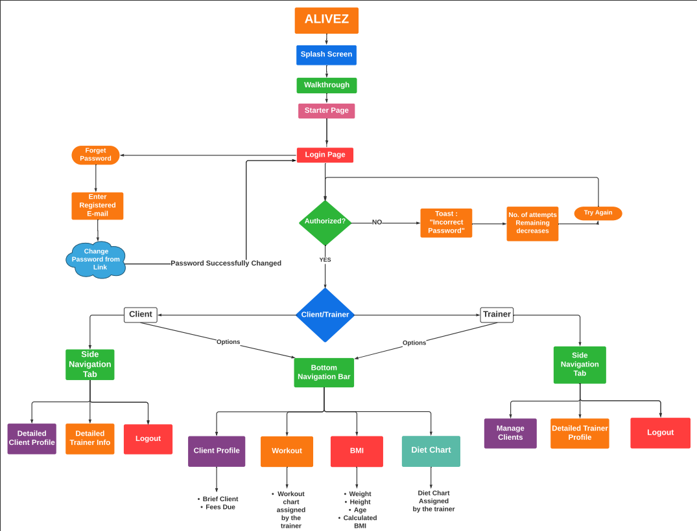

Slide 15

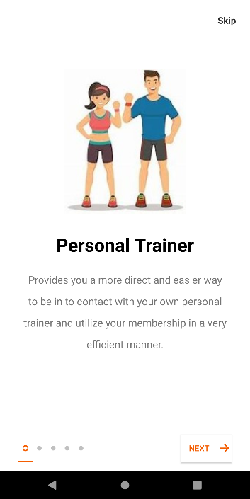
Screenshots:
General Preview:
Splash Screen
Walkthrough

Slide 16
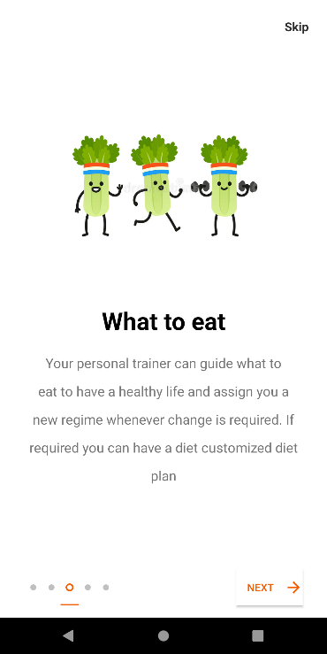
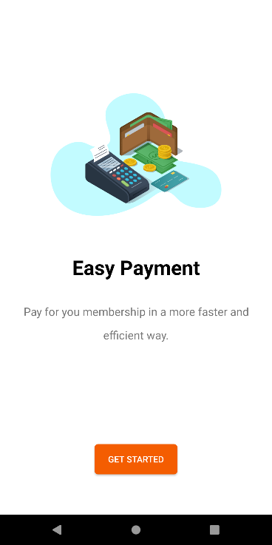
General Preview:
Walkthrough
Walkthrough

Slide 17
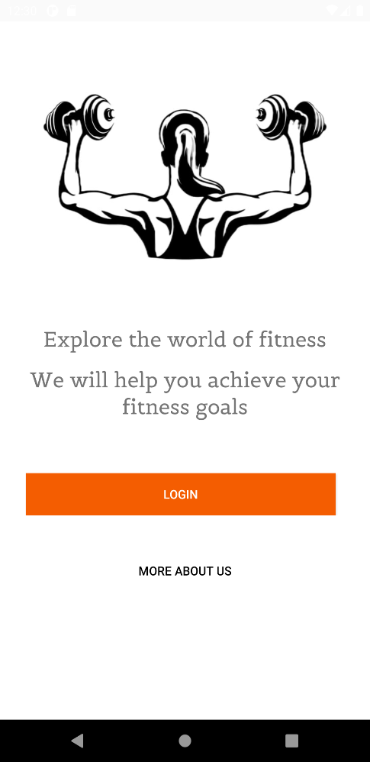
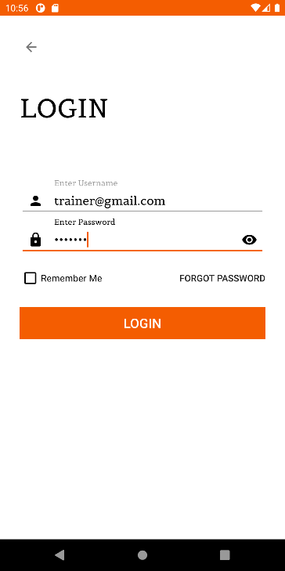
General Preview:
Login Startup
Login

Slide 18
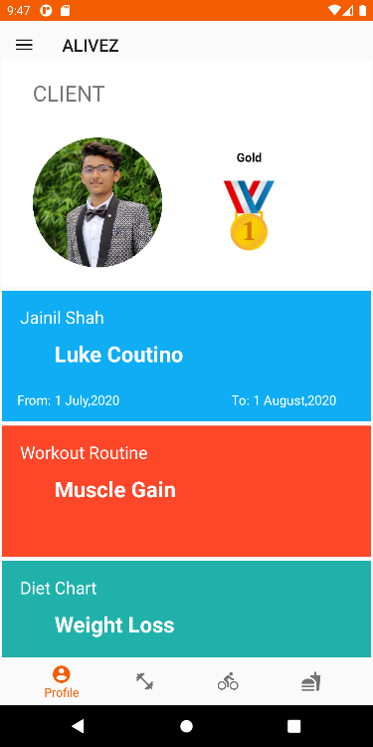
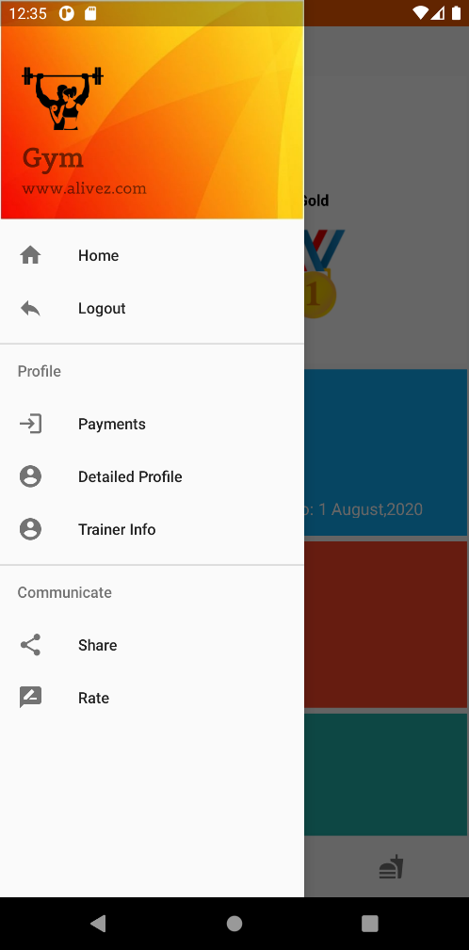
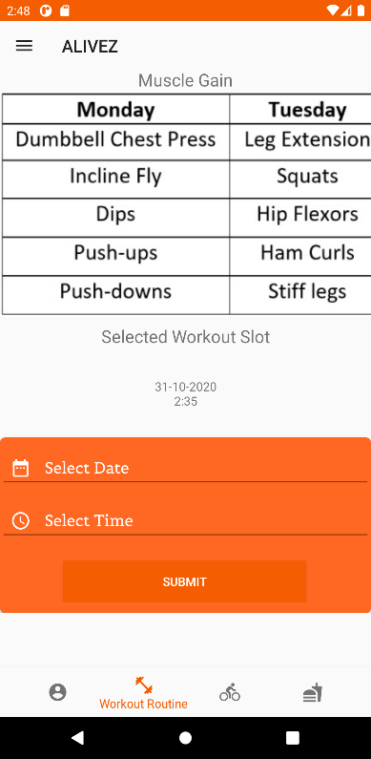
Client Preview:
Client Profile
Side Nav
Workout

Slide 19
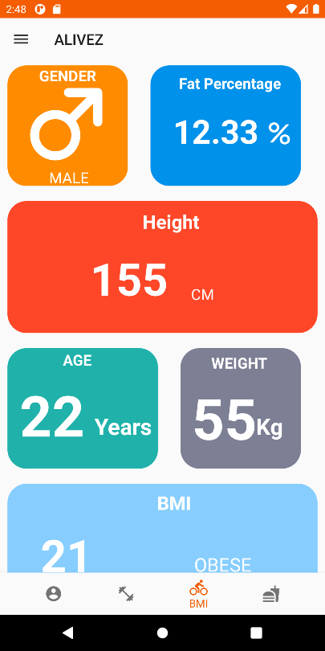
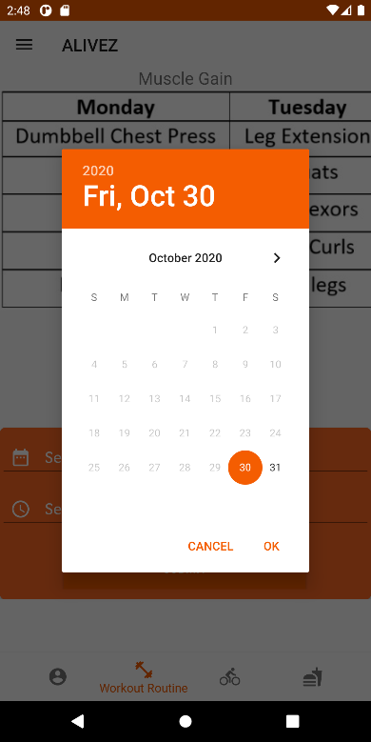
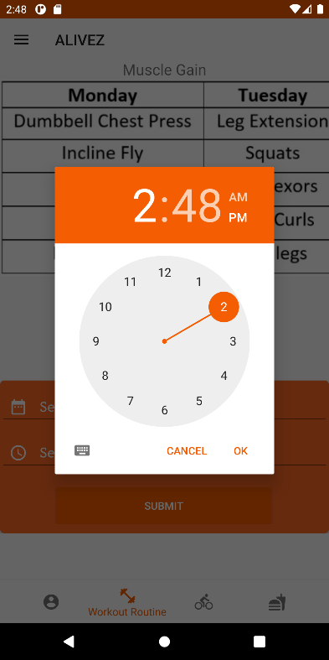
Client Preview:
BMI
Date-Picker
Time-Picker

Slide 20
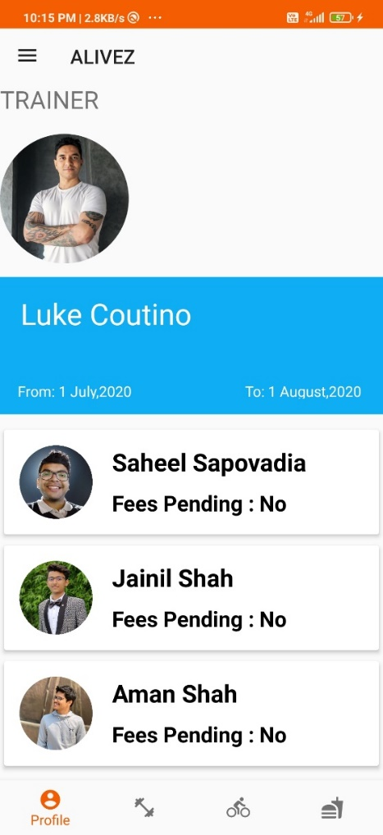
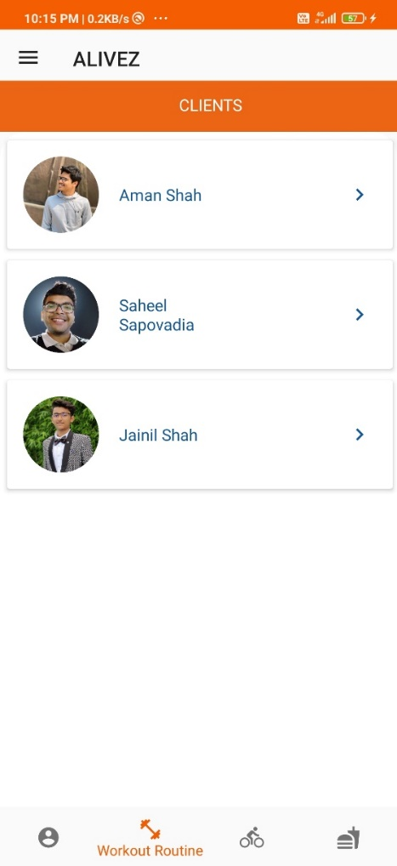
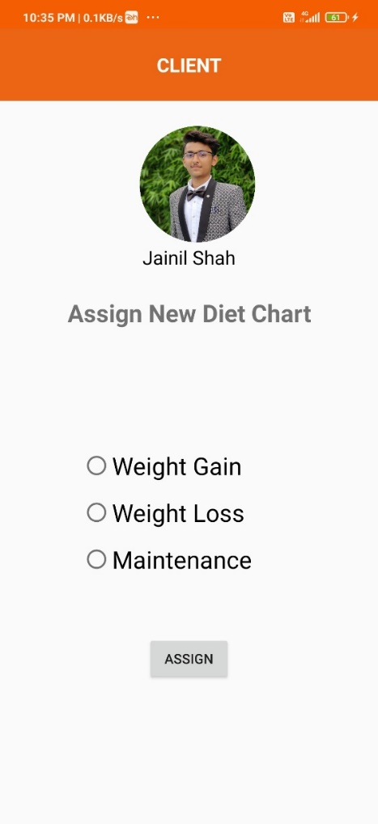
Trainer Profile
Workout
Assigning Diet

Slide 21
Limitations:
Application works only for android and not IOS.
Little bit lag experienced while executing the application.
More designing required for an attractive UI.
Feature for direct messaging and communication between client and trainer is not there.
The client has to open the application daily to check his/her assigned workout regime and diet chart.

Slide 22
Future enhancements:
Designing the application using Flutter for compatibility with IOS and android.
Using an optimized way to make the application for a lag free and a better user experience.
Designing an in-app messaging platform for better and hassle-free communication between clients and trainers.
Notifications pop-up daily at the time when the client has booked workout slot.

Slide 23
Challenges faced by us:
We had to learn a whole new IDE and a programming paradigm.
We had to modify the available codes according to our requirements.
We had to refer to original documentation of the Firebase provided by Google for transparent understanding of each and every library and API.
We also came across a lot of errors on the Android Platform which we didn’t know even though we used it daily.

Slide 24
REFERENCES:
https://developer.android.com/courses/fundamentals-training/overview-v2
https://www.coursera.org/specializations/android-app-development#courses
https://developer.android.com/guide/topics/ui/layout/cardview
https://www.youtube.com/watch?v=G6f6lm3ZCTU
https://www.youtube.com/watch?v=DW36cGMrQ2g&list=PLv3FkN9_9- cvm6fLBLiuYHNaOmcDCyenD&index=2
https://www.youtube.com/watch?v=t6TUs0FIjdw&list=PLv3FkN9_9-cvm6fLBLiuYHNaOmcDCyenD&index=1
https://www.youtube.com/watch?v=vpoPZvQGXj0&list=PLv3FkN9_9-cvm6fLBLiuYHNaOmcDCyenD&index=4
https://www.youtube.com/watch?v=HwYENW0RyY4&list=WL&index=1

Slide 25
THANK YOU

