Slide 1

ISTC SEAT ALLOCATION SYSTEM
Self-Designed “Allocation Algorithm” for ISTC Admissions

Slide 2
Literature Survey
S. No. | Paper Title | Algorithm / Implementation | Limitation (Why not directly usable)
1. | Deferred Acceptance Algorithms: History, Theory, Practice, and Open Questions | - Introduces Gale-Shapley Deferred Acceptance (DA) algorithm - Stable matching for two-sided markets - Widely used in school admissions | - Pure DA does not handle multi-reservation categories - No support for seat de-reservation or complex Indian quotas
2. | Joint Seat Allocation 2018: An Algorithmic Perspective | - Implements Multi-Reservation Deferred Acceptance (MRDA) for IIT/NIT admissions - Handles multiple quotas - Category-wise seat allocation with de-reservation | - Highly complex, tailored for large-scale national systems - Not open source, difficult to adapt for smaller institutions
3. | Centralized Admissions for Engineering Colleges in India | - Centralized, software-driven seat allocation - Focuses on fairness and transparency - Uses merit and preferences | - Lacks detailed algorithmic transparency - Does not address dynamic seat conversion or custom reservation rules

Slide 3
Introduction
Our ISTC Seat Allocation Portal is a web-based system designed to automate and optimize the allocation of limited seats in multiple courses, ensuring fairness, transparency, and adherence to reservation policies.
Core Focus:
Handles candidate preferences, merit ranking, and multiple reservation categories with dynamic seat conversion.
The algorithm is inspired by the Multi-Reservation Deferred Acceptance (MRDA) model, adapted and simplified for ISTC’s specific requirements.

Slide 4
Key Feature
Hybrid MRDA-Inspired Logic:
Combines the stability of Deferred Acceptance with the flexibility of multi-reservation handling.
Differentiators:
Supports dynamic de-reservation: unused reserved seats convert to general.
Designed for smaller institutions (not just large-scale national systems).
Transparent and auditable allocation steps.
Customizations:
Handles candidate registration, preference locking, and real-time dashboard updates.
Ensures no seat is wasted if reserved categories are underfilled.
Have Admin Panel for cross checking things to be transparent (No cheating)
IP lock for Admin and Activity log for all user.

Slide 5
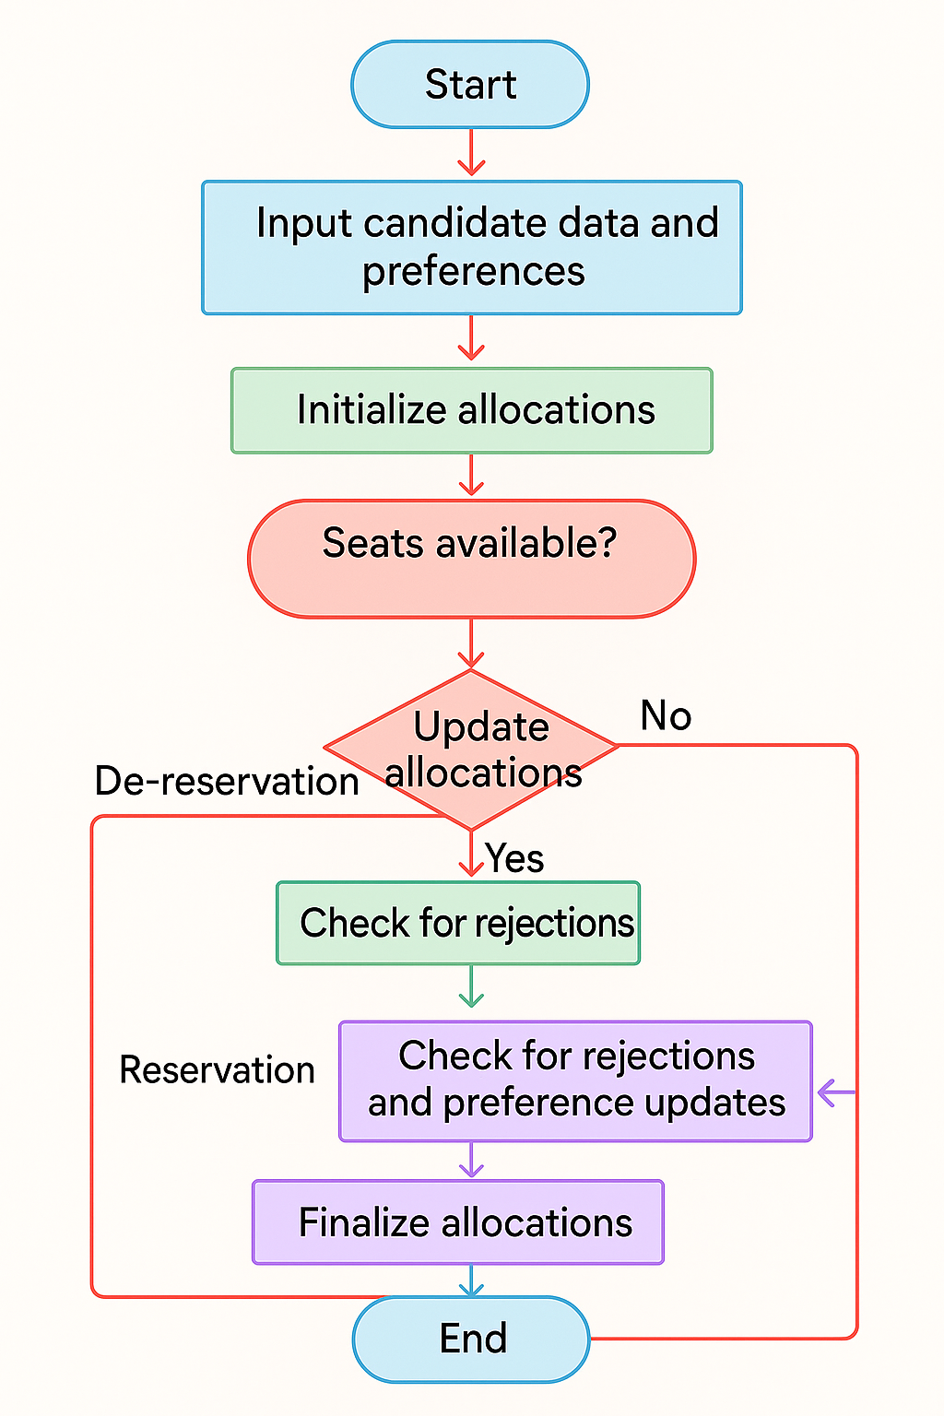
Algorithm Flowchart

Slide 6





Tech Stack (Module Description)
Backend
Next.js API routes (Node.js)
Allocation engine (TypeScript) implementing MRDA-inspired logic
Frontend
Next.js (React) with
Tailwind CSS for responsive UI
Candidate and Admin dashboards
Database
MySQL
Deployment
Ready for institutional server

Slide 7
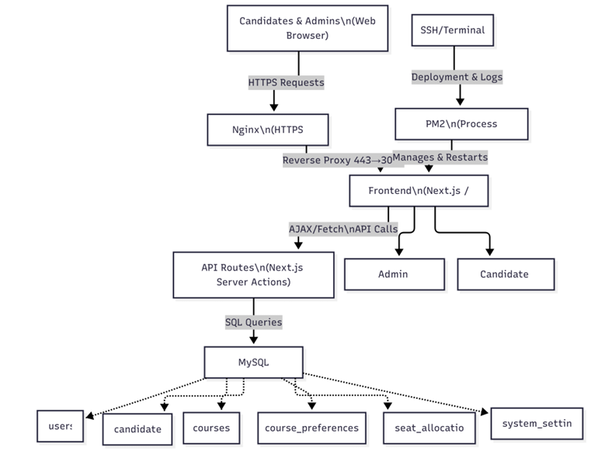
System Architecture
User Interface: Admission Portal (Applicants, Colleges, Admin)
Application Layer: Input Collection, Preference Submission
Algorithm Engine: Core Matching Algorithm (MRDA-inspired)
Database: Applicant Data, Seat Matrix, Allocation History

Slide 8
References
A. E. Roth, "Deferred acceptance algorithms: history, theory, practice, and open questions," International Journal of Game Theory, vol. 36, no. 3–4, pp. 537–569, 2008. [Online]. Available: https://web.stanford.edu/~alroth/papers/GaleandShapley.revised.IJGT.pdf
S. Baswana, P. P. Chakrabarti, Y. Kanoria, U. Patange, and S. Chandran, "Joint Seat Allocation 2018: An algorithmic perspective," arXiv preprint arXiv:1904.06698, 2019. [Online]. Available: https://arxiv.org/abs/1904.06698
S. Baswana, P. P. Chakrabarti, Y. Kanoria, U. Patange, and S. Chandran, "Centralized Admissions for Engineering Colleges in India," Interfaces, vol. 49, no. 1, pp. 1–19, 2019. [Online]. Available: https://rohitvaish.in/data/Papers/%5BBaswana+%5D%20Centralized%20Admissions%20for%20Engineering%20Colleges%20in%20India.pdf

