Slide 1

ISTC SEAT ALLOCATION SYSTEM
Self-Designed allocation Algorithm for ISTC Admissions

Slide 2
Literature Survey
S. No. | Paper Title | Algorithm / Implementation | Limitation (Why not directly usable)
1. | Deferred Acceptance Algorithms: History, Theory, Practice, and Open Questions | - Introduces Gale-Shapley Deferred Acceptance (DA) algorithm - Stable matching for two-sided markets - Widely used in school admissions | - Pure DA does not handle multi-reservation categories - No support for seat de-reservation or complex Indian quotas
2. | Joint Seat Allocation 2018: An Algorithmic Perspective | - Implements Multi-Reservation Deferred Acceptance (MRDA) for IIT/NIT admissions - Handles multiple quotas - Category-wise seat allocation with de-reservation | - Highly complex, tailored for large-scale national systems - Not open source, difficult to adapt for smaller institutions
3. | Centralized Admissions for Engineering Colleges in India | - Centralized, software-driven seat allocation - Focuses on fairness and transparency - Uses merit and preferences | - Lacks detailed algorithmic transparency - Does not address dynamic seat conversion or custom reservation rules

Slide 3
Introduction
Our ISTC Seat Allocation Portal is a web-based system designed to automate and optimize the allocation of limited seats in multiple courses, ensuring fairness, transparency, and adherence to reservation policies.
Core Focus:
Handles candidate preferences, merit ranking, and multiple reservation categories with dynamic seat conversion.
The algorithm is inspired by the Multi-Reservation Deferred Acceptance (MRDA) model, adapted and simplified for ISTC’s specific requirements.

Slide 4
Key Feature
Hybrid MRDA-Inspired Logic:
Combines the stability of Deferred Acceptance with the flexibility of multi-reservation handling.
Differentiators:
Supports dynamic de-reservation: unused reserved seats convert to general.
Designed for smaller institutions (not just large-scale national systems).
Transparent and auditable allocation steps.
Customizations:
Handles candidate registration, preference locking, and real-time dashboard updates.
Ensures no seat is wasted if reserved categories are underfilled.
Have Admin Panel for cross checking things to be transparent (No cheating)

Slide 5
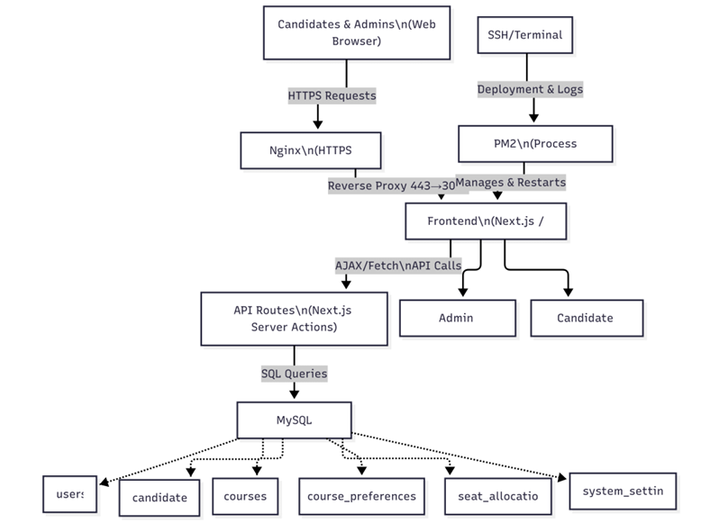
System Architecture
User Interface: Admission Portal (Applicants, Colleges, Admin)
Application Layer: Input Collection, Preference Submission
Algorithm Engine: Core Matching Algorithm (MRDA-inspired)
Database: Applicant Data, Seat Matrix, Allocation History

Slide 6
Tech Stack (Module Description)
Frontend:
Next.js (React) with Tailwind CSS for responsive UI
Candidate and Admin dashboards
Backend:
Next.js API routes (Node.js)
Allocation engine (TypeScript) implementing MRDA-inspired logic
Database:
MySQL (structured for users, candidates, courses, preferences, allocations)
Security:
Role-based access (admin/candidate)
Optional IP lock for admin routes
Deployment:
Ready for institutional server

Slide 7
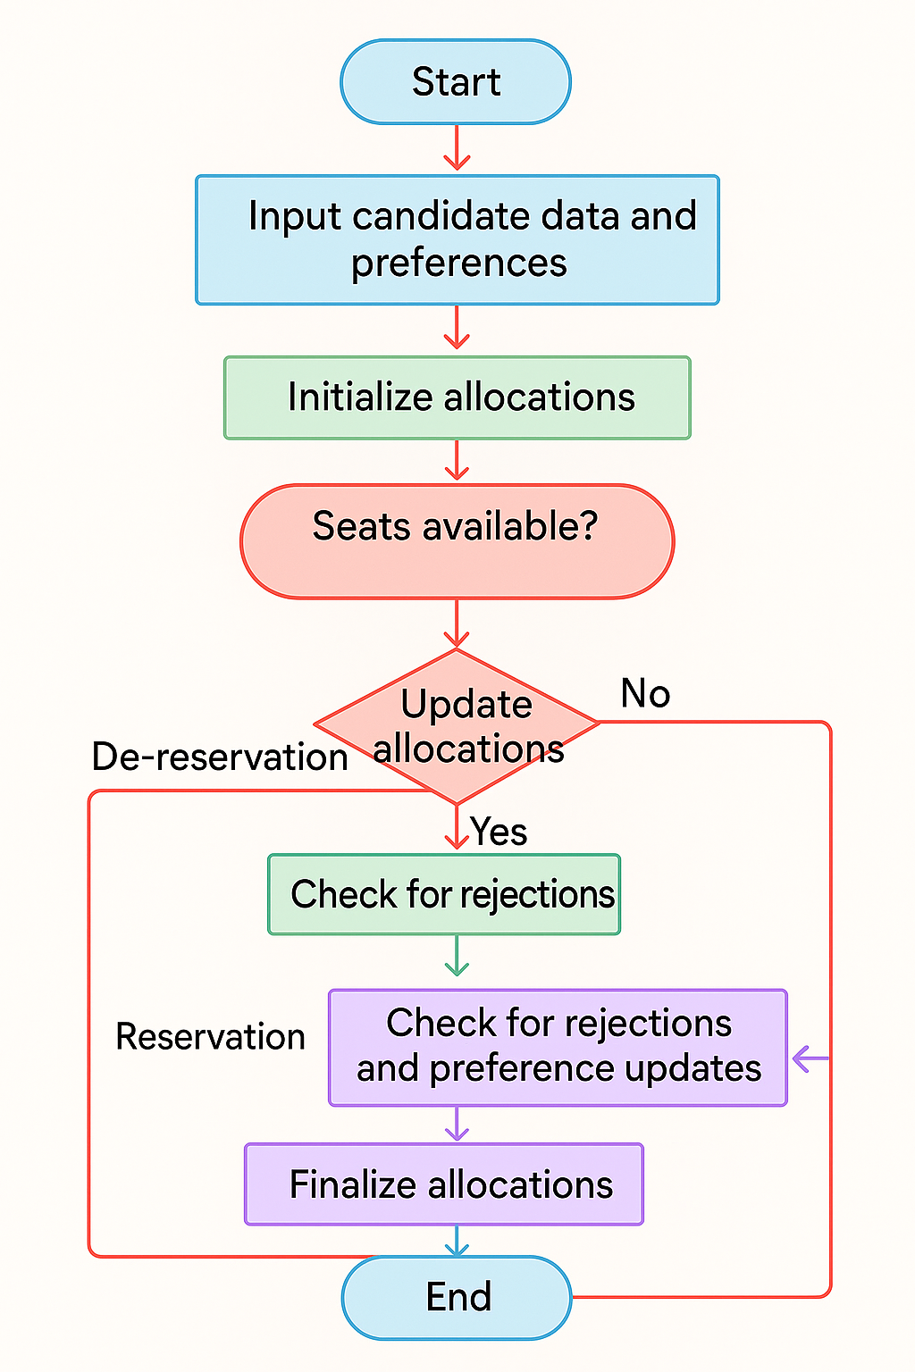
Algorithm Flowchart

Slide 8
References
A. E. Roth, "Deferred acceptance algorithms: history, theory, practice, and open questions," International Journal of Game Theory, vol. 36, no. 3–4, pp. 537–569, 2008. [Online]. Available: https://web.stanford.edu/~alroth/papers/GaleandShapley.revised.IJGT.pdf
S. Baswana, P. P. Chakrabarti, Y. Kanoria, U. Patange, and S. Chandran, "Joint Seat Allocation 2018: An algorithmic perspective," arXiv preprint arXiv:1904.06698, 2019. [Online]. Available: https://arxiv.org/abs/1904.06698
S. Baswana, P. P. Chakrabarti, Y. Kanoria, U. Patange, and S. Chandran, "Centralized Admissions for Engineering Colleges in India," Interfaces, vol. 49, no. 1, pp. 1–19, 2019. [Online]. Available: https://rohitvaish.in/data/Papers/%5BBaswana+%5D%20Centralized%20Admissions%20for%20Engineering%20Colleges%20in%20India.pdf

