Slide 1
Streamlining Client Data Access with a Chat-based LLM Interface
Team – SK
Team Members– Ketaki Jain & Shrawani Kulkarni

Slide 2
01
Problem Statement & Planning

Slide 3

Problem Statement
Organizations often struggle with efficiently accessing and understanding client data stored in internal databases.
Traditional methods of data retrieval and analysis can be time-consuming and cumbersome, leading to delays in decision-making and inefficiencies in client management.
There is a need for a streamlined and intuitive solution that allows organization members to query and receive timely, accurate insights from the database through a user-friendly interface.

Slide 4
Planning
Need
Goal
There is a need for a better, more straightforward solution that allows employees to quickly ask questions about the data and get accurate and timely answers through an easy-to-use interface
Creating a chat interface that uses a powerful AI model to read and understand client data from an internal database. This interface will allow employees to ask questions about the data and get clear and relevant answers.

Slide 5
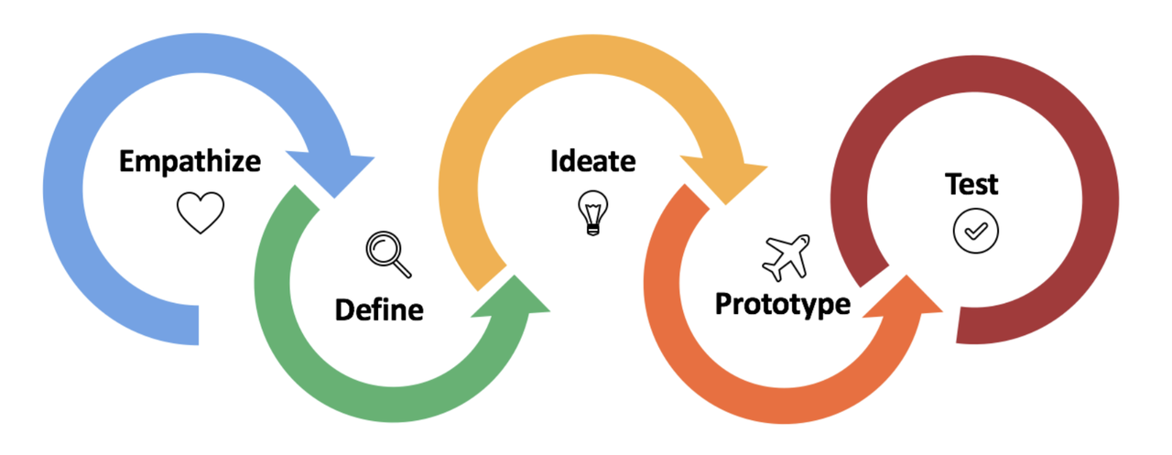
EMPATHIZE-done
DEFINE-done
IDEATE-working

Slide 6
02
Pain Points

Slide 7
Pain Points
01
02
03
04
05
06
Data Silos: fragmented data and integrating them
Slow Data Retrieval and Complex Querying
Lack of User-Friendly Tools and security issues
Data Quality Issues
Limited Access to Real-Time Data
Resource Constraints and Delayed Decision-Making

Slide 8
03
Solution Domain and Features

Slide 9
LLM – LARGE LANGUAGE MODELS
It is a sophisticated artificial intelligence system that uses deep learning techniques to understand and generate human-like text patterns.
They are used for natural language processing, translation, chatbots, content generation, sentiment analysis, and other AI-powered language-related tasks.
Improved accuracy in language tasks.
Efficient content generation.
Enhanced natural language understanding and interaction.
01
02
03

Slide 10
CHATBOT
01
02
03
What is ChatBot??
A chatbot is an AI-powered software program designed to simulate conversation with users, providing automated responses and assistance in various applications and platforms
Use
Chatbots streamline customer service, provide instant responses, automate tasks, gather feedback, assist with inquiries, deliver personalized experiences, and enhance user engagement across platforms.
Advantage
Chatbots offer 24/7 availability, handle repetitive queries, scale customer support, provide instant responses, collect data, and enhance user experience efficiently.

Slide 11


AI and ML
Natural Language Processing
Machine Learning Algorithms
NLP enables interfaces to understand and interpret human language, allowing users to interact with data using natural language queries. This streamlines the process of retrieving and analyzing data, making it more intuitive and efficient.
ML algorithms enable user interfaces to learn from patterns in data, making them capable of recognizing trends, making predictions, and providing more precise analysis. These algorithms can optimize the user interface's performance over time, leading to quicker and more accurate data retrieval and analysis.

Slide 12


AI and ML
Predictive Analytics
Personalization
AI and ML empower user interfaces to predict user behavior and data trends, allowing for proactive data retrieval and analysis. This predictive capability helps in delivering relevant insights to users even before they explicitly request the information.
By leveraging AI and ML, user interfaces can personalize the data retrieval and analysis process based on individual user preferences and historical interactions. This level of personalization leads to more efficient and accurate results tailored to the specific needs of the user.

Slide 13
Modern Methods
Data Warehousing
ELT Processes
Data Virtualization
A data warehouse is like a giant storage space for different types of data. It helps businesses analyze their information.
ELT (Extract, Load, Transform) is a data integration process where raw data is extracted, loaded into a target system, then transformed.
Data visualization presents information in graphical form, making complex data more understandable, revealing patterns, and facilitating insights and decision-making.
Advanced Analytics and BI Tools
Cloud-Based Solutions
In – Memory Databases
Advanced Analytics and BI Tools process and analyze complex data, offering insights to support informed decision-making and strategic planning.
In-Memory Computing use in-memory databases (e.g., SAP HANA, Redis) to store data in RAM rather than on disk, significantly speeding up data retrieval and analysis
Cloud-Based Solutions provide services, storage, and applications over the internet, offering scalability, accessibility, and cost-effectiveness for businesses and users.

Slide 14
Modern Methods
01
Real-Time Data Processing
Real-Time Data Processing involves capturing, processing, and analyzing data instantly, enabling immediate actions and up-to-date insights for decision-making.
02
Data Integration and API Management
Data Integration and API Management connect diverse data sources and applications, ensuring seamless communication, data sharing, and interoperability.
03
Data Governance and Quality
Data Governance and Quality involve managing and ensuring data accuracy, integrity, security, and compliance throughout its lifecycle within organizations.

Slide 15
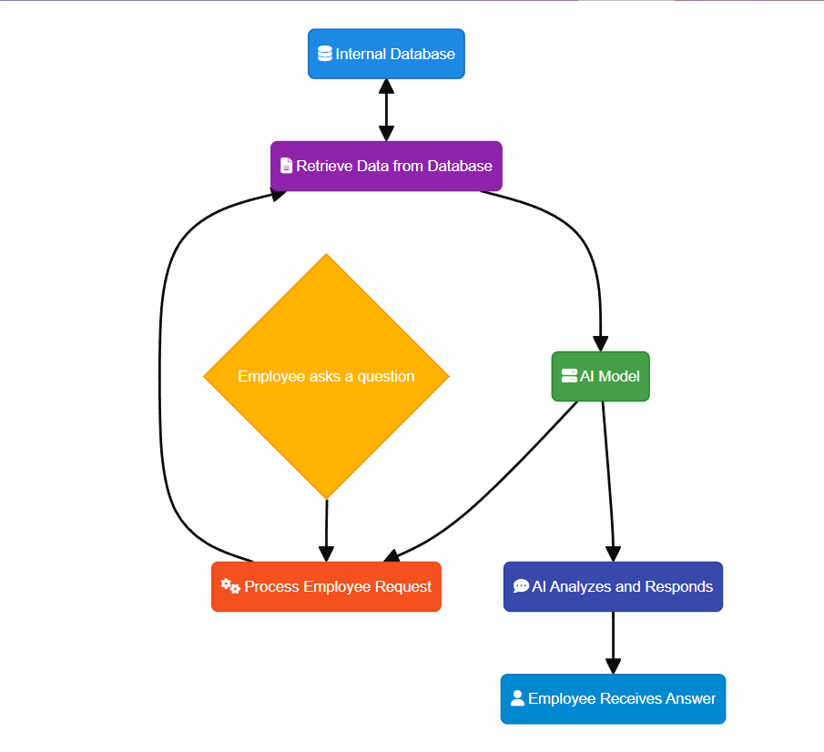
04
Workflow diagram

Slide 16
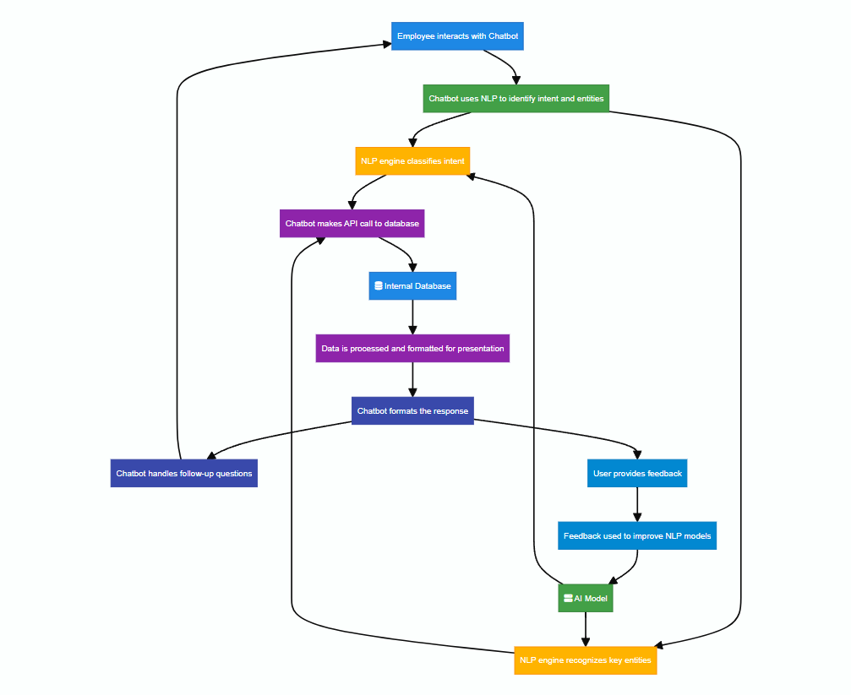

Slide 17
05
Contigency Plan and Future Scope

Slide 18
Contigency plans
System Downtime
Data Inconsistencies and Corruption
Performance and UI/UX Issues
Redundancy checks using cloud services
Maintaining backup systems
Monitoring and alerting system setup
Maintaining backup systems
Data validation
Version Control
Load Balamcing
Caching
Optimization
User Training
Feedback Mechanism
Support Options
Security Breaches
NLP Model Failures
Integration Failures
Encryption
Acess Control
Incident response
Fallback Responses
Continuous Training
Hybrid approach
Retry Mechanisms
Graceful Degradation
Error Logging

Slide 19
Scope for Improvement
Data Warehousing and Data Lakes
Data Virtualization
Interactive User Interface
Context Awareness and personalisation
AI-Driven Insights
Ease of Use through Guided Assistance and feedback loop
Security and Compliance
Enhanced Natural Language Processing
Advanced Data Analytics
Cross-Platform Support
Knowledge Management
Scalability and Performance

Slide 20
Thanks

