Slide 1
Crowd Sourced Image Filtering
Apoorva O,Keerthi G, Mayur J,Sukanya N,Dr.Uma M
KLE Technological University Vidyanagar, Hubballi-580031 Karnataka, India
December 27, 2019
Crowd Sourced Image Filtering
‹#› / 20

Slide 2
Contents
Introduction
System Design
Implementation details Discussion on optimization Results
Conclusion
Crowd Sourced Image Filtering
‹#› / 20

Slide 3
Introduction
Blur Detection
Stacked Auto-encoder(Handcrafted features) PSD(Power Spectral Density) SVD(Singular Value Decomposition)
Kurtosis
Fully Connected Neural Network
Deep Encoder-Decoder With Long Residual Skip (Generation of Ground Truth)
Crowd Sourced Image Filtering
‹#› / 20

Slide 4
Motivation
Blur detection and estimation has progressively became an imminent area of Computer Vision.
Blur in images is considered as an undesirable effect because it leads to the loss of the necessary details required for the scene interpretation.
Automatic detection of blurred and sharp pixels in an image and their classication into respective regions are very important for different image processing and computer vision application.
Further filtered images are used for 3D reconstruction of image.
Crowd Sourced Image Filtering
‹#› / 20

Slide 5
Objectives
Objectives are.
Crowd Sourced Image Filtering
‹#› / 20

Slide 6
Literature Survey
De-focus and motion blur detection with deep contextual features.
The paper does not focus on estimating the amount of blur. And blur image detection for complex image is difficult where we have both types of blur i.e de-focus and motion blur.
The paper gives a method which effectively detects blur in large homogeneous regions with large receptive fields
Blurred image region detection based on stacked auto-encoder.
The method enhances the performance as blur detection training is done in both unsupervised followed by supervised mode.
Crowd Sourced Image Filtering
‹#› / 20

Slide 7
Problem Statement
Design a framework for elimination of unwanted images from crowdsourced images i.e, ltering occluded/ blur/ text based images. We plan to model a method to perform
measure-based selection of images towards ltering of the crowdsourced images. The task in hand is to design a method to provide a quantitative measure for scoring the images and selecting them for 3D reconstruction.
Crowd Sourced Image Filtering
‹#› / 20

Slide 8
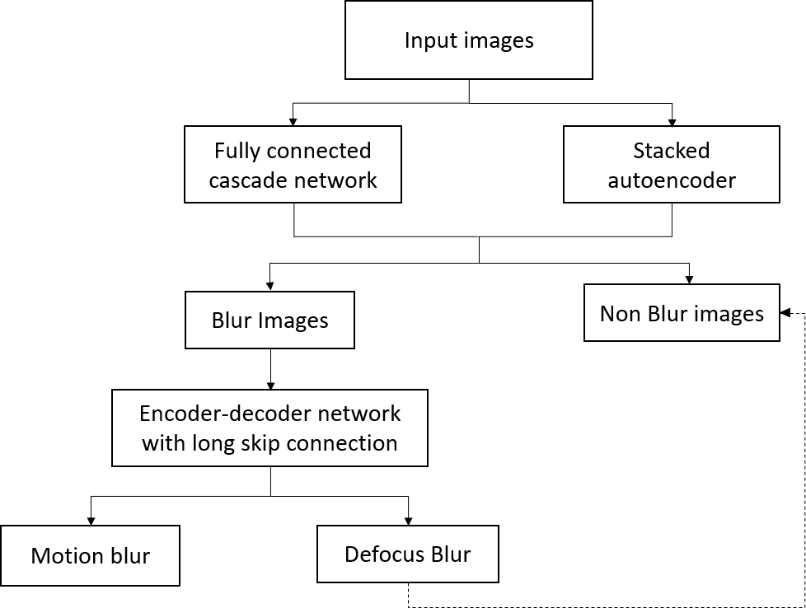
System Design
Crowd Sourced Image Filtering
‹#› / 20

Slide 9
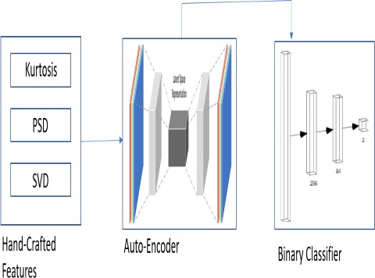
Design Alternative - 1
Stacked Auto-Encoder:
The stacked auto-encoder takes hand-crafted features and classifies images as blur or not blur
Crowd Sourced Image Filtering
‹#› / 20

Slide 10
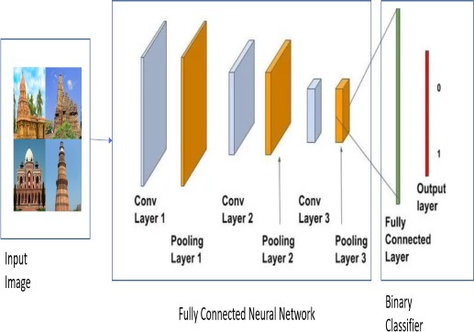
Design Alternative - 2
ConvNet:
The Input is directly given to the fully connected neural network are binary classified as blur or not blur.
Crowd Sourced Image Filtering

Slide 11
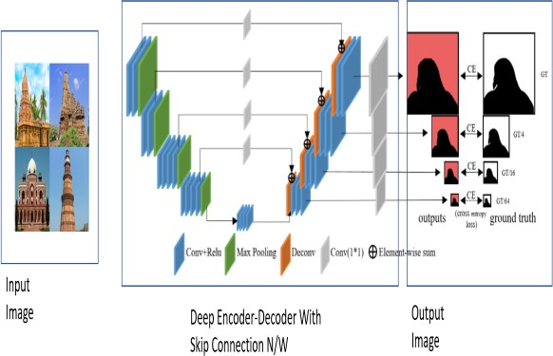
Design Alternative - 3
Deep Encoder-Decoder With Long Residual Skip :
The Skip Connection Network With Deep Encoder-Decoder classifies the blur images as motion blur and de-focus blur.
Crowd Sourced Image Filtering

Slide 12
Discuss in brief the final design with relevant figures.
Final Design
Crowd Sourced Image Filtering

Slide 13
Implementation Details
Implementation Details
Discuss on the implementation details and specifications of the final design
Crowd Sourced Image Filtering

Slide 14
Algorithm
Discuss the algorithmic flow in the final design by drawing a algorithmic flow following standard symbols like oval for input and output etc.
Crowd Sourced Image Filtering

Slide 15
Discuss on the hardware or software optimization included in the project.
Optimization
Crowd Sourced Image Filtering

Slide 16
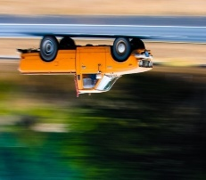
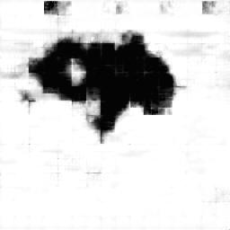
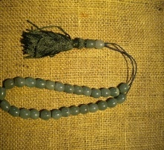
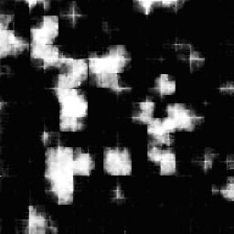
Results
1)
2)
Motion Blur Image
GT For Motion Blur Image
Non Blur Image
GT For Non-Blur Image
Apoorva O,Keerthi G, Mayur J,Sukanya N,Dr.Uma M
Crowd Sourced Image Filtering
Crowd Sourced Image Filtering
‹#› / 20

Slide 17
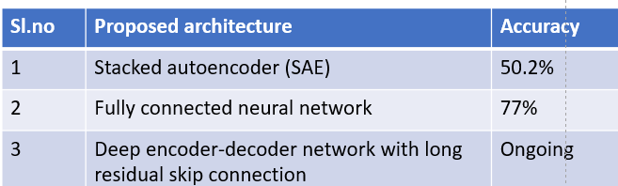
Discussion on results
Crowd Sourced Image Filtering

Slide 18
Conclusion
We proposed a deep learning-based ltering pipeline for processing the internet-sourced images of heritage sites for better 3D reconstruction.
3D reconstruction of heritage sites, using the images collected from the internet was challenging since images may contain blur, text, occlusion and shadow artefacts with reported preprocessing methods.
To improve the results for the internet sourced images we proposed filtering pipeline with a clean-up modules in order to select a suitable set of images for 3D reconstruction.
We proposed a method for clean-up using auto-encoders, convolutional neural networks and deep encoder-decoder network with long residual skip-connection to eliminate the artefacts.
Crowd Sourced Image Filtering

Slide 19
Future Scope
Discuss the future scope of your project.
Crowd Sourced Image Filtering

Slide 20
Thank-You
Thank-You
Crowd Sourced Image Filtering

