Slide 1
USC CSCI 548 Final Project Nimesh Jain Neel Shah
FasoNNNnwwhenkbewbfnista

Slide 2
Idea
Create a common integrated platform for a user to buy shoes.
When a user searches for a shoe display all the searched shoe from all the different platforms.
The user can compare the similar shoes from different platform and make a choice.
Recommend different shoes to the user based on the user past history as well as past history of similar users.
The main problem focused and solved here is Information Extraction, Information Integration into global Schema and Record Linkage.

Slide 3
Sources Used for the Project
Zappos: www.zappos.com/
Eastbay: http://www.eastbay.com/
6pm: http://www.6pm.com/
Shoezoo: http://www.shoezoo.com/
Shoebuy: http://www.shoebuy.com/
DBshoes: http://www.dbshoes.net/
The major sources of interest were zappos, eastbay & 6pm.

Slide 4
Architecture
Data Exchange
Extracting information from different source, copying the data into the system, normalize, clean, deduplication and index.
The answer to the query was provided these relations in the global database of the system.

Slide 5
Major Steps Followed
Defining schema
Information Retrieval - Wrapper generation
Data Cleaning
De-Duplication
Record Linkage
Recommender System
Evaluation of the system

Slide 6
Defining Schema
The shoe schema contains following key attributes:
Description
Current_price
Orig_price
Brand
Color
Size
Rating
Sku
Url
Image_url
product_id

Slide 7
Information Retrieval - Wrapper Generation
Scrapy and Python used to scrape product details from the webpage.
Portia was used but with no accurate results.
Wrapper constructed using xpath.
Scrapy in python was run through Scrapy Cloud for few websites to achieve speed in performance.

Slide 8
Data Cleaning
Used Open Refine tool for data cleaning
Column Unfold - For some sources the description retrieved was not appropriate. Substring of url provided better description. We created description attribute based on the url.
Normalized all the columns for incorporating null values.
Normalized size and color column for comma separated color.
Split the price column for some sources as current price and original price.
Example of one the data Cleaning : forEachIndex(value.replace(/[^0-9\.]+/,",").substring(1).split(",").sort().uniques(),i,v,if(isNonBlank(v),toNumber(v), 0)).join(",").replace("0","").substring(1)

Slide 9
De-Duplication
Removed all the duplicate items based on SKU Column with 100% acceptance rate.
Removed all the duplicate items based on description column with 95% acceptance rate.
Algorithm used to remove deduplication was Jaro Wrinkler

Slide 10
Clustering
With so many records in each data the record linkage took real long time.
The solution was to create a good blocking key.
Clustering was done based on description of shoes using nearest neighbour with distance function as Levenshtein.
The assumption here was the that all the shoes in same cluster only needs to be compared with other element.
This newly created column was used as block key

Slide 11
Record Linkage
Algorithm Used : Jaro Winkler
Record Linkage Column : Shoe Description
Acceptance Rate : 85%
Blocking Key : Column create by clustering Description
Record Linkage was performed among various combinations of different sources and we took the best results use combination of different algorithms.

Slide 12
What are different collections in the database?
6pm-zappos-ebay : This collection has records of all the linked similar shoes from the 3 different sources nmely 6pm, zappos and east bay..
6pm-zappos - records from 6pm and zappos
Ebay-zappos - records from east bay and zappos
User - id of the user and other details of the user.
User-Product - This collection have the relation of which user have provide what rating for what product.

Slide 13
Search and Data retrieval
Autocomplete on description of the product
For each search query first the system search in 6pm-zappo-eastbay database and then subsequently falls on 6pm-zappo, 6pm-eastbay and zappo-eastbay database to retrieve the results.

Slide 14
Different Tools and Technologies used
Scrappy Python and Xpath
Portia
OpenRefine
FRIL
MongoDB
Python Flask
Jquery, JavaScript, HTML/CSS
GraphLab (Recommender System)

Slide 15
Recommedation System
Collaborative filtering recommender system
This method basically fills the user-product matrix with a score and returns the k top score.
The score is calculated based on how other users have rated the prodcut which the current user have purchased.
The Pearson algorithm was used was this purpose.
Created a database for 100 user randomly sampling them for 1-7 random product and randomly assigning the rating to the product.
Create another test data which says which user like which product and then calculated precision and recall.

Slide 16
Evaluation of the System
Calculated the precision and recall for record linkage on small subset of the data.
Precision for record linkage : 88.3% Recall for record linkage : 86.7%
Manually tested the record linked data for different websites.
Calculated precision and recall for recommendation system.
Precision for recommendation system : 82.5% Recall for recommendation syste, : 80.9%

Slide 17
Demo

Slide 18
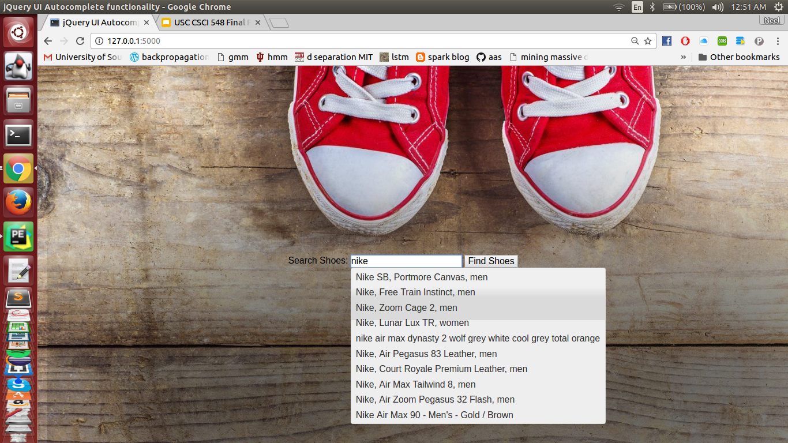
Demo

Slide 19
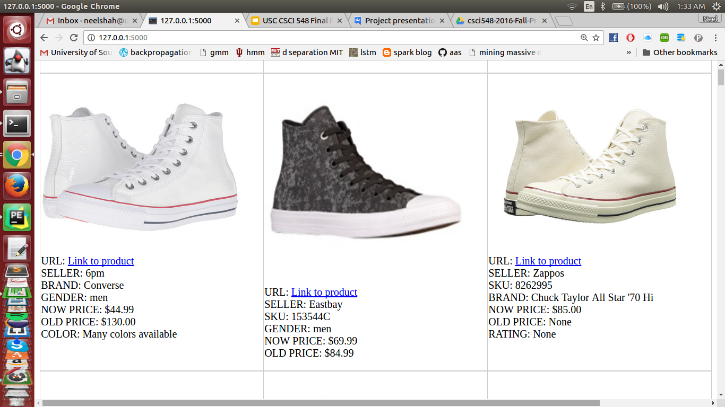
Demo Contd…(Showing related items)

Slide 20
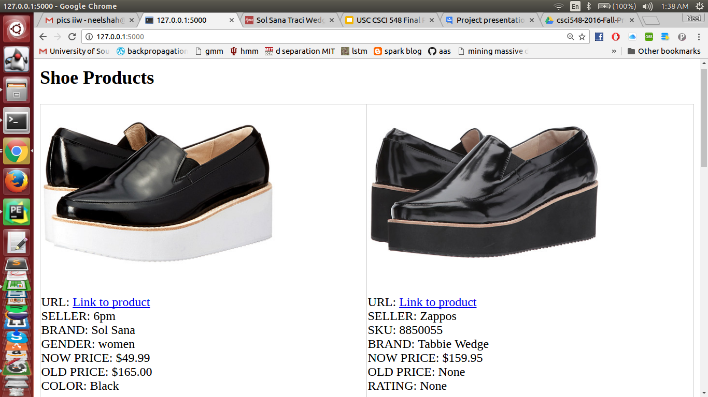
Demo Contd…(Showing related items)

Slide 21
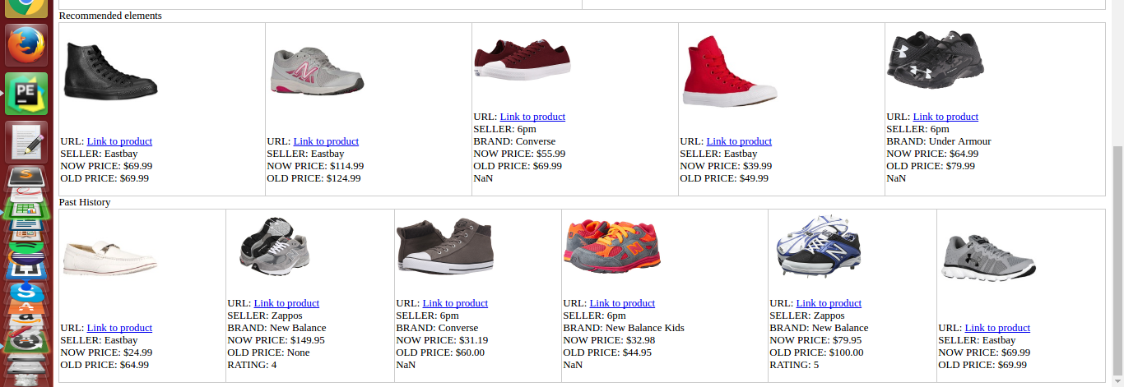
Demo Contd...(recommendation and past history)

Slide 22
THANK YOU!

