Slide 1
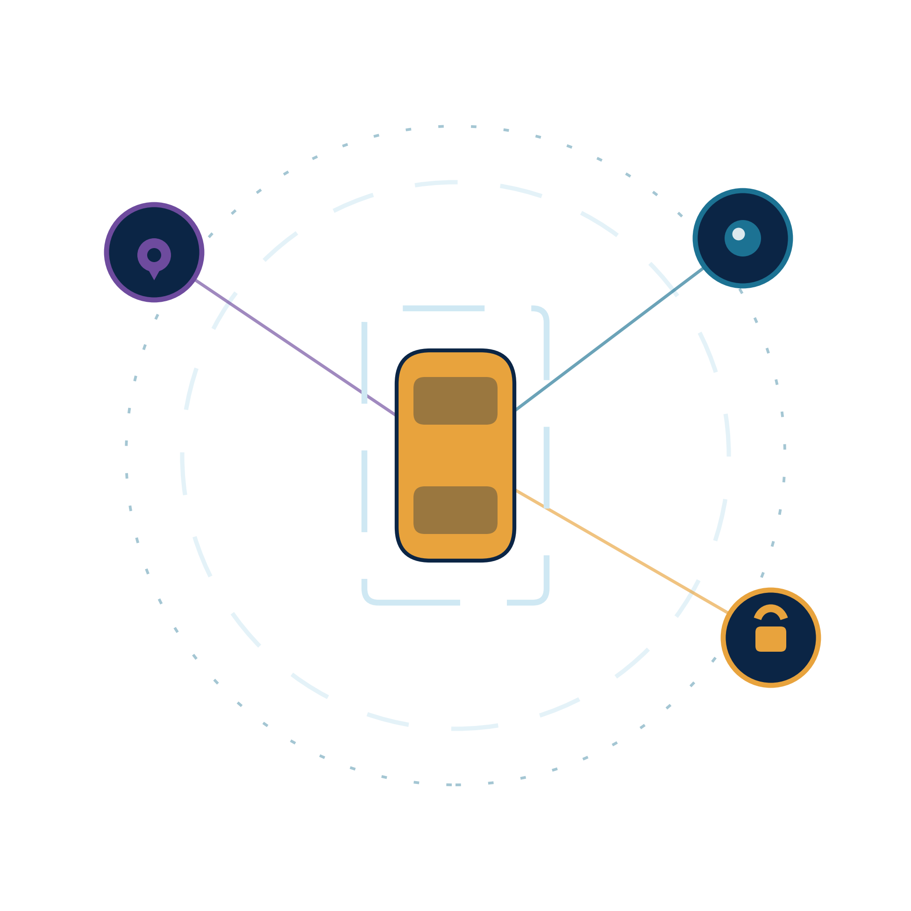
PARKFNB
The operating layer for fragmented urban parking capacity.
FIND
PROTECT
SPECIALIZE
MANAGE
MONETIZE
One network connecting demand, physical access,
live occupancy and idle capacity.
Seed Round · 2026 · Indore, Madhya Pradesh, India
PARKFNB · CONFIDENTIAL INVESTOR MATERIAL

Slide 2
CONTENTS
What this deck covers
Four sections. Click any line to jump straight to it — or use the section bar at the top of every slide.
01
›
The opportunity
A broken parking ecosystem, five demand journeys, and a market already digitising.
02
›
The product
One operating layer: discovery, physical access, live vision and space creation.
03
›
The business
Unit economics, revenue model, the gap we close and why it compounds.
04
›
The plan
What is built today, how we go to market, and what the seed round buys.
Every figure marked illustrative is scenario math from stated assumptions — pilot data replaces it as it lands.
PARKFNB · CONFIDENTIAL INVESTOR MATERIAL
02

Slide 3
01
SECTION ONE OF FOUR
The opportunity
Parking is not one problem. It is five, and they are all failures of the same missing layer.
A BROKEN ECOSYSTEM
FIVE DEMAND JOURNEYS
WHY NOW
PARKFNB · CONFIDENTIAL INVESTOR MATERIAL

Slide 4
THE PROBLEM
OPPORTUNITY
PRODUCT
BUSINESS
PLAN
Parking is not one problem — it is a broken ecosystem
Demand exists. Space exists. Infrastructure exists. What is missing is the digital layer connecting them.
Destination uncertainty
Unauthorised usage
Large-vehicle friction
Under-managed lots
Idle capacity
Drivers heading to markets, offices or hospitals cannot verify open parking in advance.
Private plot and driveway owners face squatting, with little control over who parks there.
Buses, shuttles and logistics fleets need turning radius, clearance and legal waiting space.
Commercial lots hold real capacity but still run on manual entry and passive CCTV.
Owners have no end-to-end tool for listing, booking, access, payment and payout.
WHO IT HURTS
WHO IT HURTS
WHO IT HURTS
WHO IT HURTS
WHO IT HURTS
Drivers
Space owners
Fleet operators
Lot operators
Space owners
Parkfnb turns fragmented parking capacity into a connected, bookable and controllable network.
PARKFNB · CONFIDENTIAL INVESTOR MATERIAL
04

Slide 5
DEMAND
OPPORTUNITY
PRODUCT
BUSINESS
PLAN
Five everyday parking journeys. One missing certainty.
The same failure repeats at offices, markets, temples, tourist destinations and transport hubs.
Corporate employee
Staff / corporate bus
Shopper
Tourist / pilgrim
Commercial / fleet
Needs predictable parking near the office, usually at a fixed arrival time.
Needs safe, legal short-duration waiting and pickup space.
Reaches a market or high street and only then discovers whether parking exists.
Travels to a temple or attraction with uncertain, peak-loaded nearby parking.
Needs short-duration loading, service or fleet parking near a destination.
WORK
TRANSIT
SHOP
VISIT
FLEET
Common demand signal: “I am going to X — show me a trusted place to park there, for my time window.”
PARKFNB · CONFIDENTIAL INVESTOR MATERIAL
05

Slide 6
WHY NOW · MARKET
OPPORTUNITY
PRODUCT
BUSINESS
PLAN
A large market, already digitising
Vehicle growth, dense urban cores and cheap edge compute are converging at the same time.
WHY NOW
INDIA SMART-PARKING MARKET
Market size, US$ billions
Vehicles outpacing built parking
$12.7B
300M+ registered vehicles against urban cores that cannot add supply.
12
8
17.6% CAGR
Edge compute got cheap
$4.9B
Camera-based occupancy no longer needs a sensor in every single bay.
4
0
Digital payments are ambient
2025
2026
2027
2028
2029
2030
2031
UPI makes hourly micro-transactions and instant owner payouts routine.
2025 and 2031 are cited third-party estimates; intermediate years interpolated at the cited CAGR.
Fragmented private supply + under-managed lots + access hardware + occupancy data = a far broader opportunity than a discovery app.
PARKFNB · CONFIDENTIAL INVESTOR MATERIAL
06

Slide 7
02
SECTION TWO OF FOUR
The product
One connected layer across discovery, physical access, live vision and space creation.
THE SOLUTION
PRODUCT STACK
HOW IT WORKS
CREATE · MANAGE · PROTECT
FLEET SEGMENT
PARKFNB · CONFIDENTIAL INVESTOR MATERIAL

Slide 8
THE SOLUTION
OPPORTUNITY
PRODUCT
BUSINESS
PLAN
Parkfnb: one operating layer across the parking stack
Not another parking app — a unified layer connecting demand, physical access and spatial management.
FIND
PROTECT & EARN
SPECIALIZE
MANAGE
CREATE
Drivers
Space owners
Buses & fleets
Operators
Site creators
— Discover nearby supply
— Reserve a verified slot
— Navigate and park
— List idle hours
— Control physical access
— Receive direct payout
— Match vehicle dimensions
— Reserve time slots
— Use dedicated bays
— CCTV edge AI
— ANPR + barriers
— Occupancy + pricing
— Ingest site imagery
— Optimise geometry
— Create bookable capacity
NETWORK NODE
NETWORK NODE
NETWORK NODE
NETWORK NODE
NETWORK NODE
Network effect: more supply → better discovery → more bookings → richer occupancy data → better operations.
PARKFNB · CONFIDENTIAL INVESTOR MATERIAL
08

Slide 9
PRODUCT STACK
OPPORTUNITY
PRODUCT
BUSINESS
PLAN
One platform, five asset classes, one connected layer
Different spaces need different levels of access control and intelligence — the software layer stays the same.
ASSET TYPE
LISTING & DEMAND
PHYSICAL ACCESS
INTELLIGENCE
Household / single bay
List idle hours
Smart lock controller
Booking + owner payout
Private plot / small lot
List multiple spaces
Barrier + QR / BLE
Bookings + occupancy
Mall / office / society
Manage existing capacity
Existing barrier + ANPR
CCTV analytics + pricing
Bus / fleet parking
Reserve large space
Controlled entry
Time-window + vehicle check
New parking site
Create capacity
Geometry optimiser
Slot layout + circulation
APP + ACCESS + AI + OPTIMISATION = one connected parking operating layer
PARKFNB · CONFIDENTIAL INVESTOR MATERIAL
09

Slide 10
HOW IT WORKS
OPPORTUNITY
PRODUCT
BUSINESS
PLAN
From search to settlement — with physical access in the loop
One booking flow, one access event, one automatic settlement — for both sides of the network.
DRIVER
01
02
03
04
Demand side
Search
›
Reserve
›
Unlock
›
Check out
Pick destination and time window
Lock a verified slot in advance
Navigate, then open barrier or lock
Auto exit detection and payment
PLATFORM CONTROL PLANE · verified access · live occupancy · automatic settlement
SPACE OWNER
01
02
03
04
Supply side
List
›
Set rules
›
Control
›
Get paid
Publish idle hours and bay type
Price, vehicle type, access window
Only verified bookings get access
70% owner payout, settled directly
Revenue share shown is the current pilot assumption and is subject to validation in live deployments.
PARKFNB · CONFIDENTIAL INVESTOR MATERIAL
10

Slide 11

PRODUCT 01 · CREATE
OPPORTUNITY
PRODUCT
BUSINESS
PLAN
Space Optimizer Engine
Convert unorganised plots into the maximum feasible, buildable parking capacity.
INPUT
SITE INPUT
1
Site capture
Satellite or aerial imagery, plot boundary and access points.
2
ENGINE
Geometry solver
Parking angle, bay pitch, aisle width and turning circles.
OPTIMISED OUTPUT
3
CHECKS
Constraint pass
Setbacks, ramps, circulation and access-code constraints.
4
OUTPUT
Buildable layout
118 feasible slots from a 2,450 m² plot
Slot coordinates, aisles and an access plan ready for site.
Illustrative layout. Final capacity depends on site geometry, access conditions and local engineering constraints.
PARKFNB · CONFIDENTIAL INVESTOR MATERIAL
11

Slide 12
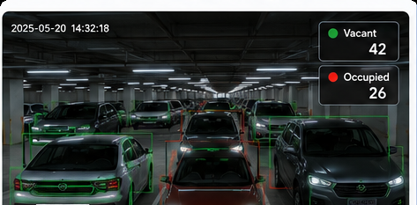
PRODUCT 02 · MANAGE
OPPORTUNITY
PRODUCT
BUSINESS
PLAN
Intelligent CCTV Vision (Edge AI)
Turn cameras that are already installed into a live occupancy signal — without a sensor in every bay.
01
Feed ingest
Pull existing CCTV streams at the edge, no cloud round-trip.
02
Vehicle detection
Detect and track vehicles across the camera's field of view.
03
Slot-level occupancy
Map detections onto the mapped bay grid, bay by bay.
04
ANPR plate match
COST POSITIONING
Read the plate and match it to the active reservation.
Reuses existing CCTV infrastructure — no per-bay sensor retrofit required.
05
Exception alerts
Flag misaligned parking, overstay and unauthorised entry.
Detection accuracy benchmarks will be published once measured in paid pilot deployments.
PARKFNB · CONFIDENTIAL INVESTOR MATERIAL
12

Slide 13
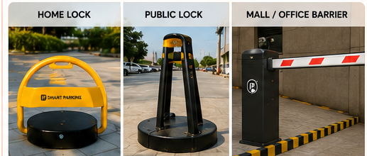
PRODUCT 03 · PROTECT
OPPORTUNITY
PRODUCT
BUSINESS
PLAN
Smart barrier hardware
A private listing is only worth something when the owner can control physical access to the bay.
BLE unlock
Low-power actuator
Target < 1.5 sec
Duty-cycled drive
Solar / long-life battery
Weather resistant
No mains wiring
Outdoor rated
UNIT ECONOMICS
Steel protective casing
Retrofit install
₹6,000–₹8,000 target hardware cost
Anti-tamper
No civil work
Target payback 4–6 months at pilot utilisation assumptions*
*Payback is a model assumption derived from the unit economics in section 03; to be validated in pilot deployments.
PARKFNB · CONFIDENTIAL INVESTOR MATERIAL
13

Slide 14
SPECIALISED SEGMENT
OPPORTUNITY
PRODUCT
BUSINESS
PLAN
Large-vehicle and fleet parking infrastructure
Purpose-built capacity for the vehicles that simply cannot use a standard parking bay.
Corporate & school shuttles
Tourist & pilgrim coaches
Commercial logistics
Pre-bookable waiting bays near offices, schools and campuses, released on a schedule.
Dedicated large bays near shrines, monuments and event venues, sized for peak arrival.
Guaranteed staging bays for last-mile delivery vehicles close to the drop radius.
SCHEDULED TIME SLOTS
DAY + OVERNIGHT BAYS
ANPR + AUTOMATED ACCESS
Spatial-engine advantage: match turning radius, height clearance and access constraints to the right bay.
PARKFNB · CONFIDENTIAL INVESTOR MATERIAL
14

Slide 15
03
SECTION THREE OF FOUR
The business
How idle hours turn into recurring revenue, and why the position gets harder to copy.
UNIT ECONOMICS
REVENUE MODEL
MARKET GAP
DEFENSIBILITY
PARKFNB · CONFIDENTIAL INVESTOR MATERIAL

Slide 16
UNIT ECONOMICS
OPPORTUNITY
PRODUCT
BUSINESS
PLAN
Monetise idle hours — not just real estate
Illustrative pilot assumptions: a 70% owner / 30% Parkfnb split on gross booking value.
NETWORK SCALE · SAME ASSUMPTIONS
PER-BAY MODEL
BAYS
MONTHLY GMV
PARKFNB TAKE
₹40 / hr × 4 hrs / day × 30 days
100
₹4.8 L
₹1.44 L
₹4,800
bays live
GROSS BOOKING VALUE PER MONTH
1,000
₹48 L
₹14.4 L
Owner payout
bays live
70% ₹3,360
1,500
₹72 L
₹21.6 L
Parkfnb take
30% ₹1,440
bays live
All figures are scenario math, not realised revenue. Utilisation, pricing and churn must be validated in pilots. · Hardware ₹6,000–₹8,000 per unit, 4–6 month target payback.
PARKFNB · CONFIDENTIAL INVESTOR MATERIAL
16

Slide 17
REVENUE MODEL
OPPORTUNITY
PRODUCT
BUSINESS
PLAN
Multi-layer monetisation across the same network
Marketplace fees build liquidity; SaaS and hardware build recurring revenue around managed supply.
SEGMENT
CUSTOMER
PRODUCT
PRICING
Drivers
Booking convenience fee
₹10–₹25 per booking
B2C
Space owners
Marketplace commission
70% owner / 30% Parkfnb
B2B2C
Commercial lots
CCTV edge AI + barriers
Setup fee + monthly SaaS
B2B
Developers / plots
Space Optimizer
Design fee + setup commission
B2B
Municipalities
Digital parking networks
Long-term infrastructure contracts
B2G
Long-term shape: high-margin software and marketplace take, layered on installed physical infrastructure.
PARKFNB · CONFIDENTIAL INVESTOR MATERIAL
17

Slide 18
MARKET GAP
OPPORTUNITY
PRODUCT
BUSINESS
PLAN
Four layers exist today — nobody connects them
Parking already has marketplaces, access hardware and vision software, but each solves a different layer.
1
2
3
4
DISCOVERY / BOOKING
›
ACCESS CONTROL
›
PARKING AI
›
SPACE CREATION
Find · reserve · pay
Barrier · lock · gate
CCTV · ANPR · occupancy
Plot → optimal layout
MARKETPLACE
HARDWARE
OPERATIONS
OPTIMISATION
PARKFNB = the connected operating layer
Demand → verified inventory → reservation → physical access → live occupancy → payout
Competitive framing based on publicly available product descriptions; to be re-validated before external circulation.
PARKFNB · CONFIDENTIAL INVESTOR MATERIAL
18

Slide 19
DEFENSIBILITY
OPPORTUNITY
PRODUCT
BUSINESS
PLAN
The system gets stronger as it scales
The moat is not a single feature — it is the compounding loop between supply, access, vision and spatial data.
PRIVATE SUPPLY
›
PHYSICAL ACCESS
›
LIVE VISION
›
SPATIAL INTELLIGENCE
›
NETWORK DATA
More bookable bays
Locks and barriers
Occupancy and ANPR
Layout and constraints
Demand and utilisation
COMPOUNDING LOOP
Moat thesis
Unifying private supply creation, physical access control, live occupancy vision and spatial intelligence on one network — each new site makes every other layer more accurate and more valuable.
PARKFNB · CONFIDENTIAL INVESTOR MATERIAL
19

Slide 20
04
SECTION FOUR OF FOUR
The plan
What is already built, how the first clusters get won, and what the seed round buys.
TRACTION
GO-TO-MARKET
THE ASK
PARKFNB · CONFIDENTIAL INVESTOR MATERIAL

Slide 21
TRACTION & VALIDATION
OPPORTUNITY
PRODUCT
BUSINESS
PLAN
Technology validated — commercial pilot is next
What is built and tested today, kept clearly separate from what the next milestone still has to prove.
✓
Platform
✓
CCTV vision
✓
Hardware
Working prototype built
Occupancy detection tested
Smart-lock prototype built
✓
Space optimiser
✓
Customer discovery
→
Commercial proof
Layout algorithm prototype built
Operator and customer discussions under way
Paid pilots, LOIs and deployment metrics — next
NEXT VALIDATION GATE
Paid pilot deployments in Indore — measuring utilisation, detection accuracy, access reliability and repeat bookings.
PARKFNB · CONFIDENTIAL INVESTOR MATERIAL
21

Slide 22
GO-TO-MARKET
OPPORTUNITY
PRODUCT
BUSINESS
PLAN
Win dense micro-markets before expanding city-wide
The strategy is supply clustering: build enough parking density around a destination to make the network useful.
01
Months 1–6
02
Months 6–12
03
Months 12–18
04
Month 18+
DESTINATION NODES
PRIVATE SUPPLY
CONSUMER SCALE
B2G EXPANSION
Acquire 20–30 bays around anchor hubs across Indore.
Add driveways and vacant plots fitted with smart access.
Target corporate staff, shoppers and tourists around live nodes.
Pursue municipal integrations once pilot economics are proven.
SOLVE COLD START
DENSER MICRO-RADIUS
MORE REPEAT BOOKINGS
SCALE CITY-WIDE
Operating principle: density first, city-wide expansion second.
PARKFNB · CONFIDENTIAL INVESTOR MATERIAL
22

Slide 23
THE ASK
OPPORTUNITY
PRODUCT
BUSINESS
PLAN
Seed funding to prove the first repeatable parking clusters
₹1.5–₹2.5 Cr for an 18-month execution window across product, hardware and pilot deployment.
USE OF FUNDS
SEED ROUND
Product & engineering
40%
₹1.5–₹2.5 Cr
Hardware tooling + batch production
25%
Pilot deployment + cluster setup
20%
18 months of runway
BD + operator partnerships
10%
Indore-first deployment, then a second cluster city.
Ops, legal + IP
5%
18-MONTH VALIDATION TARGETS
50+ sites / 1,500 slots live across Indore clusters
Hardware batch production and field testing
Recurring marketplace + B2B SaaS revenue
One municipal trial opened after pilot proof
Funding objective: prove repeatable unit economics, supply density and operational reliability — then scale.
PARKFNB · CONFIDENTIAL INVESTOR MATERIAL
23

Slide 24
PARKFNB
One network for finding, protecting, managing and monetising parking.
SEED ROUND · 2026 · INDORE, MADHYA PRADESH
CONTACT
EMAIL
PHONE
[Founder name]
[email address]
[phone number]
PARKFNB · CONFIDENTIAL INVESTOR MATERIAL

