Slide 1
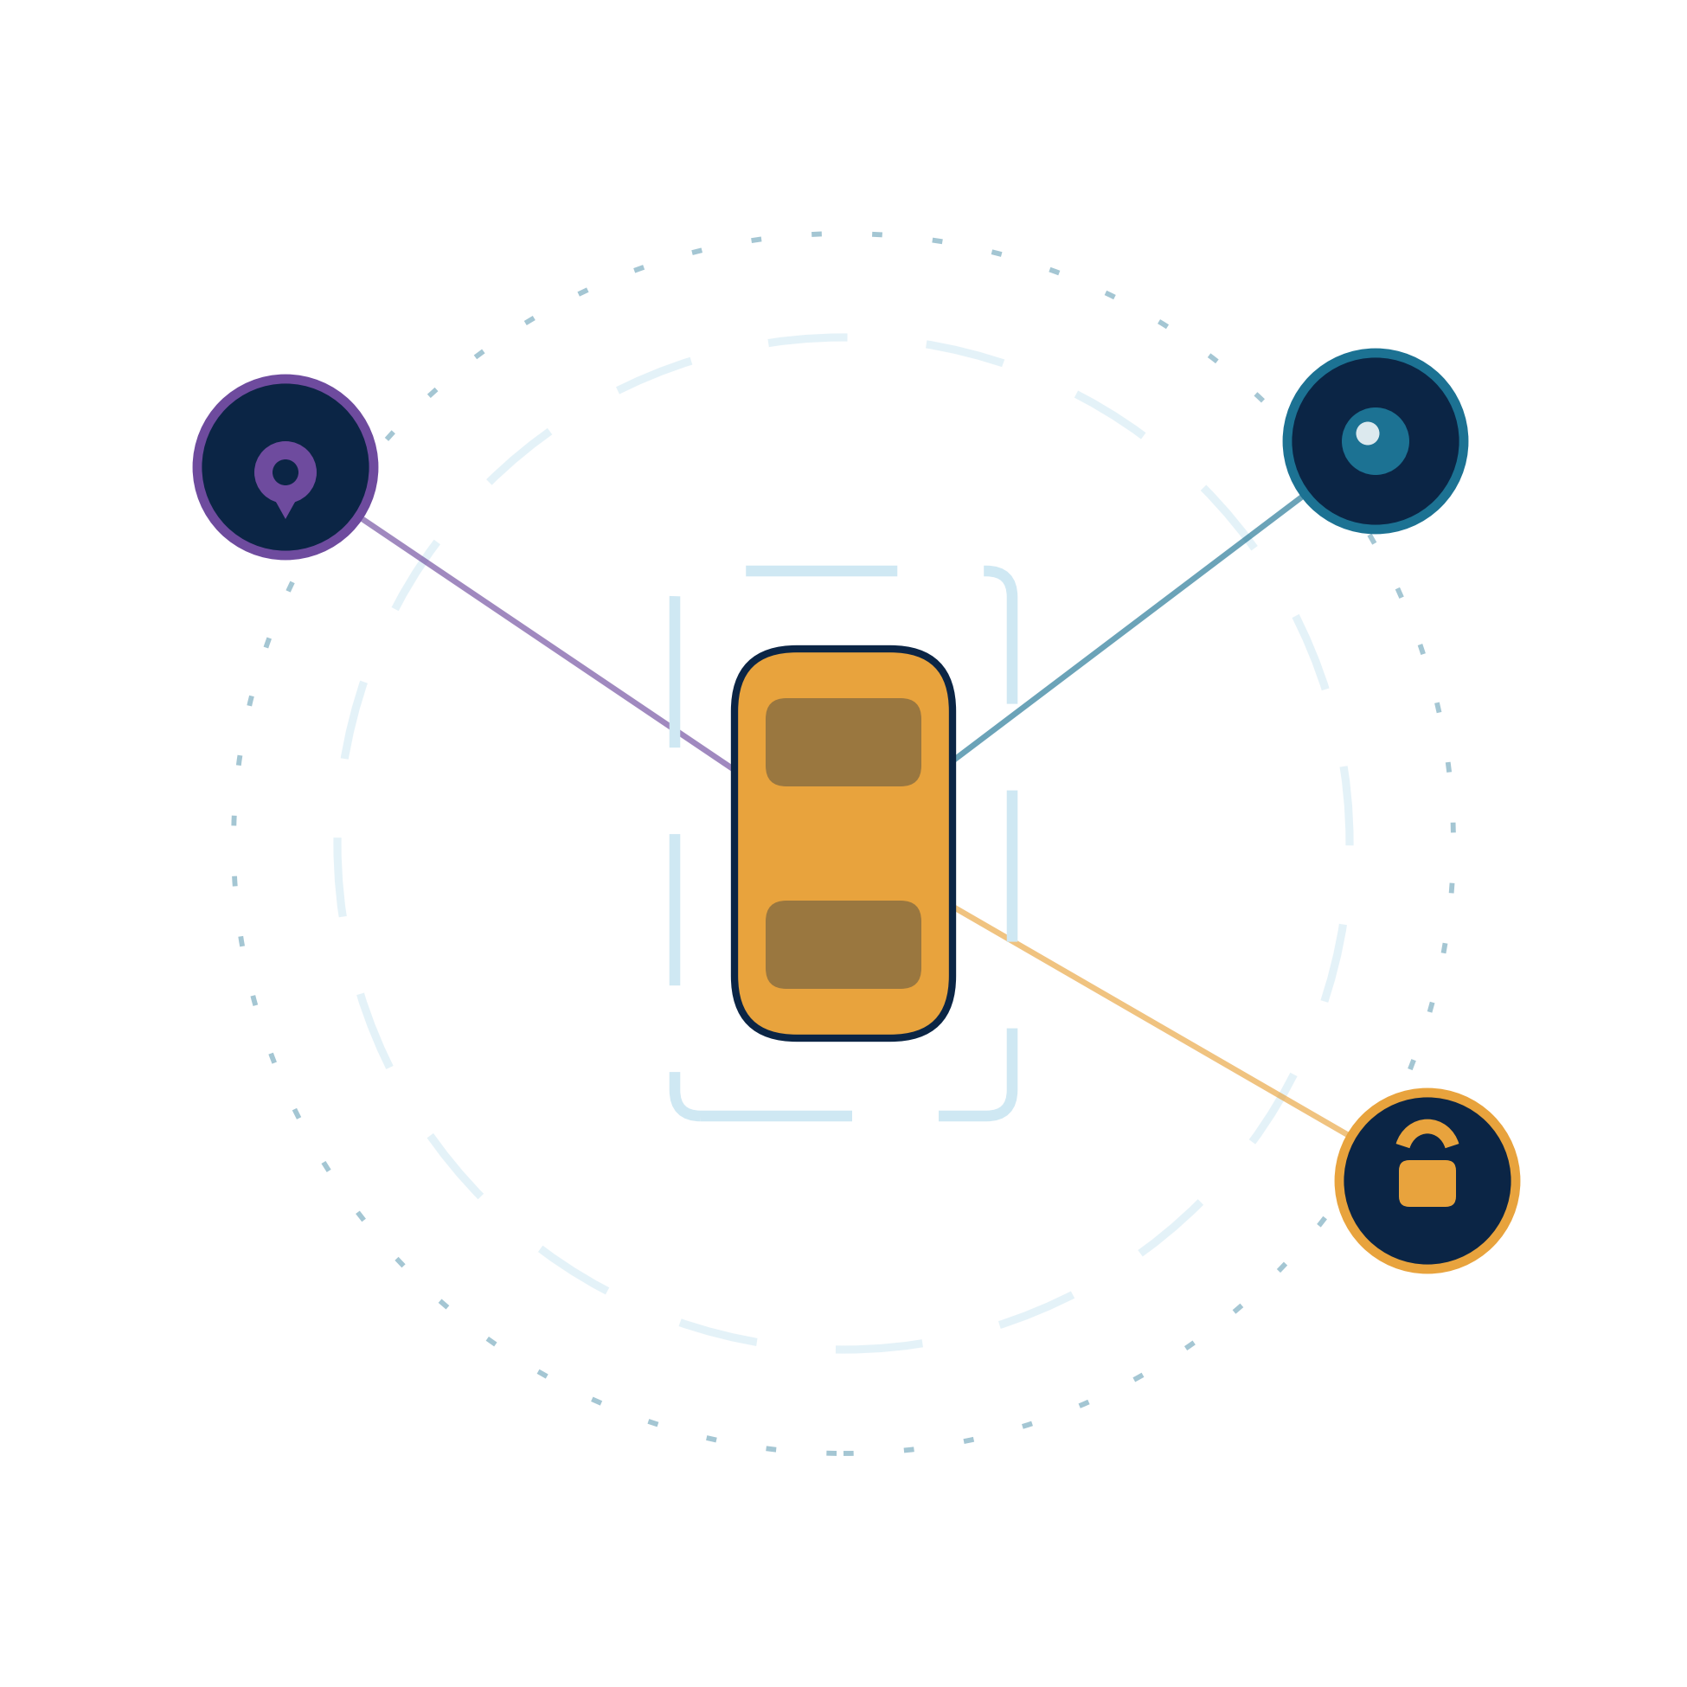
PARKBNB
The operating layer for fragmented urban parking capacity.
FIND • PROTECT • SPECIALIZE • MANAGE • MONETIZE
One network connecting demand, physical access, live occupancy and parking capacity.
Seed Investment Round · 2026 · Indore, MP, India
Parkbnb — Confidential
0

Slide 2
THE PROBLEM
Parking is not one problem — it is a broken ecosystem
Demand exists. Space exists. Infrastructure exists. What is missing is the digital layer connecting them.
1
2
3
4
5
Destination uncertainty
Unauthorized usage
Large-vehicle friction
Under-managed lots
Idle capacity
Drivers reaching markets, offices or hospitals cannot reliably verify open parking in advance.
Private parking and driveway owners face squatting with little control over who parks there.
Buses, shuttles and logistics fleets need turning radius, clearance and legal waiting space.
Commercial lots have capacity but often rely on manual entry and passive CCTV.
Owners lack an end-to-end tool for listing, booking, access, payment and payout.
Parkbnb turns fragmented parking capacity into a connected, bookable and controllable network.
Parkbnb — Confidential
1

Slide 3
DEMAND
Five everyday parking journeys. One missing certainty.
The same problem appears at offices, markets, temples, tourist destinations and transport hubs.
Corporate Employee
Staff / Corporate Bus
Shopper
Tourist / Pilgrim
Commercial / Fleet
Needs predictable parking near office, often at a fixed arrival time.
Needs safe, legal short-duration waiting / pickup space.
Reaches a market or high street and only then discovers whether parking is available.
Travels to a temple or attraction with uncertain nearby parking and peak-time demand.
Needs short-duration loading, service or fleet parking near a destination.
WORK
TRANSIT
SHOP
VISIT
FLEET
Common demand signal: “I am going to X — show me a trusted place to park there, for my time window.”
PARKBNB • CONFIDENTIAL INVESTOR MATERIAL
03

Slide 4
THE SOLUTION
Parkbnb: one operating layer across the parking stack
Not another parking app — a unified layer connecting demand, physical access and spatial management.
FIND
PROTECT & EARN
SPECIALIZE
MANAGE
CREATE
Drivers
Space owners
Buses & fleets
Operators
Site creators
Discover nearby supply
Reserve a verified slot
Navigate and park
List idle hours
Control access
Receive direct payout
Match vehicle dimensions
Reserve time slots
Use dedicated bays
CCTV Edge AI
ANPR + barriers
Occupancy + pricing
Ingest site imagery
Optimize geometry
Create bookable capacity
NETWORK NODE
NETWORK NODE
NETWORK NODE
NETWORK NODE
NETWORK NODE
Network effect: more supply → better discovery → more bookings → richer occupancy data → better operations.
Parkbnb — Confidential
2

Slide 5
PRODUCT STACK
THE SAME PLATFORM SERVES DIFFERENT PARKING ASSETS.
Different spaces need different levels of access control and intelligence — the software layer stays connected.
HOUSEHOLD / SINGLE BAY
List idle hours
Smart lock / ParkoBot-type controller
Owner payout
PRIVATE PLOT / SMALL LOT
List multiple spaces
Barrier + QR / BLE
Bookings + occupancy
MALL / OFFICE / SOCIETY
Manage existing capacity
Existing barrier + ANPR
CCTV + analytics
BUS / FLEET PARKING
Reserve large space
Controlled entry
Time-window + vehicle verification
NEW PARKING SITE
Create capacity
Geometry optimizer
Slot layout + circulation
APP + ACCESS + AI + OPTIMIZATION = ONE CONNECTED PARKING OPERATING LAYER
PARKBNB • CONFIDENTIAL INVESTOR MATERIAL
05

Slide 6
HOW IT WORKS
From search to settlement — with physical access in the loop
DRIVER
SPACE OWNER
Search destination
List idle hours
Reserve verified slot
Set rules + price
Navigate + unlock
Verified access
Auto checkout + pay
70% owner payout
PLATFORM CONTROL PLANE • verified access • live occupancy • automatic settlement
Parkbnb — Confidential
3

Slide 7
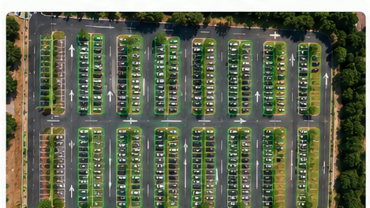
PRODUCT 01 · CREATE
Space Optimizer Engine
Convert unorganized plots into maximum feasible parking capacity.
Satellite / aerial
Site boundary
Geometry engine
Parking angles
Aisles + turning
Constraint checks
ILLUSTRATIVE OUTPUT
118 feasible slots
from a 2,450 m² plot → coordinates → aisles → access plan
Optimal layout
Illustrative example; final capacity depends on site geometry, access and engineering constraints.
Parkbnb — Confidential
4

Slide 8
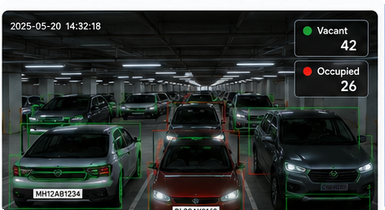
PRODUCT 02 · MANAGE
Intelligent CCTV Vision (Edge AI)
Turn existing cameras into live occupancy signals without requiring a sensor in every bay.
CCTV feed
Vehicle detection
Slot occupancy
ANPR / plate match
Wrong alignment + overstay alerts
COST POSITIONING
Reuse existing CCTV infrastructure
The original deck’s “80% cheaper” claim is intentionally removed until benchmark data is validated.
Parkbnb — Confidential
5

Slide 9
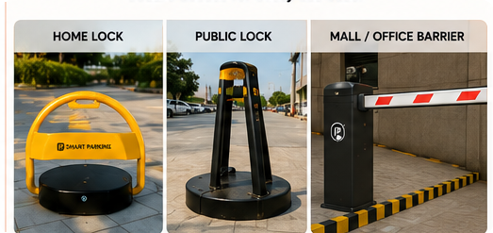
PRODUCT 03 · PROTECT
Smart barrier hardware
A private listing is only valuable when the owner can control physical access.
BLE unlock
Low-power actuator
Weather-resistant
Economics
Target < 1.5 sec
Solar / long-life battery
Steel protective casing
Target 4–6 month payback*
*Payback is a model assumption based on the unit economics shown later; validate in pilot deployments.
Parkbnb — Confidential
6

Slide 10
SPECIALIZED SEGMENT
Large vehicle & fleet parking infrastructure
Purpose-built capacity for vehicles that cannot use standard parking bays.
01
Corporate & school shuttles
02
Tourist & pilgrim coaches
03
Commercial logistics
Pre-bookable waiting bays near offices and schools.
Dedicated large bays near shrines, monuments and event venues.
Guaranteed staging bays for last-mile delivery vehicles.
Scheduled time slots
Day + overnight bays
ANPR + automated access
Spatial engine advantage:
match turning radius, height clearance and access constraints to the right bay.
Parkbnb — Confidential
7

Slide 11
UNIT ECONOMICS
Monetize idle hours — not just real estate
Illustrative pilot assumptions: 70% owner / 30% Parkbnb split on gross booking value.
NETWORK SCALE (same assumptions)
PER-BAY MODEL
₹40/hr × 4 hrs/day × 30 days
100 bays
₹4.8L GMV
₹1.44L Parkbnb take
= ₹4,800 monthly GMV
Owner 70% → ₹3,360 / month
1,000 bays
₹48L GMV
₹14.4L Parkbnb take
Parkbnb 30% → ₹1,440 / month
1,500 bays
₹72L GMV
₹21.6L Parkbnb take
All figures above are scenario math, not realized revenue. Actual utilization, pricing and churn must be validated in pilots.
Hardware cost in source deck: ₹6,000–₹8,000 per unit | payback target: 4–6 months
Parkbnb — Confidential
8

Slide 12
WHY NOW · MARKET
A large and increasingly digital parking opportunity
The source deck cites third-party India smart-parking estimates; verify figures and source methodology before external circulation.
$4.9B
$12.7B
India smart parking market
Projected market
2025 cited base size
2031 cited estimate
17.6%
300M+
CAGR
Registered vehicles
2025–2031 cited forecast
India; source-deck figure
Why Parkbnb can win
Fragmented private supply + under-managed lots + access hardware + occupancy intelligence create a broader opportunity than a parking-discovery app alone.
Source cited in original deck: MobilityForesights, IMARC Group, Astute Analytica. Third-party estimates; independently validate.
Parkbnb — Confidential
9

Slide 13
REVENUE MODEL
Multi-layer monetization
Marketplace fees create liquidity; SaaS and hardware create recurring revenue around managed supply.
B2C
Drivers
Booking convenience fee
₹10–₹25 / booking
B2B2C
Space owners
Marketplace commission
70% owner / 30% Parkbnb
B2B
Commercial lots
CCTV Edge AI + barriers
Setup fee + monthly SaaS
B2B
Developers / plots
Space Optimizer
Design fee + setup commission
B2G
Municipalities
Digital parking networks
Long-term infrastructure contracts
Long-term model: high-margin software + marketplace take, layered on installed physical infrastructure.
Parkbnb — Confidential
10

Slide 14
04 — MARKET GAP
Parking has marketplaces, parking hardware and parking software — but they solve different layers.
Parkbnb's opportunity is to connect the layers into one operating workflow.
1
2
3
4
DISCOVERY / BOOKING
ACCESS CONTROL
PARKING AI
SPACE CREATION
Find • reserve • pay
Barrier • lock • gate
CCTV • ANPR • occupancy
Plot → optimal layout
Marketplace
Hardware
Operations
Optimization
PARKBNB = CONNECTED OPERATING LAYER
Demand → verified inventory → reservation → access → occupancy → payout
Competitive framing informed by public product descriptions for JustPark, Get My Parking and parking-design platforms; capabilities should be re-validated before external circulation. citeturn0search0turn0search8
PARKBNB • CONFIDENTIAL INVESTOR MATERIAL
06

Slide 15
DEFENSIBILITY
Why the system gets stronger as it scales
The moat is not one feature — it is the combination of supply, access, vision and spatial data.
1
2
3
4
5
PRIVATE SUPPLY
PHYSICAL ACCESS
LIVE VISION
SPATIAL INTELLIGENCE
NETWORK DATA
More bookable bays
Locks + barriers
Occupancy + ANPR
Layout + constraints
Demand + utilization
Moat thesis
Unifying private supply creation + physical access + live occupancy + spatial intelligence on one network.
Competitive comparisons in the original deck should be independently verified before investor distribution.
Parkbnb — Confidential
11

Slide 16
TRACTION & VALIDATION
Technology validated — commercial pilot next
This slide intentionally separates what is built/tested from what still needs market validation.
✓
Platform
✓
CCTV vision
Working prototype built
Occupancy detection tested
✓
Hardware
✓
Space optimizer
Smart-lock prototype built
Layout algorithm prototype built
✓
Customer discovery
→
Commercial proof
Operator / customer discussions in progress
Paid pilots / LOIs / deployment metrics — next milestone
Next validation gate
paid pilot deployments in Indore → measure utilization, detection accuracy, access reliability and repeat bookings.
Do not add LOIs, accuracy, sites or revenue here until they are real and documented.
Parkbnb — Confidential
12

Slide 17
GO-TO-MARKET
Win dense micro-markets before expanding city-wide
The strategy is supply clustering: build enough parking density around a destination to make the network useful.
01
Months 1–6
DESTINATION NODES
Acquire 20–30 bays around anchor hubs in Indore.
Solve marketplace cold start
02
Months 6–12
PRIVATE SUPPLY
Add driveways and vacant plots with smart access.
Build dense micro-radius supply
03
Months 12–18
CONSUMER SCALE
Target corporate staff, shoppers and tourists around live nodes.
Increase repeat bookings
04
18+
B2G EXPANSION
Pursue municipal integrations after pilot economics are proven.
Scale city-wide
Principle: density first, city-wide expansion second.
Parkbnb — Confidential
13

Slide 18
THE ASK
Seed funding to prove the first repeatable parking clusters
₹1.5–₹2.5 Cr for an 18-month execution window.
USE OF FUNDS
SEED ROUND
Product & engineering
40%
₹1.5–₹2.5 Cr
Hardware tooling + batch production
25%
18 months runway
Pilot deployment + cluster setup
20%
BD + operator partnerships
10%
18-MONTH VALIDATION TARGETS
Ops, legal + IP
5%
• 50+ sites / 1,500 slots installed in Indore clusters
• Hardware batching + field testing
• Recurring marketplace + B2B SaaS revenue
• 1 municipal trial pursued after pilot proof
Funding objective: prove repeatable unit economics, supply density and operational reliability — then scale.
Parkbnb — Confidential
14

Slide 19
PARKBNB
Connecting fragmented parking capacity into one intelligent network.
Find. Protect. Specialize. Manage. Monetize.
CONTACT FOUNDERS
contact@parkbnb.in
Seed Investment Round · 2026
HEADQUARTERS
Indore, MP, India
Parkbnb — Confidential
15

