Slide 1
TECHFEST 2K15
A PRESENTATION ON
ACQUANETEE
TEAM ID : AQ1116
TEAM MEMBERS:
SOURABH NAHATA
JUHI SHARMA
KHUSHBOO MANDHANIYA
PALAK JAIN
INSTITUTE OF ENGINEERING AND TECHNOLOGY ,DAVV (INDORE).
Notes:
First five khushbooo
Next five palak
Next six juhi

Slide 2
OUR IDEOLOGY FOR THE PROJECT
INSPIRATION
INNOVATION
IMPlEMENTATION
Notes:
2 HRS RUNNING SLOW

Slide 3
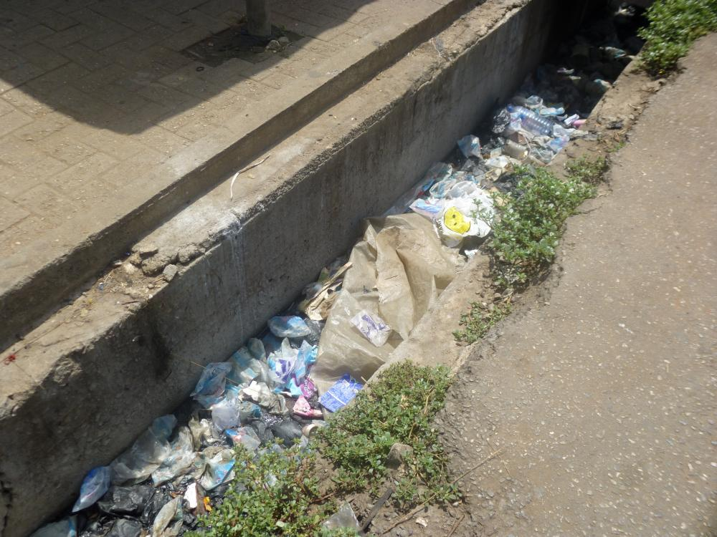
Generally, we come across this type of scenario in our locality, which has provoked us to work upon this project and to come up with a solution to this problem.
Our main focus is to design a system which can reduce or remove the problem of chocking in the sewage channels. The system is designed in such a way that it posses all the following properties:-
Easy to manufacture Easy to handle.
Energy efficient. Cost effective.
Can be used for long time.

Slide 4
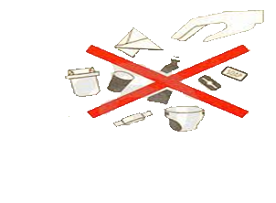
Main causes
The most common reasons found for such blockages are:
Disposal of solid waste in the channel(fermentable, cloth, plastic and paper).
Accumulation of silt or dumped debris.
Improper maintenance of drainage /sewer system.
Poor and unplanned solid waste management and insensitive attitude among the upstream residents.

Slide 5
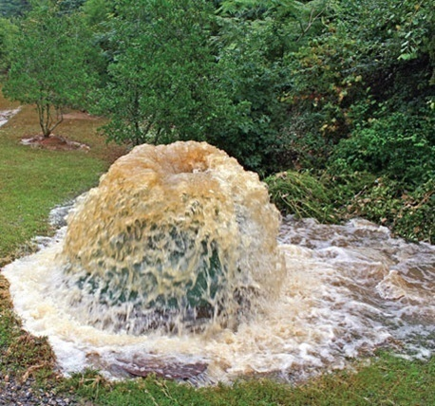
ISSUES AND
CHALLENGES
Over flowing of sewage in and around streets due to undersize existing sewerage lines.
Frequent choking & overflowing / mixing with drinking water lines.
Damaged sewer lines/appurtenances.
Encroachments on Sewers resulting in-accessibility for cleaning and maintenance

Slide 6
SOLUTION TO THE PROBLEM OF CHOCKING
The TRAP &THROW System.
The Trap & Throw system is a pick and place system which could be placed anywhere on the channel. This system helps in removal of larger wastes from the sewage channels. And hence it provides mobility to the flowing sewage removing the problem of chocking of sewage lines.
Notes:
Now lets check for the solution to the problem of chocking designed by our team..
The trap and throw system is a pick and place system which could be placed anywhere on the channel. This system helps in removal of larger wastes from the sewage channels. And hence it provides mobility to the flowing sewage removing the problem of chocking of sewage lines. Now lets check out the design of the system and thereby understanding the functions of each part.

Slide 7
DESIGNING T&T SYSTEM
Notes:
The design of system
I suppose almost everyone can relate to the figures above . From the breathtaking subject engineering drawing.....
Here in the front view we can see that there is a rotating shaft . As the name suggests will keep on rotating .
Next we see a cylinder in actual view and here concentric crcles are connected to the centre of the rotating shaft with the help of belt. So if the rotating shaft keeps on rotating this cylinder would definitely rotate with the shaft.
Now talking about the circular part covering the shaft the quarter at bottom left is made of a netted material. And the semicircular part on the upper side is made of a thin sheet of material . Now you can see that there is an opening in the central part n line to the centre of the rotating shaft on the right side of the body their lies a opening where we can apply a box specially made for the purpose of collecting the blocking materials. The dotted part on the base represents the material of base is a perforated sheet. Now along the base line of the body we can see a block rectangular in side view and triangular in top view so basically it is a prism type shape. Now moving on right side from here there is a gate which have the base region made of the plane sheet and upper region made of perforated sheet.

Slide 8
ROTATING SHAFT
CHOCKING REMOVER
BODY
COLLECTING BOX
FLOW GATES
Notes:
Isme toh bass mann se batti de dena bindass

Slide 9
Working of T&T system
The rotating shaft keeps on rotating with the help of flowing water. As any solid waste comes, it gets trapped by the perforated sieve. And then shaft’s blade move the solid waste to the over head waste collecting pit. After that the waste could be remove manually from time to time. And thereby decreasing the chocking of the channels.
Notes:
Now lets check out how the system works :-
Jitta isme likha hai usse elabrate kar k smjha dena

Slide 10
Different analysis of T&T system
COST-
The cost of a simple T&T system to be applied over a sewage channel of width 30 cm to 60 cm and height 20 cm to 50 cm is INR 400.
width 30 cm to 60 cm and height 20 cm to 50 cm
INR 400
APPLICABILITY-
The T&T system can be applied anywhere on any sewage channel. It is very useful in areas where municipal workers do not come on a regular basis for cleaning.
applied anywhere on any sewage channel
CONVERTIBILITY-
The T&T system could adopt to the changes in width of the sewage lines. Because it has the flow gates attached with it which opens to the width of sewage channel.
adopt changes in width of the sewage lines
flow gates opens to the width of sewage channel
MAINTENANCE-
The T&T system requires very less maintenance and the probability of wear & tear of system is very low.
very less maintenance
wear & tear is very low
ENERGY
REQUIRMENT-
The T&T system does not require any kind of external energy.
does not require external energy
Notes:
Same jitta likha utta smjha dena

Slide 11

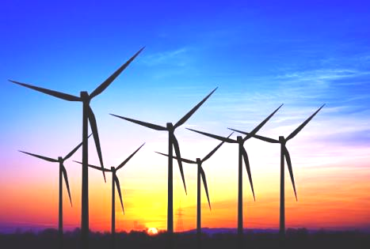
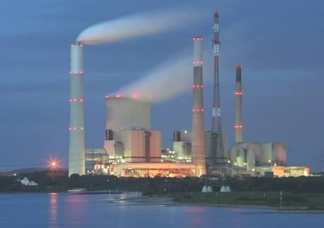
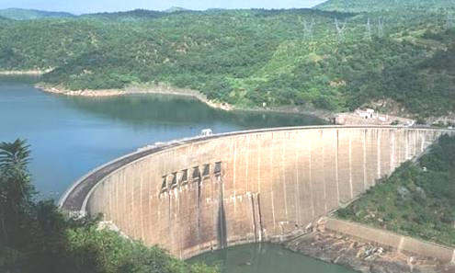
_{ENERGY+}
?
0 ENERGY
Notes:
So now the big question that comes to mind is can this zero energy device be converted into an energy + device????? lets check it out

Slide 12

HYBRID T&T SYSTEM
LOW SPEED SHAFT
GEAR BOX
CONTROLLER
GENERATOR
HIGH SPEED SHAFT
Notes:
The hybrid t&t system
From the chocking remover we connect another belt to the device shown in the dotted part on the left side .
The device is now represented in the dotted part on right hand side it consists of a low speed shaft which is then connected to the gear box the gear box here helps in increasing the speed of rotation of the shaft connected directly to the generator circuit .
Here the process takes place like
1) The radius of the chocking remover is half the radius of central pulley along the rotating shaft.
2)The radius of low speed shaft is one fifth of the radius of chocking remover , so as to increase the speed of the shaft by 5 times.
3) The gear box then converts the speed to three times the speed of the low speed shaft.
4) Thereby increasing the speed of rotation by 30 times as that of shaft.
5) The generator then generates the electrical energy which can be stored in battery using proper circuit arrangement.
6) After the charging of battery we can use the power for normal application.

Slide 13
Different analysis of hybrid T&T system
1) Energy generation increases along the flow of sewage line.
>> The net outlet of sewage from a normal house is nearly 200 litres/day.
>> Hence the flow of sewage along the flow of sewage line increases.
>> This results in increase of energy generation along the flow of sewage line.
2) The minimum energy that Hybrid T&T system generates (in 24 hrs) is sufficient to light up a 5watt bulb for next 24 hours. The maximum energy that this system can generate (in 24 hrs ) is sufficient to light up three 12watt bulbs for next 24 hours.
3) This system require very less maintenance.
4) The cost of hybrid T&T system is not much high. For a system to be applied in .
Notes:
Jitta likha as it is chapp dena

Slide 14
COMPARISON of hybrid T&T system WITH OTHER ENERGY GENERATING SYSTEMS
HYBRID T&T SYSTEM
LOW COST/SYSTEM (INSTALLATION INCLUDED)
CAN BE INSTALLED IN ANY PART OF THE WORLD
REMOVES THE PROBLEM OF CHOCKING
SOLAR ENERGY GENERATOR
COST IS HIGH
CAN BE INSTALLED ONLY WHERE SUNLIGHT IS PRESENT
NO OTHER USAGE
WIND ENERGY GENERATOR
COST IS HIGH
CAN BE INSTALLED ONLY WHERE WIND SPEED IS HIGH
NO OTHER USAGE
Notes:
Bass english m elaborate karna bakki kuch nii karna hai.

Slide 15
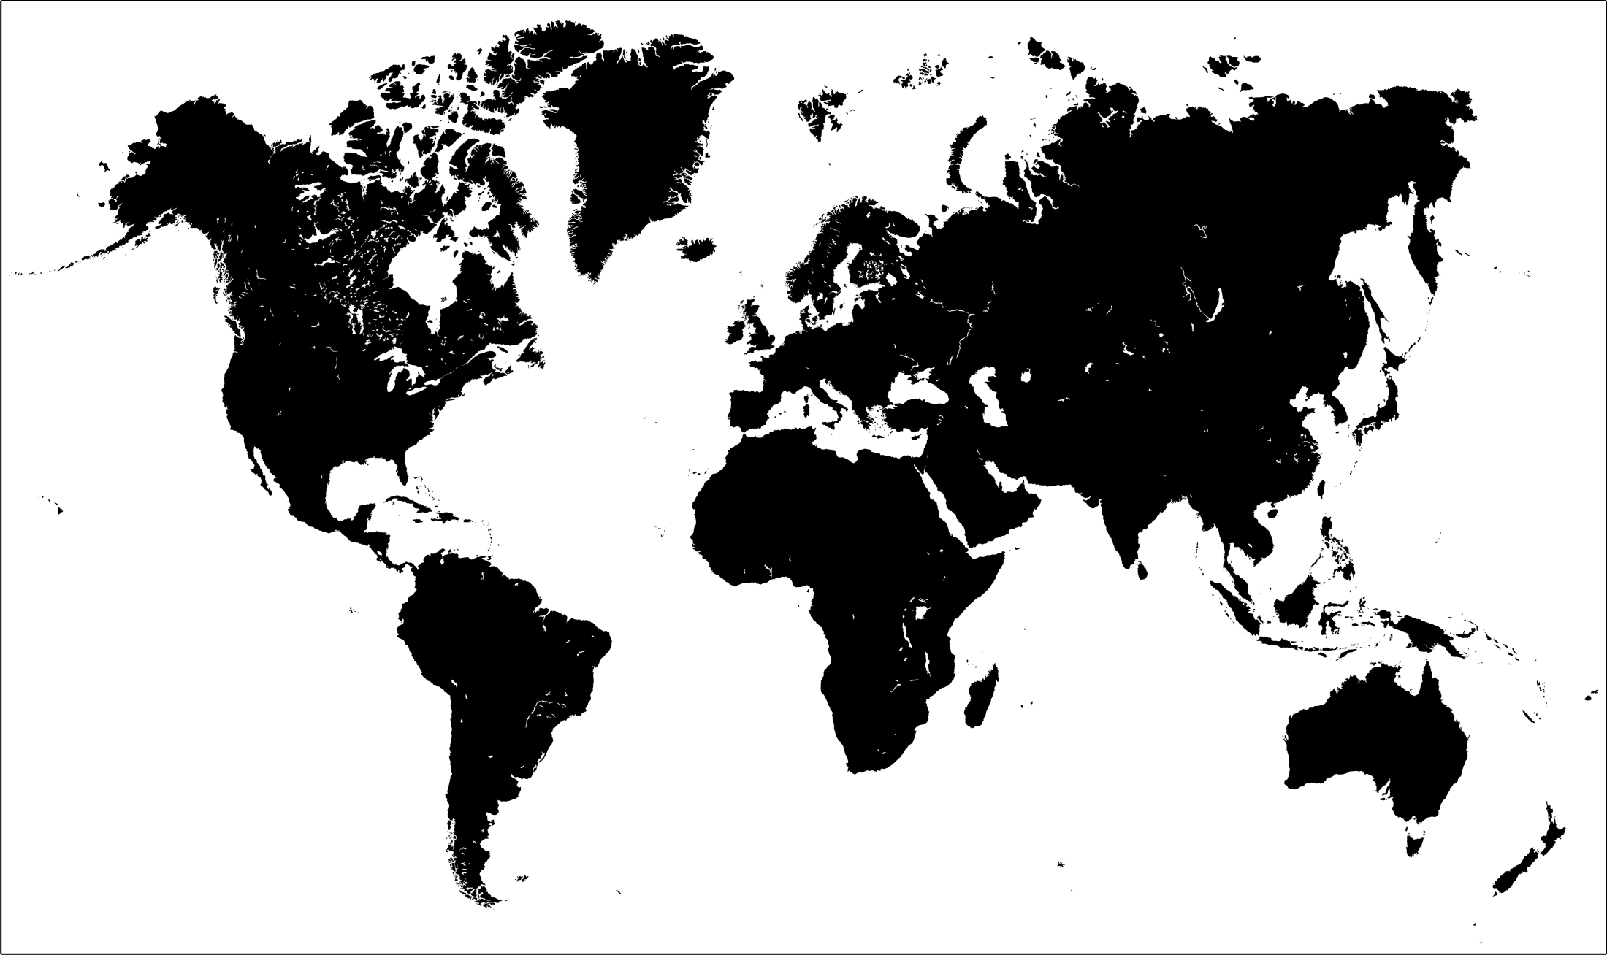
IF WE INSTALL THE HYBRID T&T SYSTEM IN WHOLE WORLD THEN WE CAN REDUCE THE USAGE OF COAL POWERED ELECTRICITY GENERATORS THERE BY REDUCING THE USAGE OF COAL . THIS WOULD REDUCE THE RATE OF GLOBAL WARMING. AND HENCE TOWARDS A SAFER ECOSYSTEM.
Notes:
As we know that global warming is a major curse for the earth at the present time . And it has become the most important issue for the nations. The leaders of the world are working now and then upon the issue. One of the most important cause of global warming is the generation of electricity using coal.
Now suppose .. IF WE INSTALL THE HYBRID T&T SYSTEM IN WHOLE WORLD THEN WE CAN REDUCE THE USAGE OF COAL POWERED ELECTRICITY GENERATORS THERE BY REDUCING THE USAGE OF COAL . THIS WOULD REDUCE THE RATE OF GLOBAL WARMING. AND HENCE TOWARDS A SAFER ECOSYSTEM.

Slide 16
THANK YOU

