Slide 1
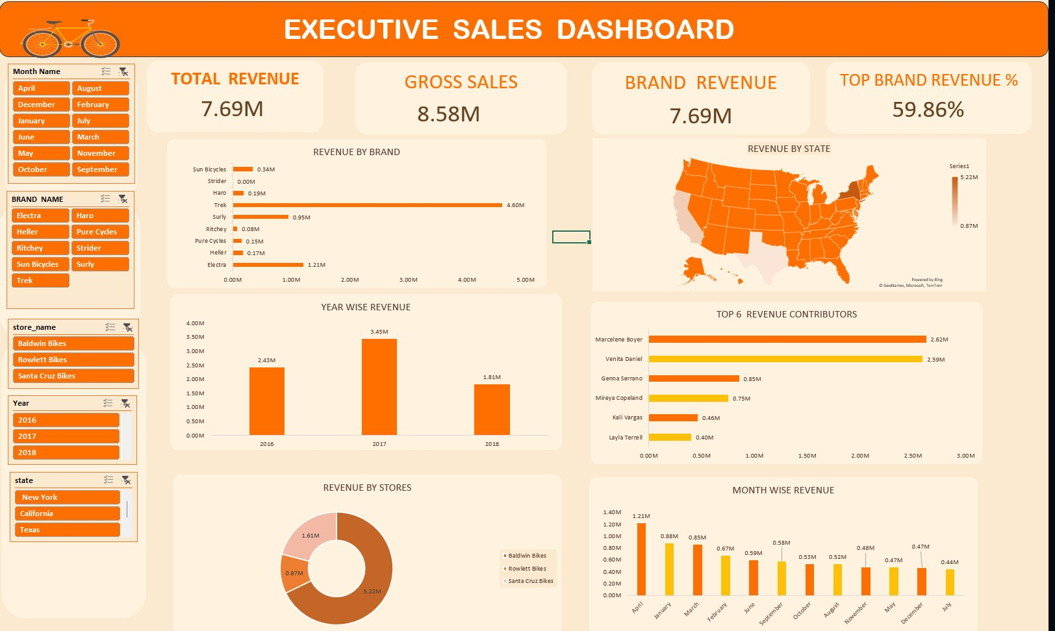
🚲 BIKE STORE
SALES ANALYSIS
A complete Business Intelligence solution covering Sales Performance · Employee Productivity · Inventory Management
📍 United States | 3 Stores | 9 Brands | 7 Categories | 2016–2018
Tools: Excel · Power Query · Power Pivot · Pivot Charts

Slide 2
PROJECT OVERVIEW
🎯
📂
🛠️
Business Objectives
Dataset
Tools & Methods
Analyze sales performance, employee productivity, and inventory management across all stores and time periods.
9 relational tables · 1,615 Orders · 4,722 Order Items · 321 Products · 1,445 Customers · 10 Staff · 3 Stores
Microsoft Excel · Power Query · Power Pivot · Pivot Tables · Pivot Charts · Slicers · Data Modeling

Slide 3
DATA MODEL & PREPARATION
🧹 Data Cleaning & Transformation
⚙️ Feature Engineering
Customers
Removed PII fields · Standardized state names
Gross Sales
Quantity × List Price
Discount Amount
Gross Sales × Discount
Staff
Combined names · Removed contact info
Revenue (KPI)
Gross Sales − Discount Amount
Stores
Removed address/contact info
Delivery Days
Shipped Date − Order Date
General
Deduplication · Key validation · Date types · State abbreviations
Delivery Status
Early / On-Time / Late
Date Intelligence
Month · Year · Quarter

Slide 4
📊 EXECUTIVE SALES DASHBOARD
Total Revenue
Gross Sales
Brand Revenue
Top Brand %
$7.69M
$8.58M
$7.69M
59.86%

Slide 5
SALES ANALYSIS – KEY FINDINGS
TOP BRAND
TOP CATEGORY
Trek
Cruisers Bicycles
Generated $4.60M — the highest revenue brand, commanding ~60% of total brand revenue.
Led all categories with 959 units ordered, followed by Mountain Bikes (866 units).
TOP STORE
BEST YEAR
Santa Cruz Bikes
2017
Contributed $5.22M in revenue — the highest performing store across all periods.
Peak revenue year with $3.45M — 42% higher than 2016's $2.43M baseline.
TOP MONTH
TOP PRODUCT
April
Trek Slash 8 27.5
Highest monthly revenue at $1.21M, driven by seasonal demand surge.
Highest single-product revenue contributor at $0.56M.

Slide 6
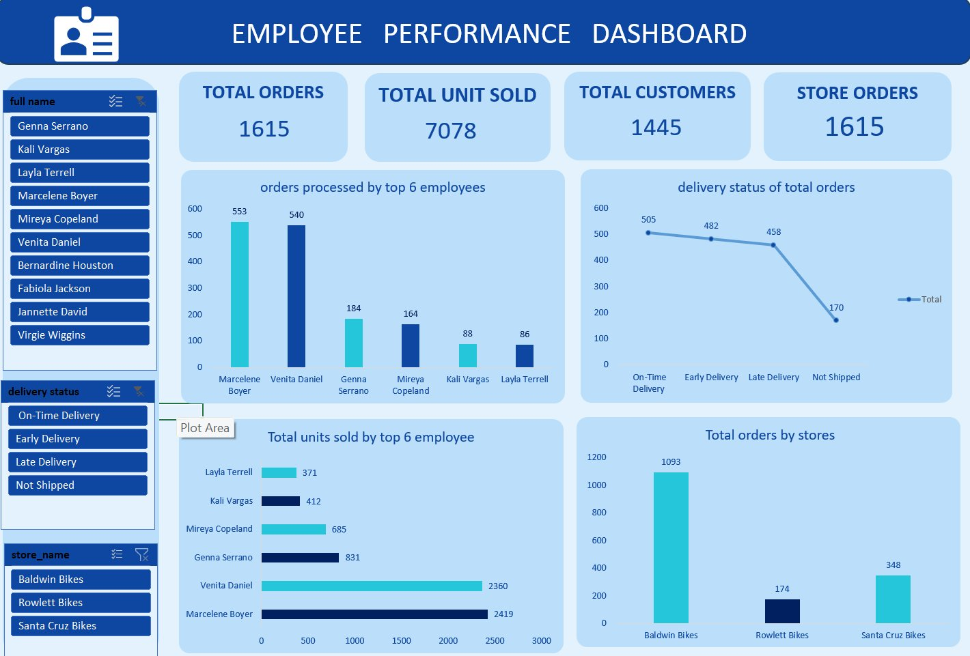
👤 EMPLOYEE PERFORMANCE DASHBOARD
Total Orders
Units Sold
Total Customers
Store Orders
1,615
7,078
1,445
1,615

Slide 7
EMPLOYEE PERFORMANCE – KEY FINDINGS
🏆 Top Employee Leaderboard
💡 Insights
Rank
Employee
Orders
Units Sold
Revenue
On-Time Delivery
505 orders delivered on time — the highest delivery status.
🥇 1
Marcelene Boyer
553
2,419
$2.62M
🥈 2
Venita Daniel
540
2,360
$2.59M
Baldwin Bikes
🥉 3
Genna Serrano
184
831
$0.85M
Top store with 1,093 orders processed.
4
Mireya Copeland
164
685
$0.75M
Employee of Year
5
Kali Vargas
88
412
$0.46M
Marcelene Boyer led both orders (553) and revenue ($2.62M).
6
Layla Terrell
86
371
$0.40M
Late Deliveries
458 orders were late — an area for improvement.

Slide 8
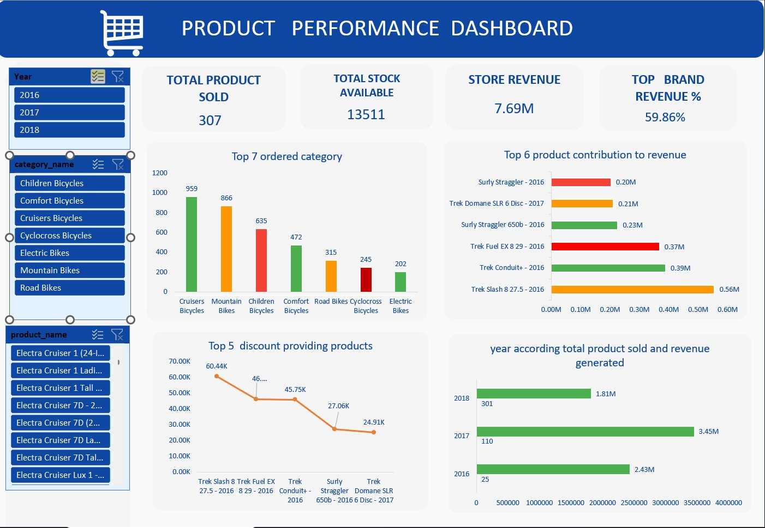
🛒 PRODUCT PERFORMANCE DASHBOARD
Products Sold
Total Stock
Store Revenue
Top Brand %
307
13,511
$7.69M
59.86%

Slide 9
PRODUCT & INVENTORY – KEY FINDINGS
📦 Category Order Volume
🏅 Top Revenue Products
Cruisers Bicycles
959
Trek Slash 8 27.5 - 2016
$0.56M
Mountain Bikes
866
Trek Conduit+ - 2016
$0.39M
Children Bicycles
635
Trek Fuel EX 8 29 - 2016
$0.37M
Comfort Bicycles
472
Surly Straggler 650b - 2016
$0.23M
Road Bikes
315
Trek Domane SLR 6 - 2017
$0.21M
Cyclocross Bikes
245
Surly Straggler - 2016
$0.20M
Electric Bikes
202
Year Revenue Trend: 2016: $2.43M → 2017: $3.45M (peak) → 2018: $1.81M

Slide 10
CONCLUSIONS & OUTCOMES
💰
REVENUE
📈
GROWTH
Trek dominates with ~60% share; Santa Cruz Bikes leads stores with $5.22M.
2017 was the peak year with $3.45M; April consistently the strongest month.
👥
TOP TALENT
📦
INVENTORY
Marcelene Boyer is Employee of the Year — highest orders (553) and revenue ($2.62M).
13,511 units in stock; Cruiser & Mountain bikes hold the highest stock levels.
🚚
DELIVERY
🎯
ACTION ITEMS
505 on-time + 482 early = strong fulfillment; 170 not-shipped orders need attention.
Replenish low-stock products, reduce late deliveries, and invest in Trek/Cruiser segments.
Thank you · Bike Store Sales Analysis Project

